Slide 1
Basic Sync-O-Matic 3000 Documentation
Dr. Charles Severance
Michigan State University
http://www.egr.msu.edu/~crs/projects/syncomat/

Slide 2
Outline
Process
Main Menu
Preferences
Using TimeIT!
Using FlipIT!
Making A Lecture

Slide 3
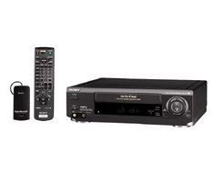
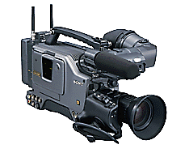
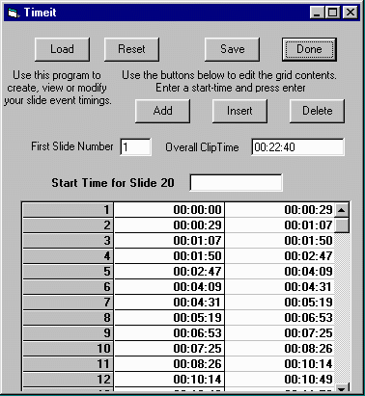
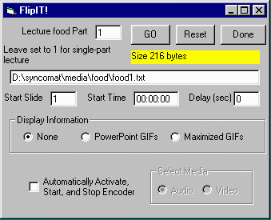
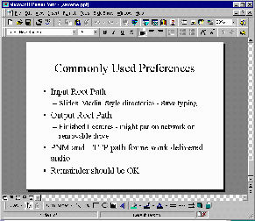
Media Directory
Audio/Video
Timing
Real Encoder
AVI Capture
PowerPoint
HTML
Directory
HTML Export

Slide 4
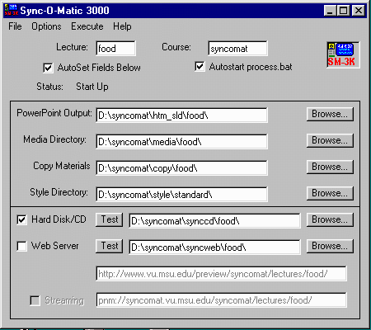
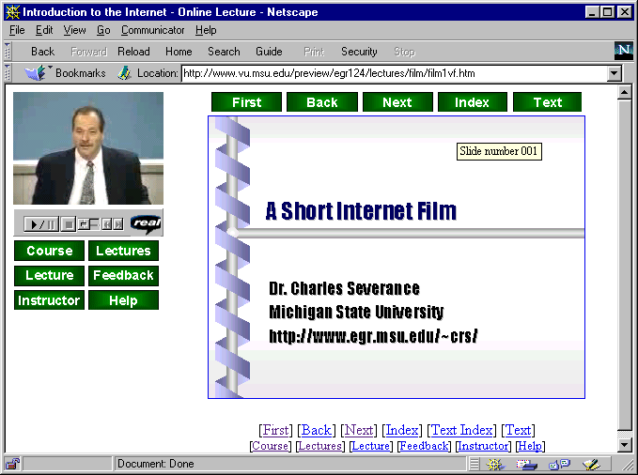


Media Directory
Audio/Video
Timing
PowerPoint
HTML
Directory
CD-ROM
Version
Directory
Web
Version
Directory
Upload

Slide 5
User Interface

Slide 6
Main Screen
Lecture Name - This is used to form PowerPoint file names, directory names, URLs, and file names - keep it less than 5 characters - In this lecture we will use “food” as the example
PowerPoint Output - This is where we will save the HMTL version of your PowerPoint presentation

Slide 7
Media Directory
Contains RealAudio, RealVideo Media and event files
  food1.rm,food2.rm
  food1.ra,food2.ra
  food1.txt,food2.txt
The above example shows two parts. If you have one part you still need to call it part “1”.

Slide 8
Copy Materials
The contents are copied into the destination directory after the lecture is produced. Use this to add necessary files or even replace files in the final output.
When you start out - leave this empty - and don’t worry about it. Once you get tired of hand editing the results of SM-3000 you will start to use it :)

Slide 9
Style Directory
The elements of a page’s appearance are controllable by the user. Much of the magic occurs in this directory.
You do not have to use my plug-in format. You can do separate viewers or put your favorite buttons on the pages.
You can make the lectures look like a course management system.

Slide 10
Starting PROCESS.BAT
When a lecture is being made, there are two phases
  first SM-3000 creates a bunch of files in the destination directory
  then it produces process.bat which contains commands to merge audio and events, create thumbnails, etc.

Slide 11
PROCESS.BAT
Normally once SM-3000 has made all the files, the batch job is started automatically. For debugging, you can do this step manually
While this job is running, SM-3000 track and displays its progress on the status bar.

Slide 12
Thumbnails
Special software is no longer needed for version 1.5

Slide 13
Verbose
When you make the lecture you will see lots of messages passing by as the files are created. The verbose option shows you these messages in a scrollable log - this is most useful when things are not working well.

Slide 14
Destination Information
You must choose the destination(s) for your lecture.
  Local Disk or CD-ROM - Useful for testing and off-line demonstrations
  A standard web server
  A web server which supports RealNetworks streaming protocols (pnm:)
Each requires different HTML

Slide 15
Hard Disk or CD-ROM
All references in the HTML are relative to the local directory - for this reason, the material must be viewed using the plug-in and frames format

Slide 16
Web Server
When you are uploading to a web server, you must specify the URL at which all of the lecture materials will be stored.
This is necessary so that the plug-in can find the media and find the slides across the network

Slide 17
Streaming Choice
You do not need to have a RealNetworks streaming server.
If you do not select streaming, all the materials will still work but they will use pseudo-streaming
This means that you can put these lectures up on any web server and have them work

Slide 18
Pseudo Streaming
In pseudo-streaming the plug-in is told to make a standard http connection to retrieve the data. It begins to retrieve the data onto disk. Once it is ahead it begins to play off the disk. Hopefully it can download fast enough that the playing never catches up.

Slide 19
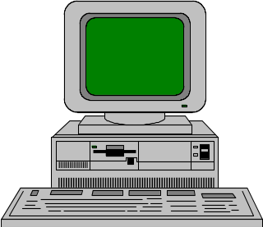
Entire file is copied to disk across the Internet as quickly as possible using
HTTP/TCP
Once sufficient data has been buffered, play begins from the disk - playing continues unless the player “catches up” to the download

Slide 20
Pseudo-Streaming
Advantages
  Works on ANY web server
  Works across firewalls that pass web traffic
  May be good when network is congested
Disadvantages
  Cannot move around randomly
  Skip ahead might take 20 minutes while all of the intervening data is downloaded

Slide 21
Streaming
Requires RealNetwork Server
Quick start-up
Quick random access
Uses special protocol - pnm:
Often pnm: URL is different from the http: URL for the same lecture
Sometimes you must move the *.rm and *.ra files into a special directory

Slide 22
Data is sent from the server to the player in packets. Depending on the performance of the connection, more or less data is sent. Data is played a short time after it arrives.
When you skip around, the player sends a message BACK to the server to begin sending packets from the new location of the file. After a brief moment the player begins playing from the new location.

Slide 23
Streaming
Advantages
  Random play
  Adaptive bandwidth usage
  Uses no local disk space
Disadvantages
  Need server software
  Must figure out the correct pnm: URL

Slide 24
Settings
Destination directory is where files will be assembled for upload - Idea: make this a network drive on server
Will NOT play from the hard disk
Pseudo-streaming you must specify the destination http address
Streaming you must specify the http: (for slides) and pnm: (for audio/video)

Slide 25
Good Steps
First, do hard disk/CD only - test until it works
Second, do pseudo-streaming - Upload and test until it works
Finally, enable streaming and upload and re-test
If hard disk/CD fails, streaming will definitely not work

Slide 26
Preferences
There are three basic areas of preferences
  Control of the main screen of SM-3000
  Control of the FlipIT! Operation
  Control of the Make Lecture Operation
Preferences are stored in the Registry

Slide 27
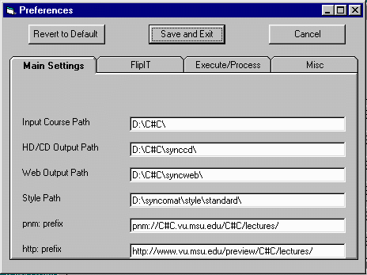
Main Input Settings

Slide 28
Main Input Preferences
Input Root Path - Used to autoset PowerPoint Output, media, and copy
Style Path - Sets default style
Output Root Path - Sets the synccd and syncweb output
You can also set default roots for http and pnm prefixes

Slide 29
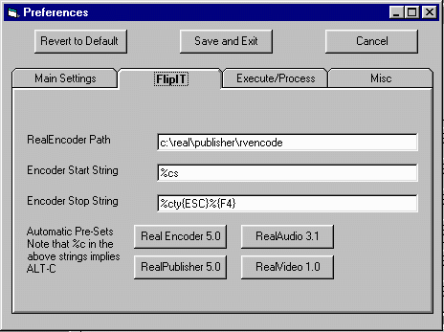
FlipIT! Preferences

Slide 30
FlipIt! Preferences
The path for the encoder to use is specified
The key sequence to start and stop the encoder is settable - %c is ALT-C
There are presets for the four common encoders which you might encounter

Slide 31
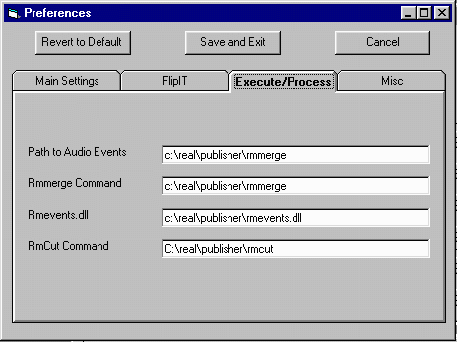
Execute/Process Preferences

Slide 32
Execute/Process Preferences
Path to program for audio events - can either be to rmmerge(>3.0) or to cevent32 (2.0)
Path to the rmmerge program - used for the video
Path to the rmevents.dll file for video or >3.0 audio

Slide 33
Execute/Process Preferences
Rmcut Command - Not currently used
Thumb command - not used in version 1.5

Slide 34
For 2.0 Audio
You may want to support the original RA 2.0 (14.4kbps) player
  Set Audio Events path to the cevents32 and SM-3000 will cevent32 style audio events - the old format requires a streaming server for synchronized multimedia
You can provide 14.4 audio using the newer (>3.0) players as well

Slide 35
TimeIT!
User
Interface

Slide 36
TimeIT! Features
Load - Retrieve and event file from disk
Reset - Start over to create new file
Save - Save the file - name food1.txt, food2.txt, etc….
Done - Exit the program
Lower half is a “time spreadsheet”

Slide 37
TimeIT!
At the bottom, TimeIT! Shows the current timing data for the slide.
  Green is used to indicate the “current row”
  Red indicates - something is wrong such as start time > end time or incomplete entry
You can highlight the row you want to operate on

Slide 38
Editing in TimeIT!
Add creates a new row below the selected row
Insert creates a new row above the selected row
Delete deletes the selected row
To modify the value in the selected row, enter the new value in the “Start Time for Slide 5”

Slide 39
Editing in TimeIT!
TimeIT! is continuously resequencing the slides as new slides are inserted - you can change the First Slide number at any time to resequence the slides
You also must specify the overall clip time so the end time of the last slide is known

Slide 40
TimeIT! Shortcomings
TimeIT! Could use some more work
  Allow for out of order slides - FlipIT! Does this but TimeIT! Will mess it up on a Load/Save
  Allow the specification of something other than a slide. Allow a URL instead.
  For example, at the end of one part, you might want to automatically start the next

Slide 41
FlipIT! User Interface

Slide 42
FlipIT!
FlipIT! Is quite a Rube Goldberg device
  Can simply record timings
  Can record timings and display PowerPoint GIFS
Can start and stop the RealAudio and RealVideo Encoders at the right time
Encoding and lecturing simultaneously can seem overwhelming at first

Slide 43
Multipart Lectures
You must specify which “part” (1, 2 .. ) this particular segment will be - if it will not be multipart - just use 1
The file names for the events, audio, and video will be automatically determined

Slide 44
FlipIT! Settings
Reset empties the events file - If you don’t reset, new events will be appended to the file
For a multi-part lecture you can set the starting slide to something larger than 1
You can also set the starting time
You can pause timing in the middle and these fields will be set properly to restart

Slide 45
More FlipIT!
Delay allows the encoder to get started before the timings are started
As you make timings, FlipIT can display nothing, Small GIFs or full-screen GIFs
You can automatically start and stop the encoder to record audio or video
Done exits
See the tutorial for details on GO :)

Slide 46
Menu Options
File | Open Save Save As Exit
  Files saved are *.som and contain all of the main screen settings
Options | Preferences
Execute - Runs TimeIT! FlipIT! and makes the lecture when you are ready
Help is pretty useless except for the version when you send me mail

Slide 47
Media Directory
Audio/Video
Timing
Real Encoder
AVI Capture
PowerPoint
HTML
Directory
HTML Export

Slide 48
Media Directory
Audio/Video
Timing
PowerPoint
HTML
Directory
CD-ROM
Version
Directory
Web
Version
Directory
Upload

Slide 49
Conclusion
It takes a while to understand all of the features of this software
The more you understand about streaming audio, video, synchronized events, HTML, etc, the more it will make sense
I really need to work on a “VCR”
This works best for “geek” or “ITV”

