Slide 1
Using the Sync-O-Matic 3000
Charles Severance
Michigan State University
http://www.egr.msu.edu/user/crs/

Slide 2
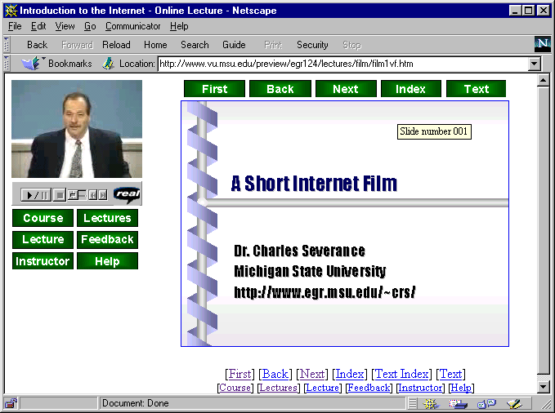

Why
Audio
Video
Sync-O-Matic
Slide Timing
PowerPoint
Style Files

Slide 3
Purpose
Sync-O-Matic is a tool which can improve the ability to deploy on-line lecture content
  Faculty can tape a lecture in a studio and studio staff can produce high quality on-line lecture within hours
  Faculty can use their own personal computer to produce lecture content with minimum of effort

Slide 4
Production Modes
Office Mode
  Do it all on your personal computer
  Capture/Digitize
Studio Mode
  Will professionally produce show to tape - then digitize
First we will discuss the techniques in the office

Slide 5
Office Mode
Audio Or Video - Quality depends on processor
PowerPoint Saved As HTML (and GIFs)
Use the FlipIT! Tool to capture timings
Must have Audio/Video Encoder Ready to Encode
Quite Automatic - Can be tricky at first

Slide 6
Create PowerPoint
Use PowerPoint-97
  Use CTRL-K to ad hyper-links to slides
  Use Note pages - they will be copied to the slides and URL-like strings will be turned into hyperlinks
Limit use of color backgrounds for modem applications
  Mostly white - 3K Colored background 30K

Slide 7
Save food.ppt As HTML
File | Save as HTML - Wizard Answers:
  Page style - irrelevant
  Select GIF - 800x600 1/2 screen for 640x480
  Information page/page colors - irrelevant
  Buttons and placement - irrelevant
  Select “Include Slide Notes In Page”
  Directory \syncomat\htm_sld\
PowerPoint adds “food” subdirectory

Slide 8
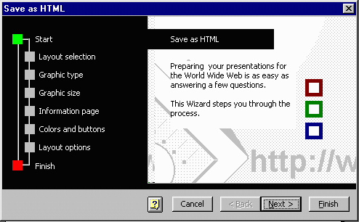
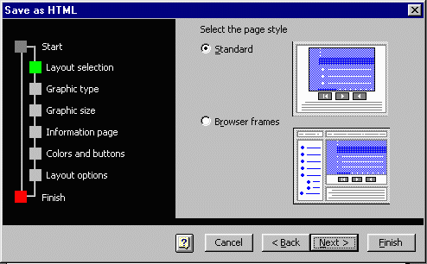
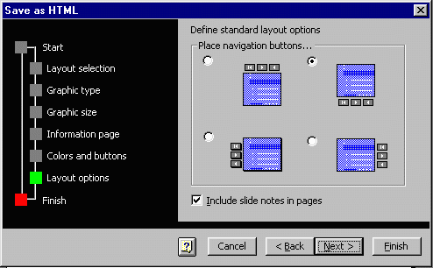
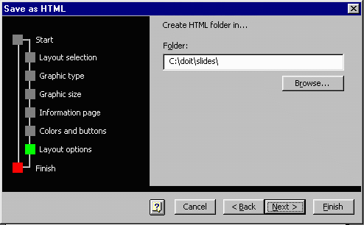

Slide 9
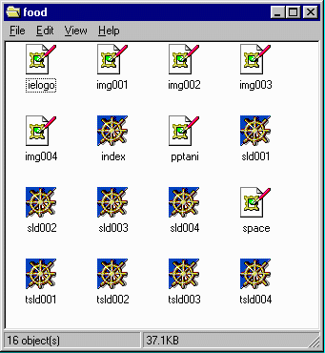
Results from PowerPoint
IMG001.GIF
SLD001.HTM
INDEX.HTM
TSLD001.HTM
Various Microsoft
GIFs
The “001” files have one for each slide

Slide 10
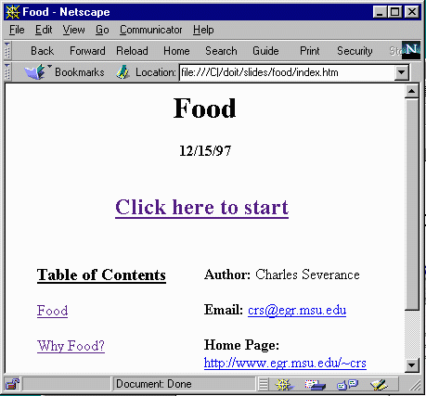
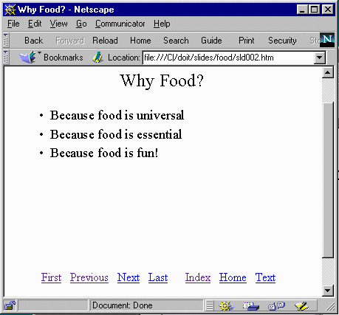
What It Looks Like

Slide 11
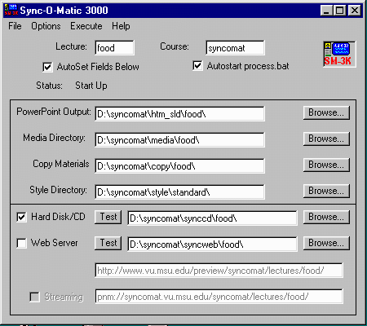
Run SM-3000!
As you type in the lecture name at the top and it sets all the paths below, based on the preferences

Slide 12
Time To Make A Lecture
FlipIT! (A tool to flip and time slides)
  Can simply record timings
  Can record timings and display PowerPoint GIFS (Which you just created)
  Can Record Timings and control
Can start and stop the RealAudio and RealVideo Encoders at the right time

Slide 13
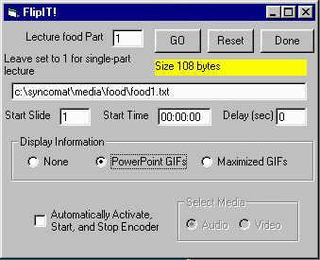
Once In FlipIT!
Set the which segment you are creating
SM-3000 thinks in terms of multi-segment lectures so food1.txt will be the timings for the first (or only) segment

Slide 14
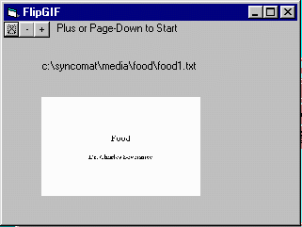
FlipIT! Choices
We will use the PPT
GIF option
Optionally enable
Encoder
Then press “GO”
FlipGIF comes up

Slide 15
FlipGIF
This does the hard work
  X Exit
  + Start the lecture and
  advance slide (Page down)
  - go backwards (Page Up)
Do NOT press “+” Yet!

Slide 16
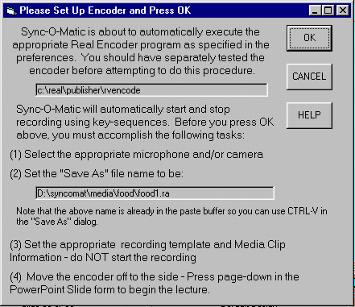
Using The Encoder
When you press GO,
Encoder will be started
Prepare to start encoding
  Live Stream
  Title/Copyright/Author
  Enable Selective Record
  File name is in the paste buffer
  Select your compression (Suggest RA 2.0 14.4)

Slide 17
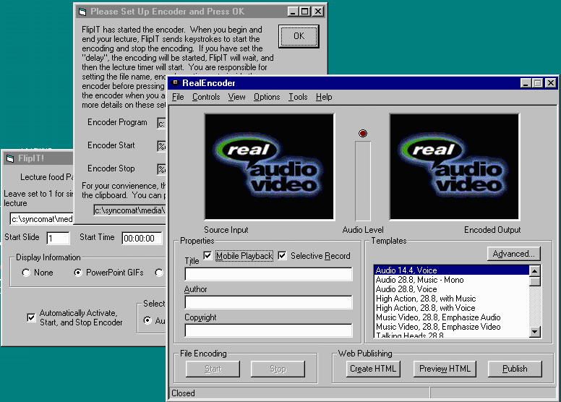

Slide 18
Time to Lecture!
Press the “+” button
  Brings up the first slide in FlipGIF
  Send keytrokes to start Encoder
  Starts Internal Timer
If you want to go to the next slide press “+”
  Advances slide in FlipGIF
  Stores elapsed time \syncomat\media\food\food1.txt

Slide 19
More Lecturing
You can press the + or - and FlipGIF will follow you
On the last slide, when done, either press the + or the X
  Records the elapsed time for last slide
  Turns off internal timer
  Stops the Encoder software

Slide 20
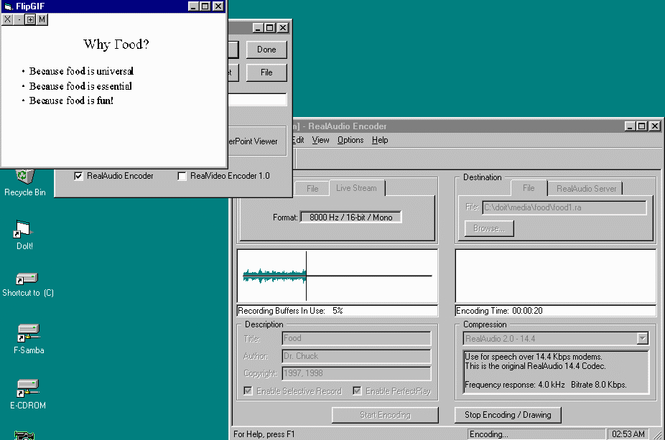
While Lecturing

Slide 21
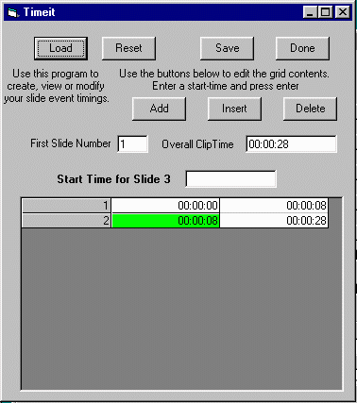
Lecture Complete
Press “Done” in
FlipIT to exit
Enter TimeIT
Load | food1.txt
TimeIT allows you
to edit the timing
if necessary
Press Done

Slide 22
Assuming Everything OK
Keep the defaults on Sync-O-Matic screen
  Destination \syncomat\synccd\food - will be created and/or emptied at start of process
  Location - CD-ROM/Hard Drive
  Media Options - don’t matter locally
Press Start
  Status will be shown as it makes progress

Slide 23
Wait for
“All Done”

Slide 24
Check The Results
Press “test” next to Hard disk/CD
  Your web browser will be opened automatically
You should see each audio/video segment

Slide 25
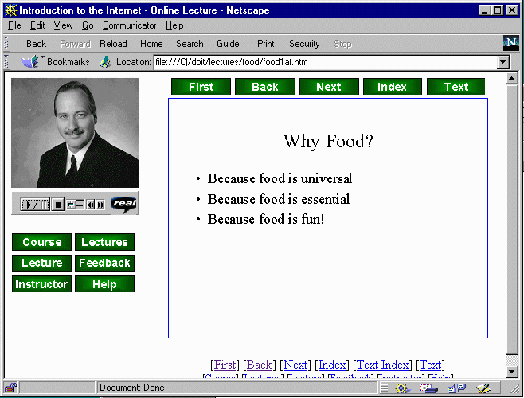

Slide 26
Lecturing In A Studio
Your office/basement might not be ideal
  You want both audio and video
  You want files for multiple bandwidths
  You want good lighting and helpful staff
  You want professional quality
Go to a studio
  Record to tape
  Can digitize many times many ways

Slide 27
Two Approaches
Teacher uses FlipIT to display slides and capture timings
Teacher uses PowerPoint Viewer and studio staff track slide changes

Slide 28
Using FlipIT in Studio
Changes
  Don’t select either Encoder
  Use Maximal GIF screen for display on TV
  Use + to start lecture and advance slide
  Use X (or + on last slide) to finish lecture
Make sure to segment numbers between segments

Slide 29
Using PowerPoint Viewer
Teacher simply gives lecture in Studio using viewer
Need slide start times - several choices
  Staff writes on 6-Up printout during taping
  Note them while digitizing the material
Use TimeIT to enter all of the starting times into each of the files \syncomat\media\food\food1.txt

Slide 30
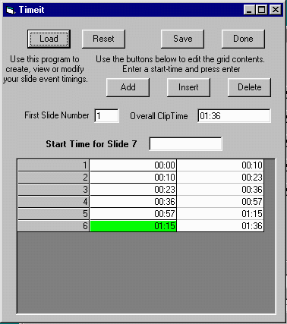
TimeIt!
Slide timing view/editor
Mini-spreadsheet
Will re-sequence automatically
Type “start-times” for each slide and press enter
Can highlight row and edit, insert or delete

Slide 31
Digitizing and Producing
After lecture is complete, digitize into \syncomat\media\food\food1.ra food2.ra food3.ra food1.rm food2.rm food3.rm
Create \syncomat\media\food\food1.txt
Make sure to export the PowerPoint slides to HTML in \syncomat\htm_sld\food\
Once all is in place - at SM-3000 Execute | Make Lecture

Slide 32
Other Settings
Can suppress thumbnail production (needs thumb.exe - Shareware)
Can manually start PROCESS.BAT (generated in \syncomat\synccd\food)
Can enable a verbose log of the slide conversion process
Then press Execute | Make Lecture

Slide 33
Collaborators
May blow up for little things
Try to reproduce and feedback to me - will fix as priorities permit
I will keep a list of new features

Slide 34
Conclusion
This is a good start - needs lots more work
Syncomat automates the process of producing an on-line lecture but still works best for “geeks”

Slide 35
Thanks
Bruce, Katie, Susi - MSU Instructional Television Staff
Raymond Laurin - MSU Undergraduate Student
Ed Jones, Texas A&M

