Slide 1
Cable Television
Power
FM
Radio
Power Line
Network
Telephone
DSL
Phone
Net
0
1Khz
1Mhz
1Ghz
Frequency

Slide 2
Telephone wiring in walls
To Telephone Company

Slide 3
Line 2
Line 1

Slide 4
Telephone Company

Slide 5
Phone
line
network
Modem
connection

Slide 6
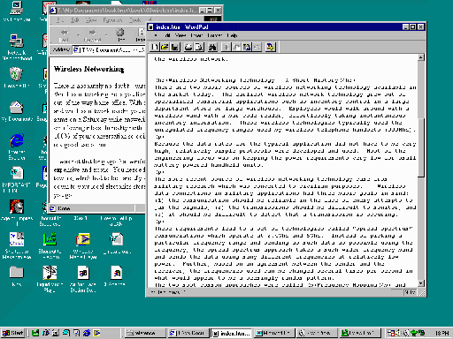
Access
Point

