Slide 1
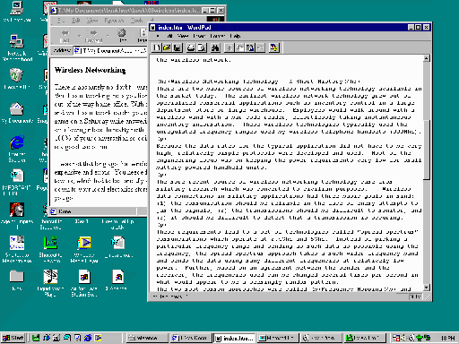
Access
Point

Slide 2


Airport
Base
Gateway

Slide 4
...
2.40Ghz
Frequency
2.48Ghz
Cable Television
Power
FM
Radio
Power Line
Network
Telephone
DSL
Phone
Net

Slide 5
Max Power
Background Noise
2.40Ghz
Frequency
2.48Ghz

