Slide 1
Wireless Home Networking
Chapter 3 Outline
Wireless Home Networking:
The Missing Manual
  By Charles Severance and Richard Wiggins
  O’Reilly, 2003
Chapter 3:
  Building a Wireless Network

Slide 2
Choosing Your Internet Service Provider
In this chapter, we assume a high speed internet connection which is either provided via cable modem or DSL
While high speed providers will try to convince you that one is better than the other, the real differentiators are the services and features rather than the underlying technology
A detailed comparison of ISP’s is in Appendix A

Slide 3
All else equal: Which to Pick?
DSL
  Dedicated pair of wires from your house to phone company
  Layered service model – two organizations involved in your tech support (AOL + local phone company) – Usually you just call one
  Internal architecture “dial-up-like” – requires PPoE software to directly connect
Cable
  Shared media between houses and with CATV
  Interference (i.e. snow on TV) can be harder for service techs to find
  One tech support
  Internal architecture is “local area network-like” so unmodified computers can connect directly to a cable modem at least to test
Since they both are extremely reliable, and we will be using a home gateway which supports either type of ISP, none of these issues should be the deciding factor

Slide 4
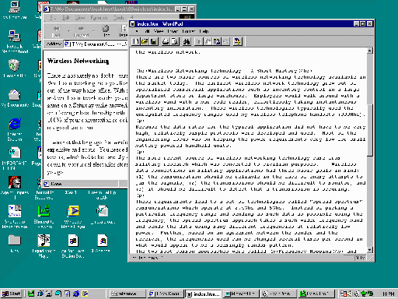

Your Mission when Choosing an ISP
To end up with a connection which includes a home router and wireless gateway
Modem
Router/
Wireless
ISP
Provided by ISP
Owned by You
Notes:
Note – it is possible (and often a good idea) to do this with a standard analog or ISDN modem

Slide 5
Ideal Situations
Your ISP recommends and supports a commodity home router that you purchase
Your ISP provides a home router as an option
  Will usually cost more
  Tech support is usually better
  Often includes wireless
  One stop solution

Slide 6
What to Avoid
An ISP which prohibits the use of a home gateway
An ISP whose tech support has no clue about home gateways
A modem which does not use Ethernet (USB)
It is generally bad to connect your computer directly to the Internet - security

Slide 7
Some things to Check
Can you get a static IP address? Nice if you run a server, but can costs $25 more per month
Are you allowed to put up a server?
Are there any ports blocked by your ISP – often they block port 80 (web service)
Note: Survey of our ISPs and features (CS, TS, RW) in a table

Slide 8
A Gateway with Built-In Wireless?
Having wireless built-into the router is generally preferable, but if your ISP is providing the home router, it may not have wireless built in – this is OK – simply purchase a wireless gateway
Wireless
Modem
Router
ISP

Slide 9
Buying A Modem
It is generally not a good idea to purchase a modem. You want to keep this the ISP’s “problem” Usually you can “lease” for $5.00 per month on the bill – this is the best option

Slide 10
Installation
Installation of High Speed service can range from simple to complex – the ISP will walk you through the process – they may ship you components that you self-install or they may send a truck to your home.
In any case, it is very important that you know what is their responsibility and what is your responsibility once the installation is complete.

Slide 11
Be prepared to restore your network to the “first installed” state when calling technical support
Unless the ISP is providing the gateway/router, the ISP will probably view your connection as having a single computer connected directly to the modem via Ethernet cabling.
When you want to call technical support because there is a problem, you should be prepared to restore this network configuration and be prepared to reinstall the vendor supplied software.
Modem
ISP

Slide 12
What is the ISP Software?
Only a small part is truly necessary to do DSL authentication
Software to surf the web and read E-Mail that you don’t really want and probably already have
Once we have the home gateway properly installed and configured we do NOT need this software (even for DSL) because the home gateway does everything (including Authentication) and the computers in the home are simply presented a network connection.
Because of this, you may want to install the ISP software on only one computer and use that computer to connect directly to the modem for testing purposes.

Slide 13
You (probably) still want a home router even with one computer
Eliminates installing all of the ISP software on your PC
Acts as a firewall blocking incoming access to your PC
Eliminates the “latest software you installed” as the reason that your network is down
If you bring another computer home, it is easy to hook up without installing a bunch of software that might mess up thew computer when you “take-it-back”
Mac OS/X and Linux works much better because most ISP software is only written for Microsoft and then only for the latest operating system
…. ‘nuff said.
Modem
Router/
Wireless
ISP

Slide 14
Choosing a Home Router
Pick a name brand
Purchase from a mainstream electronics store
Check for reviews
Look at the web site to find product documentation and technical support pages

Slide 15
Choosing a Wireless Technology
Wireless is still evolving so new technologies are emerging
Conservative choice: 802.11b – First widely adopted and deployed standard – might want to choose for your portable computers for maximum interoperability as you travel around – Maximum speed 11Mb./sec
Current state-of-the-art: 802.11g – 54MB/sec and compatible with 802.11b – good for your base station and desktop computers in your home
You might want to pick a mainstream brand and stick with it for your home. See our website. Standards insure interoperability, by picking one vendor you can learn only one set of configuration screens
For someone who wants to trick out their network, 802.11b is best choice
We assume a 802.11g base station and a mix of 802.11b and 802.11g computers
Don’t pick any technology which is not upwards compatible with 802.11b

Slide 16
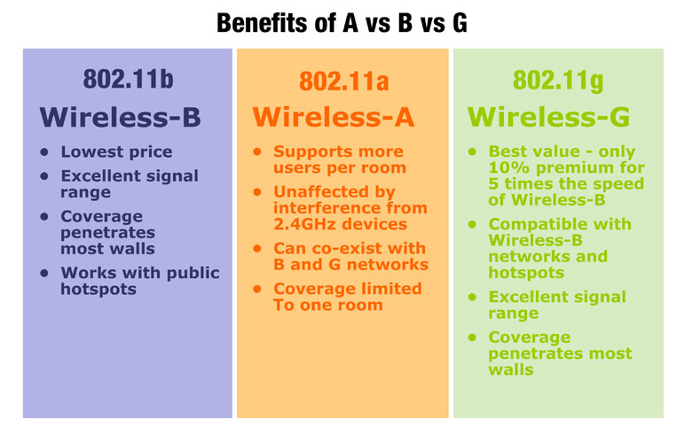
Sidebar: 802.11 choices
http://linksys.com/edu/whichstandard.asp

Slide 17
Bringing Your New Router Home
Start with a working network without the router – make sure it works after everything is powered off and powered back up
Couple of special cases
  QuickStart with cable modem, wireless and XP
  AOL As your Internet Serivce Provider

Slide 18
Cable Modem Only: Plug and Go
Scanario:
  Cable Modem ISP
  Gateway has Wireless built in
  Your computer is a portable running Windows XP
  You did not have to install any special vendor software to make things work (i.e. the cable modem provides dynamic addresses)
  Everything is working with the computer directly connect
Steps
  Unplug the computer from the cable modem
  Connect the gateway to the cable modem using the proper port (note about cabling – crossovers, etc)
  Power up modem, wait until it is up (usually about 2 minutes)
  Power up gateway wait until it is up (usually about 30 seconds)
  Plug wireless card into your computer installing drivers if necessary
  Reboot the computer
  Surf the web
If this does not work, follow the longer sequence of steps

Slide 19
A Note about AOL
AOL always ends up with their “own way” of doing things
For AOL people it is really cool – AOL truly takes care of everything.
For non-AOL people, using AOL as an ISP really gets in the way.
If you already are paying a monthly fee for dial-up AOL then AOL DSL is a very good choice
  They provide the home router (with wireless)
  You install the AOL DSL on all computers connected to the network
  It works swell – tech support is very helpful
It is not for everyone
  If you want to run a web server
  If you want to play multi-player games
  If you have a work computer that you want to use from home and the IT department at work does not want you installing AOL on it.
You can run non-AOL applications such as mail readers web browsers, and other programs as long as the AOL software is installed and establishes the connection properly

