Slide 1
Wireless Home Networking
Chapter 1 Outline
Wireless Home Networking:
The Missing Manual
  By Charles Severance and Richard Wiggins
  O’Reilly, 2003
Chapter 1:
  Wireless Networking in Your Home

Slide 2
Is Wireless Home Networking
Right for You?
You’re staring at a box containing a “Wireless Access Point and Cable/DSL Router”
  You noticed that 5 items on Amazon’s list of Top 10 electronics were wireless network devices…
    So you bought some!
  Did you make the right purchase?
  Will it work well in your home?
  The answer is YES!
With this device, you can:
  Share a broadband Internet connection among multiple computers in your home
  Build a home network of laptop computers as well as desktops without running wires

Slide 3
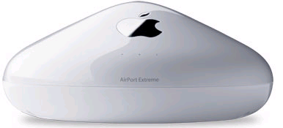
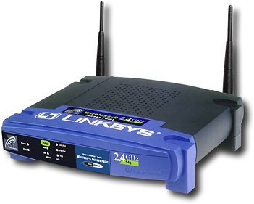
Example Wireless Access Points
Also known as “base stations”
Apple Airport Extreme
Linksys Wireless-G Broadband Router

Slide 4
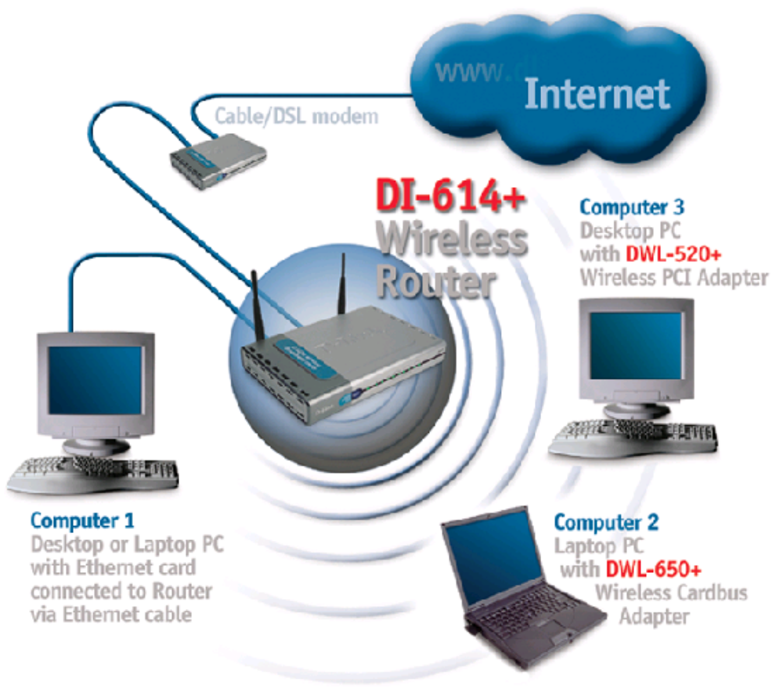
An Example Wireless Home Network

Slide 5
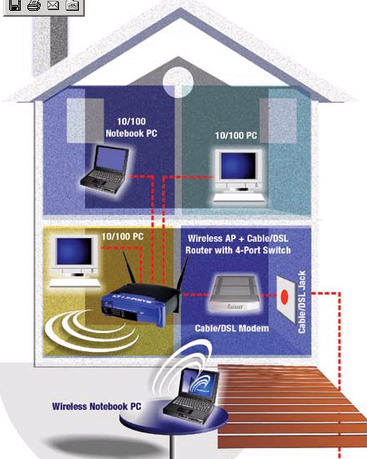
Another Example Wireless Home Network

Slide 6
Why Do I Need a Home Network?
Many homes now have more than one computer
  Perhaps a main PC…
  … and a laptop
  … or a second desktop
  … or a desktop for the kids
  … or all four!
Networking your computer lets you share their capabilities
  Just as we network computers at the office

Slide 7
What Can You Share Using a Home Network?
Every computer in the home can share a single broadband Internet connection
  Always-on Internet – no dialing
  High speed for every computer in the home
Share printers
  Mandy can draft her term paper using her PC upstairs, and send the final copy to the laser printer downstairs
Share files
  Mom can use her tablet PC to retrieve PowerPoint slides for that big presentation tomorrow
  The family photo album is archived on the main PC
Share applications
  Dad can use his laptop to update the Quicken database on the main PC

Slide 8
“But I’ve Heard Wireless Can Be a Security Risk”
Yes, if you don’t take some simple precautions
  Out of the box, wireless access points are not configured securely
  Somebody within range could conceivably break into your network
    A next-door neighbor
    That mysterious van parked outside with all the antennas on it
But in this book we’ll tell you the steps to take to secure your wireless network

Slide 9
“But I’ve Got a Big House – Will Wireless Work for Me?”
A “WiFi” (or 802.11) network does have limitations
  Number of feet from base station
  Number of walls between station and PC
  Types of construction materials
But there are solutions
  Careful placement of base station
  Replacement antennas
  Wireless signal booster
And there are wired alternatives:
    Home Phoneline (HomePNA)
      Using existing phone jacks
    Home Powerline
      Using existing power outlets
    Or, where needed, run your own Ethernet cable
In short, you can build your network to meet any needs
  And we’ll tell you how in this book.

Slide 10
If You’ve Been Shy About Building a Home Network…
Now is the time to leap!
With Windows XP and Mac OS-X, home networking is now dramatically easier than it used to be
  Older versions of Windows didn’t play well with each other
  It’s also now trivial to mix Mac and Windows
Devices to meet every need are available at very competitive prices

Slide 11
Planning Your Home Network
Other books tell you to carefully plan your network
  We don’t agree.
  You don’t know what your needs will be tomorrow.
Our suggestions:
  Buy a combination access point / cable DSL router
  Start building your network
  Add new devices (and wiring) as needed
  You can blend a wireless network with wired very easily
One important exception about planning:
  If you are building a new house, you should consider wiring every room
    For phone, data, maybe video
    You should consider running conduit throughout your house for future expansion
    Odd suggestion for a wireless book?
      Find out why we say this in Chapter ____

Slide 12
Can’t I Use a PC as My Access Point?
Yes, you can.
But we don’t recommend this for most folks:
  Setup is more complicated
  Every time you upgrade the PC you have work to do
  You have to leave the PC on all the time
    This costs electricity
  Standalone access points are easy to configure, provide firewall protection for your network, consume little power, and easily support all the computers in your home network.
But Biff down the road uses his Linux PC as a base station for his family’s home network
  Fine! More power to ‘em!

Slide 13
What Will My Home Network Cost to Build?
Under $100 for an access point
For each computer:
  Wireless PC Card for laptop: Under $50
  Wireless PCI card for desktop: Under $50
  For a wired (Ethernet) connection:
    Ethernet cable: Under $20
    Your PC probably comes with an Ethernet card
      But you can buy one for under $20
In short: for $200 or so you can build your network
  Less than the electricity to leave a PC powered up all year

Slide 14
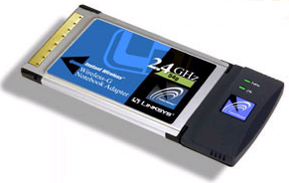
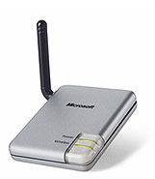
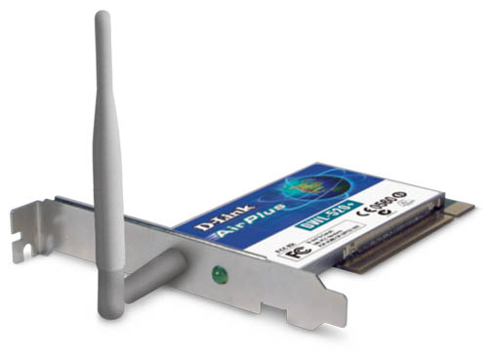
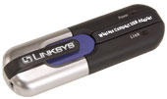
Example Wireless Devices
Wireless USB Adapter for desktop – plug into USB port
Wireless
PC Card adapter – installs in standard laptop card slot
Wireless USB Adapter – installs in a desktop PCI slot
Wireless Compact USB Adapter for laptop

Slide 15

“Wireless”? “WiFi”? “802.11”? Huh?
Yes, it’s confusing!
  This book describes how to use a family of wireless devices
The industry standard term is “WiFi” – meaning “WIreless FIdelity”
  A competing standard, HomeRF, has fallen by the wayside
WiFi is in very common use
  In businesses, small and large
  On college campuses
  In every Starbucks!
  And in home networks
A set of international standards, known as IEEE 802.11, specifies how WiFi devices work

Slide 16
Do You Guys Do as You Preach?
Yes!
Chuck’s network:
  New home built in 2000
  Cable modem for broadband in basement
  Conduit to every room in house:
    Ethernet, phone, and video cables
  Apple Airport for wireless in the house or outside
Rich’s network:
  Existing home
  DSL for broadband in basement
  Mixed network:
    Ethernet for computers, printers in basement
    Home Phoneline for upstairs office
    Wireless for first floor or outside

Slide 17
The Future of Home Networking
Kinds of applications:
  Home data networking: primarily connecting computers
  Home entertainment: television and hifi audio anywhere in the house
  Home automation: controlling appliances (lights, sprinklers, even the stove)
  Home security: Monitoring for break-ins, flood, fire; security cameras

Slide 18
Home Networking Convergence
Increasingly, we’ll use one network for all these applications
Examples already exist:
  Lansonic Digital Audio Server holds 350 CDs in MP3 format, serves music over a home network
  The popular TiVo personal video recorder now connects to your home network
    Schedule recording using a Web browser from anywhere on Earth
    View your recording of Six Feet Under using any computer on your home network

Slide 19
A Not-So-Jetsons
Home Networking Vision
Teresa realizes at work that she forgot to program the TiVo to record The Sopranos. A quick Web transaction solves that.
Chuck is at a conference in Tokyo. The same Wifi-enabled laptop he uses at home and in Ann Arbor allows him to surf the Web and to upload the PowerPoint slides he left back home.
  He uses NetMeeting for a video chat with the family
Mandy takes notes for her college class using a Tablet PC, and prints them out wirelessly at home. While she works, she listens to MP3 music archived on the main PC.
Brent uploads digital video he shot at school to the family editing PC in the basement – but he uses the PC in his bedroom as a remote terminal
The house sprinkler system checks the Weather Channel over the Internet and decides not to water today – rain is in the forecast.

