Slide 1

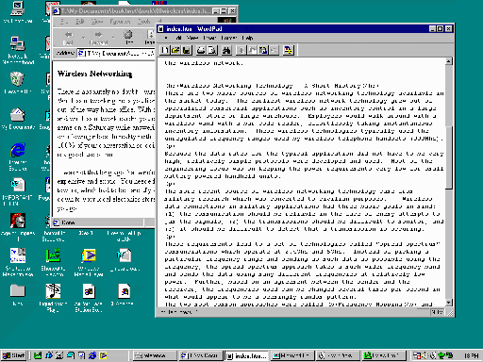
Internet
Service
Provider
Modem
Router
May all be in one unit.
Switch
Wireless
Access
Point
Wired
Computer
Wireless
Computer

Slide 2
To
Modem
Router
Switch
Switch

Slide 3
Modem
Router
ISP
Switch
Wireless
Access
Point

Slide 4
Modem
I am Sam, Sam I am.
Router
Hi Sam, use 12.17.1.48

