Slide 1
Wireless Home Networking
Chapter 4 Outline
Wireless Home Networking:
The Missing Manual
  By Charles Severance and Richard Wiggins
  O’Reilly, 2003
Chapter 4:
  Installing Your Wireless Router

Slide 2
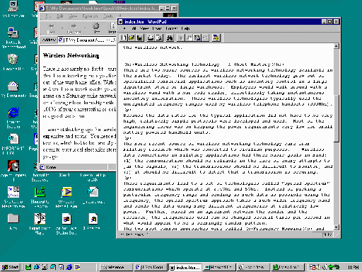

You (probably) still want a home router even with one computer
Eliminates installing all of the ISP software on your PC
Acts as a firewall blocking incoming access to your PC
Eliminates the “latest software you installed” as the reason that your network is down
If you bring another computer home, it is easy to hook up without installing a bunch of software that might mess up the computer when you “take-it-back”
Mac OS/X and Linux works much better because most ISP software is only written for Microsoft and then only for the latest operating system
You may want to install the home router from the very first moment
…. ‘nuff said.
Modem
Router/
Wireless
ISP

Slide 3
A Gateway with Built-In Wireless?
Having wireless built-into the router is generally preferable, but if your ISP is providing the home router, it may not have wireless built in – this is OK – simply purchase a wireless gateway
Wireless
Modem
Router
ISP

Slide 4
Choosing a Home Router
Pick a name brand
Purchase from a mainstream electronics store
Check for reviews
Look at the web site to find product documentation and technical support pages

Slide 5
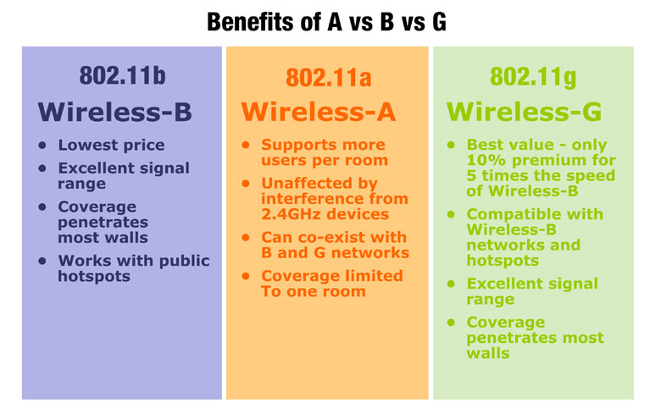
Sidebar: 802.11 choices
http://linksys.com/edu/whichstandard.asp

Slide 6
Choosing a Wireless Technology
Wireless is still evolving so new technologies are emerging
Conservative choice: 802.11b – First widely adopted and deployed standard – might want to choose for your portable computers for maximum interoperability as you travel around – Maximum speed 11Mb./sec
Current state-of-the-art: 802.11g – 54MB/sec and compatible with 802.11b – good for your base station and desktop computers in your home
You might want to pick a mainstream brand and stick with it for your home. See our website. Standards insure interoperability, by picking one vendor you can learn only one set of configuration screens
For someone who wants to trick out their network, 802.11b is best choice
We assume a 802.11g base station and a mix of 802.11b and 802.11g computers
Don’t pick any technology which is not upwards compatible with 802.11b

Slide 7
Cable Modem Only: Plug and Go
Scanario:
  Cable Modem ISP
  Gateway has Wireless built in
  Your computer is a portable running Windows XP
  You did not have to install any special vendor software to make things work (i.e. the cable modem provides dynamic addresses)
  Everything is working with the computer directly connect
Steps
  Unplug the computer from the cable modem
  Connect the gateway to the cable modem using the proper port (note about cabling – crossovers, etc)
  Power up modem, wait until it is up (usually about 2 minutes)
  Power up gateway wait until it is up (usually about 30 seconds)
  Plug wireless card into your computer installing drivers if necessary
  Reboot the computer
  Surf the web
If this does not work, follow the longer sequence of steps

Slide 8
Preparing for Installation
DSL
  Account and Password
  Note on static
Cable Modem
  Maybe nothing – when modem simply hands out DHCP addresses
  Host Name
  Note on static address
  Whether or not the MAC address matters

Slide 9
Installing The Home Router
If plug and play did not work we will go through this one step at a time, checking for problems as we go
Gather information
Disconnect computer from modem
Connect home router to gateway
Connect computer to gateway (wired or wireless)
Contact gateway
Configure gateway based on ISP parameters

Slide 10
Installing the Home Router Diagram
Disconnect computer from DSL/Cable Modem
Connect Router “WAN” port to Gateway
Portable w/
Wireless?
Yes
No
Install Wireless Card
Connect computer to router
Configure router
Connect to router with web browser
Power up (1) modem, (2) router, (3) computer
Reboot (1) router, (2) computer
Attempt to surf the web

Slide 11
Connections
Connect the Ethernet port on your modem to the “WAN” port on your router
Wireless: Install your wireless card and any drivers as directed by the card instructions
Wired: Connect Ethernet cable between computer and the data ports on the router
Call out: If you are in doubt and have both available, test the wired connection first and then switch to wireless later – XP switches very naturally
Call out: Link light – if this is not on, then don’t waste time
Call out: Connections, Status, View Available Networks, Repair Operation

Slide 12
Powering things up
Turn off everything
Power On modem, wait until it has established its connection – can take up to two minutes – most likely 45 seconds – it has a complex problem
Power on gateway – usually will be up in 15 seconds
Power up computer and log in

Slide 13

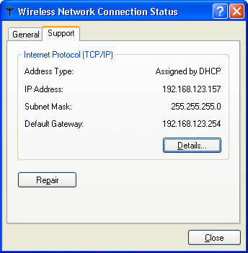
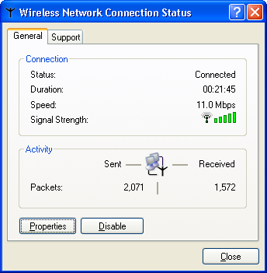
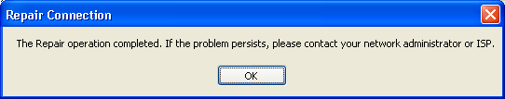
Pictures – Getting an IP Address
Check connection
  Tray icon double click
  Status screen – General and Support
  Press Repair – should respond in 5 seconds

Slide 14
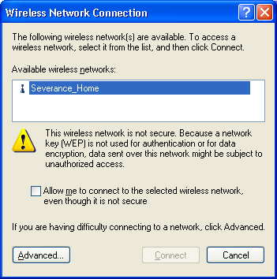
Pictures – Finding the right network
  Tray icon right click – view available networks – check allow me to connect

Slide 15
Establishing connection
Some gateways fake DNS so no matter what you go to, you end up at the gateway
Doc may tell you http://192.168.1.254/
You might look at your addess and guess .1 or .254
Usually there is no password or predefined password for the “admin” account – change this later. Generally can only configure from your LAN – but remember wireless

Slide 16
Router Configuration Areas
WAN – ISP Connection
LAN – Home network connection
Wireless – Network name, security settings
Utilities – Status, reboot, reset to defaults

Slide 17
Configuring the Router - Cable
WAN: Select DHCP
  (optionally) Host Name
  (optionally) Fake out MAC
LAN – Usually defaults OK
  DHCP
  Address Range – dynamic versus static
Wireless – Name it something
Reboot gateway – 20 seconds
Get new IP address
Try to surf - optimistic
Reconnect to gateway – May need PW this time
Check Status – did the router get an address?

Slide 18
Configuring the Router - DSL
WAN: Select PPPoE
  Account name (with or without @) and password
LAN – Usually defaults OK
  DHCP
  Address Range – dynamic versus static
Wireless – Name it something
Reboot gateway – 20 seconds
Get new IP address
Try to surf - optimistic
Reconnect to router – May need PW this time
Check Status – did the router get an address?

Slide 19
Sample with Apple Airport and Cable Modem
Step by step

Slide 20
Securing your wireless Network
Turning on WEP
Setting the WEP Key
Reboting everything and testing
Change WEP key from time to time.
If you have a problem may have to use wired connection to fix router – or reset to factory default

Slide 21
Conclusion

