Slide 1
Wireless Home Networking
Chapter 3 Outline
Wireless Home Networking:
The Missing Manual
  By Charles Severance and Richard Wiggins
  O’Reilly, 2003
Chapter 3:
  Building a Wireless Network

Slide 2
Choosing Your Internet Service Provider
In this chapter, we assume a high speed Internet connection which is either provided via cable modem or DSL
While high speed providers will try to convince you that one is better than the other, the real differentiators are the services and features rather than the underlying technology
A detailed comparison of ISP’s is in Appendix A

Slide 3
All else equal: Which to Pick?
DSL
  Dedicated pair of wires from your house to phone company
  Layered service model – two organizations involved in your tech support (AOL + local phone company) – Usually you just call one
  Internal architecture “dial-up-like” – requires PPoE software to directly connect
Cable
  Shared media between houses and with CATV
  Interference (i.e. snow on TV) can be harder for service techs to find
  One tech support
  Internal architecture is “local area network-like” so unmodified computers can connect directly to a cable modem at least to test
Since they both are extremely reliable, and we will be using a home gateway which supports either type of ISP, none of these issues should be the deciding factor

Slide 4
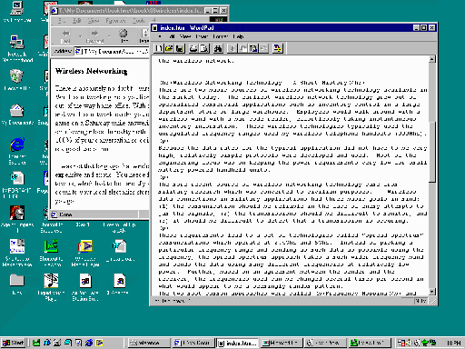

Your Mission when Choosing an ISP
To end up with a connection which includes a home router and wireless gateway
Modem
Router/
Wireless
ISP
Provided by ISP
Owned by You
Notes:
Note – it is possible (and often a good idea) to do this with a standard analog or ISDN modem

Slide 5
Ideal Situations
Your ISP recommends and supports a commodity home router that you purchase
Your ISP provides a home router as an option
  Will usually cost more
  Tech support is usually better
  Often includes wireless
  One stop solution

Slide 6
What to Avoid
An ISP which prohibits the use of a home gateway
An ISP whose tech support has no clue about home gateways
A modem which does not use Ethernet (USB)
It is generally bad to connect your computer directly to the Internet - security

Slide 7
Some things to Check
Can you get a static IP address? Nice if you run a server, but can costs $25 more per month
Are you allowed to put up a server?
Are there any ports blocked by your ISP – often they block port 80 (web service)
Note: Survey of our ISPs and features (CS, TS, RW) in a table

Slide 8
A Gateway with Built-In Wireless?
Having wireless built-into the router is generally preferable, but if your ISP is providing the home router, it may not have wireless built in – this is OK – simply purchase a wireless gateway
Wireless
Modem
Router
ISP

Slide 9
Buying A Modem
It is generally not a good idea to purchase a modem. You want to keep this the ISP’s “problem” Usually you can “lease” for $5.00 per month on the bill – this is the best option

Slide 10
Installation
Installation of High Speed service can range from simple to complex – the ISP will walk you through the process – they may ship you components that you self-install or they may send a truck to your home.
In any case, it is very important that you know what is their responsibility and what is your responsibility once the installation is complete.

Slide 11
Cable Modem Installation
Modem
Rest of
the House
Two-way
Splitter
Filter

Slide 12

DSL Installation
Splitter
Wall Jack
Modem

Slide 13
Be prepared to restore your network to the “first installed” state when calling technical support
Unless the ISP is providing the gateway/router, the ISP will probably view your connection as having a single computer connected directly to the modem via Ethernet cabling.
When you want to call technical support because there is a problem, you should be prepared to restore this network configuration and be prepared to reinstall the vendor supplied software.
Call out: Remember the order of the lights when the modem is working.
Call out: Which lights are which and which lights are important
Modem
ISP

Slide 14
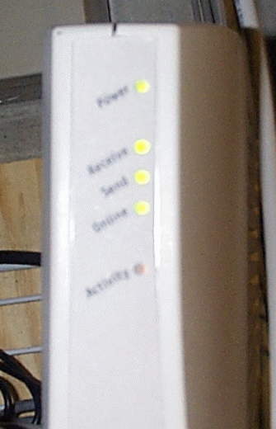
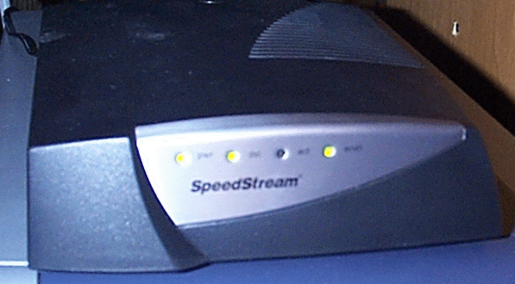
The Modem Lights
“DSL”
“Online”

Slide 15
What is the ISP Software?
Only a small part is truly necessary to do DSL authentication
Software to surf the web and read E-Mail that you don’t really want and probably already have
Once we have the home gateway properly installed and configured we do NOT need this software (even for DSL) because the home gateway does everything (including Authentication) and the computers in the home are simply presented a network connection.
Because of this, you may want to install the ISP software on only one computer and use that computer to connect directly to the modem for testing purposes.
You MAY not want to install the ISP software at all and simply install the home router – this makes sense – especially if your ISP technical support has recommended the router and is familiar with how they work

