Slide 1
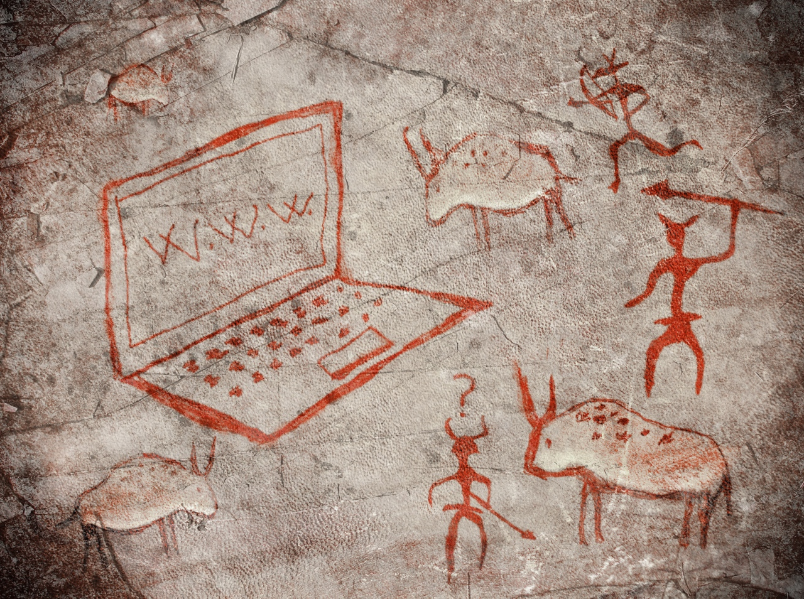

Internet Security
Dr. Charles Severance <csev@umich.edu>
http://www.dr-chuck.com/
Twitter: @drchuck
https://www.coursera.org/course/insidetheinternet

Slide 2
Paranoia
Who is out to get you?
If you are interesting or influential people want to get into your personal info.
If you are normal, folks want to use your resources or take your information to make money…
Usually no one cares… But it is safest to assume some is always trying…

Slide 3
Security is always a Tradeoff
"Perfect security" is unachievable - Must find the right tradeoff
Security .versus. Cost
Security .versus. Convenience (See also, "profit")
"More" is not always better – vendors of products will try to convince you that you *cannot live* without their particular gadget

Slide 4
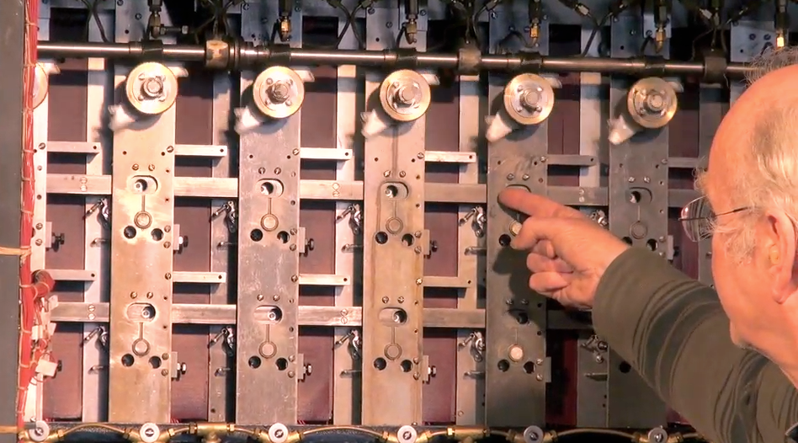
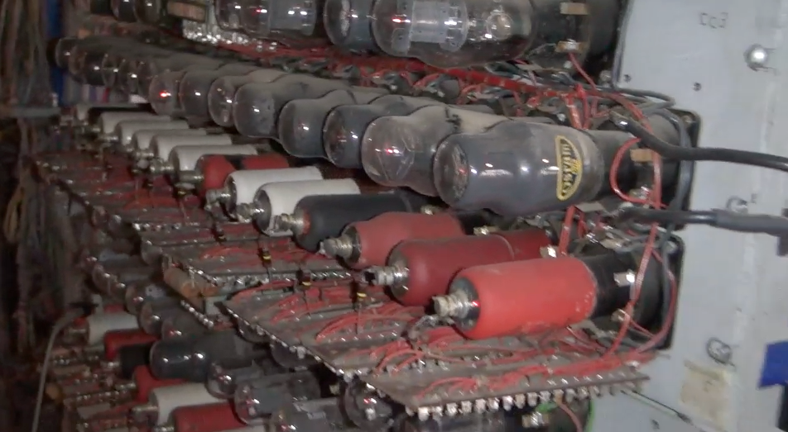
Alan Turing and Bletchley Park
Top secret code breaking effort
10,000 people at the peak (team effort)
BOMBE: Mechanical Computer
Colossus: Electronic Computer
http://www.youtube.com/watch?v=5nK_ft0Lf1s

Slide 5
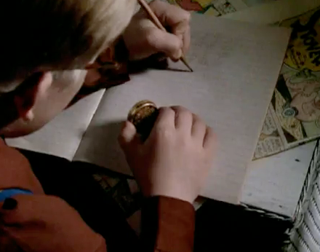
http://en.wikipedia.org/wiki/Bombe

Slide 6
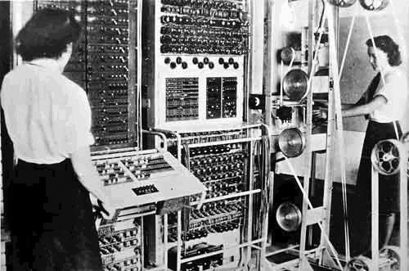
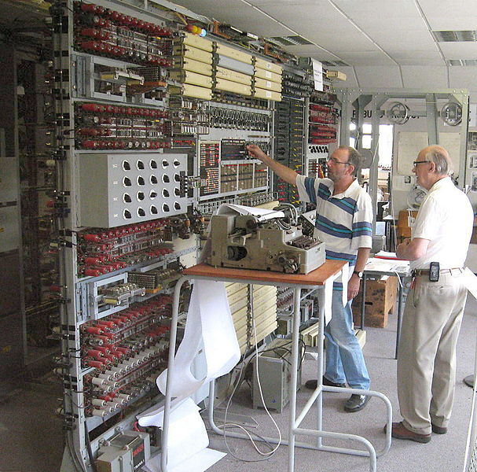
http://en.wikipedia.org/wiki/Colossus_computer
http://en.wikipedia.org/wiki/Tony_Sale

Slide 7
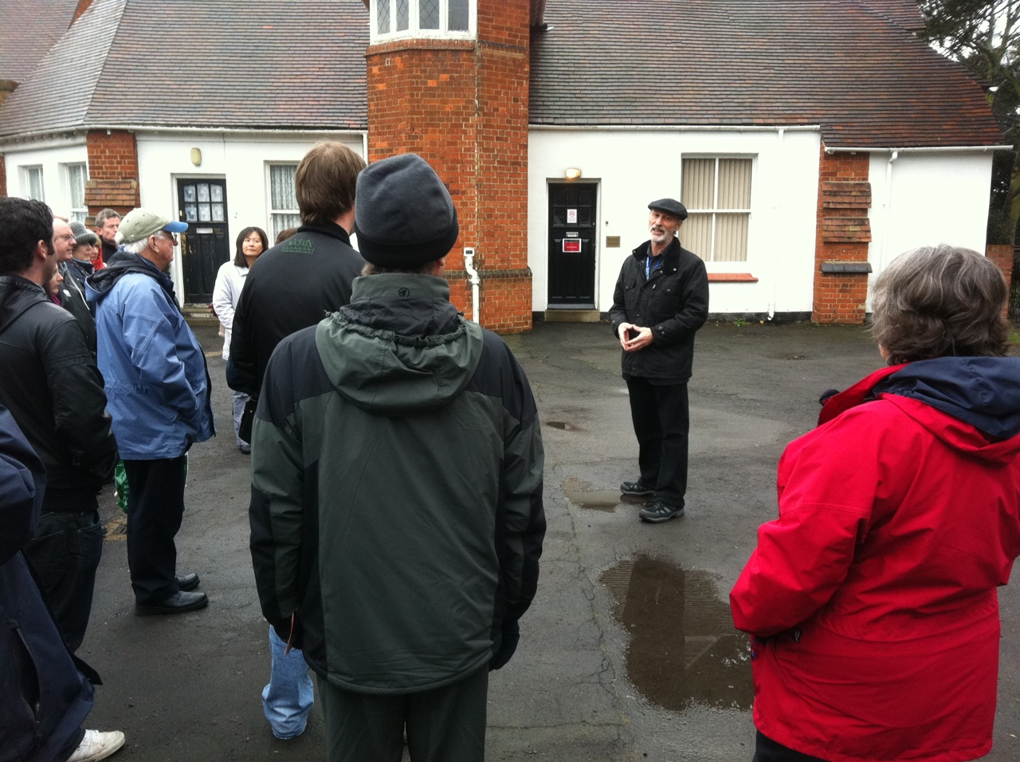
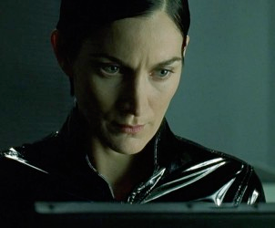
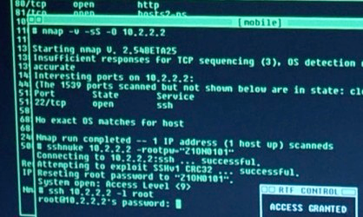
http://nmap.org/movies.html

Slide 8
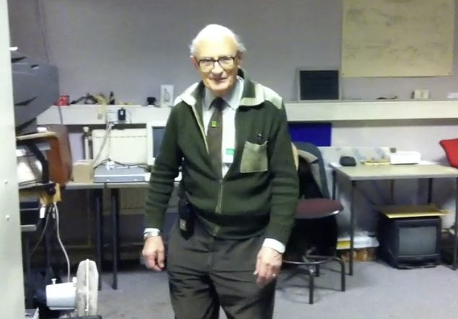
http://en.wikipedia.org/wiki/Tony_Sale
January 1931 – August 2011
http://www.youtube.com/watch?v=5nK_ft0Lf1s

Slide 9


Slide 10
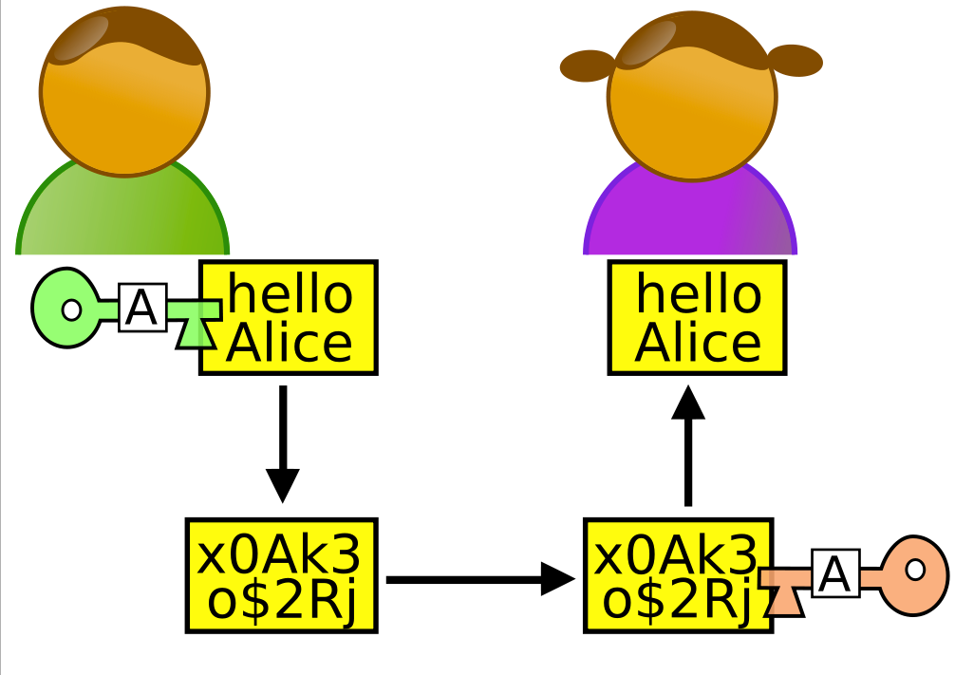
Lets Meet some Nice People
http://en.wikipedia.org/wiki/Alice_and_Bob

Slide 11
People With Bad Intent
Carol, Carlos or Charlie, as a third participant in communications.
Chuck, as a third participant usually of malicious intent
Dan or Dave, a fourth participant,
Eve, an eavesdropper, is usually a passive attacker. While she can listen in on messages between Alice and Bob, she cannot modify them.
.......
http://en.wikipedia.org/wiki/Alice_and_Bob

Slide 12

Terminology
Confidentiality
Prevent unauthorized viewing of private information
Integrity
Information is from who you think it is from and has not been modified since it was sent

Slide 13
Ensuring Confidentiality
Encryption and Decryption

Slide 14
Terminology
Plaintext is a message that will be put into secret form.
Ciphertext is a transformed version of plaintext that is unintelligible to anyone without the means to decrypt

Slide 15
Terminology
The transformation of plaintext to ciphertext is referred to as encryption.
Returning the ciphertext back to plaintext is referred to as decryption.
The strength of a cryptosystem is determined by the encryption and decryption techniques and the length of the key.

Slide 16
Two Kinds of Systems
Two basic types of cryptosystems exist, secret-key and public-key.
In a secret-key scheme, the key used for encryption must be the same key used for decryption. Also called symmetric-key cryptosystem.
Secret-key cryptosystems have the problem of secure key distribution to all parties using the cryptosystem.

Slide 17

c = d
a = b
n = o
d = e
y = z
Plaintext:
"candy"
Plaintext:
"candy"
Encrypt
Decrypt
CipherText:
"dboez"
Message Might be Intercepted
CipherText:
"dboez"
Alice
Eve
Bob

Slide 18
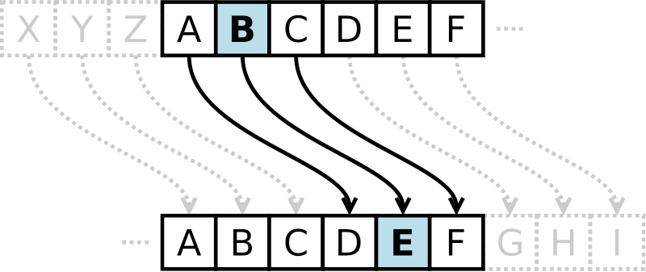
Caesar Cipher
Shift of 3
Caesar cipher is one of the simplest and most widely known encryption techniques. It is a type of substitution cipher in which each letter in the plaintext is replaced by a letter some fixed number of positions down the alphabet.
http://en.wikipedia.org/wiki/Caesar_cipher

Slide 19
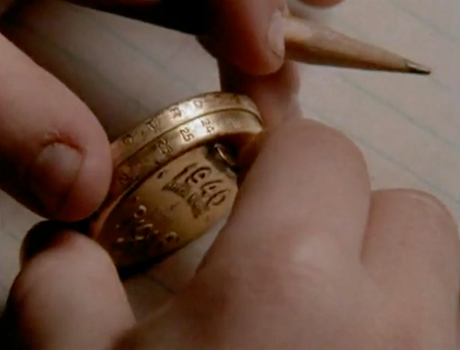
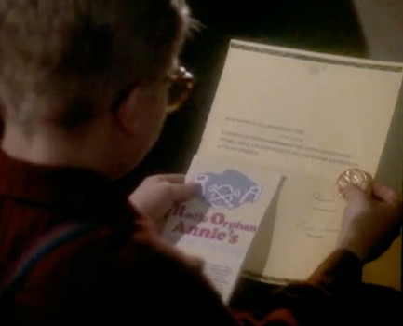
Secret Decoder Ring
http://www.youtube.com/watch?v=zdA__2tKoIU

Slide 20
Secret Decoder Ring - Shift Number
PP: A B C D E F G H I J K L M N O P Q R S T U V W X Y Z
01: B C D E F G H I J K L M N O P Q R S T U V W X Y Z A
02: C D E F G H I J K L M N O P Q R S T U V W X Y Z A B
08: I J K L M N O P Q R S T U V W X Y Z A B C D E F G H
09: J K L M N O P Q R S T U V W X Y Z A B C D E F G H I
10: K L M N O P Q R S T U V W X Y Z A B C D E F G H I J
11: L M N O P Q R S T U V W X Y Z A B C D E F G H I J K
12: M N O P Q R S T U V W X Y Z A B C D E F G H I J K L
13: N O P Q R S T U V W X Y Z A B C D E F G H I J K L M
14: O P Q R S T U V W X Y Z A B C D E F G H I J K L M N
http://www.dr-chuck.com/Secret-Decoder.pdf

Slide 21
Break the Code I
CipherText:
"upbtu"
For each number 1..26, see if when you decrypt the message using that shift, it makes sense.

Slide 22
Break the Code I
CipherText:
"upbtu"
Plaintext:
"toast"
00: A B C D E F G H I J K L M N O P Q R S T U V W X Y Z
01: B C D E F G H I J K L M N O P Q R S T U V W X Y Z A
A shift of 1

Slide 23
Break the Code II
Uryyb, zl anzr vf Puhpx naq V arrq zbarl naq n wrg.

Slide 24
Break the Code II
Uryyb, zl anzr vf Puhpx naq V arrq zbarl naq n wrg.
Hello, my name is Chuck and I need money and a jet.
www.rot13.com

Slide 25
Cryptographic Hashes
Integrity

Slide 26
Terminology
Confidentiality
Prevent unauthorized viewing of private information
Integrity
Information is from who you think it is from and has not been modified since it was sent

Slide 27
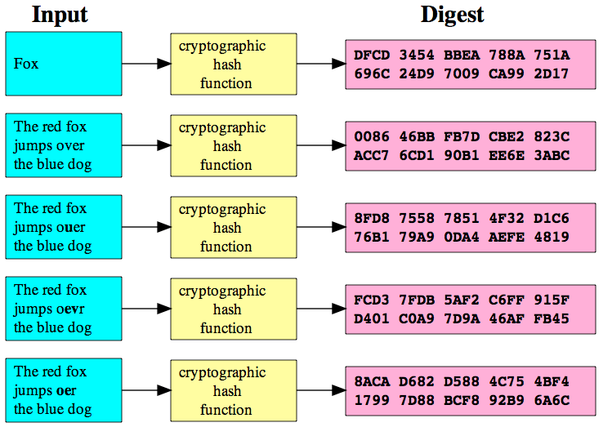
Cryptographic Hash
A cryptographic hash function is a function that takes an arbitrary block of data and returns a fixed-size bit string, the (cryptographic) hash value, such that an accidental or intentional change to the data will change the hash value. The data to be encoded is often called the "message," and the hash value is sometimes called the message digest or simply digest.
http://en.wikipedia.org/wiki/Cryptographic_hash_function

Slide 28
http://en.wikipedia.org/wiki/Cryptographic_hash_function

Slide 29
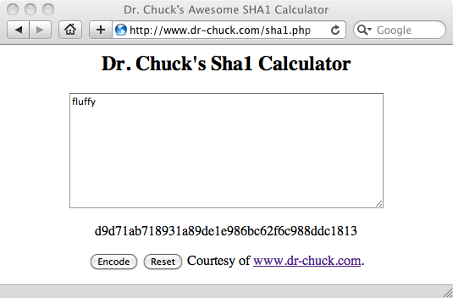
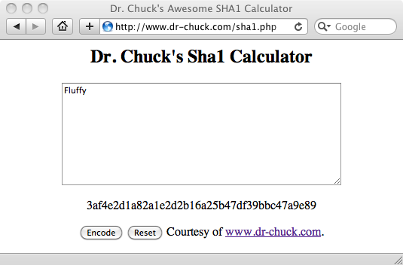
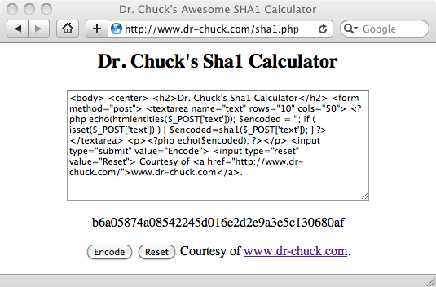
http://www.dr-chuck.com/sha1.php
http://en.wikipedia.org/wiki/SHA-1

Slide 30
Hashes for Passwords
As a general rule, systems do not store your password in plain text their databases in case they 'lose' their data
When you set the password, they compute a hash and store the hash
When you try to log in they compute the hash of what you type as a password and if it matches what they have stored - they let you in.
This is why a respectable system will never send your PW to you - they can only reset it!

Slide 31
Setting a new password
Store the 'hashed password' in the database.
fluffy
SHA-1
d9d71ab718931a89de1e986bc62f6c988ddc1813
Log in attempt
pony
SHA-1
2629fb6d2384da89796a4811ef6db5f2ac657bab
fluffy
SHA-1
d9d71ab718931a89de1e986bc62f6c988ddc1813
Match
http://www.dr-chuck.com/sha1.php

Slide 32
Digital Signatures
Message Integrity

Slide 33
Message Integrity
When you get a message from someone, did that message really come from who you think it came from?
Was the message altered while in transit or is the copy you received the same as the copy that was sent?

Slide 34
You
"Eat More Ovaltine
-- Annie"
Insecure Medium
How might we be very sure this message really came from Annie and it was not altered enroute?

Slide 35
Simple Message Signing
Shared secret transported securely 'out of band'
Before sending the message, concatenate the secret to the message
Compute the SHA digest of the message+secret
Send message + digest across insecure transport

Slide 36
Receiving a Signed Message
Receive message + digest from insecure transport
Remove digest and add secret
Compute SHA digest for message + secret
Compare the computed digest to the received digest

Slide 37
Eat More Ovaltine
Eat More OvaltineSanta
SHA-1
a79540
Eat More Ovaltinea79540
Eat More Ovaltinea79540
a79540
Eat More Ovaltine
Match! :)
Eat More OvaltineSanta
SHA-1
a79540
http://www.dr-chuck.com/sha1.php

Slide 38
Eat More Ovaltine
Eat More OvaltineSanta
SHA-1
a79540
Eat More Ovaltinea79540
Eat Less Ovaltinea79540
a79540
Eat Less Ovaltine
NO MATCH!!
Eat Less OvaltineSanta
SHA-1
109a15
http://www.dr-chuck.com/sha1.php

Slide 39
Eat More Ovaltinea79540
a79540
Eat More Ovaltine
Match! :)
Eat More OvaltineSanta
SHA-1
a79540
Free Cookies84d211
Which of these is real and which is fake?
Free Candy26497c
http://www.dr-chuck.com/sha1.php

Slide 40

Eat More Ovaltinea79540
a79540
Eat More Ovaltine
Match! :)
Eat More OvaltineSanta
SHA-1
a79540
Free Cookies84d211
Free CookiesSanta
c14d5d
X
Free Candy26497c
Free CandySanta
26497c
http://www.dr-chuck.com/sha1.php

Slide 41
Security for TCP
http://en.wikipedia.org/wiki/Secure_Sockets_Layer

Slide 42
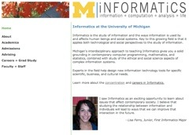
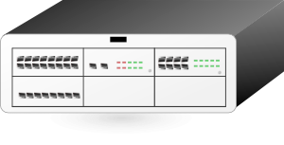


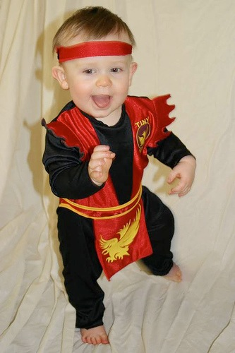
Packet
Sniffing
Clipart: http://www.clker.com/search/networksym/1
Photo CC BY: karindalziel (flickr)
http://creativecommons.org/licenses/by/2.0/

Slide 43
Transport Layer Security (TLS)
Used to be called “Secure Sockets Layer” (SSL)
Can view it as an extra layer “between” TCP and the application layer
It is very difficult but not impossible to break this security - normal people do not have the necessary compute resources to break TLS
The IP and TCP are unaware whether data has been encrypted

Slide 44
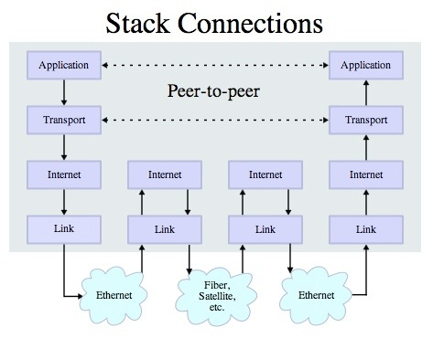
v

Slide 45

System to System Secure TCP/IP
Clipart: http://www.clker.com/search/networksym/1
Photo CC BY: karindalziel (flickr)
http://creativecommons.org/licenses/by/2.0/

Slide 46
Web-Scale Secret Management
Public Key Encryption

Slide 47
Secret Key Shortcomings
Every pair of people/systems needs a secret key
In the Internet, key distribution cannot be via the Internet because communications are insecure until you get the key!
For the Internet to work we need an approach where keys can cross the insecure Internet and be intercepted without compromising security

Slide 48
Establishing Keys at a Distance
Proposed by Whitfield Diffie and Martin Hellman in 1976
Public-key cryptosystems rely on two keys which are mathematically related to one another. Also called asymmetric-key cryptosystem.
One key is called the public key and is to be openly revealed to all interested parties.
The second key is called the private key and must be kept secret.
http://en.wikipedia.org/wiki/Public-key_cryptography

Slide 49
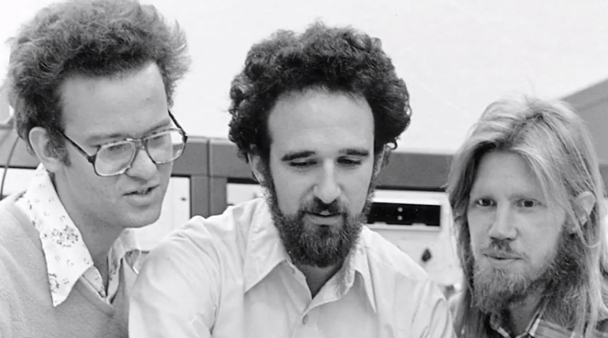
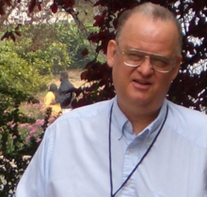
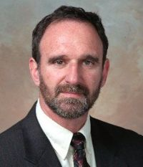

http://en.wikipedia.org/wiki/Ralph_Merkle
http://en.wikipedia.org/wiki/Martin_Hellman
http://en.wikipedia.org/wiki/Whitfield_Diffie
https://www.youtube.com/watch?v=ROCray7RTqM

Slide 50
Public Key
A message encrypted with one of the keys can only be decrypted with the other key.
It is computationally infeasible to recover one key from the other
Public-key cryptosystems solve the problem of secure key distribution because the public key can be openly revealed to anyone without weakening the cryptosystem.

Slide 51
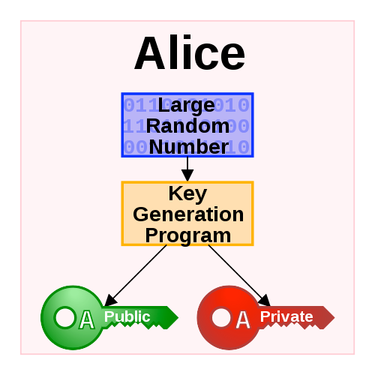
Generating Public/Private Pairs
Choose two large* random prime numbers
Multiply them
Compute public and private keys from that very large number
* The definition of "large" keeps getting bigger as computers get faster

Slide 52
Public Key Math (light)
Some functions are easy in “one direction”, but in the other, not so much!
Example: What are the factors of 55,124,159?

Slide 53
Public Key Math (light)
What are the factors of 55,124,159 (a nearly prime number)
What do you multiply 7919 by to get 55,124,159?
If you know that one of the factors is 7919, it’s also easy to find 6961!
US Patent 4,200,700 (Sep 6, 1977)

Slide 54
RSA Encryption
Implementation of secure channel based on public / private keys
Ron Rivest, Adi Shamir and Leonard Adleman
US Patent 4,405,829 (Dec 14, 1977)
http://people.csail.mit.edu/rivest/photos/Len-Adi-Ron.jpg

Slide 55
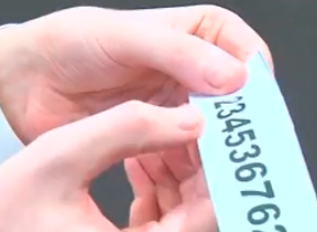
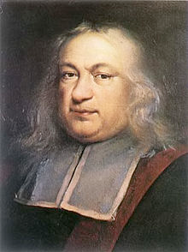
RSA Math (Light)
Prime numbers: 3 * 11 = 33
Public key: (33,7) (7 is computed from 3 and 11)
Private key: 3
Encrypt the letter f=6 (6**7) % 33 = 30 (sent)
Decrypt received text: (30**3) % 33 = 6 (f)
http://www.youtube.com/watch?v=M7kEpw1tn50
http://en.wikipedia.org/wiki/Fermat's_little_theorem
http://sergematovic.tripod.com/rsa1.html

Slide 56
You
https
Amazon.com
Message Might be Intercepted
Plaintext:
"Visa928"

Slide 57
You
Amazon.com
Message Might be Intercepted
Plaintext:
"Visa928"
Public Key
Private Key

Slide 58
You
Amazon.com
Message Might be Intercepted
Plaintext:
"Visa928"
Plaintext:
"Visa928"
Encrypt
Private Key
Public Key
Decrypt
CipherText:
"ablghyuip"
Message Might be Intercepted
CipherText:
"ablghyuip"

Slide 59
You
Amazon.com
Message Might be Intercepted
Plaintext:
"Visa928"
Plaintext:
"Visa928"
Encrypt
Private Key
Public Key
Decrypt
CipherText:
"ablghyuip"
Message Might be Intercepted
CipherText:
"ablghyuip"

Slide 60
Certificate Authorities
Integrity

Slide 61
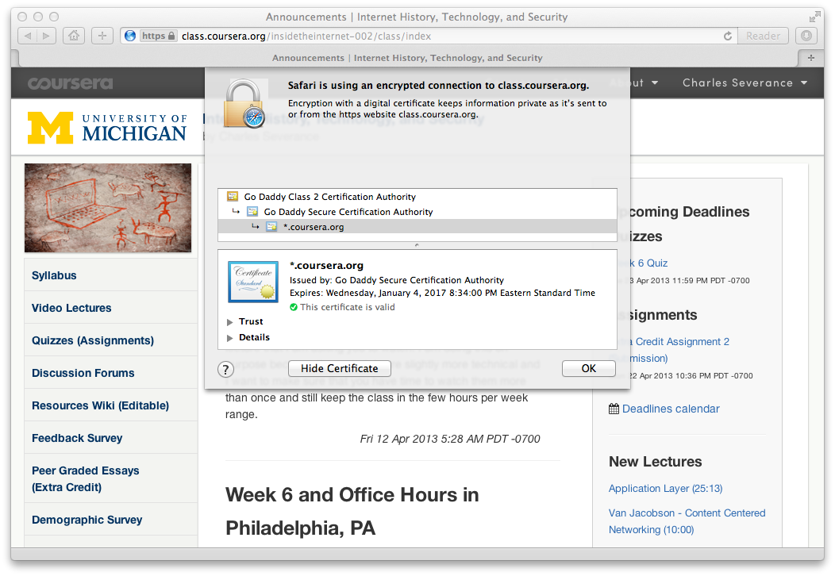
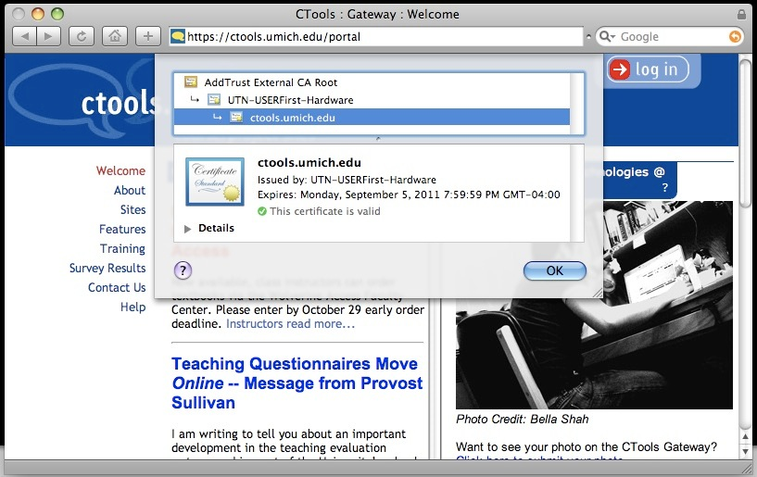

Slide 62
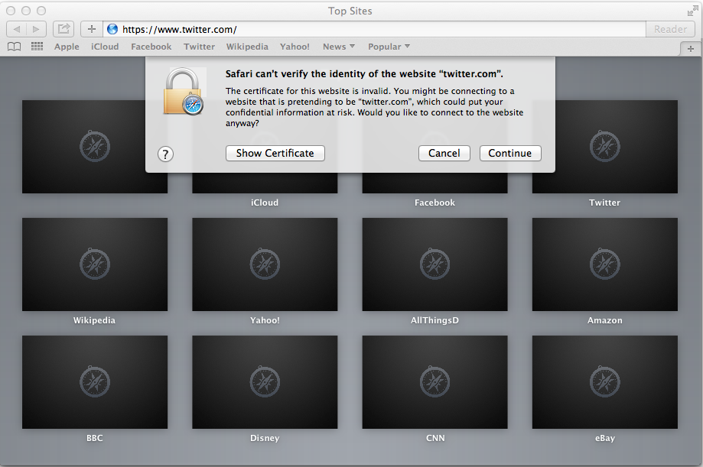

Slide 63
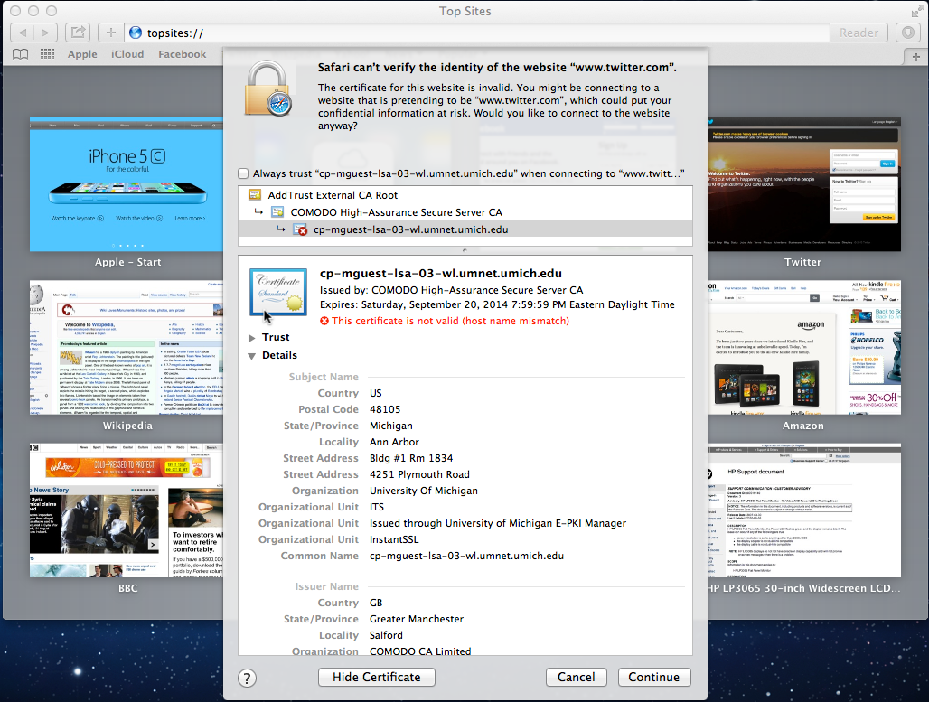

Slide 64
Public-Key Issues
Public-key cryptosystems have the problem of securely associating a public key with an individual
I am about to type in my credit card and send it - am I being Phished?
The remote server sent me a public key.
Should I use it? Is this really Amazon's public key?
http://en.wikipedia.org/wiki/Phishing

Slide 65
Digital Certificates
In cryptography, a public key certificate (also known as a digital certificate or identity certificate) is an electronic document which uses a digital signature to bind a public key with an identity — information such as the name of a person or an organization, their address, and so forth. The certificate can be used to verify that a public key belongs to an individual.
http://en.wikipedia.org/wiki/Public_key_certificate

Slide 66
Certificate Authority (CA)
A certificate authority is an entity that issues digital certificates. The digital certificate certifies the ownership of a public key by the named subject of the certificate. A CA is a trusted third party that is trusted by both the owner of the certificate and the party relying upon the certificate.
Text
http://en.wikipedia.org/wiki/Certificate_authority

Slide 67
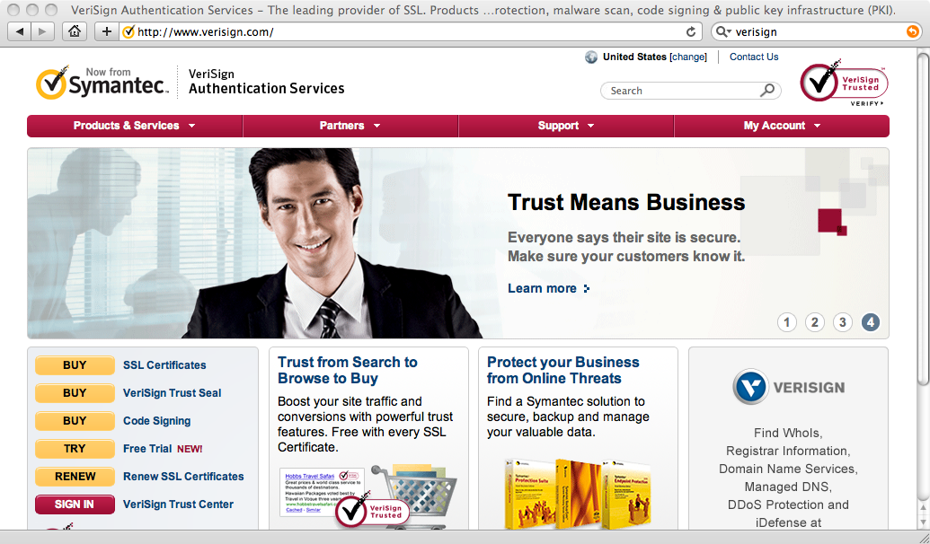

Slide 68
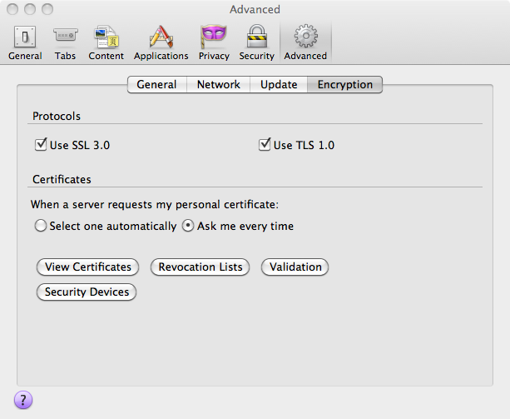
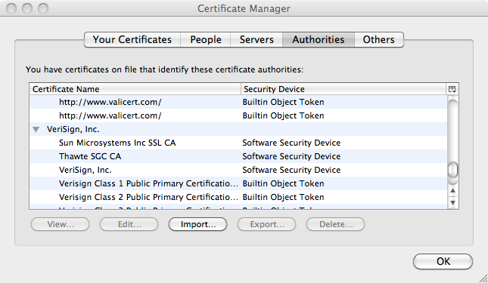
Your browser comes with certificates/public keys from some certificate authorities built in. Like Verisign.

Slide 69
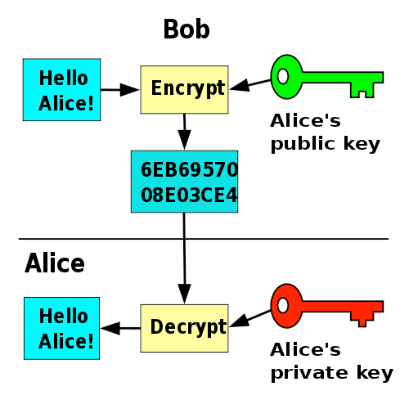
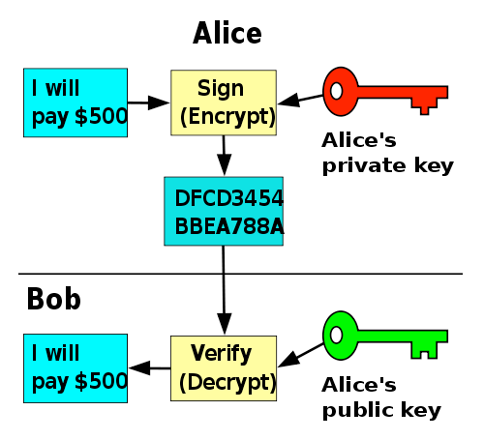
Public/Private Keys for Signing
http://en.wikipedia.org/wiki/Public-key_cryptography

Slide 70
How Amazon gets a public key signed by Verisign
Verisign Private Key
Verisign
Verisign Public Key
Amazon
Your Laptop
When you bought your laptop

Slide 71
Verisign
Verisign Private Key
Amazon Public Key
Amazon Private Key
Verisign Public Key
Amazon
Your Laptop
Six months ago

Slide 72
Verisign
Verisign Private Key
Amazon Public Key
Amazon Public Key
Amazon Private Key
Verisign Public Key
Amazon
Your Laptop
Six months ago

Slide 73
Verisign
Verisign Private Key
Amazon Public Key
Cert: Amazon
-- Verisign
Amazon Public Key
Amazon Private Key
Verisign Public Key
Amazon
Your Laptop
Six months ago

Slide 74
Verisign
Verisign Private Key
Amazon Public Key
Cert: Amazon
-- Verisign
Amazon Private Key
Verisign Public Key
Amazon
Your Laptop
Six months ago

Slide 75
Verisign
Verisign Private Key
Amazon Public Key
Cert: Amazon
-- Verisign
Amazon Private Key
Verisign Public Key
Amazon
Your Laptop
Five seconds ago

Slide 76
Verisign
Verisign Private Key
Amazon Public Key
Cert: Amazon
-- Verisign
Amazon Private Key
Amazon Public Key
Cert: Amazon
-- Verisign
Verisign Public Key
Amazon
Your Laptop
Five seconds ago

Slide 77
Verisign
Verisign Private Key
Amazon Public Key
Cert: Amazon
-- Verisign
Amazon Private Key
Amazon Public Key
Cert: Amazon
-- Verisign
Verisign Public Key
Amazon
Your Laptop
One second ago

Slide 78
Certificate Authority (CA)
A certificate authority is an entity that issues digital certificates. The digital certificate certifies the ownership of a public key by the named subject of the certificate. A CA is a trusted third party that is trusted by both the owner of the certificate and the party relying upon the certificate.
Text
http://en.wikipedia.org/wiki/Certificate_authority

Slide 79
v

Slide 80
Summary
Message Confidentiality / Message Integrity
Encrypting / Decrypting
Message digests and message signing
Shared Secret Key / Public Private Key
Gambling with Secrets: http://www.youtube.com/playlist?list=PLB4D701646DAF0817

