Slide 1

Relational Database Design
Charles Severance
www.wa4e.com
http://www.wa4e.com/lectures/SQL-02-MySQL-Design-Handout.txt

Slide 2
Relational Database Design
http://en.wikipedia.org/wiki/Relational_model

Slide 3
Database Design
Database design is an art form of its own with particular skills and experience.
Our goal is to avoid the really bad mistakes and design clean and easily understood databases.
Others may performance tune things later.
Database design starts with a picture...

Slide 4
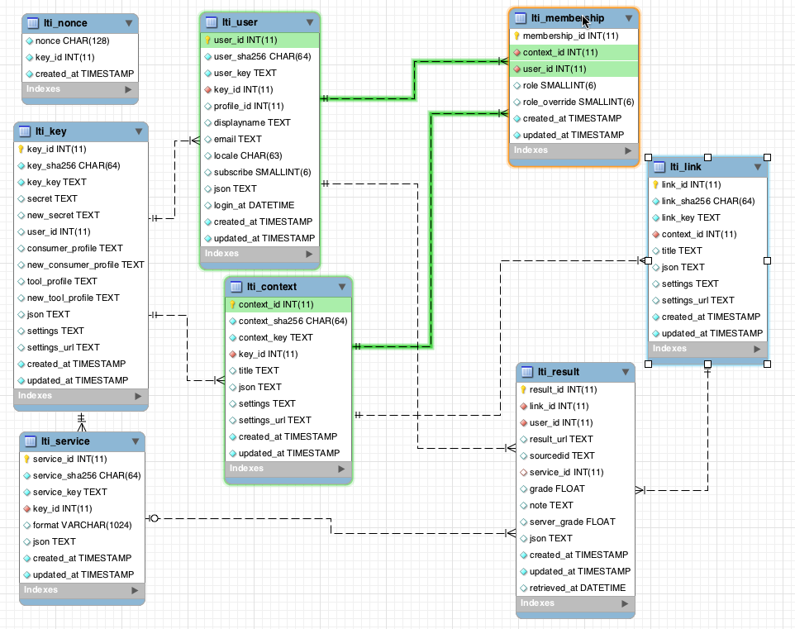
www.tsugi.org

Slide 5
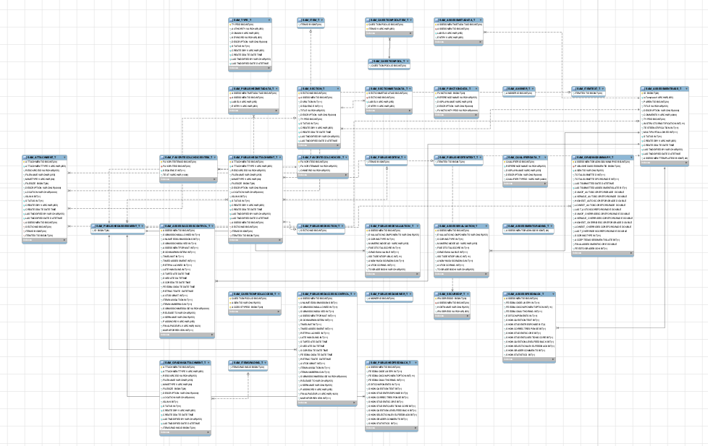
www.sakaiproject.org

Slide 6
Building a Data Model
Drawing a picture of the data objects for our application and then figuring out how to represent the objects and their relationships
Basic Rule: Don’t put the same string data in twice - use a relationship instead
When there is one thing in the “real world” there should only be one copy of that thing in the database

Slide 7
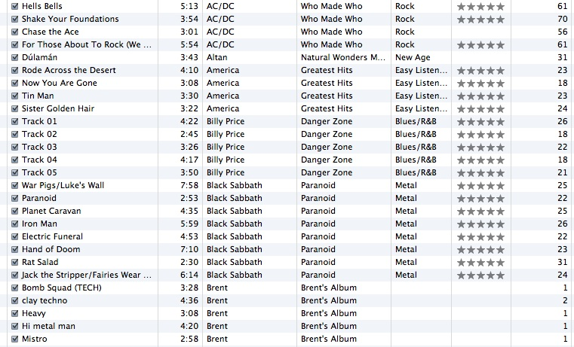
Track
Len
Artist
Album
Genre
Rating
Count

Slide 8
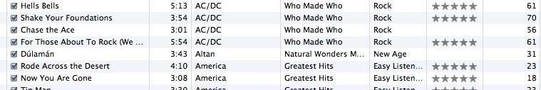
For each “piece of info”...
Is the column an object or an attribute of another object?
Once we define objects, we need to define the relationships between objects.
Len
Album
Genre
Artist
Rating
Track
Count

Slide 9
Track
Track
Artist
Rating
Album
belongs-to
Len
Artist
Count
Genre
Album
belongs-to
Rating
Len
belongs-to
Count
Genre

Slide 10
Track
Artist
Rating
belongs-to
Len
Count
Album
belongs-to
belongs-to
Genre

Slide 11
Key Terminology
Finding our way around....

Slide 12
Three Kinds of Keys
Primary key - generally an integer auto-increment field
Logical key - what the outside world uses for lookup
Foreign key - generally an integer key pointing to a row in another table
Album
album_id
title
artist_id
...

Slide 13
Primary Key Rules
Best practices:
Never use your logical key as the primary key.
Logical keys can and do change, albeit slowly.
Relationships that are based on matching string fields are less efficient than integers.
User
user_id
email
password
name
created_at
modified_at
login_at

Slide 14
Foreign Keys
A foreign key is when a table has a column containing a key that points to the primary key of another table.
When all primary keys are integers, then all foreign keys are integers. This is good - very good.
Album
album_ id
title
artist_id
...
Artist
artist_id
name
...

Slide 15
Normalization and Foreign Keys

Slide 16
We want to keep track of which band is the “creator” of each music track...
What album does this song “belong to”?
Which album is this song related to?

Slide 17
Database Normalization (3NF)
There is *tons* of database theory - way too much to understand without excessive predicate calculus
  Do not replicate data. Instead, reference data. Point at data.
  Use integers for keys and for references.
  Add a special “key” column to each table, which you will make references to.
http://en.wikipedia.org/wiki/Database_normalization

Slide 18
Integer Reference Pattern
We use integer columns in one table to reference (or look up) rows in another table.
music=> SELECT * FROM artist;
id | name
----+-------------
1 | Led Zeppelin
2 | AC/DC
music=> SELECT * FROM album;
id | title | artist_id
----+--------------+-----------
1 | Who Made Who | 2
2 | IV | 1

Slide 19
Building a Physical Data Schema

Slide 20
Track
Artist
belongs-to
Rating
Len
Album
Count
belongs-to
belongs-to
Genre

Slide 21
belongs-to
Track
Album
Title
Rating
Len
Track
Count
id
title
Album
rating
Table
Primary key
Logical key
Foreign key
id
len
title
count
album_id

Slide 22
Artist
Track
id
id
Album
name
title
id
rating
title
len
artist_id
Table
Primary key
Logical key
Foreign key
count
album_id
Genre
genre_id
id
Naming the Foreign key artist_id is a convention
name

Slide 23
Creating our Music Database
sudo -u postgres psql postgres
postgres=# CREATE DATABASE music
WITH OWNER 'pg4e' ENCODING 'UTF8';
CREATE DATABASE
postgres=#

Slide 24
CREATE TABLE artist (
id SERIAL,
name VARCHAR(128) UNIQUE,
PRIMARY_KEY(id)
);
CREATE TABLE album (
id SERIAL,
title VARCHAR(128) UNIQUE,
artist_id INTEGER REFERENCES artist(id) ON DELETE CASCADE,
PRIMARY KEY(id)
);

Slide 25
CREATE TABLE genre (
id SERIAL,
name VARCHAR(128) UNIQUE,
PRIMARY_KEY(id)
);
CREATE TABLE track (
id SERIAL,
title VARCHAR(128),
len INTEGER,
rating INTEGER,
count INTEGER,
album_id INTEGER REFERENCES genre(id) ON DELETE CASCADE,
genre_id INTEGER REFERENCES album(id) ON DELETE CASCADE,
UNIQUE(title, album_id),
PRIMARY KEY(id)
);

Slide 26
music=> \d track
Table "public.track"
Column | Type | Modifiers
----------+------------------------+----------------------------------------------------
id | integer | not null default nextval('track_id_seq'::regclass)
title | character varying(128) |
len | integer |
rating | integer |
count | integer |
album_id | integer |
genre_id | integer |
Indexes:
"track_pkey" PRIMARY KEY, btree (id)
"track_title_album_id_key" UNIQUE CONSTRAINT, btree (title, album_id)
Foreign-key constraints:
"track_album_id_fkey" FOREIGN KEY (album_id) REFERENCES album(id) ON DELETE CASCADE
"track_genre_id_fkey" FOREIGN KEY (genre_id) REFERENCES genre(id) ON DELETE CASCADE
music=>

Slide 27
music=> INSERT INTO artist (name) VALUES ('Led Zeppelin');
INSERT 0 1
music=> INSERT INTO artist (name) VALUES ('AC/DC');
INSERT 0 1
music=> SELECT * FROM artist;
id | name
----+-------------
1 | Led Zeppelin
2 | AC/DC
(2 rows)
music=>

Slide 28
music=> INSERT INTO album (title, artist_id) VALUES ('Who Made Who', 2);
INSERT 0 1
music=> INSERT INTO album (title, artist_id) VALUES ('IV', 1);
INSERT 0 1
music=> SELECT * FROM album;
id | title | artist_id
----+--------------+-----------
1 | Who Made Who | 2
2 | IV | 1
(2 rows)

Slide 29
music=> INSERT INTO genre (name) VALUES ('Rock');
INSERT 0 1
music=> INSERT INTO genre (name) VALUES ('Metal');
INSERT 0 1
music=> SELECT * FROM genre;
id | name
----+-------
1 | Rock
2 | Metal
(2 rows)

Slide 30
music=> INSERT INTO track (title, rating, len, count, album_id, genre_id)
music-> VALUES ('Black Dog', 5, 297, 0, 2, 1) ;
INSERT 0 1
music=> INSERT INTO track (title, rating, len, count, album_id, genre_id)
music-> VALUES ('Stairway', 5, 482, 0, 2, 1) ;
INSERT 0 1
music=> INSERT INTO track (title, rating, len, count, album_id, genre_id)
music-> VALUES ('About to Rock', 5, 313, 0, 1, 2) ;
INSERT 0 1
music=> INSERT INTO track (title, rating, len, count, album_id, genre_id)
music-> VALUES ('Who Made Who', 5, 207, 0, 1, 2) ;
INSERT 0 1
music=> SELECT * FROM track;
id | title | len | rating | count | album_id | genre_id
----+---------------+-----+--------+-------+----------+----------
1 | Black Dog | 297 | 5 | 0 | 2 | 1
2 | Stairway | 482 | 5 | 0 | 2 | 1
3 | About to Rock | 313 | 5 | 0 | 1 | 2
4 | Who Made Who | 207 | 5 | 0 | 1 | 2
(4 rows)

Slide 31
We Have Relationships!
music=> SELECT * FROM track;
id | title | len | rating | count | album_id | genre_id
----+---------------+-----+--------+-------+----------+----------
1 | Black Dog | 297 | 5 | 0 | 2 | 1
2 | Stairway | 482 | 5 | 0 | 2 | 1
3 | About to Rock | 313 | 5 | 0 | 1 | 2
4 | Who Made Who | 207 | 5 | 0 | 1 | 2
music=> SELECT * FROM genre;
id | name
----+-------
1 | Rock
2 | Metal
music=> SELECT * FROM album;
id | title | artist_id
----+--------------+-----------
1 | Who Made Who | 2
2 | IV | 1
music=> SELECT * FROM artist;
id | name
----+-------------
1 | Led Zeppelin
2 | AC/DC

Slide 32
Using Join Across Tables
http://en.wikipedia.org/wiki/Join_(SQL)

Slide 33
Relational Power
By removing the replicated data and replacing it with references to a single copy of each bit of data, we build a “web” of information that the relational database can read through very quickly - even for very large amounts of data.
Often when you want some data it comes from a number of tables linked by these foreign keys.

Slide 34
The JOIN Operation
The JOIN operation links across several tables as part of a SELECT operation.
You must tell the JOIN how to use the keys that make the connection between the tables using an ON clause.

Slide 35
music=> SELECT * FROM album;
id | title | artist_id
----+--------------+-----------
1 | Who Made Who | 2
2 | IV | 1
music=> SELECT * FROM artist;
id | name
----+-------------
1 | Led Zeppelin
2 | AC/DC
music=> SELECT album.title, artist.name
music-> FROM album JOIN artist
music-> ON album.artist_id = artist.id;
title | name
--------------+-------------
Who Made Who | AC/DC
IV | Led Zeppelin
What we want to see
The tables that hold the data
How the tables are linked

Slide 36
music=> SELECT * FROM album;
id | title | artist_id
----+--------------+-----------
1 | Who Made Who | 2
2 | IV | 1
music=> SELECT * FROM artist;
id | name
----+-------------
1 | Led Zeppelin
2 | AC/DC
music=> SELECT album.title, album.artist_id, artist.id, artist.name
music-> FROM album INNER JOIN artist ON album.artist_id = artist.id;
title | artist_id | id | name
--------------+-----------+----+-------------
Who Made Who | 2 | 2 | AC/DC
IV | 1 | 1 | Led Zepplin

Slide 37
music=> SELECT track.title, track.genre_id, genre.id, genre.name
music-> FROM track CROSS JOIN genre;
title | genre_id | id | name
---------------+----------+----+-------
Black Dog | 1 | 1 | Rock
Stairway | 1 | 1 | Rock
About to Rock | 2 | 1 | Rock
Who Made Who | 2 | 1 | Rock
Black Dog | 1 | 2 | Metal
Stairway | 1 | 2 | Metal
About to Rock | 2 | 2 | Metal
Who Made Who | 2 | 2 | Metal

Slide 38
music=> SELECT * FROM track;
id | title | len | rating | count | album_id | genre_id
----+---------------+-----+--------+-------+----------+----------
1 | Black Dog | 297 | 5 | 0 | 2 | 1
2 | Stairway | 482 | 5 | 0 | 2 | 1
3 | About to Rock | 313 | 5 | 0 | 1 | 2
4 | Who Made Who | 207 | 5 | 0 | 1 | 2
music=> SELECT * FROM genre;
id | name
----+-------
1 | Rock
2 | Metal
music=> SELECT track.title, genre.name
music-> FROM track JOIN genre
music-> ON track.genre_id = genre.id;
title | name
---------------+-------
Black Dog | Rock
Stairway | Rock
About to Rock | Metal
Who Made Who | Metal

Slide 39
It Can Get Complex...
music=> SELECT track.title, artist.name, album.title, genre.name
music-> FROM track
music-> JOIN genre ON track.genre_id = genre.id
music-> JOIN album ON track.album_id = album.id
music-> JOIN artist ON album.artist_id = artist.id;
title | name | title | genre
---------------+--------------+--------------+-------
Black Dog | Led Zeppelin | IV | Rock
Stairway | Led Zeppelin | IV | Rock
About to Rock | AC/DC | Who Made Who | Metal
Who Made Who | AC/DC | Who Made Who | Metal

Slide 40
title | name | title | name
---------------+--------------+--------------+-------
Black Dog | Led Zeppelin | IV | Rock
Stairway | Led Zeppelin | IV | Rock
About to Rock | AC/DC | Who Made Who | Metal
Who Made Who | AC/DC | Who Made Who | Metal

Slide 41
ON DELETE CASCADE
Child
music=> SELECT * FROM track;
id | title | len | rating | count | album_id | genre_id
----+---------------+-----+--------+-------+----------+----------
1 | Black Dog | 297 | 5 | 0 | 2 | 1
2 | Stairway | 482 | 5 | 0 | 2 | 1
3 | About to Rock | 313 | 5 | 0 | 1 | 2
4 | Who Made Who | 207 | 5 | 0 | 1 | 2
music=> SELECT * FROM genre;
id | name
----+-------
1 | Rock
2 | Metal
We are telling Postgres to "clean up" broken references
Parent
DELETE FROM Genre WHERE name = 'Metal'

Slide 42
ON DELETE CASCADE
music=> SELECT * FROM track;
id | title | len | rating | count | album_id | genre_id
----+---------------+-----+--------+-------+----------+----------
1 | Black Dog | 297 | 5 | 0 | 2 | 1
2 | Stairway | 482 | 5 | 0 | 2 | 1
3 | About to Rock | 313 | 5 | 0 | 1 | 2
4 | Who Made Who | 207 | 5 | 0 | 1 | 2
(4 rows)
music=> DELETE FROM genre WHERE name='Metal';
DELETE 1
music=> SELECT * FROM track;
id | title | len | rating | count | album_id | genre_id
----+-----------+-----+--------+-------+----------+----------
1 | Black Dog | 297 | 5 | 0 | 2 | 1
2 | Stairway | 482 | 5 | 0 | 2 | 1
(2 rows)

Slide 43
ON DELETE Choices
Default / RESTRICT – Don’t allow changes that break the constraint
CASCADE – Adjust child rows by removing or updating to maintain consistency
SET NULL – Set the foreign key columns in the child rows to null
http://stackoverflow.com/questions/1027656/what-is-mysqls-default-on-delete-behavior

Slide 44
Many-to-Many Relationships

Slide 45
www.tsugi.org

Slide 46
belongs-to
Review:
One to Many
Track
Album
Title
One
Many
Rating
Len
Track
Count
id
Table
Primary key
Logical key
Foreign key
title
Album
One
rating
id
len
title
Many
count
album_id
https://en.wikipedia.org/wiki/One-to-many_(data_model)

Slide 47
music=> SELECT * FROM track;
id | title | len | rating | count | album_id | genre_id
----+---------------+-----+--------+-------+----------+----------
1 | Black Dog | 297 | 5 | 0 | 2 | 1
2 | Stairway | 482 | 5 | 0 | 2 | 1
3 | About to Rock | 313 | 5 | 0 | 1 | 2
4 | Who Made Who | 207 | 5 | 0 | 1 | 2
One
Many
music=> SELECT * FROM genre;
id | name
----+-------
1 | Rock
2 | Metal
https://en.wikipedia.org/wiki/One-to-many_(data_model)

Slide 48

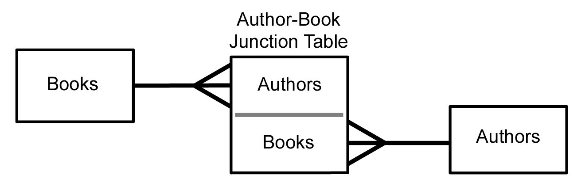
Many to Many
Sometimes we need to model a relationship that is many to many.
We need to add a “connection” table with two foreign keys.
There is usually no separate primary key.

Slide 49
member-of
User
Course
title
Many
Many
email
name
student
course
member
id
id
Many
student_id
email
title
Many
One
One
course_id
name
role
https://en.wikipedia.org/wiki/Many-to-many_(data_model)

Slide 50
Start with a Fresh Database
CREATE TABLE student (
id SERIAL,
name VARCHAR(128),
email VARCHAR(128) UNIQUE,
PRIMARY KEY(id)
) ;
CREATE TABLE course (
id SERIAL,
title VARCHAR(128) UNIQUE,
PRIMARY KEY(id)
) ;

Slide 51
course
member
student
id
Many
student_id
id
title
One
course_id
Many
email
One
role
name
CREATE TABLE member (
student_id INTEGER REFERENCES student(id) ON DELETE CASCADE,
course_id INTEGER REFERENCES course(id) ON DELETE CASCADE,
role INTEGER,
PRIMARY KEY (student_id, course_id)
) ;

Slide 52
Insert Users and Courses
music=> INSERT INTO student (name, email) VALUES ('Jane', 'jane@tsugi.org');
music=> INSERT INTO student (name, email) VALUES ('Ed', 'ed@tsugi.org');
music=> INSERT INTO student (name, email) VALUES ('Sue', 'sue@tsugi.org');
music=> SELECT * FROM student;
id | name | email
----+------+----------------
1 | Jane | jane@tsugi.org
2 | Ed | ed@tsugi.org
3 | Sue | sue@tsugi.org
music=> INSERT INTO course (title) VALUES ('Python');
music=> INSERT INTO course (title) VALUES ('SQL');
music=> INSERT INTO course (title) VALUES ('PHP');
music=> SELECT * FROM COURSE;
id | title
----+--------
1 | Python
2 | SQL
3 | PHP

Slide 53
Insert Memberships
music=> SELECT * FROM student;
id | name | email
----+------+----------------
1 | Jane | jane@tsugi.org
2 | Ed | ed@tsugi.org
3 | Sue | sue@tsugi.org
music=> SELECT * FROM course;
id | title
----+--------
1 | Python
2 | SQL
3 | PHP
INSERT INTO member (student_id, course_id, role) VALUES (1, 1, 1);
INSERT INTO member (student_id, course_id, role) VALUES (2, 1, 0);
INSERT INTO member (student_id, course_id, role) VALUES (3, 1, 0);
INSERT INTO member (student_id, course_id, role) VALUES (1, 2, 0);
INSERT INTO member (student_id, course_id, role) VALUES (2, 2, 1);
INSERT INTO member (student_id, course_id, role) VALUES (2, 3, 1);
INSERT INTO member (student_id, course_id, role) VALUES (3, 3, 0);

Slide 54
music=> SELECT * FROM student;
id | name | email
----+------+----------------
1 | Jane | jane@tsugi.org
2 | Ed | ed@tsugi.org
3 | Sue | sue@tsugi.org
music=> SELECT * FROM course;
id | title
----+--------
1 | Python
2 | SQL
3 | PHP
music=> SELECT * FROM member;
student_id | course_id | role
------------+-----------+------
1 | 1 | 1
2 | 1 | 0
3 | 1 | 0
1 | 2 | 0
2 | 2 | 1
2 | 3 | 1
3 | 3 | 0

Slide 55
music=> SELECT student.name, member.role, course.title
music-> FROM student
music-> JOIN member ON member.student_id = student.id
music-> JOIN course ON member.course_id = course. id
music-> ORDER BY course.title, member.role DESC, student.name;
name | role | title
------+------+--------
Ed | 1 | PHP
Sue | 0 | PHP
Jane | 1 | Python
Ed | 0 | Python
Sue | 0 | Python
Ed | 1 | SQL
Jane | 0 | SQL
(7 rows)

Slide 56
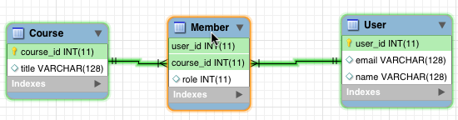
https://www.mysql.com/products/workbench/

Slide 57
www.tsugi.org

Slide 58
Complexity Enables Speed
Complexity makes speed possible and allows you to get very fast results as the data size grows.
By normalizing the data and linking it with integer keys, the overall amount of data which the relational database must scan is far lower than if the data were simply flattened out.
It might seem like a tradeoff - spend some time designing your database so it continues to be fast when your application is a success.

Slide 59
Summary
Relational databases allow us to scale to very large amounts of data.
The key is to have one copy of any data element and use relations and joins to link the data to multiple places.
This greatly reduces the amount of data that must be scanned when doing complex operations across large amounts of data.
Database and SQL design is a bit of an art form.

Slide 60

Acknowledgements / Contributions
These slides are Copyright 2010- Charles R. Severance (www.dr-chuck.com) as part of www.wa4e.com and made available under a Creative Commons Attribution 4.0 License. Please maintain this last slide in all copies of the document to comply with the attribution requirements of the license. If you make a change, feel free to add your name and organization to the list of contributors on this page as you republish the materials.
Initial Development: Charles Severance, University of Michigan School of Information
Insert new Contributors and Translators here including names and dates
Continue new Contributors and Translators here

