Slide 1


Python Dictionaries
Chapter 9
Python for Informatics: Exploring Information
www.pythonlearn.com

Slide 2




Unless otherwise noted, the content of this course material is licensed under a Creative Commons Attribution 3.0 License.
http://creativecommons.org/licenses/by/3.0/.
Copyright 2010- Charles Severance

Slide 3
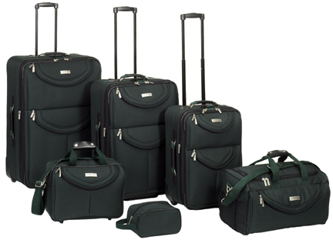
What is a Collection?
A collection is nice because we can put more than one value in them and carry them all around in one convenient package.
We have a bunch of values in a single “variable”
We do this by having more than one place “in” the variable.
We have ways of finding the different places in the variable

Slide 4
What is not a “Collection”
Most of our variables have one value in them - when we put a new value in the variable - the old value is over written
$ python
Python 2.5.2 (r252:60911, Feb 22 2008, 07:57:53)
[GCC 4.0.1 (Apple Computer, Inc. build 5363)] on darwin
>>> x = 2
>>> x = 4
>>> print x
4

Slide 5
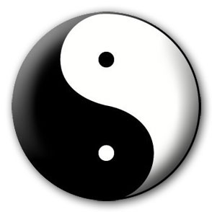


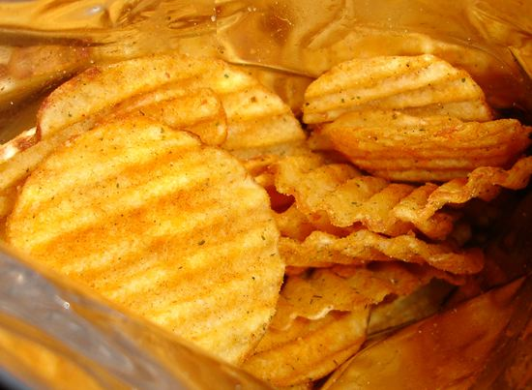
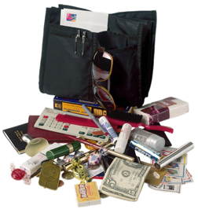
A Story of Two Collections..
List
  A linear collection of values that stay in order
Dictionary
  A “bag” of values, each with its own label

Slide 6
Dictionaries
tissue
calculator
perfume
money
candy
http://en.wikipedia.org/wiki/Associative_array

Slide 7
Dictionaries
Dictionaries are Python’s most powerful data collection
Dictionaries allow us to do fast database-like operations in Python
Dictionaries have different names in different languages
  Associative Arrays - Perl / Php
  Properties or Map or HashMap - Java
  Property Bag - C# / .Net
http://en.wikipedia.org/wiki/Associative_array

Slide 8
Dictionaries
Lists index their entries based on the position in the list
Dictionaries are like bags - no order
So we index the things we put in the dictionary with a “lookup tag”
>>> purse = dict()
>>> purse['money'] = 12
>>> purse['candy'] = 3
>>> purse['tissues'] = 75
>>> print purse
{'money': 12, 'tissues': 75, 'candy': 3}
>>> print purse['candy']
3
>>> purse['candy'] = purse['candy'] + 2’
>>> print purse
{'money': 12, 'tissues': 75, 'candy': 5}

Slide 9
Comparing Lists and Dictionaries
Dictionaries are like Lists except that they use keys instead of numbers to look up values
>>> ddd = dict()
>>> ddd['age'] = 21
>>> ddd['course'] = 182
>>> print ddd
{'course': 182, 'age': 21}
>>> ddd['age'] = 23
>>> print ddd
{'course': 182, 'age': 23}
>>> lst = list()
>>> lst.append(21)
>>> lst.append(183)
>>> print lst[21, 183]
>>> lst[0] = 23
>>> print lst[23, 183]

Slide 10
>>> lst = list()
>>> lst.append(21)
>>> lst.append(183)
>>> print lst
[21, 183]
>>> lst[0] = 23
>>> print lst
[23, 183]
List
Key
Value
[0]
21
lll
[1]
183
>>> ddd = dict()
>>> ddd['age'] = 21
>>> ddd['course'] = 182
>>> print ddd
{'course': 182, 'age': 21}
>>> ddd['age'] = 23
>>> print ddd
{'course': 182, 'age': 23}
Dictionary
Key
Value
['course']
183
ddd
['age']
21

Slide 11
Dictionary Literals (Constants)
Dictionary literals use curly braces and have a list of key : value pairs
You can make an empty dictionary using empty curly braces
>>> jjj = { 'chuck' : 1 , 'fred' : 42, 'jan': 100}
>>> print jjj
{'jan': 100, 'chuck': 1, 'fred': 42}
>>> ooo = { }>>> print ooo{}
>>>

Slide 12
Most Common Name?
marquard
cwen
zhen
zhen
csev
zhen
csev
marquard
marquard
csev
cwen
zhen
zhen

Slide 13

Most Common Name?

Slide 14
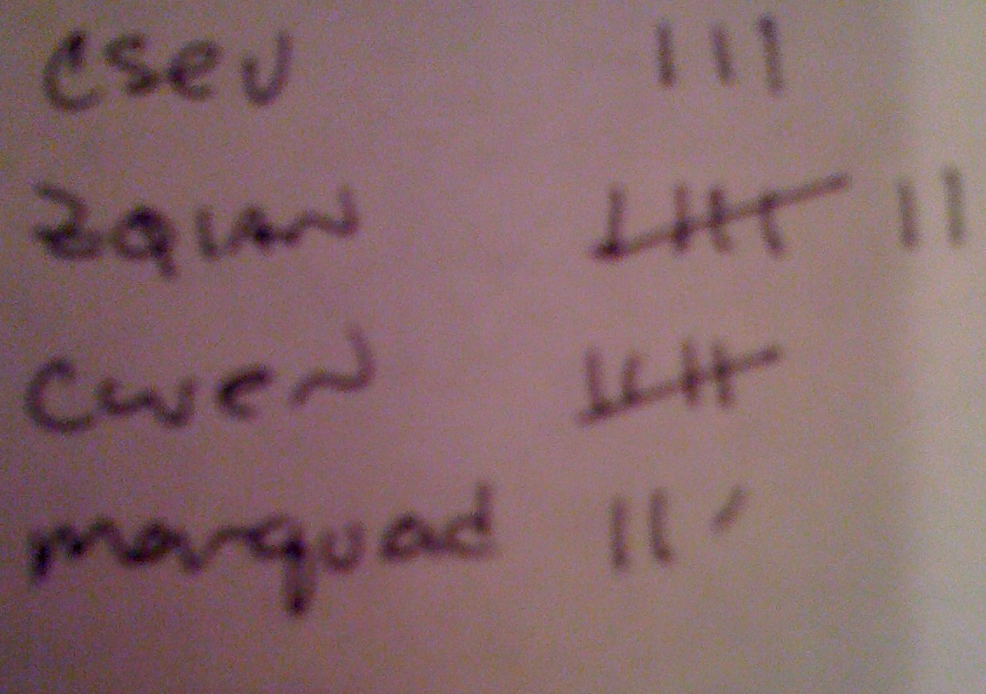
Most Common Name?
marquard
cwen
zhen
zhen
csev
zhen
csev
marquard
marquard
csev
cwen
zhen
zhen

Slide 15
Many Counters with a Dictionary
One common use of dictionary is counting how often we “see” something
Key
Value
>>> ccc = dict()
>>> ccc['csev'] = 1
>>> ccc['cwen'] = 1
>>> print ccc
{'csev': 1, 'cwen': 1}
>>> ccc['cwen'] = ccc['cwen'] + 1
>>> print ccc
{'csev': 1, 'cwen': 2}

Slide 16
Dictionary Tracebacks
It is an error to reference a key which is not in the dictionary
We can use the in operator to see if a key is in the dictionary
>>> ccc = dict()
>>> print ccc['csev']
Traceback (most recent call last):
File "<stdin>", line 1, in <module>
KeyError: 'csev'
>>> print 'csev' in ccc
False

Slide 17
When we see a new name
When we encounter a new name, we need to add a new entry in the dictionary and if this the second or later time we have seen the name, we simply add one to the count in the dictionary under that name
counts = dict()
names = ['csev', 'cwen', 'csev', 'zqian', 'cwen']
for name in names :
if name not in counts:
counts[name] = 1
else :
counts[name] = counts[name] + 1
print counts
{'csev': 2, 'zqian': 1, 'cwen': 2}

Slide 18
The get method for dictionaries
This pattern of checking to see if a key is already in a dictionary and assuming a default value if the key is not there is so common, that there is a method called get() that does this for us
if name in counts:
x = counts[name]
else :
x = 0
x = counts.get(name, 0)
Default value if key does not exist (and no Traceback).
{'csev': 2, 'zqian': 1, 'cwen': 2}

Slide 19
Simplified counting with get()
We can use get() and provide a default value of zero when the key is not yet in the dictionary - and then just add one
counts = dict()
names = ['csev', 'cwen', 'csev', 'zqian', 'cwen']
for name in names :
counts[name] = counts.get(name, 0) + 1
print counts
{'csev': 2, 'zqian': 1, 'cwen': 2}
Default

Slide 20

Simplified counting with get()
counts = dict()
names = ['csev', 'cwen', 'csev', 'zqian', 'cwen']
for name in names :
counts[name] = counts.get(name, 0) + 1
print counts
http://www.youtube.com/watch?v=EHJ9uYx5L58

Slide 21
Writing programs (or programming) is a very creative and rewarding activity. You can write programs for many reasons ranging from making your living to solving a difficult data analysis problem to having fun to helping someone else solve a problem. This book assumes that everyone needs to know how to program and that once you know how to program, you will figure out what you want to do with your newfound skills.
We are surrounded in our daily lives with computers ranging from laptops to cell phones. We can think of these computers as our ``personal assistants'' who can take care of many things on our behalf. The hardware in our current-day computers is essentially built to continuously ask us the question, ``What would you like me to do next?''.
Our computers are fast and have vasts amounts of memory and could be very helpful to us if we only knew the language to speak to explain to the computer what we would like it to ``do next''. If we knew this language we could tell the computer to do tasks on our behalf that were reptitive. Interestingly, the kinds of things computers can do best are often the kinds of things that we humans find boring and mind-numbing.

Slide 22
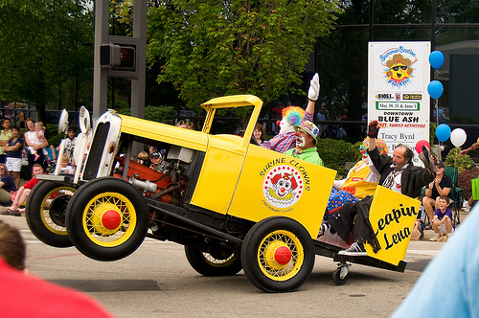

the clown ran after the car and the car ran into the tent and the tent fell down on the clown and the car

Slide 23
Counting Pattern
counts = dict()
print 'Enter a line of text:
'line = raw_input('')
words = line.split()
print 'Words:', words
print 'Counting...’
for word in words:
counts[word] = counts.get(word,0) + 1
print 'Counts', counts
The general pattern to count the words in a line of text is to split the line into words, then loop through the words and use a dictionary to track the count of each word independently.

Slide 24
Counting Words
python wordcount.py Enter a line of text:the clown ran after the car and the car ran into the tent and the tent fell down on the clown and the car
Words: ['the', 'clown', 'ran', 'after', 'the', 'car', 'and', 'the', 'car', 'ran', 'into', 'the', 'tent', 'and', 'the', 'tent', 'fell', 'down', 'on', 'the', 'clown', 'and', 'the', 'car']
Counting...
Counts {'and': 3, 'on': 1, 'ran': 2, 'car': 3, 'into': 1, 'after': 1, 'clown': 2, 'down': 1, 'fell': 1, 'the': 7, 'tent': 2}
http://www.flickr.com/photos/71502646@N00/2526007974/

Slide 25
python wordcount.py
Enter a line of text:the clown ran after the car and the car ran into the tent and the tent fell down on the clown and the car
Words: ['the', 'clown', 'ran', 'after', 'the', 'car', 'and', 'the', 'car', 'ran', 'into', 'the', 'tent', 'and', 'the', 'tent', 'fell', 'down', 'on', 'the', 'clown', 'and', 'the', 'car']Counting...
Counts {'and': 3, 'on': 1, 'ran': 2, 'car': 3, 'into': 1, 'after': 1, 'clown': 2, 'down': 1, 'fell': 1, 'the': 7, 'tent': 2}
counts = dict()
print 'Enter a line of text:
'line = raw_input('')
words = line.split()
print 'Words:', words
print 'Counting...’
for word in words:
counts[word] = counts.get(word,0) + 1
print 'Counts', counts

Slide 26
Definite Loops and Dictionaries
Even though dictionaries are not stored in order, we can write a for loop that goes through all the entries in a dictionary - actually it goes through all of the keys in the dictionary and looks up the values
>>> counts = { 'chuck' : 1 , 'fred' : 42, 'jan': 100}
>>> for key in counts:
... print key, counts[key]
...
jan 100chuck 1fred 42
>>>

Slide 27
Retrieving lists of Keys and Values
You can get a list of keys, values or items (both) from a dictionary
>>> jjj = { 'chuck' : 1 , 'fred' : 42, 'jan': 100}
>>> print list(jjj)
['jan', 'chuck', 'fred']
>>> print jjj.keys()
['jan', 'chuck', 'fred']
>>> print jjj.values()
[100, 1, 42]
>>> print jjj.items()[('jan', 100), ('chuck', 1), ('fred', 42)]>>>
What is a 'tuple'? - coming soon...

Slide 28
Bonus: Two Iteration Variables!
We loop through the key-value pairs in a dictionary using *two* iteration variables
Each iteration, the first variable is the key and the the second variable is the corresponding value for the key
>>> jjj = { 'chuck' : 1 , 'fred' : 42, 'jan': 100}
>>> for aaa,bbb in jjj.items() :
... print aaa, bbb
...
jan 100
chuck 1
fred 42
>>>
aaa
bbb
[jan]
100
[chuck]
1
[fred]
42

Slide 29

Summary

