Slide 1


Reading Files
Chapter 7
Python for Informatics: Exploring Information
www.pythonlearn.com

Slide 2




Unless otherwise noted, the content of this course material is licensed under a Creative Commons Attribution 3.0 License.
http://creativecommons.org/licenses/by/3.0/.
Copyright 2010- Charles Severance

Slide 3

What
Next?
It is time to go find some Data to mess with!
Software
Input
and Output
Devices
Central
Processing
Unit
Files R Us
Secondary
Memory
if x< 3: print
Main
Memory
From stephen.marquard@uct.ac.za Sat Jan 5 09:14:16 2008
Return-Path: <postmaster@collab.sakaiproject.org>
Date: Sat, 5 Jan 2008 09:12:18 -0500To: source@collab.sakaiproject.orgFrom: stephen.marquard@uct.ac.zaSubject: [sakai] svn commit: r39772 - content/branches/Details: http://source.sakaiproject.org/viewsvn/?view=rev&rev=39772
...

Slide 4
File Processing
A text file can be thought of as a sequence of lines
From stephen.marquard@uct.ac.za Sat Jan 5 09:14:16 2008
Return-Path: <postmaster@collab.sakaiproject.org>
Date: Sat, 5 Jan 2008 09:12:18 -0500To: source@collab.sakaiproject.orgFrom: stephen.marquard@uct.ac.zaSubject: [sakai] svn commit: r39772 - content/branches/Details: http://source.sakaiproject.org/viewsvn/?view=rev&rev=39772
http://www.py4inf.com/code/mbox-short.txt

Slide 5
Opening a File
Before we can read the contents of the file we must tell Python which file we are going to work with and what we will be doing with the file
This is done with the open() function
open() returns a “file handle” - a variable used to perform operations on the file
Kind of like “File -> Open” in a Word Processor

Slide 6
Using open()
handle = open(filename, mode)
  returns a handle use to manipulate the file
  filename is a string
  mode is optional and should be 'r' if we are planning reading the file and 'w' if we are going to write to the file.
fhand = open('mbox.txt', 'r')
http://docs.python.org/lib/built-in-funcs.html

Slide 7
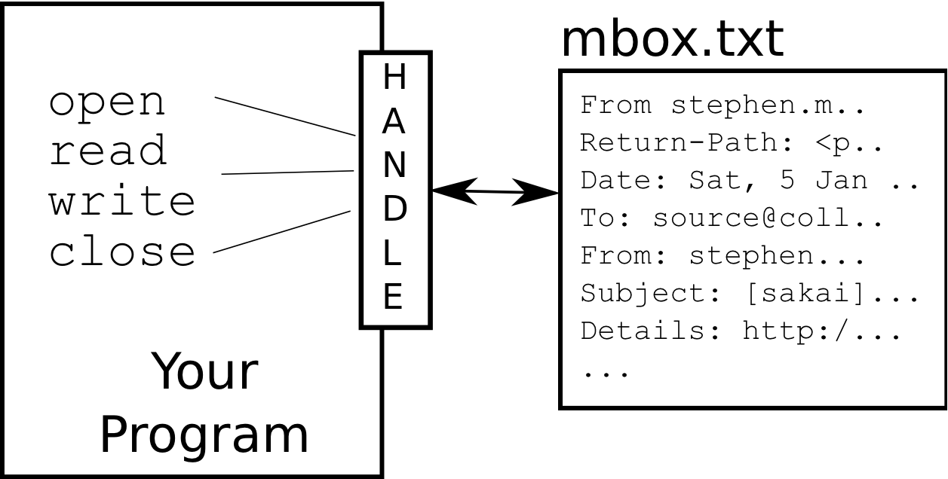
What is a Handle?
>>> fhand = open('mbox.txt')
>>> print fhand
<open file 'mbox.txt', mode 'r' at 0x1005088b0>

Slide 8
When Files are Missing
>>> fhand = open('stuff.txt')
Traceback (most recent call last): File "<stdin>", line 1, in <module>IOError: [Errno 2] No such file or directory: 'stuff.txt'

Slide 9
The newline
Character
>>> stuff = 'Hello\nWorld!’
>>> stuff'Hello\nWorld!’
>>> print stuff
HelloWorld!
>>> stuff = 'X\nY’
>>> print stuff
X
Y
>>> len(stuff)3
We use a special character to indicate when a line ends called the "newline"
We represent it as \n in strings
Newline is still one character - not two

Slide 10
File Processing
A text file can be thought of as a sequence of lines
From stephen.marquard@uct.ac.za Sat Jan 5 09:14:16 2008
Return-Path: <postmaster@collab.sakaiproject.org>
Date: Sat, 5 Jan 2008 09:12:18 -0500To: source@collab.sakaiproject.orgFrom: stephen.marquard@uct.ac.zaSubject: [sakai] svn commit: r39772 - content/branches/Details: http://source.sakaiproject.org/viewsvn/?view=rev&rev=39772

Slide 11
File Processing
A text file has newlines at the end of each line
From stephen.marquard@uct.ac.za Sat Jan 5 09:14:16 2008\n
Return-Path: <postmaster@collab.sakaiproject.org>\n
Date: Sat, 5 Jan 2008 09:12:18 -0500\nTo: source@collab.sakaiproject.org\nFrom: stephen.marquard@uct.ac.za\nSubject: [sakai] svn commit: r39772 - content/branches/\nDetails: http://source.sakaiproject.org/viewsvn/?view=rev&rev=39772\n

Slide 12
File Handle as a Sequence
A file handle open for read can be treated as a sequence of strings where each line in the file is a string in the sequence
We can use the for statement to iterate through a sequence
Remember - a sequence is an ordered set
xfile = open('mbox.txt')
for cheese in xfile:
print cheese

Slide 13
Counting Lines in a File
Open a file read-only
Use a for loop to read each line
Count the lines and print out the number of lines
fhand = open('mbox.txt')
count = 0
for line in fhand:
count = count + 1
print 'Line Count:', count
$ python open.py
Line Count: 132045

Slide 14
Reading the *Whole* File
We can read the whole file (newlines and all) into a single string.
>>> fhand = open('mbox-short.txt')>>> inp = fhand.read()>>> print len(inp)94626>>> print inp[:20]From stephen.marquar

Slide 15
Searching Through a File
We can put an if statement in our for loop to only print lines that meet some criteria
fhand = open('mbox-short.txt')
for line in fhand:
if line.startswith('From:') :
print line

Slide 16
OOPS!
What are all these blank lines doing here?
From: stephen.marquard@uct.ac.za
From: louis@media.berkeley.edu
From: zqian@umich.edu
From: rjlowe@iupui.edu
...

Slide 17
OOPS!
What are all these blank lines doing here?
From: stephen.marquard@uct.ac.za\n
\n
From: louis@media.berkeley.edu\n
\n
From: zqian@umich.edu\n
\n
From: rjlowe@iupui.edu\n
\n
...
Each line from the file has a newline at the end.
The print statement adds a newline to each line.

Slide 18
Searching Through a File (fixed)
We can strip the whitespace from the right hand side of the string using rstrip() from the string library
The newline is considered "white space" and is stripped
fhand = open('mbox-short.txt')
for line in fhand:
line = line.rstrip()
if line.startswith('From:') : print line
From: stephen.marquard@uct.ac.za
From: louis@media.berkeley.edu
From: zqian@umich.edu
From: rjlowe@iupui.edu
....

Slide 19
Skipping with continue
We can convienently skip a line by using the continue statement
fhand = open('mbox-short.txt')
for line in fhand:
line = line.rstrip()
if not line.startswith('From:') :
continue
print line

Slide 20
Using in to select lines
We can look for a string anywhere in a line as our selection criteria
fhand = open('mbox-short.txt')
for line in fhand:
line = line.rstrip()
if not '@uct.ac.za' in line :
continue
print line
From stephen.marquard@uct.ac.za Sat Jan 5 09:14:16 2008
X-Authentication-Warning: set sender to stephen.marquard@uct.ac.za using –f
From: stephen.marquard@uct.ac.zaAuthor: stephen.marquard@uct.ac.za
From david.horwitz@uct.ac.za Fri Jan 4 07:02:32 2008
X-Authentication-Warning: set sender to david.horwitz@uct.ac.za using -f...

Slide 21
Prompt for File Name
fname = raw_input('Enter the file name: ')
fhand = open(fname)
count = 0
for line in fhand:
if line.startswith('Subject:') :
count = count + 1
print 'There were', count, 'subject lines in', fname
Enter the file name: mbox.txt
There were 1797 subject lines in mbox.txt
Enter the file name: mbox-short.txt
There were 27 subject lines in mbox-short.txt

Slide 22
Bad File Names
fname = raw_input('Enter the file name: ')
try:
fhand = open(fname)
except:
print 'File cannot be opened:', fname
exit()
count = 0
for line in fhand:
if line.startswith('Subject:') :
count = count + 1
print 'There were', count, 'subject lines in', fname
Enter the file name: mbox.txt
There were 1797 subject lines in mbox.txt
Enter the file name: na na boo boo
File cannot be opened: na na boo boo

Slide 23
Summary
Secondary storage
Opening a file - file handle
File structure - newline character
Reading a file line-by-line with a for loop
Searching for lines
Reading file names
Dealing with bad files

