Slide 1


Conditional Execution
Chapter 3
Python for Informatics: Exploring Information
www.py4inf.com

Slide 2




Unless otherwise noted, the content of this course material is licensed under a Creative Commons Attribution 3.0 License.
http://creativecommons.org/licenses/by/3.0/.
Copyright 2010- Charles R. Severance

Slide 3
Conditional Steps
x = 5
X < 10 ?
Yes
Program:
x = 5
if x < 10:
print 'Smaller’
if x > 20:
print 'Bigger'
print 'Finis'
print 'Smaller'
Output:
Smaller
Finis
X > 20 ?
Yes
print 'Bigger'
print 'Finis'

Slide 4
Comparison Operators
Boolean expressions ask a question and produce a Yes or No result which we use to control program flow
Boolean expressions using comparison operators evaluate to - True / False - Yes / No
Comparison operators look at variables but do not change the variables
Python | Meaning
< | Less than
<= | Less than or Equal
== | Equal to
>= | Greater than or Equal
> | Greater than
!= | Not equal
Remember: “=” is used for assignment.
http://en.wikipedia.org/wiki/George_Boole

Slide 5
Comparison Operators
x = 5
if x == 5 :
print 'Equals 5'
if x > 4 :
print 'Greater than 4’
if x >= 5 :
print 'Greater than or Equal 5'
if x < 6 : print 'Less than 6'
if x <= 5 :
print 'Less than or Equal 5’
if x != 6 :
print 'Not equal 6'
Equals 5
Greater than 4
Greater than or Equal 5
Less than 6
Less than or Equal 5
Not equal 6

Slide 6
One-Way Decisions
x = 5
print 'Before 5’
if x == 5 :
print 'Is 5’
print 'Is Still 5’
print 'Third 5’
print 'Afterwards 5’
print 'Before 6’
if x == 6 :
print 'Is 6’
print 'Is Still 6’
print 'Third 6’
print 'Afterwards 6'
X == 5 ?
Yes
Before 5
Is 5
Is Still 5
Third 5
Afterwards 5
Before 6
Afterwards 6
No
print 'Is 5'
print 'Still 5'
print 'Third 5'

Slide 7
Indentation
Increase indent indent after an if statement or for statement (after : )
Maintain indent to indicate the scope of the block (which lines are affected by the if/for)
Reduce indent to back to the level of the if statement or for statement to indicate the end of the block
Blank lines are ignored - they do not affect indentation
Comments on a line by themselves are ignored w.r.t. indentation

Slide 8
Warning: Turn Off Tabs
Most text editors can turn tabs into spaces - make sure to enable this feature
  NotePad++: Settings -> Preferences -> Language Menu/Tab Settings
  TextWrangler: TextWrangler -> Preferences -> Editor Defaults
Python cares a *lot* about how far line is indented. If you mix tabs and spaces, you may get “indentation errors” even if everything looks fine
Please do this now while you are thinking about it so we can all stay sane...

Slide 9
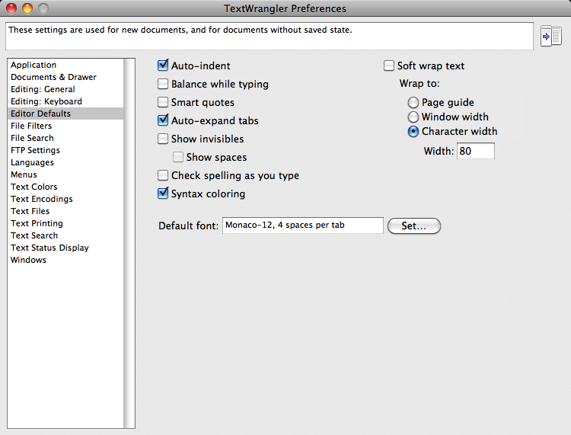

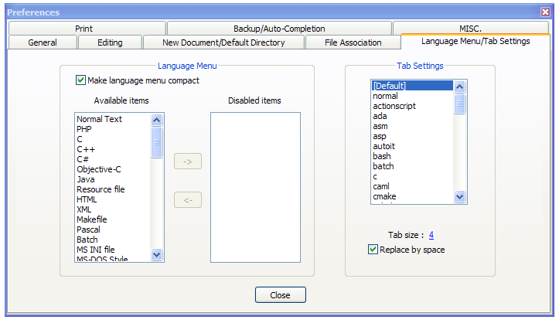
This will save you much unnecessary pain.

Slide 10
increase / maintain after if or for
decrease to indicate end of block
blank lines and comment lines ignored
x = 5
if x > 2 :
# comments
print 'Bigger than 2'
# don’t matter
print 'Still bigger'
# but can confuse you
print 'Done with 2'
# if you don’t line
# them up
x = 5
if x > 2 :
print 'Bigger than 2'
print 'Still bigger'
print 'Done with 2'
for i in range(5) :
print i
if i > 2 :
print 'Bigger than 2'
print 'Done with i', i

Slide 11
Mental begin/end squares
x = 5
if x > 2 :
print 'Bigger than 2'
print 'Still bigger'
print 'Done with 2'
for i in range(5) :
print i
if i > 2 :
print 'Bigger than 2'
print 'Done with i', i
x = 5
if x > 2 :
# comments
print 'Bigger than 2'
# don’t matter
print 'Still bigger'
# but can confuse you
print 'Done with 2'
# if you don’t line
# them up

Slide 12
Nested Decisions
x > 1
yes
no
print 'More than one'
x = 42
if x > 1 :
print 'More than one'
if x < 100 :
print 'Less than 100'
print 'All done'
x < 100
yes
no
print 'Less than 100'
print 'All Done'

Slide 13
Nested Decisions
x > 1
yes
no
print 'More than one'
x = 42
if x > 1 :
print 'More than one'
if x < 100 :
print 'Less than 100'
print 'All done'
x < 100
yes
no
print 'Less than 100'
print 'All Done'

Slide 14
Nested Decisions
x > 1
yes
no
print 'More than one'
x = 42
if x > 1 :
print 'More than one'
if x < 100 :
print 'Less than 100'
print 'All done'
x < 100
yes
no
print 'Less than 100'
print 'All Done'

Slide 15
Two Way Decisions
X = 4
Sometimes we want to do one thing if a logical expression is true and something else if the expression is false
It is like a fork in the road - we must choose one or the other path but not both
no
x > 2
yes
print 'Not bigger'
print 'Bigger'
print 'All Done'

Slide 16
Two-way using else :
X = 4
x = 4
if x > 2 :
print 'Bigger'
else :
print 'Smaller'
print 'All done'
no
x > 2
yes
print 'Smaller'
print 'Bigger'
print 'All Done'

Slide 17
Two-way using else :
X = 4
x = 4
if x > 2 :
print 'Bigger'
else :
print 'Smaller'
print 'All done'
no
x > 2
yes
print 'Smaller'
print 'Bigger'
print 'All Done'

Slide 18
Multi-way
yes
x < 2
print 'Small'
if x < 2 :
print 'Small'
elif x < 10 :
print 'Medium'
else :
print 'LARGE'
print 'All done'
no
x<10
yes
print 'Medium'
no
print 'LARGE'
print 'All Done'

Slide 19
Multi-way
X = 0
yes
x < 2
print 'Small'
x = 0
if x < 2 :
print 'Small'
elif x < 10 :
print 'Medium'
else :
print 'LARGE'
print 'All done'
no
x<10
yes
print 'Medium'
no
print 'LARGE'
print 'All Done'

Slide 20
Multi-way
X = 5
yes
x < 2
print 'Small'
x = 5
if x < 2 :
print 'Small'
elif x < 10 :
print 'Medium'
else :
print 'LARGE'
print 'All done'
no
x<10
yes
print 'Medium'
no
print 'LARGE'
print 'All Done'

Slide 21
Multi-way
X = 20
yes
x < 2
print 'Small'
x = 20
if x < 2 :
print 'Small'
elif x < 10 :
print 'Medium'
else :
print 'LARGE'
print 'All done'
no
x<10
yes
print 'Medium'
no
print 'LARGE'
print 'All Done'

Slide 22
Multi-way
if x < 2 :
print 'Small'
elif x < 10 :
print 'Medium'
elif x < 20 :
print 'Big'
elif x< 40 :
print 'Large'
elif x < 100:
print 'Huge'
else :
print 'Ginormous'
# No Else
x = 5
if x < 2 :
print 'Small'
elif x < 10 :
print 'Medium'
print 'All done'

Slide 23
Multi-way Puzzles
if x < 2 :
print 'Below 2'
elif x < 20 :
print 'Below 20'
elif x < 10 :
print 'Below 10'
else :
print 'Something else'
Which will never print?
if x < 2 :
print 'Below 2'
elif x >= 2 :
print 'Two or more'
else :
print 'Something else'

Slide 24
The try / except Structure
You surround a dangerous section of code with try and except.
If the code in the try works - the except is skipped
If the code in the try fails - it jumps to the except section

Slide 25
$ cat notry.py
astr = 'Hello Bob’
istr = int(astr)
print 'First', istr
astr = '123’
istr = int(astr)
print 'Second', istr
$ python notry.py Traceback (most recent call last): File "notry.py", line 2, in <module> istr = int(astr)ValueError: invalid literal for int() with base 10: 'Hello Bob'
All
Done

Slide 26
$ cat notry.py
astr = 'Hello Bob’
istr = int(astr)
print 'First', istr
astr = '123’
istr = int(astr)
print 'Second', istr
$ python notry.py
Traceback (most recent call last):
File "notry.py", line 2, in <module> istr = int(astr)ValueError: invalid literal for int() with base 10: 'Hello Bob'
The program stops here
All
Done

Slide 27
Generic
Computer
Software
Input
Devices
Central
Processing
Unit
Secondary
Memory
Output
Devices
Main
Memory
Notes:
Who has see a traceback in CTools?

Slide 28
$ cat tryexcept.py
astr = 'Hello Bob'
try:
istr = int(astr)
except:
istr = -1
print 'First', istr
astr = '123'
try:
istr = int(astr)
except:
istr = -1
print 'Second', istr
When the first conversion fails - it just drops into the except: clause and the program continues.
$ python tryexcept.py
First -1
Second 123
When the second conversion succeeds - it just skips the except: clause and the program continues.

Slide 29
try / except
astr = 'Bob'
print 'Hello'
astr = 'Bob'
try:
print 'Hello'
istr = int(astr)
print 'There'
except:
istr = -1
print 'Done', istr
istr = int(astr)
print 'There'
istr = -1
print 'Done', istr
Safety net

Slide 30
Sample try / except
rawstr = raw_input('Enter a number:')
try:
ival = int(rawstr)
except:
ival = -1
if ival > 0 :
print 'Nice work'else:
print 'Not a number'
$ python trynum.py
Enter a number:42
Nice work
$ python trynum.py
Enter a number:fourtytwo
Not a number
$

Slide 31
Exercise
Rewrite your pay computation to give the employee 1.5 times the hourly rate for hours worked above 40 hours.
Enter Hours: 45
Enter Rate: 10
Pay: 475.0
475 = 40 * 10 + 5 * 15

Slide 32
Exercise
Rewrite your pay program using try and except so that your program handles non-numeric input gracefully.
Enter Hours: 20
Enter Rate: nine
Error, please enter numeric input
Enter Hours: forty
Error, please enter numeric input

Slide 33
Summary
Comparison operators == <= >= > < !=
Logical operators: and or not
Indentation
One Way Decisions
Two way Decisions if : and else :
Nested Decisions
Multiway decisions using elif
Try / Except to compensate for errors

