Slide 1




LTI Advantage: The Next Big Thing in LMS Integration
Charles R. Severance
University of Michigan School of Information

Slide 2
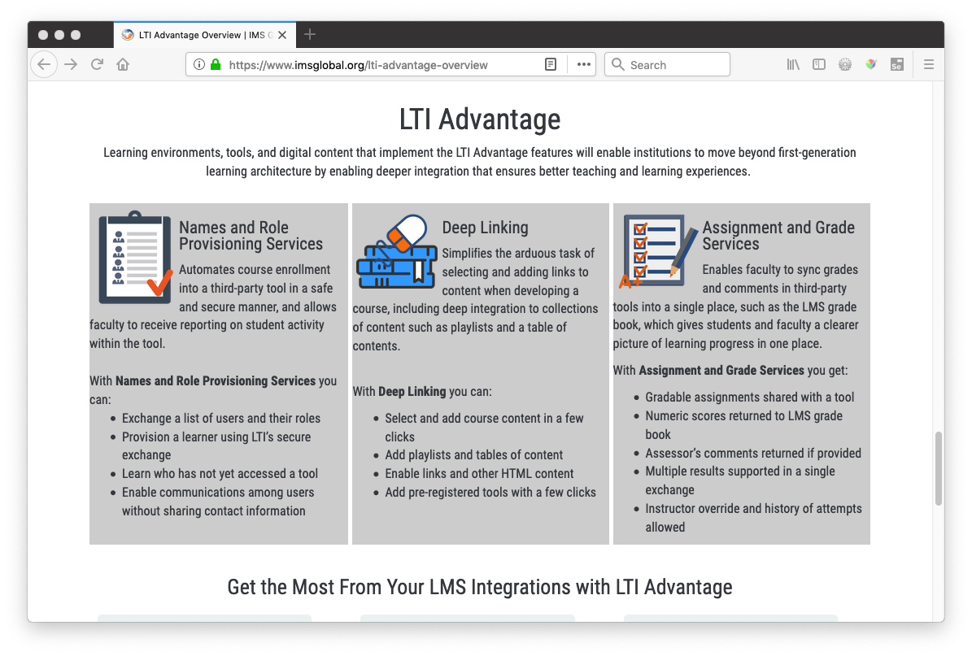

Slide 3
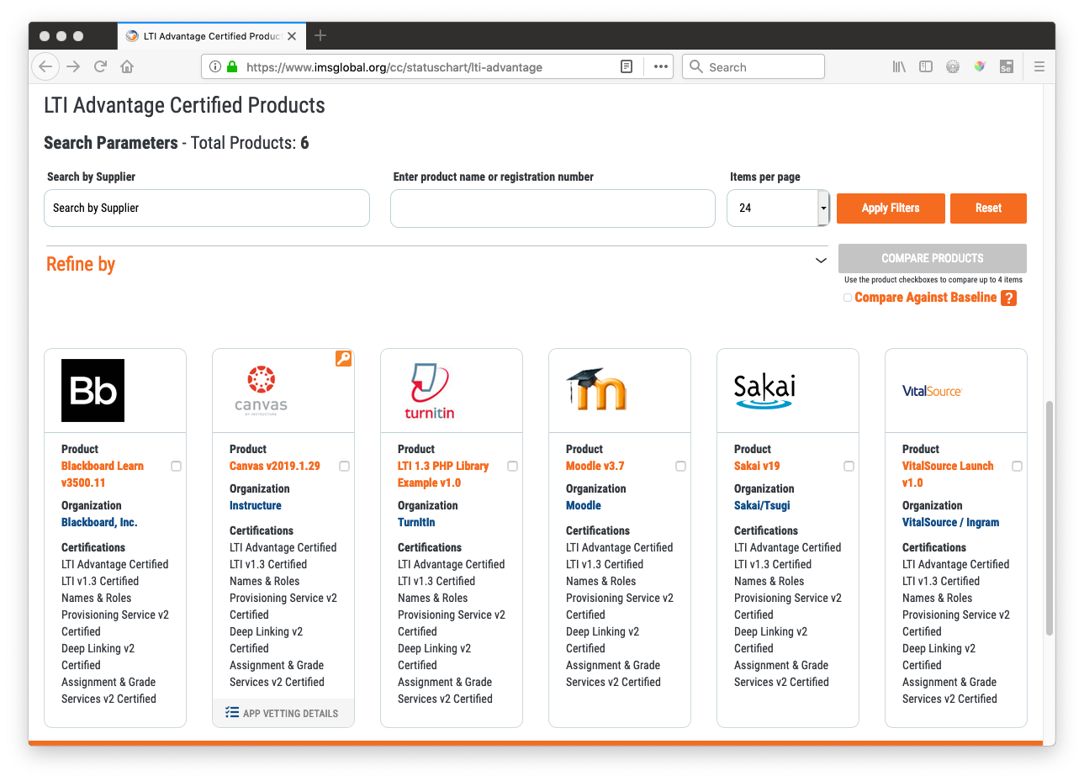

Slide 4
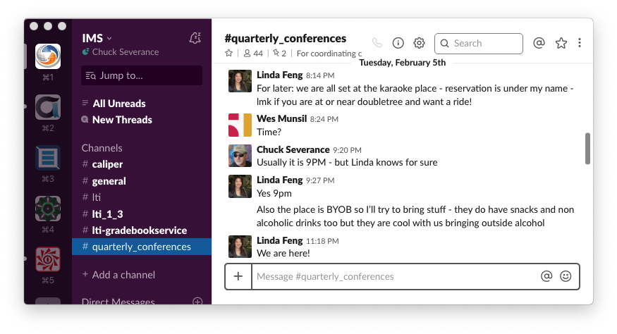

Slide 5
Do Your Own Demo
Student - https://dev1.sakaicloud.com/
Make an account
Home-> Membership - join the site "Apereo Webinar"
Lessons -> LMS Test (test.tsugicloud.org)
Instructor
Make a site Home -> Worksite Setup - Add Lessons and Gradebook
Lessons -> App Learning App -> Tsugi Store

Slide 6
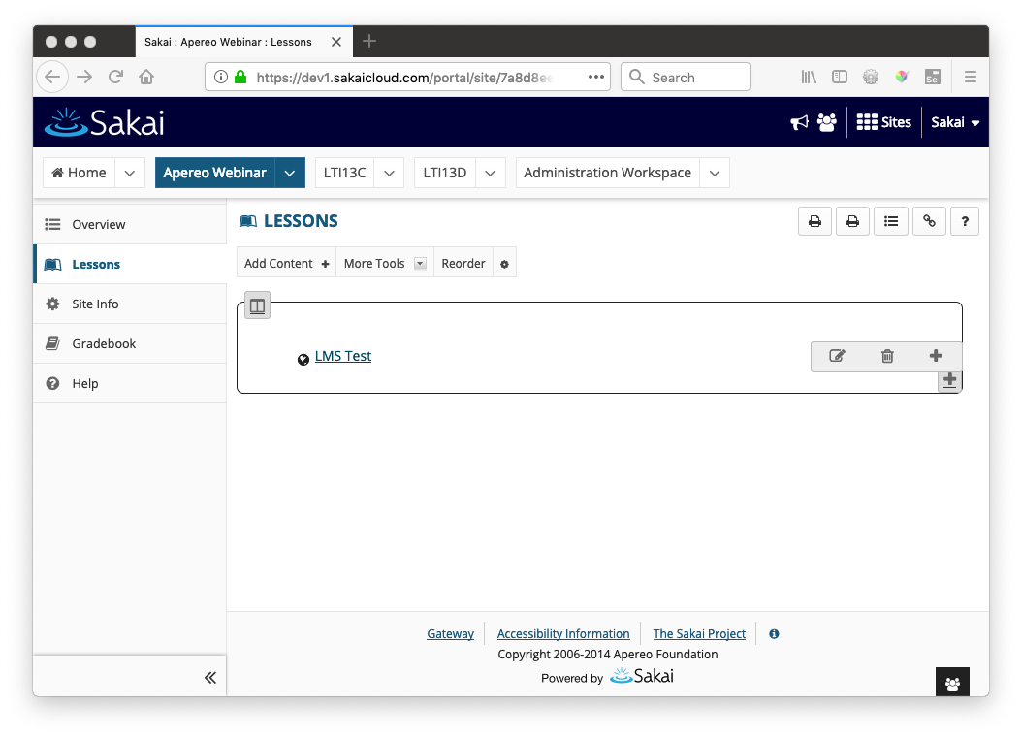
https://dev1.sakaicloud.com/

Slide 7
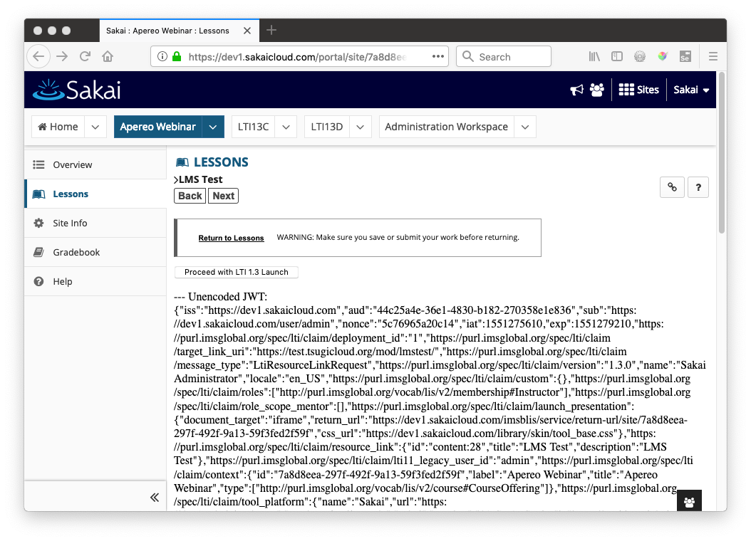
https://dev1.sakaicloud.com/

Slide 8
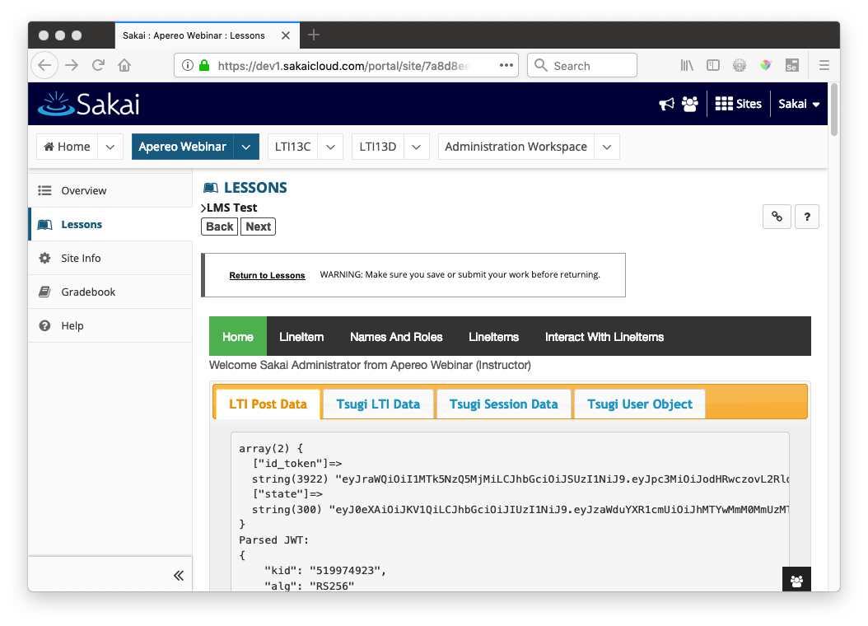
https://dev1.sakaicloud.com/

Slide 9
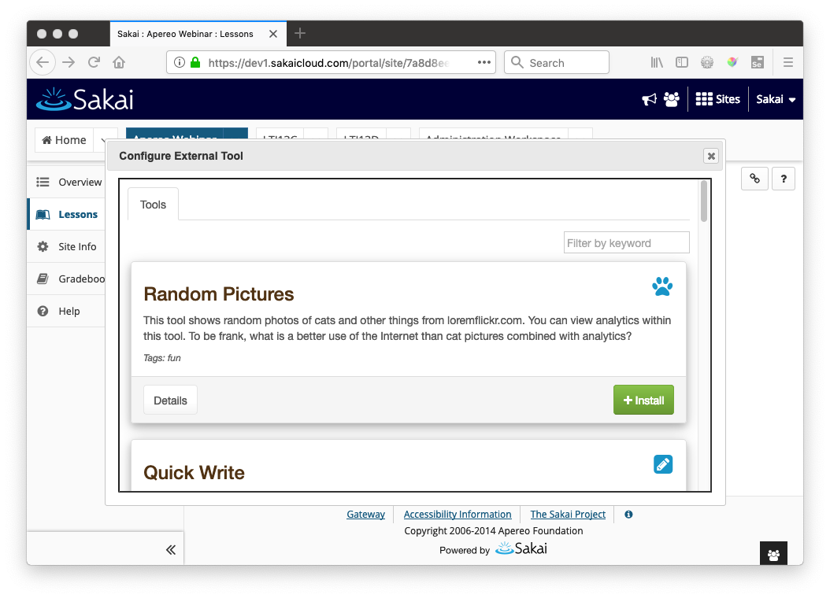
https://dev1.sakaicloud.com/

Slide 10
This is the technical talk

Slide 11
LTI Advantage Technology
New Java Web Token / OpenID Connect / PKI launch – LTI 1.3
LTI 1.3 Launch
Deep Linking Launch (Formerly Content Item)
OAuth 2.0 Services
Auto-created grade column (like LTI 1.1)
Members and roles (roster service)
Outcomes Service (tools can make new columns in the gradebook)
Unprecedented effort to simultaneously release by the "big five" LMS vendors

Slide 12
LTI 1.3 / Deep Linking Launch
Platform
Tool
LMS Test
Open ID Connect Initiation
OIDC Initialization
Open ID Connect Response
LTI 1.3 Launch JWT / PKI
Keyset URL
Tool Redirect Endpoint
Browser
Target_link_uri

Slide 13
PKI – Public Private Keys
LTI 1.1 Used a shared secret for launches and services
LTI Advantages uses a pair of Public/Private keys for each message flow
Setup is more complex
Excellent libraries in Java
Sample code: basiclti/tsugi-util/src/test/org/tsugi/lti13/LTI13PKITest.java

Slide 14
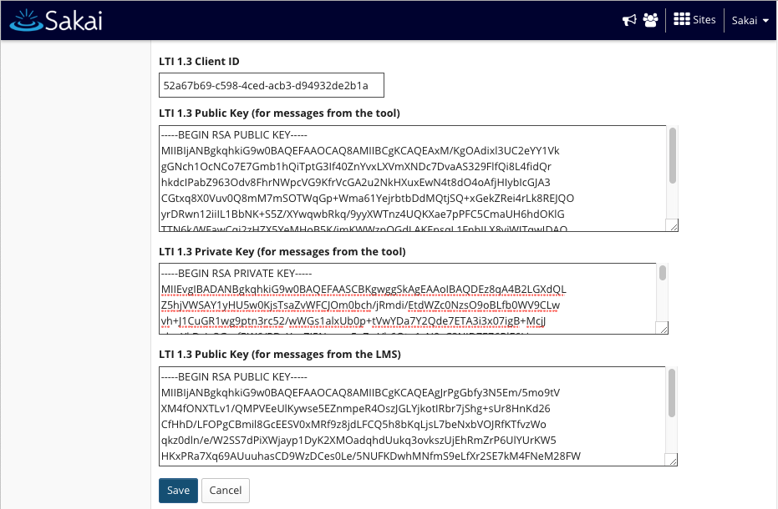

Slide 15
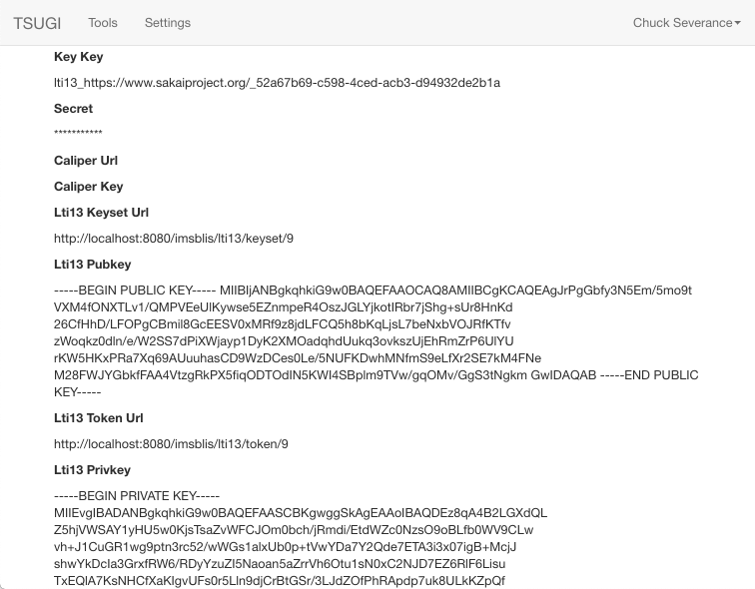

Slide 16
JSON Web Tokens - JWTs
A serialization and signing pattern for exchanging structured JSON
https://jwt.io/
Excellent libraries in Java
Sample code: basiclti/tsugi-util/src/test/org/tsugi/lti13/LLTI13JJWTTest.java

Slide 17
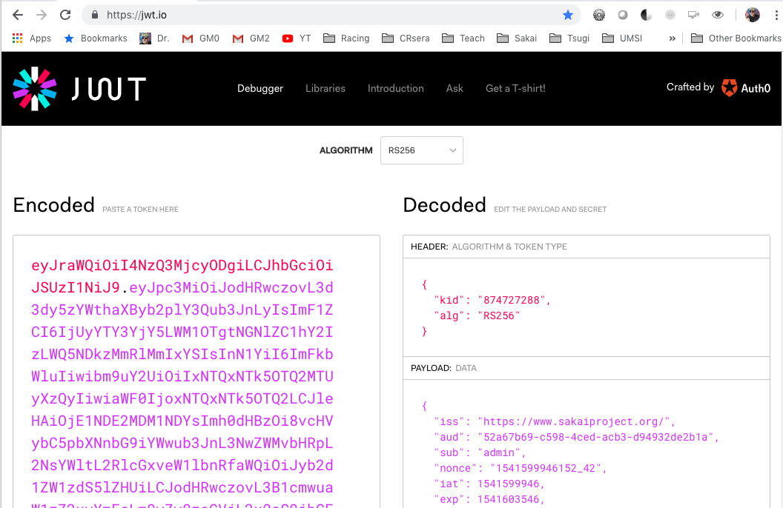

Slide 18
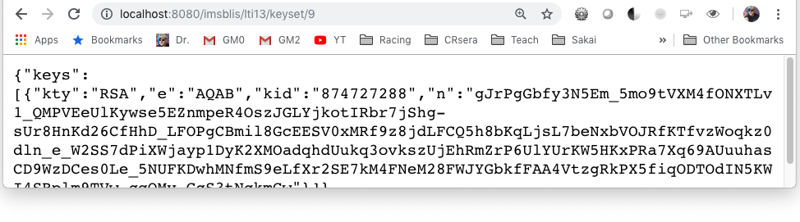
PKI Key Rotation
When the JWT is signed with a "kid", the public key to verify the message is looked up using a keyset url
Clever tools cache the kid / public key until the kid changes on a message

Slide 19
LTI 1.3 Launch
JSON "claims" in a Java Web Token signed with a public key
LMS (Platform) has a private key and shares the public key widely
Key rotation is possible using kid
Java Web Tokens
Like the LTI 1.x "base string"
Serialization and signatures
Sample code: basiclti-common/src/java/org/sakaiproject/basiclti/util/SakaiBLTIUtil.java

Slide 20
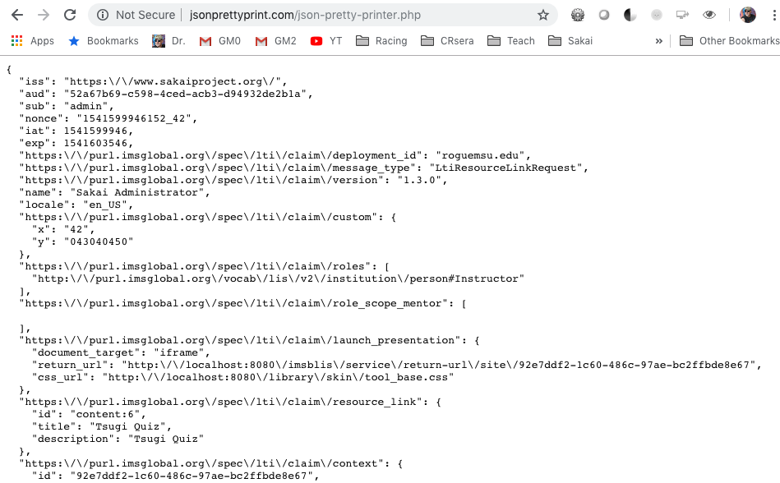

Slide 21
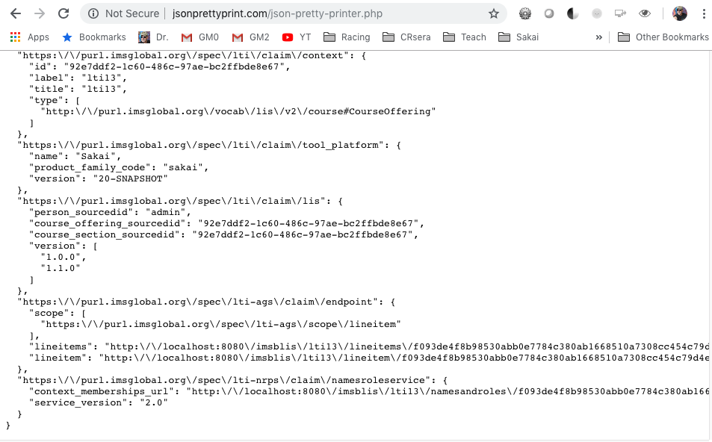

Slide 22
OAuth 2.0 Services
Server to server variant of three legged SSO
Tool has a private key and shares its public key with the LMS
Tool uses message signed with public key to request a "short-lived" token – API token is with API calls to services
When the token expires (an hour usually) the tool must re-request
Tokens have "scopes" – like an AUTHZ grant
Excellent library support in Java for OAuth 2.0

Slide 23
Names and Roles / Outcomes Services
Platform
Tool
Token Request JWT / PKI
Token end point
Token
Token
Service
Token
Service
Token
Service

Slide 24
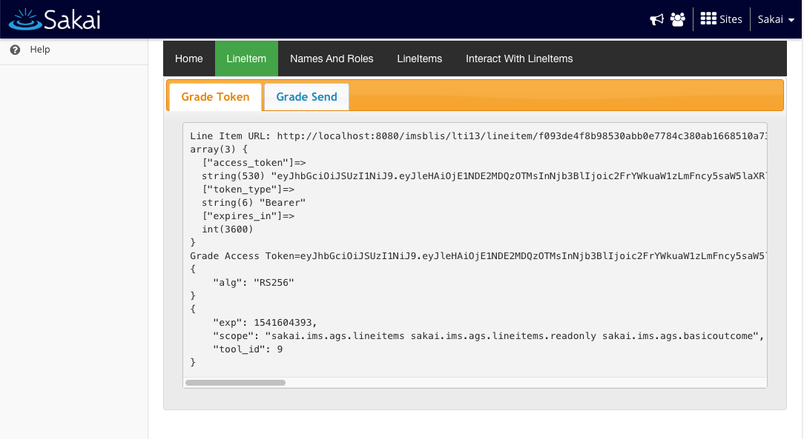

Slide 25
Code for Tokens
Tsugi: Getting an access token
tsugi/lib/src/Util/LTI13.php (418)
Sakai: Producing an Access Token
basiclti-blis/src/java/org/sakaiproject/lti13/LTI13Servlet.java (1533)
Tsugi: Using an access token
tsugi/lib/src/Core/Result.php (231)
tsugi/lib/src/Util/LTI13.php (122)

Slide 26
Observations
Great cooperation between and amongst LMS vendors and Tool Vendors – this was essential to the success of LTI Advantage
There will be a lot of pressure from LMS Vendors
Away from proprietary LMS APIs where LTI Advantage is sufficient
Away from LTI 1.1
Good news and bad news
The basics of LTI Advantage is surprisingly easy when you have sample code
There will be a lot of lousy LTI Advantage Tool implementations (ad for Tsugi)
SASSifying of the commercial LMS vendors is a complicating factor

Slide 27
Transition Issues
Good news and bad news
The basics of LTI Advantage is surprisingly easy when you have sample code
There will be a lot of lousy LTI Advantage Tool implementations (ad for Tsugi)
Commercial LMS vendors are getting SASSier
This will make it harder on tools
Integrations will happen "above" institutions and be selected by institutions
Sakai (and I think Moodle) have a very smooth LTI 1.1 -> LTI 1.3 transition path

Slide 28
We are about two years away from the dawn of the real NGDLE

