Slide 1
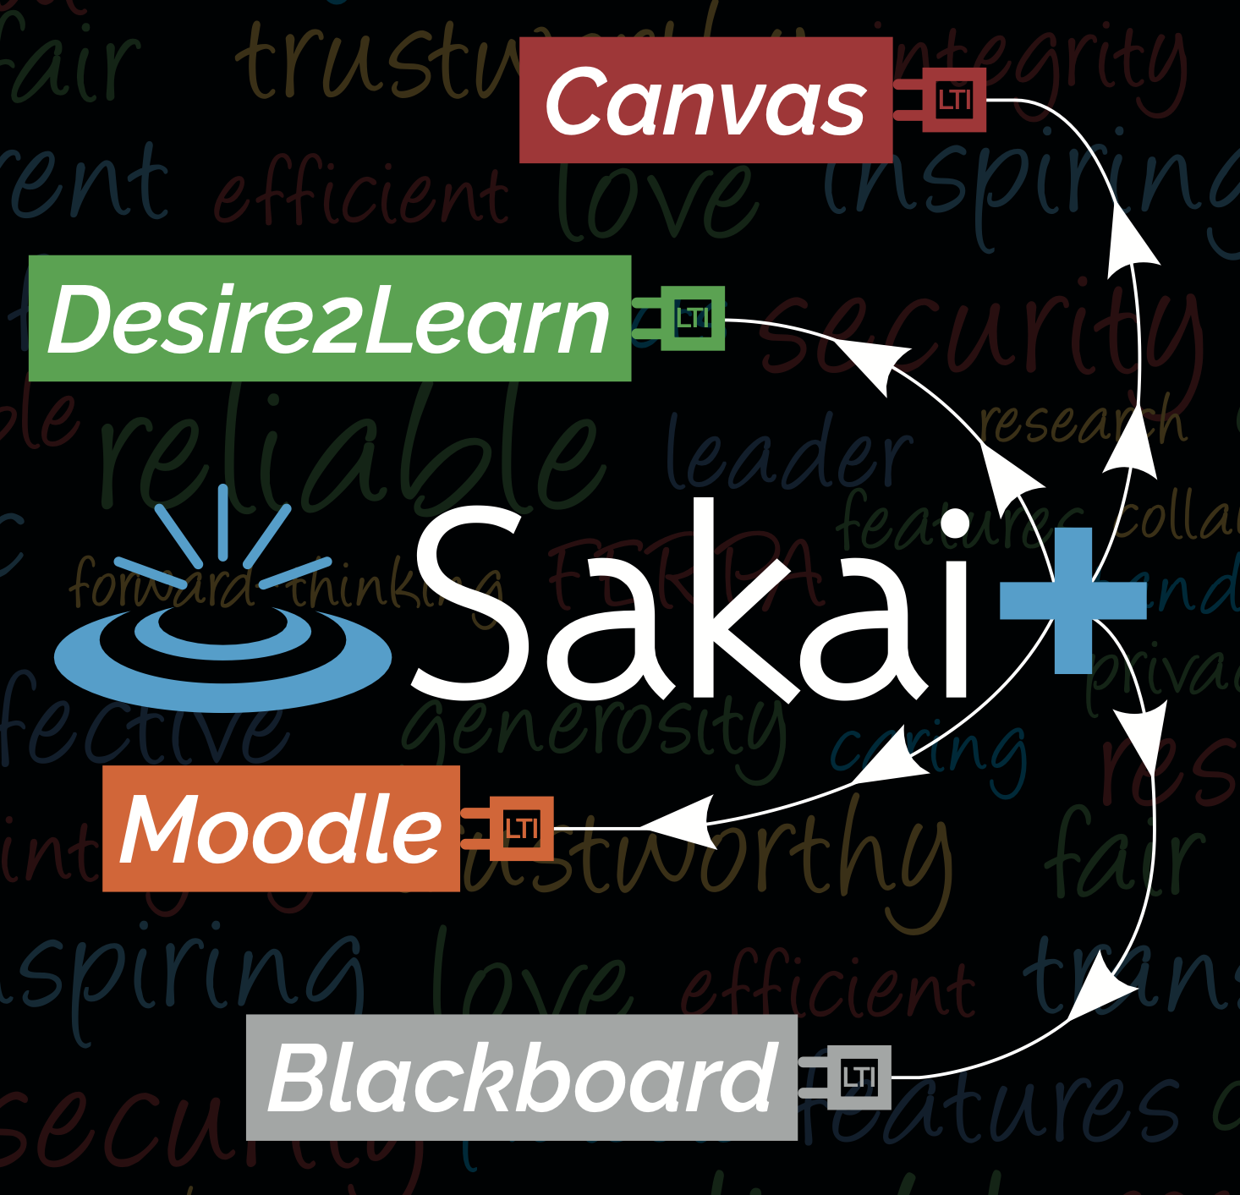
Introducing SakaiPlus
Dr. Charles Severance
Sakai PMC Chair
www.sakailms.org/plus

Slide 2
LMS's Over Time
The beginning (1997-2010)
Lots of startups / innovation / competition
Self Hosted
Purchase / Consolidation
Faculty / Instructional design are the primary audience
The Post-LTI generation (2010 – present)
One of the most visible core campus services
LMS Innovation slows – stability is the new focus
LTI Tools – lots of startups / innovation / competition
IT Leadership are the primary audience

Slide 3
LTI Over Time
LTI 1.1 – 2011
Model – LTI tool is a single learning activity with zero or one grades
May not even need the student's name or email
Just one of many items in course content
The LMS does all the sequencing
LTI 1.3 – 2019
LTI tool can have the entire roster and make as many grade book columns as it likes
Publisher content – One launch and the tool does content sequencing
Course content authored, sequences and experienced in the tool

Slide 4
The Trends We See…
LMS Innovation is Slowing
LMS Satisfaction is "meh"
Switching to a new LMS is a lot of work and then … "meh"
Faculty and Instructional Designers are finding LTI tools that lets them create meaningful content and engage students
The LMS is becoming a learning portal with a basic, unexciting, content sequencing experience

Slide 5
Looking at SakaiLMS..
Campus IT has been told Sakai as Campus-wide service is "more work than a commercial SASS offering"
Faculty and instructional designers love Sakai
Sakai continues to innovate
Sakai wants to build on our strengths and not try to get between the IT organization and its "SASS LMS / Learning Portal"

Slide 6
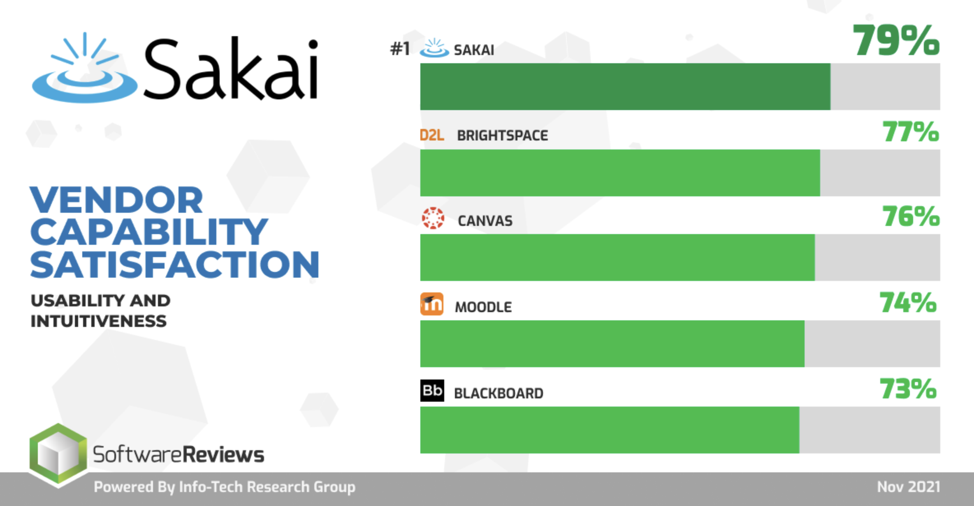

Slide 7

Innovative learning experiences are happening outside the LMS using LTI 1.3…

Slide 8
Innovative learning experiences are happening outside the LMS using LTI 1.3… Make all of Sakai an LTI 1.3 tool

Slide 10
SakaiPlus – LMS Multiverse
Part of Sakai 23
Sakai can plug into any LMS using LTI Advantage (1.3)
Retrieves and synchronizes roster data
Synchronizes all grade book activity
Launch / grades / notifications from campus LMS
Author and teach course in Sakai

Slide 11
Some things are simpler
Sakai only serves a small fraction of the campus population
Performance tuning is simpler
Upgrades are simpler
Hosting is simpler
Costs are lower
The heavy lifting is done by the Campus LMS

Slide 12
Benefits
Your faculty or instructional designers have an option if they don't love the campus LMS
They have an active and engaged community
Participation
Support
Innovation

Slide 13
Demo

