Slide 1
Learning Management Systems Implementations
Charles Severance
Sakai PMC Chair
University of Michigan School of information

Slide 2
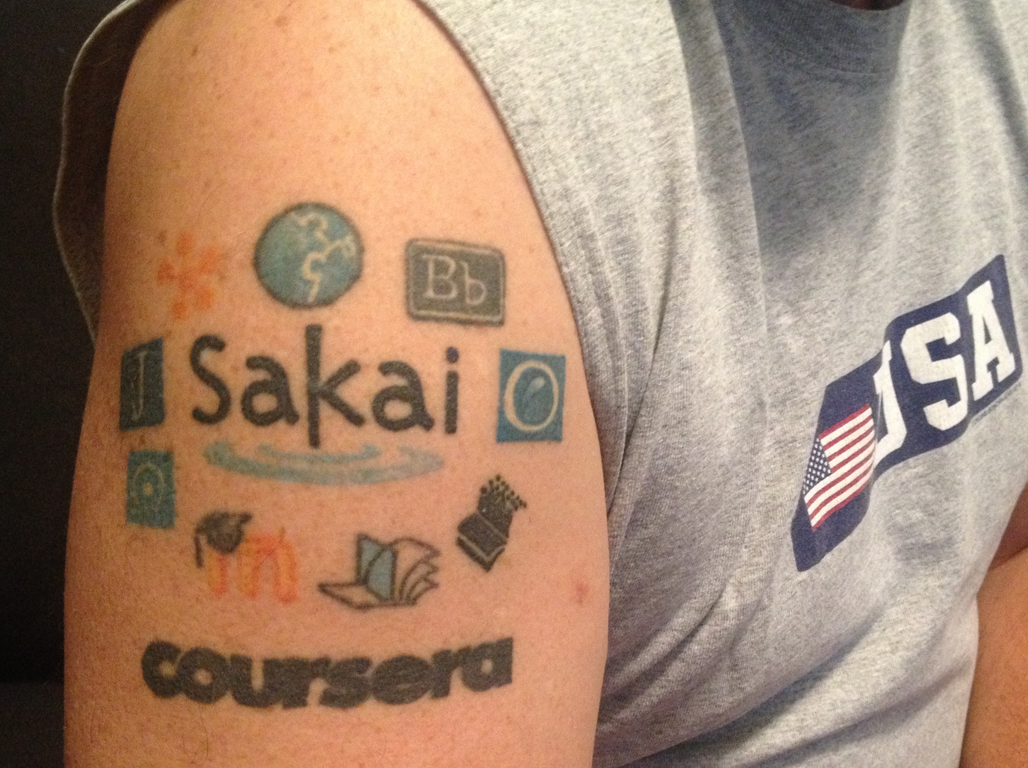


A DECADE+ of Leadership
Early 2000 – Commercial systems needed disrupting
2004 Sakai and Moodle emerge to great fanfare
2008-2011 Standards Emerge
Learning Tools Interoperability
Common Cartridge

Slide 3
In 2016
Open Source is most the best solution when the needs of teachers are truly considered
Sakai and Canvas at the forefront of standards innovations
Other LMS's focus on prompting aging platforms

Slide 4
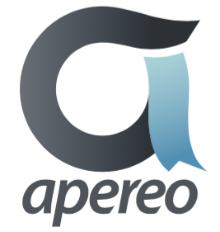




Beyond 2016
Next Generation Digital Learning Environment (NGDLE)
Old line LMS / Publishers say "We already are NGDLE"
Open Source (Apereo) is letting lots of "new flowers" grow
EdExchange
Image Quiz
Learning Analytics Processor
Open Dashboard
OpenLRS
https://www.apereo.org/content/projects-communities

Slide 5
Action To Take
Universities should join and support Apereo
Regardless of the LMS they run
Academic Open Source is an important commons and source of innovation
https://www.apereo.org/content/apereo-member-organizations

