Slide 1
Annual Report
Rob Abel
IMS Chief Executive Officer
rabel@imsglobal.org
http://www.imsglobal.org/
http://www.imsglobal.org/imsglobal2014annualreport.pdf
Follow IMS Global:
@LearningImpact

Slide 2

IMS Global Learning Consortium
World’s primary K-20 educational technology standards member consortium: 20 year history, 330+ member organizations (institutions & suppliers), accelerating growth & adoption
25+ IMS standards enable IT/academic technology flexibility, efficiency and agile innovation in a time of rapid change
IMS works closely with our community on adoption of new technologies and building awareness through Learning Impact Leadership Institute conference and awards program (May)
imsglobal.org @LearningImpact

Slide 3
IMS Mission Statement
The mission of the
IMS Global Learning Consortium
is to advance technology
that can affordably scale and improve educational participation and attainment

Slide 4

Learning Impact Leadership:
Giving Every Mind & Every Person the Chance to Be Great!
. . . via Learning

Slide 5
2015 to date

Slide 6
IMS Context

Slide 7




Assessment
Collaboration
e-Portfolio
Video Capture
e-Text, etc.
PARTNER
APP
CATALOG
APPS &
TOOLS
SUPPLIER/
DEVELOPER
ANALYTICS
Index,
Search
Launch, Authorize,
Contextualize
Partner = Trusted Institution(s)
or Approved Suppliers(s)
Click
Stream
Peer-to-peer network
LEARNING
PLATFORM/
PORTAL/LOR
Data
INSTITUTION
ANALYTICS
Apps
Actions
INSTITUTION
APP
CATALOG
IMS
Digital
Learning
Services
Standards
Data
Authenticate,
Group,
Report
IMS Community
App Sharing
Architecture (CASA)
IMS Caliper
Analytics
Framework
STUDENT
INFO/ERP
SYSTEM
LTI,
Common Cartridge,
QTI, LIS
Pathways
Achievements
IMS ARCHITECTURE
FOR EDUCATIONAL
INNOVATION
Competency Requirements Record (CORE)
Electronic Transcript Supplement

Slide 8
APPS &
TOOLS
PARTNER
APP
CATALOG
SUPPLIER/
DEVELOPER
ANALYTICS
Seamless Enterprise Integration via IMS Standards
Peer-to-peer network
Click
Stream
LEARNING
PLATFORM/
PORTAL/LOR
Apps
INSTITUTION
ANALYTICS
Data
INSTITUTION
APP
CATALOG
Metadata
Interventions
IMS Community
App Sharing
Architecture (CASA)
STUDENT
INFO/ERP
SYSTEM
IMS Caliper
Analytics
Framework
Pathways
Achievements
IMS ARCHITECTURE
FOR EDUCATIONAL
INNOVATION
Competency Requirements Record
Electronic Transcript Supplement

Slide 9

































Learning Platforms that Accept IMS Apps! http://imscatalog.org/
Notes:
ROB
Does LTI provide real evidence that there can be a single approach for integrating with multiple software platforms?
Yes, over 20 learning platforms accept LTI apps – and growing.
In addition, there are now over 100 certified LTI applications !!!
In fact there were close to 100 new certifications in 2013 alone.

Slide 10

2015 to date only

Slide 11
Learning Tools Interoperability
To enable Remote Tools and Content to be easily integrated into, and accessed from, an LMS (not limited to LMSs)
Several versions now available to support evolving requirements
Key concepts are the:
Tool Provider (TP) and Tool Consumer (TC)

Slide 12
Tool Consumer
Tool Provider
Settings
Profile
Tool
Roster
Profile
Tool Proxy Runtime
Outcomes
TC
User
Tool Proxy Runtime
Tool Proxy
Tool
Launch++
Secret
Secret
TC
Admin
TP
Admin
IMS Learning Tools
Interoperability (LTI)

Slide 13

LTI 1.0/1.1 Messaging
1. URL, key, secret
Tool Provider
System Administrator
2. Configure
Admin
4. Launch request (context, user, role)
Tool Consumer
Course
3. Click link
Outcomes service (read, update, delete)
Teacher or Student
Out-of-band connection
Browser connection
Server-to-server connection

Slide 14
LTI 1.2 Messaging
1. URL, key, secret
Tool Provider
5. Request TC Profile
Service requests
System Administrator
2. Configure
Admin
4. Launch request (context, user, role, profile URL)
Tool Consumer
Course
3. Click link
Outcomes service (read, update, delete)
Out-of-band connection
Browser connection
Server-to-server connection
Teacher or Student

Slide 15
Learning Tools Interoperability v2.0
LTIv2.0 is LTIv1.0 on steriods!
Now a platform for supporting the entire lifecycle of a tool with:
Service discovery
An extensible service framework (core+custom)
Uses REST/JSON-LD as the binding form
An excellent tutorial is available at
http://developers.imsglobal.org/tutorials.html#lti2

Slide 16
LTI v2.0 Messaging
Tool
1. Tool registration
2. Request TC Profile
Tool Provider
3. Send Tool Proxy
5. Service requests
Tool
Tool
System Administrator
4. Enable tool(s)
Admin
7. Launch request (context, user, role)
Tool Consumer
Course
6. Click link
Out-of-band connection
Browser connection
Server-to-server connection
Teacher or Student

Slide 17
Comparison of LTI Versions
Feature | LTI 1.0 | LTI 1.1 | LTI 1.2 | LTI 2.0 | Comment
Basic Launch | X | X | X | X | LTI2 reduces optional data requirements
Simple Outcomes |  | X | X | X | Return single numeric value.
TC Profile |  |  | X | X | Metadata for the TC’s available services.
Tool Proxy |  |  |  | X | Metadata for the TC/TP interface contract.
Credential Man^{gmt} |  |  |  | X | Automatic secure exchange of key/secret.
Registration Flow |  |  |  | X | TC initiated new tool provisioning.
Model-Driven Doc |  |  | X | X | Tool generated docs from UML.
REST Services |  |  | X | X | LTIv1.2 limits REST to TC only.

Slide 18
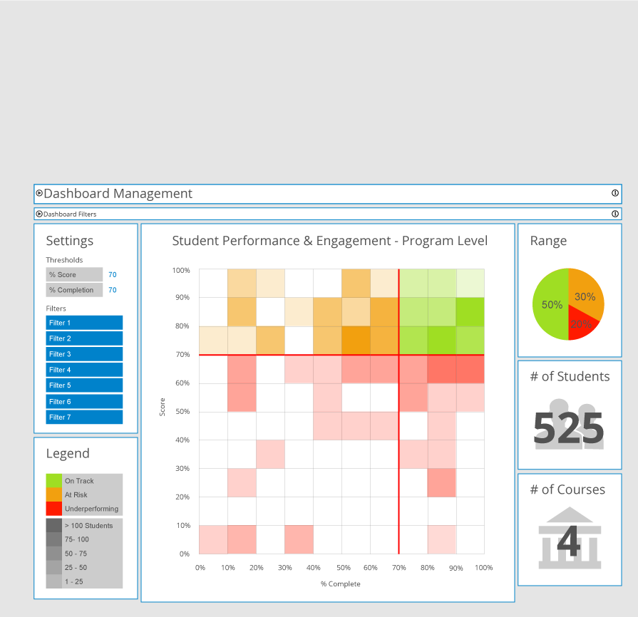


Caliper Learning Analytics Ecosystem
EDU
Students
Instructors
Curriculum
Admins
Learning
Research
Adaptive
Personalize
OPERATIONS
PLATFORMS
IMS Caliper Enabled Services
Caliper Sensor Endpoint(s)
Compliant Data Mgmnt Services
MOBILE EDU APPS
S
S
Data
Management
Services
Data
Stores
EP
EDU TOOLS / SERVICES
S
LEARNING PLATFORMS
S
PUBLISHER / COURSEWARE SOLUTIONS
S
S
= Sensor
EP
= Sensor EndPoint
Notes:
Why not xAPI/Tincan?: dominated by a single commercial entity, no structure, weak extension framework, plus the importance of stewardship of the spec should not be underestimated.

Slide 19
Caliper Learning Analytics Ecosystem
Students
USERS
Instructors
Curriculum
Admins
Learning
Research
OPERATIONS
PLATFORMS
IMS Caliper Enabled Services
Caliper Sensor Endpoint(s)
Compliant Data Mgmnt Services
MOBILE EDU APPS
S
S
Data
Management
Services
Data
Stores
EP
EDU TOOLS / SERVICES
S
LEARNING PLATFORMS
S
PUBLISHER / COURSEWARE SOLUTIONS
S
S
= Sensor
EP
= Sensor EndPoint

Slide 20
IMS Caliper Learning Analytics Ecosystem
Students
Dashboard(s)
USERS
Instructors
Curriculum
Admins
Learning
Research
OPERATIONS
PLATFORMS
IMS Caliper Enabled Services
Caliper Sensor Endpoint(s)
Compliant Data Mgmnt Services
MOBILE EDU APPS
S
S
Data
Management
Services
Data
Stores
EP
EDU TOOLS / SERVICES
S
LEARNING PLATFORMS
S
PUBLISHER / COURSEWARE SOLUTIONS
S
S
= Sensor
EP
= Sensor EndPoint

Slide 21
Caliper event
Learning Context
Activity Context
Base statement
target
edApp
actor
generated
group
action
membership
Time (ISO 8601)
startedAtTime
fedSession
object
endedAtTime
duration
Notes:
Anatomy of an event.

Slide 22
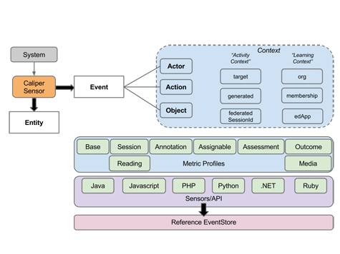
IMS Caliper: Click Stream Data for Learning Analytics

Slide 23
Why Caliper?
Standardization: encourage a common, extensible yet structured approach to describing, collecting and transporting learner interaction data for later consumption by researchers, educators, platforms, apps and services.
Innovation: provide a extensible data model, controlled vocabularies and an API that enables new uses of learner interaction data.
Interoperability: promote data exchange, sharing, mashups between systems, institutions and people.
Stewardship: evolve an EDU-optimized technical specification under the auspices of IMS Global and its member institutions and organizations.
Notes:
Why not xAPI/Tincan?: dominated by a single commercial entity, no structure, weak extension framework, plus the importance of stewardship of the spec should not be underestimated.

Slide 24
Scope: Caliper
instrument
persist
use
describe
collect
transport
store
analyze
visualize
report
share
predict
intervene
adapt
feedback
Notes:
Tricky issues not yet resolved: privacy, data ownership, data sharing, tracking (where is my stuff?) between systems, organizations and stakeholders.

Slide 25
Scope: Caliper 1.0
instrument
persist
use
describe
collect
transport
store
analyze
visualize
report
share
predict
intervene
adapt
Notes:
Caliper provides a specification for describing, collecting and transporting learner interactions; we do not specify an event store nor do we specify the types of tools and visualizations required to make sense of the data. We provide the plumbing/common gauge rail that simplifies data collection, transmission and sharing/interoperability and enables a broad spectrum of “uses”.

Slide 26
Caliper fundamentals
Information model: standardized set of learning activity profiles & controlled vocabularies that extend set of foundational metrics.
API: governs the interactions between Caliper, apps, platforms, services, event store(s).
Sensor: code library designed to simplify instrumentation of platforms/apps/services. Multiple bindings: Java, JS, Ruby, Python, PHP, .Net.
Conformance: test suite ensuring implementation compliance.
Dev community: docs, presentations, bootcamps, reference implementations.
Notes:
Started in 2014, iterative development, deliberate oscillations between doc and code writing designed to increase project velocity.

Slide 27
The Sensor API
API Methods
initialize () – initialise the API
description (id, time, context) – send the learning context information
measure (id, time, event) – send the caliper event data
Technology base
REST/JSON-LD

Slide 28
Sensor API & Metric Profiles
Defining the set of Caliper Events for some MPs
Current set of MPs being defined are:
Reading - reading textual content
Assessment - undertaking a test or quiz
Annotation - annotating content
Performance – grading/scoring of some content
Media – interaction with video/audio systems

Slide 29

Caliper code repos (Github)
sensors
caliper-java
caliper-js
caliper-ruby
caliper-python
caliper-php (includes example)
caliper-net
sample code
caliper-java-example
caliper-net-example
support
caliper-contexts
caliper-conformance
caliper-common-fixtures
future?
caliper-model/profiles
caliper-docs
Notes:
Development repos currently private. Release branches will be made public. Contributions accepted only from IMS members. Contributors must sign an Apache-style Individual Contributor Agreement (ICA).
Octocat

Slide 30
Thank You! Questions, Issues & Comments
http://www.imsglobal.org/
http://www.imsglobal.org/edupub/index.html
Follow IMS Global:
@LearningImpact

