Slide 1
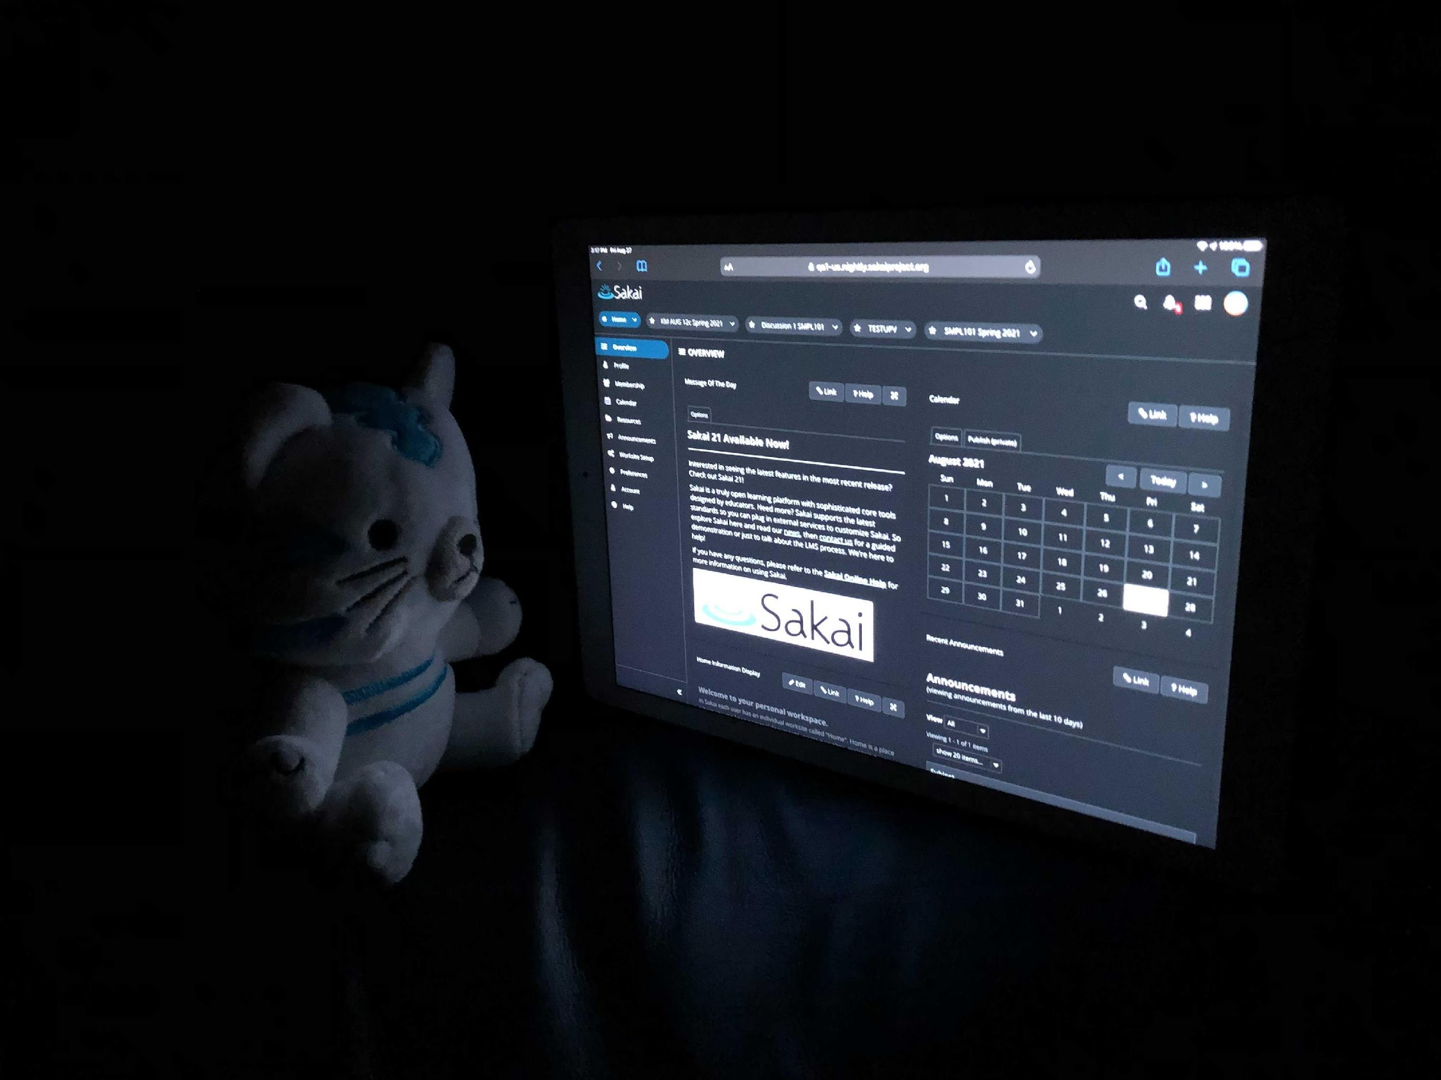
A Peek into the Crystal Ball to see the Future of Learning Tools Interoperability
Charles Severance
University of Michigan
csev@umich.edu

Slide 2

Agenda
Quick History of LTI
Coming soon to a spec near you
Demo

Slide 3


Sakai and LTI
Sakai (and Tsugi) have always been at the forefront of research into how to best advance interoperability. Sakai supports most LTI innovations when they are released or earlier.
There are 1-3 well attended LTI meetings per week. A lot of collaborative engineering to insure interoperability.

Slide 4
Timeline
LTI 1.0 – No Grades
LTI 2.0 🗑🔥
1-3 meetings per week collaborative development and testing in the IMS WG
2010
2011
2014
2019
2021
LTI 1.1 – Basic Outcomes - Tattoo
LTI Advantage – LTI 1.3, Assignments and Grades, Names and Roles

Slide 5
Preview of Coming Attractions
Submission Review
Grading Workflow
Adds "for user" launch into a student's grade record from the LMS gradebook to the LTI tool
Fits nicely into Sakai's Assignments Tool model
activityProgress – Initialized / Started / InProgress / Submitted / Completed
gradingProgress – Pending / Manual / Failed / NotReady / Failed / FullyGraded
Fits nicely into Sakai's Assignments Tool model

Slide 6

DEMO TIME

Slide 7
This is just a start. The fun begins when we polish up the UI/UX and build new assignment types outside of Sakai.

Slide 8
SAK-46192 - Refactor Assignments / LTI External Tools For Sakai 21/22
Sakai 21 stored LTI grades for the assignment in the Gradebook
This confused nearly all of the Assignments workflow
Led to lots of little breakages (SAK-45897 - Umbrella LTI JIRA)
Sakai 22 post SAK-46192 stores LTI grades for assignments in Assignments – which then copies them to gradebook
This made an LTI assignment very similar to any other kind of assignment and assignment features started working
New LTI workflow features fit into Assignments perfectly
Coming soon to a Sakai-21 near you...

Slide 9



Summary
These new features are destined for Sakai 22 and back port it to Sakai 21. Sakai 21 introduced the first version of the LTI Assignment type.

Slide 10
THANK YOU
Charles Severance
csev@umich.edu www.dr-chuck.com
Many thanks to Wilma and Andrea

