Slide 1
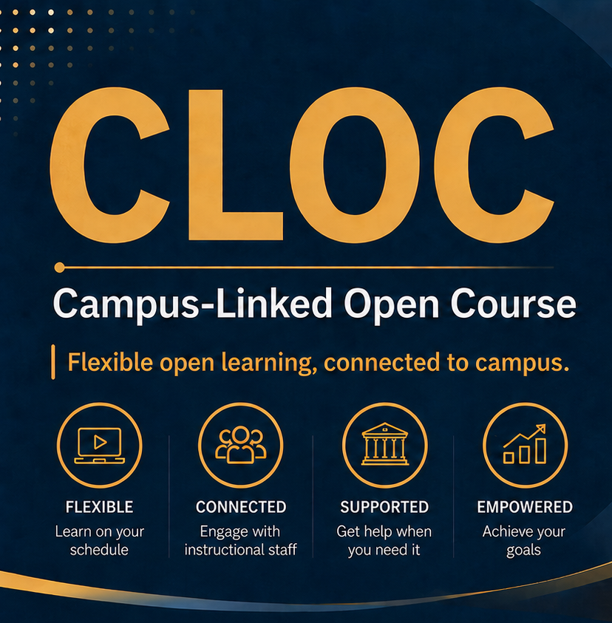
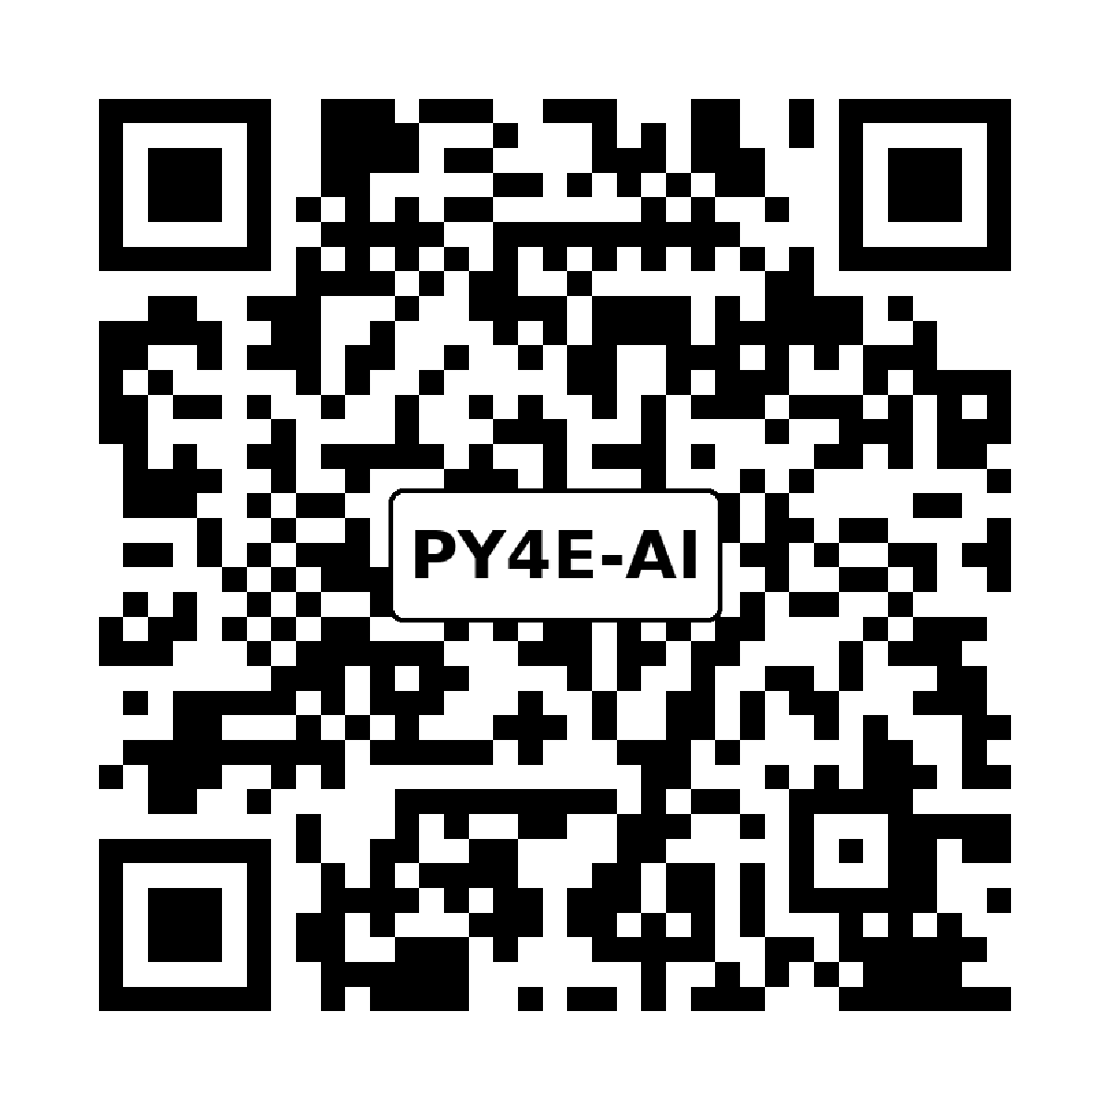
Python for Everybody
with AI
A Campus-Linked Open Course
CLOC-502
Begins January 1, 2027
Dr. Charles R. Severance (Dr. Chuck)
$300 • supports instructional staff
This is an experiment to explore feasibility of this course model.
python.dr-chuck.com
Notes:
Hi, I’m Dr. Chuck, and I would like to invite you to register for a new course and new kind of online learning experience. In Janyary 2027, I will be offering Python for Everybody with AI using the Campus Linked Open Course Model.

Slide 2
Hello, I’m Dr. Charles Severance and I am a professor at the University of Michigan School of Information. I would like to invite you to register for my new "Python for Everybody with AI" January 2027. This will be a new course and a new way of teaching an online course that I call "Campus Linked Open Course" or CLOC.

Slide 3
What is a Campus-Linked Open Course (CLOC)?
A CLOC is tightly linked to an on-campus section of a course which it is being taught
MOOC
open access
large scale
mostly self-directed
no live support
no instructor interaction
often an old copy of an on-campus course
CLOC-502
course calendar / cohort
weekly communications
instructor interaction
weekly live help sessions
open enrollment
low cost / non-credit
certificate/badge
schedule / no late points
no exams /no grades
cohort 15 weeks
self-paced for 360 days
UMSI-502
course calendar / cohort
weekly communications
instructor interaction
weekly live help sessions
limited enrollment
campus credit cost
real deadlines / late points
exams and grades
course ends after 15 weeks
Django CLOC
course calendar / cohort
weekly communications
instructor interaction
weekly live help sessions
open enrollment
low cost / non-credit
schedule / no late points
no exams /no grades
cohort 15 weeks
self-paced for 360 days
certificate/badge maybe
CLOC is not “MOOC plus.” It is a non-credit experience aligned with an on-campus course.

Slide 4
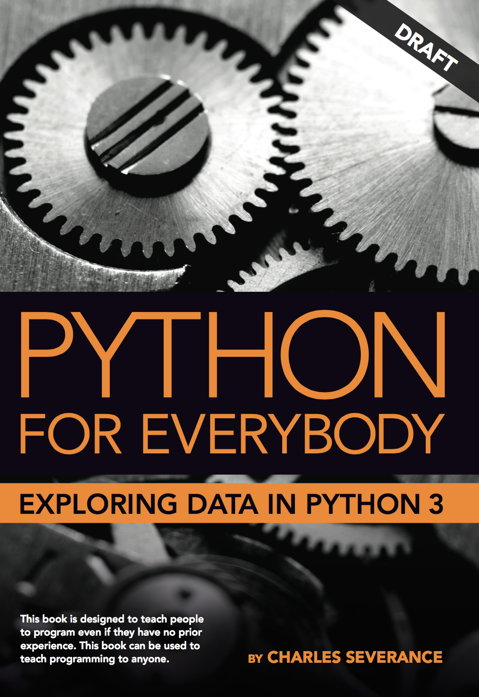
Python for Everybody
The most popular Programming Course in the World – www.py4e.com
Came out of SI502 taught on at University of Michigan School of Information 2009-2017
Developed free and open text book (www.py4e.com)
  Translated into >10 languages
On Coursera, edX, FutureLearn, FreeCodeCamp
  > 10 Million Students
Taught at 100s of high Schools, Colleges and Universities around the world free materials – www.py4e.com
No AI and will stay that way – lots of students want to learn and experience AI-free courses
But many students want to learn to use AI.

Slide 5
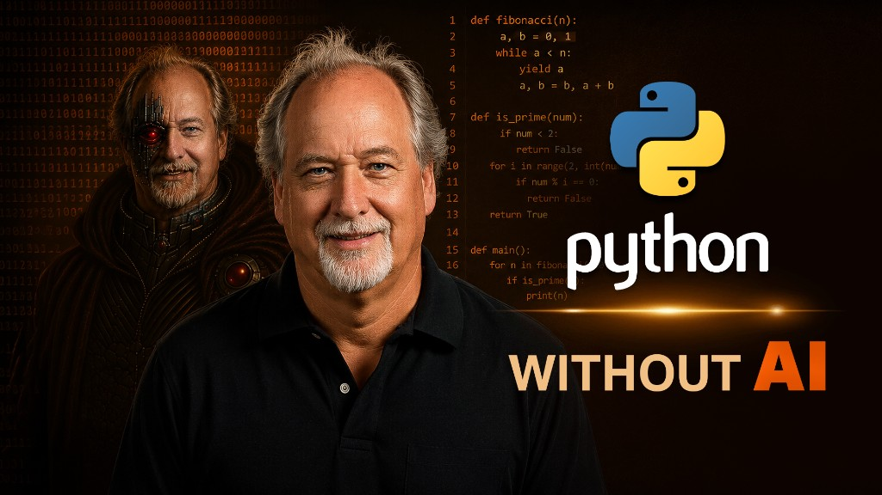
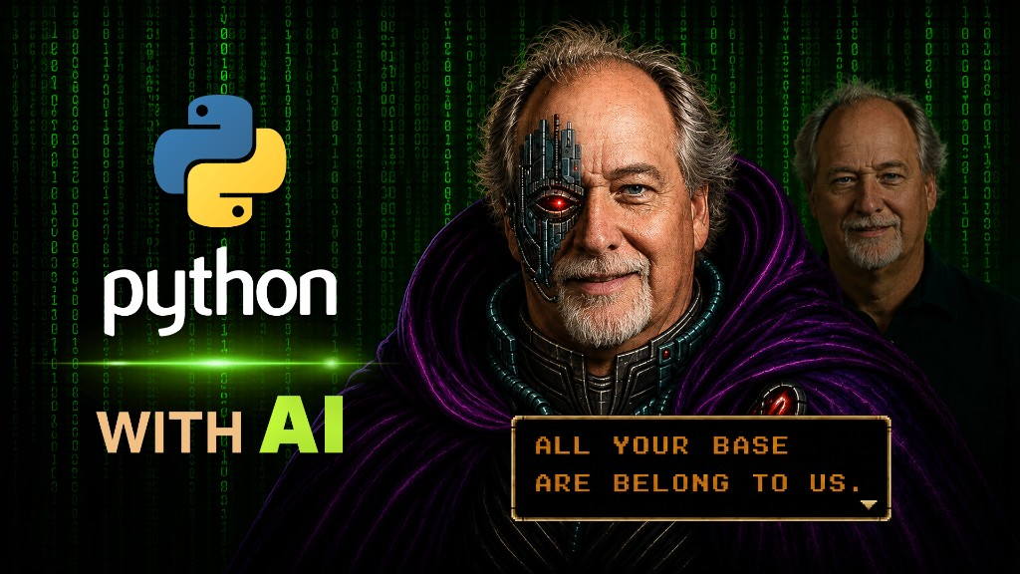
Python for Everybody with AI
This is not Vibe Coding – It is Learning Python
Same textbook – different course outline
Learn Python Basics without AI
  Take exam without AI
Learn Python Basics (again) with AI
  Take exam with AI
Advanced problem solving with Python and AI
The hope and goal is students with zero programming skill or experience can solve quite advanced problems with Python+AI
Easy to learn (like PY4E)
Strong skills at the end (PY4E-AI)

Slide 6


Why should you take CLOC-502?
I think it is difficult to stay motivated in self-paced online courses…
I think you would learn better and faster with:
a calendar and due dates
office hours and responsive help
human feedback when the course is confusing
a cohort moving through the material together
a sense of a "real college experience"
building a bicycle 🚲 while we ride it
CLOC lets you learn online at low cost and anywhere in the world (like a MOOC) while providing campus-like vibe, rhythm and support.
python.dr-chuck.com

Slide 7

CLOC-502 Details and Registration
Python for Everybody with AI – CLOC-502
Cost: $300
Enrollment: Now through January 13, 2027
First due date is January 22
Instructional Assistant Sessions start January 13
Late Enrollment: January 13 – February 2
Financial Aid – 90% discount – depends on paid enrollment – Decision early January
python.dr-chuck.com
Flexible online learning + campus connection

Slide 8
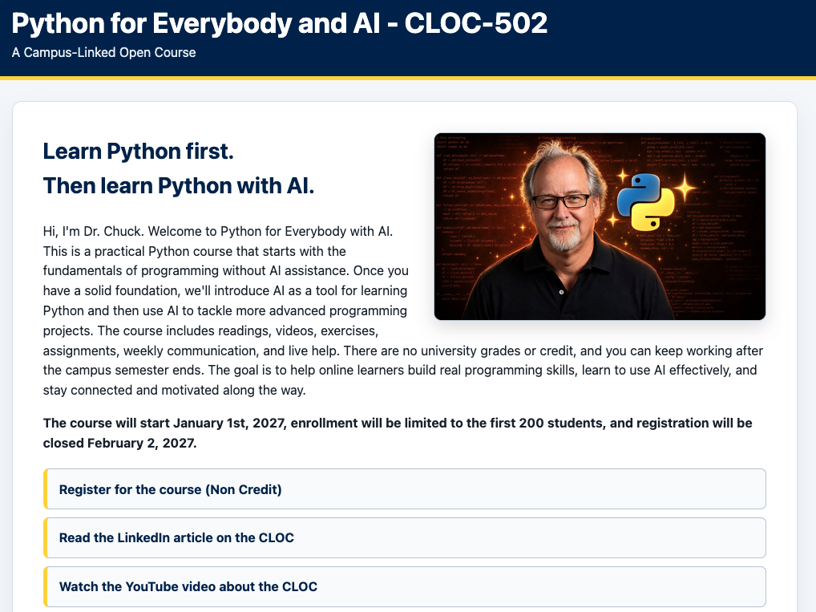
python.dr-chuck.com

Slide 9
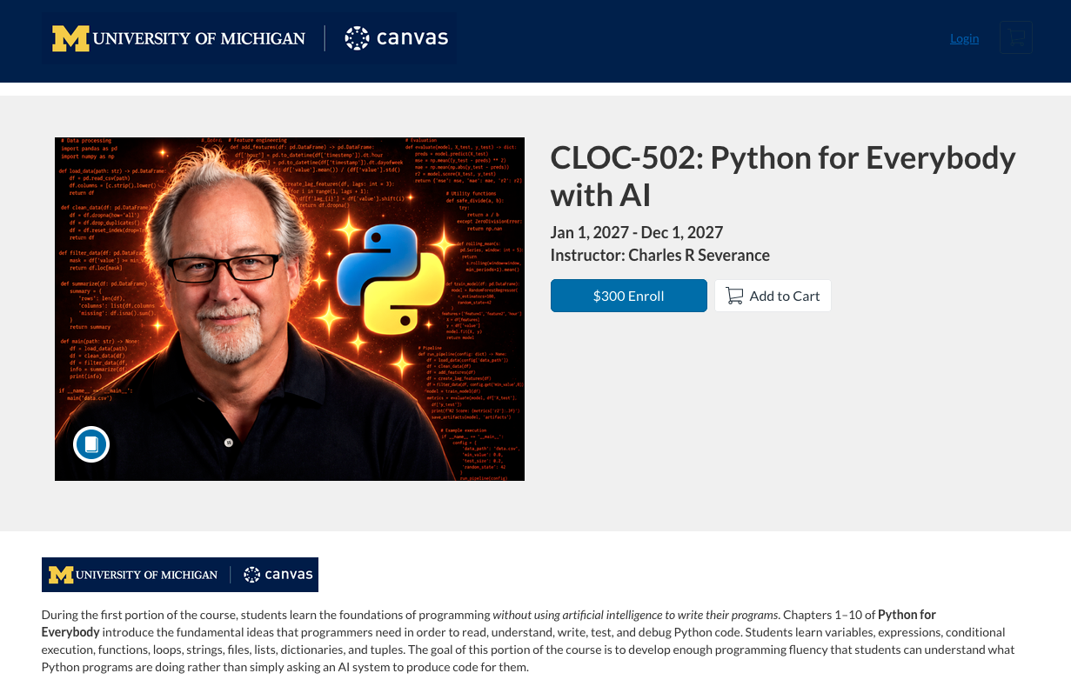
python.dr-chuck.com

Slide 10
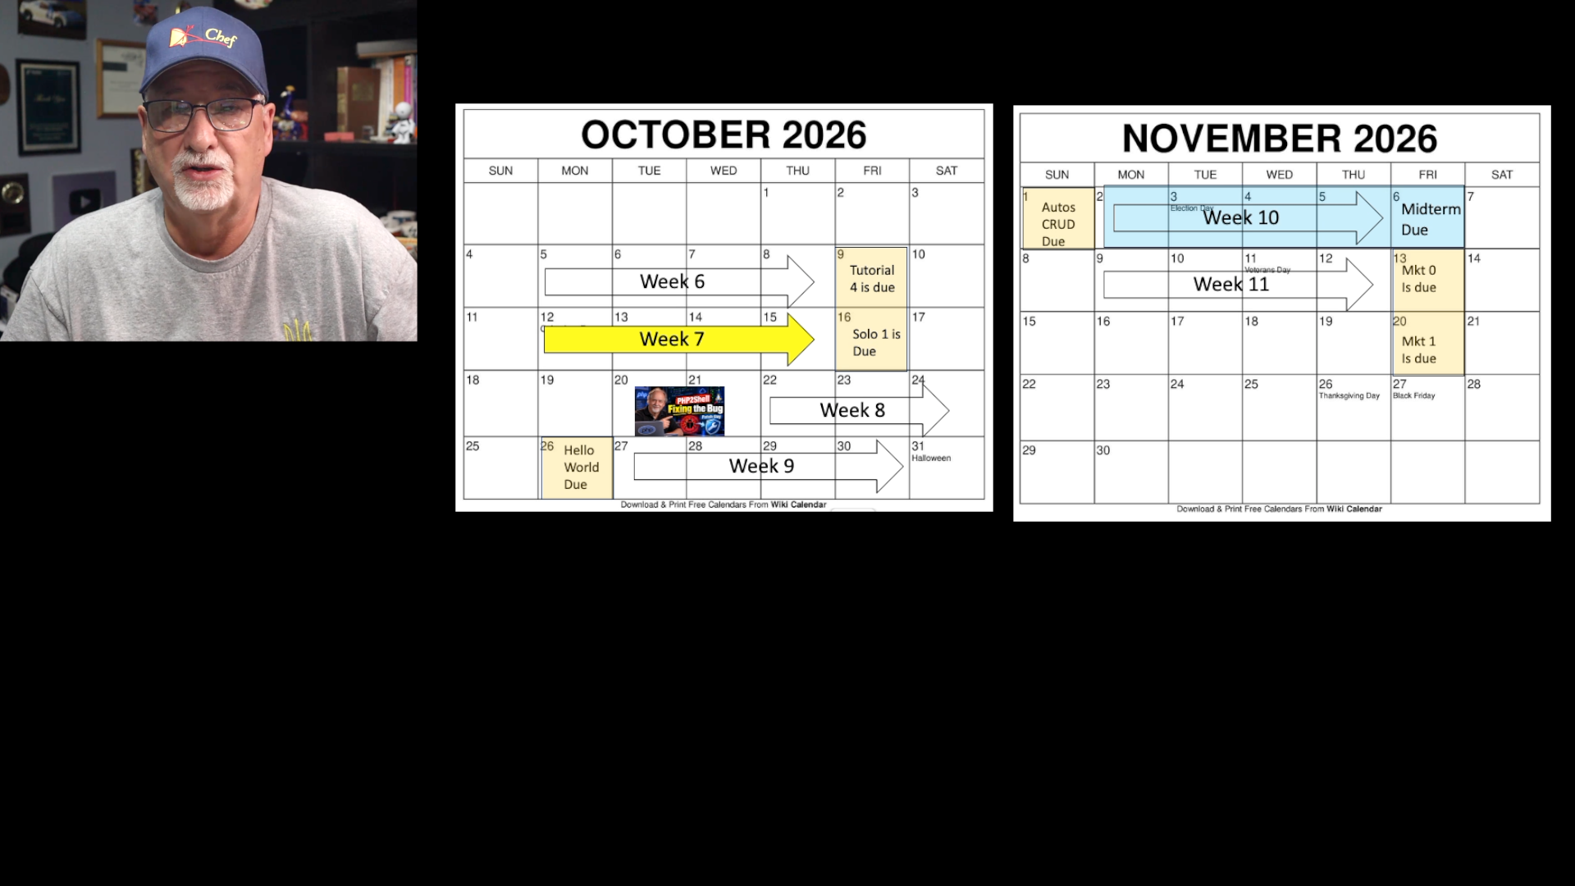
Current CLOC offering (in progress)
A focused pilot for Building Web Applications in Django.
Week 10 Lecture:
Cost: $300
September - December 2026
CLOC students who are not finished have until August 2027 – self paced
Students see and can take exams and extra-credit assignments but they are not required
20 students – many come to my office hours ☺
Some students keep up every week – some are taking their time
I am learning a lot…
https://www.youtube.com/watch?v=7UCYqqJmLDY

Slide 11
Comments from Students
"One of the best things about this CLOC-357 is that it doesn't feel like just another online course. It's often difficult to stay motivated in self-paced online courses, but having the opportunity to interact directly with Dr. Chuck makes the learning experience much more personal, engaging, and enjoyable." - Pranab
CLOC-357 – Software Development with Django
"CLOC-357 genuinely made me fall in love with programming in ways I hadn't expected. It got me hooked on OOP, and I even dug a little deeper with Objects First with Java to understand objects and classes more deeply." – Pravin
"CLOC-357 has the pace of a college course, but we get the option of spreading it for a whole year if we can't keep up the pace." - Zvi
"I've taken online classes on other platforms, and it took me too long to finish them, and I had to start over many times. In CLOC-357 I am motivated because I know I am part of this community class, with students on campus and students in my section. Knowing I am measured relative to the other students creates this pressure to be active every week." - Mohammed
Your approach to teaching Python and OOP concepts through Django as a practical vehicle has been transformative. In CLOC-537, rather than presenting abstract theory first, you ground each concept in a real application, which allows the underlying ideas to land naturally. - Corey

Slide 12
This is an experiment (Alternative Learning Initiative – ALI)
Our experience in this first offering will define all future offerings from me and other UMSI Faculty
Listen
Adjust
Improve
•
office-hour feedback
•
clarify instructions
•
future offerings
•
live session questions
•
add examples
•
better interaction
•
email
•
tune sessions
•
stronger online support
•
patterns across assignments
•
create extra material
•
clearer CLOC model
I need to make a report to my fellow faculty throughout the semester.
python.dr-chuck.com
Notes:
This is an experiment, and we will learn from it as we go. Online students will be encouraged to share feedback during office hours, in live sessions, and by email. When several people struggle with the same assignment or explanation, that is useful information. We may add examples, clarify instructions, adjust sessions, or create additional material.

Slide 13
One course.
Campus and open sections.
A shared schedule, a shared instructional community, and a better chance to feel connected to the process of learning.
Please join me in January 2027
python.dr-chuck.com
Notes:
I think there is an important space between a completely self-paced online course and formal university enrollment. A Campus-Linked Open Course is meant to occupy that space. One course. Campus and online learners. A shared schedule, a shared instructional community, and a better chance for online learners to feel connected. Welcome to Building Web Applications in Django. Welcome to the experiment. And welcome to the CLOC.

