Slide 1
Technical Aspects of Tsugi

Slide 2
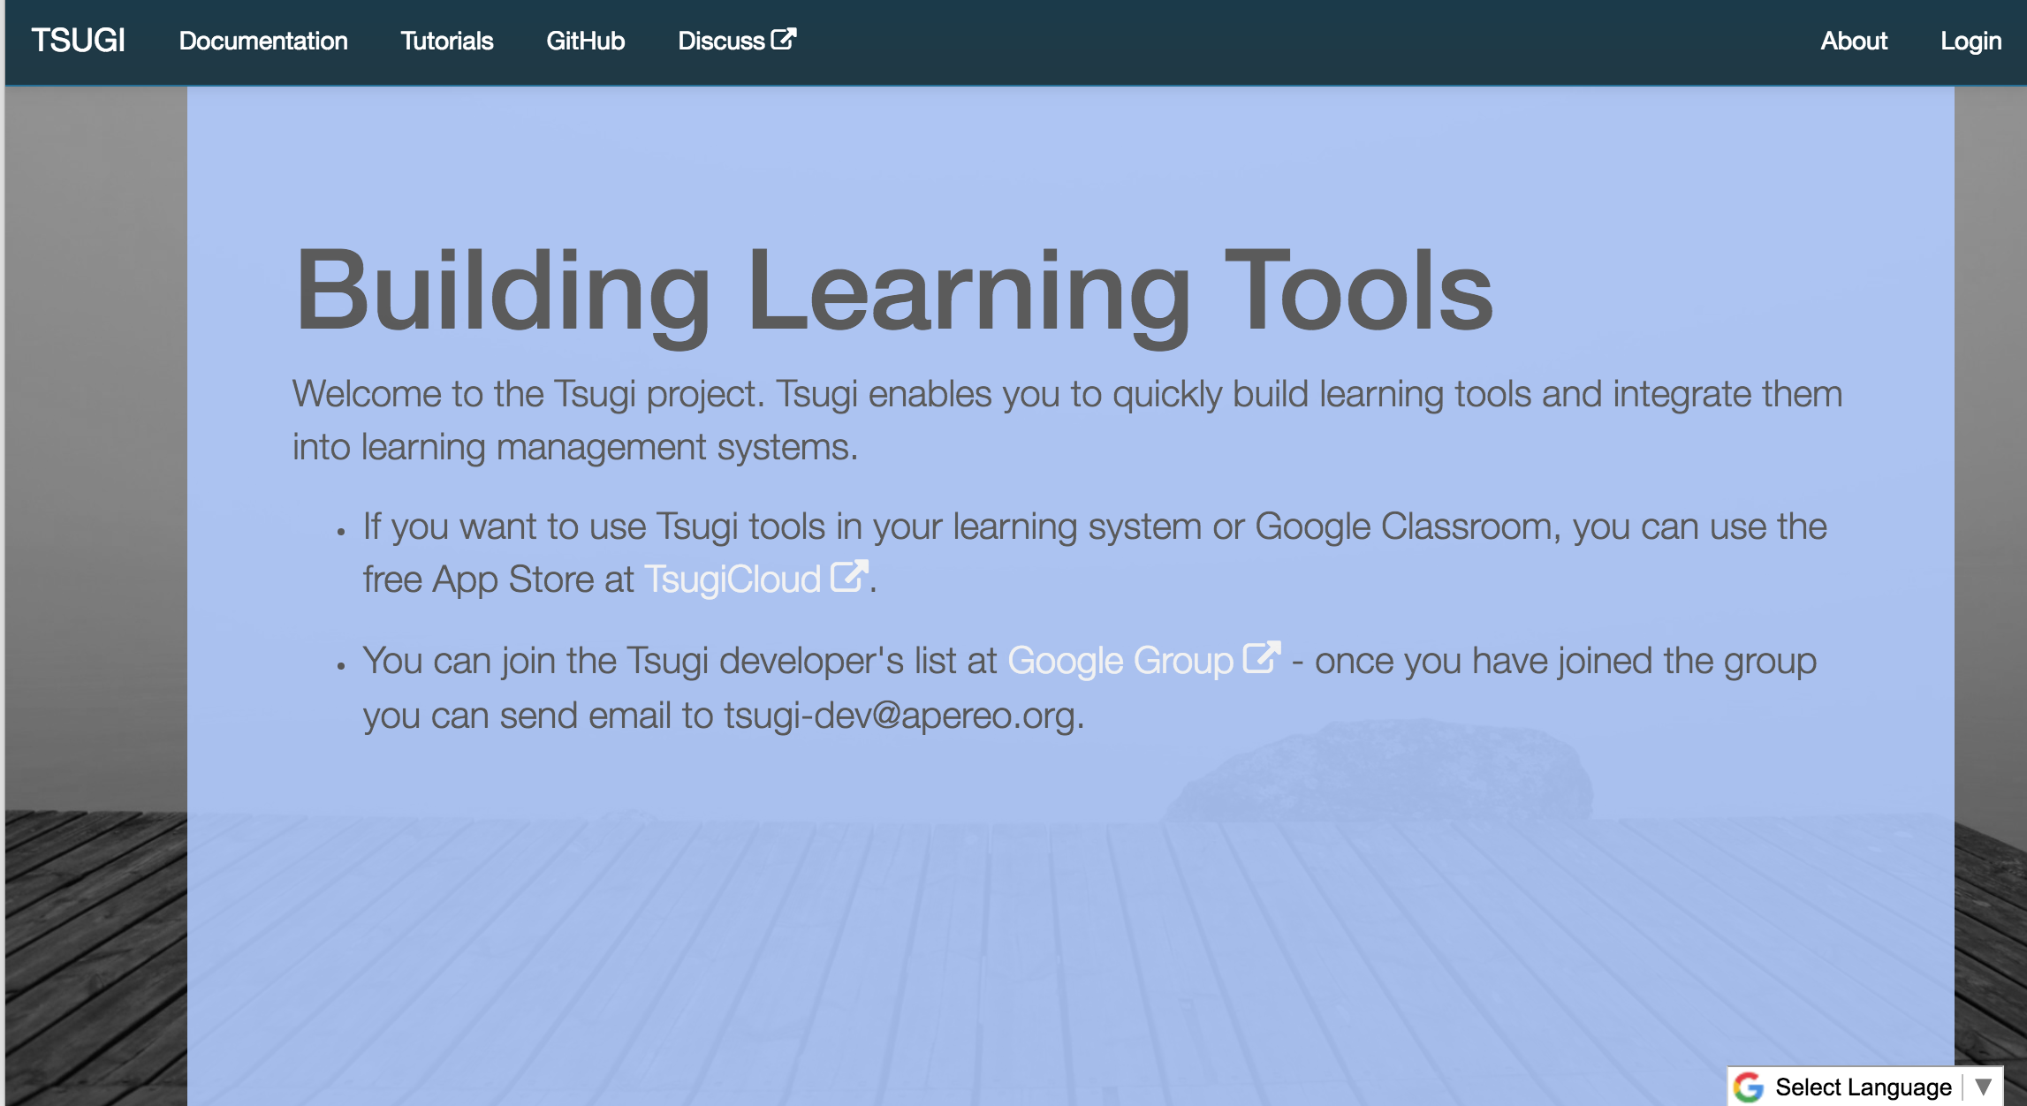
www.tsugi.org

Slide 3
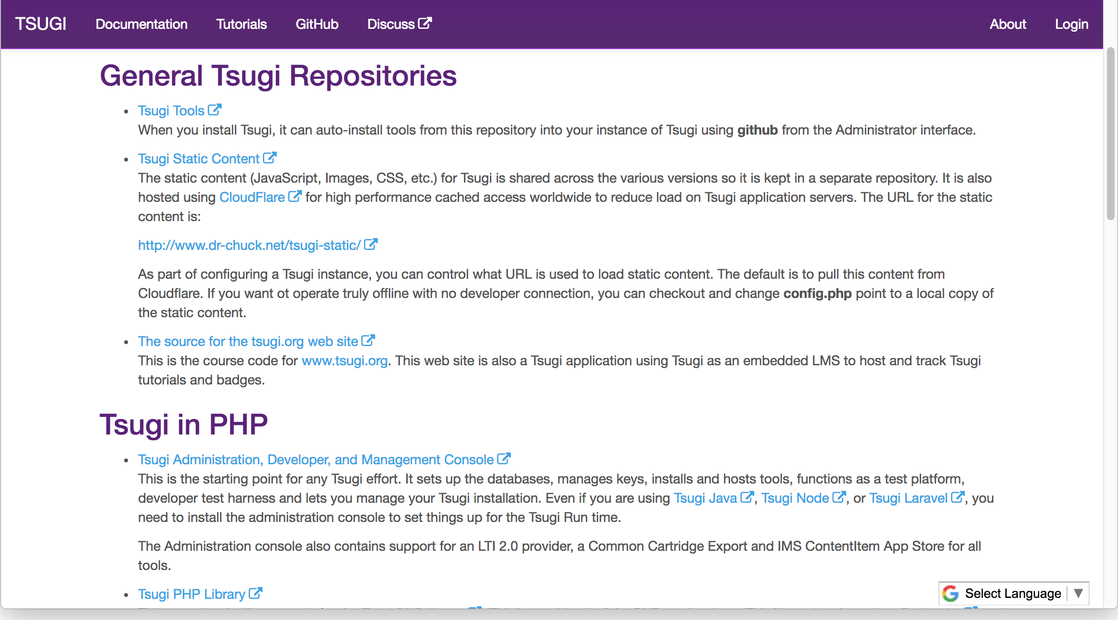

Slide 4
Advantages of a Tsugi App?
LTI 1.0, LTI 1.1, LTI 2.0, Caliper, Common Cartridge, LTI Advantage …
You did not use email as logical key in the user table. Correct length!
Session Management / Extension / Expiry
Support Offline Grading – Peer grading Applications
Coping with unreliable Tool Consumers – Grade resend
Build Thin Cartridges From LTI Links
Handling Settings on URL, Custom parameters, etc.
Support Cross-LMS Setting Dialogs
Works behind CloudFlare CDN / Proxy
Make use of windows.post messages to resize iframes

Slide 5
Advantages of Tsugi Tools
Work with lots of LMS's even though you never tested with more than one
Even when those LMS's have bugs!
You don't set cookies in iframes
You can handle multiple courses / roles in multiple tabs
Handle LMS's that don't give you features (i.e. placement settings)
You don't do navigation inception.
You handle weird / changing lis_sourcedid values from Moodle
You can reliably / securely connect LTI accounts with direct logins
You have a flexible UI / work flow for issuing keys (LTI 1.1 and LTI 1.3 soon)
Your tool works with Google Classroom – is that a thing?

Slide 6
Tsugi in the cloud…
You have a hosting environment
Admin interface / key management / data management
You have free / open Amazon / Google recipes
Designed for 100% uptime in the cloud - auto upgrade code/database
Like a WordPress for your learning tools
You can contribute your tool to an open app store like TsugiCloud.org
You can make money submitting your tool from a commercial app store

Slide 7
Coming: Tsugi and GDPR
Dr. Chuck rants about privacy for educational data for a while…
The end of Raiders of the Lost Ark
Data models / APIs don't break when Name / Email is not provided
Data models support "Cached PII"
Data models to support timed data expiry
UI will support custom expiry for
Keys (Tennants) / Courses (Instructors) / Users (Students)

Slide 8
Tsugi Tool
Tsugi App
???
UI/UX APIs
Look / Feel
UI Widgets
\Tsugi\UI
\Tsugi\Settings
Opinionated APIs
Convention / Database Model / Session
Easy for App Developer to Use
\Tsugi\Core
Utility APIs
Implement Standards
Portable / Reusable outside Tsugi
\Tsugi\Util

Slide 9
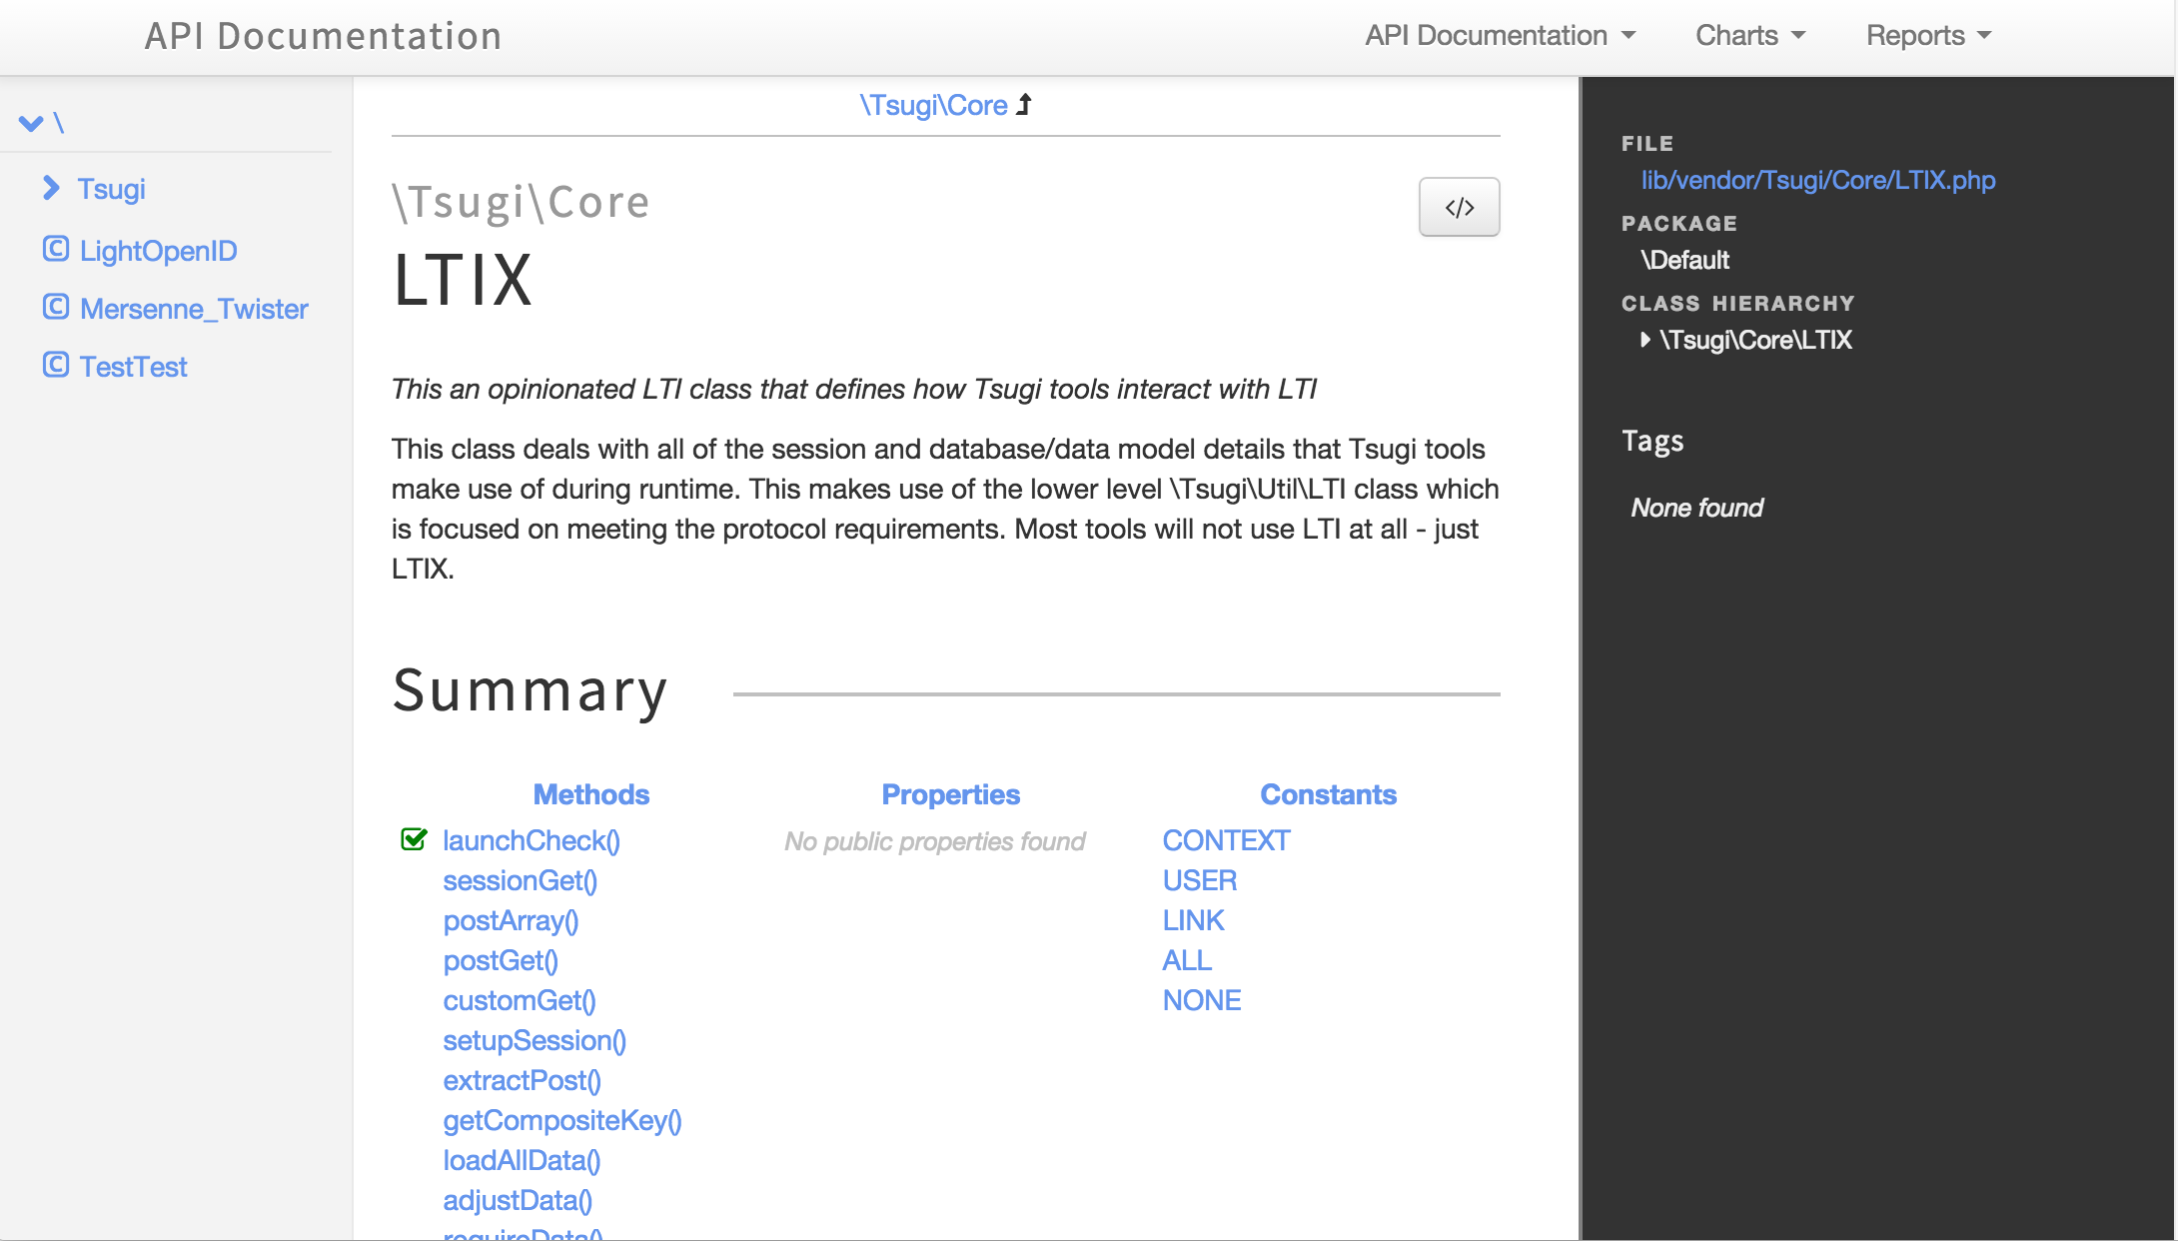
http://do1.dr-chuck.com/tsugi/phpdoc/classes/Tsugi.Core.LTIX.html

Slide 10
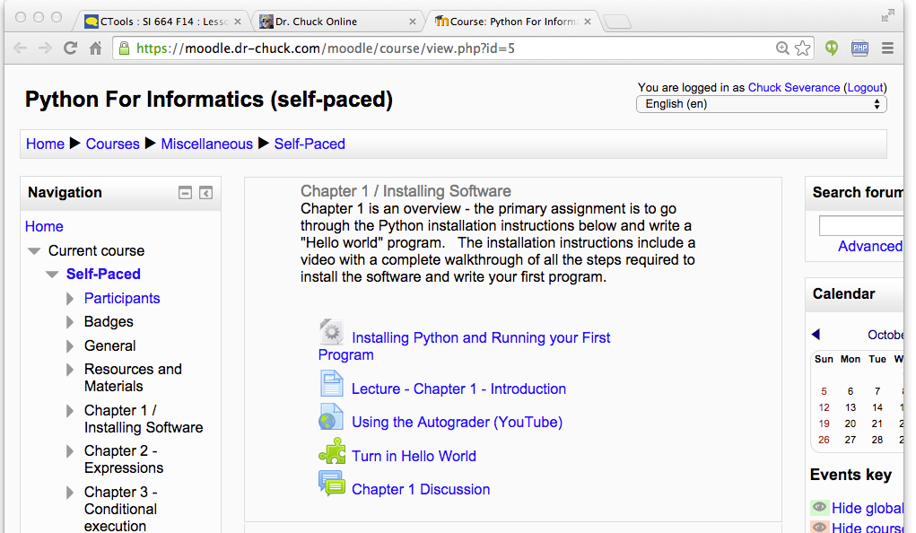
Tenant
Context
User
Link (Many)
Data Model

Slide 11
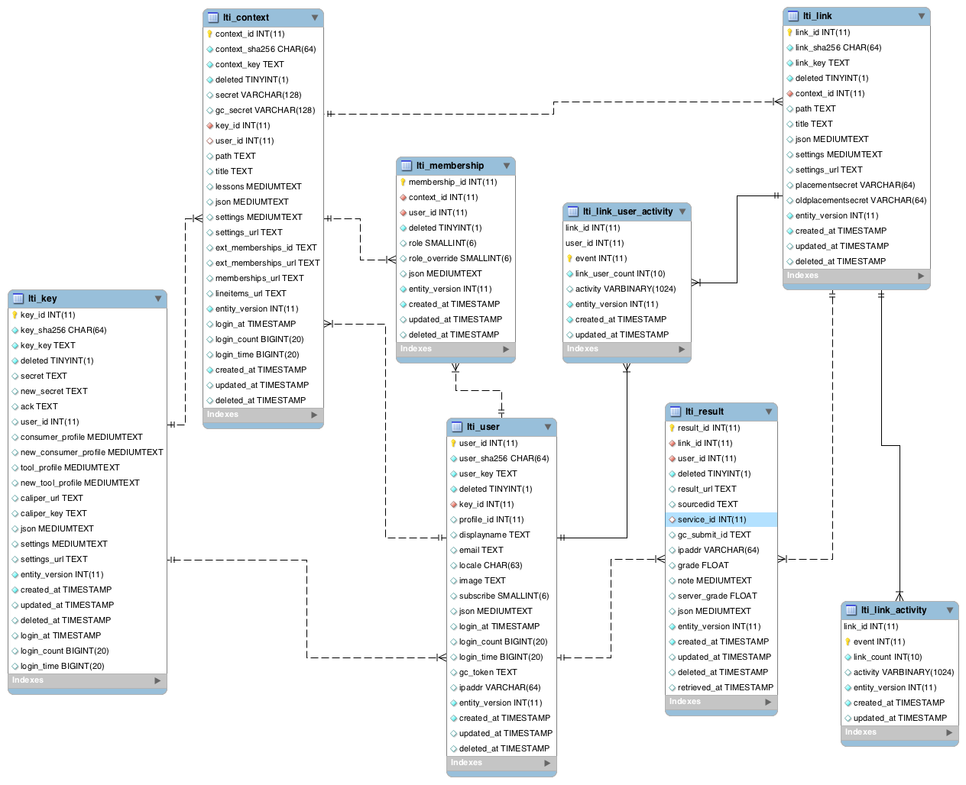

Slide 16
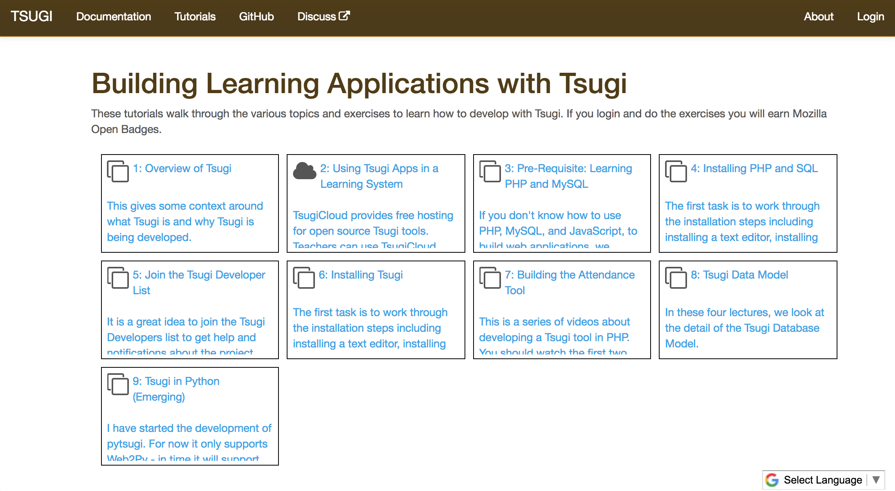

Slide 17
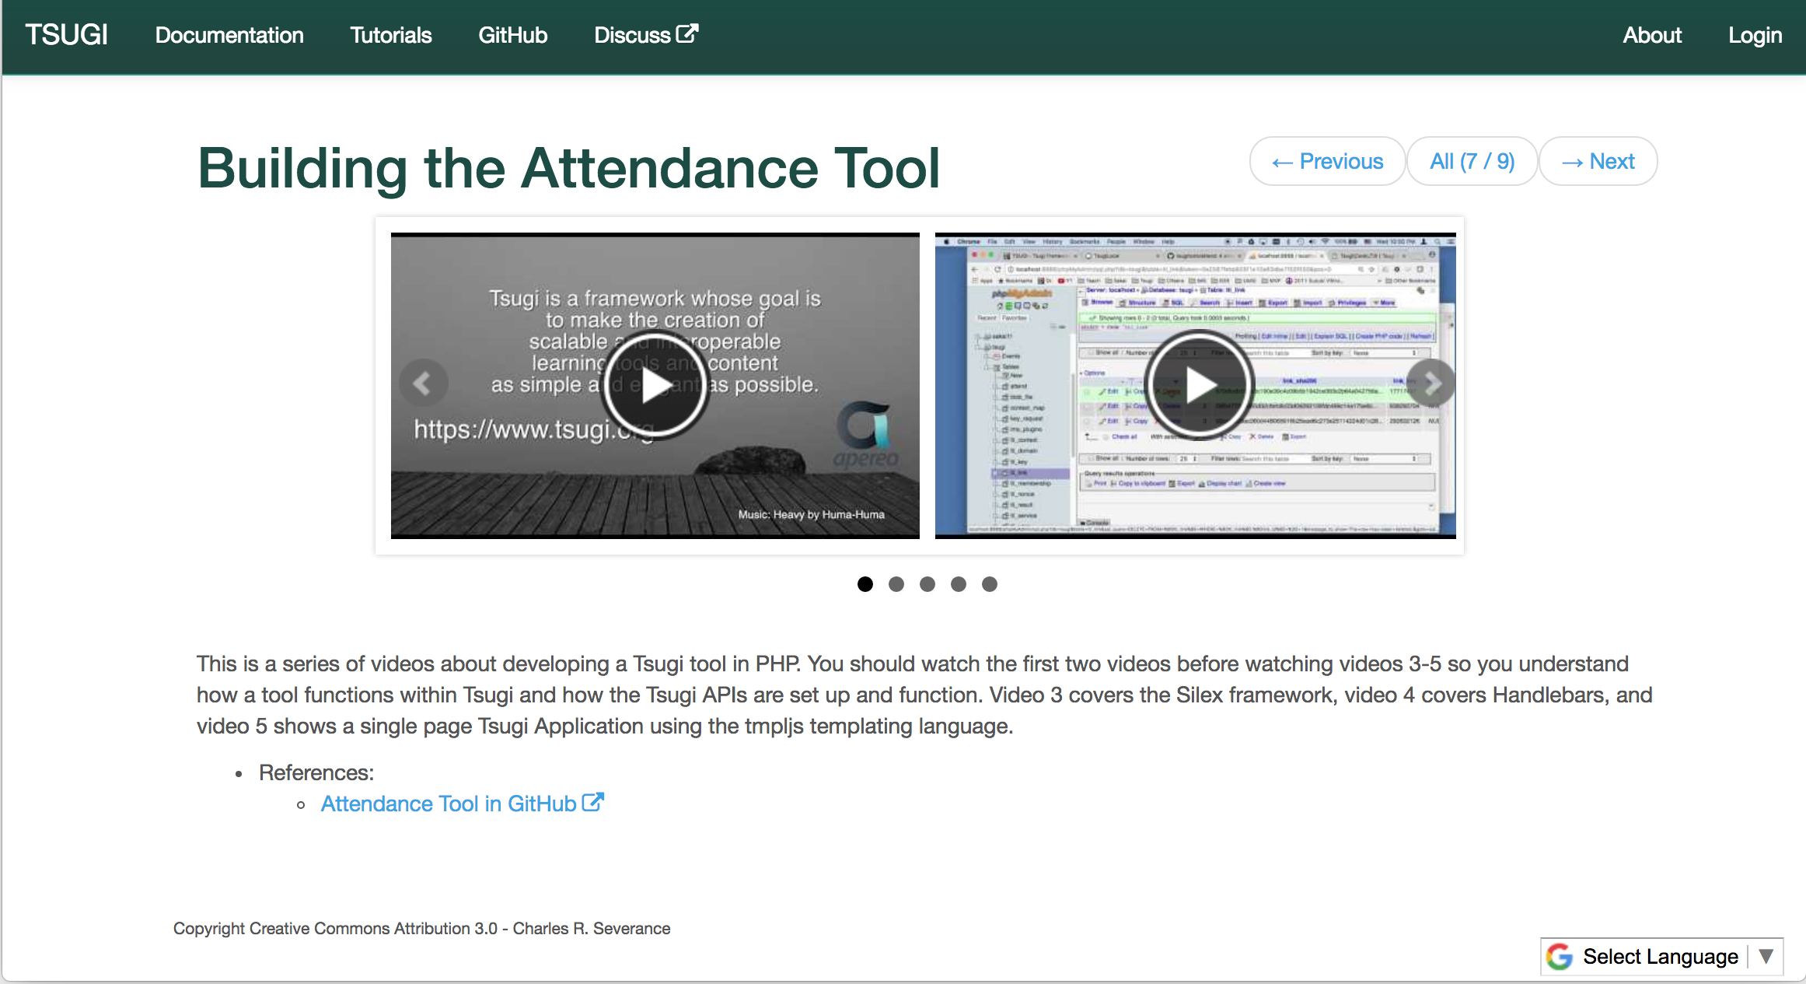

Slide 18
C
l
o
u
d
f
l
a
r
e
Amazon – www.tsugicloud.org
F
I
r
e
w
a
l
l
Application
Load
Balancer
EC2
Aurora
EC2
EFS
…
EC2
DynamoDB
Google – dev.tsugicloud.org
Kubernetes
CloudSQL
Ingress
Service
Load
Balancer
Docker
NFS
…
Docker
DataStore
https://github.com/tsugicloud

Slide 19
Summer Project: TBlocks
Tsugi PHP Tools in post-GDPR world
TBlock model
Each tool is a container
No direct access to the database
Interacts with Core Tsugi using a local API backed by a REST web service
Launch data – Course / User / Link / Result
Uses Link / Result scoped JSON
Accesses a Link scoped scoped key / value store
Can support more than PHP easily (i.e. Python / Django / Node)

Slide 20
End
User
Docker
A
P
I
Tsugi PHP
Docker
Launch
A
P
I
A
P
I
App Store
Tool
Tool
Database
Tsugi TBlocks

Slide 21
Summer Project: LTI 1.3
LTI 1.3
Java Web Tokens for Signing
OAuth 2.0
Public / Private Keys
More complex – but better library support
Tsugi PHP already "supports" LTI 1.3 launches
Prototyped at 2018 Learning Impact – May 2018

Slide 22
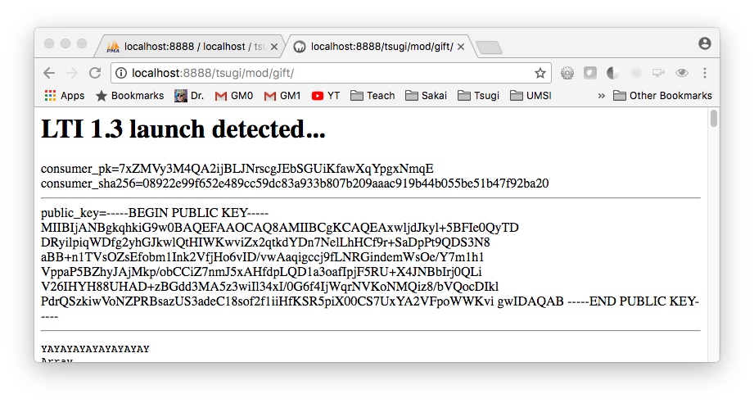

Slide 23
Tsugi SWOT
Strengths
PHP API is mature and in production
Cloud deployment patterns are mature
Weaknesses
PHP Tool Pattern falls short of GDPR scrutiny when apps are mixed into a store
PHP ☹
Weaknesses
No app developers making / submitting general tools
Opportunities
Expand into Canvas / Blackboard
Python won't be all that hard
Threats
Working on the bus factor

Slide 24


Source: Ian Dolphin

