Slide 1

Sakai Overview
Charles Severance
Chief Architect, Sakai Project
www.sakaiproject.org
csev@umich.edu www.dr-chuck.com
KYOU / sakai
Boundary, Situation

Slide 2
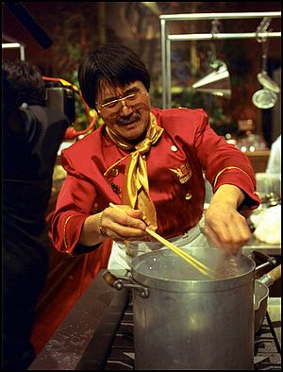
The Sakai Project
“The University of Michigan, Indiana University, MIT, Stanford, the uPortal Consortium, and the Open Knowledge Initiative (OKI) are joining forces to integrate and synchronize their considerable educational software into a pre-integrated collection of open source tools.”
Sakai Project receives $2.4 million grant from Mellon

Slide 3
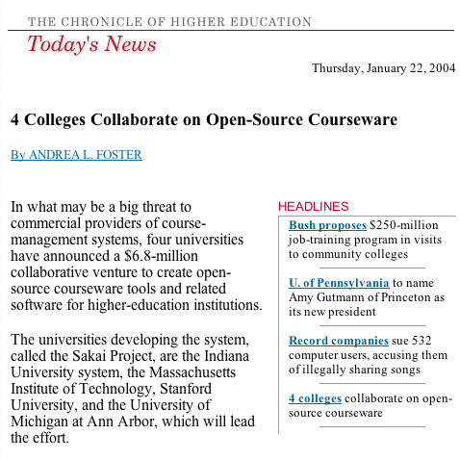

Slide 4
Sakai Funding
Each of the 4 Core Universities Commits
  5+ developers/architects, etc. under Sakai Board project direction for 2 years
  Public commitment to implement Sakai
  Open/Open licensing – “Community Source”
So, overall project levels
  $4.4M in institutional staff (27 FTE)
  $2.4M Mellon, $300K Hewlett
  Additional investment through partners

Slide 5
What is Sakai?
Sakai is a project - a grant for two years.
Sakai is an extensible framework - provides basic capabilities to support a wide range of tools and services
Sakai is a set of tools - written and supported by various groups
Sakai is a product - a released bundle of the framework and a set of tools which have been tested and released as a unit

Slide 6
The Sakai Project

Slide 7
Goals of the Sakai Project
Develop an open-source collaborative learning environment
  Suitable for use as a learning management system
  Suitable for use as a small group collaboration system
  Suitable for building research collaboratories
  Improve teaching and learning by providing a rich and extensible environment
  Bring research and teaching together
  Move towards a personal learning and lifelong learning environment

Slide 8
Sakai Organization
Sakai Board
UM, IU, Stanford, MIT,
UCB, Foothill, OKI,
uPortal, Hull (UK)
Joseph Hardin
Sakai PI
Board Chair
Architecture
Team
Product
Requirements
Team
Project
Management
Sakai
Educational
Partners

Slide 9
Sakai Educational Partners - Feb 1, 2004
Arizona State University
Boston University School of Management
Brown University
Carleton College
Carnegie Foundation for Advancement of Teaching
Carnegie Mellon University
Coastline Community College
Columbia University
Community College of Southern Nevada
Cornell University
Dartmouth College
Florida Community College/Jacksonville
Foothill-De Anza Community College
Franklin University
Georgetown University
Harvard University
Johns Hopkins University
Lubeck University of Applied Sciences
Maricopa County Community College
Monash University
Nagoya University
New York University
Northeastern University
North-West University (SA)
Northwestern University
Ohio State University
Portland State University
Princeton University
Roskilde University (Denmark)
Rutgers University
Simon Fraser University
State University of New York
Stockholm University
SURF/University of Amsterdam
Tufts University
Universidad Politecnica de Valencia (Spain)
Universitat de Lleida (Spain)
University of Arizona
University of California Berkeley
University of California, Davis
University of California, Los Angeles
University of California, Merced
University of California, Santa Barbara
University of Cambridge, CARET
University of Cape Town, SA
University of Colorado at Boulder
University of Delaware
University of Hawaii
University of Hull
University of Illinois at Urbana-Champaign
University of Minnesota
University of Missouri
University of Nebraska
University of Oklahoma
University of Texas at Austin
University of Virginia
University of Washington
University of Wisconsin, Madison
Virginia Polytechnic Institute/University
Whitman College
Yale University
In Process
University of Melbourne, Australia
University of Toronto, Knowledge Media Design Institute

Slide 10
Sakai SEPP Meetings
Provide a forum for the core and the SEPP to interact and for the SEPP members to interact with one another
  June 2004 - Denver Colorado (180)
  December 2004 - New Orleans (200+)
  June 8-14 - Baltimore
    Community Source Week
    uPortal, Sakai, OSPI
  December TBD - Austin, TX
Sakai meetings are invitation-only for SEPP members

Slide 11
Sakai Commercial Affiliates
Companies who will use/sell/support Sakai
  The rSmart group
  Unicon
  Embanet
  Sungard SCT
Provides companies access to Sakai core developers and SEPP staff
Access to members-only Sakai meetings (I.e. like the SEPP)

Slide 12
IMS Tool Portability Group
To work on ‘interoperability’ between and among CMS’s/CLE’s
Focus is on making tools portable between systems (Sakai, WebCT, and Blackboard)
Established to further the discussion with commercial and other CMS/CLE providers
Will use web services and IFRAMES
Will show working demonstration at the July 2005 Alt-I-lab with Samigo in Sakai, WebCT, and Blackboard

Slide 13
The Sakai Product (and Tools)

Slide 14
Placing the Sakai “Product”
Learning Management Systems
  BlackBoard
  Angel
  WebCT
Collaborative Environments
  Lotus Notes
  Microsoft SharePoint
Collaborative Frameworks
  Moodle

Slide 15
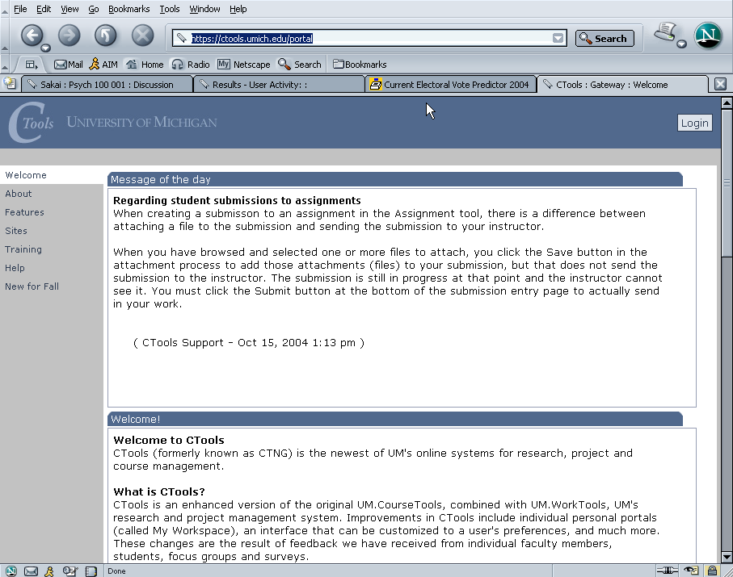
Ctools – Production Sakai at University of Michigan

Slide 16
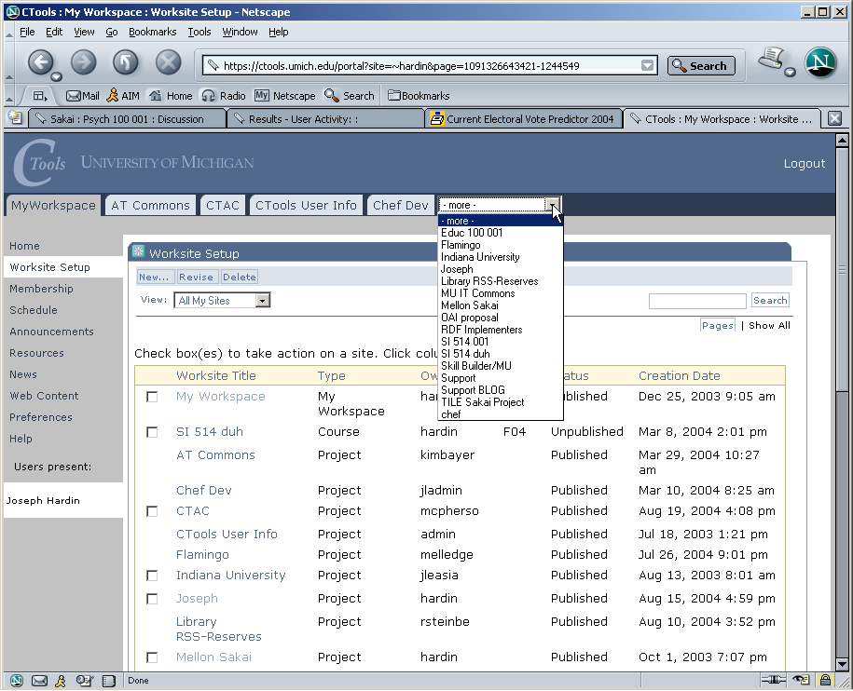
Ctools – List of Worksites – Classes, Projects

Slide 17
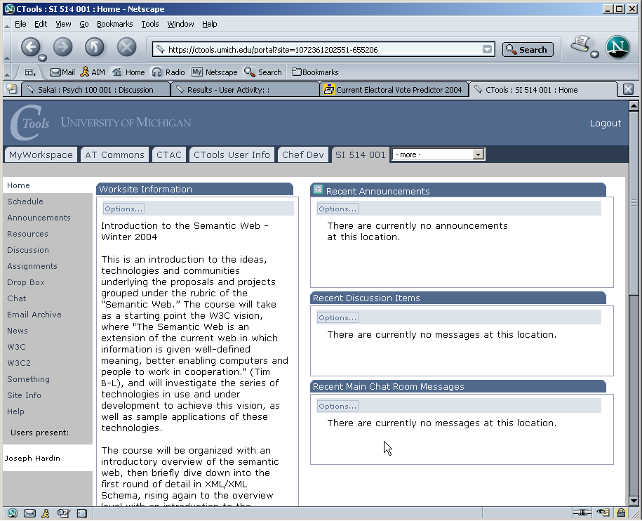
Site/class home page

Slide 18
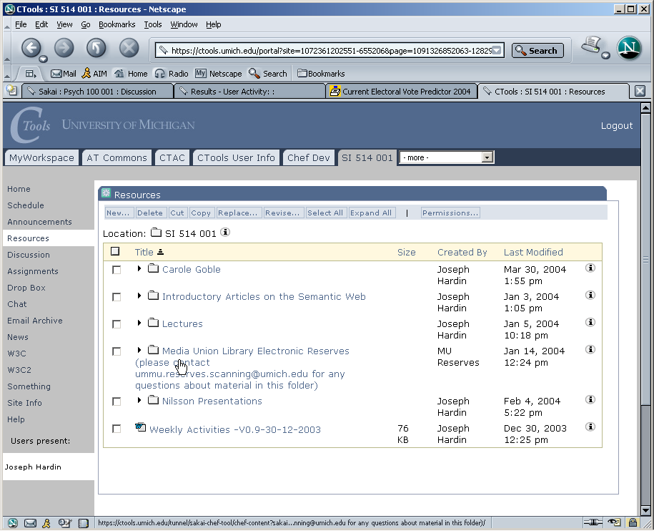
Site Resources area

Slide 19
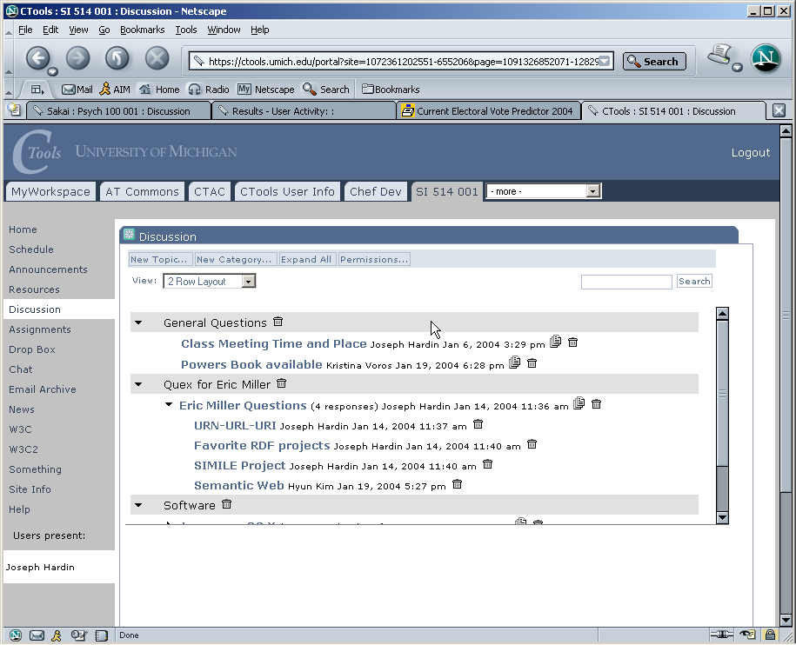
Discussion tool – Forums

Slide 20
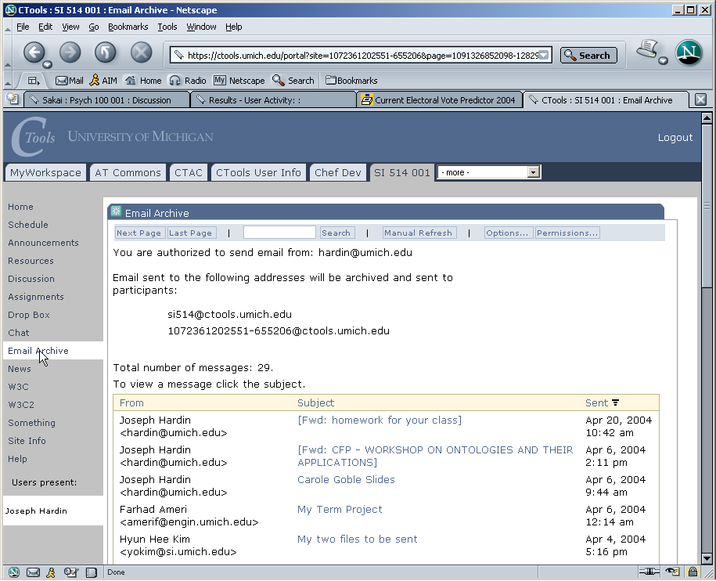
Email Archive

Slide 21
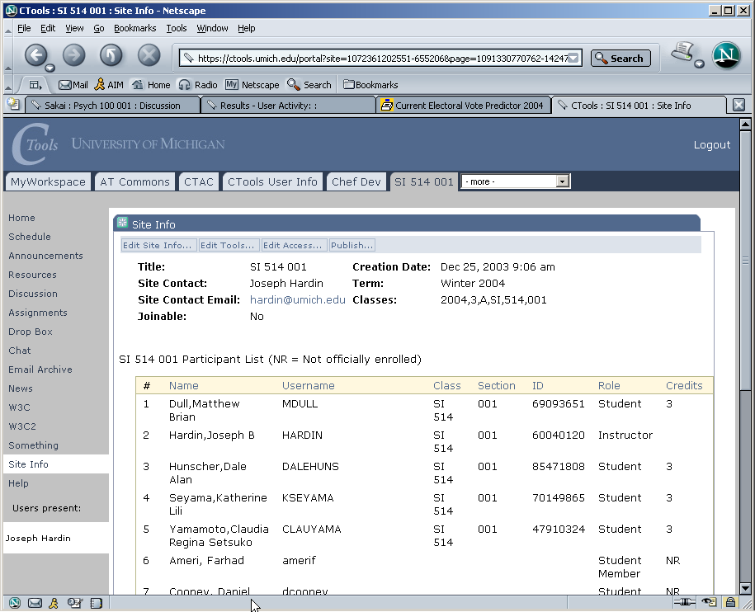
Site Info – class list

Slide 22
Sakai Releases
Sakai 1.0 - basic collaborative system - suitable for small pilots
Sakai 1.5 - basic collaborative learning system - suitable for significant pilot’s
Sakai 2.0 - collaborative learning system - suitable for significant production deployments
Sakai 3.0 - hardening, portal integration, preparation for post-project

Slide 23
Sakai 1.0
Great for small group collaboration
Plug-in for single sign on and authentication
All tools from CHEF, ported to Sakai
Java Server Faces 1.0 development environment with initial set of Sakai tags
Clustered environment support
Scalability limited in terms of number of sites and number of users (some complex structures maintained in memory)

Slide 24
Sakai 1.0 Tools
Admin: Alias Editor (chef.aliases)
Admin: Archive Tool (chef.archive)
Admin: Memory / Cache Tool
(chef.memory)
Admin: On-Line (chef.presence)
Admin: Realms Editor (chef.realms)
Admin: Sites Editor (chef.sites)
Admin: User Editor (chef.users)
Announcements (chef.announcements)
Assignments (chef.assignment)
C. R. U. D. (sakai.crud)
Chat Room (chef.chat)
Discussion (chef.discussion)
Discussion (chef.threadeddiscussion)
Dissertation Checklist (chef.dissertation)
Dissertation Upload
(chef.dissertation.upload)
Drop Box (chef.dropbox)
Email Archive (chef.mailbox)
Help (chef.contactSupport)
Membership (chef.membership)
Message Of The Day (chef.motd)
My Profile Editor (chef.singleuser)
News (chef.news)
Preferences (chef.noti.prefs)
Recent Announcements
(chef.synoptic.announcement)
Recent Chat Messages (chef.synoptic.chat)
Recent Discussion Items
(chef.synoptic.discussion)
Resources (chef.resources)
Sample (sakai.module)
Schedule (chef.schedule)
Site Browser (chef.sitebrowser)
Site Info (chef.siteinfo)
Web Content (chef.iframe)
Worksite Setup (chef.sitesetup)
WebDAV

Slide 25
Sakai 1.5
1.5 = halfway between 1.0 and 2.0
A production ready collaborative learning environment
Scaling significantly improved - memory structures moved into the data base and tuned for performance.
Revised JSF 1.1 development environment
IFRAME Portal integration
Additional plug ins for sites (classes) and roles within sites
Some aspects of Sakai framework and APIs will still be in flux through 2.0

Slide 26
Sakai 1.5 Tools
Samigo - QTI compliant assessment engine (Stanford)
Syllabus Tool (Indiana)
Context Sensitive Help (Indiana)
Presentation Tool (SEPP)
Contributed Tools (not part of bundle)
  Blackboard Import (Texas)
  Xwiki (Cambridge)
Portfolio Tool - OSPI (R-Smart) (separate release)

Slide 27
Sakai 2.0
Sakai Style Guide compliance for the core tools
Improved content management
Hierarchical sites throughout
Sakai APIs and framework complete
TPP Published
Significant polish beyond 1.5

Slide 28
Sakai 2.0 (New Tools)
Melete - module editor
Gradebook
Contributed tools
  TBD…

Slide 29
Sakai 3.0
Internationalization
Portal Integration
  WSRP
  JSR-168
Web Services
Hardening, design documentation
Possible:
  JSP and/or JYTHON

Slide 30
Sakai in Early Production
University of Michigan
  September 2004 - Sakai 1.0 production
  January 2005 - Sakai 1.5 production
  CourseTools scheduled for shutdown 4/05
Indiana University
  September 2004 - Sakai 1.0 small pilot
  January 2005 - Sakai 1.5 large pilot
  September 2005 - Sakai 2.0 full production

Slide 31
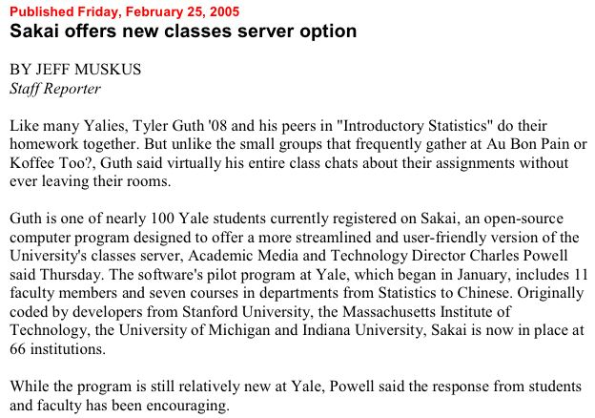
SEPP In Production

Slide 32
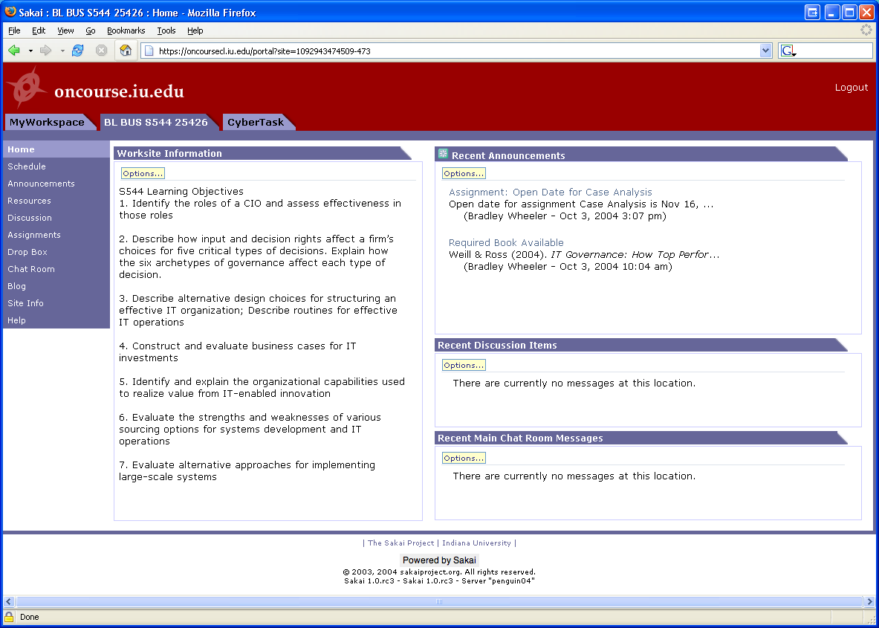
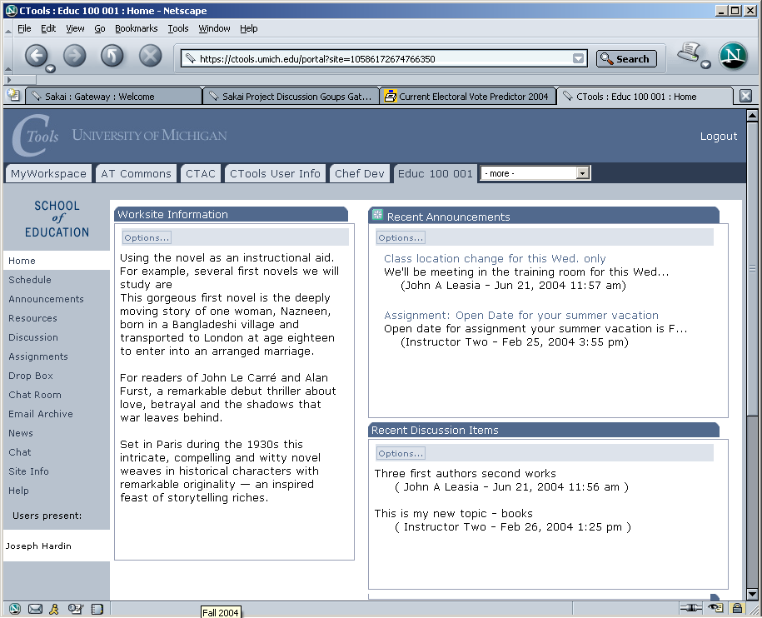
In production use
With >25,000 users
at U Michigan
On to Stanford, UC-Berkeley, Foothill, MIT in 2005
Notes:
The SAME Sakai software is in use at uMich and Indiana. Pilots to follow at Stanford and MIT. Many of Sakai’s (current) 47 partners and many others have downloaded the code and been working with it. The Open Source Portfolio Initiative, Version 2.0, is built on the Sakai architecture and can be used solo or integrated with Sakai.

Slide 33
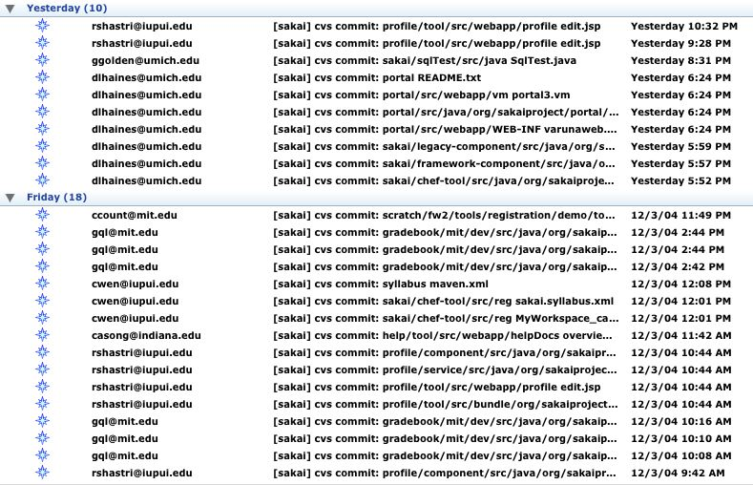
CVS – Core Effort - ~35/day

Slide 34
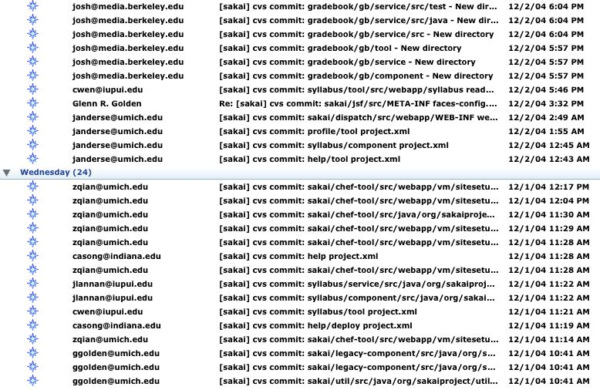

Slide 35
The Sakai Framework

Slide 36
Sakai Technical Goals
Provide environment to write tools and services which seamlessly move from one Sakai deployment to another
Provide environment where the addition of a new tool does not de-stabilize the existing tools
Provide environment to allow tools to exist both within Sakai and standalone (I.e. easy porting of external tools into Sakai without requiring rewrite)
Provide capabilities so that Sakai services and tools can be accessed using web services.

Slide 37
Sakai Foundational Documents
Sakai Style Guide - Describes in detail how Sakai tools are to look and operate regardless of implementation technology
Sakai Java Framework - Describes the Sakai Application Framework (SAF) as implemented in Java
Sakai Tool Portability Profile - Describes how to write tools and services to be portable across Sakai systems (in progress)

Slide 38
Service Oriented Architecture
Decompose tool code into presentation elements and service elements
Provide an abstraction (API) which shields the tool code from the implementation details of the service code.
Allows separate development of the tools and services.
Allows effective unit testing of services
Allows an implementation to be replaced transparently with another implementation as long as the API contract is fully met

Slide 39
Service Oriented Architecture
Browser
Browser
My
Monolithic
Code
Presentation
Code
Service
Interface
(i.e. API)
Service
Code
Persistence
Persistence

Slide 40
Sakai Application Framework
SAF - Kernel - An augmented web application which enables the Sakai APIs to be called from the web application - this is a rich but not constraining environment
SAF - Common Services - A set of common services available to all tools (authentication, authorization, hierarchy, repository, others)
SAF - Presentation Services - A set of Sakai specific JSF tags to handle presentation details and provide widgets such as a date-picker or WSYWIG editor.

Slide 41
Sakai Integration and Development Choices
Develop a TPP Compliant Tool
  Assured to be portable across Sakai environments
Integrate a web application
  Responsible for own presentation and compliance to style guide (may use Sakai JSF tags if JSF is used)
  Can operate both stand-alone and within Sakai
Integrate via web-services
  Capability being developed

Slide 42
Sakai TPP Tools
SAF - Presentation Services
Tool Layout (JSP)
Tool Code (Java)
Application Services
SAF - Common Services
SAF - Kernel

Slide 43
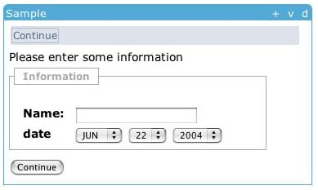
Sakai Tool Layout in JSF
<sakai:view_container title="#{msgs.sample_title}">
<sakai:tool_bar> <sakai:tool_bar_item/> </sakai:tool_bar>
<sakai:instruction_message
value="#{msgs.sample_one_instructions}" />
<sakai:group_box
title="#{msgs.sample_one_groupbox}">
<h:inputText
value="#{MyTool.userName}" />
<sakai:date_input
value="#{MyTool.date}" />
<sakai:button_bar> <sakai:button_bar_item action="#{MyTool.processActionDoIt} value="#{msgs.sample_one_cmd_go}" />
</sakai:button_bar>

Slide 44
Sakai Service Providers
Common Services are localized using plug-ins
  UserDirectoryProvider
  RealmProvider
  CourseManagementProvider
These will be expanded
  RepositoryProvider
  OKI OSID Based Providers
Plug-ins do not replace the persistence, they are consulted in order to populate Sakai structures
SAF - Common Services
User Provider
Role Provider
Course Provider

Slide 45
Sakai, IMS, and Web
Services
Header
Button
Button
Button
Button
Button
Button
Tool Area
1
6
5
CLE Environment
7
External Web Application
Web
Services
Application
Code
Launch
Control
4
Session
And Services
Bootstrap
HTML/HTTP
3
2
Web Services

Slide 46
Sakai and Portals
Sakai was initially intended to be a “portal plus a bunch of tools” - shake well and viola! You have a learning management system.
Initially this seemed simple enough
  Buttons and rectangles
  Collection of tools deployed in various configurations with various administration options
Portals and Learning Management systems turn out to be very different problems to solve
Sakai needs to work both in a portal and LMS environment (a bit stressful)

Slide 47
Portals .vs. LMS
Organized by enterprise and are often driven by the office of communications (Library, HR, Athletics, President)
Often geared to individual customization
Many small rectangles to provide a great deal of information on a single screen
Portals think of rectangles operating independently - like windows
Think “Dashboard”
Organized by academic aspects and are driven by the registrar (Colleges, Departments)
LMS’s are customizable by faculty or departments but not typically by students
LMS’s like one tool on the screen at a time.
LMS’s think of navigation as picking a tool or switching from one class to another
Think “Application”

Slide 48
Sakai Portal Integration Goals
Sakai TPP Tools will run in JSR-168 portals - “Write once run anywhere”.
An entire Sakai site can be included at some point in an enterprise portal
  iFrames - separate sign on (or WebISO)
  WSRP - shared sign on via trust between portal and Sakai
Portions many Sakai sites, tools, or pages can be aggregated to produce a personal federated view for an individual - moves toward a personal learning and research environment.

Slide 49
Installing and Deploying Sakai
Download Quick Start and follow instructions - 5-10 minutes - this is a developer edition with an in-memory database (HSQLDB)
Install a real database (MySql, Oracle) and reconfigure Sakai to run in production

Slide 50
The Sakai Community
Main site: www.sakaiproject.org
Bugs: bugs.sakaiproject.org
Sakai-wide collaboration area
  collab.sakaiproject.org
  sakai-dev@sakaiproject.org
  sakai-user@sakaiproject.org
Sakai Educational Partners (SEPP)
  Separate mailing lists
  Dedicated staff
  Two meetings per year

Slide 51
Sakai’s Future
Initial grant ends December 2005
Long term steady state
  The SEPP is renamed “Sakai” (800K/year)
  Governance is merit-based (like Apache)
  Core elements of Sakai are pretty stable (see 3.0)
  Small SEPP funded team (5+) and contributed in-kind resources to keep the core maintained and slowly evolving
Short Term
  May be an extension from Mellon
  May have increased commercial support

Slide 52
Summary
Sakai certainly get the award for “most hype” in 2004
The project continues to deliver releases on schedule
The 1.5 release is the first “production ready” release for the learning management application space
The 2.0 release will really “tell the tale” of the impact of Sakai in the long term
Many are “early adopters” and willing to commit very deeply to be part of the creation of Sakai while others are waiting as customers and will take it when it “comes out”. Both of these are good approaches.

