Slide 1

JASIG
  Community – Collaboration
  uPortal – HyperContent – CAS
  2005 Mellon RIT/Scholarly Communications Retreat
  (March 28-29)

Slide 2
Overview
Tools and Techniques
  Community Building
  Software Development
  Quality Assuarance
JASIG uPortal
  State of the Project
  Recent Developments
  Sakai Collaboration & Integration
JASIG HyperContent
JASIG CAS

Slide 3
JASIG
Community
Conferences
Clearinghouse
Development Projects
Organization
Funding
Staff
Industry Partners

Slide 4
A Portal Framework for Higher Education
“For education, by education”
Build a community and share extertise across institutions
Influence vendors and agencies and promote open standards

Slide 5
Bootstrap
JASIG Project
  $700,00 Mellon Funding
  University of Delaware administration
  3 year project, completed 12/03
Sakai Project
  580,000 Mellon Funding
  University of Michigan administration
  University of Delaware subcontractor
  2 year project, ends 12/05

Slide 6
Development
One dozen core university contributors
  Columbia, Yale, British Columbia, Delaware, Princenton, Cornell, Memorial Union of Newfoundland, Rutgers
Contracted commercial developers
  Instructional media and magic
  UNICON

Slide 7
Commercial Relationships
WebCT
Blackboard Building Blocks
SCT Luminis ( 200+ sold)
UNICON Academus, Support and Consulting
iAssessment K12 ASP
Sigma Systems
Computer Aid Support
RSmart – Sakai, OSPI, Kuali

Slide 8
Adoption
Over 200 production, 50 implementing
16 countries
5 commercial vendors
Hunders of thousands of users
Large, small, k-12, government, commercial

Slide 9

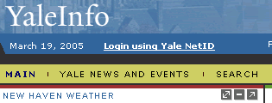













Slide 10











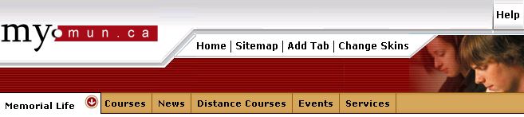


Slide 11
History
Version
Date
Delivered
1.0
Jul 2000
Beta
1.5
Feb 2001
Roles
1.6
Jun 2001
Performance
2.0
Feb 2002
Introduced XSLT architecture
2.1
Dec 2002
Remote channel, Web proxy, statistics
2.2
Jan 2004
Internationalization, WSRP, aggregated layout

Slide 12
Portal Power
Customization and Personalization

Slide 13
Integration Senarios / Collaboration
Ichannel
CwebProxy
XML document (CAS Proxy authN)
Portlet Adaptor

Slide 14
Recent Developments
Memory Issues
  Rutgers / Unicon Collaboration
Springing forward
  PersonDirectory
  Evolutionary
  Backward Compatability
Release Strategy

Slide 15
uPortal 2.5 Roadmap
More robust JSR-168 support
Improved Exception Handling
Support for J2SE 5.0 (JDK 1.5)
XML API standardization
XHTML/CSS Default Theme
Conconcurrecy standardization

Slide 16
uPortal 2.6 Roadmap
Stability, Stability, Stability
Improved Theme Support
Layout Management
Advanced Presentation Options
Enhanced WSRP Consumption

Slide 17
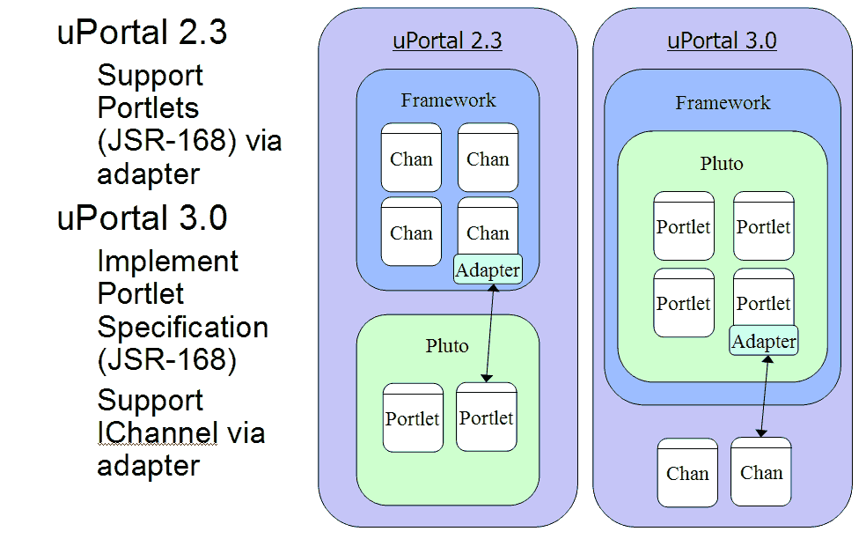
Uportal and JSR-168

Slide 18
Uportal 3.0 Priorites

Slide 19
Inter-Project Touch Points

Slide 20
Maximizng Synergies

Slide 21
Tools and Techniques
Community & Collaboration
  Confluence
  Fisheye / CVSMonitor
  Maven Reports
  Mailing Lists & Archives
Software Developement
  CVS
  JIRA
  Ant / Maven
  YourKit
  Eclipse
Quality Assuarance
  Junit
  Clover
  YourKit

Slide 22
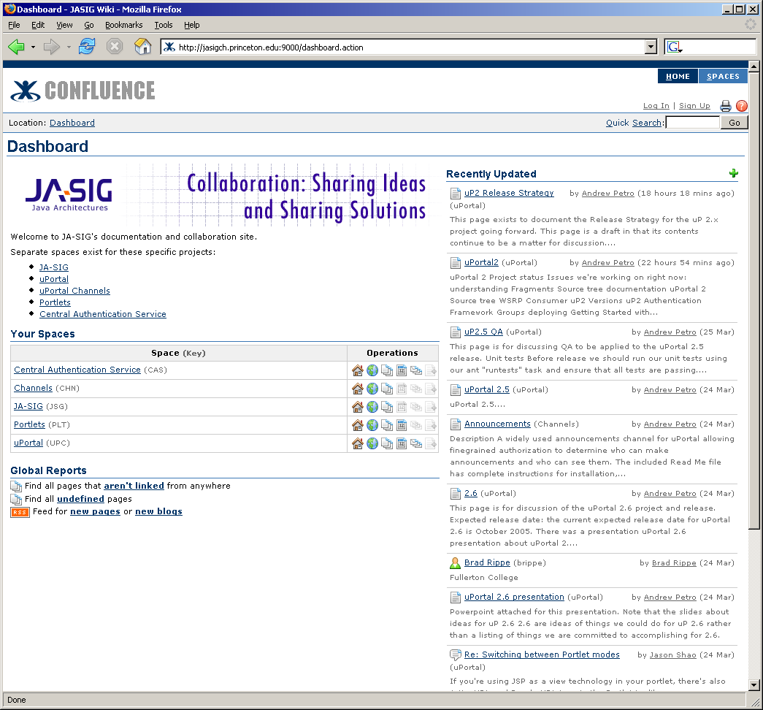
Confluence

Slide 23
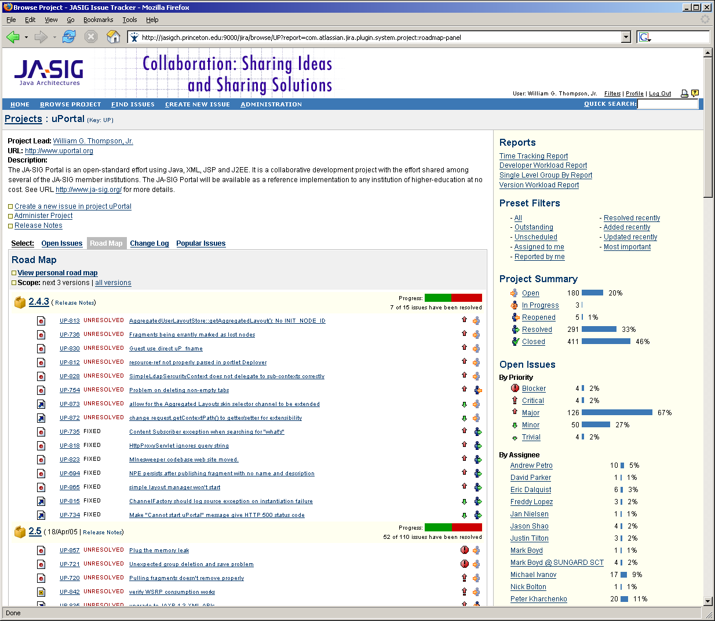
JIRA

Slide 24
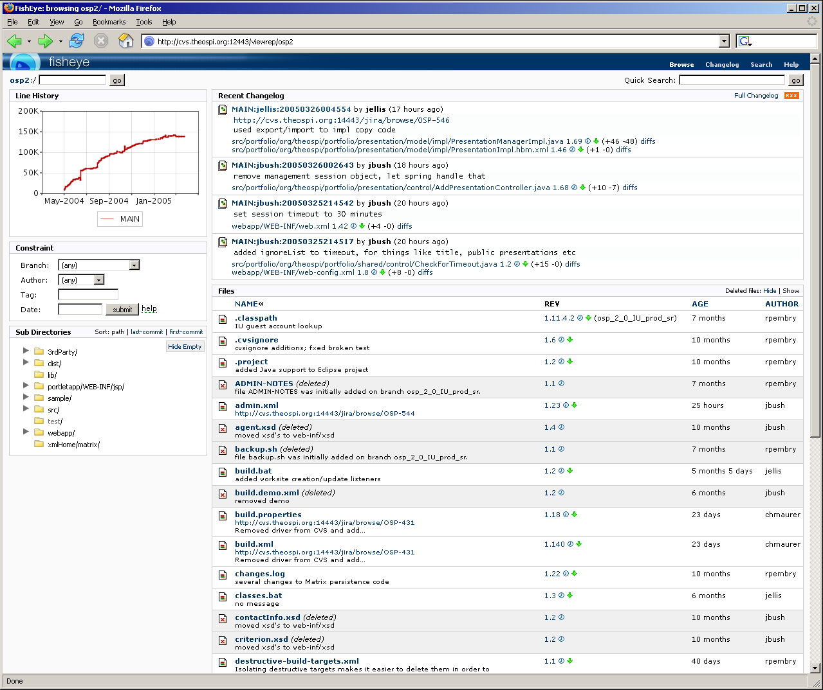
CVSMonitor/Fisheye

Slide 25
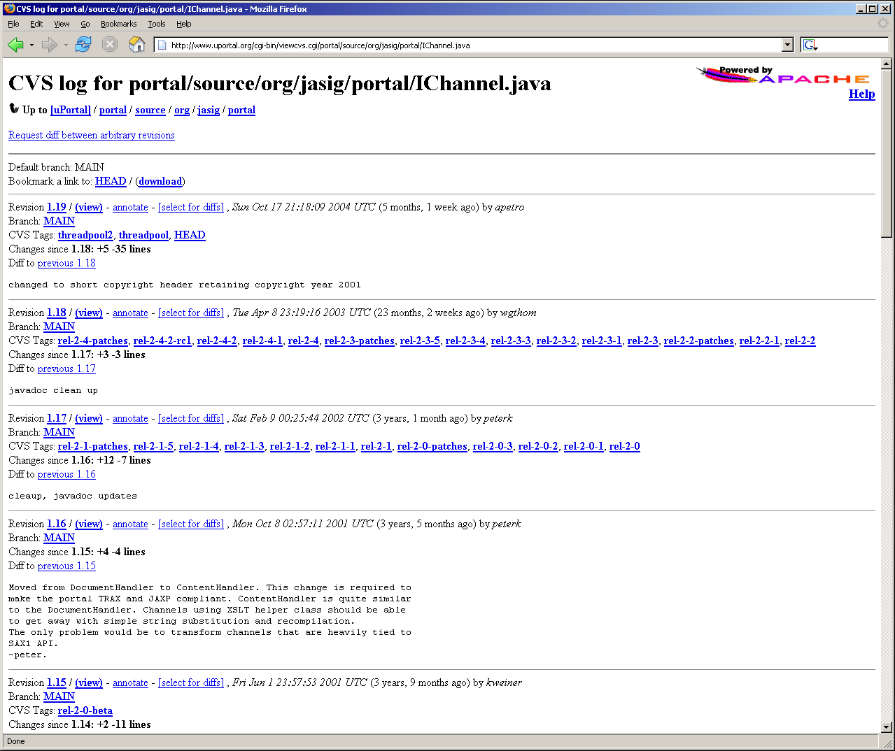
ViewCVS

Slide 26
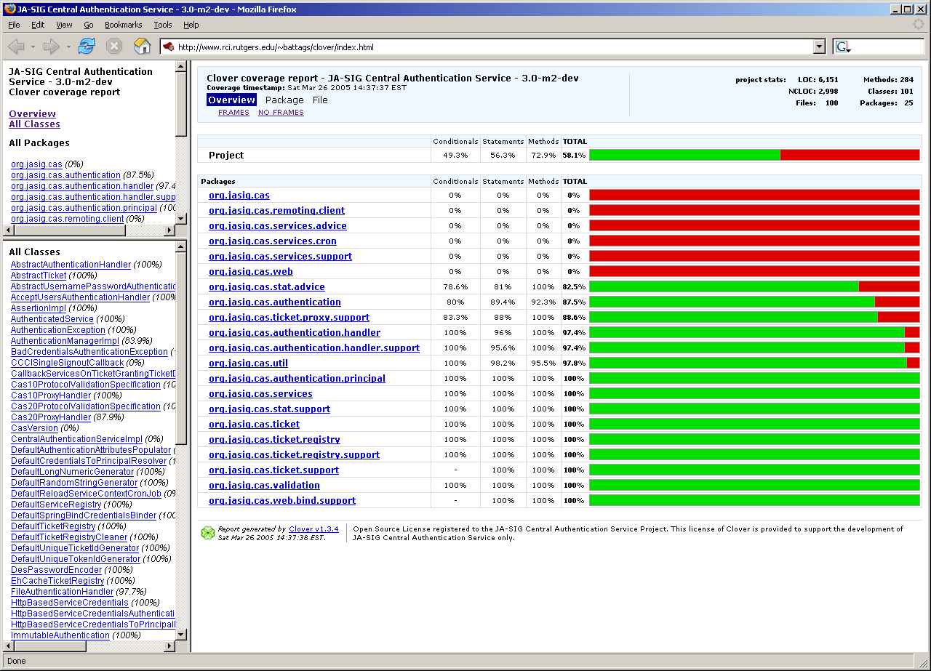
Junit/Clover

Slide 27
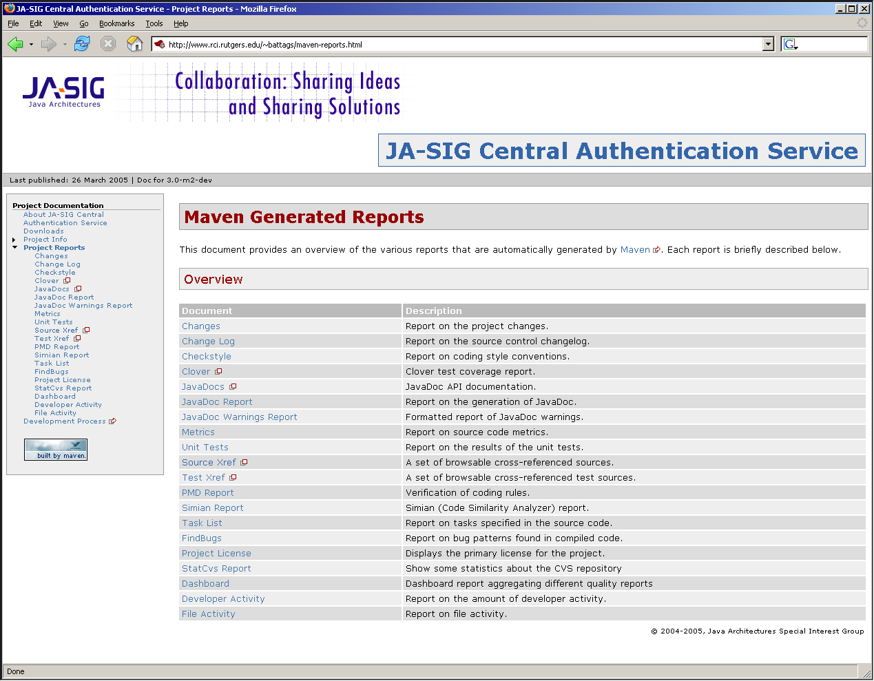
CAS Maven

Slide 28
Joint Sakai/uPortal Requirements
Requirement I: Sakai as CLE is well-integrated into a wide range of enterprise portals (including uPortal) using standard web services (WSRP)
Requirement II: Sakai collaborative tools work in uPortal as uPortal channels/portlets.
Requirement III: uPortal can act as a federator across many Sakai and/or uPortal environments to produce a personal learning and research environment.

Slide 29
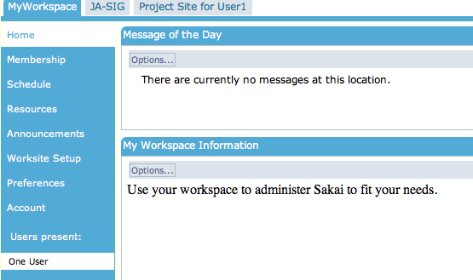
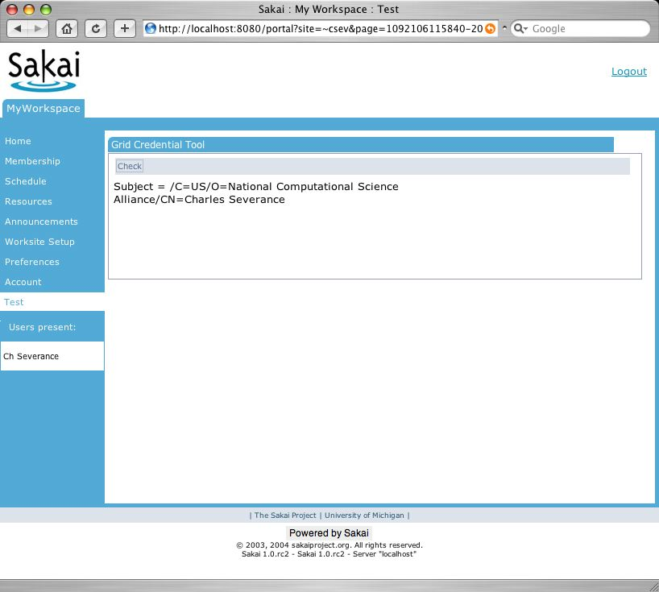
Sakai integrates seamlessly into many portals using standard WSRP
(Requirement I)
uPortal
WebSphere
Home
Athletics
Courses
Home
Athletics
Courses
MS-Portal
Home
Athletics
Courses
tool
tool
Sakai

Slide 30
Work Breakdown: Sakai in Portals
uPortal delivery: WSRP Consumer
  Delivered in uPortal 2.3, improved in uPortal 2.4
  Needed to provide Sakai test environment
Sakai delivery: IFrame Producer
  Sakai 1.5 - February 2005
  Provides basic capability
Sakai delivery: WSRP Producer
  To be delivered in Sakai 2.0
  June 2005

Slide 31
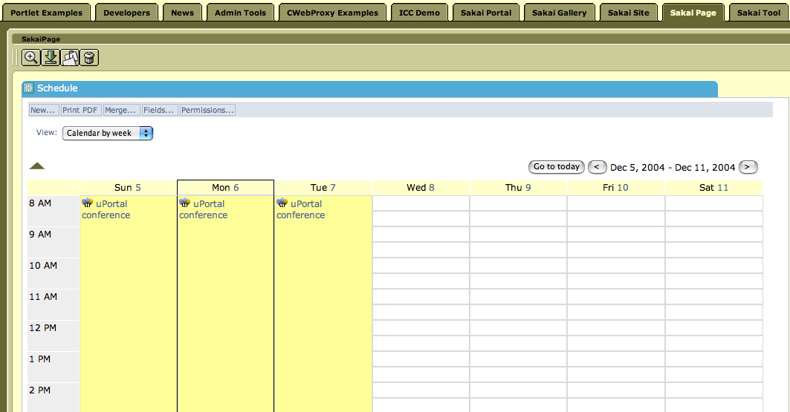
Pouring Sakai’s Tools into uPortal as Channels…
(Requirement II)
uPortal’s JVM
uPortal
New Channel
UBC Mail
Sakai Chat
Sakai Presentation
Sakai Discussion
Cartoon channel
…..
Sakai
Velocity Tool
Sakai
JSF Tool
Sakai Services, APIs,
Components

Slide 32
Technical Detail: How to get Sakai’s Tools into uPortal as Channels… (Requirement II)
uPortal
uPortal
JSR-168
Velocity to JSR-168
JSF to JSR-168
Sakai
Velocity Tool
Sakai
JSF Tool
User, Site,
Role Plug-ins
Sakai Services, APIs,
Components
SAF - Kernel - uPortal Version
uPortal’s JVM

Slide 33
Work Breakdown: Sakai Tools in uPortal
uPortal Delivery: JSR-168 container
  Initially delivered in uPortal 2.4
  Significant improvement coming in uPortal 3.0
Sakai Delivery: Sakai tools as JSR-168
  Refactor “Sakai Kernel” in Sakai 2.0 (6/2005)
  Adapt Sakai Kernel to uPortal and JSR-168 (with help from Yale) (12/2005)

Slide 34
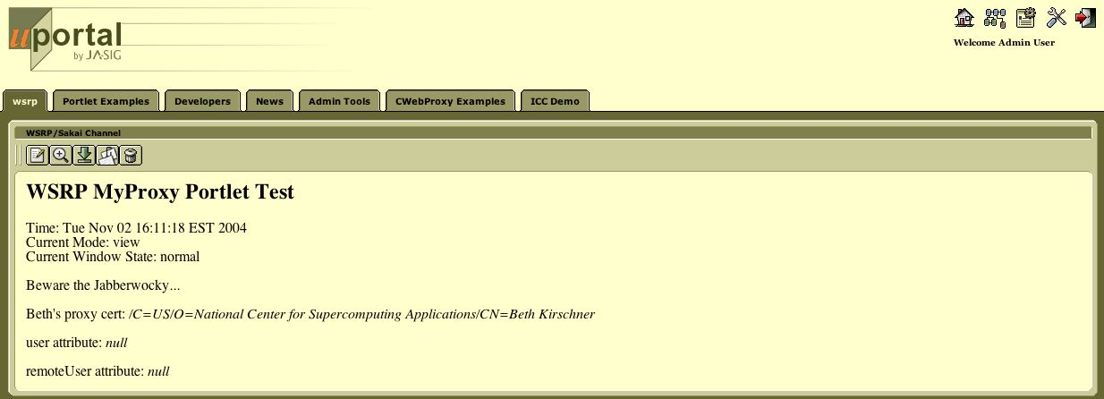
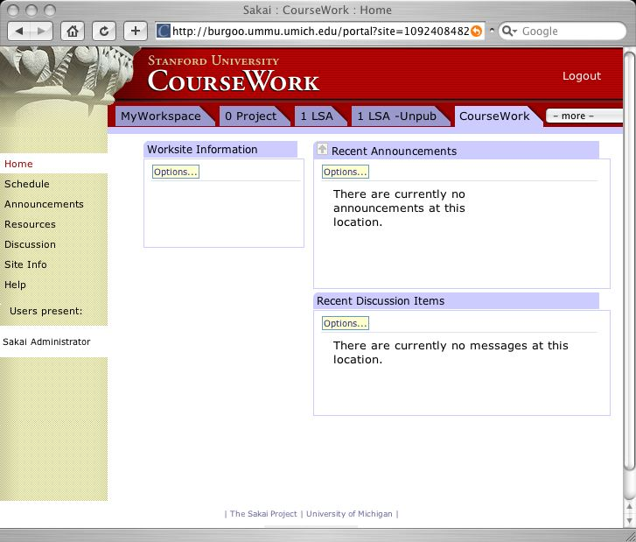
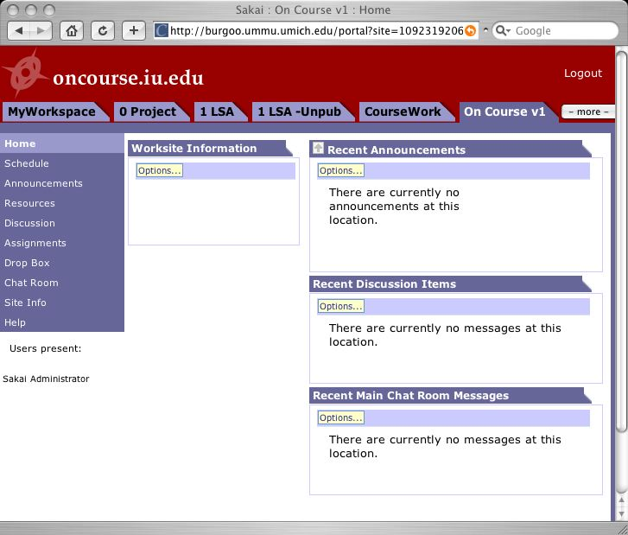
uPortal “Federates” across many Sakai and uPortal instances using web services producing a personal learning and research environment (Requirement III)
myPortal
tool
tool
uPortal
tool
tool
tool
tool
tool
tool
Sakai
Sakai
Sakai

Slide 35
Work Breakdown: Federation
uPortal Delivery: WSRP Producer
  Scheduled for uPortal 3.0 (6/2005)
Joint Delivery: Improved WSRP Consumer in uPortal
  May be done jointly (12/2005)
Sakai Delivery: Improved WSRP Producer
  Sakai 3.0 (12/2005)

Slide 36
Sakai and uPortal Collaboration Mechanics
Architect and board member exchange
Cross attendance at meetings (Public, Developer, and ad. hoc.)
Requirements communication
  Essential requirements (WSRP Consumer, JSR-168)
  Desired requirements (improve hierarchy, pushed fragments)
Beginning co-development
  Sakai kernel elements <--> uPortal 3.0
  Rosetta stone staff members (UM, MIT, Yale)

Slide 37
JASIG HyperContent
June, 2004: v. 1.4. Full-featured enterprise content management based on Java, XML, XSL
  Manager and administration channels run in uPortal.
June, 2005: v.2.0. Runs standalone without a portal requirement.
  Only dependencies are Java SDK 1.4, servlet engine, and hard disk.
  Highly customizable; enhanced ease of use/navigation.
  Full multi-server transaction support at level of individual files, such as XML documents, serialized objects, etc.
  Projects can define custom workflows, groups and permissions, in addition to their own assets and processing pipelines.
October, 2005;: v.2.x.
  WSRP content delivery and discovery via an integrated UDDI registry

Slide 38
JASIG CAS 2.0
Yale CAS 1.0/2.0
  Centralized Web Authentication
  Proxy Authentication / Delegated Authority
  Interoperability
    Java, JSP, PL/SQL, ASP, Apache, PAM, Perl, Zope, WebObjects, ColdFusion, Acegi,
    CAS Generic Handler
  CASified Applications
    uPortal, Mantis, pNews, Sympa, TikiWiki
  CASifying Applications
    Sakai, Oracle Calendar, Oracle Portal, Oracle Financials, Acegi

Slide 39
JASIG CAS 3.0
  Supple, Extensible and Elegant
    Domain Driven Design
      Ubiquitious Language
    Spring Framework
  Provide extension points for well-known modifications and new features
    Web Services
    SAML
    Shibboleth
  Maintain backward compatiabiltiy with CAS 1.0/2.0 plugins and clients

