Slide 1
Sakai Portal Approach
03/2005
Charles Severance
Sakai Chief Architect

Slide 2
Background
There have been several documents describing the relationship between Sakai and uPortal and changes to the plans between Sakai and uPortal
  Originally, the grant proposal had a very simplified view of the merging of the software
  In June 2004, David Haines of the Sakai team made significant modifications to a 2.4 uPortal in the name of delegating all Sakai navigation to uPortal. These changes seemed too uPortal specific and drastic to many and so a new approach was needed.
  The new approach was to break the effort into two phases - first we would focus on WSRP and iFrames as integration points and then get the JSR-168 and operating in the same JVM later.
  The first phase has been in progress for some time and continues - the first Phase is still the most important aspect of Sakai’s portal integration, and should be delivered by the June 2005 timeframe.
  This document begins to add detail to the pre-design for the second phase for delivery in the December 2005 timeframe.
This document should not be perceived as changing the Phase I / Phase II relationship - just adding detail to the _x0010_Phase II effort

Slide 3
Sakai and Portals
Sakai was initially intended to be a “portal plus a bunch of tools” - shake well and viola! You have a learning management system.
Initially this seemed simple enough
  Buttons and rectangles
  Collection of tools deployed in various configurations with various administration options
Portals and Learning Management systems turn out to be very different problems to solve
Sakai needs to work both in a portal and LMS environment (a bit stressful)

Slide 4
uPortals and Sakai Assume Different Things Right Now
uPortal
Often geared to individual customization
Many small rectangles to provide a great deal of information on a single screen
Portals think of rectangles operating independently - like windows
Sakai
Customizable by faculty or departments but not typically by students
One tool on the screen at a time.
Thinks of navigation as picking a tool or switching from one class to another
These types of profound differences between portals and collaborative environments are present with other LMS and Portal software …

Slide 5
Sakai Portal Integration Goals
Sakai TPP Tools will run in JSR-168 portals - “Write once run anywhere” allows portals to have collaborative tools scattered throughout
An entire Sakai site can be included at some point in an enterprise portal
  iFrames - separate sign on (or WebISO)
  WSRP - shared sign on via trust between portal and Sakai
Portions many Sakai sites, tools, or pages can be aggregated to produce a personal federated view for an individual - moves toward a personal learning and research environment.

Slide 6
What are not goals
uPortal administration replaces Sakai administration when Sakai is acting as a LMS or collaborative environment
uPortal navigation supports every need that Sakai has to be a LMS or collaborative environment
  Hierarchy, context, inherited AUTHZ, etc.
  We now call this oversimplified approach “take uPortal, add Sakai channels, shake vigorously, and viola! uPortal becomes a Learning Management System!”
A key effect of this (non-goal) is that uPortal is allowed to be the best possible Enterprise Portal it can be - not some weird compromise in the name of becoming increasingly Sakai-like.

Slide 7
Sakai Portal Integration Directions
Summer 2004, we were encouraged by uPortal management and others to switch from a path where we would begin doing unique non-standard stuff within uPortal to an approach which is portal-agnostic first.
Outline
  Sakai 1.0 internal aggregator with iFrames (10/04)
  Sakai 1.5 - iFrames (02/05)
  Sakai 2.0 - WSRP (05/05)
  Post 2.0 - uPortal in the same JVM with Sakai

Slide 8
Aligning Roadmaps
uPortal
JSR-168
WSRP
Consumer
Navigation
Improvements
Well
Understood
WSRP
Producer
Phase I
Phase II
Single JVM
uPortal
Integration
JSR-168
Support
WSRP
Producer
iFrame
“Producer”
Design Issues
Remain
Sakai
Originally expected to be June 2005

Slide 9
Phase I - Deployment
In Phase I, Sakai and uPortal will be deployed separately - they will be either in different JVMs or on different servers.
Integration will be based on iFrames in uPortal pointing at Sakai or WSRP pointing at Sakai
This integration will work between Sakai and any portal product which supports iFrames
The management and administration will be done separately for Sakai and uPortal

Slide 10
Phase II - Deployment
In Phase II the goal is to get uPortal and Sakai into the same JVM with uPortal handling navigation and layout for Sakai portlets running within uPortal
Sakai portlets will produce JSR-168 and be integrated into uPortal as JSR-168 portlets.
In a Phase II deployment Sakai will continue to interoperate with other portals using WSRP and iFrames with uPortal acting as the WSRP producer.
There are many technical challenges for this to be completed. This requires significant co-engineering for both uPortal and Sakai

Slide 11
Phase I - Through Sakai 2.0
I Frames and WSRP
Sakai 2.0 finally catches up to uPortal 2.x

Slide 12
iFrames (Phase I)
While iFrames are inelegant, they provide a basic mechanism for integrating with a wide range of portals and other aggregation frameworks.
The Sakai internal aggregator will produce iFrames of various elements ranging from the Sakai page minus the header, a single Sakai site, and a page within a Sakai site.
This capability is scheduled to be part of the 1.5 release of Sakai.

Slide 13
WSRP Producer within Sakai
(Phase I)
Initial design evaluation has been completed on the feasibility of WSRP as a connection between Sakai and portals (see slide later)
This will be accomplished by adding a WSRP producer to Sakai
The expectation is that integration can be done without requiring modifications to WSRP.
A key point is that the tools will be instanced within Sakai using standard Sakai management tools. WSRP Producer will be able to access tool or site instances but not create new instances in the initial release.
The first integration between Sakai and uPortal using WSRP should be in the Sakai 2.0 release.

Slide 14
Recent Work on URLs in Sakai
http://localhost:8080/portal - View Sakai as it currently stands.
http://localhost:8080/gallery - View the default site and show site navigation but without branding.
http://localhost:8080/site/JA-SIG - View just a site (no site navigation). This is a Sakai site, not an external web site.
http://localhost:8080/page/1102305173230-1 - View a particular page in a site without seeing the site itself.
http://localhost:8080/tool/1102303862142-8 - View only a single tool from a page (e.g. just a chat room).
These forms can be combined (e.g. http://localhost:8080/site/JA-SIG/page/1102305173230-1) so that the user can be "pre-navigated" to a particular page on a particular site and still get to choose other pages within the site.
Thanks to David Haines

Slide 15
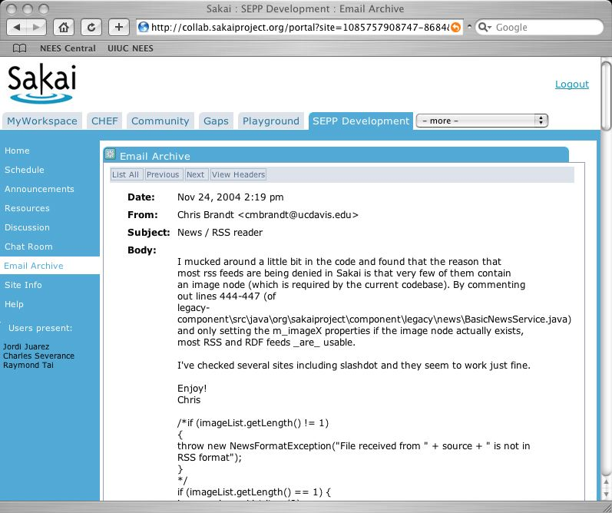
BookMarking allows direct launching into Sakai, pre-navigated
http://localhost:8080/portal/322305714341-2/page/1102305173230-1

Slide 16
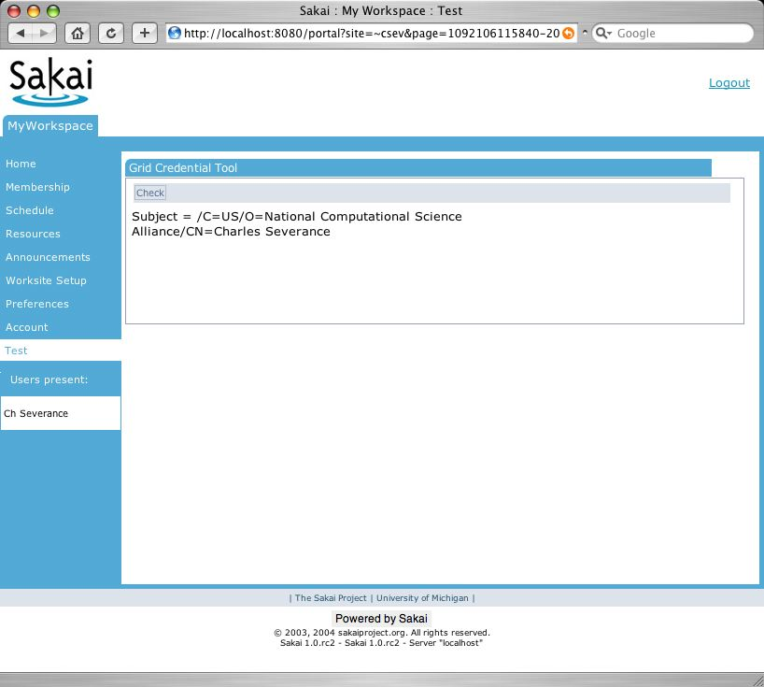
“Concentric Rectangles”
http://sakai.edu/portal
http://sakai.edu/page/1102305173230-1
http://sakai.edu/tool/110203682142-8
http://sakai.edu/site/JA-SIG/
http://sakai.edu/gallery

Slide 17
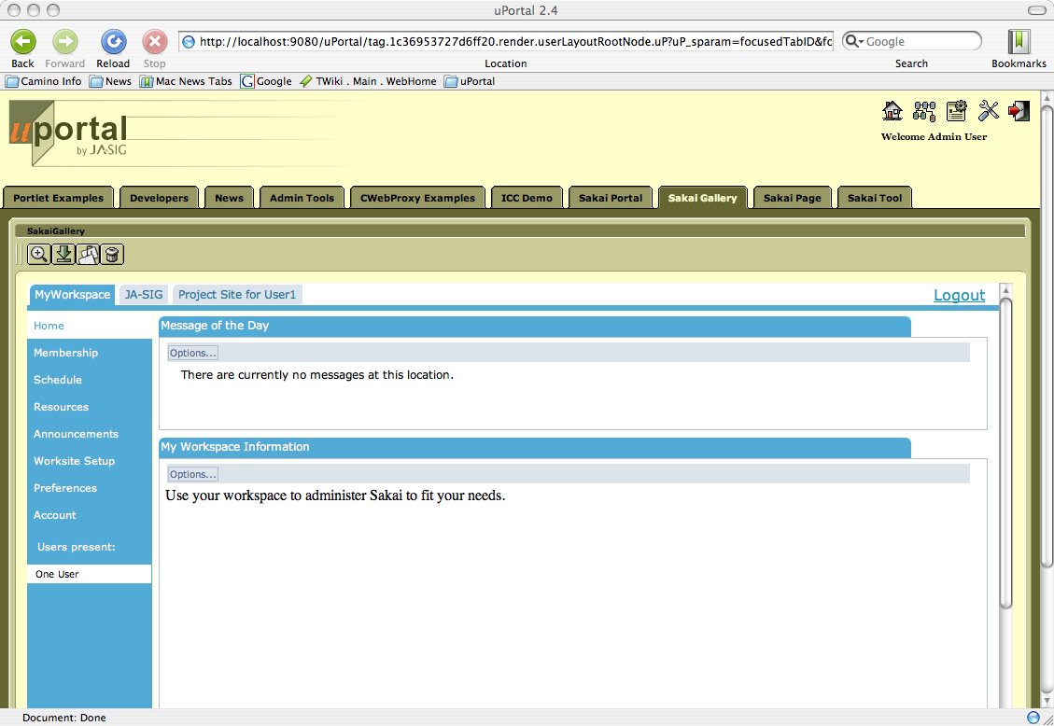
Gallery – site without branding

Slide 18
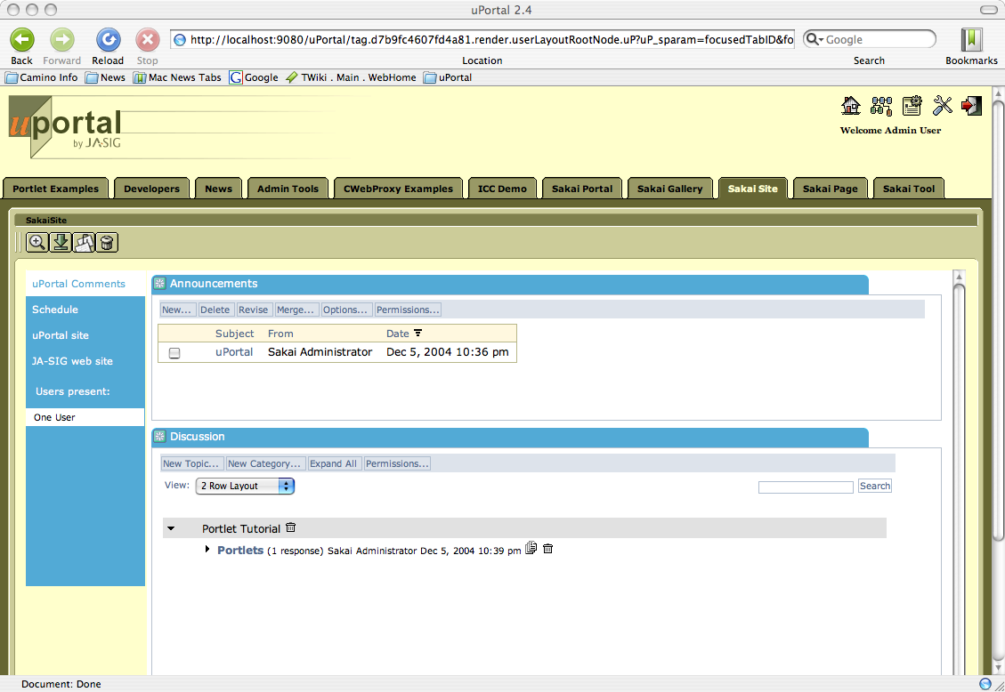
Site

Slide 19
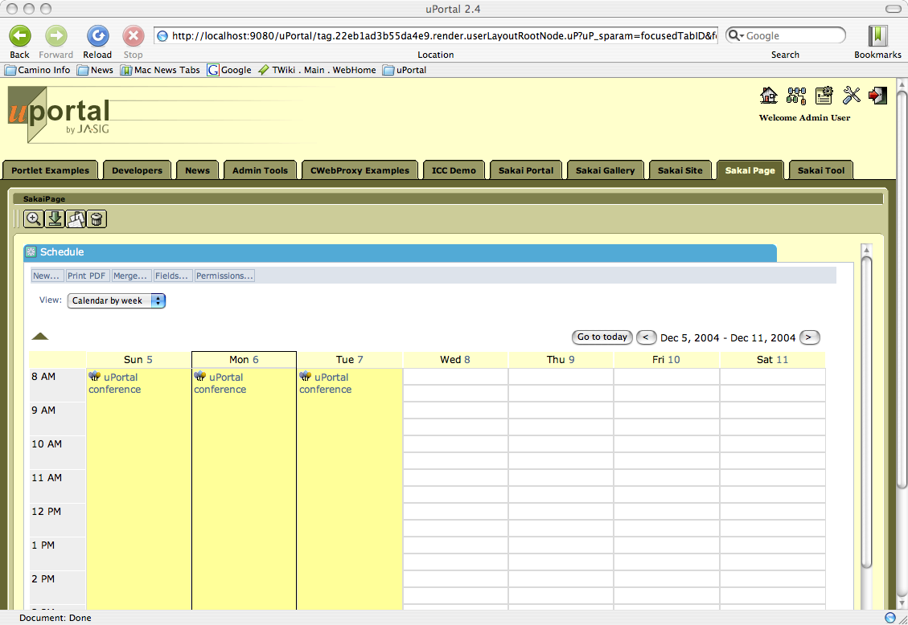
Page

Slide 20
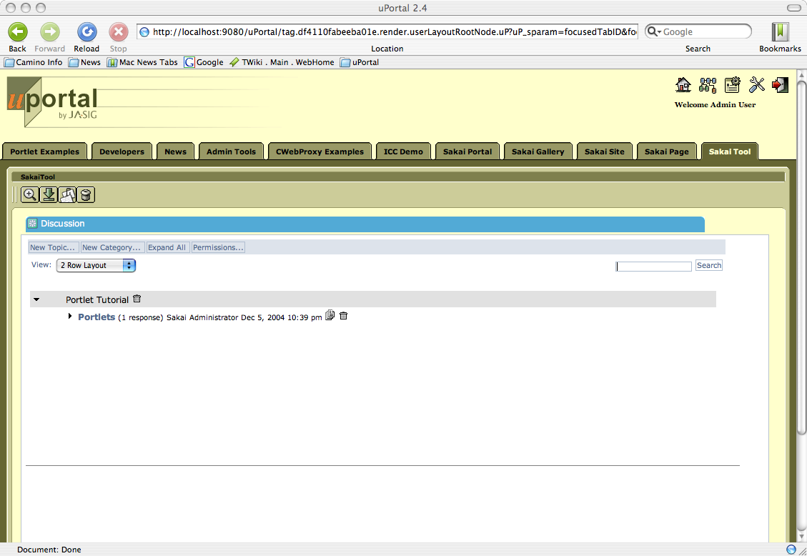
Tool

Slide 21
Quick iFrames Advertisement
iFrames are “evil”, but they have a certain charm…
Every portal on the planet will work with them because they have “include another web-site” capability.
Sakai can now work within a static HTML site, PHP site, or any site
Sakai 1.x tools *love* iFrames and don’t suffer from the “refresh = reset” problem

Slide 22
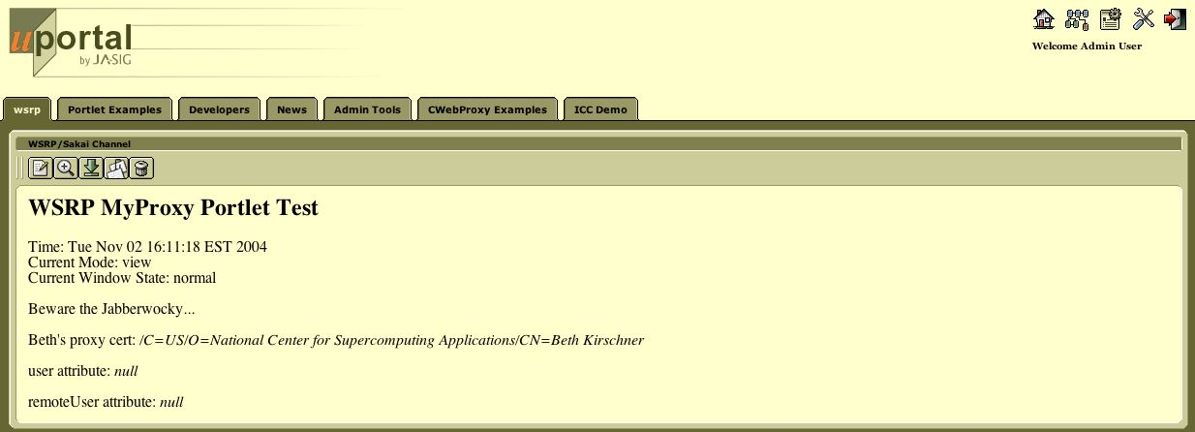
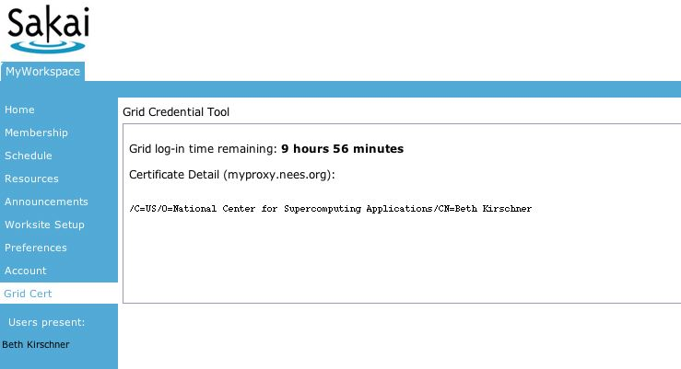
Initial Test
WSRP
Integration
WSRP
Some very early testing has been done to explore the feasibility of WSRP connections which has proved fruitful.
Work has begun in earnest in making Sakai a complete WSRP producer for Sakai 2.0.

Slide 23
Direct viewing
In a browser
iFrame and
Single-sign-on
WSRP in portal
Portal
Portal
HTTP
HTTP
WSRP
Sakai
/site servlet
/app servlet
WSRP4J servlet
JSF
JSF
JSF
Vel
tool
tool
tool
legacy
tool

Slide 24
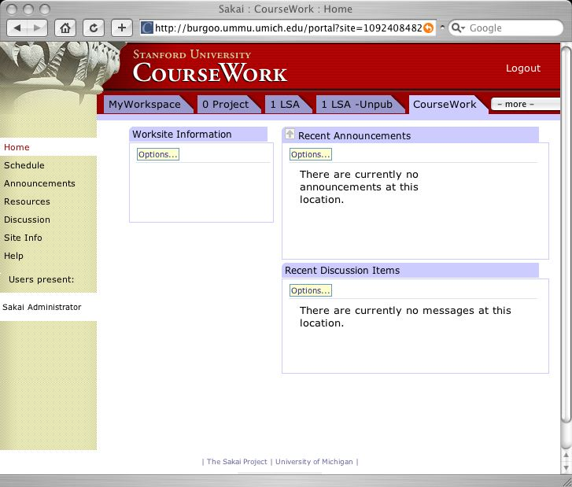
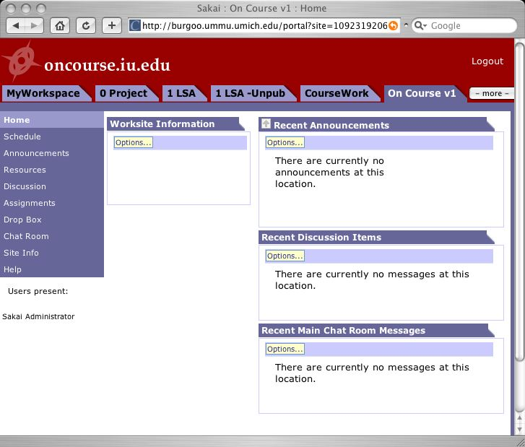
Using WSRP and uPortal to Federate across Sakai sites and provide extreme user flexibility in presentation
Portal
Non-Sakai
Tool
Non-Sakai
Non-Java Tools
tool
tool
WSRP
WSRP
WSRP
WSRP
HTTP
HTTP
HTTP
Sakai
Sakai
Sakai
tool
tool
tool
tool
tool
tool

Slide 25
Phase I Tasks
WSRP Consumer in uPortal (complete in uPortal 2.4)
iFrame Producer in Sakai (Sakai 1.5)
WSRP Producer in Sakai (Sakai 2.0)
Working on Phase I deliverables: Beth Kirshner (UM), Vishal Goenka (Sungard)
May start effort to build better WSRP consumer if Sakai’s producer becomes “better”

Slide 26
Phase II - Beyond Sakai 2.0
Sakai tools live in uPortal…

Slide 27
Lets Review
Phase I is the primary cross-portal “portable” deliverable
Phase II is very uPortal specific and while it (hopefully) does not require modifications to uPortal, it does entail a non-trivial “porting” process. Perhaps once this is done for uPortal, other portals can be attacked.
Sakai tools (Chat, Discussion, etc) will appear in uPortal as channels using JSR-168 working like any other channel
Sakai tools will be managed by the uPortal administration tools
These tools will be running inside the same JVM as uPortal
uPortal will render all portal navigation (unchanged)

Slide 28
The
Problem….
uPortal’s JVM
uPortal
New Channel
UBC Mail
Sakai Chat
Sakai Presentation
Sakai Discussion
Cartoon channel
…..
Sakai
Velocity Tool
Sakai
JSF Tool
Sakai Services, APIs,
Components

Slide 29
It is simple enough - all we need is the “pink stuff”
uPortal’s JVM
uPortal
uPortal
JSR-168
Velocity to JSR-168
JSF to JSR-168
Sakai
Velocity Tool
Sakai
JSF Tool
User, Site,
Role Plug-ins
Sakai Services, APIs,
Components
SAF - Kernel - uPortal Version

Slide 30
Sakai Application Framework
SAF - Kernel - components, logging, session, context/placement, authentication, thread local etc.
SAF - Common Services - Authentication, Authorization, Hierarchy, Content
Application Services - Chat Service (not part of SAF)
Tool code (not part of SAF)
SAF - Presentation Services (JSF and Velocity)

Slide 31
Sakai Application Framework
SAF - Presentation Services
Tool Layout (JSP / Velocity)
Tool Code (Java)
Application Services
SAF - Common Services
SAF - Kernel

Slide 32
SAF - Kernel
As small as possible
  Tool registration, component loader, thread conditioning, Sakai Session, current User.
  No persistence - effectively “conditions a thread in a webapp” for use by Sakai tools and services
SAF - Common Services are built on the Kernel plus Database Connections
We will modify the SAF kernel to operate in a 168 / uPortal environment.
We should not need to modify the common services once the SAF kernel works.
Kernel is scheduled for completion 4/1/2005

Slide 33
JSF - JSR-168
According to others, it does not work in uPortal 2.x
This needs to work - it would be nice to have this part of the uPortal distribution
Sakai to date has not done any evaluation
OGCE has done some evaluation

Slide 34
Velocity to JSR-168
This is already done partially by the OGCE project
Some issues remain (multiple portlets on same page)
May need additional work to support Sakai variant of Velocity
Needs to be “finished” and fully tested
Nice to have integrated into uPortal distribution

Slide 35
Sakai Plug-ins
Sakai depends on external plug ins for its user authentication, group information, and role within group information
We can write uPortal versions of these plug ins which call the stock uPortal APIs to satisfy Sakai’s needs in this area.
This should be straightforward

Slide 36
Some Issues
There may be aspects of the Sakai Application Framework Kernel which are useful to uPortal (component, session, etc)
These aspects may also “collide” with uPortal uses of things like Spring for their own internal purposes.
The SAF-Kernel port will require help from both the uPortal architects and the Sakai architects.

Slide 37
Phase II Tasks
These tasks will be primarily done by Sakai resources (lead by Yale)
  Make JSR-168 - JSF work in uPortal
  Make SAF - Kernel work within uPortal
    Significant work
  Make JSR-168 - Velocity Gateway work
  Build plug-ins for Sakai Common Services which talk to uPortal users and groups.
Broader task
  Solve the ability to deliver asynchronous events to the browser. (Sakai’s courier)

Slide 38
Portal Plans Summary
While integration between Sakai and uPortal was not as simple as we had hoped (i.e. “JSR-168” is a magic wand), there is still a roadmap for integration which will deliver on the original goals of Sakai.
Design and priority choices focused early effort on the biggest wins with the lowest risk so that customers can deploy maximal capability as early as possible.
We are making good progress and look like we will be accelerating the beginning of Phase II effort to April 2005 using resources provided by Yale.

