Slide 1

Sakai Overview
Charles Severance
Chief Architect, Sakai Project
www.sakaiproject.org
csev@umich.edu www.dr-chuck.com
KYOU / sakai
Boundary, Situation

Slide 2

The Sakai Project
“The University of Michigan, Indiana University, MIT, Stanford, the uPortal Consortium, and the Open Knowledge Initiative (OKI) are joining forces to integrate and synchronize their considerable educational software into a pre-integrated collection of open source tools.”
Sakai Project receives $2.4 million grant from Mellon

Slide 3
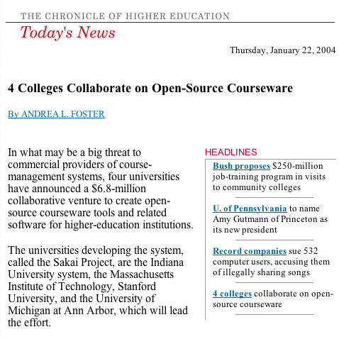

Slide 4
Sakai Funding
Each of the 4 Core Universities Commits
  5+ developers/architects, etc. under Sakai Board project direction for 2 years
  Public commitment to implement Sakai
  Open/Open licensing – “Community Source”
So, overall project levels
  $4.4M in institutional staff (27 FTE)
  $2.4M Mellon, $300K Hewlett
  Additional investment through partners

Slide 5
What is Sakai?
Sakai is a project - a grant for two years which transitions to a broader community for long term maintenance
Sakai is an extensible software framework - provides basic capabilities to support a wide range of tools and services
Sakai is a set of tools - written and supported by various groups
Sakai is a product - a released bundle of the framework and a set of tools which have been tested and released as a unit

Slide 6
The Sakai Product (and Tools)

Slide 7
Placing the Sakai “Product”
Learning Management Systems
  BlackBoard
  Angel
  WebCT
Collaborative Environments
  Lotus Notes
  Microsoft SharePoint
Collaborative Frameworks
  Moodle

Slide 8
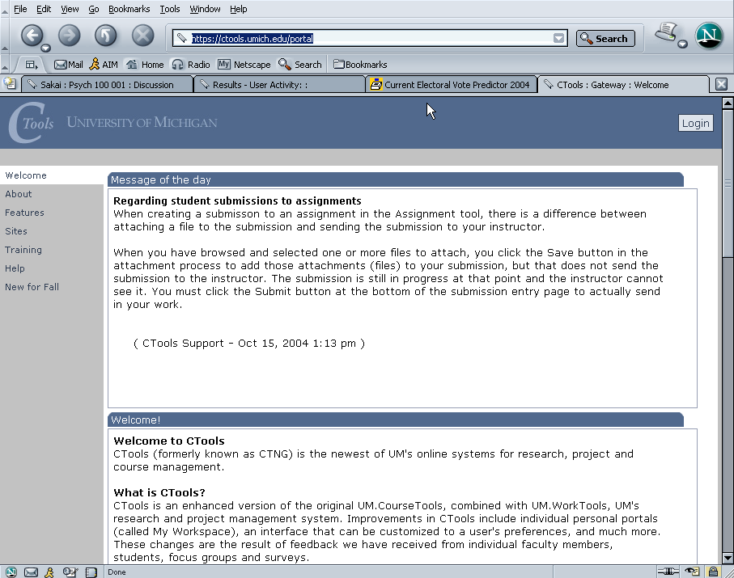
Ctools – Production Sakai at University of Michigan

Slide 9
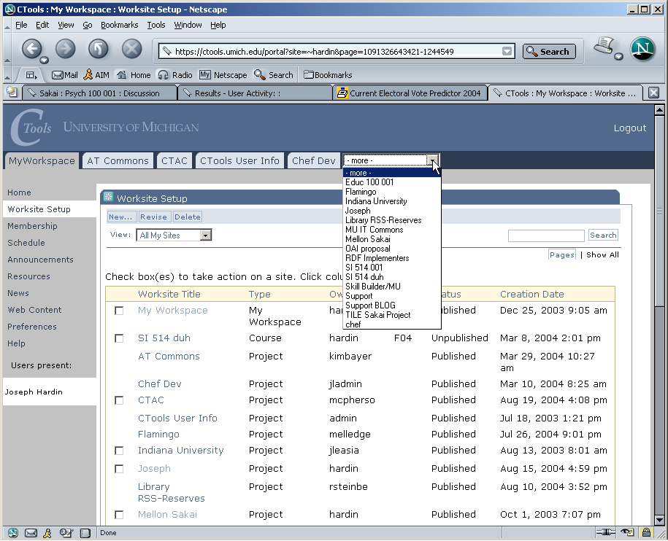
Ctools – List of Worksites – Classes, Projects

Slide 10
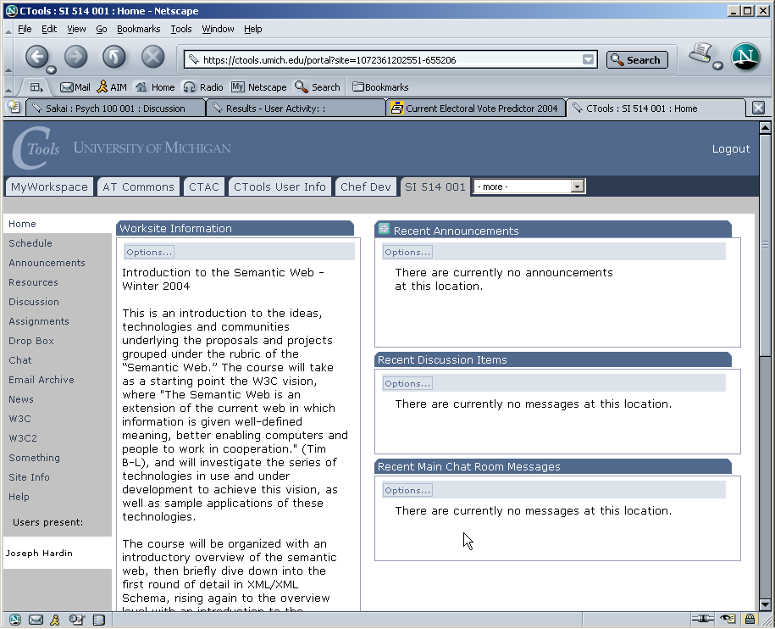
Site/class home page

Slide 11
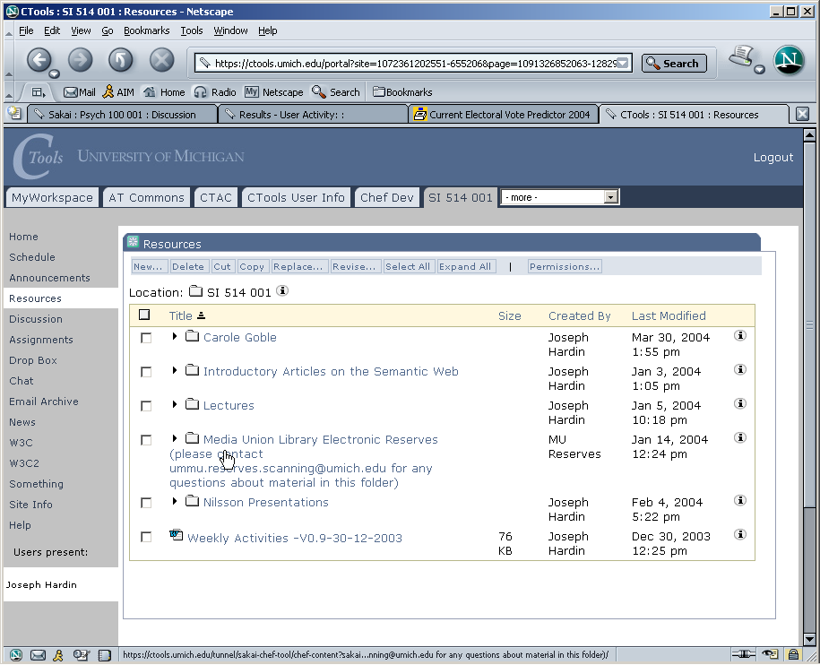
Site Resources area

Slide 12
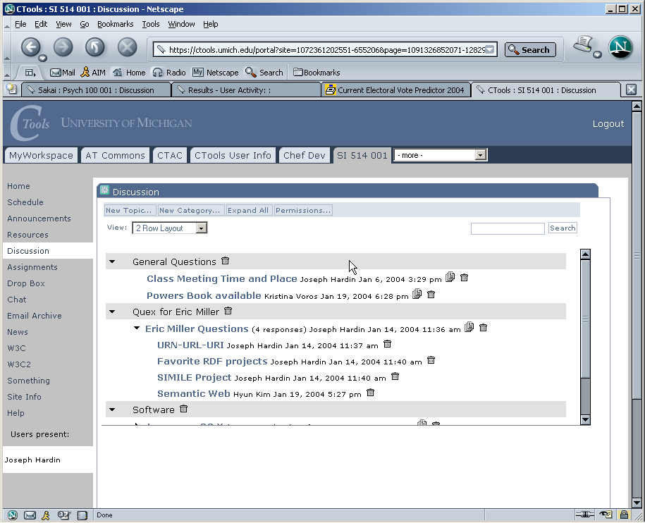
Discussion tool – Forums

Slide 13
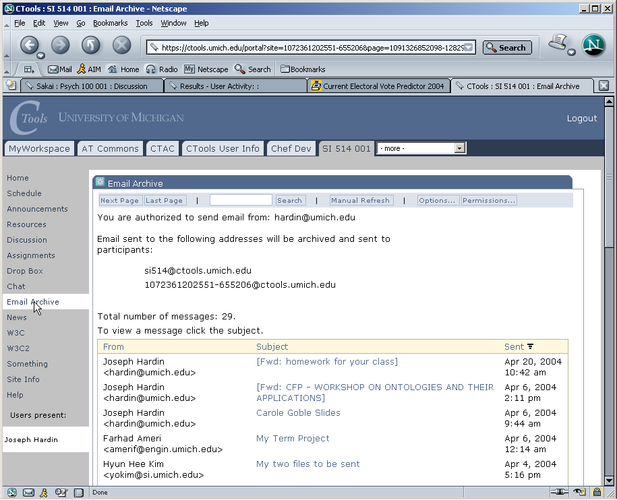
Email Archive

Slide 14
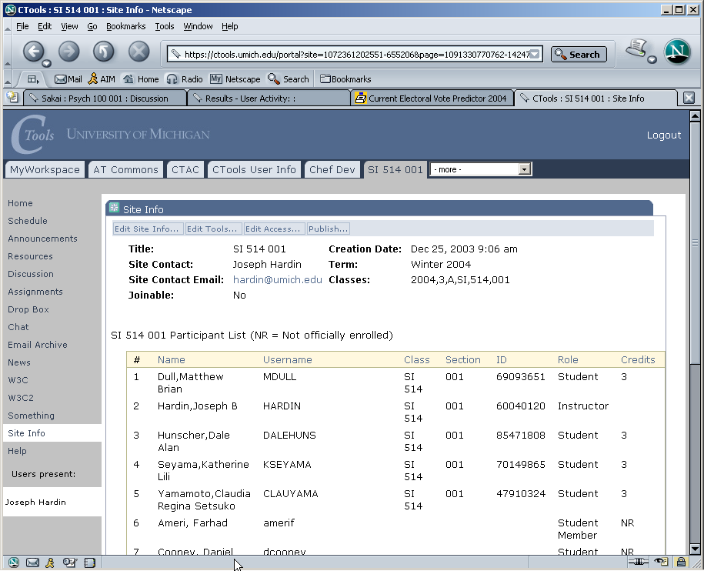
Site Info – class list

Slide 15
Sakai Releases
Sakai 1.0 - basic collaborative system - suitable for small pilots
Sakai 1.5 - basic collaborative learning system - suitable for significant pilot’s
Sakai 2.0 - collaborative learning system - suitable for significant production deployments
Sakai 3.0 - hardening, portal integration, preparation for post-project

Slide 16
Sakai 1.0 Tools
Admin: Alias Editor (chef.aliases)
Admin: Archive Tool (chef.archive)
Admin: Memory / Cache Tool
(chef.memory)
Admin: On-Line (chef.presence)
Admin: Realms Editor (chef.realms)
Admin: Sites Editor (chef.sites)
Admin: User Editor (chef.users)
Announcements (chef.announcements)
Assignments (chef.assignment)
C. R. U. D. (sakai.crud)
Chat Room (chef.chat)
Discussion (chef.discussion)
Discussion (chef.threadeddiscussion)
Dissertation Checklist (chef.dissertation)
Dissertation Upload
(chef.dissertation.upload)
Drop Box (chef.dropbox)
Email Archive (chef.mailbox)
Help (chef.contactSupport)
Membership (chef.membership)
Message Of The Day (chef.motd)
My Profile Editor (chef.singleuser)
News (chef.news)
Preferences (chef.noti.prefs)
Recent Announcements
(chef.synoptic.announcement)
Recent Chat Messages (chef.synoptic.chat)
Recent Discussion Items
(chef.synoptic.discussion)
Resources (chef.resources)
Sample (sakai.module)
Schedule (chef.schedule)
Site Browser (chef.sitebrowser)
Site Info (chef.siteinfo)
Web Content (chef.iframe)
Worksite Setup (chef.sitesetup)
WebDAV

Slide 17
Sakai 1.5 Tools
Samigo - QTI compliant assessment engine (Stanford)
Syllabus Tool (Indiana)
Context Sensitive Help (Indiana)
Presentation Tool (SEPP)
Contributed Tools (not part of bundle)
  Blackboard Import (Texas)
  Xwiki (Cambridge)
Portfolio Tool - OSPI (R-Smart) (separate release)

Slide 18
Sakai 2.0 (New Tools)
Melete - Online classroom - lesson editor (Foothill)
Grade Book (UC Berkeley)

Slide 19
Sakai Etudes Faculty Review
Most core tools - very nice
Discussion tool - needs work
Melete - Online Classroom - very very nice
WorkSite Setup - very very nice
Missing features
  Individual messaging
  Student tracking

Slide 20
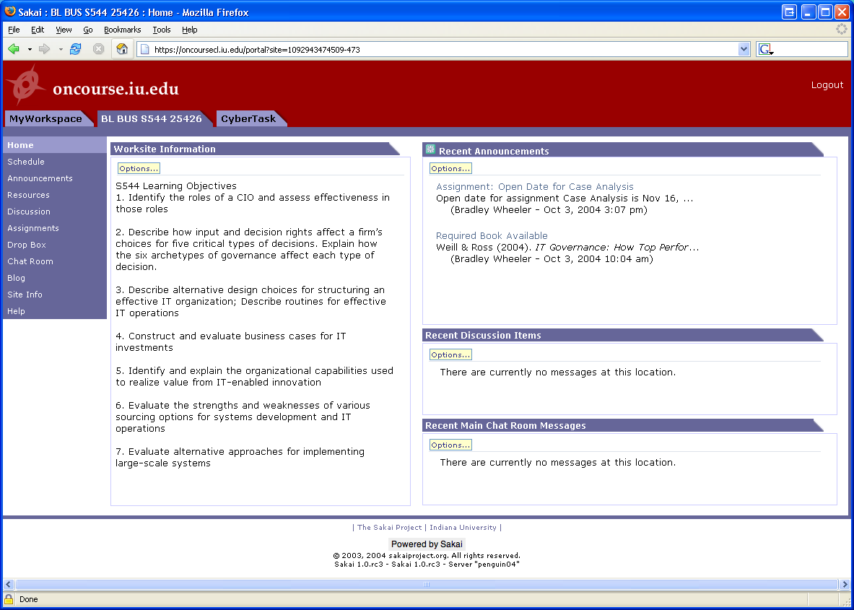
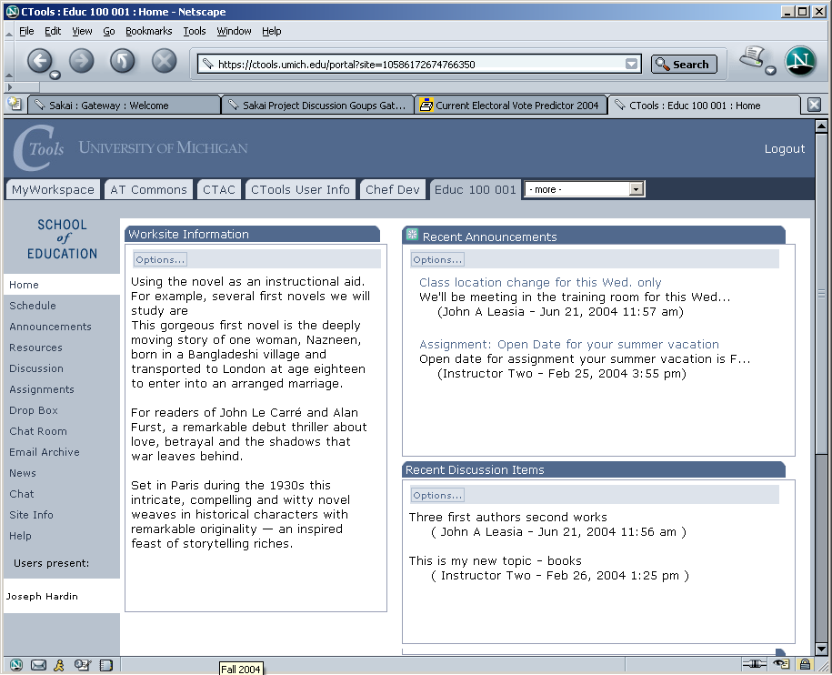
In production use
With >25,000 users
at U Michigan
On to Stanford, UC-Berkeley, Foothill, MIT in 2005
Notes:
The SAME Sakai software is in use at uMich and Indiana. Pilots to follow at Stanford and MIT. Many of Sakai’s (current) 47 partners and many others have downloaded the code and been working with it. The Open Source Portfolio Initiative, Version 2.0, is built on the Sakai architecture and can be used solo or integrated with Sakai.

Slide 21
Sakai in Early Production
University of Michigan
  September 2004 - Sakai 1.0 production
  January 2005 - Sakai 1.5 production
Indiana University
  September 2004 - Sakai 1.0 small pilot
  January 2005 - Sakai 1.5 large pilot
  September 2005 - Sakai 2.0 full production
Yale University
  January 2005 - Sakai 1.5 small pilot
Etudes / Foothill
  April 2005 - Sakai 1.5 medium sized pilot

Slide 22
The Sakai Project

Slide 23
Goals of the Sakai Project
Develop an open-source collaborative learning environment
  Suitable for use as a learning management system
  Suitable for use as a small group collaboration system
  Suitable for building research collaboratories
  Improve teaching and learning by providing a rich and extensible environment
  Bring research and teaching together
  Move towards a personal learning and lifelong learning environment

Slide 24
Sakai Organization
Sakai Board
UM, IU, Stanford, MIT,
UCB, Foothill, OKI,
uPortal, Hull (UK)
Joseph Hardin
Sakai PI
Board Chair
Architecture
Team
Product
Requirements
Team
Project
Management
Sakai
Educational
Partners

Slide 25
Sakai Educational Partners - Feb 1, 2004
Arizona State University
Boston University School of Management
Brown University
Carleton College
Carnegie Foundation for Advancement of Teaching
Carnegie Mellon University
Coastline Community College
Columbia University
Community College of Southern Nevada
Cornell University
Dartmouth College
Florida Community College/Jacksonville
Foothill-De Anza Community College
Franklin University
Georgetown University
Harvard University
Johns Hopkins University
Lubeck University of Applied Sciences
Maricopa County Community College
Monash University
Nagoya University
New York University
Northeastern University
North-West University (SA)
Northwestern University
Ohio State University
Portland State University
Princeton University
Roskilde University (Denmark)
Rutgers University
Simon Fraser University
State University of New York
Stockholm University
SURF/University of Amsterdam
Tufts University
Universidad Politecnica de Valencia (Spain)
Universitat de Lleida (Spain)
University of Arizona
University of California Berkeley
University of California, Davis
University of California, Los Angeles
University of California, Merced
University of California, Santa Barbara
University of Cambridge, CARET
University of Cape Town, SA
University of Colorado at Boulder
University of Delaware
University of Hawaii
University of Hull
University of Illinois at Urbana-Champaign
University of Minnesota
University of Missouri
University of Nebraska
University of Oklahoma
University of Texas at Austin
University of Virginia
University of Washington
University of Wisconsin, Madison
Virginia Polytechnic Institute/University
Whitman College
Yale University
In Process
University of Melbourne, Australia
University of Toronto, Knowledge Media Design Institute

Slide 26
Sakai SEPP Meetings
Provide a forum for the core and the SEPP to interact and for the SEPP members to interact with one another
  June 2004 - Denver Colorado (180)
  December 2004 - New Orleans (200+)
  June 8-14 - Baltimore
    Community Source Week
    uPortal, Sakai, OSPI
  December TBD - Austin, TX

Slide 27
Sakai Commercial Affiliates
Companies who will use/sell/support Sakai
  The rSmart group
  Unicon
  Embanet
  Sungard SCT
Provides companies access to Sakai core developers and SEPP staff
Access to members-only Sakai meetings (I.e. like the SEPP)

Slide 28
IMS Tool Portability Group
To work on ‘interoperability’ between and among CMS’s/CLE’s
Focus is on making tools portable between systems (Sakai, WebCT, and Blackboard)
Established to further the discussion with commercial and other CMS/CLE providers
Will use web services and IFRAMES
Will show working demonstration at the July 2005 Alt-I-lab with Samigo in Sakai, WebCT, and Blackboard

Slide 29
What is “Community Source”?

Slide 30
Pure Commercial Software
Communication between Stakeholders and Shareholders is in the form of large checks.
Shareholders
Desire to maximize profit
Make most decisions so as to maximize profit
Have final say in terms of developer priority - usually priorities have to do with profit
Stakeholders
Expect that because so much money is being paid that there is some form of indemnification in return (no one was ever fired for buying Cisco)
Are willing to pay handsomely so as to be able to get good nights sleep
Tell end users that they are using the best product that money can buy
Can resist end-user demands for change because company is unwilling to change
Commercial Developers
Understand critical link between revenue and paycheck
Focus is on stability of software rather than on features - as such features change slowly
Do not even know stakeholders
There is almost no direct communication between stakeholders and developers because then the developers might actually start changing (and breaking) the software.
= Most Powerful in Structure

Slide 31
Pure Open Source Software
Open Source Developers
Type 1: Passionate individual who finds work on this software interesting
Type 2: Paid consultant whose job it is to get a open-source software to pass test suites so as to show that there is an open-source reference implementation
Teams formed based on personal time and motivation or a commercial venture with a short-term agenda
Effort level ebbs and flows depending on commercial needs of the moment
Performance and reliability are second-order issues
Cool features and programming chops rule the day (and night)
Stakeholders
Love the notion that they have “free” software and source code.
Hate the fact that there is no one to call - “if it breaks you get to keep both pieces”
Look at open source solutions at a moment in time and make a yes/no decision based on state of the software at the moment of analysis
Must self-indemnify by keeping lots of staff with questionable grooming habits “in case” something goes wrong.
Once open source is chosen, may find it hard to sleep at night.
Probably won’t get to keep the savings form the open source decision beyond this fiscal year.
There is virtually no communication at all between Stakeholders and Developers because they operate in completely orthogonal areas of the space-time continuum and if they ever ran across one another - they would not even recognize that they were in the same species.

Slide 32
Community Source
Secondary Stakeholders
At least the core developers have to be responsible for reliability and performance
The core developers have a boss who can be complained to
Can pay some money to Core to get “indemnification”
Can contribute to the Core “in kind”
Can join the core with enough commitment
Can pay Commercial Support for “extra indemnification”.
Commercial Support
At least the core developers have to be responsible for reliability and performance
The core developers have a boss who can be complained to
Can pay some money to the Core for some “indemnification”
Can make money from secondary stakeholders
Core Stakeholders
It turns out that they actually have a lot of money and programmers
If they pool resources, we would be instantly larger than many small commercial R&D operations.
Tired of writing big checks, and begging for features
Form coalition of the “committed”
Get quite excited when developers start doing what they are told.
Must learn that this is harder than it looks - must gain company-like skills.
Actually responsible for both the development and production of the software.
Core Developers
Work for the stakeholders so they want to make the Stakeholders happy
Open Source Developers
Can participate in the process based on contributions and chops
Issues:
How can this be kept stable after founders reduce commitment?
If successful, what stops this from going commercial?
What is the right license for the IP produced as part of the Core?
What types of software is appropriate for this? Payroll software?

Slide 33
The Sakai Community
Main site: www.sakaiproject.org
Bugs: bugs.sakaiproject.org
Sakai-wide collaboration area
  collab.sakaiproject.org
  sakai-dev@sakaiproject.org
  sakai-user@sakaiproject.org
Sakai Educational Partners (SEPP)
  Separate mailing lists
  Dedicated staff
  Two meetings per year

Slide 34
Sakai’s Future
Initial grant ends December 2005
Transition to Community Source
  The SEPP is renamed “Sakai” (800K/year)
  Governance is merit-based (like Apache)
  Core elements of Sakai software are pretty stable
  Small Community funded team (5+) to keep the core maintained and slowly evolving
  Significant contributed in-kind resources Michigan, Indiana, Yale, Foothill, Stanford

Slide 35
Summary
Working on Sakai feels like a fast paced commercial startup
We are “owned” by the Universities and Colleges which make up our community
Unlike most grant projects, deadlines, quality, and performance matter - a lot
The two year project has needed close coordination and strong leadership because we have built, rebuilt, defined and redefined on a very tight schedule

Slide 36
Going Forward
By Summer 2005, the core Sakai software will be very solid - the rewrites will be done
Conservative organizations can just adopt and use Sakai or even out-source their Sakai to a commercial vendor
Organizations with money and ideas can begin to innovate rapidly and share their work with many others

