Slide 1

Sakai Overview
Charles Severance
Chief Architect, Sakai Project
www.sakaiproject.org
csev@umich.edu www.dr-chuck.com
KYOU / sakai
Boundary

Slide 2

The Sakai Project
“The University of Michigan, Indiana University, MIT, Stanford, the uPortal Consortium, and the Open Knowledge Initiative (OKI) are joining forces to integrate and synchronize their considerable educational software into a pre-integrated collection of open source tools.”
Sakai Project receives $2.4 million grant from Mellon

Slide 3
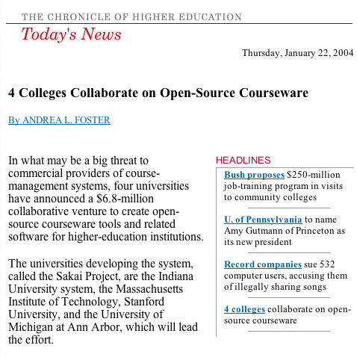

Slide 4
Sakai Funding
Each of the 4 Core Universities Commits
  5+ developers/architects, etc. under Sakai Board project direction for 2 years
  Public commitment to implement Sakai
  Open/Open licensing – “Community Source”
So, overall project levels
  $4.4M in institutional staff (27 FTE)
  $2.4M Mellon, $300K Hewlett
  Additional investment through partners

Slide 5
What is Sakai?
Sakai is a project - a grant for two years which transitions to a broader community for long term maintenance
Sakai is an extensible software framework - provides basic capabilities to support a wide range of tools and services
Sakai is a set of tools - written and supported by various groups
Sakai is a product - a released bundle of the framework and a set of tools which have been tested and released as a unit

Slide 6
The Sakai Product (and Tools)

Slide 7
Placing the Sakai “Product”
Learning Management Systems
  BlackBoard
  Angel
  WebCT
Collaborative Environments
  Lotus Notes
  Microsoft SharePoint
Collaborative Frameworks
  Moodle

Slide 8
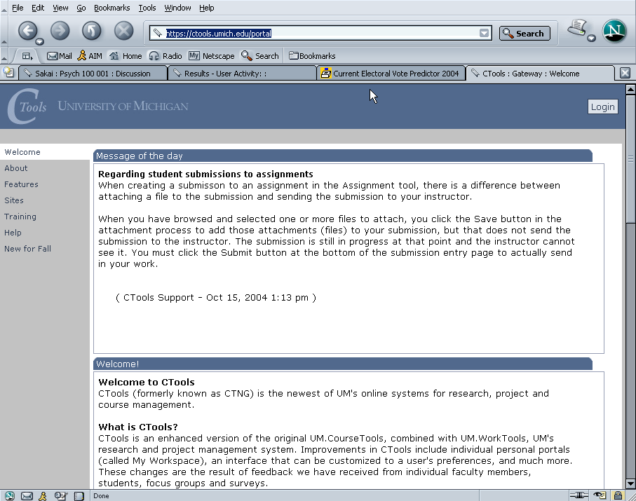
Ctools – Production Sakai at University of Michigan

Slide 9
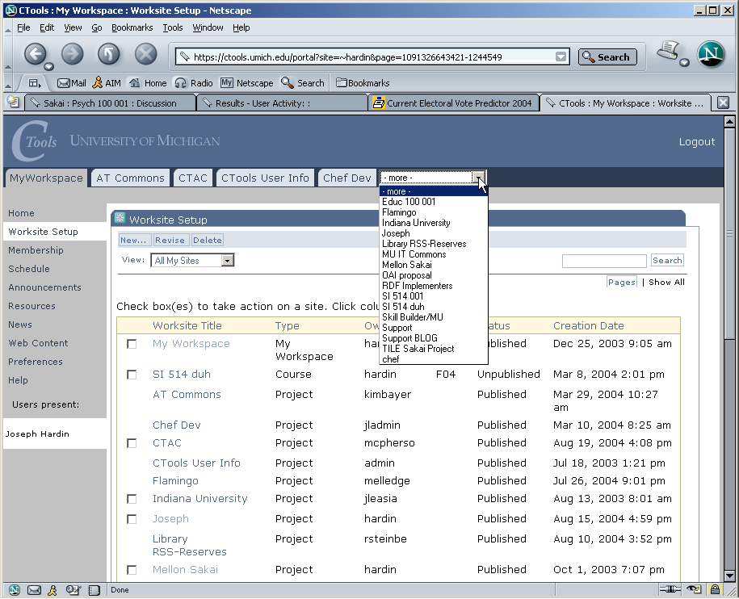
Ctools – List of Worksites – Classes, Projects

Slide 10
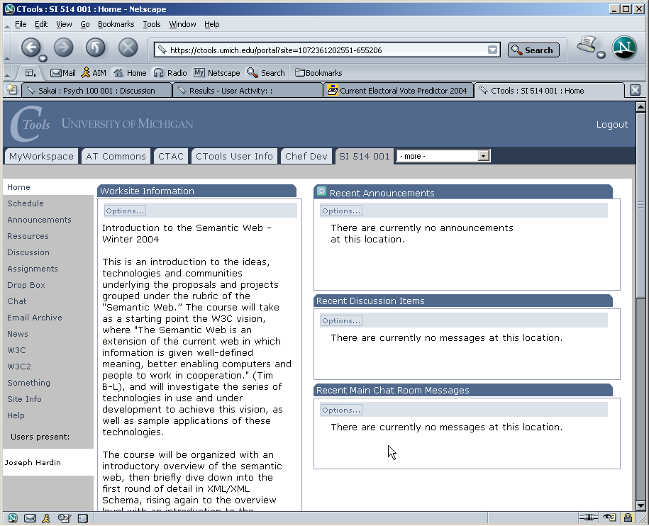
Site/class home page

Slide 11
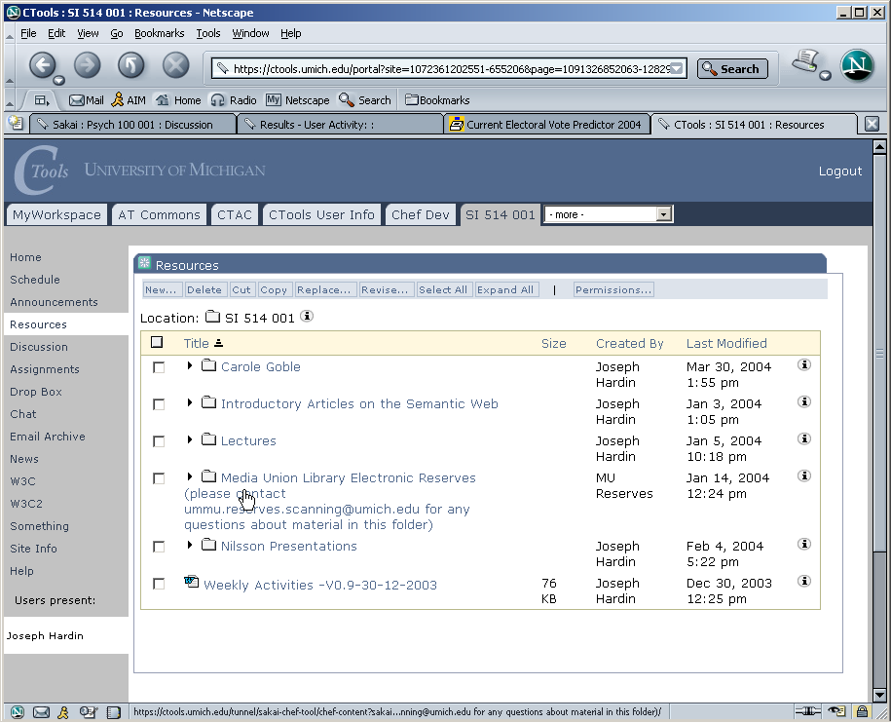
Site Resources area

Slide 12
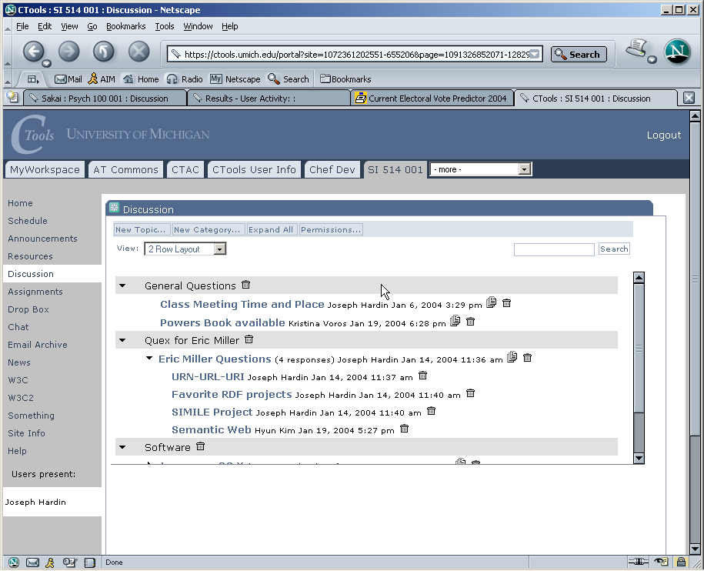
Discussion tool – Forums

Slide 13
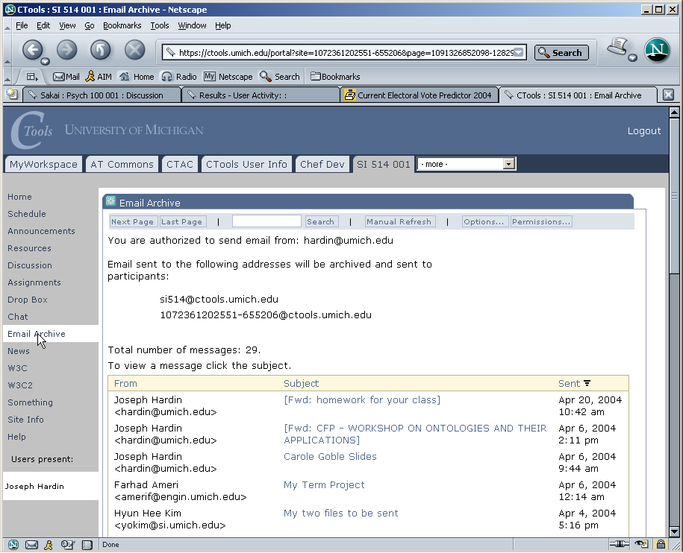
Email Archive

Slide 14
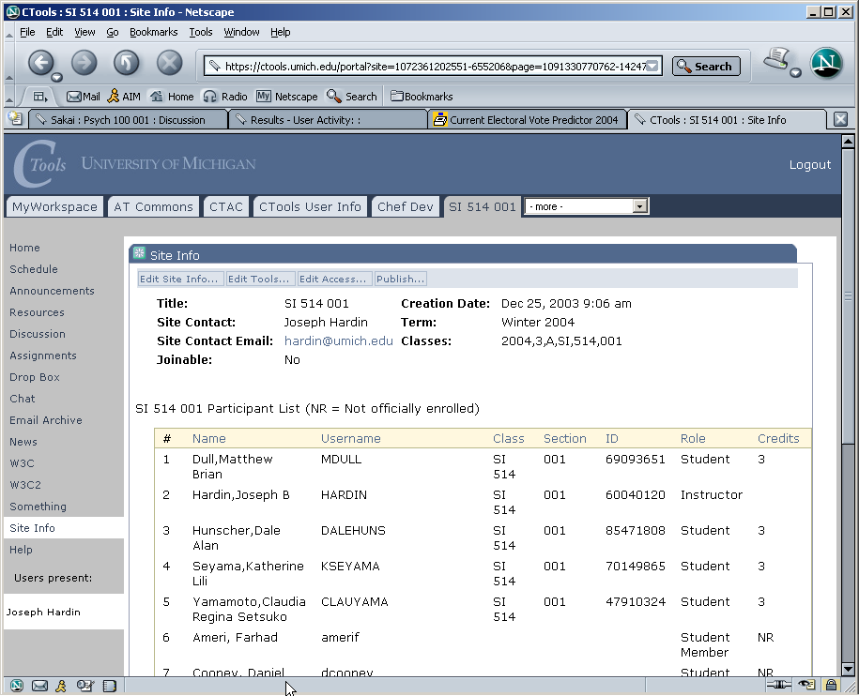
Site Info – class list

Slide 15
Sakai Releases
Sakai 1.0 - basic collaborative system - suitable for small pilots
Sakai 1.5 - basic collaborative learning system - suitable for significant pilot’s
Sakai 2.0 - collaborative learning system - suitable for significant production deployments
Sakai 3.0 - hardening, portal integration, preparation for post-project

Slide 16
Sakai 1.0 Tools
Admin: Alias Editor (chef.aliases)
Admin: Archive Tool (chef.archive)
Admin: Memory / Cache Tool
(chef.memory)
Admin: On-Line (chef.presence)
Admin: Realms Editor (chef.realms)
Admin: Sites Editor (chef.sites)
Admin: User Editor (chef.users)
Announcements (chef.announcements)
Assignments (chef.assignment)
C. R. U. D. (sakai.crud)
Chat Room (chef.chat)
Discussion (chef.discussion)
Discussion (chef.threadeddiscussion)
Dissertation Checklist (chef.dissertation)
Dissertation Upload
(chef.dissertation.upload)
Drop Box (chef.dropbox)
Email Archive (chef.mailbox)
Help (chef.contactSupport)
Membership (chef.membership)
Message Of The Day (chef.motd)
My Profile Editor (chef.singleuser)
News (chef.news)
Preferences (chef.noti.prefs)
Recent Announcements
(chef.synoptic.announcement)
Recent Chat Messages (chef.synoptic.chat)
Recent Discussion Items
(chef.synoptic.discussion)
Resources (chef.resources)
Sample (sakai.module)
Schedule (chef.schedule)
Site Browser (chef.sitebrowser)
Site Info (chef.siteinfo)
Web Content (chef.iframe)
Worksite Setup (chef.sitesetup)
WebDAV

Slide 17
Sakai 1.5 Tools
Samigo - QTI compliant assessment engine (Stanford)
Syllabus Tool (Indiana)
Context Sensitive Help (Indiana)
Presentation Tool (SEPP)
Portfolio Tool - OSPI (R-Smart) (separate release)

Slide 18
Sakai 2.0 (New Tools)
Completely re-written Kernel (UM / MIT)
Melete - Online classroom - lesson editor (Foothill)
Grade Book (UC Berkeley / MIT )

Slide 19
Tools from Partners
FlowTalk (Cambridge)
BlackBoard Import (U Texas)
Xwiki (Cambridge)
Mail / Messaging (Northwestern / Yale)
WebDav Features (Rutgers)
Many bug fixes.

Slide 20
Sakai Etudes Faculty Review
Most core tools - very nice
Discussion tool - needs work
Melete - Online Classroom - very very nice
WorkSite Setup - very very nice
Missing features
  Individual messaging
  Student tracking

Slide 21
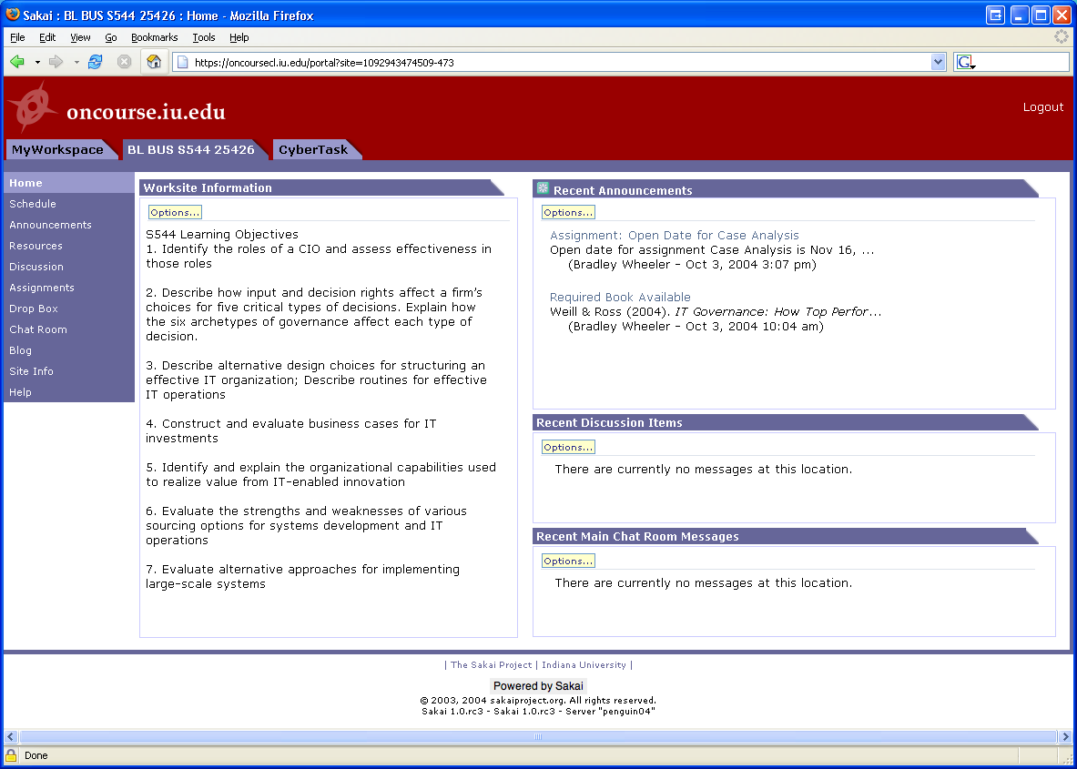
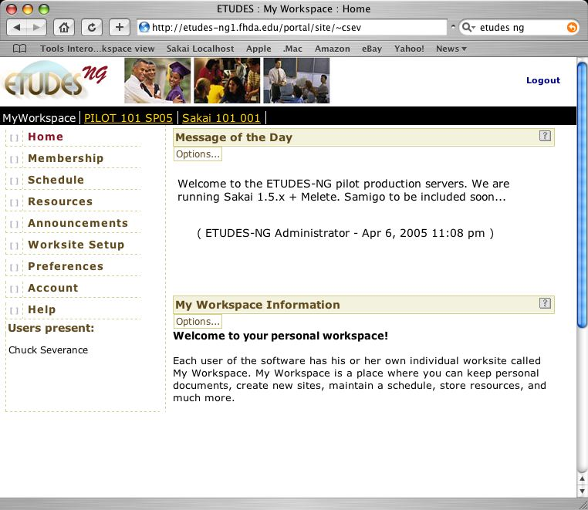
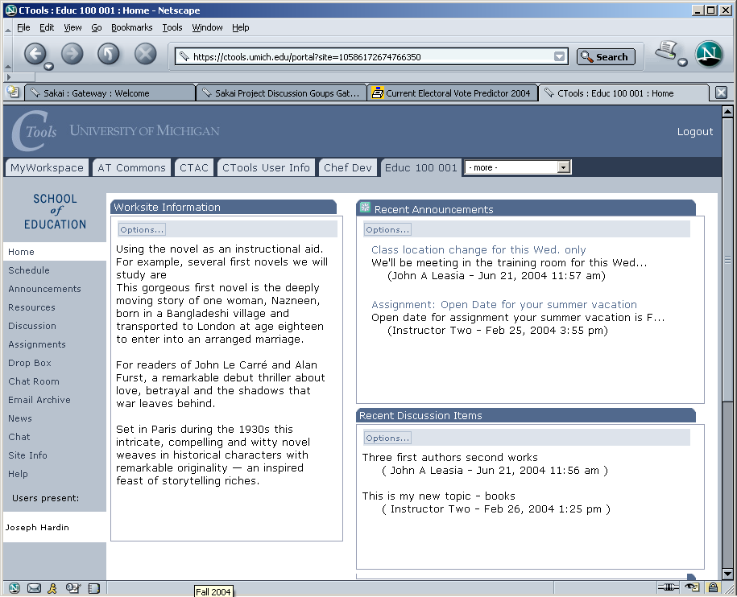
In production use
With >25,000 users
at U Michigan
Notes:
The SAME Sakai software is in use at uMich and Indiana. Pilots to follow at Stanford and MIT. Many of Sakai’s (current) 47 partners and many others have downloaded the code and been working with it. The Open Source Portfolio Initiative, Version 2.0, is built on the Sakai architecture and can be used solo or integrated with Sakai.

Slide 22
Sakai in Production
University of Michigan
  September 2004 - Sakai 1.0 production
  January 2005 - Sakai 1.5 production
Indiana University
  September 2004 - Sakai 1.0 small pilot
  January 2005 - Sakai 1.5 large pilot
  September 2005 - Sakai 2.0 full production
Yale University
  January 2005 - Sakai 1.5 small pilot
Etudes / Foothill
  April 2005 - Sakai 1.5 medium sized pilot

Slide 23
Sakai Adoption Plans
Boston University School of Management
Carleton College
Columbia University
Johns Hopkins University
Lueck University of Applied Sciences, Germany
Massachusetts Institute of Technology
Northwestern University
Stanford University
University of California, Berkeley
University of California, Los Angeles
University of California, Merced
University of Cape Town, SA
University Fernando Pessoa, Portugal
University of Lleida, Spain
University of Missouri
University of Virginia
Whitman College
Yale University
Type “Sakai Adoption Plans” into Google

Slide 24
The Sakai Project

Slide 25
Goals of the Sakai Project
Develop an open-source collaborative learning environment
  Suitable for use as a learning management system
  Suitable for use as a small group collaboration system
  Suitable for building research collaboratories
  Improve teaching and learning by providing a rich and extensible environment
  Bring research and teaching together
  Move towards a personal learning and lifelong learning environment

Slide 26
Sakai Organization
Sakai Board
UM, IU, Stanford, MIT,
UCB, Foothill, OKI,
uPortal, Hull (UK)
Joseph Hardin
Sakai PI
Board Chair
Architecture
Team
Product
Requirements
Team
Project
Management
Sakai
Educational
Partners

Slide 27
Sakai Educational Partners - Feb 1, 2004
Arizona State University
Boston University School of Management
Brown University
Carleton College
Carnegie Foundation for Advancement of Teaching
Carnegie Mellon University
Coastline Community College
Columbia University
Community College of Southern Nevada
Cornell University
Dartmouth College
Florida Community College/Jacksonville
Foothill-De Anza Community College
Franklin University
Georgetown University
Harvard University
Johns Hopkins University
Lubeck University of Applied Sciences
Maricopa County Community College
Monash University
Nagoya University
New York University
Northeastern University
North-West University (SA)
Northwestern University
Ohio State University
Portland State University
Princeton University
Roskilde University (Denmark)
Rutgers University
Simon Fraser University
State University of New York
Stockholm University
SURF/University of Amsterdam
Tufts University
Universidad Politecnica de Valencia (Spain)
Universitat de Lleida (Spain)
University of Arizona
University of California Berkeley
University of California, Davis
University of California, Los Angeles
University of California, Merced
University of California, Santa Barbara
University of Cambridge, CARET
University of Cape Town, SA
University of Colorado at Boulder
University of Delaware
University of Hawaii
University of Hull
University of Illinois at Urbana-Champaign
University of Minnesota
University of Missouri
University of Nebraska
University of Oklahoma
University of Texas at Austin
University of Virginia
University of Washington
University of Wisconsin, Madison
Virginia Polytechnic Institute/University
Whitman College
Yale University
In Process
University of Melbourne, Australia
University of Toronto, Knowledge Media Design Institute

Slide 28
Sakai SEPP Meetings
Provide a forum for the core and the SEPP to interact and for the SEPP members to interact with one another
  June 2004 - Denver Colorado (180)
  December 2004 - New Orleans (200+)
  June 8-14 - Baltimore
    Community Source Week
    uPortal, Sakai, OSPI
  December TBD - Austin, TX

Slide 29
Sakai Commercial Affiliates
Companies who will use/sell/support Sakai
  The rSmart group
  Unicon
  Embanet
  Sungard SCT
Provides companies access to Sakai core developers and SEPP staff
Access to members-only Sakai meetings (I.e. like the SEPP)

Slide 30
IMS Tool Portability Group
To work on ‘interoperability’ between and among CMS’s/CLE’s
Focus is on making tools portable between systems (Sakai, WebCT, and Blackboard)
Established to further the discussion with commercial and other CMS/CLE providers
Will use web services and IFRAMES
Will show working demonstration at the July 2005 Alt-I-lab with Samigo in Sakai, WebCT, and Blackboard

Slide 31
The Sakai Framework

Slide 32
Sakai Technical Goals
Provide environment to write tools and services which seamlessly move from one Sakai deployment to another
Provide environment where the addition of a new tool does not de-stabilize the existing tools
Provide environment to allow tools to exist both within Sakai and standalone (I.e. easy porting of external tools into Sakai without requiring rewrite)
Provide capabilities so that Sakai services and tools can be accessed using web services.

Slide 33
Sakai Foundational Documents
Sakai Style Guide - Describes in detail how Sakai tools are to look and operate regardless of implementation technology
Sakai Java Framework - Describes the Sakai Application Framework (SAF) as implemented in Java
Sakai Tool Portability Profile - Describes how to write tools and services to be portable across Sakai systems (in progress)

Slide 34
Service Oriented Architecture
Decompose tool code into presentation elements and service elements
Provide an abstraction (API) which shields the tool code from the implementation details of the service code.
Allows separate development of the tools and services.
Allows effective unit testing of services
Allows an implementation to be replaced transparently with another implementation as long as the API contract is fully met

Slide 35
Service Oriented Architecture
Browser
Browser
My
Monolithic
Code
Presentation
Code
Service
Interface
(i.e. API)
Service
Code
Persistence
Persistence

Slide 36
Sakai Application Framework
SAF - Kernel - An augmented web application which enables the Sakai APIs to be called from the web application - this is a rich but not constraining environment
SAF - Common Services - A set of common services available to all tools (authentication, authorization, hierarchy, repository, others)
SAF - Presentation Services - A set of Sakai specific JSF tags to handle presentation details and provide widgets such as a date-picker or WSYWIG editor.

Slide 37
Sakai Integration and Development Choices
Develop a TPP Compliant Tool
  Assured to be portable across Sakai environments
Integrate a web application
  Responsible for own presentation and compliance to style guide (may use Sakai JSF tags if JSF is used)
  Can operate both stand-alone and within Sakai
Integrate via web-services
  Capability being developed

Slide 38
Sakai TPP Tools
SAF - Presentation Services
Tool Layout (JSP)
Tool Code (Java)
Application Services
SAF - Common Services
SAF - Kernel

Slide 39
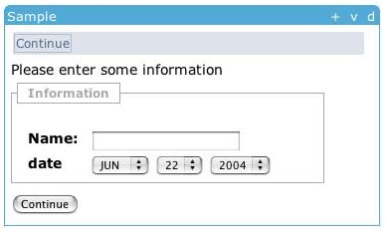
Sakai Tool Layout in JSF
<sakai:view_container title="#{msgs.sample_title}">
<sakai:tool_bar> <sakai:tool_bar_item/> </sakai:tool_bar>
<sakai:instruction_message
value="#{msgs.sample_one_instructions}" />
<sakai:group_box
title="#{msgs.sample_one_groupbox}">
<h:inputText
value="#{MyTool.userName}" />
<sakai:date_input
value="#{MyTool.date}" />
<sakai:button_bar> <sakai:button_bar_item action="#{MyTool.processActionDoIt} value="#{msgs.sample_one_cmd_go}" />
</sakai:button_bar>

Slide 40
Sakai Service Providers
Common Services are localized using plug-ins
  UserDirectoryProvider
  RealmProvider
  CourseManagementProvider
These will be expanded
  RepositoryProvider
  OKI OSID Based Providers
Plug-ins do not replace the persistence, they are consulted in order to populate Sakai structures
SAF - Common Services
User Provider
Role Provider
Course Provider

Slide 41
Sakai, IMS, and Web
Services
Header
Button
Button
Button
Button
Button
Button
Tool Area
1
6
5
CLE Environment
7
External Web Application
Web
Services
Application
Code
Launch
Control
4
Session
And Services
Bootstrap
HTML/HTTP
3
2
Web Services

Slide 42
Sakai and Portals
Sakai was initially intended to be a “portal plus a bunch of tools” - shake well and viola! You have a learning management system.
Initially this seemed simple enough
  Buttons and rectangles
  Collection of tools deployed in various configurations with various administration options
Portals and Learning Management systems turn out to be very different problems to solve
Sakai needs to work both in a portal and LMS environment (a bit stressful)

Slide 43
Portals .vs. LMS
Organized by enterprise and are often driven by the office of communications (Library, HR, Athletics, President)
Often geared to individual customization
Many small rectangles to provide a great deal of information on a single screen
Portals think of rectangles operating independently - like windows
Think “Dashboard”
Organized by academic aspects and are driven by the registrar (Colleges, Departments)
LMS’s are customizable by faculty or departments but not typically by students
LMS’s like one tool on the screen at a time.
LMS’s think of navigation as picking a tool or switching from one class to another
Think “Application”

Slide 44
Sakai Portal Integration Goals
Sakai TPP Tools will run in JSR-168 portals - “Write once run anywhere”.
An entire Sakai site can be included at some point in an enterprise portal
  iFrames - separate sign on (or WebISO)
  WSRP - shared sign on via trust between portal and Sakai
Portions many Sakai sites, tools, or pages can be aggregated to produce a personal federated view for an individual - moves toward a personal learning and research environment.

Slide 45
Installing and Deploying Sakai
Download Quick Start and follow instructions - 5-10 minutes - this is a developer edition with an in-memory database (HSQLDB)
Install a real database (MySql, Oracle) and reconfigure Sakai to run in production

Slide 46
What is “Community Source”?

Slide 47
Pure Commercial Software
Communication between Stakeholders and Shareholders is in the form of large checks.
Shareholders
Desire to maximize profit
Make most decisions so as to maximize profit
Have final say in terms of developer priority - usually priorities have to do with profit
Stakeholders
Expect that because so much money is being paid that there is some form of indemnification in return (no one was ever fired for buying Cisco)
Are willing to pay handsomely so as to be able to get good nights sleep
Tell end users that they are using the best product that money can buy
Can resist end-user demands for change because company is unwilling to change
Commercial Developers
Understand critical link between revenue and paycheck
Focus is on stability of software rather than on features - as such features change slowly
Do not even know stakeholders
There is almost no direct communication between stakeholders and developers because then the developers might actually start changing (and breaking) the software.
= Most Powerful in Structure

Slide 48
Pure Open Source Software
Open Source Developers
Type 1: Passionate individual who finds work on this software interesting
Type 2: Paid consultant whose job it is to get a open-source software to pass test suites so as to show that there is an open-source reference implementation
Teams formed based on personal time and motivation or a commercial venture with a short-term agenda
Effort level ebbs and flows depending on commercial needs of the moment
Performance and reliability are second-order issues
Cool features and programming chops rule the day (and night)
Stakeholders
Love the notion that they have “free” software and source code.
Hate the fact that there is no one to call - “if it breaks you get to keep both pieces”
Look at open source solutions at a moment in time and make a yes/no decision based on state of the software at the moment of analysis
Must self-indemnify by keeping lots of staff with questionable grooming habits “in case” something goes wrong.
Once open source is chosen, may find it hard to sleep at night.
Probably won’t get to keep the savings form the open source decision beyond this fiscal year.
There is virtually no communication at all between Stakeholders and Developers because they operate in completely orthogonal areas of the space-time continuum and if they ever ran across one another - they would not even recognize that they were in the same species.

Slide 49
Community Source
Secondary Stakeholders
At least the core developers have to be responsible for reliability and performance
The core developers have a boss who can be complained to
Can pay some money to Core to get “indemnification”
Can contribute to the Core “in kind”
Can join the core with enough commitment
Can pay Commercial Support for “extra indemnification”.
Commercial Support
At least the core developers have to be responsible for reliability and performance
The core developers have a boss who can be complained to
Can pay some money to the Core for some “indemnification”
Can make money from secondary stakeholders
Core Stakeholders
It turns out that they actually have a lot of money and programmers
If they pool resources, we would be instantly larger than many small commercial R&D operations.
Tired of writing big checks, and begging for features
Form coalition of the “committed”
Get quite excited when developers start doing what they are told.
Must learn that this is harder than it looks - must gain company-like skills.
Actually responsible for both the development and production of the software.
Core Developers
Work for the stakeholders so they want to make the Stakeholders happy
Open Source Developers
Can participate in the process based on contributions and chops
Issues:
How can this be kept stable after founders reduce commitment?
If successful, what stops this from going commercial?
What is the right license for the IP produced as part of the Core?
What types of software is appropriate for this? Payroll software?

Slide 50
The Sakai Community
Main site: www.sakaiproject.org
Bugs: bugs.sakaiproject.org
Sakai-wide collaboration area
  collab.sakaiproject.org
  sakai-dev@sakaiproject.org
  sakai-user@sakaiproject.org
Sakai Educational Partners (SEPP)
  Separate mailing lists
  Dedicated staff
  Two meetings per year

Slide 51
Sakai’s Future
Initial grant ends December 2005
Transition to Community Source
  The SEPP is renamed “Sakai” (800K/year)
  Governance is merit-based (like Apache)
  Core elements of Sakai software are pretty stable
  Small Community funded team (5+) to keep the core maintained and slowly evolving
  Significant contributed in-kind resources Michigan, Indiana, Yale, Foothill, Stanfordm Berkley

Slide 52
Summary
Working on Sakai feels like a fast paced commercial startup
We are “owned” by the Universities and Colleges which make up our community
Unlike most grant projects, deadlines, quality, and performance matter - a lot
The two year project has needed close coordination and strong leadership because we have built, rebuilt, defined and redefined on a very tight schedule

Slide 53
Going Forward
By Summer 2005, the core Sakai software will be very solid - the rewrites will be done
Conservative organizations can just adopt and use Sakai or even out-source their Sakai to a commercial vendor
Organizations with money and ideas can begin to innovate rapidly and share their work with many others

