Slide 1
Sakai
Dr. Charles Severance
Note: This talk was given at the Apple
WWDC on 6/7/2005

Slide 2
What is Sakai?
A project—an initial grant for two years
A community—an emerging group of people and resources supporting the code and each other, realizing large scale Open Source efficiencies
in HigherEd
An extensible framework for building collaborative—provides basic capabilities to support a wide range of tools and services—teaching
and research
A product with:
  A released bundle of the framework and
  A set of tools—written and supported by various groups
  and individuals—which have been tested and released as a unit
Notes:
The one sentence elevator speech is “Sakai is an Open Source LMS”. But it is much more than that...

Slide 3
Why You Should Care
Education Institutions and Customers
  Deploy on Mac OS X Server, Xserve
  Extensibility enables innovation faculty and staff
  Keep control of the software used for teaching, learning, and collaboration
Commercial and Open/Community Source Developers
  Integrate your own code, widget to create Mac OS X, QT/MPEG workflows
  Provide consulting, technical support, local integration, etc.
Content Providers
  Allows entry to campuses which formerly build their own learning management systems
  Provides opportunity to affect standards used by BlackBoard and WebCT
Notes:
Open source is not so much about cost - more about destiny control.
SakaI does not want to become commercial - we cede that to companies associated with Sakai.
Evolved and new standards may be the ultimate contribution of Sakai.

Slide 4
The Sakai Project
Funding and Initial Institutional Partners

Slide 5
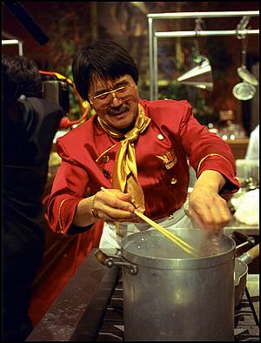
The Sakai Project
The University of Michigan, Indiana University, MIT, Stanford, the uPortal Consortium, and the Open Knowledge Initiative (OKI) are joining forces to integrate and synchronize their considerable educational software into a pre-integrated collection of open source tools.
Sakai Project receives $2.4 million grant from Mellon
Notes:
Many different home grown LMS systems - Mellon was seed money to initially coalesce four to one with the potential to lead to many more adopting the software.

Slide 6
Sakai Funding
Each of the 4 Core Universities Commits
  5+ developers/architects, etc. under Sakai Board project direction for 2 years
  Public commitment to implement Sakai
  Open/Open licensing—“Community Source”
So, overall project levels
  $4.4M in institutional staff (27 FTE)
  $2.4M Mellon, $300K Hewlett
  Additional investment through partners
Notes:
All of the resources funded by the grant and in-kind contributed report to the board to do “Sakai” bidding under the direction of the PI and Chief Architect.

Slide 7
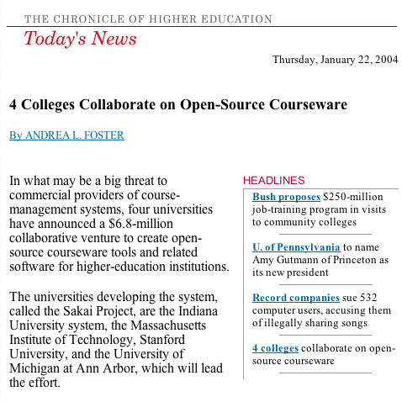
Notes:
Mellon “branding”
Gets lots of attention

Slide 8

Consolidation
Industry Shakeout
Black
Board
In a way, the Sakai “Project” is just a “blip” in the evolution of an Open Source CLE
Commercial
WebCT
?
Consolidation
Coordination
Home Grown
Sakai Project
1995
2002
2004
2007
Notes:
Emphasize the difference between the Sakai project and Sakai in the future. The need for close collaboration during the “grand rewrite”. Sakai project is just a blip - we hope it is transformational.

Slide 9
The Sakai Community
Close coordination for two years to quickly build the critical mass for open source enterprise Collaborative Learning Environment

Slide 10
Sakai Organization
Joseph Hardin
Sakai PI
Board Chair
Sakai Board
UM, IU, Stanford, MIT,
UCB, Foothill, OKI,
uPortal, Hull (UK)
Product
Requirements
Team
Architecture
Team
Project
Management
Sakai
Educational
Partners
Notes:
This is the organizational chart for the first two years. Central control like a startup. First must satisfy the needs of the four (six) adopters. Significant rewrite and new work. Not evolutionary at all. Hard work - not a lot of fun.

Slide 11
Sakai Educational Partners—Feb 1, 2005
Arizona State University
Boston University School of Management
Brown University
Carleton College
Carnegie Foundation for Advancement of Teaching
Carnegie Mellon University
Coastline Community College
Columbia University
Community College of Southern Nevada
Cornell University
Dartmouth College
Florida Community College/Jacksonville
Foothill-De Anza Community College
Franklin University
Georgetown University
Harvard University
Johns Hopkins University
Lubeck University of Applied Sciences
Maricopa County Community College
Monash University
Nagoya University
New York University
Northeastern University
North-West University (SA)
Northwestern University
Ohio State University
Portland State University
Princeton University
Roskilde University (Denmark)
Rutgers University
Simon Fraser University
State University of New York
Stockholm University
SURF/University of Amsterdam
Tufts University
Universidad Politecnica de Valencia (Spain)
Universitat de Lleida (Spain)
University of Arizona
University of California Berkeley
University of California, Davis
University of California, Los Angeles
University of California, Merced
University of California, Santa Barbara
University of Cambridge, CARET
University of Cape Town, SA
University of Colorado at Boulder
University of Delaware
University of Hawaii
University of Hull
University of Illinois at Urbana-Champaign
University of Melbourne, Australia
University of Minnesota
University of Missouri
University of Nebraska
University of Oklahoma
University of Texas at Austin
University of Toronto, Knowledge Media Design Institute
University of Virginia
University of Washington
University of Wisconsin, Madison
Virginia Polytechnic Institute/University
Whitman College
Yale University
Notes:
More adopters once the attention started to build.
Cost to join is 10K for three years. We get one new member each week approximately each week. There is almost no “direct benefit” to being a member. These fees support staff directed to help the partners use Sakai. The idea is that we did not have time to have the core spend all its time doing outreach.

Slide 12








Sakai Commercial Affiliates
The Sakai Educational Community License is BSD-like and allows complete flexibility in terms of the creation of and licensing of derivative works.
This allows different commercial companies to interact in different
ways without any limitations
imposed by license.
Notes:
Sakai encourages commercial companies to make money selling and supporting and adding value to Sakai. Sakai itself only produces and QA’s the software - any local development, customization, support, etc is either performed by local staff or by a commercial company.

Slide 13
Sakai Meetings
Provide a forum for the core and the SEPP to interact and for the SEPP members to interact with one another
  June 2004—Denver Colorado (180) (Members only)
  December 2004—New Orleans (200+) (Members only)
  June 8-14—Baltimore (400+ expected)
    Community Source Week
    uPortal, Sakai, OSPI
  December TBD—Austin, TX (Public)
Notes:
The Baltimore meeting is the first meeting which is open to both Sakai SEPP members and the public.

Slide 14
Sakai’s Future
Initial grant ends December 2005
Transition to Community Source
  The SEPP is renamed “Sakai” (1-2 Million/year)
  Governance is merit-based (like Apache)
  Core elements of Sakai software are pretty stable
  Small Community funded team (~10) to keep the core maintained and slowly evolving
  Most new development will be done outside of the core
  Significant continued in-kind resources Michigan, Indiana, Yale, Foothill, Stanford, and Berkley
Notes:
Much of the future governance will be discussed and decided during the sakai meeting this week. Community source is a little different than Open Source. Community Source is where the core stake holders are actually the customers. Commercial = Shareholders, Open Source = developers. I work for a CIO - in Sakai I work for 120 CIOs. In Apache I am just an individual. After January 2006, I will work *only* for 120 CIOs (i.e. UM will be 1/120th of my influence).

Slide 15
The Sakai Product
A Collaborative Learning Environment—Suitable for use in Teaching and Learning, Research Collaboration, and ad Hoc Group Communication.

Slide 16






Placing the Sakai Product
A Collaboration and Learning Environment
Teaching
And
Learning
Collaboration
Notes:
Sakai is a Collaborative Learning Environment.

Slide 17
Sakai Releases
Enterprise Quality Teaching and Learning and Collaboration
Sakai 1.0
Sakai 1.5
Sakai 2.0
Sakai 2.1
Jan 2004
Jan 2005
Jan 2006
Collaboration
Teaching and Learning
Enterprise “suitability”
Notes:
Sakai 1.0 influenced by CHEF from UM - LMS = Collaboration - Research Collaboratory Background.
Sakai 1.5 begins to fill the teaching and learning gaps and improves performance and scalability
Sakai 2.0 continues to fill the T/L gaps and continues to improve enterprise suitability. Expect 10-15 adopters in significant pilot.
Sakai 2.0 has a RC1 as of Yesterday. Delivery date is June 15.
Sakai 2.1 will be Fall 2005 - General improvement in all areas.

Slide 18
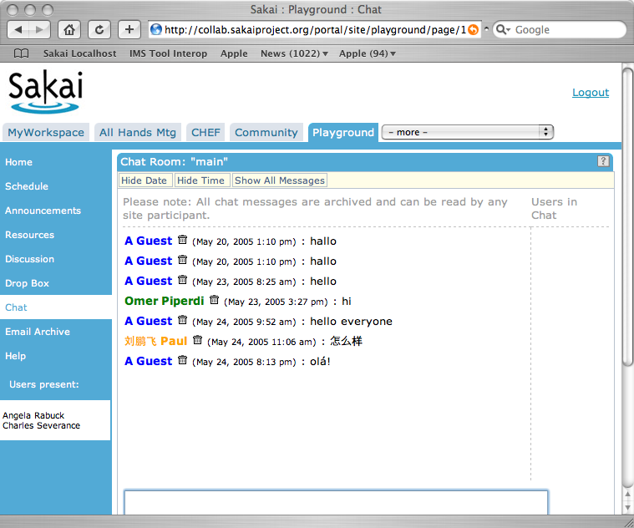
Sakai 1.0 Tools
Announcements
Assignments
Chat Room
Threaded Discussion
Drop Box
Email Archive
Message Of The Day
News/RSS
Preferences
Resources
Schedule
Web Content
Worksite Setup
WebDAV
Notes:
Very much influenced by CHEF. Note that UMICH thinking of teaching and learning as collaboration. No real learning focused tools - all generic collaboration tools.

Slide 19
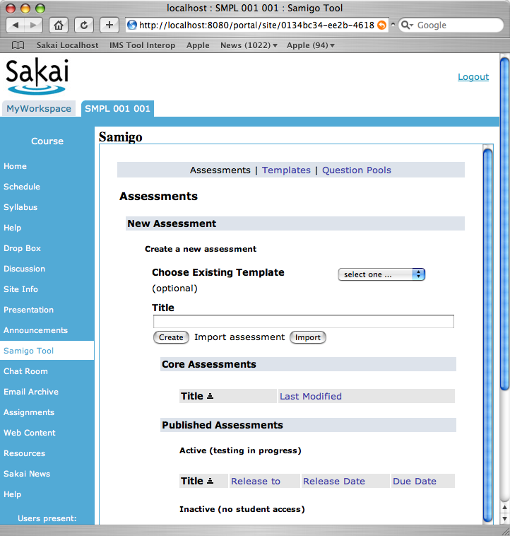
Sakai 1.5 Tools
Samigo—QTI compliant assessment engine (Stanford)
Syllabus Tool (Indiana)
Context Sensitive Help (Indiana)
Presentation Tool (SEPP)
Portfolio Tool—OSPI (R-Smart) (separate release)
Notes:
Beginning to fill the learning gaps. Improve performance and scalability.

Slide 20
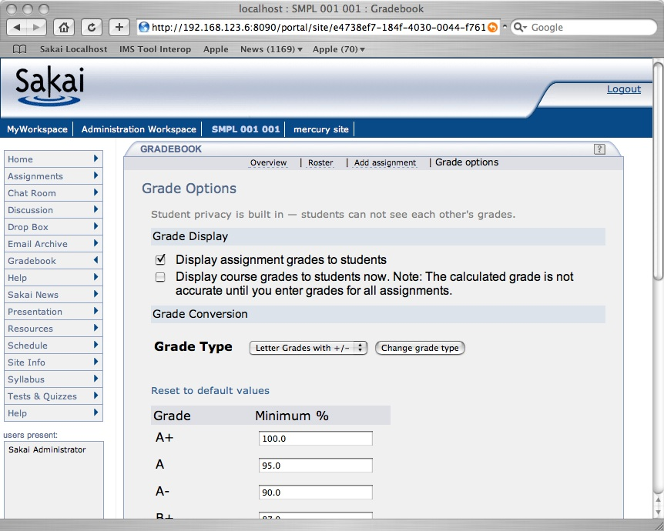
Sakai 2.0 Tools
Completely re-written Kernel (UM / MIT)
Melete - Online classroom - lesson editor (Foothill)
Profile Tool (Indiana)
Grade Book (UC Berkeley / MIT )
Notes:
Improved developer and deployment and configuration. Increasingly enterprise friendly. Increasingly well documented.
Release June 15 - rc1 on the street now.

Slide 21
Demo
Setting up a Worksite for Collaborative Group Projects

Slide 22
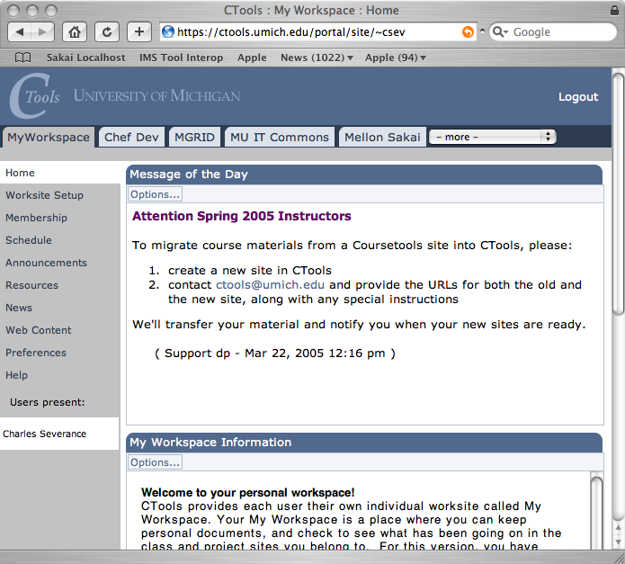
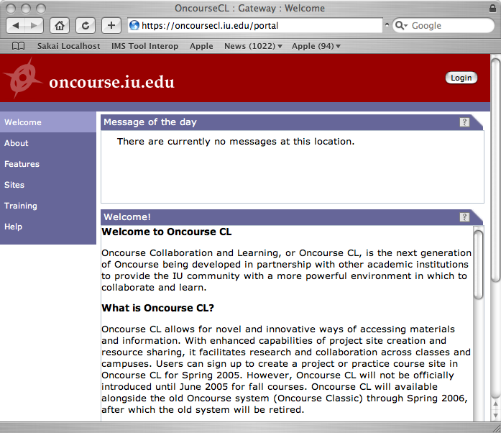
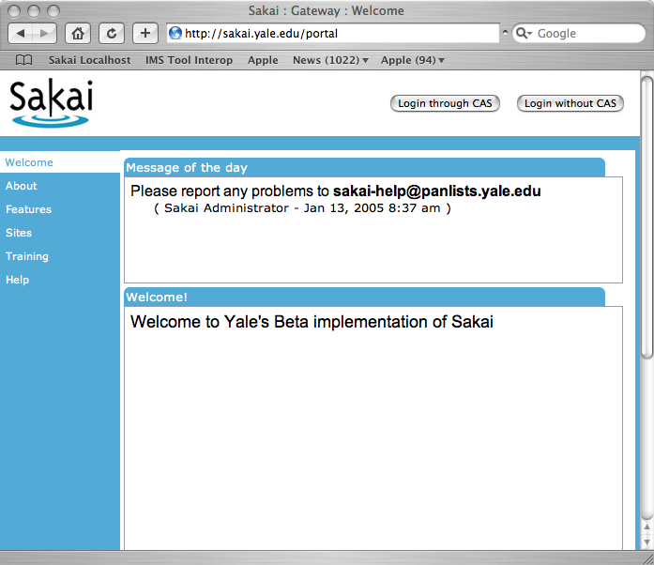
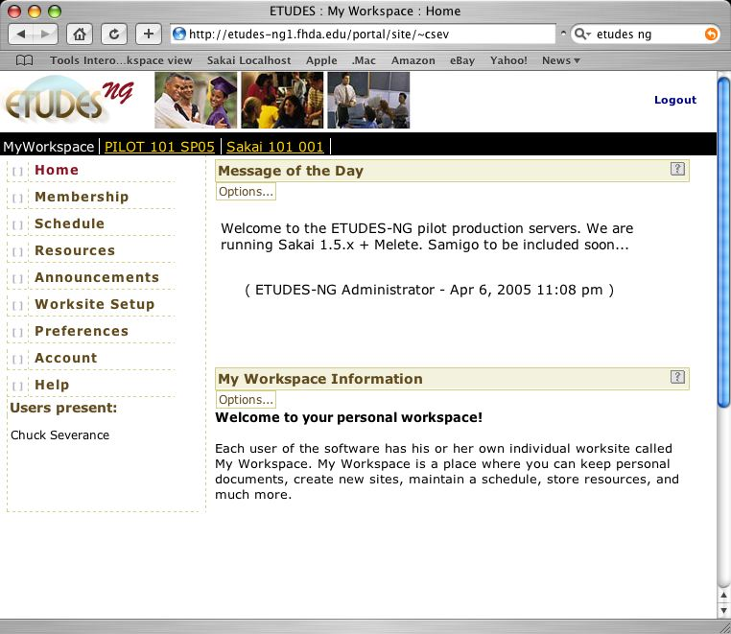
Sakai in Production
University of Michigan
  September 2004
Indiana University
  January 2005
Yale University
  January 2005
Etudes / Foothill
  April 2005
Notes:
These are the sites that are running 24x7 with real user bases that are teaching significant number of classes. They have a special place in my heart. Their CIOs all have my cell phone number and don’t hesitate to call on the weekend.

Slide 23







Sakai Adoption Plans
Boston University School of Management
Carleton
Columbia University
Johns Hopkins University
Lueck University of Applied Sciences, Germany
Massachusetts Institute of Technology
Northwestern University
Stanford University
University of California, Berkeley
• University of California, Los Angeles
• University of California, Merced
• University of Cape Town, SA
• University Fernando Pessoa, Portugal
• University of Lleida, Spain
• University of Missouri
• University of Virginia
• Whitman College
Type “Sakai Adoption Plans” into Google
Notes:
Merced is starting with Sakai and nothing else.

Slide 24
The Sakai Framework
The need to satisfy the often conflicting goals of ease of use, ease of expansion, configuration flexibility, environmental portability and rock-solid production reliability suitable for enterprise deployment.

Slide 25
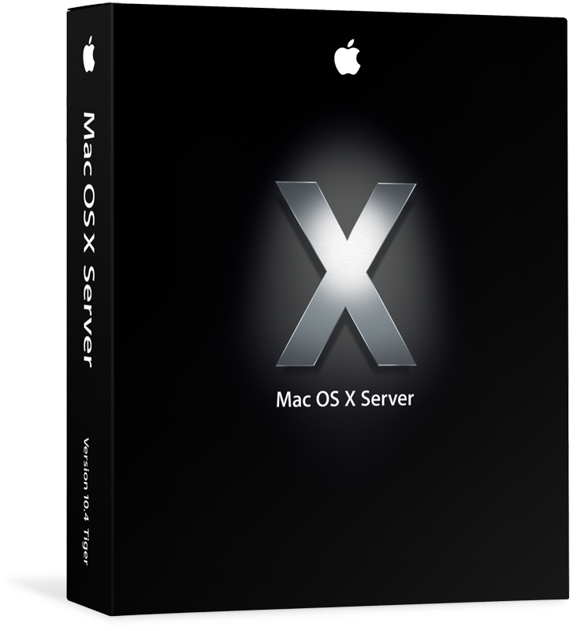
Sakai Foundational Technologies
Java
1.4
Apache - SSL, mod_jk, WEBISO, virtual hosting
Sakai consists of technologies chosen to be common in Java Enterprise Environments.
Sakai requires Tomcat 5.x but can make use of all of the open source elements included in
Mac OS X Server.
Sakai
Tomcat 5.5
Spring
Hibernate
Java Server Faces
Velocity (legacy)
JBoss and Tomcat 4.1
Included
in OS/X Server
MySql 4.1
Oracle is
*available* for
X/Serve
Oracle
Notes:
Oracle is available.
All other elements needed by Sakai are either part of the Sakai install or part of the X/Server out of the box.

Slide 26
Service Oriented Architecture
Browser
Browser
Presentation
Code
Service
Interface
(i.e. API)
My
Monolithic
Code
Service
Code
Persistence
Persistence
Notes:
I call this a “two-layer architecture” - “middle-ware” is another term that fits here.
Decompose tool code into presentation elements and service elements
Provide an abstraction (API) which shields the tool code from the implementation details of the service code - document and publish the API.
Allows separate development of the tools and services.
Allows effective unit testing of services
Allows an implementation to be replaced transparently with another implementation as long as the API contract is fully met

Slide 27
Sakai Application Framework
SAF—Presentation Services
Tool Layout (JSP)
Framework
Tool Code (Java)
Application
Application Services
SAF—Common Services
SAF—Kernel
Notes:
Kernel - An augmented web application which enables the Sakai APIs to be called from the web application - this is a rich but not constraining environment - insures that Common services are portable.
Common Services - A set of common services available to all tools (authentication, authorization, hierarchy, repository, others)
Presentation Services - A set of Sakai specific JSF tags to handle presentation details and provide widgets such as a date-picker or WSYWIG editor.

Slide 28
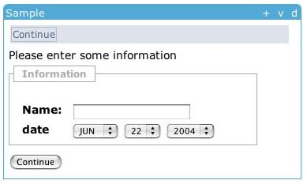
Sakai Presentation Services
<sakai:view_container title="#{msgs.sample_title}">
<sakai:tool_bar> <sakai:tool_bar_item/> </sakai:tool_bar>
<sakai:instruction_message
value="#{msgs.sample_one_instructions}" />
<sakai:group_box
title="#{msgs.sample_one_groupbox}">
<h:inputText
value="#{MyTool.userName}" />
<sakai:date_input
value="#{MyTool.date}" />
<sakai:button_bar> <sakai:button_bar_item action="#{MyTool.processActionDoIt} value="#{msgs.sample_one_cmd_go}" />
</sakai:button_bar>
Notes:
This is an example of how the presentation services work. Sakai provides a tag set which enforces style guide compliance, accessibility, internationalization, etc. The attempt is to do as much as possible in the framework and keep the tools as clean and simple as possible.

Slide 29
Sakai Service Providers
Common Services are localized using plug-ins
  UserDirectoryProvider
  RealmProvider
  CourseManagementProvider
These will be expanded
  OKI OSID Based Providers
Plug-ins do not replace the persistence, they are consulted in order to populate Sakai structures
SAF—Common Services
User Provider
Role Provider
Course Provider
Notes:
Sakai has an internal data model that is not supposed to be touched by local integrators. Local information is integrated into Sakai using the provider APIs. In the 2.0 release we use Sakai legacy plugins - in future releases we will be moving to support OKI Open Service Interface Definitions (OSIDs) as the plugin mechanism for enterprise data.

Slide 30
Sakai And OKI
OKI is one of the founding partners of the Sakai project
The Sakai Framework's use of OSIDs focuses on using OSIDs to integrate enterprise information into Sakai—this is expected for the 2.1 release
The Sakai Common APIs are designed based on adopting the design principles and terminology of the OSIDs (Agent, Asset, etc). This is done so that the Sakai APIs and OSIDs will remain in close alignment and each can benefit from innovations of the other
A number of tools including Samigo and Presentation use OSID APIs internally in Sakai 1.5 and 2.0

Slide 31
IMS Tool Portability Group
To work on ‘interoperability’ between and among CMS’s/CLE’s
Focus is on making tools portable between systems (Sakai, WebCT, and Blackboard)
Established to further the discussion with commercial and other CMS/CLE providers
Will use web services and IFRAMES
Will show working demonstration at the July 2005 Alt-I-lab with Samigo in Sakai, WebCT, and Blackboard
Notes:
Describe what IMS is.

Slide 32
Sakai, IMS, and Web Services
Header
HTML/HTTP
Button
Button
Button
Button
Button
Button
Tool Area
Web Services
1
6
5
7
Web
Services
Application
Code
CLE Environment
External Web Application
Launch
Control
4
Session
And Services
Bootstrap
3
2
Notes:
This is loosely based on WebCT’s PowerLinks and BlackBoard’s Chalkbox.

Slide 33
Summary or Why You Cared
Education Institutions and Customers
  Sakai provides FOSS enterprise-quality software for teaching, learning
  By adopting Sakai, institutions gain control over their own destiny w.r.t. teaching and learning on their campuses
Commercial and Open/Community Source Developers
  Sakai’s licensing is very commercial-friendly—many opportunities to add value to Sakai profitably
  Sakai’s founding principles are to engourage commercial affiliates and support those affiliates
Content Providers
  Sakai is taking a leadership role and working with OKI and IMS to develop cross-LMS standards and provide a reference implementation
  for those standards
  Allows content providers to build to a single standard and deploy across Sakai, WebCT, Moodle, Blackboard, etc...
Notes:
If you are a CIO of a higher ed institution, keep us on radar. If you are an early adopter come and join us. If you are a late adopter, wait 6 months and re-check.
If you are running a company with strong revenue stream from Higher Ed - doing customization for BB, WebCT - better take a look at Sakai.
If you are a content/widget provider - watch closely the IMS effort closely - re-check in the Fall.

Slide 34
Sakai and Apple
Among the developer team, 70% develop on Apple systems
  More dev-QA is done on Apple OS X than any other system :)
Sakai’s internal collaboration server runs on Mac OS/X Server
  collab.sakaiproject.org
Advantages of Mac OS/X and XServe when running Sakai
  Simple operating system maintenance (patches, etc)
  Java pre-installed and kept up to date
  Probably the ideal platform for small installations where there is not a dedicated system administrator

Slide 35
Sakai: More Information And Next Steps
Main site: www.sakaiproject.org
  Bugs: bugs.sakaiproject.org
Sakai-wide collaboration area
  collab.sakaiproject.org
  sakai-dev@sakaiproject.org
  sakai-user@sakaiproject.org
Maclearningenvironments.org
  Integrating Apple technologies into new Learning Environments
  Open and Community Source Learning Infrastructure Projects
  Mac OS X Server implementations and deployments of Sakai
  Community Built on Sakai

