Slide 1
Sakai Architecture
Charles Severance
Sakai Chief Architect
June 8, 2005

Slide 2
A Bit of History
The first “release” of Sakai was 12/03
Sakai was funded 01/04
Sakai 1.0 Alpha 02/04
  A number of groups reviewed it technically and concluded that its internal structure was “icky”
Framework II proposed - 08/04
  A cleanup/rewrite of the Sakai framework 08/04
  We did not have time to stop and rewrite…
  FWII - Research/Design 08/04 - 01/05

Slide 3
More History
Sakai 1.0 released 10/04
  Old framework - improved performance and reliability
Sakai 1.5 was 02/05
  Old framework - Samigo integrated
Framework II started 01/04
  Overlapped with 1.5 and 1.5.1 - slowly split focus and resources.

Slide 4
Release 2.0
Framework II kernel in place
Integrated - Gradebook and Samigo
Legacy tools internationalized
Legacy tools improved to be partially compliant with the style guide.
In summary, just about every end-user GUI element has been touched or is new.
Web services
The storage and services are still very 1.5-like
New skin
Notes:
Talk about the pumpkin - who is the pumpkin.

Slide 5
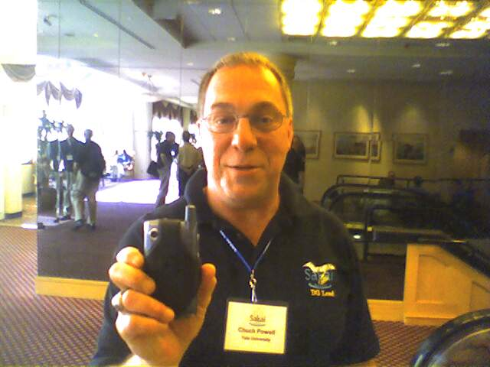
Release 2.0
Framework II kernel in place
Integrated - Gradebook and Samigo
Legacy tools internationalized
Legacy tools improved to be partially compliant with the style guide.
In summary, just about every end-user GUI element has been touched or is new.
Web services
The storage and services are still very 1.5-like
New skin

Slide 6
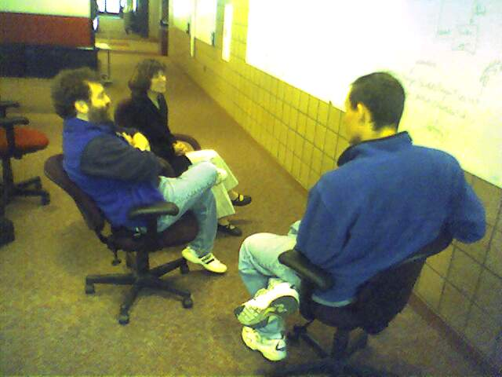
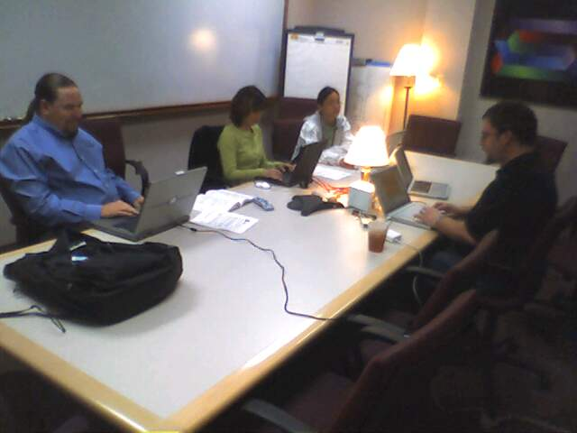
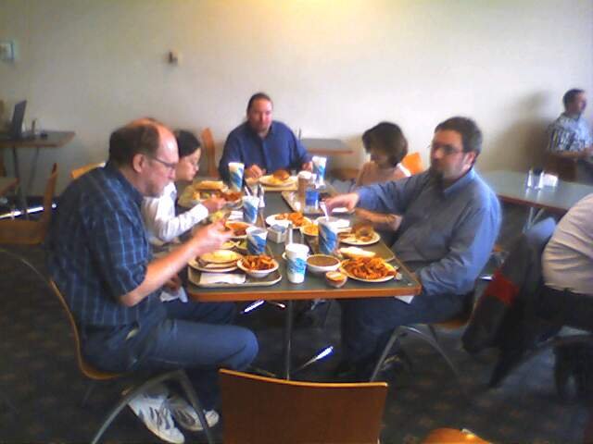
Release Process 2.0
Integration Week - May 16 - 20
  Resulted in Release 2.0 Alpha 1
QA
  Led by Carol Dippel
  Both core and volunteer QA were centrally coordinated
JIRA - bug tracking and release planning
Notes:
Michigan, Indiana, Stanford, Berkeley, and rSmart.
Series of Alpha followed by RC releases.
Currently in code freeze on all of Sakai 2.0. RC2 is cut and available.

Slide 7
Release 2.0 Packaging
Demo
  Unpack and start - one command
  Use Case: “show your boss”
  Includes everything else: 60MB +
  Zip for Windows and tar.gz for UNIX
Source
  Intended to configure and install for production - providers, skins, database connection, etc etc.
  Does not include pre-requisites
Binary
  Pre-compiled version of source ready to drop into your Tomcat and configure
Notes:
Very different from Sakai 1.5 - possible because of much cleaner configuration
Only pre requisite for Demo is Java.
Intent is for all distributions to be self-contained.
Unpack and look at the README :)

Slide 8
Still to come…
The new Common API portion of Framework II
Hierarchy
Sections and Groups (framework and tool changes)
Improved Enterprise Integration including OSIDs
WSRP portal integration
More significant tool re-factor and redesign
Producing uniform storage approach which works both for OSPI and Sakai
IMS Tool Interoperability launcher

Slide 9
Framework I

Slide 10
Framework I
Organically grown over five years
Heavily influenced by Jakarta Jetspeed and CHEF
During year one speed to release was of the essence
Framework I = CHEF - Jetspeed and Turbine + Spring and JSF
Used web app to store components to get class loader isolation
Used Tomcat-specific advanced (and recent) features

Slide 11
Sakai 1.5 Internal Design
Sakai 1.0 and 1.5 would be best characterized as “monolithic Kernels”
  Good design and factoring between tools and Services
  Within the services - good use of interfaces throughout, but factoring is sub-optimal and dependencies are too complex
  Sakai 1.0 has User and role plug insn
  Sakai 1.5 adds course/site and improves role plug ins
  Sakai 1.5 had simple support for raw servlets developed at the last minute - used for Samigo and Xwiki

Slide 12
Sakai 1.0
Sakai Velocity
Support
Sakai JSF
Support
Sakai Velocity
Tools
Sakai JSF
Tools
Sakai Service Implementations
Enterprise Data
User
Provider
Role
Provider
Notes:
Blue is framework, green is application space

Slide 13
Sakai 1.5
Sakai Velocity
Support
Sakai JSF
Support
Sakai Velocity
Tools
Sakai JSF
Tools
Sakai Servlet
Tools
Sakai Service Implementations
Enterprise Data
User
Provider
Role
Provider
Course
Provider
Sakai Servlet
Filter
Notes:
Green is application domain - blue is framework

Slide 14
Framework II

Slide 15
Sakai 2.0 Internal Design
Significant re-factor of functionality
  SAF - Kernel
    Components/Spring Session, Tool registry, Identity
    Support for Sakai tools, basic servlets, web services, and webdav
    Thread conditioning, Servlet filter
    Kernel enables the other services
  SAF - Services
    Primary support APIs which for tool interactions
  SAF - Presentation Services
    JSF, Velocity, Servlet
Major goal: Support for servlets, web services, and webdav using the Kernel

Slide 16
SAF Design Documents
Sakai Tool Model
Sakai Sessions
Sakai Request Flow
Sakai Mercury Portal
Sakai Use of Maven
Sakai Configuration
Sakai Charon Portal
Sakai Component Model
Sakai Authentication
These documents on collab.sakaiproject.org
“Sakai Development”

Slide 17
Sakai 2.0 Services
The Sakai Services are also re-factored
  SAF - Common Services
    File system, authentication, authorization, hierarchy, sites
  SAF - Framework Services
    Events, Portal, Navigation
  SAF - Application Services
    Chat, Discussion, Grading, Course Management, …

Slide 18
Sakai 2.0
Factoring
Sakai Velocity
Support
Sakai JSF
Support
Sakai Velocity
Tools
Sakai JSF
Tools
Sakai Servlet
Tools
Sakai
Application
Services
Sakai
Framework
Services
Enterprise Data
Sakai
Common
Services
User
Provider
Role
Provider
Course
Provider
Sakai Kernel and RequestFilter
Notes:
Green is application domain and blue is framework domain.

Slide 19
SAF - Kernel
Does not go “above” servlet level - “provisions” a Sakai servlet (and its thread) to fully operate
Elements (6900 lines of code)
  Components - Interaction with Spring to register/retrieve the Sakai API implementations with class-loader isolation
  Session
    httpSession - shared Sakai-wide for user/login
    sakaiSession - shared Sakai-wide for user/login
    sakaiToolSession - scoped by user/login/placement
  Tool registry - including support for “helpers”
  Identity of current logged in user
  Utilities including thread local support
Notes:
Does not go above servlet level means that this all works for code which “extends httpServlet” and even code which does low level stuff like response.write - this allows many things to be integrated into Sakai including basic servlets with API adapters (like Xwiki).
A properly scoped wrapped httpSession object is provided for those servlet activities that make use of httpSession (such as JSF).

Slide 20
SAF - Components
It is like container-wide Spring components, each with their own class loader
In Sakai 1.0 and 1.5 we placed components in webapps to get the class loader isolation, but we ended up with load-order problems
In Sakai 1.0 and 1.5 we “bent” Spring to orchestrate Sakai components
In Sakai 2.0 components simply appear “in Spring”
Notes:
Load order problems - bummed because it was so fundamental. Whoever figured out the context.xml trick - much appreciated.

Slide 21
SAF-Components
common/lib
spring
sakaiComponentManager
tomcat/components
component-1
WEB-INF
components.xml
classes
lib
component-2
WEB-INF
components.xml
classes
lib
tomcat/webapps/app1
WEB-INF
web.xml
ContextListener
tomcat/webapps/app2
ComponentManager
or
Spring
While it is not preferred, come components live in webapps. A ContextLoaderListener loads all of the components from a webapp. All globally registered components are available to Spring for injection (Interface names are the bean names) or via the Sakai ComponentManager API using Service Locator pattern.
Each component looks like a webapp, but with no web.xml. Each has classes and its own “lib”. Their class loader uses common and shared.
Notes:
The primary value is the separated class loaders. This way components with very large jar footprints like JENA, Globus, can be used without polluting shared. This allows multiple versions of things like xerxces to exist within the same JVM transparently.

Slide 22
SAF-Components Benefits
Separate class loaders for each component, and each webapp
Allows the jar footprint of one component not to be forced to overlap with all of the other components, tools, portal, etc.
  Multiple conflicting xerxes can be kept separate
  Adding/replacing a tool or component does not break things like the portal or other components
Provides an EJB-like isolation but using Spring to connect components to client code
Notes:
We have worked with Spring and had some initial discussions.

Slide 23
SAF - Session
Tomcat Sessions leave much to be desired
  Cross-context dispatch issues (fights between Pluto and Tomcat - changes between dot versions)
  Not well suited for Web Services or WebDav when browser is not involved
  Lifecycle issues - can’t always count on cleanup
  Scope issues - Shared / Servlet / Portlet
Sakai sessions solve all of these problems

Slide 24
SAF-Session Scenarios
Cookie set via login or at SSO via WebISO
Browser A
Browser B
Tool X1
Tool X2
Basic Auth
(Cookie opt)
WS Auth
Session ID
Tool Y1
Tool Y2
WebDav
Client
WS or
WSRP
Client
Filter
Renderer Servlet
Re-dispatch
Filter
Filter
Filter
Filter
WebDav
Servlet
Axis
Servlet
Tool X
(Portlet)
Tool Y
(Servlet)
Sakai APIs need logged in user, current session, etc.
Notes:
For each incoming request scenario, the filter sets appropriate Sakai Session, produces wrapped httpSession, and in the case of a tool, gets placement scoped session. In some situations, WebDav and WebServices, the filter may not be able to completely set up session so the WebDav or Axis servlet must participate in session establishment.
WebDav may or may not support cookies. Web Services will not support cookies.

Slide 25
Sakai Tool Registry
Each tool is self-contained in the source tree
Tools self-deploy
Kernel provides tool registry for portals to find tools and tools to find one another
Helper model is presentation agnostic
<registration>
<tool
id="sakai.presentation"
title="Presentation"
description="Presentation”
>
<category name="course" />
<category name="project" />
</tool>
</registration>
Notes:
No more central deploy or registration code to “add yourself to” - it all self-organizes at run-time.

Slide 26
Goal: Isolate non-Portable stuff to Kernel
SAF - Kernel + Filter
Sakai Velocity
Support
Sakai JSF
Support
Sakai Velocity
Tools
Sakai JSF
Tools
Sakai Servlet
Tools
Sakai
Framework
Services
Sakai
Application
Services
Sakai
Common
Services
Session, Identity, Components, Thread Setup
Notes:
This is from the view of the kernel. The kernel is intended to provide enough services “a warm fuzzy environment” so that all of these elements can be relatively portable across servlet and portlet containers.

Slide 27
Sakai 2.0 Elements

Slide 28
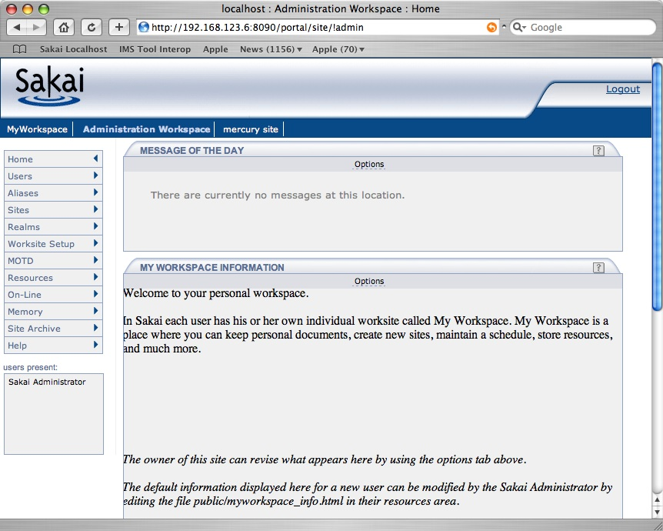
New Skin
Notes:
Sakai 2.0 has a new skin - Thanks to Gonzalo Silverio, Vivian Sinou and Teri Cartright.

Slide 29
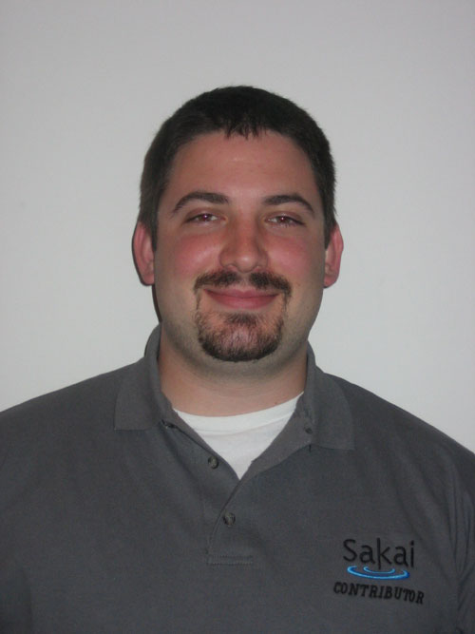
Enterprise Integration
User, Realm, and Course plug ins
Plug in APIs are still legacy
Sample providers in release: JLDAP, OpenLDAP, Kerberos, and IMS Enterprise in a database
Documentation needs to be improved for Realm and Course providers
Will evolve this capability in the Enterprise WG
Notes:
JLDAP - David Ross of Albany Medical College and Rishi Pande, Virginia Tech
Kerberos - Seth Theriault Columbia University - Kerberos
OpenLDAP - Adrian Fish, Lancaster University Centre for e-Science, Jose Garcia, Universitat de Lleida, Alex Balleste, Universitat de Lleida

Slide 30
Java Server Faces
Most of the 2.0 effort was focused support of Samigo, Gradebook, and Melete - this evolved into the “sakaix” tags
Support for both MyFaces and Sun Reference Implementation
Need to merge the sakai and sakaix tag set post 2.0 and complete cleanup
Need to revisit the style guide now that we have some experience with style guide
Notes:
Thanks to Jon Andersen, Ed Smiley, and Ray Davis.

Slide 31
Web Services
Web Services
Client
Based on Axis 1.2
Release 2.0 includes sample PHP client
Jakarta Axis
WS End Point
Sakai Kernel
Sakai APIs
Notes:
This was very simple because of the Sakai 2.0 kernel

Slide 32
Sakai Web Services Endpoint
import org.sakaiproject.api.kernel.session.Session;
import org.sakaiproject.api.kernel.session.cover.SessionManager;
public class SakaiSession {
public String checkSession(String id) {
System.out.println("session id="+id);
Session s = SessionManager.getSession(id);
if (s == null)
{
System.out.println("no session established");
return "Session Null";
}
else
{
String resp = "session: " + s.getId()
+ " user id: " + s.getUserId()
+ " user enterprise id: " + s.getUserEid()
+ " inactive after: " + s.getMaxInactiveInterval();
System.out.println(resp);
return resp;
}
}
}

Slide 33
Sakai Web Services Client
require_once('SOAP/Client.php');
if ( ! $_POST['url'] ) $_POST['url'] =
"http://nightly2.sakaiproject.org/sakai-axis/";
if ( $_POST['login'] ) {
$site_url = $_POST['url'] . 'SakaiLogin.jws?wsdl';
echo ("Loggging in to Sakai Web Services at ".$site_url);
$wsdl=new SOAP_WSDL($site_url);
// Create an object directly from the proxy code
$myProxy=$wsdl->getProxy();
$session=$myProxy->login("admin","admin");
echo ("Session:");
print_r ($session );
$_POST['session'] = $session;
}
Notes:
In PHP no less…

Slide 34
Web Services Image
~/dev/sakai2 csev$ find . -name '*.php'
./webservices/axis/test/basic/sakai_basic_test.php
~/dev/sakai2 csev$

Slide 35
Rendering
Architecture
User’s
Browser
Layout/Placement
Information
Renderer
Kernel Tool Registry
Request Filter
Tool A
Tool B
Tool C
Notes:
No more tunnel
No more ROOT webapp
Causes the URL naming pattern to change

Slide 36
Tool Dispatch and Helpers
User’s
Browser
To make use of a helper, a tool finds the helper by tool ID and then re-dispatches requests
to the helper.
Renderer
Kernel Tool Registry
Request Filter
Tool
Helper

Slide 37
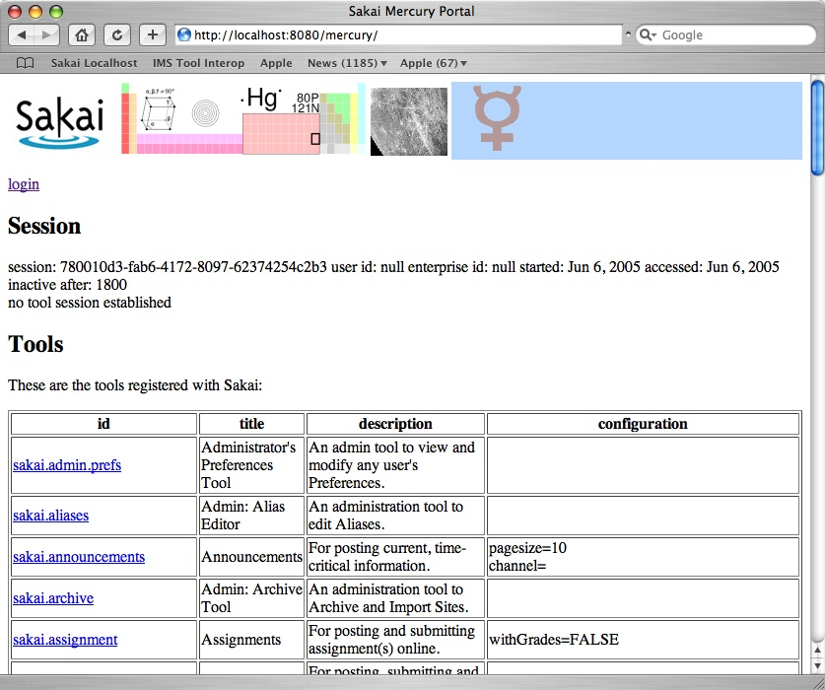
Mercury

Slide 38
Mercury
Portal
User’s
Browser
Mercury
Kernel Tool Registry
Request Filter
Tool A
Tool B
Tool C
Notes:
Has no layout nor placement - excellent for quick testing of tools. All tools live in one context “mercury”.

Slide 39
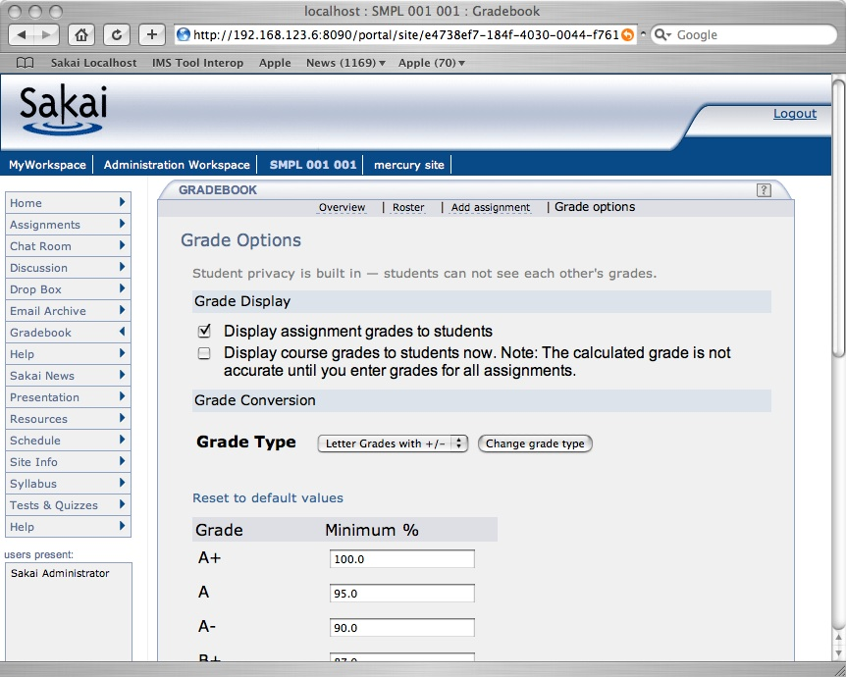
Charon Image

Slide 40
Charon
Portal
User’s
Browser
Sakai Sites
Charon
Kernel Tool Registry
Request Filter
Tool A
Tool B
Tool C
Notes:
End user built in portal - Sakai site aware.
Produces new iFrame naming convention. Se documents up on sakai-dev on collab.sakaiproject.org.
Charon is pure servlet (no Velocity)

Slide 41
Many Portals..
Browser
Browser
Browser
Portal
uPortal
Sedna
Charon
Mercury
TILE?
WSRP
JSR-168
Varuna
Kernel Tool Registry
Request Filter
Tool A
Tool B
Tool C
Web Services
Notes:
Sakai is designed to support many “portals” a portal is simply a consumer of tool markup. Abstracting making tool registration abstract allows this. We may develop a portal to support accessibility which does not use any iframes and supports significant GUI re-factoring based on profiles. WSRP is well developed and should be present in 2.1. The “168 shim” consumer is on the drawing boards. WSRP wil support any portal while JSR-168 will be initially developed for uPortal.

Slide 42
Courier
Based on XMLHttpRequest
No more clicks! No more spinning browser icons.
Not part of the portal - part of each tool
Flexible in terms of timing - 60 seconds for presence - 10 seconds for chat
Acessibility improved

Slide 43

I18N and L10N
JSF tools are bundle based
University de Ledia - Added bundles to legacy tools
This is just a start
  Need preferences and configuration
  L10N will identify flaws in the I18N
Several languages are starting right away
Discussion Group - Beth Kirshner and Alex Batiste

Slide 44
Developer Issues
All in one CVS
All one Eclipse - Eclipse files are nicely maintained nicely maintained
Dependencies re-factored
  Can drop tools and components in and out trivially
Demo = CVS + “maven sakai” + zip

Slide 45
A Few Concerns
Change Courier to be Accessible, Accessible Rendering, Integrate hierarchy throughout - both features and throughout the legacy services - change context from "Site Id" to "Hierarchy Position" throughout, Url Mapping and a site navigator which shows children recursively, Build Sakai Filing and Repository APIs, Performance test hibernate for clustered applications, Build OSID covers for Sakai APIs and document OBAs, WSRP Integration, IMS Tool Portability - develop spec, write reference implementation, IMS Content Import throughout as necessary, IMS Enterprise support?, Gradebook - Finish / Rewrite, Samigo - Finish - Integrate with Gradebook, Refactor CVS to make solid core module and more optional modules - build and make process to assemble these automatically to make a release, Build connections between legacy and Sakai APIs - understand and solve impedance mismatches, Course Management API throughout, Hierarchy Management tools and building, Build OKI OSID plug in capabilities, Sakai APIs need to support plugins, Review and Revise Framework Further, Make sure to use Servlet Filters throughout and eliminate tunneling, Wholistic review of site info and worksite setup in terms of flow and usability, Re-Evaluate the use of locks (especially Site edit ting, Worksite setup, and all the admin tools), Evaluate legacy APIs for possible promotion, Support Search Throughout, Internationalization, Rewriting old tools, Accessibility throughout, Design and implement Helper Mode in JSF Tools - "cross-tool navigation”, Support for MS-SQL, Support for DC, and LOM and generic Metadata throughout with configurable Metadata editor and metadata editor helper, Take some time and get to the point where we truly bake in RDF, Design the low level resource model, Enhance the development, and debugging process.

Slide 46
A Few Concerns
Change Courier to be Accessible, Accessible Rendering, Integrate hierarchy throughout - both features and throughout the legacy services - change context from "Site Id" to "Hierarchy Position" throughout, Url Mapping and a site navigator which shows children recursively, Build Sakai Filing and Repository APIs, Performance test hibernate for clustered applications, Build OSID covers for Sakai APIs and document OBAs, WSRP Integration, IMS Tool Portability - develop spec, write reference implementation, IMS Content Import throughout as necessary, IMS Enterprise support?, Gradebook - Finish / Rewrite, Samigo - Finish - Integrate with Gradebook, Refactor CVS to make solid core module and more optional modules - build and make process to assemble these automatically to make a release, Build connections between legacy and Sakai APIs - understand and solve impedance mismatches, Course Management API throughout, Hierarchy Management tools and building, Build OKI OSID plug in capabilities, Sakai APIs need to support plugins, Review and Revise Framework Further, Make sure to use Servlet Filters throughout and eliminate tunneling, Wholistic review of site info and worksite setup in terms of flow and usability, Re-Evaluate the use of locks (especially Site edit ting, Worksite setup, and all the admin tools), Evaluate legacy APIs for possible promotion, Support Search Throughout, Internationalization, Rewriting old tools, Accessibility throughout, Design and implement Helper Mode in JSF Tools - "cross-tool navigation”, Support for MS-SQL, Support for DC, and LOM and generic Metadata throughout with configurable Metadata editor and metadata editor helper, Take some time and get to the point where we truly bake in RDF, Design the low level resource model, Enhance the development, and debugging process.

Slide 47
Summary

Slide 48
Important DG/WG’s
I18N and L10N
Enterprise Integration
Framework
Portal Integration
Research Applications
Content
Library

Slide 49
Technical Futures
Rob Lowden / Chuck Severance
June 10, 2005

Slide 50
Sakai Beyond 2.0 - Features
None of this is a commitment - just the topics that will be on the minds of the development team after 2.0.

Slide 51
Timeline
Sakai 2.0 is the right thing to run for the 2005-2006 school year
  2.0.x releases will happen - bugs etc.
Sakai 2.1 October/November timeframe
  May want to ignore this release
  T.O.S. Schools will likely run in January
Sakai 3.0 will be Spring 2006 for Fall 2006 deploy
This is now the general pattern. Is the numbering right?

Slide 52
Users and Groups
This is a wide range of modifications to tools to make them “Group Aware”
Post an announcement to
  Whole site
  Group A
  Group B
Set of tools to define groups (part of site - all you need is maintain role)

Slide 53
Discussion Tool
Needs to be improved
*Everyone* has an opinion as to how to fix this
Foothill is working on a discussion tool
FYI: Look at Flowtalk - A simple E-Mail enhanced discussion tool that works in Sakai, CourseWork, etc.
Notes:
Discussion at Foothill is more important than the next release of their own.

Slide 54
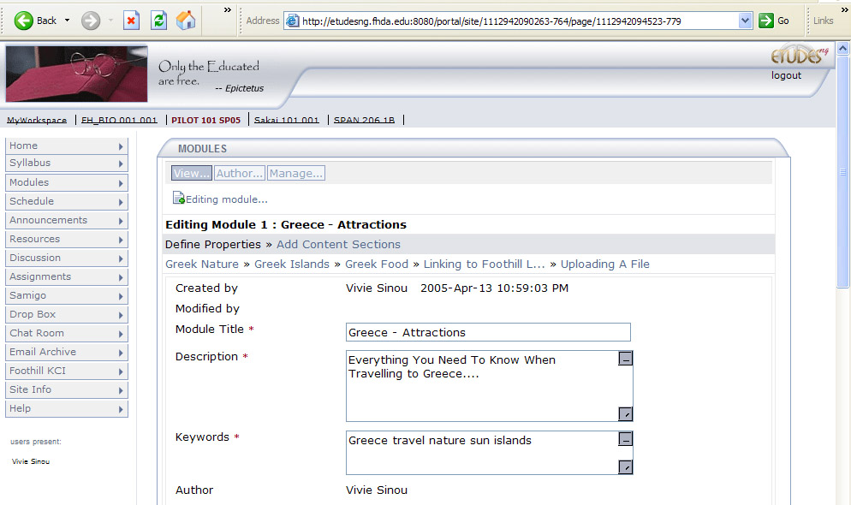
Melete Image
Melete will be independently released as a “drop-in” for 2.0.
Notes:
Melete is a module system - similar to a lite version of SCORM. It is an authoring and player environment and fully integrated into Sakai. The development of Melete could well be a model for the future development of significant tools. Melete was *not* done by the core. It was done by Foothill and Vivian Sinou (who is a board member but not core). The entire project team was at Foothill - funded by Hewlitt. The core team (Chuck and lance visited Foothill for advice and design but Foothill did *all* the work. Other members of the core team provided technical assistance such as Jon Andersen on JSF.
For now Melete is not in the bundle but will be a trivial drop-in for Sakai 2.0. Unzip one file and re-deploy.

Slide 55
TwinPeaks
Allows for pluggable search of online content repositories
Include content in the WYSWIG editor
Developed at Indiana University, DR OSID support added by MIT/OKI
Demonstration by Jeff Kahn

Slide 56
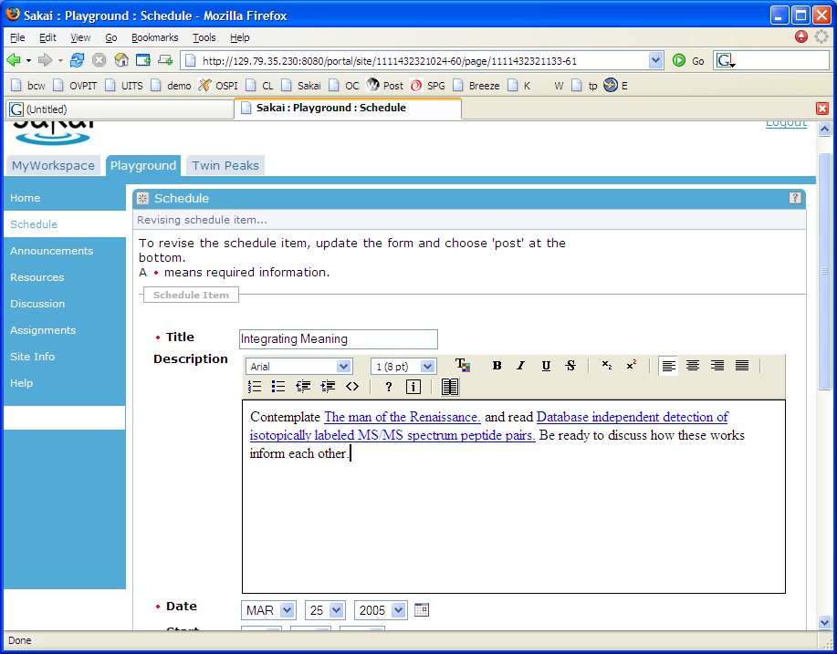
Search as part of
WYSIWYG Editor

Slide 57
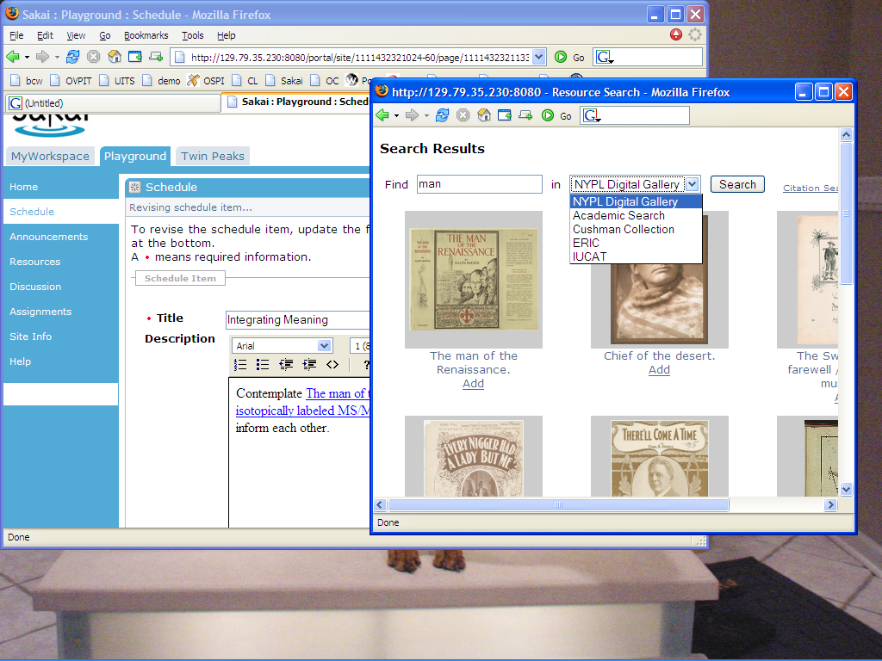

Slide 58
Import / Export
Needs to be much cleaner
Syllabus profile gradebook
Needs to be IMS Content
  Some code already exists in Melete

Slide 59
Sakai Beyond 2.0 - Framework
None of this is a commitment - just the topics that will be on the minds of the development team after 2.0.

Slide 60
Hierarchy and Common APIs
Related to user’s and groups, but different - this is more infrastructure and access control inheritance up and down trees of sites
  Define user with read access to all courses in engineering
  Navigate to all engineering courses (up, down)
Common APIs Agent, Authorization, etc. will get far more focus after 2.0
  Providers will change
  Wide scale deployment likely to be Fall 2006

Slide 61
Accessiblity
Build iFrame free portal
  Portal part is relatively straightforward
  Tool use of frames (Chat, Discussion) needs to be handled
Also investigating ways to make iFrames friendly (I.e. within Charon)
Accessible notification
Flexible presentation (like TILE)

Slide 62
IMS Tool Portability Group
To work on ‘interoperability’ between and among CMS’s/CLE’s
Focus is on making tools portable between systems (Sakai, WebCT, and Blackboard)
Established to further the discussion with commercial and other CMS/CLE providers
Will use web services and IFRAMES
Will show working demonstration at the July 2005 Alt-I-lab with Samigo in Sakai, WebCT, and Blackboard
Notes:
Describe what IMS is.

Slide 63
Sakai, IMS, and Web
Services
Header
Button
Button
Button
Button
Button
Button
Tool Area
1
6
5
CLE Environment
7
External Web Application
Web
Services
Application
Code
Launch
Control
4
Session
And Services
Bootstrap
HTML/HTTP
3
2
Web Services

Slide 64
Sakai 1.5 and OSPI 2.0
OSPI
Tools
Sakai
Access
OSPI
Access
OSPI
Publish
Sakai
Resource
Sakai
WebDav
OSPI
Resource
OSPI
WebDav
Sakai Content
API
OSPI Repo
API
Notes:
In Sakai 1.5 and OSPI 2.0 - there are completely separate stovepipes.

Slide 65
Goal State Sakai/OSPI
OSPI
Tools
Superset
Access
OSPI
Publish
Superset
Resource
Superset
WebDav
Superset Repo
API
Modified
Notes:
To fully align OSPI we will need to refactor all the areas where there is overlap to produce Superset versions.

Slide 66

WSRP Activities
SunGard-led and funded: Vishal Goenka
Working with uPortal in their WSRP 3.0 effort
As we really try to use WSRP, we identify issues in the standard and WSRP4J implementation
Sakai and uPortal are becoming involved in WSRP standards activities and WSRP4J

Slide 67
WSRP
“Portal”
WSRP Consumer
Portal
WSRP
Placements
Apache WSRP4J
Sakai Sites
Sakai WSRP
Kernel Tool Registry
Request Filter
Tool A
Tool B
Tool C
Web Services
Notes:
WSRP Portal was produced by Vishal Goenka of SunGard SCT over the past six months. It uses the kernel’s tool registry and tool dispatch just like every other portal. The Sakai WSRP portal satisfies the Apache WSRP4J producer API.

Slide 68
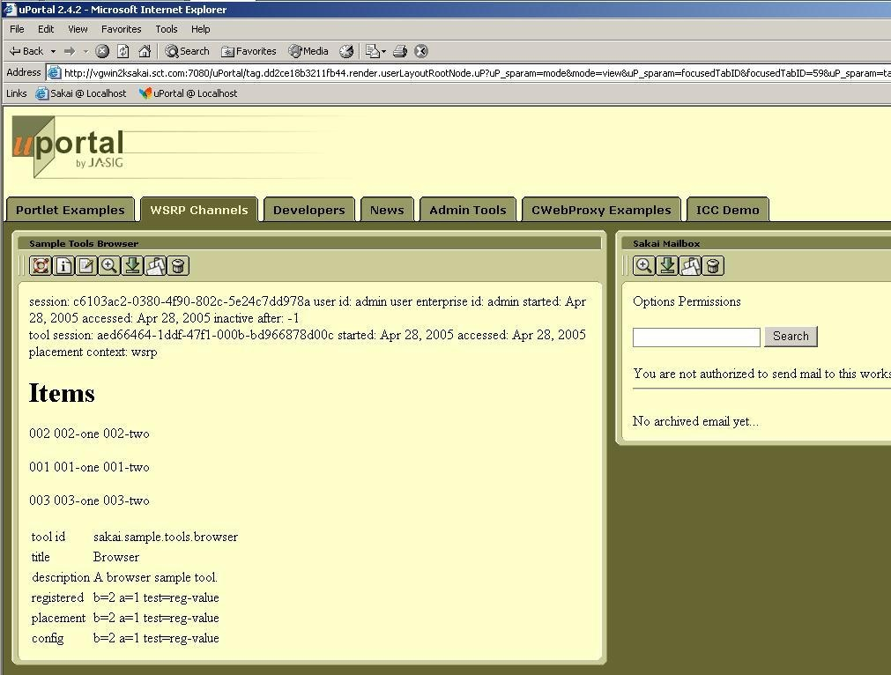
WSRP Image

Slide 69
JSR-168
Goal state: Some of the Sakai tools operate as channels in uPortal
  Not trivially portable to other portals
  WSRP delivers the portability between portals
WSRP is clearing the path in the architecture
Working on summit similar to WSRP summit - really uPortal needs to be the lead here
Notes:
For a Sakai site or tool placement to appear - use WSRP. To use Sakai tool in a uPortal - do JSR-168.
With JSR-168 uPortal is completely controlling placement.

Slide 70
Because Kernel transparently sets up session, user identity, and thread in ways are opaque to the Sakai Tools and Services, we can create a new version of the Kernel to operate in a uPortal/JSR-168 environment.
uPortal’s JVM
uPortal
uPortal
JSR-168
Velocity to JSR-168
JSF to JSR-168
Sakai
Velocity Tool
Sakai
JSF Tool
User, Site,
Role Plug-ins
Sakai Services, APIs,
Components
SAF - Kernel - uPortal Version

Slide 71
Now You Are Just Talking Crazy!
None of this is really on a schedule of any kind but we think about it when we get a free moment.

Slide 72
The Future..
In February, the board asked me to do a thought experiment…
  What if we had five more years with funding at $10 million per year?

Slide 73
Cross Tool Search
It would be nice to add Lucene throughout
This is “Resource Object Model Stuff”
This further breaks down stovepipes
Access Control must be maintained
How do we make sure that search includes your question pools, Melete modules, uploaded word files, chat messages, OSPI structured objects…

Slide 74
New API Implementations
Chat
  Jabber
Notification
  Jabber
Calendar
  iCalendar

Slide 75
Sakai, IMS, and Web
Services
Header
Button
Button
Button
Button
Button
Button
Tool Area
1
6
5
CLE Environment
7
External Web Application
Web
Services
Application
Code
Launch
Control
4
Session
And Services
Bootstrap
HTML/HTTP
3
2
Web Services

Slide 76
Moodle
Header
Button
Button
Button
Button
Button
Button
Tool Area
HTML/HTTP
Web Services
Tomcat
Sakai
Tool
IMS
Launch
Moodle
Launch
Apache
Sakai Shim
This is a crazy idea with no way to figure out if this will work without giving it a try. Probably the most challenging will be storing back to Sakai.
Moodle
Tool

Slide 77
Sakai and Institutional Repositories
Sakai will function as a collaborative environment in a wide range of applications
  Teaching and Learning
  Research and Cyber Infrastructure
  Ad hoc collaboration
Increasingly these collaborative activities are considered to be producing valuable digital “assets” and information worthy of long term storage and curation
There is a natural synergy between Sakai and institutional repositories

Slide 78
Inbound Object Flow
Search
View
The lens or disseminator understands the data model and is capable of rendering the objects. The lens is part of the IR.
Reuse
Sakai
IR
Index
Lens
Store
Create and use in native form
Prepare for
storage
Data
Model
Curate, convert, update and maintain over time
Ingest
The IR establishes a data model for “site” objects. The CLE hands sites to the IR. The IR may have to do “model” or content cleanup before completing the ingest process.

Slide 79
Outbound Object Flow
Sakai can find and re-use objects in the repository.
Search
View
View
Sakai
Search
Index
Lens
Lens
Reuse
Reuse
Data
Model
Data
Model
IR

Slide 80
JSR-170 - Content Repository
Java Content Repository
  File-system plus metadata
Replaces our ContentHosting API with a standard API
Provides promise of plug ability of implementation including vendor-provided repositories
Sakai
IR
Other
Apps
….
JSR-170
Repository

Slide 81
June 2006
Sakai running at 30 institutions, with 2 million daily users who are each using Sakai 20 times per day….
  Making 10 million new “learning resources” per day
  What do we do with these resources? How do we manage them? How do we find them? How do we reuse the resources? How do we recombine them to make new “objects”?
  This is *not* Google - because these learning objects are all fine grained access controlled..

Slide 82
June 2006
Sakai running at 30 institutions, with 2 million daily users who are each using Sakai 20 times per day….
  Making 10 million new “learning resources” per day
  What do we do with these resources? How do we manage them? How do we find them? How do we reuse the resources? How do we recombine them to make new “objects”?
  This is *not* Google - because these resources are all fine grained access controlled..
Data Portability - Format Agnostic
RDF - Resource Definition Format

Slide 83

RDF Chicken or Egg?
Sources of
RDF Information
Consumers of RDF
Information *
Longwell
Sakai/RDF
PiggyBank
Simile
RDF
Protocols
and
Formats
Dspace
Simile
Fedora
Haystack
Blogs
Annotea
RDFizers
Infrastructure
JENA, etc..
Infrastructure
JENA, etc..
Data and Metadata
* A common approach in RDF is that consumers often consume, add value, and re-produce.

Slide 84
RDF Chicken or Egg?
Sources of
RDF Information
Consumers of RDF
Information *
getData()
Longwell
Sakai/RDF
PiggyBank
Simile
RDF
Protocols
and
Formats
Dspace
Simile
Fedora
Haystack
Blogs
Annotea
RDFizers
Infrastructure
JENA, etc..
Infrastructure
JENA, etc..
Data and Metadata
* A common approach in RDF is that consumers often consume, add value, and re-produce.

Slide 85
RDF Producers
Adding RDF to repositories will make existing “Curated Resources” available via RDF
  DSPACE
  Fedora
  EduCommons
  OCW
Adding RDF to Sakai would create a massive source of “Organic” Resources
  Interesting information - personal information, calendar entries, chat messages, e-Mail
  Educational objects
  Fine-grain access control

Slide 86
More Ideas…
Add video conferencing orchestration to Sakai - VRVS ?
Federated Sakai - Bringing together placements from many Sakai’s to one “portal” through WSRP
Offline Sakai - Download all of the data in a site, work with it off-line, upload and resynchronize
Ajax Portal and JSF Render Kit
Flash Portal
Non-Web Clients - Desktop versions of Sakai
…..

Slide 87
New Sakai Funding
Good News: Our funding is extended
$10 Million per year - 5 years
400 * 2.5 * $100K = $10M
Turn to the person sitting next to you and say “thank you for the software.”
There is a bit of an organizational problem yet to be solved…

Slide 88
Summary
Locally motivated distributed efforts
Distributed Ownership
Coordination is still needed - control not

Slide 89
How to Contribute (now)
Distributed Leaders
  I give someone a picture on a napkin and tell them that “you have 6 months” - keep in touch
Individual contributors with committer mentors
  An existing committer runs interference does commits, helps fit into schedules, etc
  The next six months - the existing committers will be busy - but less so than the past 6 months - more time for mentors…

Slide 90
Moodle
Header
Button
Button
Button
Button
Button
Button
Tool Area
HTML/HTTP
Web Services
Tomcat
Sakai
Tool
IMS
Launch
Moodle
Launch
Apache
Sakai Shim
This is a crazy idea with no way to figure out if this will work without giving it a try. Probably the most challenging will be storing back to Sakai.
Moodle
Tool

Slide 91
How to Communicate
Don’t be shy on the dev list!
Matchmaker service - find others interested in the same thing
When in doubt - ask. csev@umich.edu or Rob or a Board Member

Slide 92

Q & A
Any questions?
Just do it!

