Slide 1

Sakai Update
VRE Workshop
Charles Severance
Sakai Chief Architect
June 22, 2005
http://www.dr-chuck.com/talks.php?id=48

Slide 2
This is a short summary of four hours of presentations:
Overview of Sakai Project
http://www.dr-chuck.com/talks.php?id=46
Sakai Technical Update
http://www.dr-chuck.com/talks.php?id=47

Slide 3
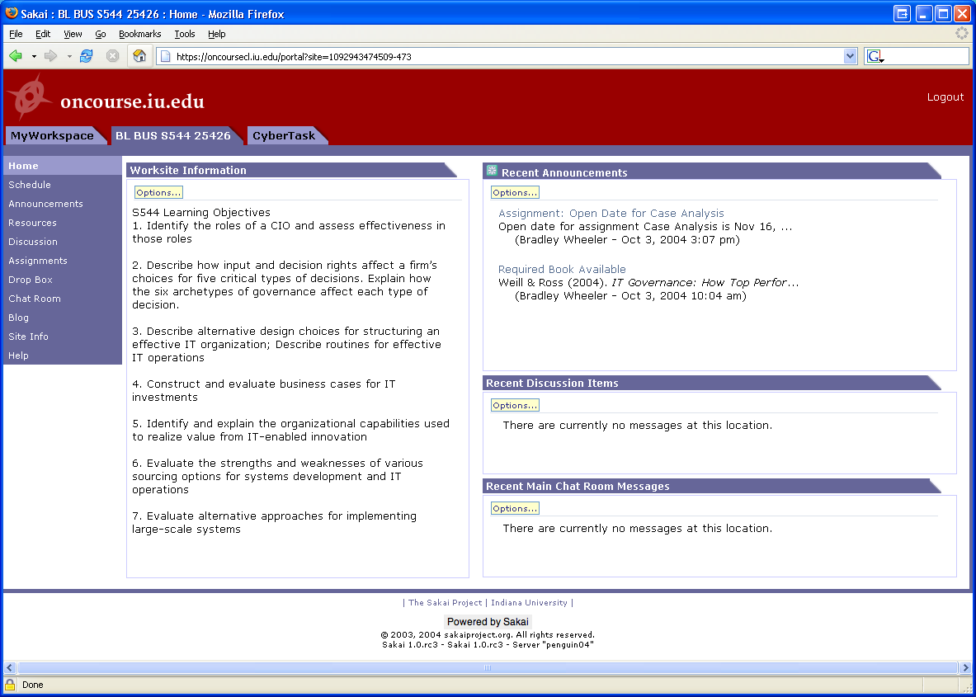
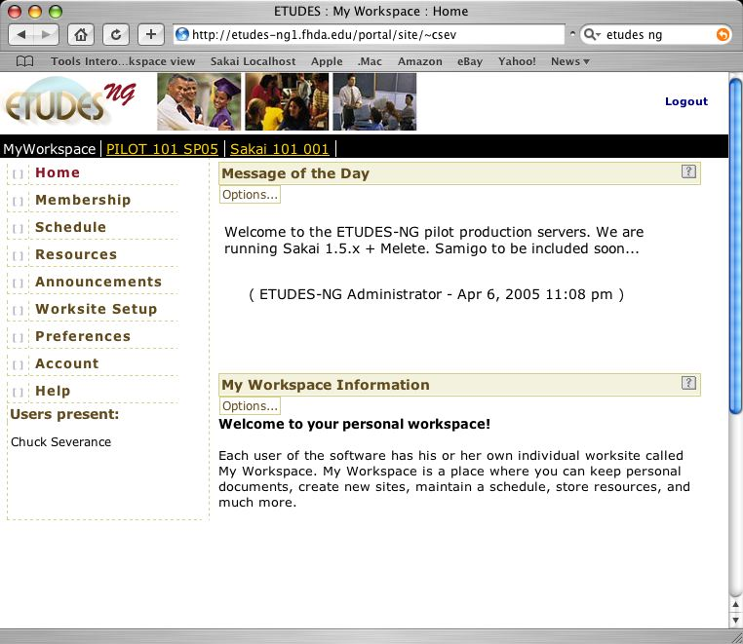
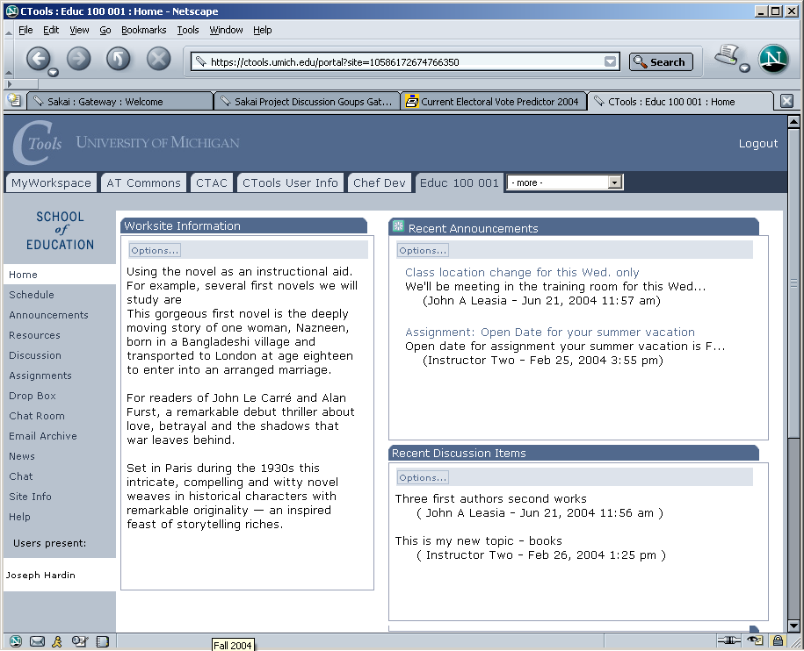
Sakai 2.0 released June 15, 2005
10+ Sites in production

Slide 4
Quick Summary of Sakai 2.0

Slide 5
Web Services
Web Services
Client
Based on Axis 1.2
Release 2.0 includes sample PHP client
Jakarta Axis
WS End Point
Sakai Kernel
Sakai APIs
Notes:
This was very simple because of the Sakai 2.0 kernel

Slide 6
Sakai Web Services Endpoint
import org.sakaiproject.api.kernel.session.Session;
import org.sakaiproject.api.kernel.session.cover.SessionManager;
public class SakaiSession {
public String checkSession(String id) {
System.out.println("session id="+id);
Session s = SessionManager.getSession(id);
if (s == null)
{
System.out.println("no session established");
return "Session Null";
}
else
{
String resp = "session: " + s.getId()
+ " user id: " + s.getUserId()
+ " user enterprise id: " + s.getUserEid()
+ " inactive after: " + s.getMaxInactiveInterval();
System.out.println(resp);
return resp;
}
}
}

Slide 7
Sakai Web Services Client
require_once('SOAP/Client.php');
if ( ! $_POST['url'] ) $_POST['url'] =
"http://nightly2.sakaiproject.org/sakai-axis/";
if ( $_POST['login'] ) {
$site_url = $_POST['url'] . 'SakaiLogin.jws?wsdl';
echo ("Loggging in to Sakai Web Services at ".$site_url);
$wsdl=new SOAP_WSDL($site_url);
// Create an object directly from the proxy code
$myProxy=$wsdl->getProxy();
$session=$myProxy->login("admin","admin");
echo ("Session:");
print_r ($session );
$_POST['session'] = $session;
}
Notes:
In PHP no less…

Slide 8
IMS Tool Portability Group
To work on ‘interoperability’ between and among CMS’s/CLE’s
Focus is on making tools portable between systems (Sakai, WebCT, and Blackboard)
Established to further the discussion with commercial and other CMS/CLE providers
Will use web services and IFRAMES
Will show working demonstration at the July 2005 Alt-I-lab with Samigo in Sakai, WebCT, and Blackboard
Notes:
Describe what IMS is.

Slide 9
Sakai, IMS, and Web
Services
Header
Button
Button
Button
Button
Button
Button
Tool Area
1
6
5
CLE Environment
7
External Web Application
Web
Services
Application
Code
Launch
Control
4
Session
And Services
Bootstrap
HTML/HTTP
3
2
Web Services

Slide 10
Sakai and Portals

Slide 11
Portals .vs. LMS
Organized by enterprise and are often driven by the office of communications (Library, HR, Athletics, President)
Often geared to individual customization
Many small rectangles to provide a great deal of information on a single screen
Portals think of rectangles operating independently - like windows
Think “Dashboard”
Organized by academic aspects and are driven by the registrar (Colleges, Departments)
LMS’s are customizable by faculty or departments but not typically by students
LMS’s like one tool on the screen at a time.
LMS’s think of navigation as picking a tool or switching from one class to another
Think “Application”

Slide 12

WSRP Activities
SunGard-led and funded: Vishal Goenka
Working with uPortal in their WSRP 3.0 effort
As we really try to use WSRP, we identify issues in the standard and WSRP4J implementation
Sakai and uPortal are becoming involved in WSRP standards activities and WSRP4J

Slide 13
WSRP
“Portal”
WSRP Consumer
Portal
WSRP
Placements
Apache WSRP4J
Sakai Sites
Sakai WSRP
Kernel Tool Registry
Request Filter
Tool A
Tool B
Tool C
Web Services
Notes:
WSRP Portal was produced by Vishal Goenka of SunGard SCT over the past six months. It uses the kernel’s tool registry and tool dispatch just like every other portal. The Sakai WSRP portal satisfies the Apache WSRP4J producer API.

Slide 14
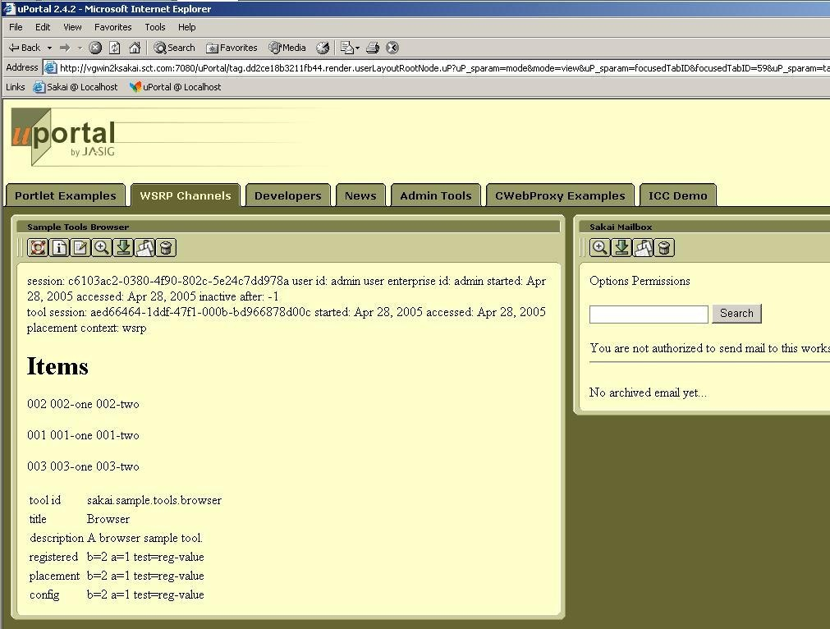
WSRP Image

Slide 15
JSR-168
Goal state: Some of the Sakai tools operate as channels in uPortal
  Not trivially portable to other portals
  WSRP delivers the portability between portals
WSRP is clearing the path in the architecture
Working on summit similar to WSRP summit - really uPortal needs to be the lead here
Notes:
For a Sakai site or tool placement to appear - use WSRP. To use Sakai tool in a uPortal - do JSR-168.
With JSR-168 uPortal is completely controlling placement.

Slide 16
Because Kernel transparently sets up session, user identity, and thread in ways are opaque to the Sakai Tools and Services, we can create a new version of the Kernel to operate in a uPortal/JSR-168 environment.
uPortal’s JVM
uPortal
uPortal
JSR-168
Velocity to JSR-168
JSF to JSR-168
Sakai
Velocity Tool
Sakai
JSF Tool
User, Site,
Role Plug-ins
Sakai Services, APIs,
Components
SAF - Kernel - uPortal Version

Slide 17
Sakai and Repositories

Slide 18
Sakai and Institutional Repositories
Sakai will function as a collaborative environment in a wide range of applications
  Teaching and Learning
  Research and Cyber Infrastructure
  Ad hoc collaboration
Increasingly these collaborative activities are considered to be producing valuable digital “assets” and information worthy of long term storage and curation
There is a natural synergy between Sakai and institutional repositories

Slide 19
There is a Difference…
Collaborative Systems
Many different systems may be active at the same time
Systems evolve, improve, and are often replaced every few years
Systems focused of the dynamic needs of users and applications
Thousands of simultaneous users
Performance tuning
Must be very easy to use almost unnoticeable
Used informally hundreds of times per day per user
Institutional Repositories
Generally one system for the institution
Long term strategic choice for institution
System focused on accessing, indexing, curation, and storage
Millions of high quality objects properly indexed
Data and metadata quality
Must enforce standards and workflow to insure data quality
Most use is very purposeful: search, publish, add value
Notes:
Collaborative systems often allow materials to be sloppy (copyright for example). IR’s must be very clear on copyright as there are likely to be different rules w.r.t. materials in IR’s. This may require some cleanup on materials from collab systems when moving to an IR.

Slide 20
Some Questions to Ponder..
Should Sakai simply use the IR as its online storage so that the data is already ingested?
Should PeopleSoft store all of its data in the Institutional Repository?
Is Sakai an adequate Institutional Repository in its current form? With Sakai is there any reason to have an Institutional Repository?
Is there a difference between Institutional Repository, Institutional Storage, and Database Services?

Slide 21
High Level View
Collaborative
Learning
System
Library
Assets
Institutional
Repository
Research
Activities
Publishing
Activities
The I.R. is the constant across time and application for the institution.
Notes:
In addition to the “online” institutional repository, there is a separate notion of archival repository which has less “online” focus but instead focuses on archival of data for a very long time. Imagine the archive of HR data for hundreds of years.

Slide 22
Inbound Object Flow
Search
View
The lens or disseminator understands the data model and is capable of rendering the objects. The lens is part of the IR.
Reuse
Sakai
IR
Index
Lens
Store
Create and use in native form
Prepare for
storage
Data
Model
Curate, convert, update and maintain over time
Ingest
The IR establishes a data model for “site” objects. The CLE hands sites to the IR. The IR may have to do “model” or content cleanup before completing the ingest process.
Preparation for storage may include cleanup, conversion, copyright clearance, and other workflow step.

Slide 23
Outbound Object Flow
Sakai can find and re-use objects in the repository.
Search
View
View
Sakai
Search
Index
Lens
Lens
Reuse
Reuse
Data
Model
Data
Model
IR

Slide 24
Institutional Repository Technologies
DSpace - is a connected set of features that includes repository, delivery mechanisms, and both user and administrative interfaces.
OCW - IR focused on long term archival of teaching and learning material
IBM Content Manager - Highly media oriented IR
Fedora - has been developed primarily as “repository” without a specific user interface
Artstor - is an example of a repository that is cross-institutional built around particular collection and technologies to manage that collection

Slide 25
Will there ever be “one” Institutional Repository?
Each current repository project covers a particular space / technology.
Problems like long-term curation, extremely complex objects, rich media understanding are difficult to do in the general case.
Some short term localized convergence may happen as one project adopts technology from another.
Data portability between systems is the needed innovation to make IR choice more transparent.

Slide 26
Going Forward
Instead of solving the problem by creating a single IR technology that is a superset - which might take years
Focus on data portability between systems - reduce the impedance mismatch (or needed conversion between systems)
RDF enables object portability across systems, languages, and technologies

Slide 27
Tangible Steps
Move Sakai and other LMS/CMS systems toward RDF
  Experiment with using RDF as native storage format instead of relational or file-system
  RDF has yet to demonstrate scalable performance needed for >100K active users - this is a research area
Move institutional repositories toward RDF
  Move from schema-based stovepipe objects to OWL/RDF based objects with referential integrity
  Explore dimensions of portability of disseminator / lenses - this is an important research area
Use these efforts to demonstrate practical data interchange in ways that greatly enhance teaching and learning
Notes:
At some level RDF is a low-level enabler which is a pre-requisite. In a way RDF is like “Ethernet” is for the Internet. Additional aspects beyond RDF include OWL (Web Ontology Language) defines the models of data represented in RDF. And beyond RDF and OWL, there is the development of software that understands different onltolgies at increasing levels of semantic understanding.

Slide 28
Proposed Strategy
Short Term
  Choose one or more IR’s to work with
  Develop with IMS Content based Export (schema-based)
  Work on lenses / disseminators for the Sakai IMS Content Object in selected IR systems
  Work will be done in the context of the entire Sakai project (I.e. not just the core 6)

Slide 29
Proposed Strategy (cont.)
Medium Term
  Encourage RDF in Sakai and IR’s
  Explore performance aspects of RDF as raw storage mechanism within Sakai
  Encourage the development of RDF variants of standards like IMS Content and IMS Enterprise
  Investigate JSR-170 and its implication for RDF representation and potential technology alignment
  Encourage the development of cross-IR lenses / disseminator standards

Slide 30
Proposed Strategy (cont.)
Long term
  Explore ways in which data movement between IR’s and online systems can be made more implicit
  At some point the boundary begins to blur and the systems begin to appear to be seamless.

Slide 31
Thank you for your time….
Overview of Sakai Project
http://www.dr-chuck.com/talks.php?id=46
Sakai Technical Update
http://www.dr-chuck.com/talks.php?id=47
http://www.dr-chuck.com/talks.php?id=48

