Slide 1
Sakai: Building the framework for collaborative E-Research
Charles Severance
Sakai Chief Architect
csev@umich.edu
www.dr-chuck.com?talks.php

Slide 2
E-Research Framework Choices
Portal Software?
  uPortal, GridSphere, Liferay, .NET
Repository Software?
  Fedora, Dspace, Plone
Collaborative Software?
  Sakai, Sharepoint, Lotus Notes ?
Web Services and loose coupling?
Notes:
Say you are starting an E-Research project, what software should you use?

Slide 3
Aspects of Collaborative E-Research
Collaboration
Data
Resources
Notes:
E-Research going forward is people working together around some set of resources (compute, experimental, etc) and some collections of data - all interlinked. Perhaps at the beginning of a project or in a small project - it will seem like there is only one aspect - like “we are building a data repository for physicists”. But over time, the requirements will expand to fit the needs.

Slide 4
The Right Technology
Collaboration
Sakai
Data
Resources
Fedora
uPortal
Notes:
Depending on how you view your particular E-Research at the beginning, you might start with very different software as a starting point and get started - after all these projects usually end up behind schedule and in a big hurry to do *something*. So everyone “picks one”.

Slide 5
Collaboration .vs. Portal
Basic organization is about the shape of the people and groups
Customization based on the “group leaders”
New groups form quickly and organically
Doing one thing at a time - chat, upload - perhaps multiple active windows on a desktop
Very interactive
Think of navigation as picking a tool or switching from one class to another
Think “Application”
Basic organization is about the thing it represents - Teragrid, NVO
Site customization is based on the resource owners
Sometimes there is an individual customization aspect
Many small rectangles to provide a great deal of information on a single screen
Portals think of rectangles operating independently - like windows
Think “Dashboard”

Slide 6
Collaboration .vs. Repository
Many different systems may be active at the same time
Systems evolve, improve, and are often replaced every few years
Systems focused on the dynamic needs of users and applications
Thousands of simultaneous online users
Performance tuning
Must be very easy to use; almost unnoticeable
Used informally hundreds of times per day per user
Think “E-Mail”
Generally one system for the area
Long term strategic choice for institution
System focused on accessing, indexing, curation, and storage
Millions of high quality objects properly indexed
Data and metadata quality
Must enforce standards and workflow to insure data quality
Most use is very purposeful: search, publish, add value
Think “Library”
Notes:
Collaborative systems often allow materials to be sloppy (copyright for example). IR’s must be very clear on copyright as there are likely to be different rules w.r.t. materials in IR’s. This may require some cleanup on materials from collab systems when moving to an IR.

Slide 7
Is this what the user wants?
Collaboration
Sakai
?
Data
Resources
Fedora
uPortal
Notes:
Depending on how you view your particular E-Research elephant, you might start with very different software as a starting point and get started - after all these projects usually end up behind schedule and in a big hurry to do *something*. So everyone “picks one”.

Slide 8

Why are all of these projects so different?
Why are all these projects so different?
D
C
C
C
R
D
R
Notes:
Everyone picks something different - because they are the PI and in a hurry - everyone is in a hurry? Everyone wants to solve some most important aspect “first”.
Legend: Data Collaboration Research…

Slide 9

Why is my teaching tool different?
Why is the tool I teach with so different from my research tools?
C
D
C
C
C
R
D
R
Notes:
Everyone picks something different - because they are the PI and in a hurry - everyone is in a hurry? Everyone wants to solve some most important aspect “first”.

Slide 10
If data and resources are important to Research, why not use them in teaching too?
Perhaps data and resources would be useful in teaching too… Would my research be useful in my teaching?
C
D
C
D
R
C
C
R
D
R
Notes:
Everyone picks something different - because they are the PI and in a hurry - everyone is in a hurry? Everyone wants to solve some most important aspect “first”.

Slide 11
Teaching, Research, Collaboration, Data, and Portals are all part of an E-Research solution…
The Sakai product cannot do everything (Collaboration, Portal, and Data)
But the users want it all seamlessly integrated and easy to use…
Notes:
How to go about doing this?

Slide 12
How we do this now…
VRE Customers
IE Customers
VRE “Experts”
IE “Experts”
Collaborative
VLE/VRE/IE
Requirements
When we treat Virtual Learning, Virtual Research, and Information Environments as different, we end up developing divergent environments which satisfy similar requirements in very different ways based on the experts who are funded to produce the VRE, VLE, or IE solutions.
Each expert group is often influenced by a different field of research: VLE’s are influenced by Educational Technology experts, VRE’s are often influenced by Computer Scientists, while IE’s are influenced by Library Sciences.
VLE “Experts”
VLE Customers
Notes:
Stop building stovepipes….
Virtual Research Environments - Domain Scientists and Computer Scientists - funded by NSF and DOE.
Virtual Learning environments - Educational technology folks and CIOs - funded by general fund and foundations.
Information Environments - Digital Library and Information Science folks - funded by General Funds and NSF.
There are not just three solutions - these are three areas. Within each area there are a myriad of solutions technology-wise - roughly one solution for every PI.

Slide 13
Requirements Overlap
VRE Physics
Visualization
Grid Computing
Teaching
Learning
VRE Chemistry
Repository
IE Social
Science
QTI
Scorm
Attendance
Annotation
Chat
Discussion
Resources
Shared Data
Notes:
In Sakai, we talk to educational tech folks, computer scientists, information scientists, librarians, domain scientists, and crazy individual faculty members.
We try to get folks to build broadly usable solutions to the extent possible - but not at the expense of the innovation they need at the moment.
A seemingly specialized solution may generalize or rboaden over time.
Sakai is trying to accrete those common capabilities in our “core” release.

Slide 14
Users want it to be seamless..
Customers
Customers
VRE “Experts”
IE “Experts”
Collaborative
VLE/VRE
Requirements
As painful as it may be, the VRE, VLE, and IE experts must begin to coordinate so that some point in the future, users don’t have environments with completely different approaches to the same problem.
VLE “Experts”
Customers

Slide 15
Why not apply it all to learning and integrate it together?
Personal Learning/Research Environment
VRE
IE
Requirements
The Personal Learning/Research Environment (PLRE) effectively adds a “productivity” layer to the VLE/VRE/IE space which unifies the look/feel/usability across the multiple sources of information
VLE
Notes:
If we focus on what the user wants to see, it all becomes a single “desktop”

Slide 16


Someday the PLRE will not be a browser
Better user experience
Increased productivity
More complex to build
Difficult to keep up with changing technology
a. pure html web page
b. web page based, but with browser enhancements
c. browser extension
d. dedicated desktop network client
e. extensible desktop application platform
f. common desktop application

Slide 17
Technical Roadmap for Sakai
Portal Integration
  JSR-168
  WSRP
Data Repository Integration
Web Services
PLRE Example
Notes:
This is the quest for the holy grail. The key notion is that Sakai won’t be the only solution. Sakai won’t even be the “top of the heap” like a portal. Sakai *will* integrate seamlessly with all of these and continuously push for seamless integration but based on the rich capabilities of many applications - not producing one single brand new uuber application.

Slide 18
Chalk Talk:E-Research Phases
NEES 1.1
NEES 3.0
NEES 4.0
CHEF
OGCE 1.1
Jetspeed
OGCE 2
Sakai
GridPort 2
GridPort 3
GridPort
uPortal
Alliance
GridSphere
XCAT
Competition
Collaboration
Convergence
Notes:
This requires a great deal of working with other groups over the years. But Sakai is big enough that this is an important part of our job…

Slide 19
Sakai and Portals

Slide 20
Collaboration .vs. Portal
Basic organization is about the shape of the people and groups
Customization based on the “group leaders”
New groups form quickly and organically
Doing one thing at a time - chat, upload - perhaps multiple active windows on a desktop
Very interactive
Think of navigation as picking a tool or switching from one class to another
Think “Application”
Basic organization is about the thing it represents - Teragrid, NVO
Site customization is based on the resource owners
Sometimes there is an individual customization aspect
Many small rectangles to provide a great deal of information on a single screen
Portals think of rectangles operating independently - like windows
Think “Dashboard”

Slide 21
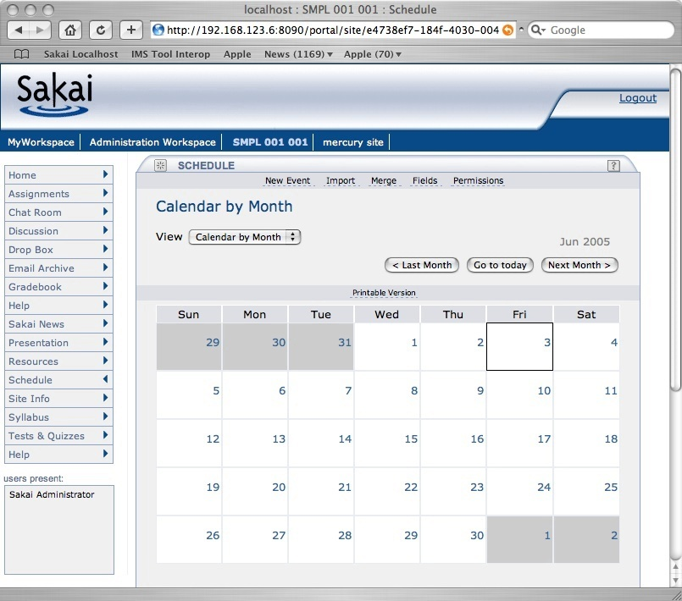
Sakai’s Rectangles
Login
Branding
Site
Selection
Tool
Selection
Tool Area
Presence

Slide 22
Rectangle Handles
http://sakai.edu/portal/gallery
http://sakai.edu/portal/page/<id>
http://sakai.edu/portal/tool/<id>
http://sakai.edu/portal/site/<id>
Notes:
We can feed these rectangles out via iFrame and coming up via WSRP in a portable manner and JSR-168 with some effort within each portal.

Slide 23
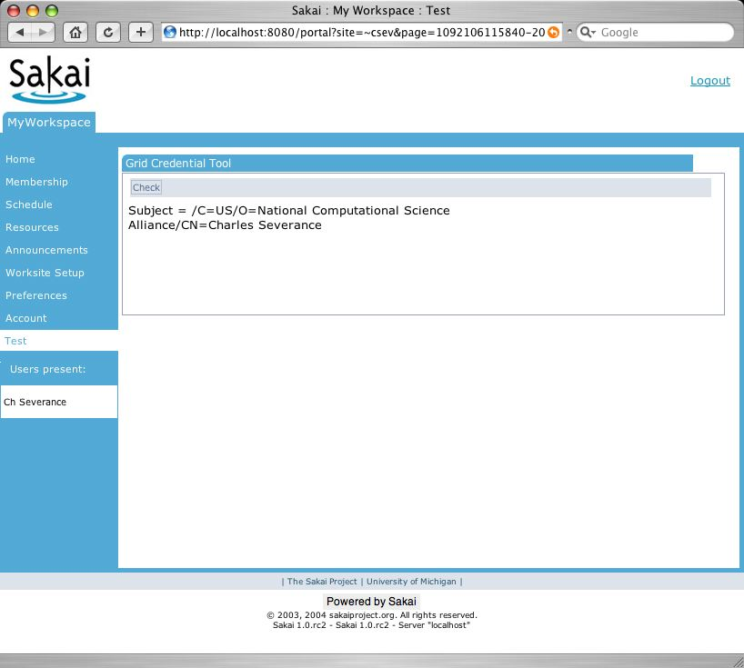
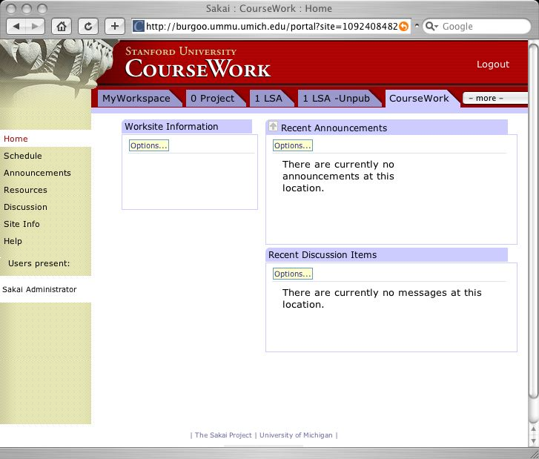
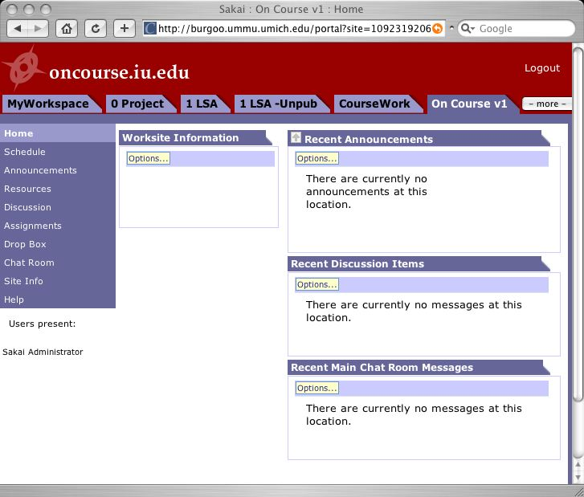
WSRP for
Federation
Portal
Non-Sakai
Tool
Non-Sakai
Non-Java Tools
tool
tool
WSRP
WSRP
WSRP
WSRP
HTTP
HTTP
HTTP
Sakai
Sakai
Sakai
tool
tool
tool
tool
tool
tool

Slide 24

WSRP Activities
SunGard-led and funded: Vishal Goenka
Working with uPortal in their WSRP uPortal 3.0 effort
As we really try to use WSRP, we identify issues in the standard and WSRP4J implementation
Sakai and uPortal are becoming involved in WSRP standards activities and WSRP4J
Notes:
WSRP is kind of a joke - Sakai and uPortal are fixing it.

Slide 25
WSRP
“Portal”
WSRP Consumer
Portal
WSRP
Placements
Apache WSRP4J
Sakai Sites
Sakai WSRP
Kernel Tool Registry
Request Filter
Tool A
Tool B
Tool C
Web Services
Notes:
WSRP Portal was produced by Vishal Goenka of SunGard SCT over the past six months. It uses the kernel’s tool registry and tool dispatch just like every other portal. The Sakai WSRP portal satisfies the Apache WSRP4J producer API.

Slide 26
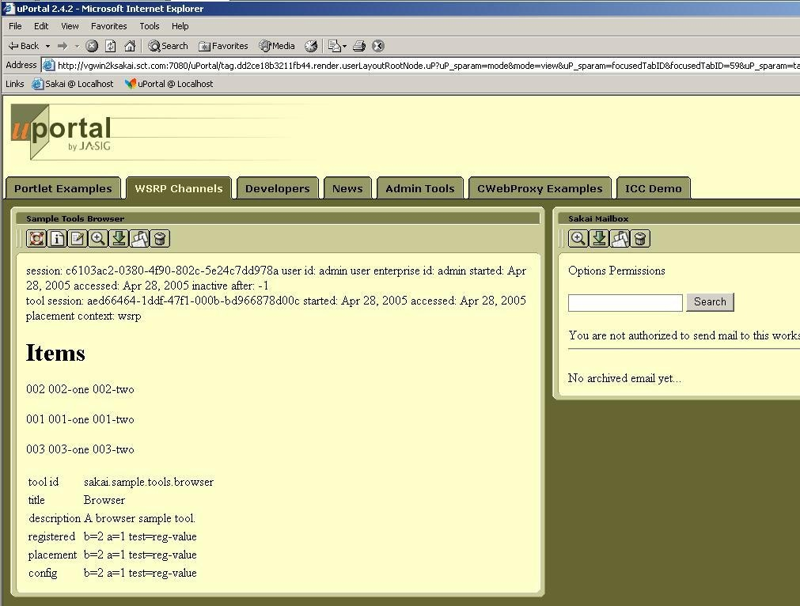
WSRP Image

Slide 27
Sakai and JSR-168
Goal state: Sakai tools operating as portlets in uPortal
  Sakai is not trivially portable to JSR-168 portals because it is an application - not a portlet
  WSRP delivers the portability across portals and federation requirement
  JSR-168 delivers tools usable in multiple contexts
WSRP is clearing the path in the architecture
Working on cross-project JSR-168 summit similar to WSRP summit - really uPortal needs to be the lead here
Notes:
For a Sakai site or tool placement to appear - use WSRP. To use Sakai tool in a uPortal - do JSR-168.
With JSR-168 uPortal is completely controlling placement.

Slide 28
Because Kernel transparently sets up session, user identity, and thread in ways are opaque to the Sakai Tools and Services, we can create a new version of the Kernel to operate in a uPortal/JSR-168 environment.
uPortal’s JVM
uPortal
uPortal
JSR-168
Velocity to JSR-168
JSF to JSR-168
Sakai
Velocity Tool
Sakai
JSF Tool
User, Site,
Role Plug-ins
Sakai Services, APIs,
Components
SAF - Kernel - uPortal Version

Slide 29
Sakai and Repositories

Slide 30
Collaboration .vs. Repository
Many different systems may be active at the same time
Systems evolve, improve, and are often replaced every few years
Systems focused on the dynamic needs of users and applications
Thousands of simultaneous online users
Performance tuning
Must be very easy to use; almost unnoticeable
Used informally hundreds of times per day per user
Think “E-Mail”
Generally one system for the area
Long term strategic choice for institution
System focused on accessing, indexing, curation, and storage
Millions of high quality objects properly indexed
Data and metadata quality
Must enforce standards and workflow to insure data quality
Most use is very purposeful: search, publish, add value
Think “Library”
Notes:
Collaborative systems often allow materials to be sloppy (copyright for example). IR’s must be very clear on copyright as there are likely to be different rules w.r.t. materials in IR’s. This may require some cleanup on materials from collab systems when moving to an IR.

Slide 31
High Level View
Collaborative
And Learning
System
Data
Sources
Data
Repository
Research
Activities
Publishing
Activities
The data is the constant across applications and technologies.
Notes:
The DR has a wide range of needs and many applications which will interact with the repo in many ways.
It is the wrong reaction to look at this picture and conclude that the cool thing is to build another repository. Projects are already underway like Fedora and Dspace that have blazed some trails - working with them is better than inventing one’s own from nothing.

Slide 32
Inbound Object Flow
Search
View
The lens or disseminator understands the data model and is capable of rendering the objects. The lens is part of the DR.
Reuse
Sakai
DR
Index
Lens
Store
Create and use in native form
Prepare for
storage
Data
Model
Curate, convert, update and maintain over time
Ingest
The DR establishes a data model for “site” objects. The CLE hands sites to the DR. The DR may have to do “model” or content cleanup before completing the ingest process.
Preparation for storage may include cleanup, conversion, copyright clearance, and other workflow steps.
Notes:
One of the goals here is data portability - making data relevant *beyond* the initial application that created it.

Slide 33
Outbound Object Flow
Sakai can find and re-use objects in the repository.
Search
View
View
Sakai
Search
Index
Lens
Lens
Reuse
Reuse
Data
Model
Data
Model
DR
Notes:
Remember that this is only how Sakai will interoperate with the repository. Other applications will use the repo as well.

Slide 34
Data Repository Technologies
DSpace - is a connected set of features that includes repository, delivery mechanisms, and both user and administrative interfaces.
OCW - IR focused on long term archival of teaching and learning material
IBM Content Manager - Highly media oriented IR
Fedora - has been developed primarily as a “repository” without a specific user interface
Artstor - is an example of a repository that is cross-institutional built around particular collection and technologies to manage that collection

Slide 35
Will there ever be “one” Data Repository?
Each current repository project covers a particular space / technology.
Problems like long-term curation, extremely complex objects, rich media understanding are difficult to do in the general case.
Some short term localized convergence may happen as one project adopts technology from another.
Data portability between systems is the needed innovation to make IR choice more transparent.

Slide 36
Going Forward
Instead of solving the problem by creating a single DR technology that is a superset - which might take years
Focus on data portability between systems - reduce the impedance mismatch (or needed conversion between systems)
RDF enables object portability across systems, languages, and technologies

Slide 37
Tangible Steps for Sakai
Move Sakai and other Collaboration systems toward RDF
  Experiment with using RDF as native storage format instead of relational or file-system
  RDF has yet to demonstrate scalable performance needed for >100K active users - this is a research area
Move data repositories toward RDF
  Move from schema-based stovepipe objects to OWL/RDF based objects with referential integrity
  Explore dimensions of portability of disseminator / lenses - this is an important research area
Notes:
At some level RDF is a low-level enabler which is a pre-requisite. In a way RDF is like “Ethernet” is for the Internet. Additional aspects beyond RDF include OWL (Web Ontology Language) defines the models of data represented in RDF. And beyond RDF and OWL, there is the development of software that understands different onltolgies at increasing levels of semantic understanding.

Slide 38
Web Services and PLRE

Slide 39
Web Services
Web Services allow flexible reuse of capabilities, services, etc.
  WSRP presentation
  SOAP - RPC
Web Services Issues
  Security

Slide 40
Web Services
Web Services
Client
Web Services shipped in Sakai 2.0
Based on Axis 1.2
Release 2.0 includes sample PHP client
Jakarta Axis
WS End Point
Sakai Kernel
Sakai APIs
Available in Sakai 2.0
Samples Only
Notes:
Sakai 2.0 ships with a fully integrates web services capability - the particular WSDL and web services are not yet defined - this is there to enable the development of new applications, uses, and ways to integrate with Sakai.

Slide 41
Sakai Web Services Endpoint
import org.sakaiproject.api.kernel.session.Session;
import org.sakaiproject.api.kernel.session.cover.SessionManager;
public class SakaiSession {
public String checkSession(String id) {
System.out.println("session id="+id);
Session s = SessionManager.getSession(id);
if (s == null)
{
System.out.println("no session established");
return "Session Null";
}
else
{
String resp = "session: " + s.getId()
+ " user id: " + s.getUserId()
+ " user enterprise id: " + s.getUserEid()
+ " inactive after: " + s.getMaxInactiveInterval();
System.out.println(resp);
return resp;
}
}
}
Notes:
Web Services under Axis is really easy to use. There are many issues - security, performance, and interoperability (especially with .NET) - but this is a journey we must take.
Given my experience with Web Services so far I am glad we built a solid application first and then added web services to is rather than starting with web services.

Slide 42
Sakai Web Services Client
require_once('SOAP/Client.php');
if ( ! $_POST['url'] ) $_POST['url'] =
"http://nightly2.sakaiproject.org/sakai-axis/";
if ( $_POST['login'] ) {
$site_url = $_POST['url'] . 'SakaiLogin.jws?wsdl';
echo ("Loggging in to Sakai Web Services at ".$site_url);
$wsdl=new SOAP_WSDL($site_url);
// Create an object directly from the proxy code
$myProxy=$wsdl->getProxy();
$session=$myProxy->login("admin","admin");
echo ("Session:");
print_r ($session );
$_POST['session'] = $session;
}
Notes:
In PHP no less…

Slide 43
Mini PLRE: Replacing the Sakai Navigation with Web Services and a Desktop Application
Notes:
This is a little project that I did to demonstrate Sakai flexibility.

Slide 44
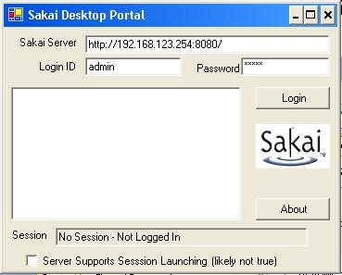
PLRE Client Version 0.0001
- Server
- Site
Tool
Tool
+ Site
+ Server
Imagine a system-tray icon.
Imagine this handling *any* WSRP endpoint…
Imagine this handling your different identities across domains…
Sakai
X
Sakai
X
Notes:
Imaging that the GUI was actually useful….

Slide 45
Portals are not just user interfaces - they are servers too. E-Research is more than portals.
Rob Allan,
Technical Manager,
Advanced Research Computing Centre,
Daresbury Laboratory, UK
July 12, 2005
- Server
- Site
Tool
Tool
+ Site
+ Server

Slide 46

In Summary
Collaboration
Software
Notes:
Sakai may initially come to the party as a piece of collaborative software.

Slide 47
In Summary
Collaboration
Software
Data
Repositories
Resource
Portals
Notes:
But our requirements coming from many directions (teaching, research, small group work) require us to connect to other major technologies and smoothly integrate. These requirements often come with large (financial and talent) resource pools - the open source model. In Sakai we see the high level across technologies and constituent groups (teaching, research, ad hoc) and try to bring comunities together to work on common requirements.

Slide 48
In Summary
Personal Learning/Research Environment
Collaboration
Software
Data
Repositories
Resource
Portals
Notes:
The goal is not to replace these software elements but for Sakai to work with them to be so well integrated that we all together deliver the ultimate user goal of E-Science/E-Research/ and E-Learning. And then leverage that smooth integration to *finally* realize the real requirements of the end user - easy to use and powerful. This is not just GUI integration - it is back end integration and data interchange as well.
I think the resources needed to fully deliver on this picture are 200 people for five years. Thanks heaven for the open source model.
Funny - when we get done - after all that work - it will just be a tiny icon in people’s system tray :)

Slide 49
Thank you for your time…
www.dr-chuck.com/talks.php
csev@umich.edu

