Slide 1
Authentication and Authorization in Sakai
Charles Severance
Sakai Chief Architect
www.dr-chuck.com/talks.php
Notes:
TALK ID 49

Slide 2
Outline
Sakai’s Authorization and Authentication Requirements
Sakai’s Internal Authorization and Authentication Structures
Integrating Enterprise Authorization and Authentication information into Sakai
Some slides were adapted from John Leasia’s Configuration presentation from the Sakai User Meeting.

Slide 3
Scenarios
Browser
WebDav
Client
Web Services
Client
Portal - WSRP
Consumer
WebISO, Form-based
Http/Basic
ID/PW
ID/PW and others
ID/PW, proxy, trust and others
Sakai
Internal Accounts
Enterprise information, User Directory, Course Information, Roster Information, Role Information
Notes:
Just do animations here - this is outline.

Slide 4
What is Sakai?
Sakai is intended to be an enterprise application - centrally deployed as the campus-wide or state-wide deployments
Sakai is intended to both solve the “well-known” collaborative and learning requirements as well as enable significant innovation in collaboration and learning.
Notes:
System mean

Slide 5
Ideal Model For Campus Security Team
mod_xyz
App
1
….
mod_xyz
WebISO
XYZ
System
App
N
Firewall
Real
Credentials

Slide 6
Sakai Requirements
WebISO is not sufficient
Must be able to validate against “real credentials” - Usually ID/PW
Must handle “guest” accounts - not officially affiliated with the university
  Guest lecturers
  Colleagues

Slide 7
Scenarios
Browser
WebDav
Client
Web Services
Client
Portal - WSRP
Consumer
WebISO, Form-based
Http/Basic
ID/PW
ID/PW and others
ID/PW, proxy, trust and others
Sakai
Internal Accounts
Enterprise information, User Directory, Course Information, Roster Information, Role Information
Notes:
Browsers support WebISO - redirect and everything
WebDAV is a web-services client - forget it is HTTP - Clients all use Basic Authentication over HTTPS (Mac OS/X finally does https in 10.4)
Web Services will be an increasing requirement as nifty content authoring systems want to operate on the user’s desktop and store data in Sakai over web services.
WSRP initially will be used to integrate with the *one* campus portal - but increasingly it will become a way for an individual to get uniform access to many Sakai systems. Teach multiple places, work on collaborative projects in their fields, be part of planning a conference… All might use Sakai - I want one desktop view for all of them multiple and cross campus.
Typical configuration is to use WebISO to provide protection for the browser access to Sakai and provide genuine credential access (at the bottom) for web services, web dav, etc.

Slide 8
A Conversation about WebISO
Sakai Team: We need ID/PW for some cool feature (WebDAV, Web Services, desktop authoring tool or whatever)
Security Team: Use WebISO - it is our policy
Sakai Team: WebDav is not a browser it is a web service client - it cannot handle redirects
Security Team: Use WebISO - it is our policy
Sakai Team: That would require Microsoft and Apple to alter their operating systems because WebDAV is part of those operating systems
Security Team: Too bad - talk to Microsoft about that - Use WebISO - it is our policy
Security Team (To Faculty): Sorry we cannot support WebDAV (other cool feature) because of security policies
Faculty to CIO: Blah blah blah we need cool feature…
CIO to Security Team: The faculty need the cool feature
Security Team: Use WebISO - it is our policy
CIO: Could you clarify exactly who made that policy?

Slide 9
Scenarios
Browser
WebDav
Client
Web Services
Client
Portal - WSRP
Consumer
WebISO, Form-based
Http/Basic
ID/PW
ID/PW and others
ID/PW, proxy, trust and others
Sakai
Internal Accounts
Enterprise information, User Directory, Course Information, Roster Information, Role Information
Notes:
Discussing Sakai’s internal structures. These are designed for maximum flexibility and quite controllable by enterprise information - but usually far more complex than enterprise systems AUTHZ capability.

Slide 10
Sakai’s Internal Security Model
Internally, use fine-grained function based security
  Can “this user” perform “this function” on “this object” (in this context)
  Can Chuck perform chat.delete on the “office hours chat” (in course EE100) ?
Roles used to give “easy to use” fine grain security sets handles
The roles and role to fine-grain mapping is flexible on a site by site and user by user basis

Slide 11
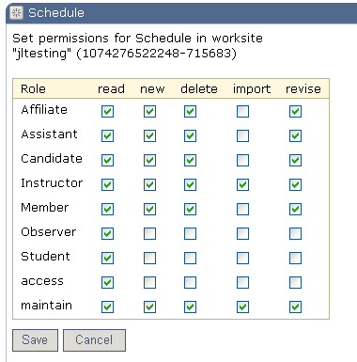
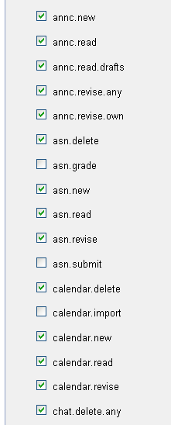
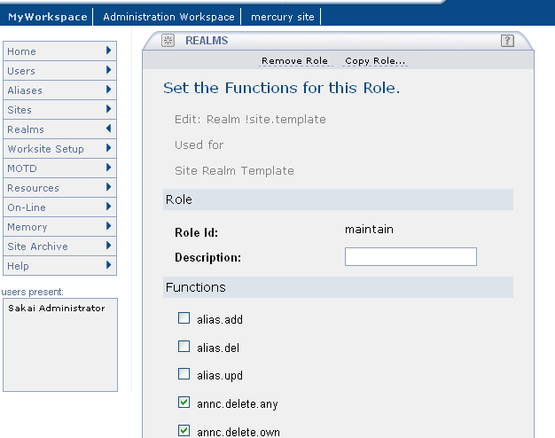
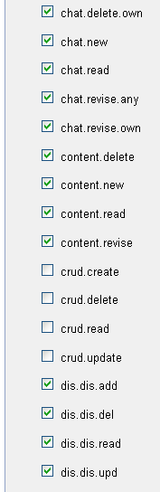
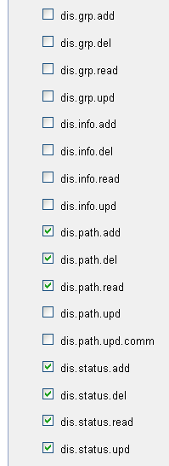
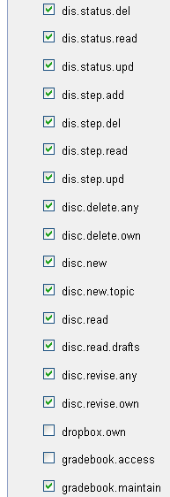
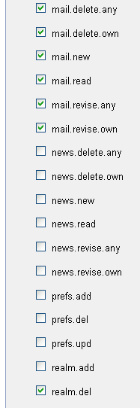
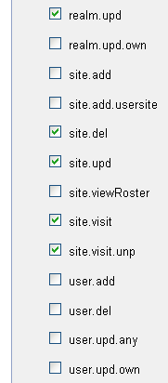
Permissions (Functions) and Roles
Notes:
There are many fine-grained permissions.
Animation: They are contextalized within a site and to a lesser decree a user.

Slide 12
Sites and
Permissions
Site: EE100 (Course)
Instructor: chat.read chat.delete, chat.post
Student: chat.read, chat.post
Chuck: Instructor
Glenn: Student
Daphne: Student
Site: Sakai-Dev (Project)
Committer: chat.read chat.delete, chat.post
Contributor: chat.read, chat.post
Observer: chat.read
Daphne: Committer
Chuck: Observer
Site: HCI100 (Course)
Instructor: chat.read chat.post, chat.delete
Student: chat.read
Daphne: Instructor
Chuck: Student
Notes:
The primary area where users are given roles and roles are mapped to permissions are at the site level. Roles and permissions are scoped to a site and can be dramatically different from site to site. Some sites are courses, others are projects, and others might be a student club.

Slide 13
Site Templates
Site: Type=Project
Committer: chat.read chat.delete, chat.post
Contributor: chat.read, chat.post
Observer: chat.read
Site: Type=Course
Instructor: chat.read chat.delete, chat.post
Student: chat.read, chat.post
Site: Type=Club
President: chat.read chat.post, chat.delete
Secretary: chat.delete
Member: chat.read, chat.post
Notes:
Site templates are a way to pre-populate a site of a particular type at creation time. Otherwise sites would start out “empty”. Changing the site templates does not affect existing sites.
Note to self - need to think about site.helper

Slide 14
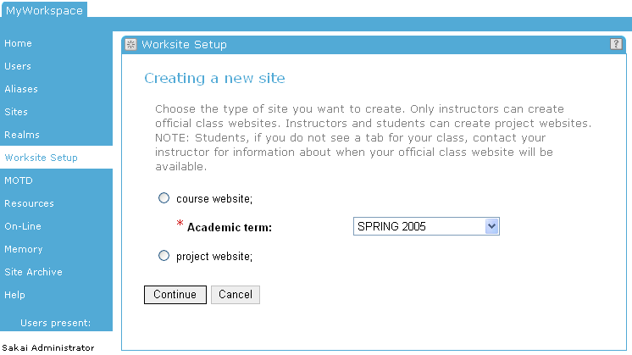
Site Types
Notes:
This is an example of a site being created. In this system (Oot of the Box) there are two site types.

Slide 15
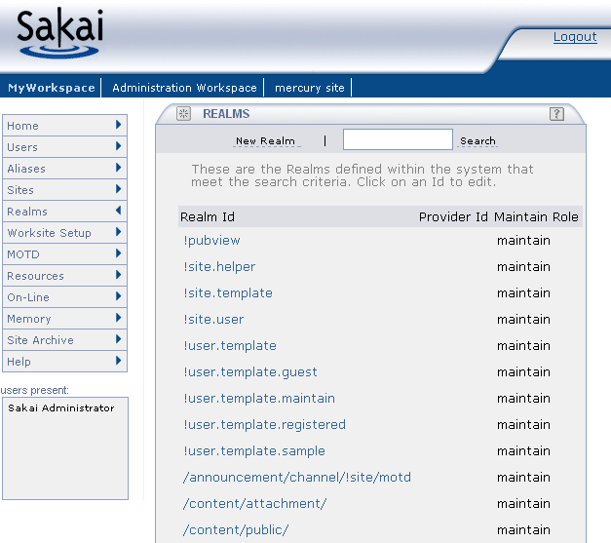
Worksite type default roles, permissions
Sakai OOTB
Notes:
There is just one template in Sakai out of the box.

Slide 16
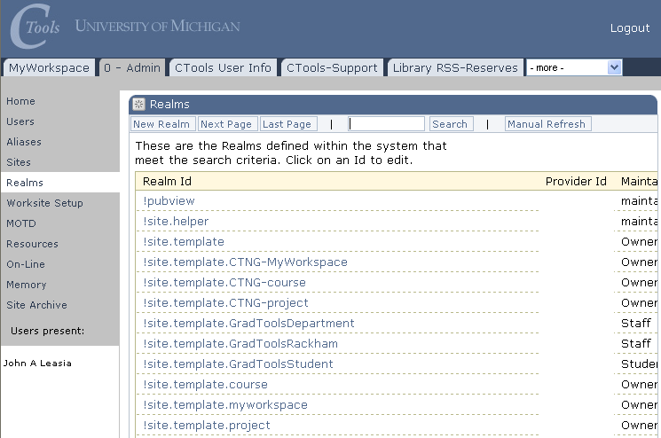
Worksite type default roles, permissions
UM CTools
Notes:
At Michigan, we have many different templates for different site types.

Slide 17
Add Hierarchy (Sakai 2.1)
Site: /
SysAdmin: *.*
Mary: SysAdmin
Site: Eng (College)
Dean: *.*
Jane: Dean
Site: Sakai-Dev (Project)
Committer: chat.read chat.delete, chat.post
Contributor: chat.read, chat.post
Observer: chat.read
Daphne: Committer
Chuck: Observer
Site: EE (Dept)
Mary: Instructor
Site: HCI (Dept)
*role*: disallow chat.delete
Site: EE100 (Course)
Instructor: chat.read chat.delete, chat.post
Student: chat.read, chat.post
Chuck: Instructor
Glenn: Student
Daphne: Student
Site: HCI100 (Course)
Instructor: chat.read chat.post, chat.delete
Student: chat.read
Daphne: Instructor
Chuck: Student

Slide 18
User types
Users can have types
  Scope is the system-wide and defined at user-create time
  User type is different from Roles (scoped in a site)
Users (accounts) get pre-populated permissions
  !user.template.<type>
    Where <type> is the account type (e.g., guest, registered)
  !user.template
    For untyped accounts

Slide 19
Sakai OOTB

Slide 20
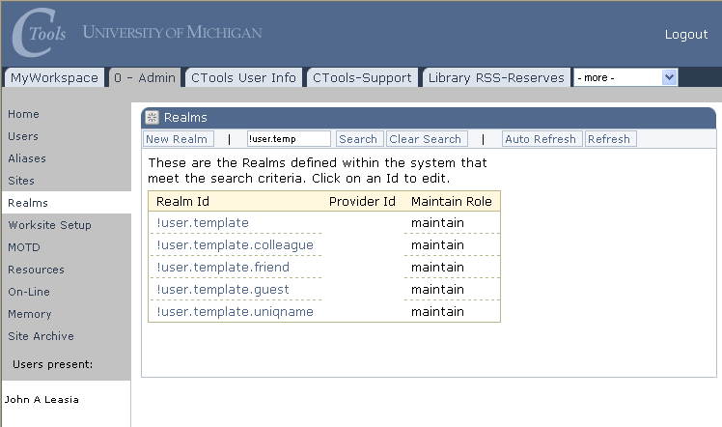
UM CTools

Slide 21
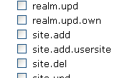
User types
!user.templates are realms – they have roles
It is the .auth role for a !user.template that controls the account’s rights in the application scope
site.add permission in the .auth role controls whether the account can create new worksites or not
Users do not alter their
own “realms” - this comes
either from a template or is
done by the admin
Notes:
There are very few roles places in the User’s realm because they effectively “trump” site scoped roles. User roles are application-wide - they tend to grant application wide capabilities.

Slide 22
Summary So Far…
When you are trying to develop an application that spans Lotus Notes to PhpBB to Blackboard, you need a very flexible authorization mechanism.
It is not likely that any campus-wide AUTHZ mechanism will have the flexibility and granularity of Sakai.
Notes:
Could Sakai benefit from some SAML instead of so many checkboxes? Sure… But. These authorization questions are asked 5-15 times per web transaction. In Sakai they are fully normalized and each is done in a single query so fast this it is barely noticable. All changes are instant and online. In certain cases, the system “notices” an authorization change and your screen is updated before you press a button. Sakai has a notification bus deep inside of it.
AIHTZ is highly contextalized.

Slide 23
Scenarios
Browser
WebDav
Client
Web Services
Client
Portal - WSRP
Consumer
WebISO, Form-based
Http/Basic
ID/PW
ID/PW and others
ID/PW, proxy, trust and others
Sakai
Internal Accounts
Enterprise information, User Directory, Course Information, Roster Information, Role Information
Notes:
Now we get to the fun stuff - integrating enterprise information into Sakai - this is where we take all of that Sakai flexibility and make it work exactly the way we want for our local installation.

Slide 24
Providers in
Sakai
Sakai Velocity
Support
Sakai JSF
Support
Sakai Velocity
Tools
Sakai JSF
Tools
Sakai Servlet
Tools
Sakai
Application
Services
Sakai
Framework
Services
Enterprise Data
Sakai
Common
Services
User
Provider
Role
Provider
Course/Site
Provider
Sakai Kernel and RequestFilter
Notes:
Everything in Sakai is highly abstracted across interfaces. Integrators are *not* ever supposed to mess with Sakai tables. All enterprise integration is done using very clean APIs which Sakai consults as Sakai needs information.
Green is application domain and blue is framework domain.

Slide 25
User Directory Provider
Very mature - since Sakai 1.0
User type is controlled by provider - this controls the user template when the user is created
Can provide fully populated User objects or just answer ID/PW queries
Consulted at log-in
Supports special “properties” known to the provider
Sample providers in release 2.0: JLDAP, OpenLDAP, Kerberos, and IMS Enterprise in a database
Notes:
User type is system-wide - guest, kerberos, faculty, etc. For each type a template is needed. Controls the (relatively few

Slide 26
Course Provider
Does not auto-populate courses
Provides the course list when instructor is making a new worksite
Consulted during “New Site” operation
Significant work needed here
  Need to make into a Site provider
  Need to be able to set site type from provider
  Need to come up with auto population mechanism
Notes:
Early design choice in Sakai was not to pre-load every single course at the beginning of the semester, but to give the instructor a tool to make new sites (course or otherwise). The Course Provider simply populates the list of courses available to the instructor.
WorkSite Setup graphic up next.

Slide 27
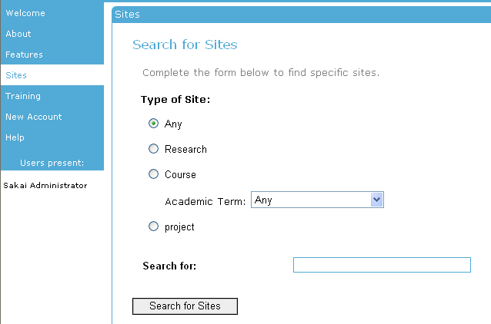
Notes:
Course Provider provides information when creating sites of type “course”.

Slide 28
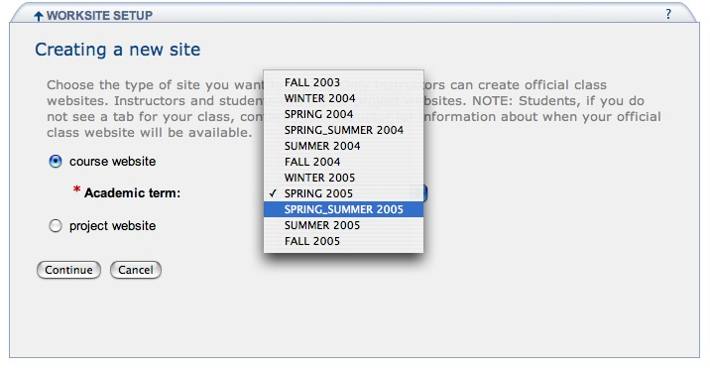
Where does this list come from?

Slide 29
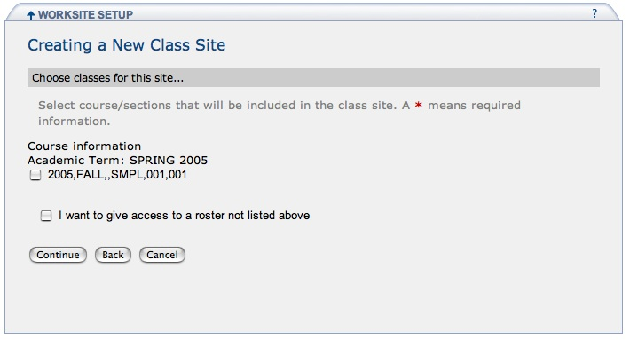
public List getInstructorCourses(String instructorId,
String termYear, String termTerm)
ID: 2005,FALL,,SMPL,001,001
TERMID: FALL 2005
TITLE: Sample Course

Slide 30
Exploding the Course
ID AT UM
Unit
Section
Unit
2005,FALL,A,SMPL,001,001
Campus
Course
This is like a GUID - Not the user visible Title.
public String getCourseName(String courseId)
Are there any semantics on this ID beyond a GUID?

Slide 31
When Multiple Course ID’s
are checked…
Five Sections
Two Sections
2002,2,A,EDUC,504,[001,002,003,004,006]+2002,2,A,LSA,101,[002,003]
Two External “Courses”

Slide 32
Exploding the External Provider ID
2002,2,A,EDUC,504,[001,002,003,004,006]+2002,2,A,LSA,101,[002,003]
Realm Information comes from these Course ID’s:
2002,2,A,EDUC,504,001
2002,2,A,EDUC,504,002
2002,2,A,EDUC,504,003
2002,2,A,EDUC,504,004
2002,2,A,EDUC,504,006
2002,2,A,LSA,101,002
2002,2,A,LSA,101,003

Slide 33
Realm Provider (Role)
Consulted at login
What are the sites and roles within each site for this user
If the system is using many different roles throughout, this code must feed the proper site the proper role
Sakai internal tables are updated as changes from the provider are noticed.

Slide 34
When Worksite Setup is Done
Site: FFEB
Realm: /site/FFEB
Type: Course
E-Provider:
2002,2,A,EDUC,504,[001,002,003,004,006]+
2002,2,A,LSA,101,[002,003]
Title: SI 653 001
Student: chat.read
Instructor: chat.read, chat.delete
Chuck is Maintain
Active/Internal
2002,2,A,EDUC,504,[001,002,003,004,006]+2002,2,A,LSA,101,[002,003]

Slide 35
Site: FFEB
Realm: /site/FFEB
Type: Course
E-Provider:
2002,2,A,EDUC,504,[001,002,003,004,006]+
2002,2,A,LSA,101,[002,003]
Title: SI 653 001
Student: chat.read
Instructor: chat.read, chat.delete
Chuck Maintain
Active/Internal
Glenn is Student
Glenn is Student Active/External
Provider wins
David is Student
David is TA Active/Internal
Internal wins to protect.
Zhen is Student
Zhen is Student Inactive/Internal
Internal wins to protect.
Inactive over rides
Provided roles

Slide 36
Providers in 2.0
UserDirectoryProvider is in good shape
Realm and Course Providers are adequate for providing information for Type=course sites
Lack of pre-populating all sites is probably biggest concern in 2.0 for integration staff.

Slide 37
One Future AUTHN Direction
I would like to move Sakai toward supporting a generic proxy credential throughout Sakai
  CAS and Grid/PKI are good examples
  Everything pluggable - no specific dependency
  Probably the first application will be pushed through via WSRP - web services may not be far behind

Slide 38
Summary
Sakai internally is very complex but very configurable
Sakai’s provider architecture is designed to take advantage of a wide range of enterprise information sources
Sakai’s providers will improve as new requirements are encountered and we have time to work on them

Slide 39
Questions…
www.sakaiproject.org
collab.sakaiproject.org
www.dr-chuck.com/talks.php
Notes:
ID 49

