Slide 1
Sakai Technical Update and Futures
Charles Severance
Sakai Chief Architect
August 2, 2005
www.dr-chuck.com/talks.php?id=54

Slide 2
Release 2.0
Framework II kernel in place
New learning-oriented tools
Legacy tools internationalized
Legacy tools improved to be partially compliant with the style guide.
In summary, just about every end-user GUI element has been touched or is new.
Web services
The storage and services are still very 1.5-like
New skin

Slide 3
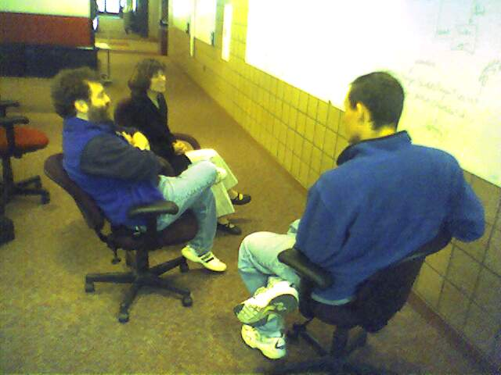
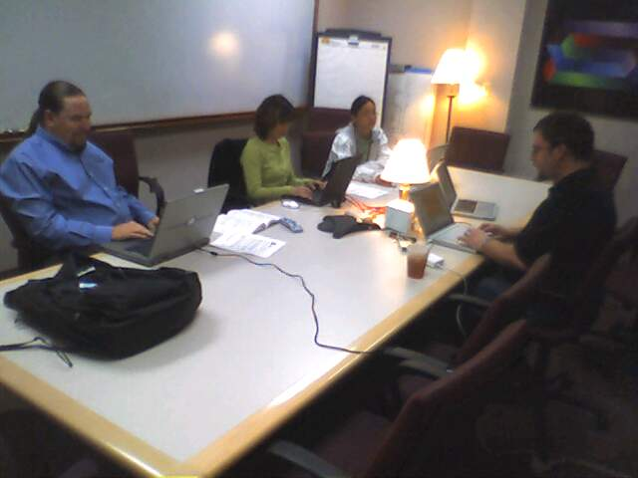
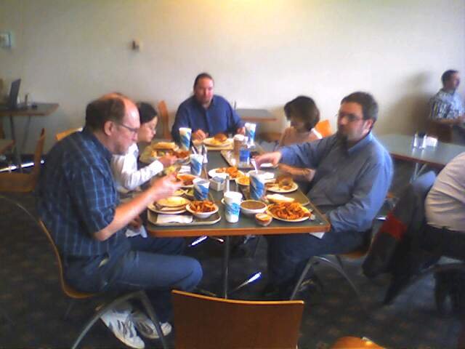
Release Process 2.0
Integration Week - May 16 - 20
  Resulted in Release 2.0 Alpha 1
QA
  Led by Carol Dippel
  Both core and volunteer QA were centrally coordinated
JIRA - heavily used bug tracking and release management
Released June 15, 2005
Notes:
Michigan, Indiana, Stanford, Berkeley, and rSmart.
Series of Alpha followed by RC releases.
Made the exact date.
Currently working on a 2.0.1 patch release and 2.1 next release for November 15.

Slide 4
Release 2.0 Packaging
Demo
  Unpack and start - one command
  Use Case: “show your boss”
  Includes everything else: 60MB +
  Zip for Windows and tar.gz for UNIX
Source
  Intended to configure and install for production - providers, skins, database connection, etc etc.
  Does not include pre-requisites
Binary
  Pre-compiled version of source ready to drop into your Tomcat and configure
Notes:
Very different from Sakai 1.5 - possible because of much cleaner configuration
Only pre requisite for Demo is Java.
Intent is for all distributions to be self-contained.
Unpack and look at the README :)

Slide 5
Sakai 2.0 Internal Design
Significant re-factor of functionality
  SAF - Kernel
    Components/Spring Session, Tool registry, Identity
    Support for Sakai tools, basic servlets, web services, and webdav
    Thread conditioning, Servlet filter
    Kernel enables the other services
  SAF - Services
    Primary support APIs which for tool interactions
  SAF - Presentation Services
    JSF, Velocity, Servlet
Major goal: Clean support for servlets, web services, and webdav using the Kernel

Slide 6
SAF Design Documents
Sakai Tool Model
Sakai Sessions
Sakai Request Flow
Sakai Mercury Portal
Sakai Use of Maven
Sakai Configuration
Sakai Charon Portal
Sakai Component Model
Sakai Authentication
others
These documents on collab.sakaiproject.org
“Sakai Development”

Slide 7
SAF - Kernel
Does not go “above” servlet level - “provisions” a Sakai servlet (and its thread) to fully operate
Elements (6900 lines of code)
  Components - Interaction with Spring to register/retrieve the Sakai API implementations with class-loader isolation
  Session
    httpSession - shared Sakai-wide for user/login
    sakaiSession - shared Sakai-wide for user/login
    sakaiToolSession - scoped by user/login/placement
  Tool registry - including support for “helpers”
  Identity of current logged in user
  Utilities including thread local support
Notes:
Does not go above servlet level means that this all works for code which “extends httpServlet” and even code which does low level stuff like response.write - this allows many things to be integrated into Sakai including basic servlets with API adapters (like Xwiki).
A properly scoped wrapped httpSession object is provided for those servlet activities that make use of httpSession (such as JSF).

Slide 8
SAF - Components
It is like container-wide Spring components, each with their own class loader
In Sakai 1.0 and 1.5 we placed components in webapps to get the class loader isolation, but we ended up with load-order problems
In Sakai 1.0 and 1.5 we “bent” Spring to orchestrate Sakai components
In Sakai 2.0 components simply appear “in Spring”
Notes:
Load order problems - bummed because it was so fundamental.
Whoever figured out the context.xml trick - much appreciated.
”Spring Enterprise Beans”

Slide 9
SAF-Components
common/lib
spring
sakaiComponentManager
tomcat/components
component-1
WEB-INF
components.xml
classes
lib
component-2
WEB-INF
components.xml
classes
lib
tomcat/webapps/app1
WEB-INF
web.xml
ContextListener
tomcat/webapps/app2
ComponentManager
or
Spring
While it is not preferred, some components live in webapps. A ContextLoaderListener loads all of the components from a webapp. All globally registered components are available to Spring for injection (Interface names are the bean names) or via the Sakai ComponentManager API using Service Locator pattern.
Each component looks like a webapp, but with no web.xml. Each has classes and its own “lib”. Their class loader uses common and shared.
Notes:
The primary value is the separated class loaders. This way components with very large jar footprints like JENA, Globus, can be used without polluting shared. This allows multiple versions of things like xerxces to exist within the same JVM transparently.
As an example, in CHEF and Sakai pre 2.0 - you could not build a system both with Globus and JENA because of jar-wars.

Slide 10
SAF-Components Benefits
Separate class loaders for each component, and each webapp
Allows the jar footprint of one component not to be forced to overlap with all of the other components, tools, portal, etc.
  Multiple conflicting xerxes can be kept separate
  Adding/replacing a tool or component does not break things like the portal or other components
Provides an EJB-like isolation but using Spring to connect components to client code
Notes:
We have worked with Spring and had some initial discussions.

Slide 11
SAF - Session
Tomcat Sessions leave much to be desired
  Cross-context dispatch issues (fights between Pluto and Tomcat - changes between dot versions)
  Not well suited for Web Services or WebDav when browser is not involved
  Lifecycle issues - can’t always count on cleanup
  Scope issues - Shared / Servlet / Portlet
Sakai sessions solve all of these problems

Slide 12
SAF-Session Scenarios
Cookie set via login or at SSO via WebISO
Browser A
Browser B
Tool X1
Tool X2
Basic Auth
(Cookie opt)
WS Auth
Session ID
Tool Y1
Tool Y2
WebDav
Client
WS or
WSRP
Client
Filter
Renderer Servlet
Re-dispatch
Filter
Filter
Filter
Filter
WebDav
Servlet
Axis
Servlet
Tool X
(Portlet)
Tool Y
(Servlet)
Sakai APIs need logged in user, current session, etc.
Notes:
For each incoming request scenario, the filter sets appropriate Sakai Session, produces wrapped httpSession, and in the case of a tool, gets placement scoped session. In some situations, WebDav and WebServices, the filter may not be able to completely set up session so the WebDav or Axis servlet must participate in session establishment.
WebDav may or may not support cookies. Web Services will not support cookies but may have some type of session ability “in-band”.

Slide 13
Web Services
Web Services allow flexible reuse of API and services in contexts beyond the Sakai interfaces
  WSRP presentation
  SOAP - RPC
Web Services Issues
  Security
  Performance
  API needs to tend towards document-style rather than RPC-style
Notes:
APIs need to be reengineered.

Slide 14
Web Services
Web Services
Client
Web Services shipped in Sakai 2.0
Based on Axis 1.2
Release 2.0 includes sample PHP client
Jakarta Axis
WS End Point
Sakai Kernel
Sakai APIs
Available in Sakai 2.0
Samples Only
Notes:
Sakai 2.0 ships with a fully integrates web services capability - the particular WSDL and web services are not yet defined - this is there to enable the development of new applications, uses, and ways to integrate with Sakai.

Slide 15
Sakai Web Services Endpoint
import org.sakaiproject.api.kernel.session.Session;
import org.sakaiproject.api.kernel.session.cover.SessionManager;
public class SakaiSession {
public String checkSession(String id) {
System.out.println("session id="+id);
Session s = SessionManager.getSession(id);
if (s == null)
{
System.out.println("no session established");
return "Session Null";
}
else
{
String resp = "session: " + s.getId()
+ " user id: " + s.getUserId()
+ " user enterprise id: " + s.getUserEid()
+ " inactive after: " + s.getMaxInactiveInterval();
System.out.println(resp);
return resp;
}
}
}
Notes:
Web Services under Axis is really easy to use. There are many issues - security, performance, and interoperability (especially with .NET) - but this is a journey we must take.
Given my experience with Web Services so far I am glad we built a solid application first and then added web services to is rather than starting with web services.

Slide 16
Sakai Web Services Client
require_once('SOAP/Client.php');
if ( ! $_POST['url'] ) $_POST['url'] =
"http://nightly2.sakaiproject.org/sakai-axis/";
if ( $_POST['login'] ) {
$site_url = $_POST['url'] . 'SakaiLogin.jws?wsdl';
echo ("Loggging in to Sakai Web Services at ".$site_url);
$wsdl=new SOAP_WSDL($site_url);
// Create an object directly from the proxy code
$myProxy=$wsdl->getProxy();
$session=$myProxy->login("admin","admin");
echo ("Session:");
print_r ($session );
$_POST['session'] = $session;
}
Notes:
In PHP no less…

Slide 17
Rendering
Architecture
User’s
Browser
Layout/Placement
Information
Renderer
Kernel Tool Registry
Request Filter
Tool A
Tool B
Tool C
Notes:
No more tunnel
No more ROOT webapp
Causes the URL naming pattern to change

Slide 18
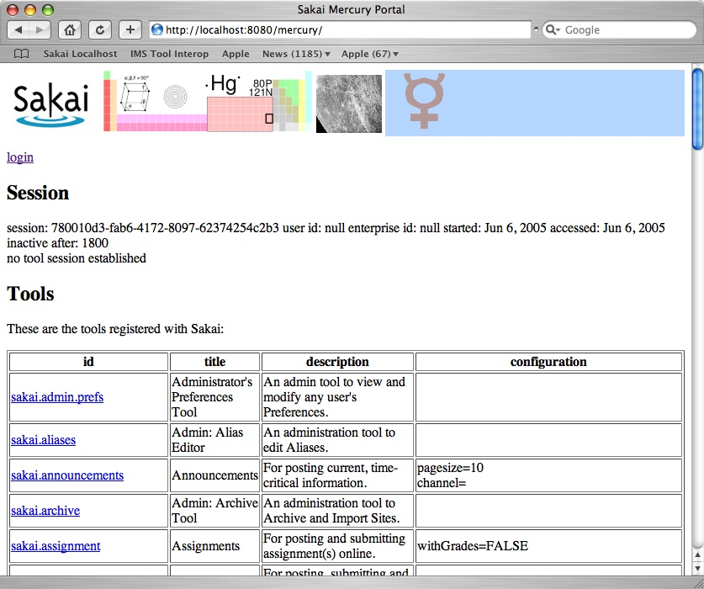
Mercury

Slide 19
Mercury
Portal
User’s
Browser
Mercury
Kernel Tool Registry
Request Filter
Tool A
Tool B
Tool C
Notes:
Has no layout nor placement - excellent for quick testing of tools. All tools live in one context “mercury”.

Slide 20
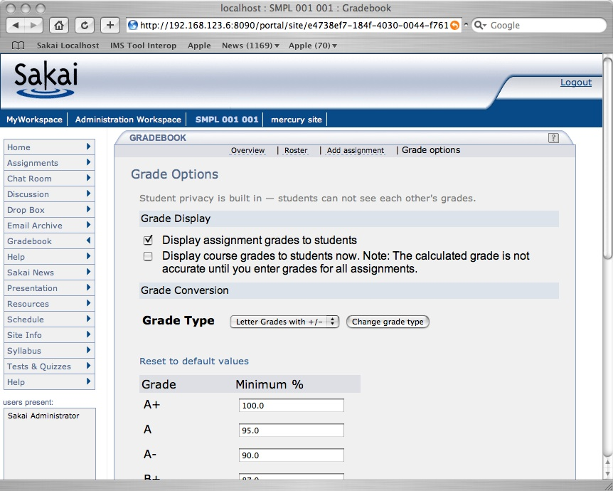
Charon Image

Slide 21
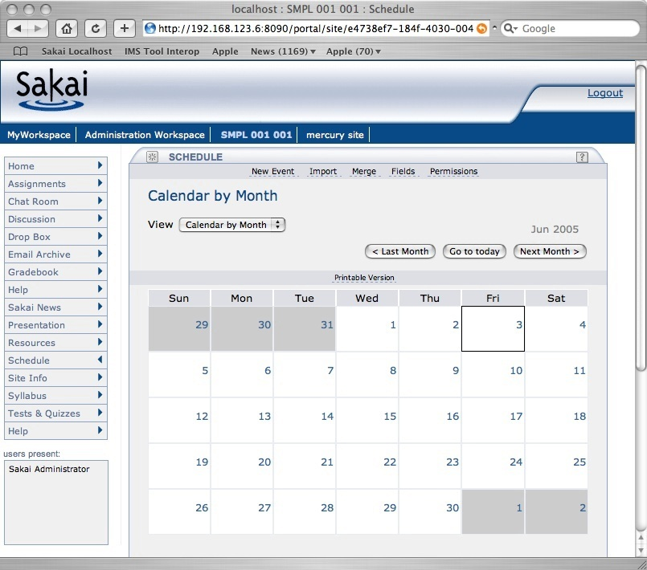
Charon
Portal
Sakai Sites
Charon
Kernel Tool Registry
Request Filter
Tool A
Tool B
Tool C
Notes:
End user built in portal - Sakai site aware.
Produces new iFrame naming convention. Se documents up on sakai-dev on collab.sakaiproject.org.
Charon is pure servlet (no Velocity)

Slide 22
Many Portals..
Browser
Browser
Browser
Portal
uPortal
Sedna
Charon
Mercury
TILE?
WSRP
JSR-168
Varuna
Kernel Tool Registry
Request Filter
Tool A
Tool B
Tool C
Web Services
Notes:
Sakai is designed to support many “portals” a portal is simply a consumer of tool markup. Abstracting making tool registration abstract allows this. We may develop a portal to support accessibility which does not use any iframes and supports significant GUI re-factoring based on profiles. WSRP is well developed and should be present in 2.1. The “168 shim” consumer is on the drawing boards. WSRP will support any portal while JSR-168 will be initially developed for uPortal. Each JSR-168 portal will require some special porting work.

Slide 23
Sakai 2.0 Elements

Slide 24
Visible Aspects
New Skin
Style Guide
Significantly Improved WorkStite Setup
  Pretty much can completely admin a site without the admin tools
Resources Tool Metadata
Internationalization
Improved Courier

Slide 25
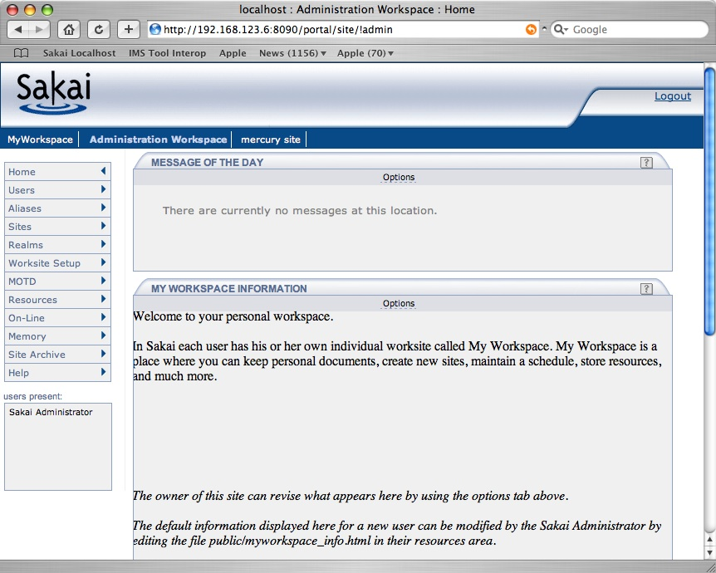
New Skin
Notes:
Sakai 2.0 has a new skin - Thanks to Gonzalo Silverio, Vivian Sinou and Teri Cartright.

Slide 26
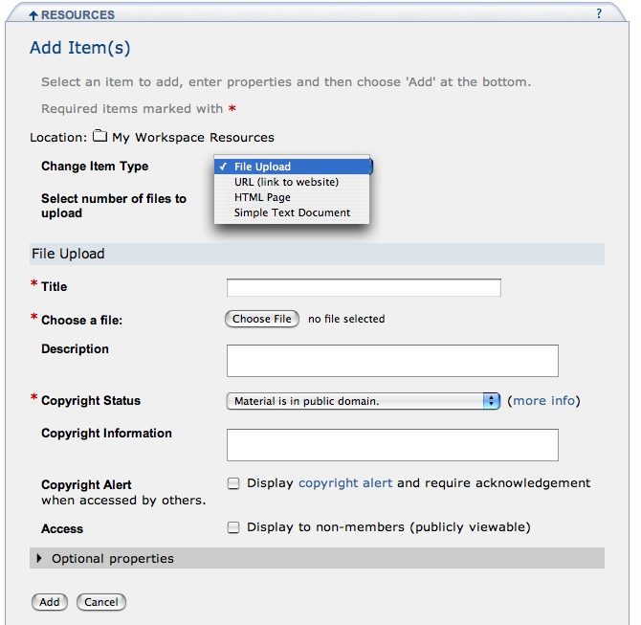
Style Guide
Notes:
Sakai has a style guide and the tool GUIs have been re-factored to be consistent across tools and comply with the style guide. Each tool has been looked at and smoothed over - workflow wise.

Slide 27
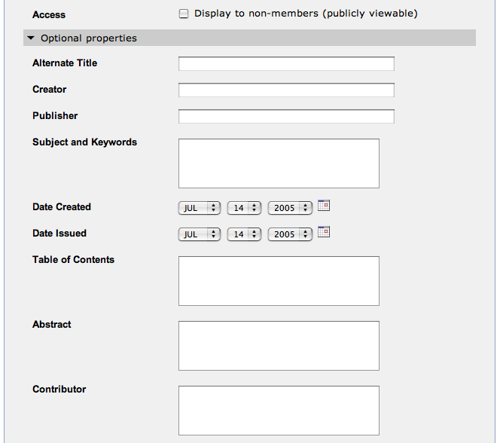
Metadata on all Resources
Notes:
Each object in Sakai 2.0 now can have metadata markup. This is supported in the XML format for Sakai import and exports. Sakai ships configured with “Dublin-core” as the available metadata schema. Sakai 2.0 can support more than one system-wide schema applied to all resources.
As an example, in NEES, we could define a very simple schemes to capture NEES common metadata on objects placed in Sakai.

Slide 28
Courier
Based on XMLHttpRequest
No more clicks! No more spinning browser icons.
Not part of the portal - part of each tool
Flexible in terms of timing - 60 seconds for presence - 10 seconds for chat
Login timeout now 30 minutes
Acessibility improved

Slide 29

I18N and L10N
JSF tools are bundle based
University de Ledia - Added bundles to legacy tools
This is just a start
  Need preferences and configuration
  L10N will identify flaws in the I18N
Several languages are starting right away
Discussion Group - Beth Kirshner and Alex Batiste

Slide 30
Sakai Beyond 2.0 - Features

Slide 31
Still to come…
The new Common API portion of Framework II
Hierarchy
Sections and Groups (framework and tool changes)
Improved Enterprise Integration including OSIDs
WSRP portal integration
More significant tool re-factor and redesign
Producing resource model approach which works both for OSP and Sakai
IMS Tool Interoperability launcher

Slide 32
Top Priority for 2.1
The ability to define subsections within a class
The ability to control the display or sorting of objects (like announcements) based on section membership
The ability to sort and filter data within tools (like the grade book) based on section membership and other section information such as role
The ability to control within Sakai the membership and roles of sections within courses. This is called the “Section Tool”.

Slide 33
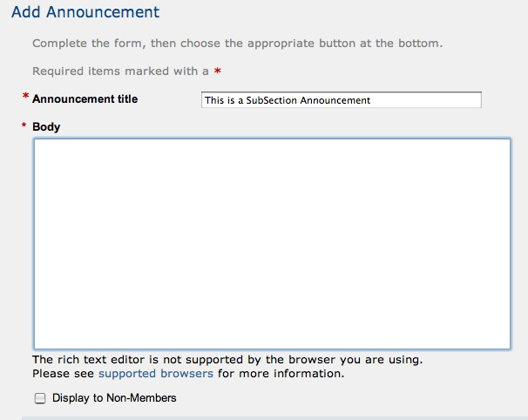
Sakai 2.1 Section Aware GUI - Subgroup Publishing
Display to Members (default)
Display to Non-Members
Display to Selected SubGroups
Section 001
Section 002
Section 003
Notes:
In Sakai 2.1 there will be an additional option if subgroups are defined for the site. If the user picks the radio button to specify sub-group access control, the subgroups are presented with check boxes (or other appropriate multi-select GUI) to allow the instructor to post to any combination of the subgroups.
The precise GUI is up to the design team - this is just showing the functionality needed. The top three are “choose only one” while the section list is multiple select.
There is a whole separate GUI capability which is also being designed which provides sorting and filtering based on sub-sectioning.
While this is a simple and elegant new capability, it requires significant new framework work because Sakai 2.0 does not (1) understand the notion of subgroups at all and (2) has no notion of fine-grained access control to an object like an announcement (I.e. all announcements have identical access control settings within a Site in Sakai 2.0).

Slide 34
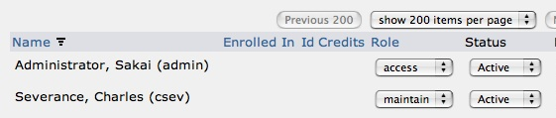
2.1 Site - Permissions Tool
Permission
Set
New AubSite
SubSite: Green
csev maintain
Green (group) access
Lead maintain
Member access
SubSite: Red
csev maintain
Red (group) observe
Lead maintain
ViceLead access
Member
Display to Members (default)
Display to Non-Members
observe
access
maintain
Display to Selected SubSItes
Green
Red
Notes:
The permissions tool is what was the participant list tool in Sakai 2.0. There are several differences. First permissions can be granted to an individual (like in 2.0), group or group/role commbination. Also, the user can create sub-sites. These sub-sites can be granted permissions as well. Within a group, each role can be given a different set of permissions.
In reality the “Role” label in the participant list screen in this screen in 2.0 is not really a role at all. It is a set of permissions. Like “rwx’ or “rlidikwa”. As an example, “Access” means someone who can mostly read objects, and write a few objects. Observer is someone who can only read objects and “Maintain” has read and write access to all objects.
Each individual (csev), group (Red), or membership type within group (Red/Lead) can be assigned a different permission set.
When the user creates a “SubSite”, they automatically trigger the code in tools to allow the setting of an object (like a new announcement) to have the option to restrict the viewing of the object to selected SubSites.

Slide 35
Storing
Objects/
Entities
G49
maintain
N20
G50
access
G49
maintain
A53
G50/Learner
N17
N18
N19
access
Display to Members
Selected SubGroups
G50/TA
maintain
A51
A56
A52
Display to Members
A57
Display to Members
Selected SubGroups
Selected SubGroups
N17/G50
N17/G50
N18/G51
N18/G51
N19/G52
N19/G52
Notes:
Each Entity stores which Node(s) is/are associated with it. In this example, there are five announcements. A key aspect is that entities can associate with more than one Node as in the example of A52. Looking at permissions, A51 is viewable by the instructors (G49) and all of (G50). A51 is modifiable by the instructors (G49) and the G50/TA group. Because the link from N17 to N20 is marked as “do not inherit”, the permission grants at node N20 are irrelevant.
A52 is similarly published to N18 and N19 and gets permissions. This means that the TA’s for either G51 or G52 can write A52 and the students from G51 and G52 can read A52.
A53 is inheriting from N20 so the instructor can write and everyone else (TA or student) can only read. This is identical behavior to 2.0.
Note that the checkbox list is populated from the list (N17, N18, and N19). This means that there is flexibility between the actual groups and the “logical subgroups” as presented to the user. The owner of the site can be quite flexible in who/how the grants are managed for the subgroups. This also means that a number of objects (A51, A56, A57) can have their permissions instantly changed by altering the grants on N17.
It also means that we could add a whole new group into N17 permission-wise with a few grants on N17.

Slide 36
“unBlockable in every way…”
G85
N1
G86
*.*
access
S11
Sched
G87
ANNC
maintain
N15
G49
G50
maintain
access
N16
G51
Sched
S15
N20
access
ANNC
access
G52
G50/Learner
N17
N18
N19
G52/Learner
access
access
G50/TA
maintain
maintain
G52/TA
Notes:
Continuing, we can imagine granting broad capabilities to department or college level administrators. By making these grants non-blockable, power flows down regardless of the block indicators.
N15 is a departmental node where a departmental administrator's group (G86) is given “access” permission for all nodes/courses/sites within the department. We could even place a site S11 (add some tools) at Node N15 and grant “maintain” to the G87 group. Because of the blocks, the G87 group has no power beyond Node N15 while G86 has broad access power at N15 and below.
At node N1, Group G85 is given some very broad powers over the whole tree. It is not blockable at all :)

Slide 37
Accessiblity
Build iFrame free portal
  Portal part is relatively straightforward
  Tool use of frames (Chat, Discussion) needs to be handled
Also investigating ways to make iFrames friendly (I.e. within Charon)
Accessible notification
Flexible presentation (like TILE)

Slide 38
IMS Tool Portability Group
To work on ‘interoperability’ between and among CMS’s/CLE’s
Focus is on making tools portable between systems (Sakai, WebCT, and Blackboard)
Established to further the discussion with commercial and other CMS/CLE providers
Uses web services and IFRAMES
Demonstration at the July 2005 Alt-I-lab with Samigo in Sakai, WebCT, and Blackboard
Spec should be in review September 2005
Notes:
Describe what IMS is.

Slide 39
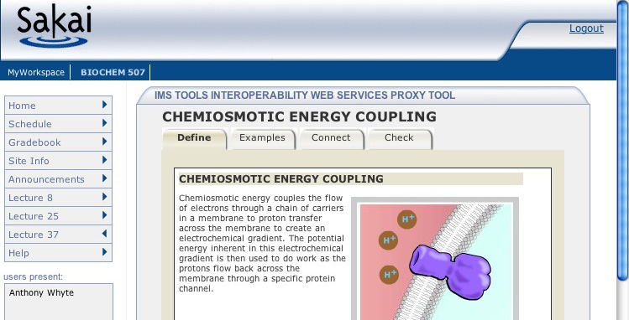
1
6
JVM
Samigo, ConceptTutor, Etc
Sakai
7
Application
Code
Sakai Web
Services
Outcome
Sakai APIs
4
Session
And Services
Bootstrap
5
3
Sakai
IMS Proxy
Launch
2

Slide 40
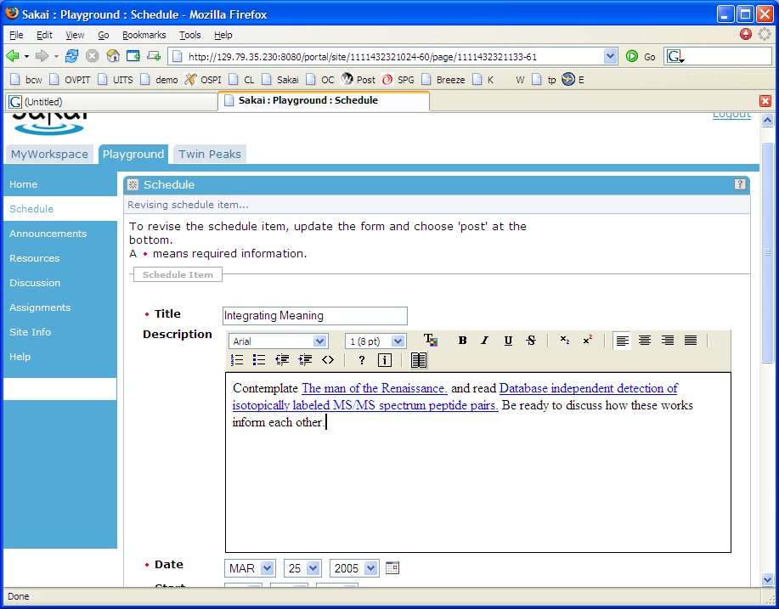
TwinPeaks: Searching Data Repositories
Search as part of
WYSIWYG Editor
Notes:
Allows for pluggable search of data repositories for use in Sakai sites in various contexts
Include content in the WYSWIG editor
Developed at Indiana University, DR OSID support added by MIT/OKI
Should be in release 2.1 - may be part of the resource picker and usable across the entire system.

Slide 41
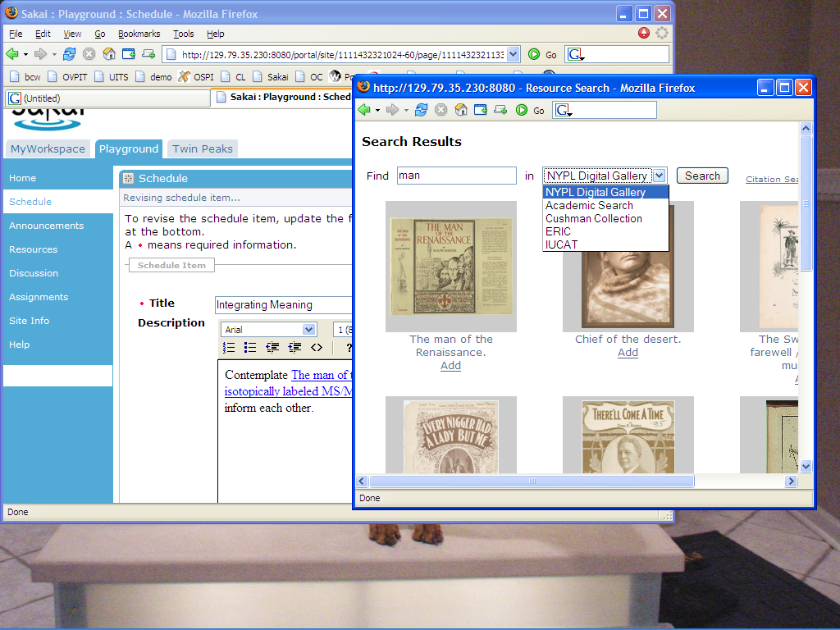

Slide 42
Sakai 1.5 and OSP 2.0
OSPI
Tools
Sakai
Access
OSPI
Access
OSPI
Publish
Sakai
Resource
Sakai
WebDav
OSPI
Resource
OSPI
WebDav
Sakai Content
API
OSPI Repo
API
Notes:
In Sakai 1.5 and OSPI 2.0 - there are completely separate stovepipes.

Slide 43
Goal State Sakai/OSP
OSPI
Tools
Superset
Access
OSPI
Publish
Superset
Resource
Superset
WebDav
Superset Repo
API
Modified
Notes:
To fully align OSPI we will need to refactor all the areas where there is overlap to produce Superset versions.

Slide 44
Structured
Objects
Structured Objects
Structured Object
Notes:
Contribution From Open Source Portfolio Project (OSP)
“Add Structured Object” Resource in Sakai Resource Tool
Schema Based - Each structured “Object Type” is defined by its own Schema loaded into Sakai
Think “vCard” or “Address Book entry”
Also think “Experiment” or “Trial”
Generic Metadata like dublin-Core can be applied to structured objects
Being Added to Sakai by OSP Team over Summer.
This is effectively Jim’s Meta Data Browset being moved into Sakai as a base functionality. Subtle difference - Jim’s browser was RDF-Based, Structured objects are Schema-based (they are simpler for end-users to handle)

Slide 45
Sakai Portal and Repository Integration Approach

Slide 46

Sakai’s Initial Value Proposition
Collaboration
Software
Notes:
Adoptees are attracted to Sakai for both teaching and research collaboration software as a replacement for Lotus Notes or Balckboard.

Slide 47
Sakai’s Real Scope
Collaboration
Software
Data
Repositories
Resources
Portals
Notes:
But once those base requirements are satisfied, the needs quickly move to close integration with two other major existing and emerging enterprise activities. These requirements are uniform across different adoption communities.
These requirements often come with large (financial and talent) resource pools - the open source model. In Sakai we see the high level across technologies and constituent groups (teaching, research, ad hoc) and try to bring communities together to work on common requirements.
We know we won’t be able to do it all.

Slide 48
Integration
Portal
  WSRP - Web Services for Remote Portals
  JSR-168 - Portlet API
Data Repositories
  Data
  Library

Slide 49
Collaboration .vs. Portal
Basic organization is about the shape of the people and groups
Customization based on the “group leaders”
New groups form quickly and organically
Doing one thing at a time - chat, upload - perhaps multiple active windows on a desktop
Very interactive
Think of navigation as picking a tool or switching from one class to another
Think “Application”
Basic organization is about the thing it represents - Teragrid, NVO
Site customization is based on the resource owners
Sometimes there is an individual customization aspect
Many small rectangles to provide a great deal of information on a single screen
Portals think of rectangles operating independently - like windows
Think “Dashboard”

Slide 50
Sakai’s Rectangles
Login
Branding
Site
Selection
Tool
Selection
Tool Area
Presence

Slide 51
Rectangle Handles
http://sakai.edu/portal/gallery
http://sakai.edu/portal/page/<id>
http://sakai.edu/portal/tool/<id>
http://sakai.edu/portal/site/<id>
Notes:
We can feed these rectangles out via iFrame and coming up via WSRP in a portable manner and JSR-168 with some effort within each portal.

Slide 52

WSRP Activities
SunGard-led and funded: Vishal Goenka
Working with uPortal in their WSRP 3.0 effort
As we really try to use WSRP, we identify issues in the standard and WSRP4J implementation
Sakai and uPortal are becoming involved in WSRP standards activities and WSRP4J

Slide 53
WSRP
“Portal”
WSRP Consumer
Portal
WSRP
Placements
Apache WSRP4J
Sakai Sites
Sakai WSRP
Kernel Tool Registry
Request Filter
Tool A
Tool B
Tool C
Web Services
Notes:
WSRP Portal was produced by Vishal Goenka of SunGard SCT over the past six months. It uses the kernel’s tool registry and tool dispatch just like every other portal. The Sakai WSRP portal satisfies the Apache WSRP4J producer API.

Slide 54
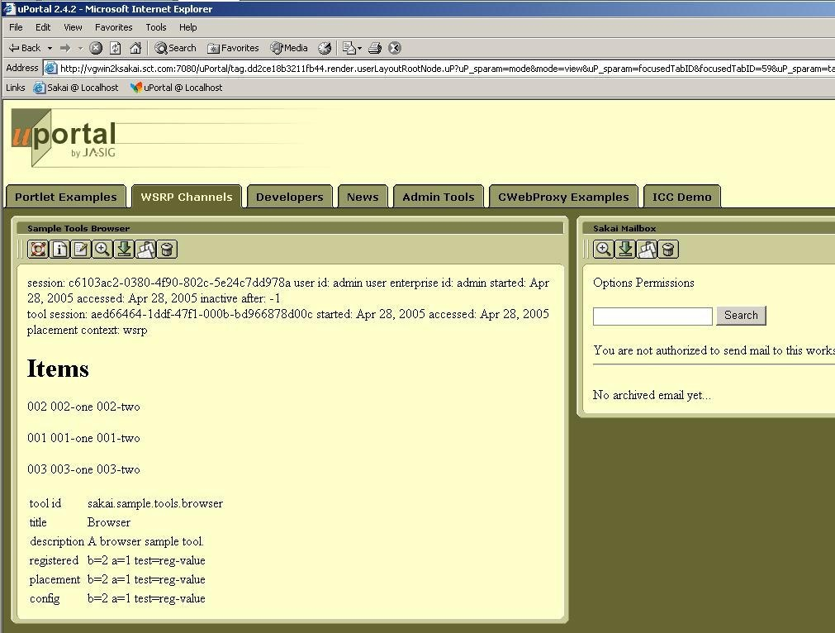
WSRP Image

Slide 55
JSR-168
Goal state: Some of the Sakai tools operate as channels in uPortal
  Not trivially portable to other portals
  WSRP delivers the portability between portals
WSRP is clearing the path in the architecture
Working on summit similar to WSRP summit - really uPortal needs to be the lead here
Notes:
For a Sakai site or tool placement to appear - use WSRP. To use Sakai tool in a uPortal - do JSR-168.
With JSR-168 uPortal is completely controlling placement.

Slide 56
Because Kernel transparently sets up session, user identity, and thread in ways are opaque to the Sakai Tools and Services, we can create a new version of the Kernel to operate in a uPortal/JSR-168 environment.
uPortal’s JVM
uPortal
uPortal
JSR-168
Velocity to JSR-168
JSF to JSR-168
Sakai
Velocity Tool
Sakai
JSF Tool
User, Site,
Role Plug-ins
Sakai Services, APIs,
Components
SAF - Kernel - uPortal Version

Slide 57
High Level View
Collaborative
And Learning
System
Data
Sources
Data
Repository
Research
Activities
Publishing
Activities
The data is the constant across applications and technologies.
Notes:
The DR has a wide range of needs and many applications which will interact with the repo in many ways.
It is the wrong reaction to look at this picture and conclude that the cool thing is to build another repository. Projects are already underway like Fedora and Dspace that have blazed some trails - working with them is better than inventing one’s own from nothing.

Slide 58
Collaboration .vs. Repository
Many different systems may be active at the same time
Systems evolve, improve, and are often replaced every few years
Systems focused on the dynamic needs of users and applications
Thousands of simultaneous online users
Performance tuning
Must be very easy to use; almost unnoticeable
Used informally hundreds of times per day per user
Think “E-Mail”
Generally one system for the area
Long term strategic choice for institution
System focused on accessing, indexing, curation, and storage
Millions of high quality objects properly indexed
Data and metadata quality
Must enforce standards and workflow to insure data quality
Most use is very purposeful: search, publish, add value
Think “Library”
Notes:
Collaborative systems often allow materials to be sloppy (copyright for example). IR’s must be very clear on copyright as there are likely to be different rules w.r.t. materials in IR’s. This may require some cleanup on materials from collab systems when moving to an IR.

Slide 59
Inbound Object Flow
Search
View
The lens or disseminator understands the data model and is capable of rendering the objects. The lens is part of the DR.
Reuse
Sakai
DR
Index
Lens
Store
Create and use in native form
Prepare for
storage
Data
Model
Curate, convert, update and maintain over time
Ingest
The DR establishes a data model for “site” objects. The CLE hands sites to the DR. The DR may have to do “model” or content cleanup before completing the ingest process.
Preparation for storage may include cleanup, conversion, copyright clearance, and other workflow steps.
Notes:
One of the goals here is data portability - making data relevant *beyond* the initial application that created it.

Slide 60
Outbound Object Flow
Sakai can find and re-use objects in the repository.
Search
View
View
Sakai
Search
Index
Lens
Lens
Reuse
Reuse
Data
Model
Data
Model
DR
Notes:
Remember that this is only how Sakai will interoperate with the repository. Other applications will use the repo as well.

Slide 61
Data Repository Technologies
DSpace - is a connected set of features that includes repository, delivery mechanisms, and both user and administrative interfaces.
OCW - IR focused on long term archival of teaching and learning material
IBM Content Manager - Highly media oriented IR
Fedora - has been developed primarily as a “repository” without a specific user interface
Artstor - is an example of a repository that is cross-institutional built around particular collection and technologies to manage that collection

Slide 62
Will there ever be “one” Data Repository?
Each current repository project covers a particular space / technology.
Problems like long-term curation, extremely complex objects, rich media understanding are difficult to do in the general case.
Some short term localized convergence may happen as one project adopts technology from another.
Data portability between systems is the needed innovation to make IR choice more transparent.

Slide 63
Going Forward
Instead of solving the problem by creating a single DR technology that is a superset - which might take years
Focus on data portability between systems - reduce the impedance mismatch (or needed conversion between systems)
RDF enables object portability across systems, languages, and technologies

Slide 64
Tangible Steps for Sakai
Move Sakai and other Collaboration systems toward RDF
  Experiment with using RDF as native storage format instead of relational or file-system
  RDF has yet to demonstrate scalable performance needed for >100K active users - this is a research area
Move data repositories toward RDF
  Move from schema-based stovepipe objects to OWL/RDF based objects with referential integrity
  Explore dimensions of portability of disseminator / lenses - this is an important research area
Notes:
At some level RDF is a low-level enabler which is a pre-requisite. In a way RDF is like “Ethernet” is for the Internet. Additional aspects beyond RDF include OWL (Web Ontology Language) defines the models of data represented in RDF. And beyond RDF and OWL, there is the development of software that understands different onltolgies at increasing levels of semantic understanding.

Slide 65
Sakai: Inverted
The Personal Learning and Research Environment

Slide 66
Sakai: Inverted
The Personal Learning and Research Environment

Slide 67
Sakai’s Real Scope
Collaboration
Software
Data
Repositories
Resources
Portals
Notes:
But our requirements coming from many directions (teaching, research, small group work) require us to connect to other major technologies and smoothly integrate. These requirements often come with large (financial and talent) resource pools - the open source model. In Sakai we see the high level across technologies and constituent groups (teaching, research, ad hoc) and try to bring comunities together to work on common requirements.

Slide 68
Is this what the user wants?
Sakai
?
Collaboration
Software
SRB
uPortal
Data
Repositories
Resources
Portals
Fedora
DSpace
GridSphere
Notes:
Depending on how you view your particular E-Research elephant, you might start with very different software as a starting point and get started - after all these projects usually end up behind schedule and in a big hurry to do *something*. So everyone “picks one”.

Slide 69
The User’s Desktop
Personal Learning/Research Environment
Collaboration
Software
Data
Repositories
Resource
Portals
Notes:
The goal is not to replace or rewrite these software elements but for Sakai to work with them to be so well integrated that we all together deliver the ultimate user goal of E-Science/E-Research/ and E-Learning. And then leverage that smooth integration to *finally* realize the real requirements of the end user - easy to use and powerful. This is not just GUI integration - it is back end integration and data interchange as well.
I think the resources needed to fully deliver on this picture are 200 people for five years. Thanks heaven for the open source model.
Funny - when we get done - after all that work - it will just be a tiny icon in people’s system tray :)

Slide 70
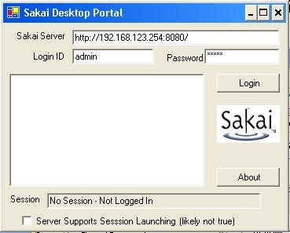
PLRE Client Version 0.0001
- Server
- Site
Tool
Tool
+ Site
+ Server
Sakai
X
Sakai
X
Notes:
Imagine that the GUI was actually useful….

Slide 71
Charon
Portal
Sakai Sites
Charon
Kernel Tool Registry
Request Filter
Tool A
Tool B
Tool C
Notes:
End user built in portal - Sakai site aware.
Produces new iFrame naming convention. Se documents up on sakai-dev on collab.sakaiproject.org.
Charon is pure servlet (no Velocity)

Slide 72
Mini PLRE: Replacing the Sakai Navigation with Web Services and a Desktop Application
Notes:
This is a little project that I did to demonstrate Sakai flexibility.

Slide 73
Mini-PLRE
- Server
- Site
Tool
Tool
+ Site
+ Server
Sakai Sites
Sites Web Service
Kernel Tool Registry
Request Filter
Tool A
Tool B
Tool C
Notes:
End user built in portal - Sakai site aware.
Produces new iFrame naming convention. Se documents up on sakai-dev on collab.sakaiproject.org.
Charon is pure servlet (no Velocity)

Slide 74
PLRE Client Version 0.0001
- System X
- Site
Tool
Tool
+ Site
+ System Y
Imagine a system-tray icon.
Imagine this handling *any* WSRP endpoint (Sakai or portals)….
Imagine this handling your different identities across domains and federation…
Imagine this as a toolbar button in a desktop application…
Sakai
X
Sakai
Y
Notes:
Imaging that the GUI was actually useful….

Slide 75
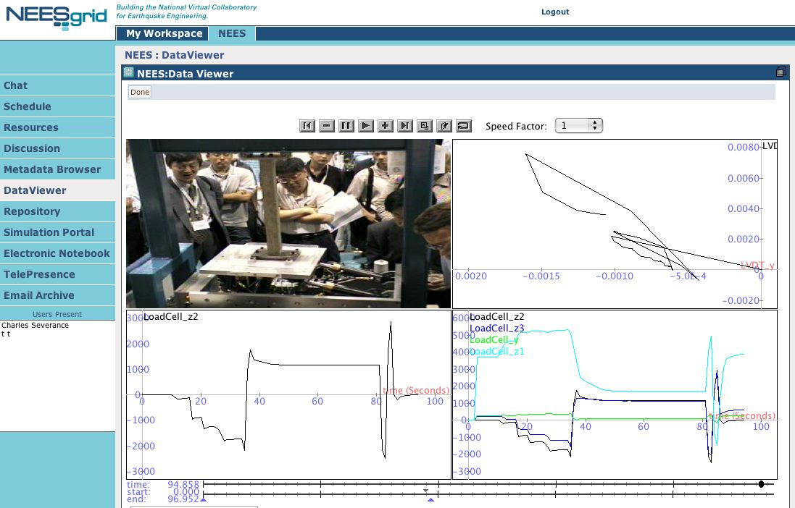
Notes:
The inversion of Sakai is complete.

Slide 76
Portals are not just user interfaces - they are servers too. E-Research is more than portals.
Rob Allan,
Technical Manager,
Advanced Research Computing Centre,
Daresbury Laboratory, UK
July 12, 2005
- Server
- Site
Tool
Tool
+ Site
+ Server

Slide 77
Questions and Summary

