Slide 1
Next Generation
Learning Infrastructure
Sakai and Mac OS X Server
Dr. Charles Severance
http://www.sakaiproject.org/
http://www.dr-chuck.com/
Notes:
How many have heard about Sakai?
How many of your campuses are planning on running production Sakai? Production is something up 100% of time and in use by real users who expect it to be up.
How many will be running some Sakai in production by this Fall?

Slide 2
What is Sakai?
A project—an initial grant for two years
A non-profit member supported foundation to sustain the Sakai community—an emerging group of people and resources supporting the code and each other, realizing large scale Open Source efficiencies
in Higher Ed
A product with:
  A released bundle of the framework and
  A set of tools—written and supported by various groups
  and individuals—which have been tested and released as a unit
An extensible framework for building collaborative teaching
and research tools and services
Notes:
The one sentence elevator speech is “Sakai is an Open Source LMS”. But it is much more than that...

Slide 3
The Sakai Project
Funding and initial institutional partners

Slide 4
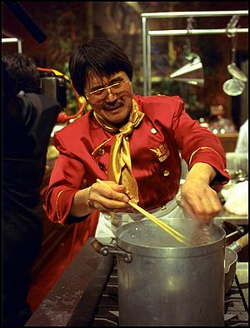
The Sakai Project
The University of Michigan, Indiana University, MIT, Stanford, the uPortal Consortium, and the Open Knowledge Initiative (OKI) are joining forces to integrate and synchronize their considerable educational software into a pre-integrated collection of open source tools.
Sakai Project receives $2.4 million grant from Mellon
Notes:
Many different home grown LMS systems - Mellon was seed money to initially coalesce four to one with the potential to lead to many more adopting the software.

Slide 5
The Sakai Project
Each of the 4 Core Universities Commits
  5+ developers/architects, etc. under Sakai Board project direction for 2 years
  Public commitment to implement Sakai
  Open/Open licensing—“Community Source”
Overall project levels
  $4.4M in institutional staff (27 FTE)
  $2.4M Mellon, $300K Hewlett
  Additional investment through partners
The “Sakai Project” transforms into the Sakai Foundation January 2006
Notes:
All of the resources funded by the grant and in-kind contributed report to the board to do “Sakai” bidding under the direction of the PI and Chief Architect.

Slide 6

Consolidation
Industry Shakeout
Black
Board
Black
Board
+
WebCT
Commercial
WebCT
Home Grown
Sakai Project
Foundation...
1995
2002
2004
2007
Notes:
Emphasize the difference between the Sakai project and Sakai in the future. The need for close collaboration during the “grand rewrite”. Sakai project is just a blip - we hope it is transformational.

Slide 7
Consolidation
Industry Shakeout
Black
Board
Black
Board
+
WebCT
Commercial
WebCT
Is Foundation supposed to be cut off?
From Duarte
This is how it was provided. I have created
an alternative solution above and hid
this version incase it was intentional.
Home Grown
Sakai Project
Foundation...
1995
2002
2004
2007
Notes:
Emphasize the difference between the Sakai project and Sakai in the future. The need for close collaboration during the “grand rewrite”. Sakai project is just a blip - we hope it is transformational.

Slide 8
The Sakai Community
Close coordination for two years to quickly build the critical mass for open source enterprise
Collaborative Learning Environment

Slide 9

Sakai Foundation
Formed as a non-profit corporation to support, sustain, and promote Sakai.
Initial foundation board is the Sakai project board with open nominations and election for three retiring Sakai board members.
Annual budget of $1M from member contributions
  Expect to have 4-6 staff positions funded by the Foundation
  Two conferences per year at 100K each
Membership fee is $10,000 per year for educational institutions, non-profits, or commercial partners.
Upcoming Sakai Conference
December 7-9
Austin Texas
http://sakaiproject.org/austin
Notes:
Example staff may include, Executive Director, CTO & Architect, Administrative Support,
Framework Development & Architecture, Communications Manager,
Partner Tech Support & Documentation, QA & Release Manager.
Development staff will come from the community or be contributed as “in-kind” from Sakai members to the board.

Slide 10
Sakai Members
Albany Medical College
Monash University
University of California, Los Angeles
Arizona State University
Nagoya University
University of California, Merced
Australian National University
New York University
University of California, Santa Barbara
Boston University School of Management
Northeastern University
University of Cambridge, CARET
Brown University
North-West University (SA)
University of Cape Town, SA
Carleton College
Northwestern University
University of Colorado at Boulder
Carnegie Foundation for Advancement of Teaching
Ohio State University
University of Delaware
Carnegie Mellon University
Portland State University
University of Hawaii
82 and Growing
Ceritos Community College
Princeton University
University of Hull
Coast Community College District
Rice University
University of Illinois at Urbana-Champaign
Columbia University
Ringling School of Art and Design
University of Melbourne
Cornell University
Roskilde University (Denmark)
University of Michigan
Dartmouth College
Rutgers University
University of Minnesota
Florida Community College at Jacksonville
Simon Fraser University
University of Missouri
Foothill-De Anza Community College
Stanford University
University of Nebraska
Franklin University
State University of New York
University of North Texas
Georgetown University
Stockholm University
University of Oklahoma
Harvard University
SURF/University of Amsterdam
University of South Africa (UNISA)
Hosei University IT Research Center
Syracuse University
University of Texas at Austin
Indiana University
Texas State University - San Marcos
University of Toronto, Knowledge Media Design Institute
Johns Hopkins University
Tufts University
University of Virginia
Lancaster University
Universidad Politecnica de Valencia (Spain)
University of Washington
Loyola University, Chicago
Universitat de Lleida (Spain)
University of Wisconsin, Madison
Lubeck University of Applied Sciences
University College Dublin
Virginia Polytechnic Institute/University
Maricopa County Community College
University of Arizona
Whitman College
Marist College
University of California, Office of the Chancellor
Yale University
MIT
University of California Berkeley
University of California Berkeley
University of California, Davis

Slide 11




Sakai Major Collaborators
  Open Knowledge Iniative (OKI)
  IMS Standards
    Tool Interoperability (TI) standard
    Common Cartridge (CC) standard
  Open Source Portfolio Initiative
  JA-SIG / uPortal

Slide 12
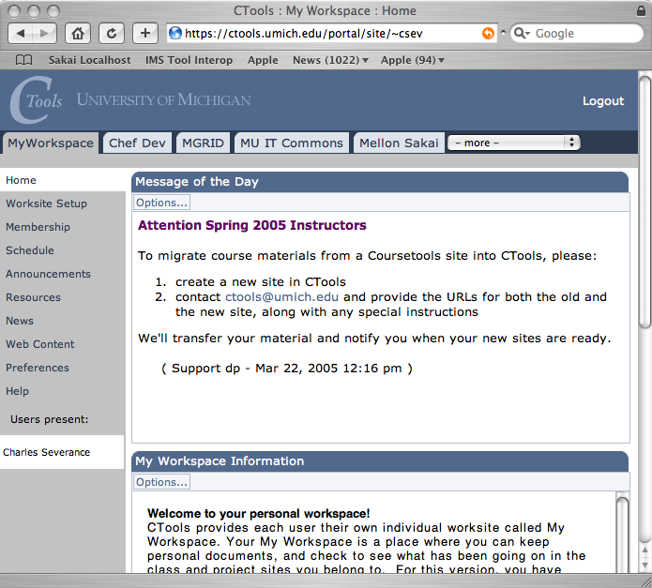
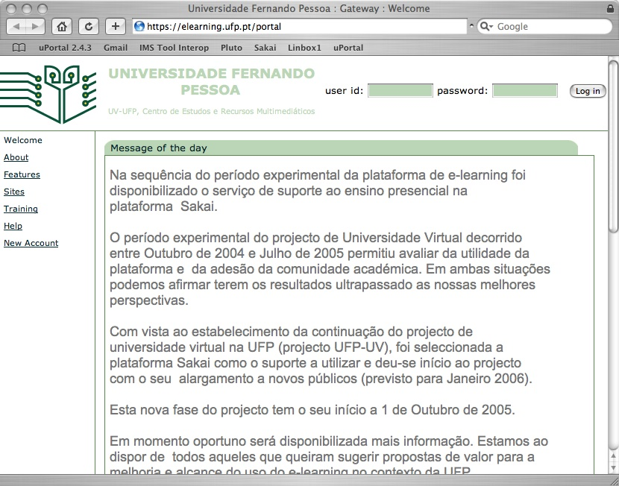
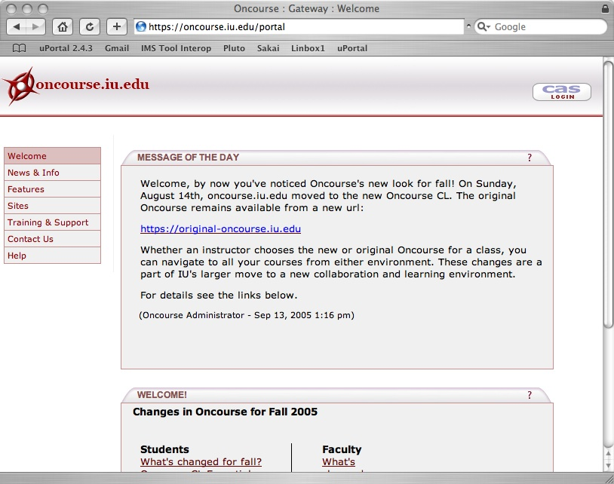
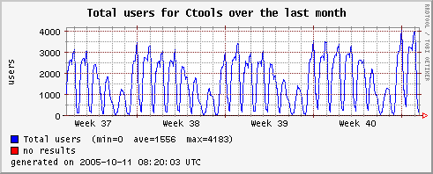
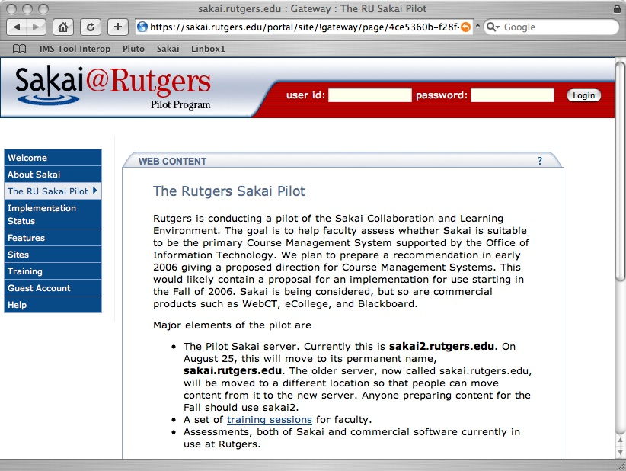
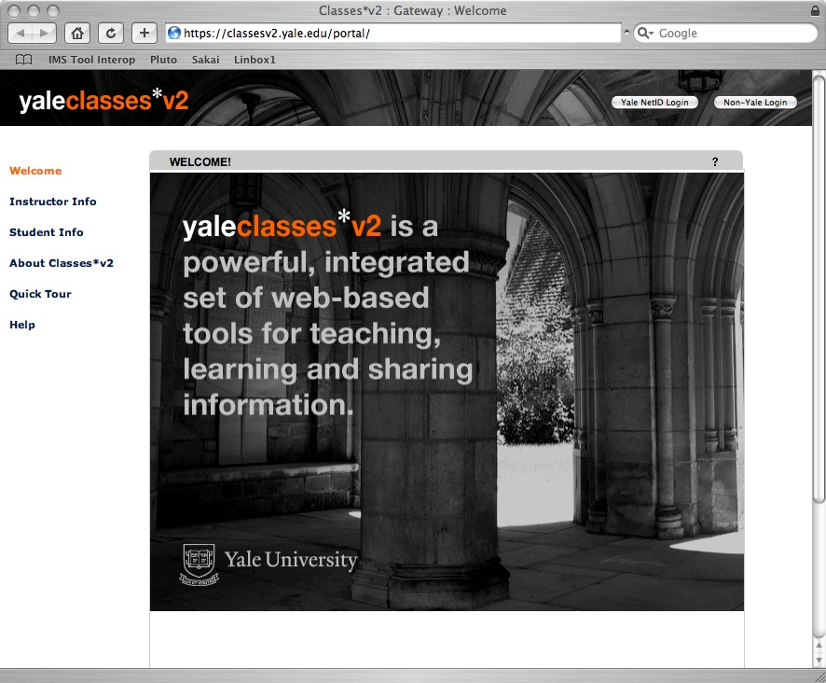
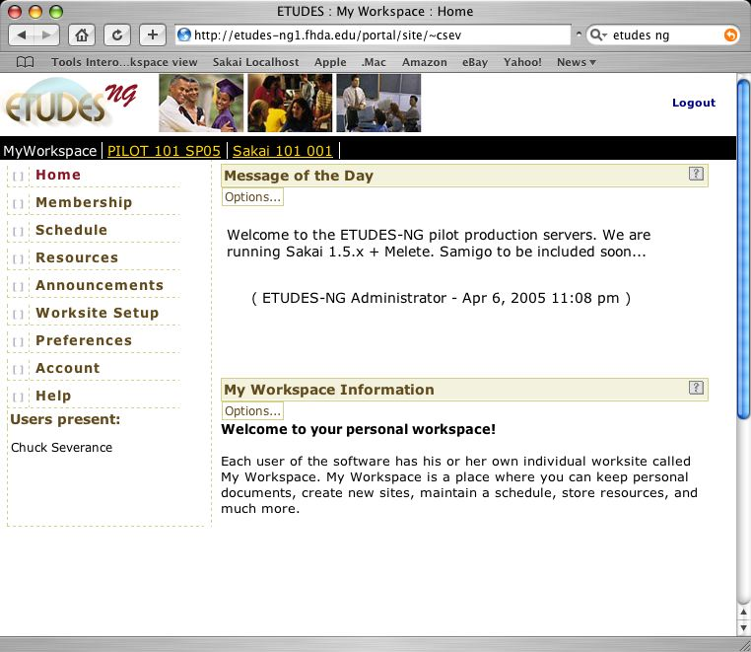
Sakai in Production
Notes:
These are the sites that are running 24x7 with real user bases that are teaching significant number of classes. UM 9/04, IU 1/05, Yale 1/05, Foothill 4/2005, Rutgers 9/2005. One animation - CTools usage graph.

Slide 13

Sakai and Apple
Among the developer team, 70% develop on Apple systems
  More dev-QA is done on Apple OS X than any other system :)
Sakai’s internal collaboration server runs on Mac OS X Server
  collab.sakaiproject.org
Advantages of Mac OS X and Xserve when running Sakai
  Simple operating system maintenance (patches, etc)
  Java pre-installed and kept up to date
  An ideal platform for installations where there is not a dedicated system administrator

Slide 14
Sakai Commercial Affiliates
The Sakai Educational Community License is BSD-like and allows complete flexibility in terms of the creation of and licensing of derivative works.
This allows different commercial companies to interact in different
ways without any limitations
imposed by license.
More to say later . . .
Stay tuned!
Notes:
Sakai encourages commercial companies to make money selling and supporting and adding value to Sakai. Sakai itself only produces and QA’s the software - any local development, customization, support, etc is either performed by local staff or by a commercial company.

Slide 15
The Sakai Product
A Collaborative Learning Environment—
Suitable for use in teaching and learning, research collaboration, and ad hoc group communication

Slide 16






Placing the Sakai Product
A collaboration and learning environment
Teaching
and
Learning
Collaboration (including eResearch)
Notes:
Sakai is a Collaborative Learning Environment. Sakai can be applied in both a teaching and learning environment as well as research collaboration.

Slide 17
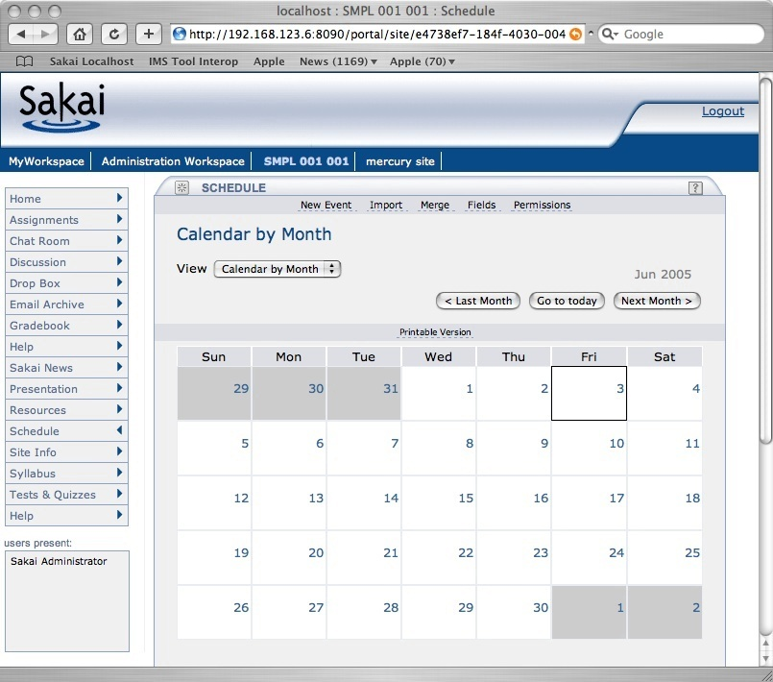
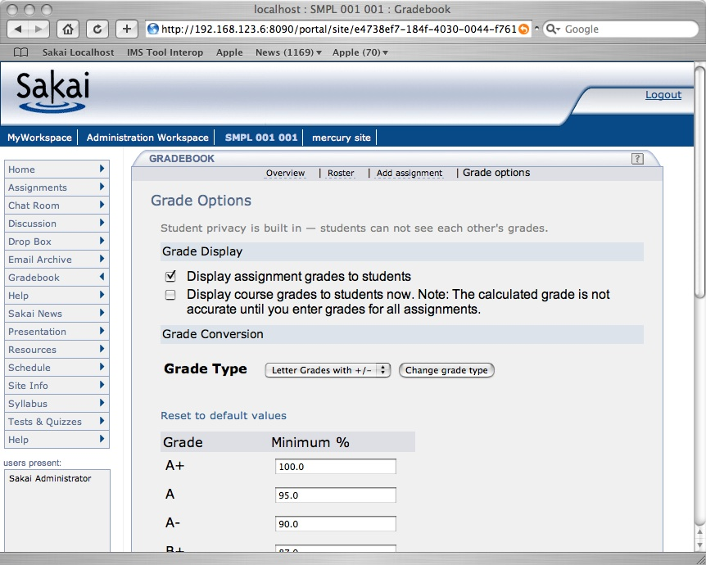
Sakai 2.1 Tools
Announcements
Assignments
Chat Room
Threaded Discussion
Drop Box
Email Archive
Gradebook
Melete - Content Editor
Message Of The Day
News/RSS
Preferences
Presentation
Profile / Roster
Resources
TwinPeaks - Repository Search
Samigo - QTI Assessment
Schedule
Section Management
Syllabus
Web Content
Worksite Setup
WebDAV
Notes:
Some tools are generic and other tools are focused on teaching and learning.
May also be a wiki in the 2.1 release. New tools under community development include shared whiteboard, multipoint audio, multipoint video, blog, and shared display.

Slide 18
The Sakai Framework
The need to satisfy the often conflicting goals of ease of use, ease of expansion, configuration flexibility, environmental portability and rock-solid production reliability suitable for enterprise deployment.

Slide 19
Sakai Technical Goals
Component based expandability
Appearance of a single well-integrated application
Flexible Presentation (HTML, Portals)
Support for Web Services
Flexibility in Expansion including non-Java
Production-ready

Slide 20
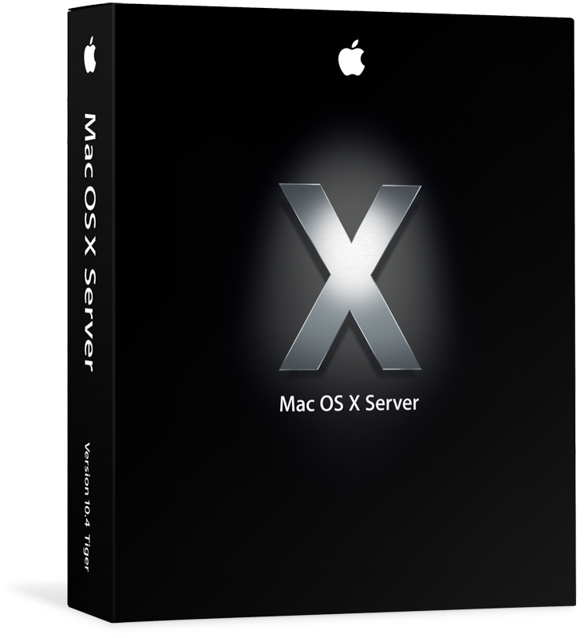
Sakai Foundational Technologies
Java
1.4
Apache - SSL, mod_jk, WEBISO, virtual hosting
Sakai consists of technologies chosen
to be common in
Java Enterprise Environments.
Sakai requires Tomcat 5.x but can make use of all of the open source elements included in
Mac OS X Server.
Sakai
Tomcat 5.5
Spring
Hibernate
Java Server Faces
Velocity (legacy)
JBoss and Tomcat 4.1
Included
in OS X Server
MySql 4.1
Oracle is
available for
Mac OS X Server
Oracle
Notes:
Oracle is available.
All other elements needed by Sakai are either part of the Sakai install or part of the Mac OS X Server out of the box.

Slide 21
Service Oriented Architecture
Browser
Browser
My
Monolithic
Code
Presentation
Code
Service
Interface
(i.e. API)
Service
Code
Persistence
Persistence
Notes:
I call this a “two-layer architecture” - “middle-ware” is another term that fits here.
Decompose tool code into presentation elements and service elements
Provide an abstraction (API) which shields the tool code from the implementation details of the service code - document and publish the API.
Allows separate development of the tools and services.
Allows effective unit testing of services
Allows an implementation to be replaced transparently with another implementation as long as the API contract is fully met
Great for web services.

Slide 22
Sakai Applications and Framework
SAF—Presentation Services
Abstract Tool Layout
Tool Code (Java)
Service
Interface
(i.e. API)
Application Services
SAF—Common Services
Framework
SAF—Kernel
Application
Notes:
Kernel - An augmented web application which enables the Sakai APIs to be called from the web application - this is a rich but not constraining environment - insures that Common services are portable.
Common Services - A set of common services available to all tools (authentication, authorization, hierarchy, repository, others)
Presentation Services - A set of Sakai specific JSF tags to handle presentation details and provide widgets such as a date-picker or WSYWIG editor.

Slide 23
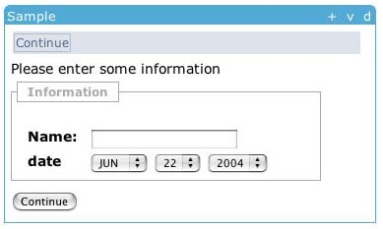
Sakai Presentation Service Abstraction
<sakai:view_container title="#{msgs.sample_title}">
<sakai:tool_bar> <sakai:tool_bar_item/> </sakai:tool_bar>
<sakai:instruction_message
value="#{msgs.sample_one_instructions}" />
<sakai:group_box
title="#{msgs.sample_one_groupbox}">
<h:inputText
value="#{MyTool.userName}" />
<sakai:date_input
value="#{MyTool.date}" />
<sakai:button_bar> <sakai:button_bar_item action="#{MyTool.processActionDoIt} value="#{msgs.sample_one_cmd_go}" />
</sakai:button_bar>
Notes:
This is an example of how the presentation services work. Sakai provides a tag set which enforces style guide compliance, accessibility, internationalization, etc. The attempt is to do as much as possible in the framework and keep the tools as clean and simple as possible.

Slide 24
Sakai on the Desktop
Sakai Desktop Client
Presentation
Axis
Tool Layout
Web Svcs
WS End Point
Tool Code
Service
Interface
(i.e. API)
Framework
Application
Sakai Framework and Application Services
HTML
Notes:
The Sakai Desktop client uses a combination of web services and HTML to produce a rich, experience directly on the user’s desktop. This is part of the reason that Sakai focuses on abstracting the presentation layer in addition to the API to the Sakai Framework and Services.

Slide 25

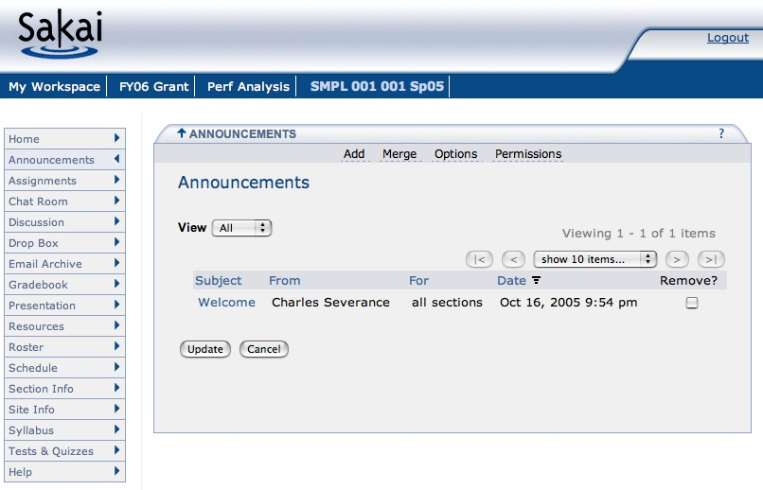

Sakai Browser-Based Presentation
The standard Sakai interface is through a web browser.
This is only one of the possible ways to view Sakai.
Sakai

Slide 26
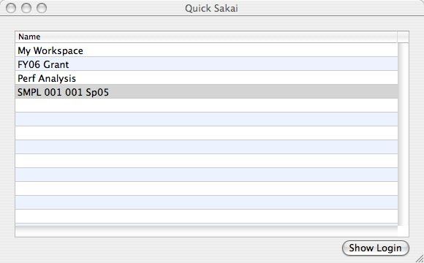

Sakai Apple Desktop
The Sakai Apple Desktop application is an experiment in a new way of presenting Sakai information directly from the desktop.
Sakai

Slide 27
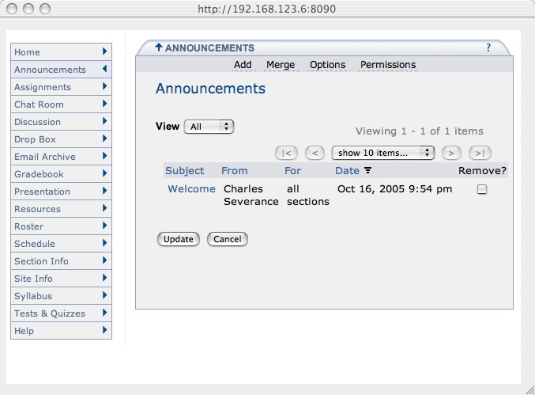
Sakai Apple Desktop
The Sakai Apple Desktop application is an experiment in a new way of presenting Sakai information directly from the desktop.
Sakai
Sakai

Slide 28
Sakai
More Information
  Main site
  Sakai-wide collaboration area
    collab.sakaiproject.org
  MacLearningEnvironments.org
    Integrating Apple technologies into new Learning Environments
    Open and Community Source Learning Infrastructure Projects
    Community built on Mac OS X Server deployment of Sakai

Slide 29
Sakai
Next Steps
  Visit us here in the Apple Booth

