Slide 1
Sakai Technical Overview
Charles Severance
Sakai Chief Architect
November 7, 2005

Slide 2
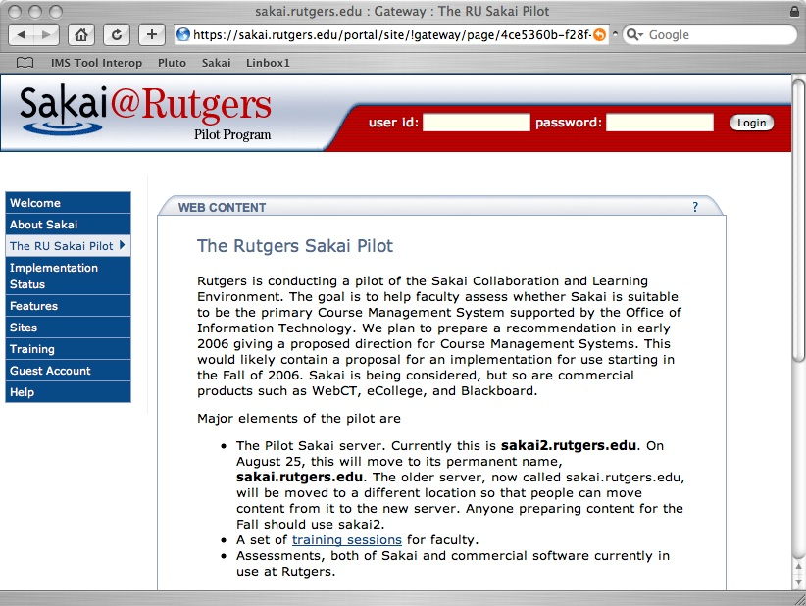
The Ideal Sakai Deployment
Take an empty Sakai system
  Choose a set of 10-15 tools for your needs
  Choose a set of Services (web services, etc)
  Add some local customizations, look feel, language etc
And you have a production ready system
Tools and capabilities written by many different groups or individuals
Sakai
Tool
Library
Sakai
Framework
Sakai
Service
Library
Local
Customization

Slide 3
Sakai Goals
Component based expandability
Appearance of a single well-integrated application
Flexible Presentation (HTML, Portals)
Support for Web Services
Flexibility in Expansion including non-Java
Production-ready

Slide 4
Framework, Tools and Services
Tools
  Cannot do any type of persistence
  Responsible for presentation (GUI)
Services
  Must provide documented API
  Cannot do any presentation (not aware of HTML at all)
  Must access other services through service APIs (not data models)
Framework
  Provides registration for tools and service
  Provides common capabilities
  Knows nothing of domain objects

Slide 5
Component Based Expansion

Slide 6
Sakai Service Rules
Tool A
Tool B
Tools can access Service APIs
Services can access Service APIs
We must be able to swap Service implementations
X API
Y API
Service X
Impl
Service Y
Impl
X Data
Model
Y Data
Model

Slide 7
Substituting Service Implementations
Tool A
Tool B
If a deployment chooses to implement Service X is using web services, there is no data model and any implementation-X specific access is no longer available.
X API
Y API
Service X
WS Impl
Service Y
Impl
X Web
Service
Y Data
Model

Slide 8
Sakai Framework
Registration of tools and services
Provides portability between environments where possible
  HTML / Web Services
Framework includes presentation elements as well to support tools
The Sakai Framework
Sakai
TPP Tool
Sakai
TPP Tool
Sakai
Service
Sakai
Service

Slide 9
Functionality Flow
Goal: no replication of code
Code trends toward the broadest and most reusable are of the system
  Framework
  Service
  Tools
As long as it does not break the “rules”
The Sakai Framework
Sakai
TPP Tool
Sakai
TPP Tool
Sakai
Service
Sakai
Service

Slide 10
Goal: Appear as Single Integrated Application

Slide 11
Why Build A Sakai Tool?
Want your website under a button in Sakai?
Want your PHP app to know the current logged in Sakai User?
Want a servlet “in Sakai” but with a minimum of rework?
Full blown Sakai tool - released separately?
An optional part of the Sakai release?
A core part of the Sakai release?
Notes:
There is a significant difference between these options.

Slide 12
Sakai Goals (may conflict)
A collaborative application
  Reusable objects (Quiz Questions) across many tools
  Component based - any component can be removed without harming the system
Extremely easy to expand - reduce barriers to adding a new tool
Notes:
To be fully integrated a tool must follow many rules. These rules are still evolving.
However to encourage innovation, we also want to allow simple expansion.
Question: Would you rather have a Quizzing tool that does not export automatically or no Quizzing tool at all?
First we cover the “highly integrated case” (Tools written in Java which want to look like they are “part of Sakai”.

Slide 13
Current
Reuse in 2.0
Anouncements
Resources
Presentation
Samigo
Melete
Notes:
Announcements can attach from resources
Presentations are uploaded into resources.
Melete and Samigo store their content in their own tables or files.

Slide 14
Better
Reuse
Anouncements
Resources
Presentation
Samigo
Melete
Notes:
We want new attachments for announcements to show up in resources… We want to use TwinPeaks for announcement attachments. Presentation needs an upload mode so you don’t have to figure out how to use Resources by reading the Presentation help.
Samigo and Melete need to be modified to store and use files, etc from resources.
During authoring, Melete needs to be able search for questions and quizzes stored in Samigo, add them to a Melete module, and then while the student is “taking” the Melete module, Melete will temporarily use Samigo to display the answer and then get it back so as to decide what to do next.

Slide 15
Flexibility in reuse
Anouncements
Resources
Presentation
Samigo
Melete
Scorm
Authoring
Notes:
What if UC Davis wants to write a SCORM authoring environment. Now it needs to talk to Samigo and the resources tool. Perhaps Melete will want to include a SCORM module as a step in a Melete module. And perhaps the SCORM authoring environment will want a full and ocmplete export of everything including the quizzes and questions from Samigo.
Yikes.

Slide 16
So you want to write a new tool?
Anouncements
Resources
Presentation
Samigo
Language
Module
Melete
Scorm
Authoring
Notes:
Say you are the Yale Language Learning Center and you want to write a Template Authoring system which will provide little lesssons for Melete and elsewhere.
What do you have to do? You have to support Melete during authoring with searching capabilties and hand out handles to your templates. When Melete is playing a model you will be handed back the handl to your object and then expected to play it. There may be a neede to import or export your object.

Slide 17
Building Tools
To meet the goals of Sakai it is not sufficient to simply build a stovepipe tool
While much of what is described here is “optional”, the more “integrated” a tool intends to be, the more “required” these elements become
Notes:
A stovepipe is a tool that stands alone and does a single function with no interaction with the rest of the system or any other tools.

Slide 18
Two Layer Architecture
Task
Tool
Task
Tool
Presentation
Public Abstraction
Task API
Task
API
Impl.
Persistence,
Business Logic,
ORM, etc…
Task DB
Task DB

Slide 19
To fully integrate into “Sakai
Task
Tool
Helper
Other
Tools
Web
Services
Task API
Task
API
Impl.
Internationalization
AutoDDL
Import/export
Authorization
Sakai DB
Placement
Components
Notes:
With great power comes great responsibility.
We are building a component based collaborative application not a portal which shows a bunch of stove pipes in a single web page.
Everything is “optional” but not optional to fully play in Sakai. The question is whether or not you are building a tool that fully plays in Sakak.

Slide 20
Sakai 2.0 Framework

Slide 21
Sakai 2.0 Design Approach
Significant re-factor of functionality
  SAF - Kernel
    Components/Spring Session, Tool registry, Identity
    Support for Sakai tools, basic servlets, web services, and webdav
    Thread conditioning, Servlet filter
    Kernel enables the other services
  SAF - Services
    Primary support APIs which for tool interactions
  SAF - Presentation Services
    JSF, Velocity, Servlet
Major goal: Clean support for servlets, web services, and webdav using the Kernel

Slide 22
SAF Design Documents
Sakai Tool Model
Sakai Sessions
Sakai Request Flow
Sakai Mercury Portal
Sakai Use of Maven
Sakai Configuration
Sakai Charon Portal
Sakai Component Model
Sakai Authentication
others
These documents on collab.sakaiproject.org
“Sakai Development”

Slide 23
SAF - Kernel
Does not go “above” servlet level - “provisions” a Sakai servlet (and its thread) to fully operate
Elements (6900 lines of code)
  Components - Interaction with Spring to register/retrieve the Sakai API implementations with class-loader isolation
  Session
    httpSession - shared Sakai-wide for user/login
    sakaiSession - shared Sakai-wide for user/login
    sakaiToolSession - scoped by user/login/placement
  Tool registry - including support for “helpers”
  Identity of current logged in user
  Utilities including thread local support
Notes:
Does not go above servlet level means that this all works for code which “extends httpServlet” and even code which does low level stuff like response.write - this allows many things to be integrated into Sakai including basic servlets with API adapters (like Xwiki).
A properly scoped wrapped httpSession object is provided for those servlet activities that make use of httpSession (such as JSF).

Slide 24
SAF - Components
It is like container-wide Spring components, each with their own class loader
In Sakai 1.0 and 1.5 we placed components in webapps to get the class loader isolation, but we ended up with load-order problems
In Sakai 1.0 and 1.5 we “bent” Spring to orchestrate Sakai components
In Sakai 2.0 components simply appear “in Spring”
Notes:
Load order problems - bummed because it was so fundamental.
Whoever figured out the context.xml trick - much appreciated.
”Spring Enterprise Beans”

Slide 25
SAF-Components
common/lib
spring
sakaiComponentManager
tomcat/components
component-1
WEB-INF
components.xml
classes
lib
component-2
WEB-INF
components.xml
classes
lib
tomcat/webapps/app1
ComponentManager
or
Spring
tomcat/webapps/app2
ComponentManager
or
Spring
All globally registered components are available to Spring for injection (Interface names are the bean names) or via the Sakai ComponentManager API using Service Locator pattern.
Each component looks like a webapp, but with no web.xml. Each has classes and its own “lib”. Their class loader uses common and shared.
Notes:
The primary value is the separated class loaders. This way components with very large jar footprints like JENA, Globus, can be used without polluting shared. This allows multiple versions of things like xerxces to exist within the same JVM transparently.
As an example, in CHEF and Sakai pre 2.0 - you could not build a system both with Globus and JENA because of jar-wars.

Slide 26
SAF-Components Benefits
Separate class loaders for each component, and each webapp
Allows the jar footprint of one component not to be forced to overlap with all of the other components, tools, portal, etc.
  Multiple conflicting xerxes can be kept separate
  Adding/replacing a tool or component does not break things like the portal or other components
Provides an EJB-like isolation but using Spring to connect components to client code
Notes:
We have worked with Spring and had some initial discussions.

Slide 27
SAF - Session
Tomcat Sessions leave much to be desired
  Cross-context dispatch issues (fights between Pluto and Tomcat - changes between dot versions)
  Not well suited for Web Services or WebDav when browser is not involved
  Lifecycle issues - can’t always count on cleanup
  Scope issues - Shared / Servlet / Portlet
Sakai sessions solve all of these problems

Slide 28
SAF-Session Scenarios
Cookie set via login or at SSO via WebISO
Browser A
Browser B
Tool X1
Tool X2
Basic Auth
(Cookie opt)
WS Auth
Session ID
Tool Y1
Tool Y2
WebDav
Client
WS or
WSRP
Client
Filter
Renderer Servlet
Re-dispatch
Filter
Filter
Filter
Filter
WebDav
Servlet
Axis
Servlet
Tool X
(Portlet)
Tool Y
(Servlet)
Sakai APIs need logged in user, current session, etc.
Notes:
For each incoming request scenario, the filter sets appropriate Sakai Session, produces wrapped httpSession, and in the case of a tool, gets placement scoped session. In some situations, WebDav and WebServices, the filter may not be able to completely set up session so the WebDav or Axis servlet must participate in session establishment.
WebDav may or may not support cookies. Web Services will not support cookies but may have some type of session ability “in-band”.

Slide 29
Web Services

Slide 30
Web Services
Web Services allow flexible reuse of API and services in contexts beyond the Sakai interfaces
  WSRP presentation
  SOAP - RPC
Web Services Issues
  Security
  Performance
  API needs to tend towards document-style rather than RPC-style
Notes:
APIs need to be reengineered.

Slide 31
Web Services
Web Services
Client
Web Services shipped in Sakai 2.0
Based on Axis 1.2
Release 2.0 includes sample PHP client
Jakarta Axis
WS End Point
Sakai Kernel
Sakai APIs
Available in Sakai 2.0
Samples Only
Notes:
Sakai 2.0 ships with a fully integrates web services capability - the particular WSDL and web services are not yet defined - this is there to enable the development of new applications, uses, and ways to integrate with Sakai.

Slide 32
Sakai Web Services Endpoint
import org.sakaiproject.api.kernel.session.Session;
import org.sakaiproject.api.kernel.session.cover.SessionManager;
public class SakaiSession {
public String checkSession(String id) {
System.out.println("session id="+id);
Session s = SessionManager.getSession(id);
if (s == null)
{
System.out.println("no session established");
return "Session Null";
}
else
{
String resp = "session: " + s.getId()
+ " user id: " + s.getUserId()
+ " user enterprise id: " + s.getUserEid()
+ " inactive after: " + s.getMaxInactiveInterval();
System.out.println(resp);
return resp;
}
}
}
Notes:
Web Services under Axis is really easy to use. There are many issues - security, performance, and interoperability (especially with .NET) - but this is a journey we must take.
Given my experience with Web Services so far I am glad we built a solid application first and then added web services to is rather than starting with web services.

Slide 33
Sakai Web Services Client
require_once('SOAP/Client.php');
if ( ! $_POST['url'] ) $_POST['url'] =
"http://nightly2.sakaiproject.org/sakai-axis/";
if ( $_POST['login'] ) {
$site_url = $_POST['url'] . 'SakaiLogin.jws?wsdl';
echo ("Loggging in to Sakai Web Services at ".$site_url);
$wsdl=new SOAP_WSDL($site_url);
// Create an object directly from the proxy code
$myProxy=$wsdl->getProxy();
$session=$myProxy->login("admin","admin");
echo ("Session:");
print_r ($session );
$_POST['session'] = $session;
}
Notes:
In PHP no less…

Slide 34
Flexible Presentation

Slide 35
Abstract Architecture
Client
To render a Sakai response, the tools, and services work with other elements
  Presentation Support
  Aggregation
The Abstract Sakai Environment
Aggregator
Presentation
Tools
Services
System

Slide 36
External
Aggregator
Writing a Tool
The Sakai Framework
Internal
Aggregator
Each tool describes its presentation needs in a generic fashion - the framework provides mechanisms to render the tool’s presentation
The tool is unaware of any aggregation or final presentation
Tools may produce “application” services related to the tools (chat tool / chat service)
A service built for a particular tool should still operate through an API and be available to other tools
Presentation
Support
The Sakai Tool Environment
Sakai Tool
Presentation
Sakai
Tool Code
Application
Services
Framework
Services
System

Slide 37
uPortal via
WSRP
An Example
The Sakai Framework
HTML Based
Aggregator
This is a tool written using the Sakai JSF widget set
The tool builds its own API (Schedule)
The tool makes use of framework APIs.
The tool is rendered in HTML and displayed within uPortal via the Web Services for Remote Portlets (WSRP) protocol
Outside the tool, there is great flexibility which is hidden to the tool
Sakai JSF
Widget Set
The Sakai Tool Environment
GUI layout
(JSF/JSP)
Schedule
Tool (Java)
Schedule
API (Java)
OSID Id
API
System

Slide 38
Rendering Flexibility
Sakai
iframe
Portals via
iframe
Sakai
Non iframe
Portals via
WSRP
uPortal via
JSR-168
The Sakai Framework
Servlet/HTML
Renderer
WSRP
Renderer
JSR-168
Renderer
Sakai JSF
Widget Set
The Sakai Tool Environment
Java Server
Faces in JSP
Java Tool Logic
Java Beans
Sakai Application
Services
Sakai and/or OKI
APIs
Notes:
There are many rendering options within Sakai, but the tool code does not have to change. Because presentation is delegated to the JSF widget set, all of this flexibility is hidden from the application.

Slide 39
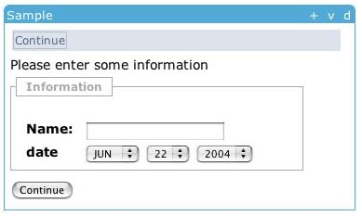
Tool Display in JSF
<sakai:view_container title="#{msgs.sample_title}">
<sakai:tool_bar> <sakai:tool_bar_item/> </sakai:tool_bar>
<sakai:instruction_message
value="#{msgs.sample_one_instructions}" />
<sakai:group_box
title="#{msgs.sample_one_groupbox}">
<h:inputText
value="#{MyTool.userName}" />
<sakai:date_input
value="#{MyTool.date}" />
<sakai:button_bar> <sakai:button_bar_item action="#{MyTool.processActionDoIt} value="#{msgs.sample_one_cmd_go}" />
</sakai:button_bar>
Notes:
Showing the separation between the “within tool” presentation and “within framework” presentation details. The tools use Sakai Widgets to express their layout needs and the framework renders the tags as appropriate for the different presentation approaches.
The variable values are populated from Java bean getter methods provided by the Java tool code in the display backing bean.

Slide 40
Describing Actions in JSF
<h:inputText
value="#{MyTool.userName}" />
MyTool.userName() {
}
<sakai:date_input
value="#{MyTool.date}" />
MyTool.date() {
}
<sakai:button_bar> <sakai:button_bar_item action="#{MyTool.processActionDoIt} value="#{msgs.sample_one_cmd_go}" />
</sakai:button_bar>
MyTool.processActionDoIt() {
}
Notes:
Similarly, the presentation in JSF links actions in the presentation to methods in the Java code which is the backing bean..

Slide 41
Support For Velocity Tools
Sakai
Stand-Alone
uPortal via
iframe
The Sakai Framework
HTML Based
Aggregator
Sakai Velocity
Support Layer
Sakai JSF
Widget Set
The Sakai Legacy Environment
The Sakai Tool Environment
Velocity
Templates
Java Server
Faces in JSP
Sakai Legacy
Tools
Java Tool Logic
Java Beans
Sakai Legacy
Services
OKI OSID
Legacy Covers
Sakai Application
Services
Sakai
Framework APIs
Hibernate
OKI OSIDs
Notes:
In addition to support for JSF tools, there is an environment to support the tools developed for the precursor to Sakai (CHEF). This compatibility layer allows all of the CHEF tools to fully operate in Sakai.

Slide 42
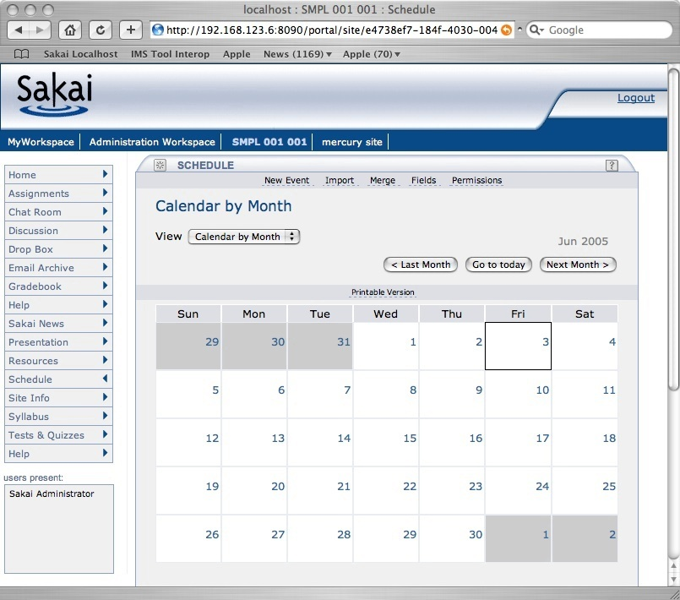
HTML Aggregator - Charon
Login
Branding
Site
Selection
Tool
Selection
Tool Area
Presence
Notes:
There are multiple ways to display Sakai tools - the basic and default portal is called “Charon”. Charon is used when Sakai is operating stand-alone and uses iframes to assemble the tools into an application.

Slide 43
Charon
Portal
Sakai Sites
Charon
Kernel Tool Registry
Request Filter
Tool A
Tool B
Tool C
Notes:
End user built in portal - Sakai site aware.
Produces new iFrame naming convention. Se documents up on sakai-dev on collab.sakaiproject.org.
Charon is pure servlet (no Velocity)

Slide 44
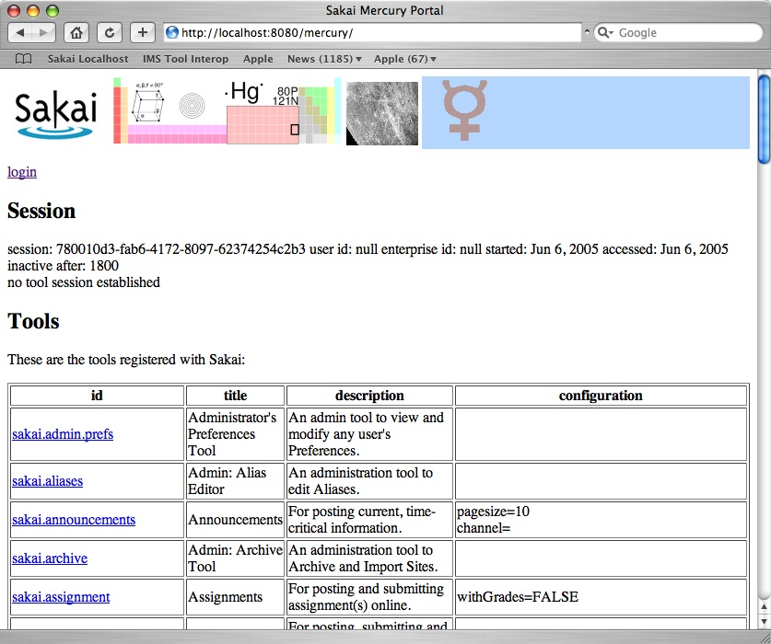
Mercury

Slide 45

WSRP Activities
SunGard-led and funded: Vishal Goenka
Working with uPortal in their WSRP 3.0 effort
As we really try to use WSRP, we identify issues in the standard and WSRP4J implementation
Sakai and uPortal are becoming involved in WSRP standards activities and WSRP4J

Slide 46
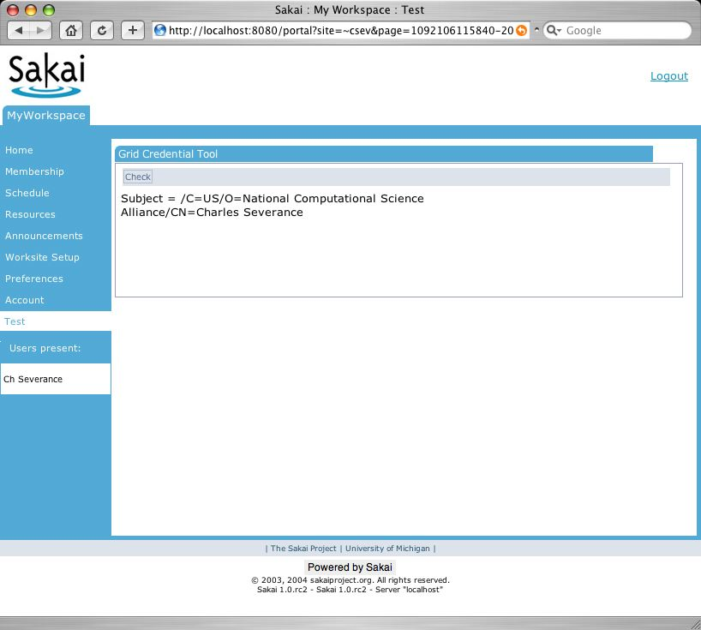
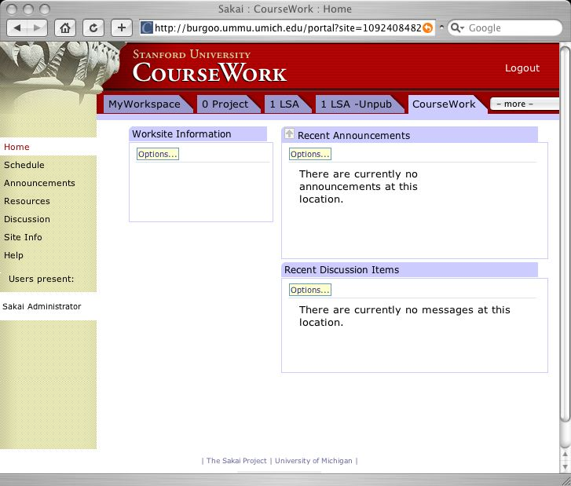
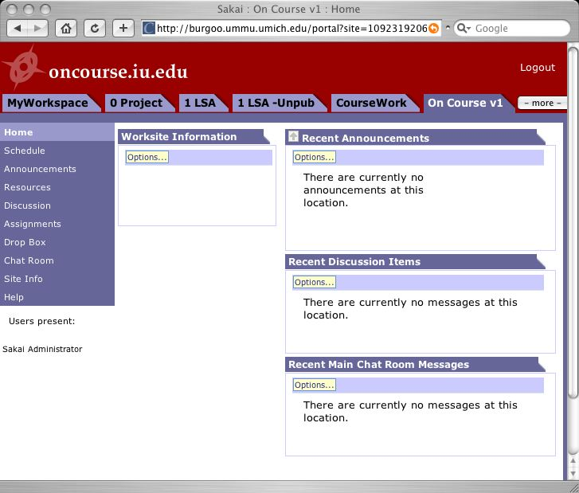
WSRP Use Case
Portal
Non-Sakai
Tool
Non-Sakai
Non-Java Tools
tool
tool
WSRP
WSRP
WSRP
WSRP
HTTP
HTTP
HTTP
Sakai
Sakai
Sakai
tool
tool
tool
tool
tool
tool

Slide 47
WSRP
“Portal”
WSRP Consumer
Portal
WSRP
Placements
Apache WSRP4J
Sakai Sites
Sakai WSRP
Kernel Tool Registry
Request Filter
Tool A
Tool B
Tool C
Web Services
Notes:
WSRP Portal was produced by Vishal Goenka of SunGard SCT over the past six months. It uses the kernel’s tool registry and tool dispatch just like every other portal. The Sakai WSRP portal satisfies the Apache WSRP4J producer API.

Slide 48
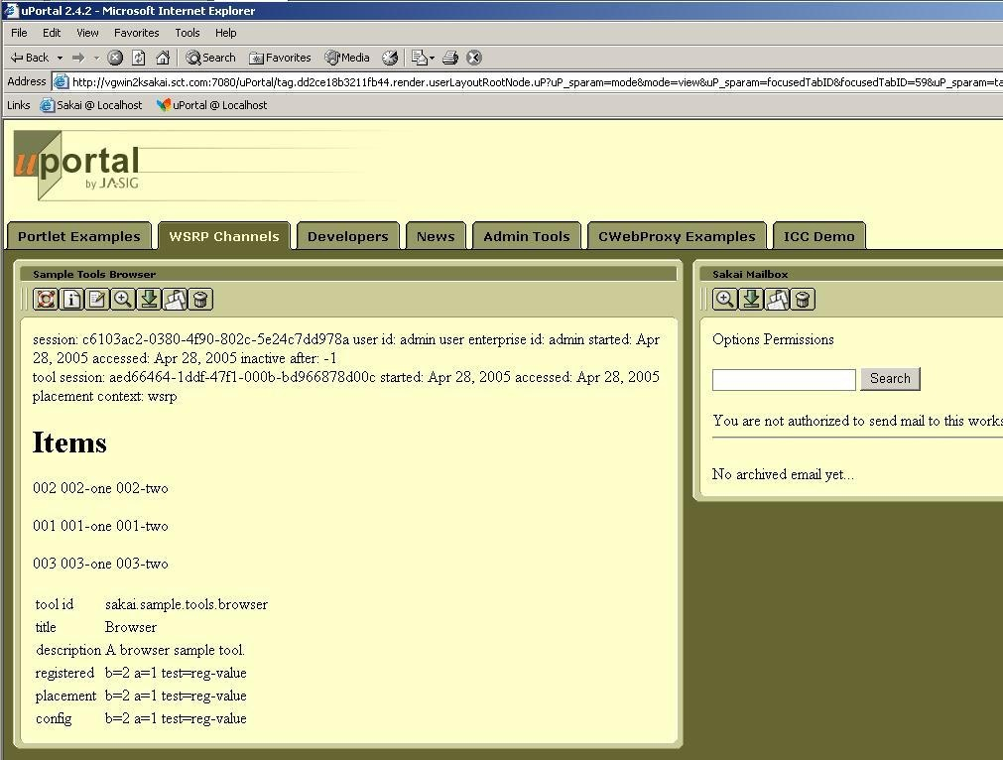
WSRP Image

Slide 49
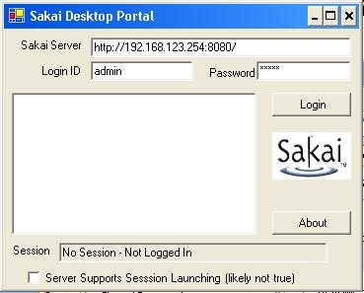
Visual Basic Portal
- Server
- Site
Tool
Tool
+ Site
+ Server
Sakai Sites
Sites Web Service
Kernel Tool Registry
Request Filter
Tool A
Tool B
Tool C
Notes:
End user built in portal - Sakai site aware.
Produces new iFrame naming convention. Se documents up on sakai-dev on collab.sakaiproject.org.
Charon is pure servlet (no Velocity)

Slide 50
Visual Basic Portal
- System X
- Site
Tool
Tool
+ Site
+ System Y
Sakai
X
Sakai
Y
Notes:
Imaging that the GUI was actually useful….

Slide 51
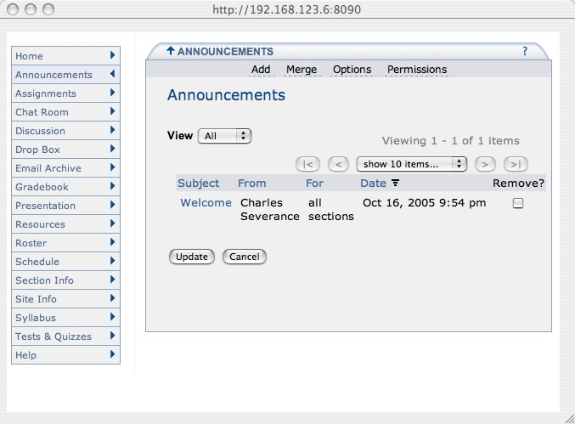
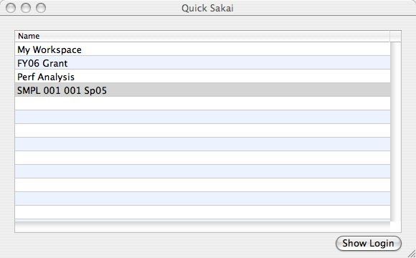

QuickSakai: Apple Desktop

Slide 52
Many Portals..
Browser
Browser
Browser
Web
Portal
Desktop
Portal
Sedna
Charon
Mercury
Astro ??
WSRP
Web Svc
Varuna
Kernel Tool Registry
Request Filter
Tool A
Tool B
Tool C
Web Services
Notes:
Sakai is designed to support many “portals” a portal is simply a consumer of tool markup. Abstracting making tool registration abstract allows this. We may develop a portal to support accessibility which does not use any iframes and supports significant GUI re-factoring based on profiles. WSRP is well developed and should be present in 2.1. The “168 shim” consumer is on the drawing boards. WSRP will support any portal while JSR-168 will be initially developed for uPortal. Each JSR-168 portal will require some special porting work.

Slide 53
Ease of Expansion Including non-Java Tools

Slide 54
Sakai Goals (may conflict)
A collaborative application
  Reusable objects (Quiz Questions) across many tools
  Component based - any component can be removed without harming the system
Extremely easy to expand - reduce barriers to adding a new tool
Notes:
To be fully integrated a tool must follow many rules. These rules are still evolving.
However to encourage innovation, we also want to allow simple expansion.
Question: Would you rather have a Quizzing tool that does not export automatically or no Quizzing tool at all?
First we cover the “highly integrated case” (Tools written in Java which want to look like they are “part of Sakai”.

Slide 55
Simpler Routes to New Tools
May want to write in PHP, or some other language other than java
May not want to comply with “Sakai” rules such as import/export, accessibility, or internationalization
May just want very small distribution (I.e. not part of the Sakai release)
Perhaps a very innovative early concept

Slide 56
IMS Tool Portability Group
Focus is on making tools portable between systems (Sakai, WebCT, and Blackboard)
Established to further the discussion with commercial and other CMS/CLE providers
Uses web services and IFRAMES
Does not require tools to be written in Java
Working demonstration at the July 2005 Alt-I-lab with Samigo in Sakai, WebCT, and Blackboard
Notes:
Describe what IMS is.

Slide 57
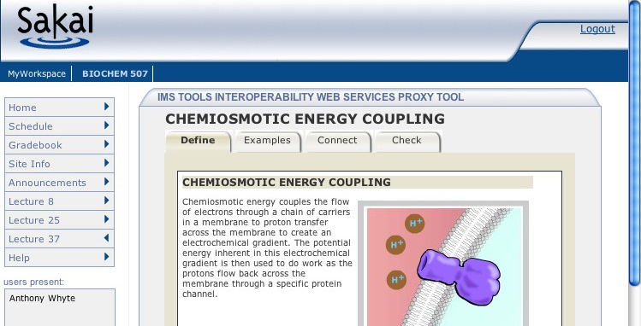
How IMS TI Works
1
6
JVM
Samigo, ConceptTutor, Etc
Sakai
7
Application
Code
Sakai Web
Services
Outcome
Sakai APIs
4
Session
And Services
Bootstrap
5
3
Sakai
IMS Proxy
Launch
2

Slide 58
Going Forward

Slide 59
Sakai 2.1
Expected December 1, 2005
Performance improvements and bug fixes
Sections and Groups within a Site
  Section Tool, Announcements, Gradebook, Samigo
Provisional Tools
  SU Tool, Roster Tool, Wiki, WSRP, TwinPeaks

Slide 60
Sakai 2.2 (best guess)
Second Quarter 2006
Hierarchy
Open Source Portfolio
More tools Section Aware
IMS Content Packaging Import and Export
Provisional Tools (initial list)
  Mail Tool, IU Discussion Tool, Melete, JSR-168 Portlet, IMS Tool Portability, Blog, JForums

Slide 61
Way Long Term
Sakai / uPortal tightly integrated
  JSR-168, WSRP Consumer, WSRP Producer
JSR-170 - Java Content Repository
IMS Common Cartridge
All domain objects fully modeled with published Data models and RDF/OWL support

Slide 62
Summary / Questions
Thank you for your time

