Slide 1
Sakai PLRE Slides
(extracted)
Charles Severance
Ad. Hoc. Talk at JISC/CETIS meeting, November 15, 2005

Slide 2
Web Services and Web Applications
WS Client
Presentation
Presentation
Abstraction
Web Svcs
Axis
Layout
ToDo Layout
Framework
WS End Point
Other Tools
ToDo Code
Service
Interface
(i.e. API)
Application
Other Services
ToDo Service
SAF—Common Services
SAF—Kernel
Notes:
Kernel plays a key role. Part of making things symmetric between web applications and web services.
Kernel completely rewritten for Sakai 2.0.

Slide 3

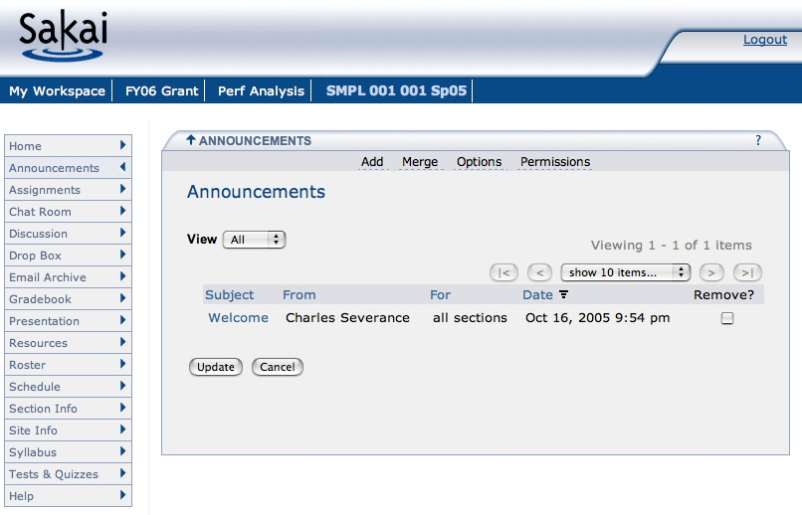

Sakai Browser-Based Presentation
The standard Sakai interface is through a web browser.
This is only one of the possible ways to view Sakai.
HTML
Sakai

Slide 4
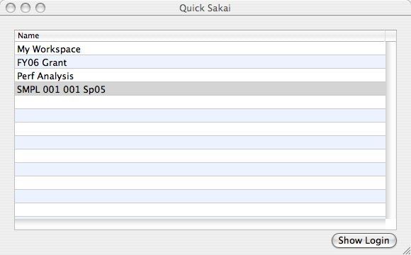

Sakai Apple Desktop
The Sakai Apple Desktop application is an experiment in a new way of presenting Sakai information directly from the desktop.
Sakai
Web Svcs

Slide 5
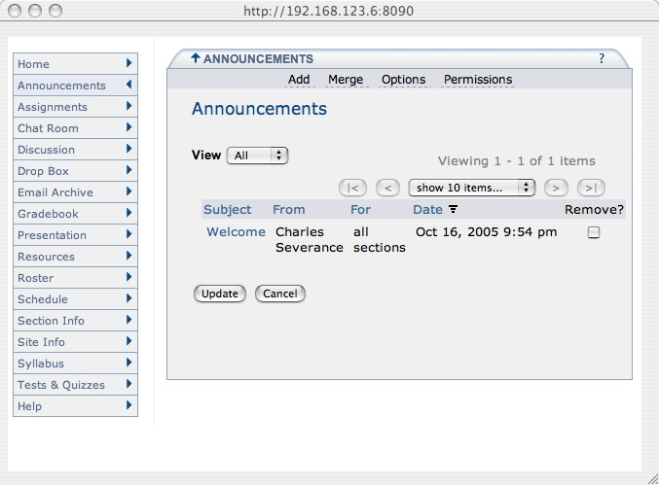
Sakai Apple Desktop
The Sakai Apple Desktop application is an experiment in a new way of presenting Sakai information directly from the desktop.
Sakai
HTML
Sakai
Web Svcs

Slide 6
Sakai: Inverted
The Personal Learning and Research Environment

Slide 7

Sakai’s Real Scope
Collaboration
Software
Data
Repositories
Resources
Portals
Notes:
But our requirements coming from many directions (teaching, research, small group work) require us to connect to other major technologies and smoothly integrate. These requirements often come with large (financial and talent) resource pools - the open source model. In Sakai we see the high level across technologies and constituent groups (teaching, research, ad hoc) and try to bring comunities together to work on common requirements.

Slide 8
Is this what the user wants?
Sakai
?
Collaboration
Software
SRB
uPortal
Data
Repositories
Resources
Portals
Fedora
DSpace
GridSphere
Notes:
Depending on how you view your particular E-Research elephant, you might start with very different software as a starting point and get started - after all these projects usually end up behind schedule and in a big hurry to do *something*. So everyone “picks one”.

Slide 9
The User’s Desktop
Personal Learning/Research Environment
Collaboration
Software
Data
Repositories
Resource
Portals
Notes:
The goal is not to replace or rewrite these software elements but for Sakai to work with them to be so well integrated that we all together deliver the ultimate user goal of E-Science/E-Research/ and E-Learning. And then leverage that smooth integration to *finally* realize the real requirements of the end user - easy to use and powerful. This is not just GUI integration - it is back end integration and data interchange as well.
I think the resources needed to fully deliver on this picture are 200 people for five years. Thanks heaven for the open source model.
Funny - when we get done - after all that work - it will just be a tiny icon in people’s system tray :)

Slide 10
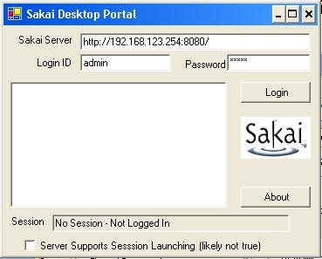
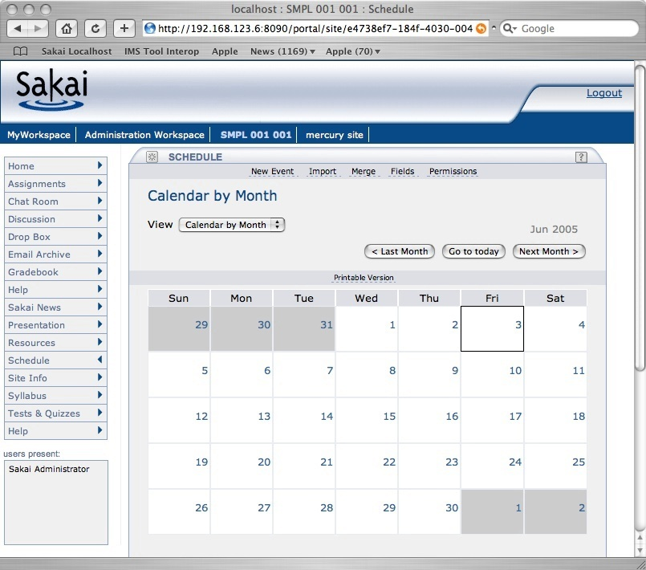
PLRE Client Version 0.0001
- Server
- Site
Tool
Tool
+ Site
+ Server
Sakai
X
Sakai
X
Notes:
Imagine that the GUI was actually useful….

Slide 11
Charon
Portal
Sakai Sites
Charon
Kernel Tool Registry
Request Filter
Tool A
Tool B
Tool C
Notes:
End user built in portal - Sakai site aware.
Produces new iFrame naming convention. Se documents up on sakai-dev on collab.sakaiproject.org.
Charon is pure servlet (no Velocity)

Slide 12
Mini PLRE: Replacing the Sakai Navigation with Web Services and a Desktop Application
Notes:
This is a little project that I did to demonstrate Sakai flexibility.

Slide 13
Mini-PLRE
- Server
- Site
Tool
Tool
+ Site
+ Server
Sakai Sites
Sites Web Service
Kernel Tool Registry
Request Filter
Tool A
Tool B
Tool C
Notes:
End user built in portal - Sakai site aware.
Produces new iFrame naming convention. Se documents up on sakai-dev on collab.sakaiproject.org.
Charon is pure servlet (no Velocity)

Slide 14
PLRE Client Version 0.0001
- System X
- Site
Tool
Tool
+ Site
+ System Y
Imagine a system-tray icon.
Imagine this handling *any* WSRP endpoint (Sakai or portals)….
Imagine this handling your different identities across domains and federation…
Imagine this as a toolbar button in a desktop application…
Sakai
X
Sakai
Y
Notes:
Imaging that the GUI was actually useful….

Slide 15
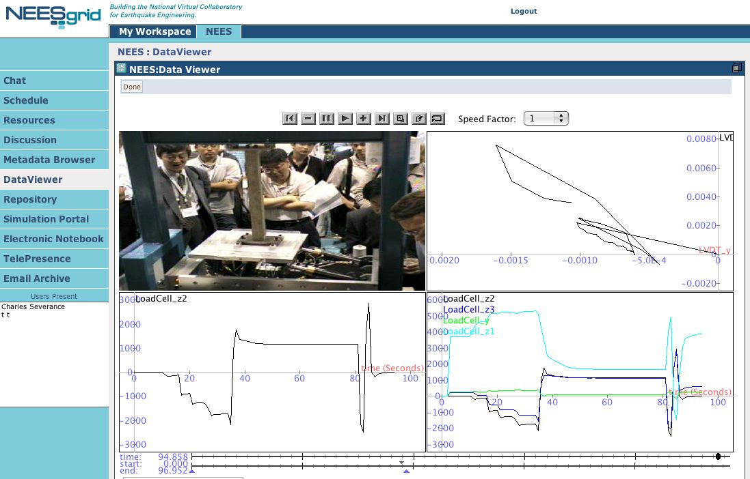
Notes:
The inversion of Sakai is complete.

Slide 16
Portals are not just user interfaces - they are servers too. E-Research is more than portals.
Rob Allan,
Technical Manager,
Advanced Research Computing Centre,
Daresbury Laboratory, UK
July 12, 2005
- Server
- Site
Tool
Tool
+ Site
+ Server

