Slide 1
Personal Learning Environments
Mark van Harmelen, Martin Weller, Steve Green, Anthony Beal, Isabel Falconer, Rob Allan, Rob Crouchley, Stefano Ghazzali, Christina Smart, Phil Beauvoir, Tom Franklin, Roger Rist, Charles Severance, Colin Milligan, Bill Olivier, Sharon Perry, Sandy Britain, Stephen Powell, Tore Hoel, Maia Dimitrova, Oleg Liber, Brian Sutton, Matthew Dovey

Slide 2
Agenda
High Level Overview
Demonstration / Quick Talks
  Manchester Framework
  The Learning Matrix
  Sakai
  PLEX
Reference model
  Presentation
  Rework

Slide 3
Why PLE?
Why Technology in Learning
VLE’s focus most on the needs of institutions
  Learners may interact with multiple institutions at one moment in time
  Learners interact with many institutions over time
Why Personal Learning Environment - This is so complex that we need to focus scope in areas like features, usability, etc etc - the underlying notions are rather general

Slide 4
How PLE?
Enhance the user’s “Desktop” - defined as technology under the user’s control
Must address transition from well-entrenched VLEs to PLEs
Supplements VLE initially and then possibly supplants VLEs in some areas

Slide 5
Aspects of PLE
User controlled Information Store
Extensible via plugins
No fixed computer - users will migrate around
Provisioning
Negotiation of Learning
Learning Flow
Notes:
A PLE may be useful outside of learning - but the “Learning” comes in in terms of what plugins we develop first, how we test prototype PLE’s for suitability and evolve their features. In all likelyhood, many capabilities which are developed

Slide 6
Manchester Framework
Manchester CS with Bodington influences
PLE as extension of VLE - Desktop PLE provides subset of VLE capability
Data exchange based on file-style exchange VFS Protocol
VFS Protocol - DAV-like particularly suited to supporting PLE

Slide 7
Manchester Framework
VLE
(Browser)
Local
Machine
PLE
(Browser)
HTTP + VFS extensions
HTML
HTML
Server
Servlets
Servlets
Tomcat
Tomcat
Virtual File
System
Virtual File
System
Notes:
PLE gets as much as needed depending on what is already in PLE.

Slide 8
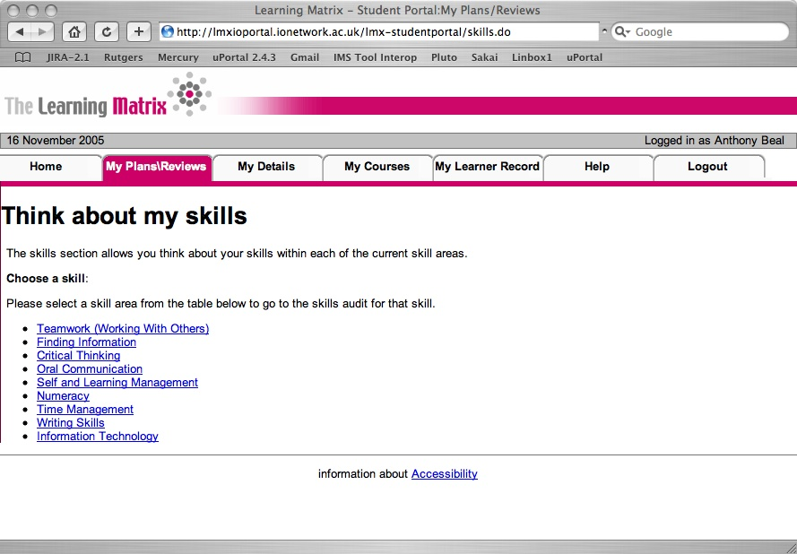
The Learning Matrix

Slide 9
Sakai Overview
Sakai Project (R/D)
Alternative Presentation Views
  Visual Basic
  Apple Desktop
Uses web services and HTML
Federation Use Case

Slide 10
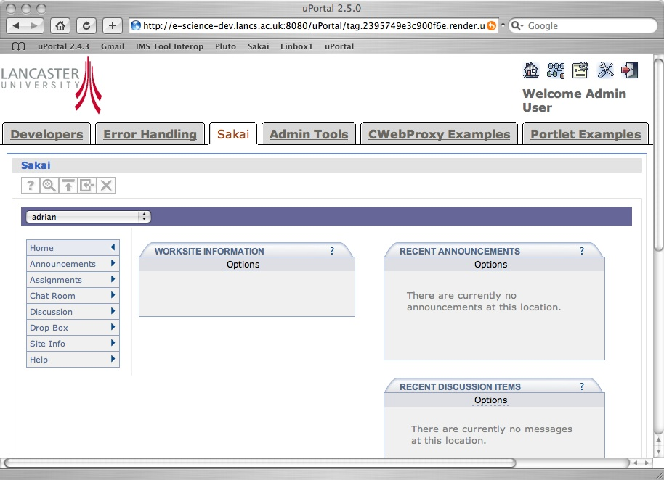
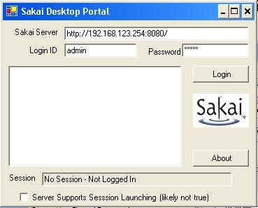
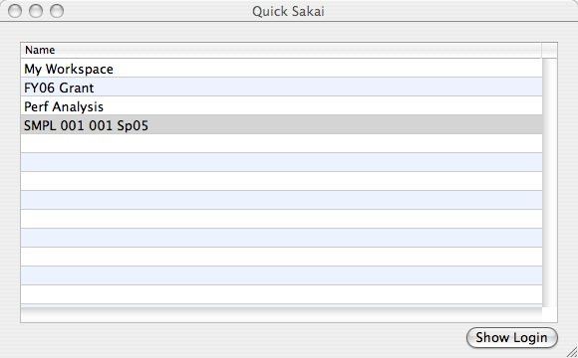
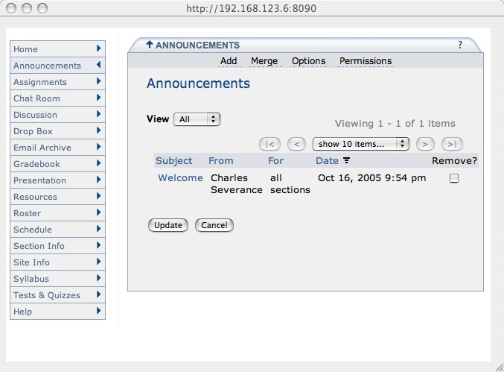
Sakai PLE Approach
JSR 168
PC Desktop
Apple Desktop
- System X
- Site
Tool
Tool
+ Site
+ System Y
HTML
Web Services
HTML
Sakai

Slide 11
PLEX
CETIS / Bolton
Prototype effort around PLE Reference Model work
Follow on to Colloquia ideas
Two Prototype Implementations
  Liferay Portal Portlet
  Eclipse Desktop Application

Slide 12
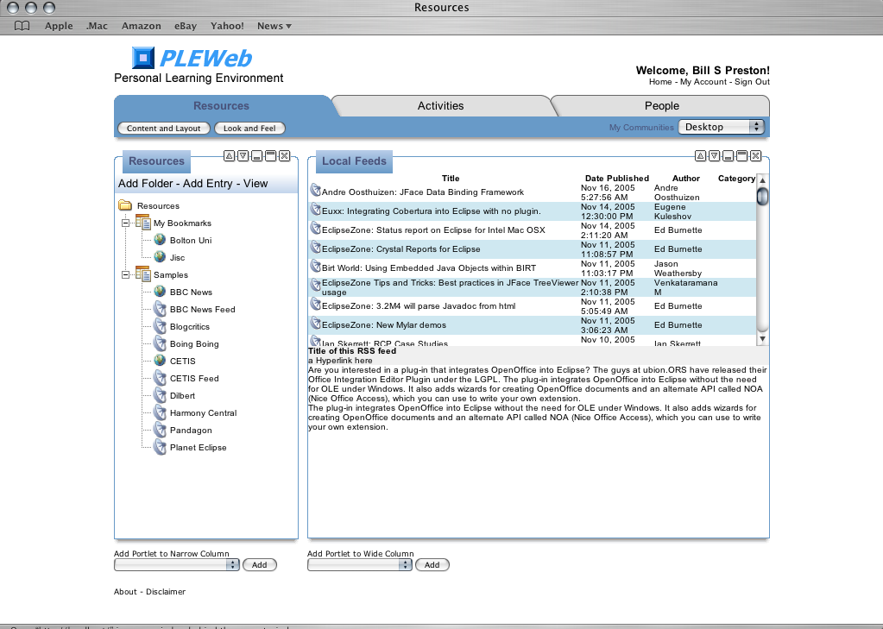
PLE Web Portal

Slide 13
Eclipse Platform
Desktop application
Current prototype: thick client w.r.t. data organization browser display for information delivery
  Includes basic provisioning
  Exploring RDF as representation/exchange - FOAF, etc
Architecture allows thick information delivery elements

Slide 14
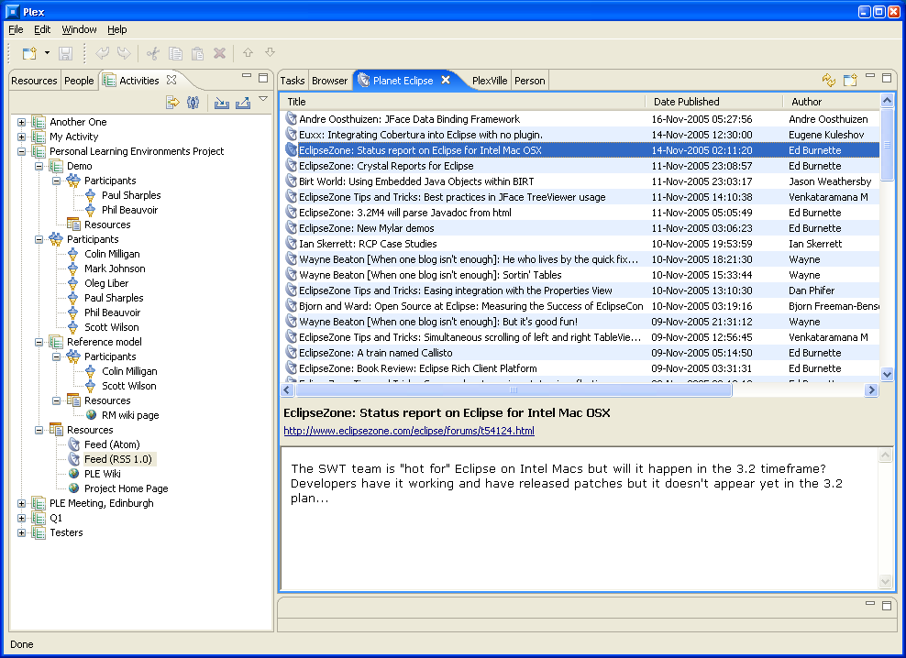
Plex ScreenShots

Slide 15
Draft Reference Model
Presentation by Colin Milligan
Discussion
  Appropriateness of approach
  Feedback
  Brainstorming

Slide 16
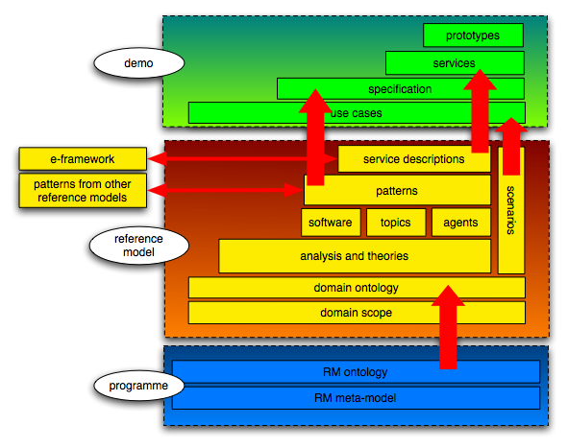

Slide 17
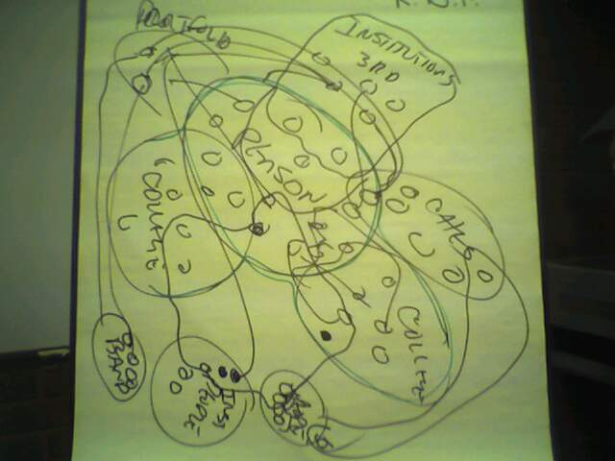
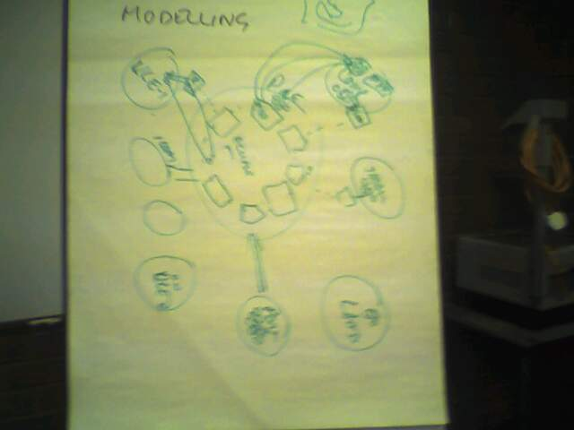
Brainstorming re-Models
Problem Space Model
Software Transition Model
Notes:
Thin Eportfolo. Ameoba Infinite dimensions.

Slide 18
Going Forward
Continue model work
Relationship between VLE’s and PLEs
  Explore and define
  Develop prototype specs
  Explore making standard that might be used across VLE’s
Explore the potential application PIE and PRE
Begin work in usability
Begin to explore how environment shold be designed to adapt to different ages
Pose question and explore: Will PLE be better? Pedagogy?
Goal for prototype - good enough to not throw away
www.cetis.ac.uk/members/ple/
Notes:
Comments from the group??

