Slide 1
Sakai Overview
Dr. Charles Severance
http://www.sakaiproject.org/
http://www.dr-chuck.com/talks.php?id=61
Notes:
Abstract: This presentation gives a brief overview of the Sakai project. The topics covered range from the history of the project all the way up to a simple overview of the Sakai architecture. The presentation describes Sakai's placement in the market, Sakai community governance, Sakai's commercial affiliates, Sakai adoption, and a number of other topics.

Slide 2
What is Sakai?
A project—an initial grant for two years
A community and foundation—a group of people and resources supporting the code and each other, realizing large scale Open Source efficiencies
in HigherEd
A collaboration and learning product with:
  A set of tools—written and supported by various groups
  and individuals—which have been tested and released as a unit
An extensible framework for building collaborative—provides basic capabilities to support a wide range of tools and services—teaching
and research
Notes:
The one sentence elevator speech is “Sakai is an Open Source LMS”. But it is much more than that...

Slide 3
The Sakai Project
Funding and Initial Institutional Partners

Slide 4
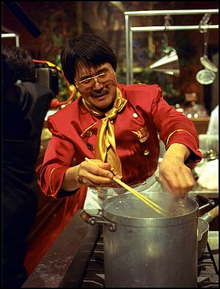
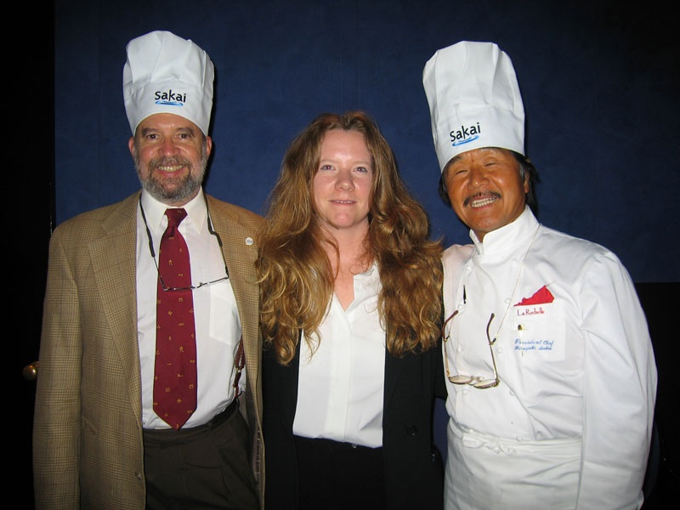
The Sakai Project
The University of Michigan, Indiana University, MIT, Stanford, the uPortal Consortium, and the Open Knowledge Initiative (OKI) are joining forces to integrate and synchronize their considerable educational software into a pre-integrated collection of open source tools.
Sakai Project receives $2.4 million grant from Mellon
Notes:
Make sure to explain the name.
Many different home grown LMS systems - Mellon was seed money to initially coalesce four to one with the potential to lead to many more adopting the software.

Slide 5
The Sakai Project
Each of the 4 Core Universities Commits
  5+ developers/architects, etc. under Sakai Board project direction for 2 years
  Public commitment to implement Sakai
  Open/Open licensing—“Community Source”
Overall project levels
  $4.4M in institutional staff (27 FTE)
  $2.4M Mellon, $300K Hewlett
  Additional investment through partners
The “Sakai Project” transforms into the Sakai Foundation January 2006
Notes:
All of the resources funded by the grant and in-kind contributed report to the board to do “Sakai” bidding under the direction of the PI and Chief Architect.

Slide 6

Consolidation
Industry Shakeout
Black
Board
Black
Board
+
WebCT
Commercial
WebCT
Home Grown
Sakai Project
Foundation...
1995
2002
2004
2007
Notes:
Emphasize the difference between the Sakai project and Sakai in the future. The need for close collaboration during the “grand rewrite”. Sakai project is just a blip - we hope it is transformational.

Slide 7
The Sakai Foundation
Moving beyond a Project to a Foundation to support an open source enterprise Collaborative Learning Environment

Slide 8

Sakai Foundation
Formed as a non-profit corporation to support, sustain, and promote Sakai.
Initial foundation board is the Sakai project board with open nominations and election for three retiring Sakai board members.
Annual budget of $1M from member contributions
  Expect to have 4-6 staff positions funded by the Foundation
  Support two conferences per year at 100K each
Membership fee is $10,000 per year for educational institutions, non-profits, or commercial partners.
Upcoming Sakai Conference
December 7-9
Austin Texas
http://sakaiproject.org/austin
Notes:
Example staff may include, Executive Director, CTO & Architect, Administrative Support,
Framework Development & Architecture, Communications Manager,
Partner Tech Support & Documentation, QA & Release Manager.
Development staff will come from the community or be contributed as “in-kind” from Sakai members to the board.

Slide 9
Sakai Members
Albany Medical College | Monash University | University of California, Los Angeles
Arizona State University | Nagoya University | University of California, Merced
Australian National University | New York University | University of California, Santa Barbara
Boston University School of Management | Northeastern University | University of Cambridge, CARET
Brown University | North-West University (SA) | University of Cape Town, SA
Carleton College | Northwestern University | University of Colorado at Boulder
Carnegie Foundation for Advancement of Teaching | Ohio State University | University of Delaware
Carnegie Mellon University | Portland State University | University of Hawaii
Ceritos Community College | Princeton University | University of Hull
Coast Community College District | Rice University | University of Illinois at Urbana-Champaign
Columbia University | Ringling School of Art and Design | University of Melbourne
Cornell University | Roskilde University (Denmark) | University of Michigan
Dartmouth College | Rutgers University | University of Minnesota
Florida Community College at Jacksonville | Simon Fraser University | University of Missouri
Foothill-De Anza Community College | Stanford University | University of Nebraska
Franklin University | State University of New York | University of North Texas
Georgetown University | Stockholm University | University of Oklahoma
Harvard University | SURF/University of Amsterdam | University of South Africa (UNISA)
Hosei University IT Research Center | Syracuse University | University of Texas at Austin
Indiana University | Texas State University - San Marcos | University of Toronto, Knowledge Media Design Institute
Johns Hopkins University | Tufts University | University of Virginia
Lancaster University | Universidad Politecnica de Valencia (Spain) | University of Washington
Loyola University, Chicago | Universitat de Lleida (Spain) | University of Wisconsin, Madison
Lubeck University of Applied Sciences | University College Dublin | Virginia Polytechnic Institute/University
Maricopa County Community College | University of Arizona | Whitman College
Marist College | University of California, Office of the Chancellor | Yale University
MIT | University of California Berkeley | University of California Berkeley
 | University of California, Davis
82 and Growing

Slide 10




Sakai Major Collaborators
  Open Knowledge Iniative (OKI)
  IMS Standards
    Tool Interoperability (TI) standard
    Common Cartridge (CC) standard
  Open Source Portfolio Initiative
  JA-SIG / uPortal

Slide 11








Sakai Commercial Affiliates
The Sakai Educational Community License is BSD-like and allows complete flexibility in terms of the creation of and licensing of derivative works.
This allows different commercial companies to interact in different
ways without any limitations
imposed by license.
Notes:
Sakai encourages commercial companies to make money selling and supporting and adding value to Sakai. Sakai itself only produces and QA’s the software - any local development, customization, support, etc is either performed by local staff or by a commercial company.

Slide 12
Community Source Model
Where the core stakeholders are the customers.

Slide 13
Pure Commercial Software
Software Company
Customer
Shareholders Management
Money
CIOs
Product
Product
Deployment
Company
Developers
Customer
Developers
Notes:
Requirements are communicated slowly. There is little communication between customer developers and the company developers.

Slide 14
Apache-style Source Software
Apache
Customer
CIOs
Product
Product
Deployment
Individual
Contributors
Customer
Developers
Notes:
The Apache model places the individual developers as the most powerful in the organization. The contributors are all volunteers and chosen based on individual merit. The average customer has little ability to impact the direction of a product beyond hiring someone and trying to get that person to become a committer. Many projects have a large commercial involvement (often IBM). This is an excellent model for infrastructure like Tomcat and Axis.

Slide 15
Community Software
Sakai
Customer
Money
Board
CIOs
Requirements
Product
Product
Deployment
Sakai
Developers
Customer
Developers
Cooperate
Notes:
In Sakai, the connections are much more direct communication both at a leadership level and at a technical level. Over time increasingly the customer developers will become the driving force for innovation and the Sakai developers will provide integration and release services. Customers can interact directly with Sakai. The Sakai requirements “bubble up” from the customers.
Community source is a little different than Open Source. Community Source is where the core stake holders are actually the customers. Commercial = Shareholders, Open Source = developers. I work for a CIO - in Sakai I work for 120 CIOs. In Apache I am just an individual. After January 2006, I will work *only* for 120 CIOs (i.e. UM will be 1/120th of my influence).

Slide 16
The Sakai Product
A Collaborative Learning Environment—
Suitable for use in teaching and learning, research collaboration, and ad Hoc group communication

Slide 17






Placing the Sakai Product
A Collaboration and Learning Environment
Teaching
and
Learning
Collaboration (including eResearch)
Notes:
Sakai is a Collaborative Learning Environment. Sakai can be applied in both a teaching and learning environment as well as research collaboration.

Slide 18
Teaching and Research Collaboration
Requirements Overlap
Quizzes
Grading Tools
Syllabus
SCORM
Grid Computing
Visualization
Physics
Research
Collaboration
Teaching
and
Learning
Data Repository
Chat
Discussion
Resources
Earthquake
Research
Collaboration
Large Data
Libraries
Notes:
Sakai

Slide 19
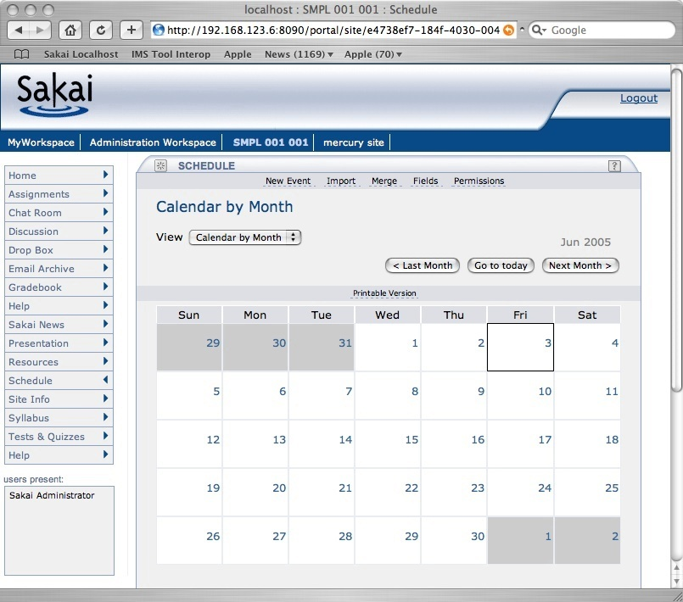
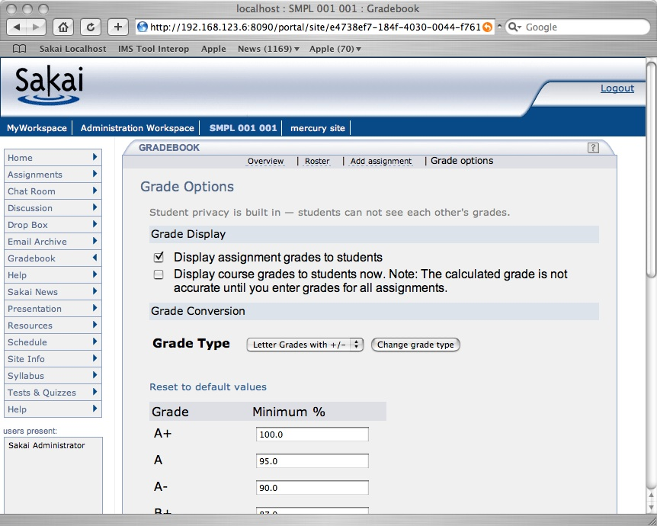
Sakai 2.1 Tools
Announcements
Assignments
Chat Room
Threaded Discussion
Drop Box
Email Archive
Gradebook
Melete - Content Editor
Message Of The Day
News/RSS
Preferences
Presentation
Profile / Roster
Resources
TwinPeaks - Repository Search
Samigo - QTI Assessment
Schedule
Section Management
Syllabus
Web Content
Worksite Setup
WebDAV
Notes:
Some tools are generic and other tools are focused on teaching and learning.
May also be a wiki in the 2.1 release. New tools under community development include shared whiteboard, multipoint audio, multipoint video, blog, and shared display.

Slide 20
Sakai Foundational Technologies
Sakai consists of technologies chosen to be common in Java Enterprise Environments.
Java
1.4
Apache - SSL, mod_jk, WEBISO, virtual hosting
Sakai
Tomcat 5.5
Spring
Hibernate
Java Server Faces
Velocity (legacy)
Oracle
MySql 4.1

Slide 21
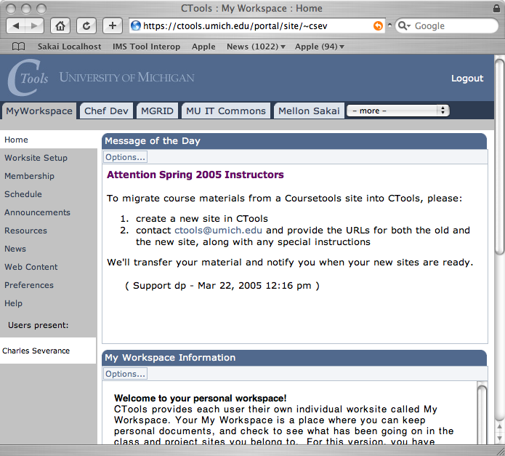
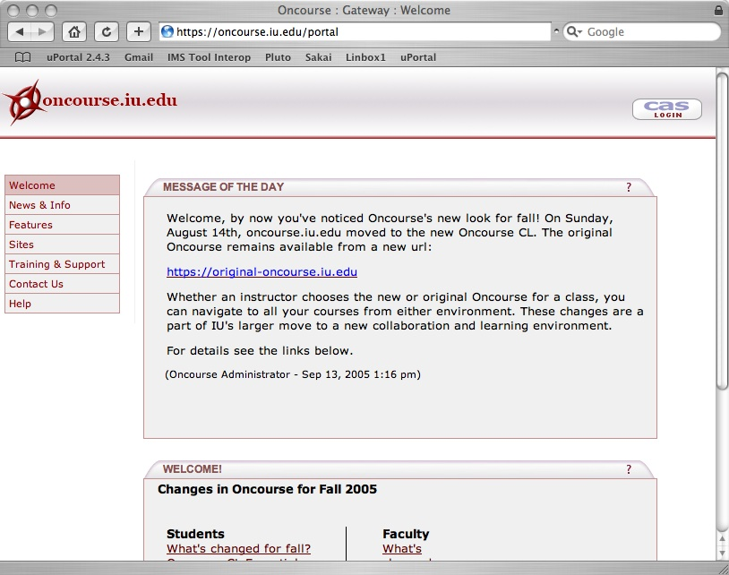
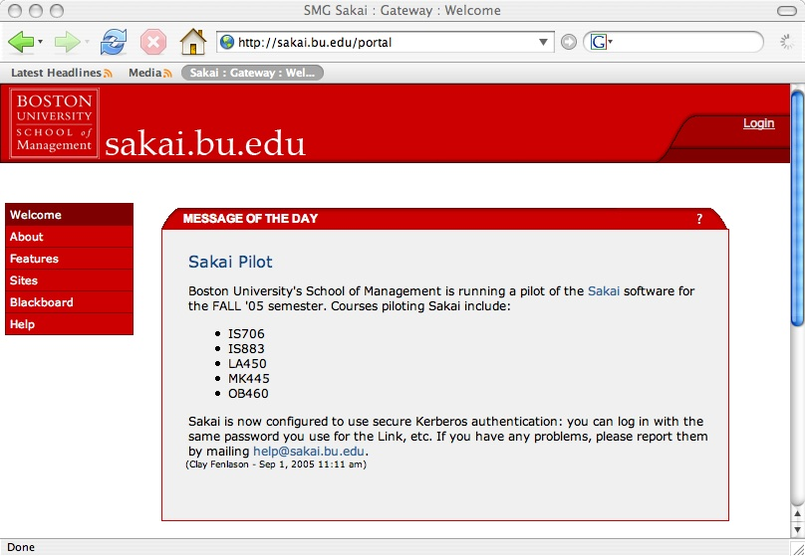
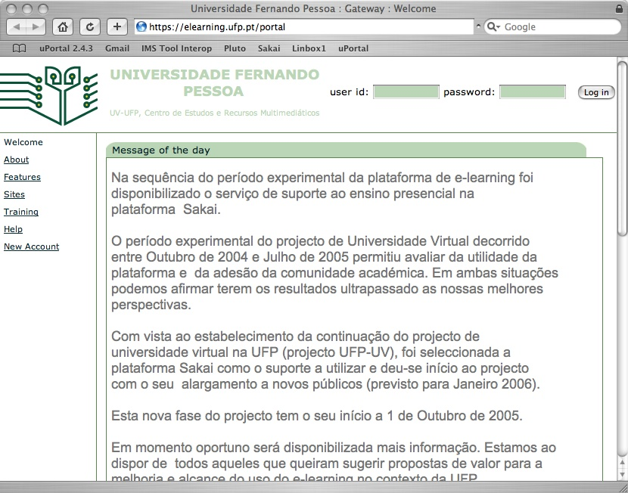
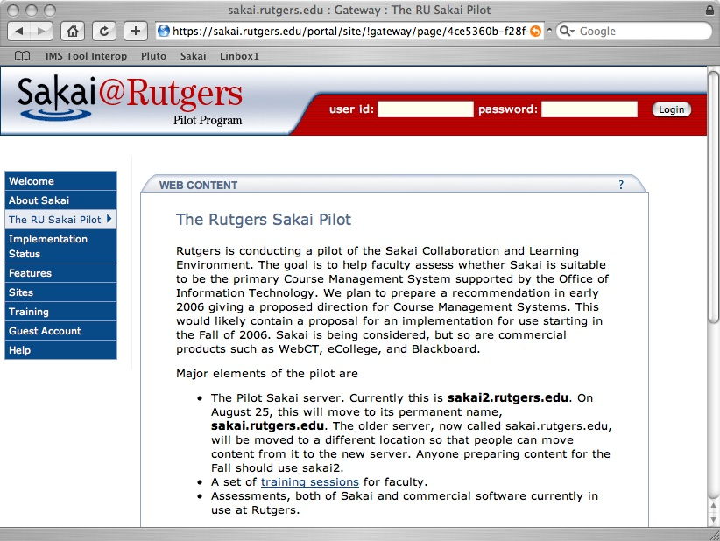
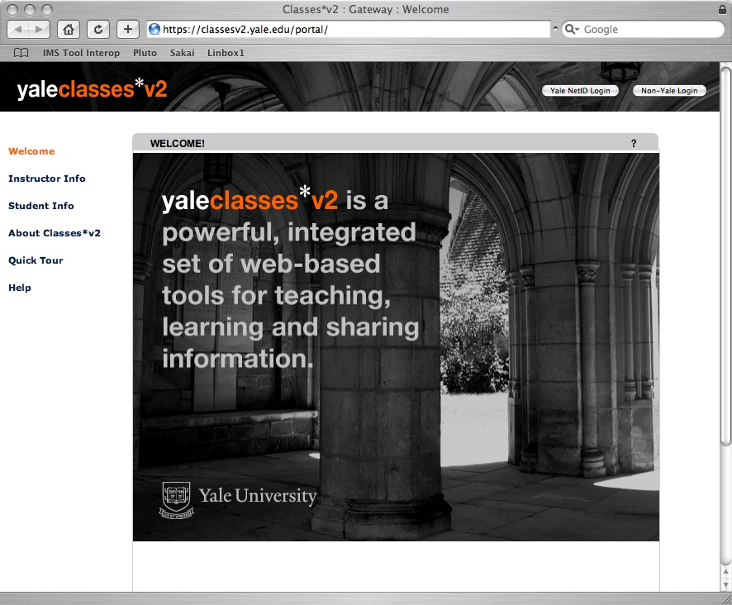
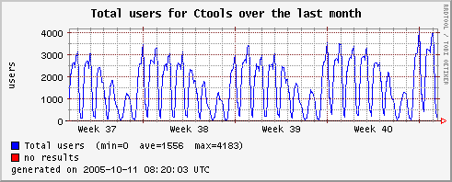
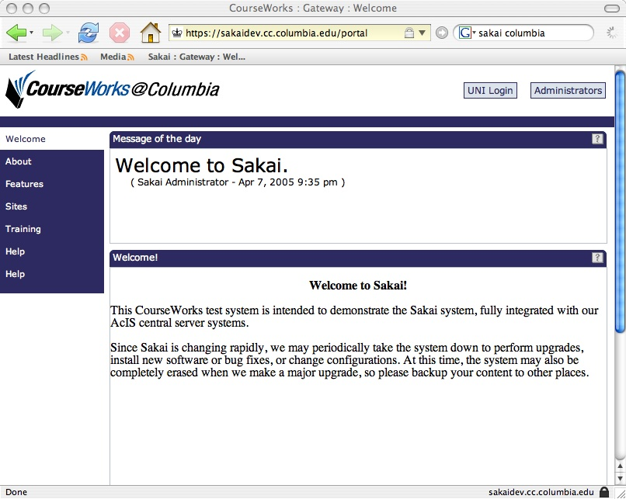
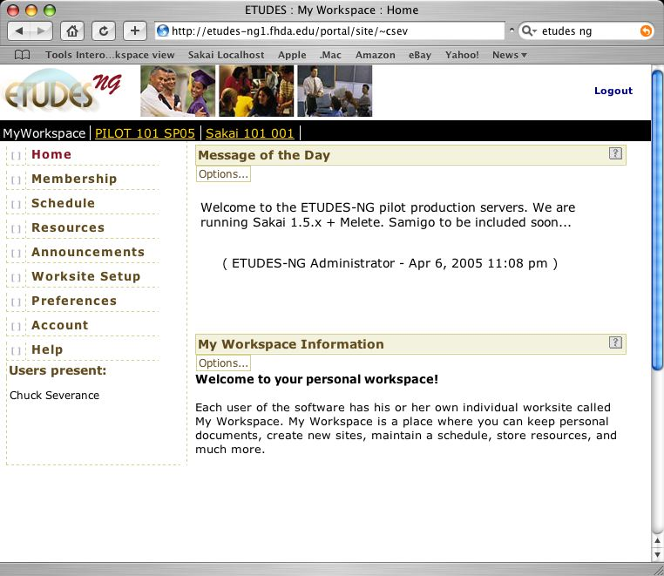
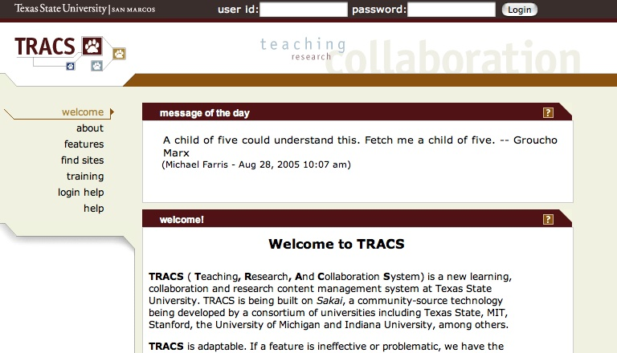
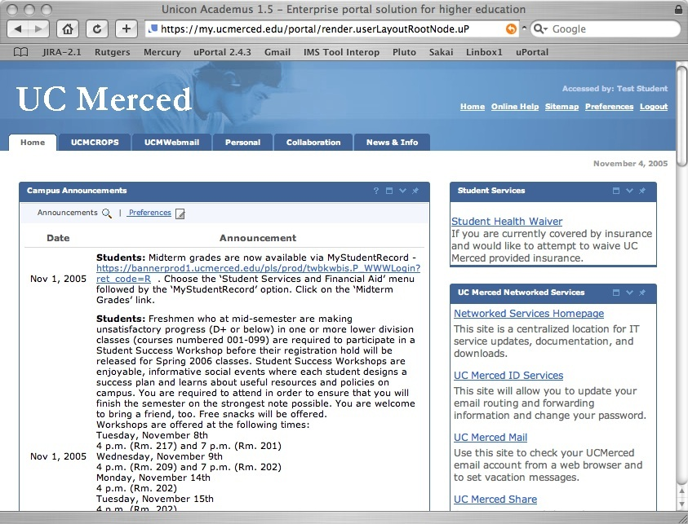
Sakai in Production
Text
Google: “powered by sakai”
Notes:
These are the sites that are running 24x7 with real user bases that are teaching significant number of classes. UM 9/04, IU 1/05, Yale 1/05, Foothill 4/2005, Rutgers 9/2005. Merced is starting with Sakai and nothing else. One animation - CTools usage graph.

Slide 22





Sakai Adoption Plans
Boston University School of Management
Carleton
Johns Hopkins University
Lueck University of Applied Sciences, Germany
Massachusetts Institute of Technology
Northwestern University
• Stanford University
• University of California, Berkeley
• University of Cape Town, SA
• University of Lleida, Spain
• University of Missouri
• University of Virginia
• Whitman College
Type “Sakai Adoption Plans” into Google

Slide 23
The Sakai Framework
The need to satisfy the often conflicting goals of ease of use, ease of expansion, configuration flexibility, environmental portability and rock-solid production reliability suitable for enterprise deployment.

Slide 24
Service Oriented Architecture
Browser
Browser
My
Monolithic
ToDo List
Servlet
ToDo
Presentation
Service
Interface
(i.e. API)
ToDo Service
Code
Persistence
Persistence
Notes:
I call this a “two-layer architecture” - “middle-ware” is another term that fits here.
Decompose tool code into presentation elements and service elements
Provide an abstraction (API) which shields the tool code from the implementation details of the service code - document and publish the API.
Allows separate development of the tools and services.
Allows effective unit testing of services
Allows an implementation to be replaced transparently with another implementation as long as the API contract is fully met
Great for web services.

Slide 25
Fitting Into the Sakai Framework
SAF—Presentation Services
Browser
Presentation
Abstraction
ToDo Tool Layout (JSP)
Framework
ToDo Tool Code (Java)
Service
Interface
(i.e. API)
Application
Other Services
ToDo Service
SAF—Common Services
SAF—Kernel
Notes:
Kernel - An augmented web application which enables the Sakai APIs to be called from the web application - this is a rich but not constraining environment - insures that Common services are portable.
Common Services - A set of common services available to all tools (authentication, authorization, hierarchy, repository, others)
Presentation Services - A set of Sakai specific JSF tags to handle presentation details and provide widgets such as a date-picker or WSYWIG editor.

Slide 26
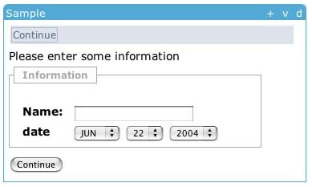
Sakai Presentation Services
<sakai:view_container title="#{msgs.sample_title}">
<sakai:tool_bar> <sakai:tool_bar_item/> </sakai:tool_bar>
<sakai:instruction_message
value="#{msgs.sample_one_instructions}" />
<sakai:group_box
title="#{msgs.sample_one_groupbox}">
<h:inputText
value="#{MyTool.userName}" />
<sakai:date_input
value="#{MyTool.date}" />
<sakai:button_bar> <sakai:button_bar_item action="#{MyTool.processActionDoIt} value="#{msgs.sample_one_cmd_go}" />
</sakai:button_bar>
Notes:
This is an example of how the presentation services work. Sakai provides a tag set which enforces style guide compliance, accessibility, internationalization, etc. The attempt is to do as much as possible in the framework and keep the tools as clean and simple as possible.
Europe is Date Month Year.’

Slide 27
Web Services and Web Applications
WS Client
Presentation
Presentation
Abstraction
Web Svcs
Axis
Layout
ToDo Layout
Framework
WS End Point
Other Tools
ToDo Code
Service
Interface
(i.e. API)
Application
Other Services
ToDo Service
SAF—Common Services
SAF—Kernel
Notes:
Kernel plays a key role. Part of making things symmetric between web applications and web services.
Kernel completely rewritten for Sakai 2.0.

Slide 28

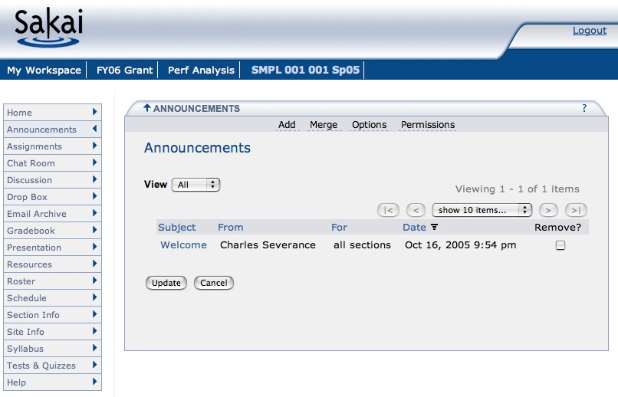

Sakai Browser-Based Presentation
The standard Sakai interface is through a web browser.
This is only one of the possible ways to view Sakai.
HTML
Sakai

Slide 29
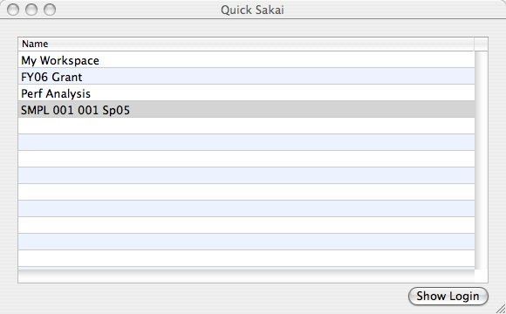

Sakai Apple Desktop
The Sakai Apple Desktop application is an experiment in a new way of presenting Sakai information directly from the desktop.
Sakai
Web Svcs

Slide 30
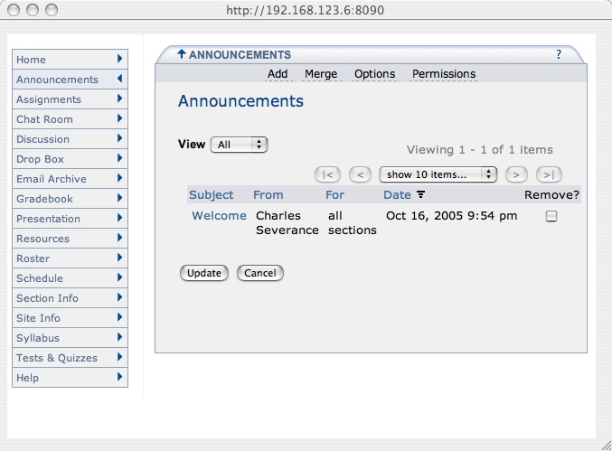
Sakai Apple Desktop
The Sakai Apple Desktop application is an experiment in a new way of presenting Sakai information directly from the desktop.
Sakai
HTML
Sakai
Web Svcs

Slide 31
Sakai: More Information
Main site: www.sakaiproject.org
  Bugs: bugs.sakaiproject.org
Sakai-wide collaboration area
  collab.sakaiproject.org
  sakai-dev@sakaiproject.org
  sakai-user@sakaiproject.org
My talks
  http://www.dr-chuck.com/talks.php

