Slide 1
NEESGrid - A Collaborative Portal Study
Charles Severance
University of Michigan
NEESGrid SI Team
www.neesgrid.org

Slide 2
Research Collaboration
Two Basic Applications of Sakai in Research
  Provide collaborative services to researchers which get used in an organic fashion.
  Use Sakai as part of a large field-wide initiative attempting to use collaboration to advance the field

Slide 3
Field-Wide Research Efforts
Basic problems
  Getting people together
  Retaining Data
  Defining and retaining Metadata
  Sharing access to resources like computers or experimental equipment

Slide 4
Examples
NEES - www.neesit.org
BIRN (Biomedical Informatics Research Network) -- www.nbirn.net
GEON (GEOsciences Network) -- www.geongrid.org
LOOKING (Laboratory for the Ocean Observatory Knowledge INtegration Grid) -- www.lookingtosea.ucsd.edu
ORION (Ocean Research Interactive Observatory Networks) -- www.orionprogram.org
NEON (National Ecological Observatory Network) -- www.neoninc.org

Slide 5
NEES Components
New experimental facilities (15)
  Oregon State University, Rensselaer Polytechnic Institute, University of Buffalo, University of Colorado at Boulder, University of Minnesota, University of Nevada at Reno, University of Texas at Austin, and the University of California campuses at Berkeley, Davis and Los Angeles
Collaborative Software System: NEESGrid
  Collaboration (Sakai)
  Data capture and sharing
  Tele-presense and Tele-operation
  Simulation
  Support for Hybrid Simulation and Physical Experiments

Slide 6
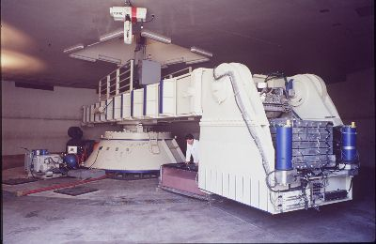
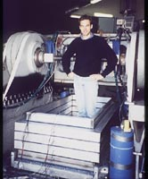
Centrifuge: UC Davis

Slide 7
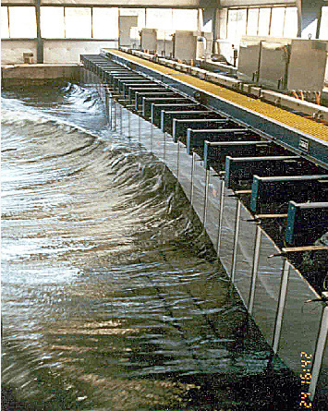
Wave basin: Oregon State

Slide 8
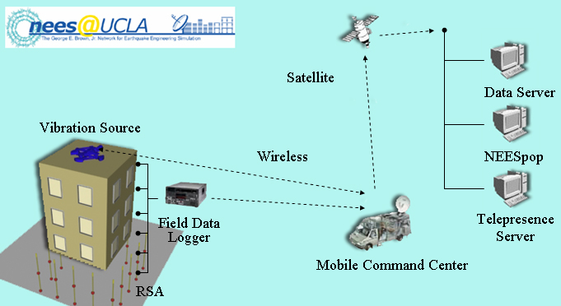
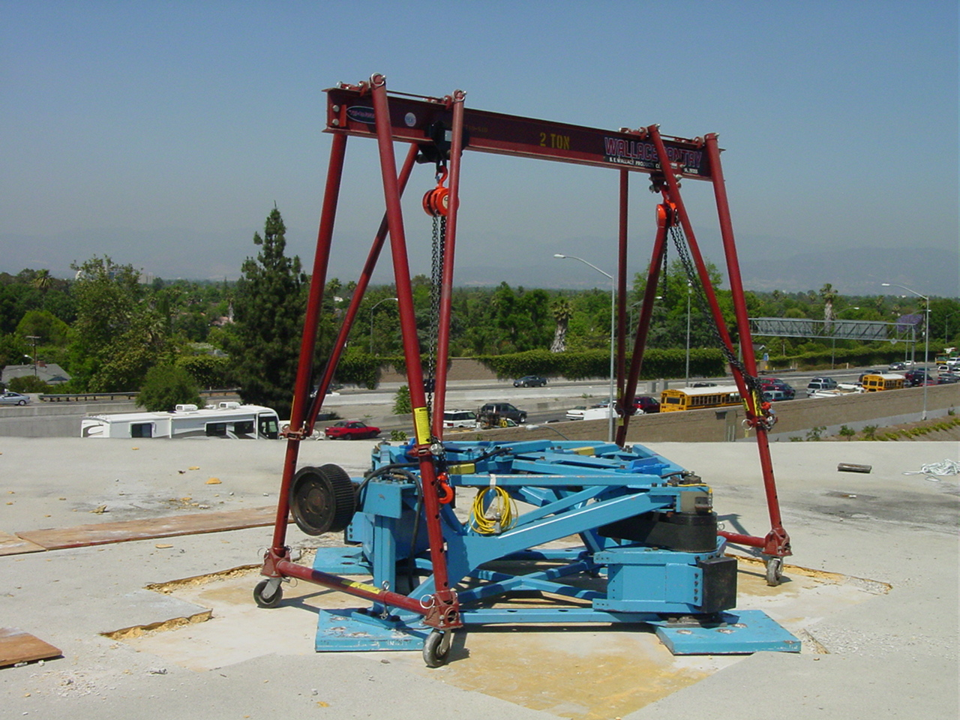
Field structural: UCLA

Slide 9
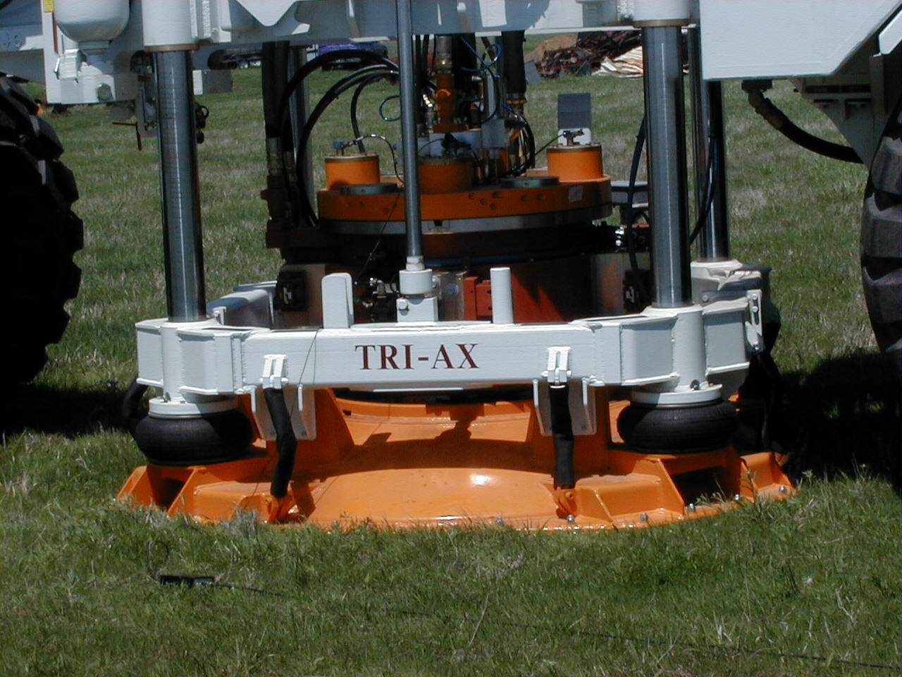
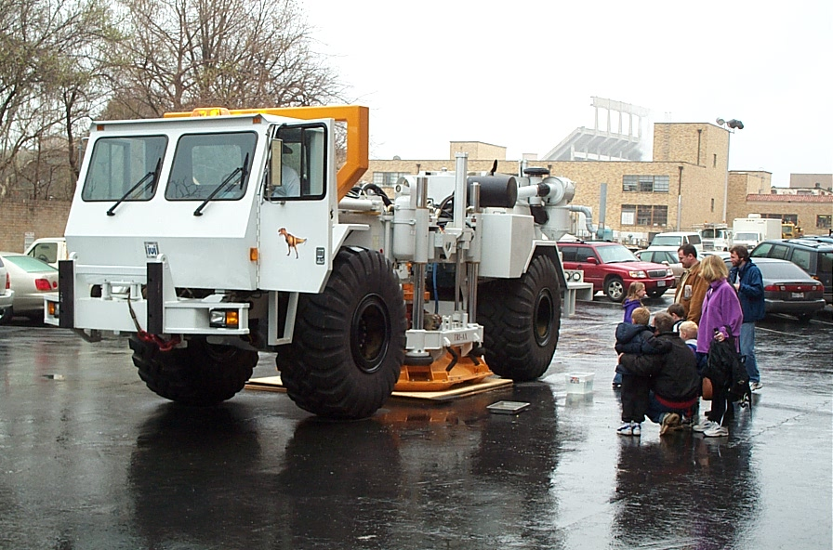
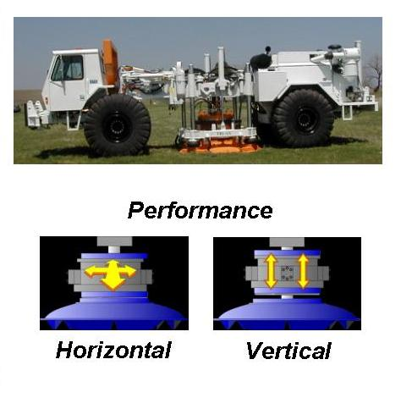
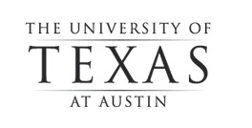
Field geotechnical: UT Austin

Slide 10

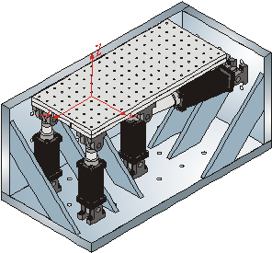
Multi-Axial Full-scale Sub-Structuring Testing & Simulation Facility
University of Illinois at Urbana-Champaign
Loading and Boundary Condition Boxes
(LBCB)

Slide 11
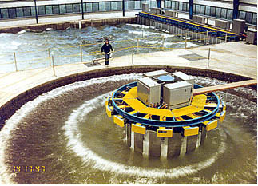
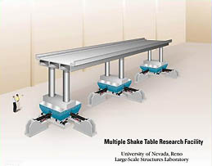
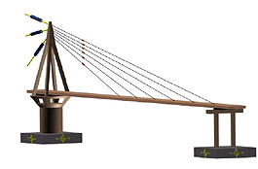
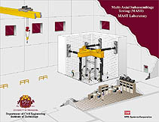
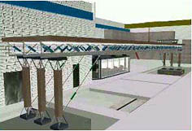
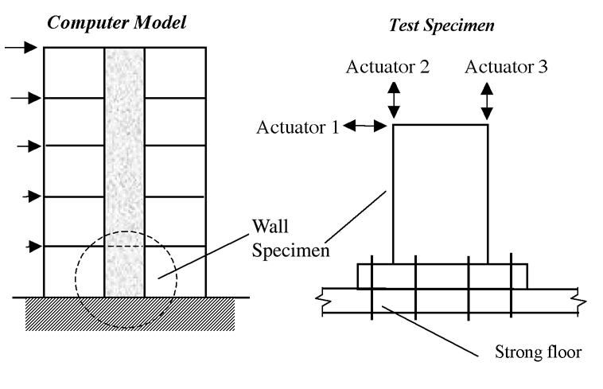
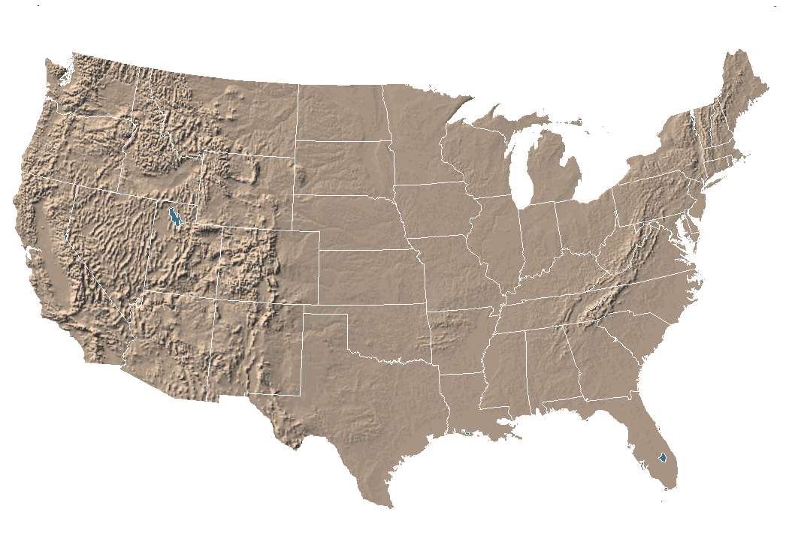
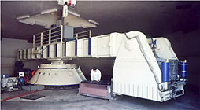
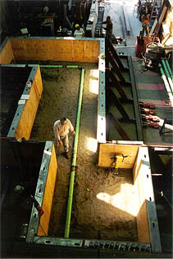
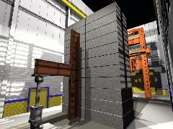
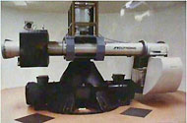
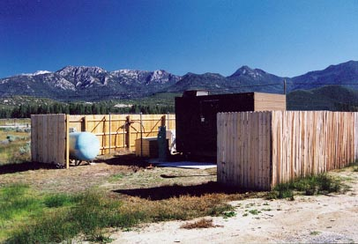
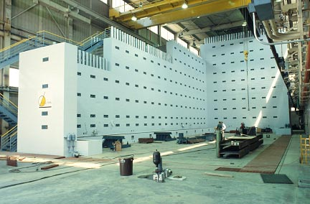
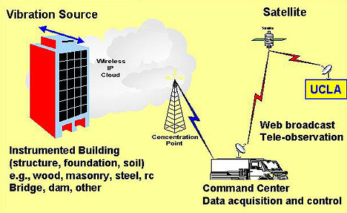
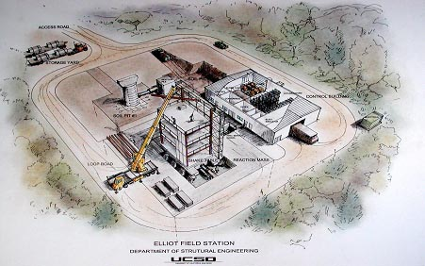
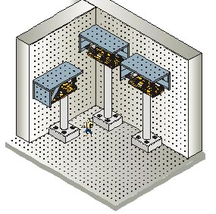
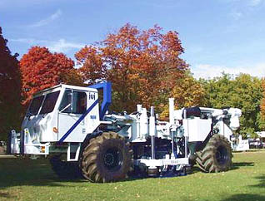

Slide 12
If we build it, they will collaborate
Data and access to data represent fundamental barriers to dispersed collaboration
Efficient movement of vast amounts of data is a prime rationale for cyberinfrastructure
Federating, visualizing and mining data are principle challenges

Slide 13
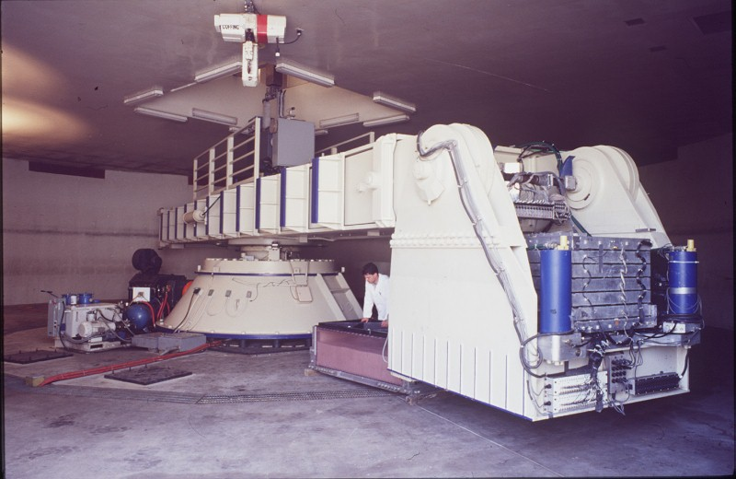
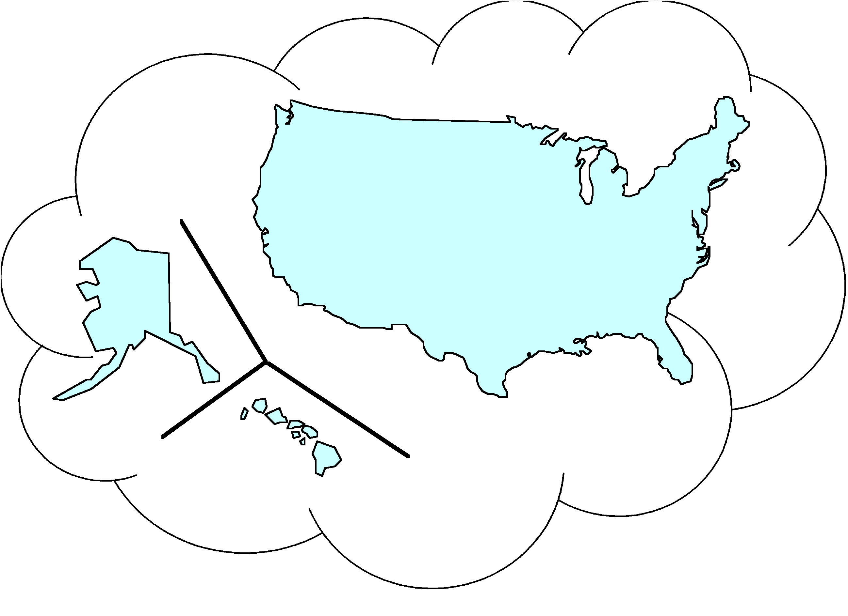

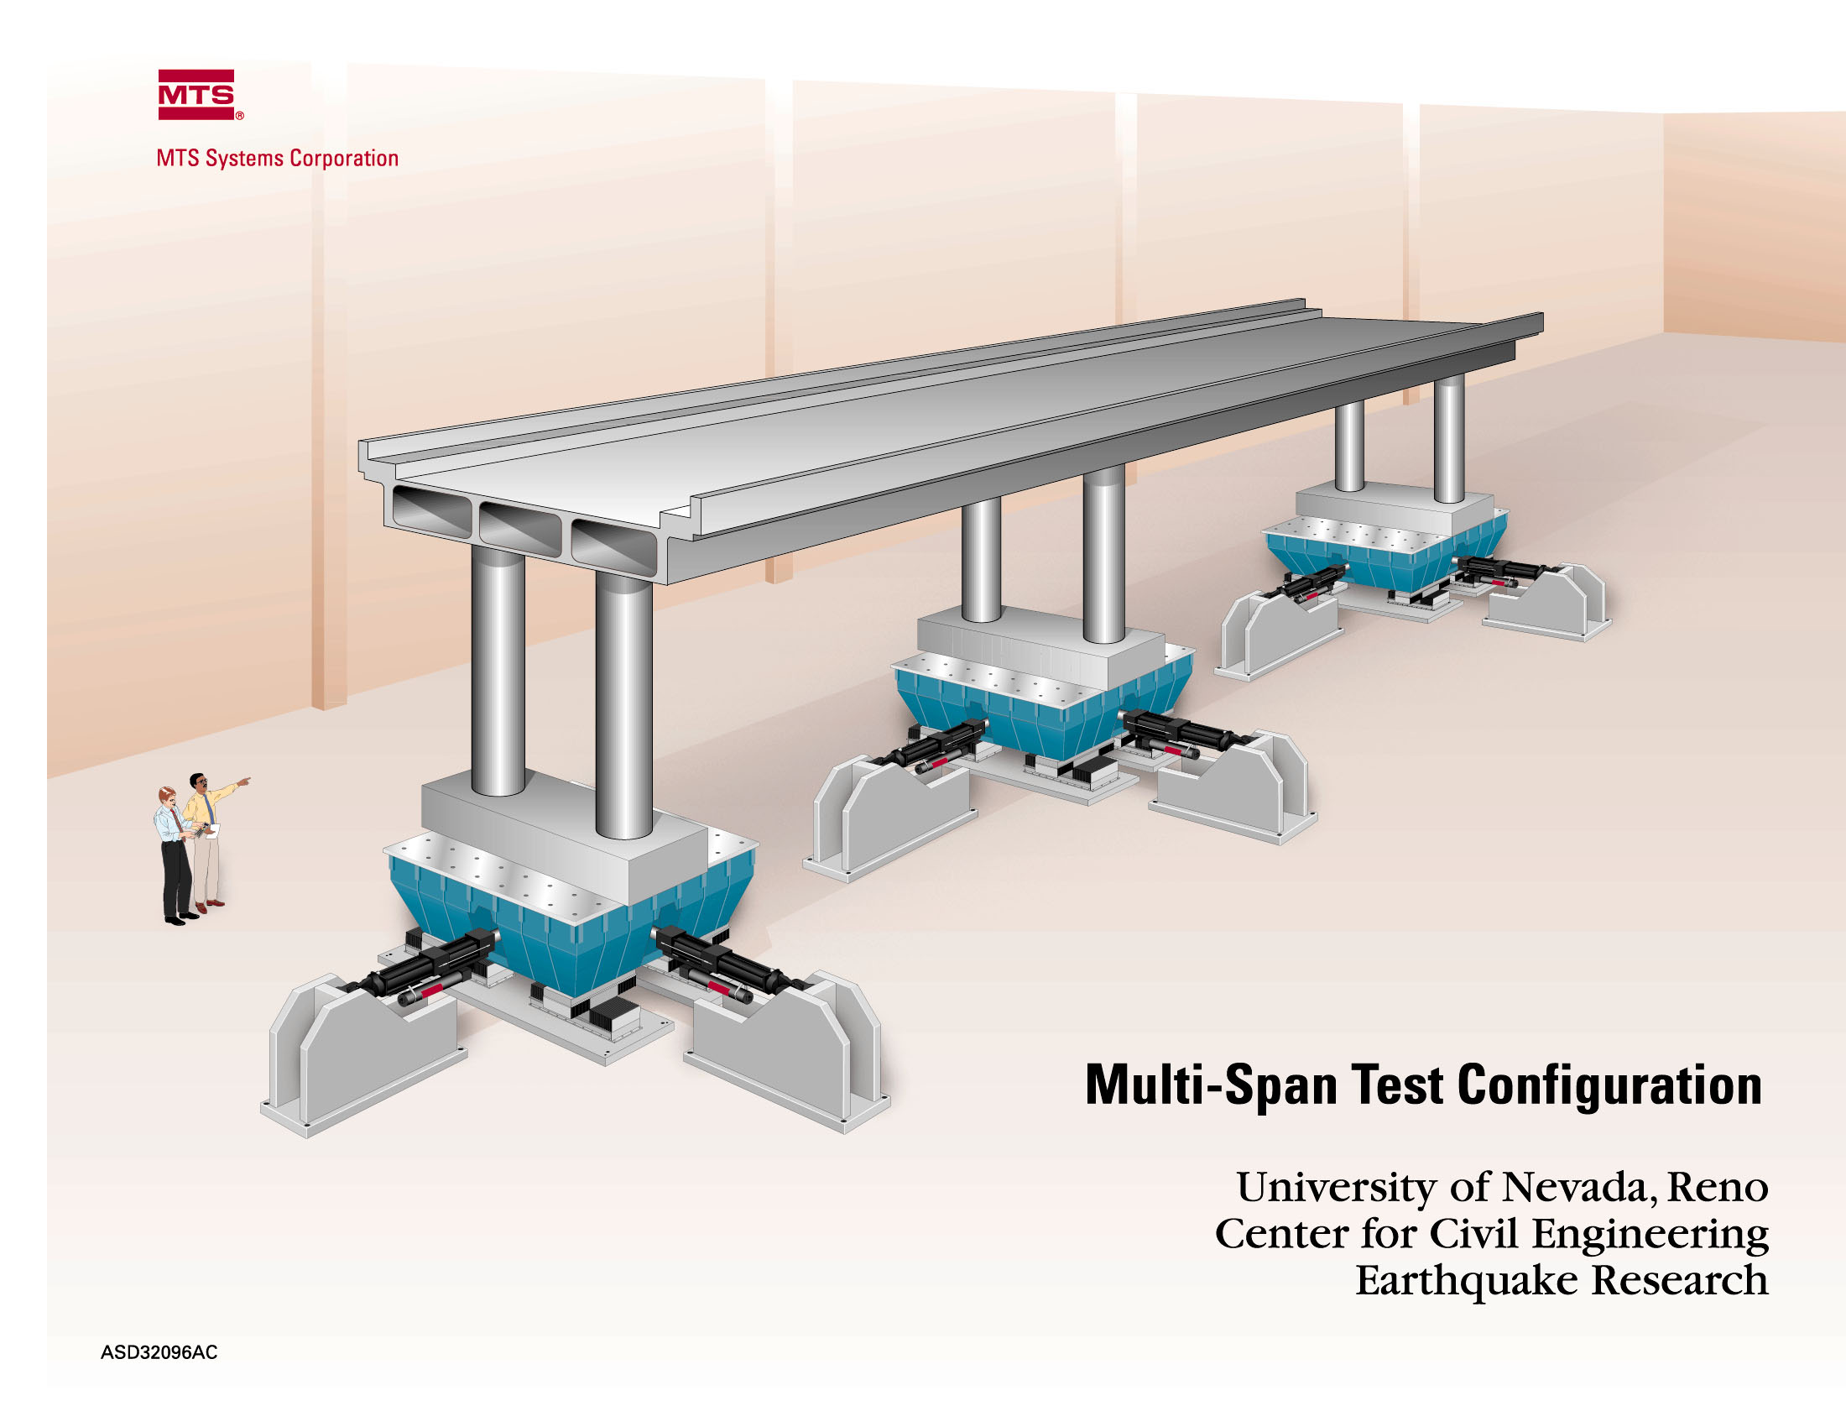
Remote Users
NEES Resources
(Faculty, Students, Practitioners)
Instrumented Structures and Sites
Simulation Tools Repository
Laboratory Equipment
Field Equipment
Curated Data Repository
Leading Edge Computation
Global Connections
Remote Users: (K-12 Faculty and Students)
Laboratory Equipment

Slide 14
Sakai’s Value in NEES
Allows many ad hoc groups to be formed across institutions dynamically
All the collaborative activity is recorded with a great deal of explicit metadata
As the groups exchange data and files through resources, e-Mail, webdav, the activities is recorded and tagged.
In addition, metadata capbilities allow the capture of explicit metadata as required by the NEES community
Sakai also functions as a portal to give access to capabilities without requiring software distribution.

Slide 15
Data Models and Sakai

Slide 16
Overall Data Modeling Efforts
NEES
Site
Site A
Site B
Site C
Specifications
Database
Equipment
People
Equipment
People
Project
Description
Experiments
Trials
Experiments
Trials
Domain
Tsnumai
Shake Table
Centrifuge
Specific
Geotech
models
Specimen
Specimen
Specimen
Specimen
Common
Elements
Units
Sensors
Descriptions
Data /
Data
Data
Data
Observations

Slide 17
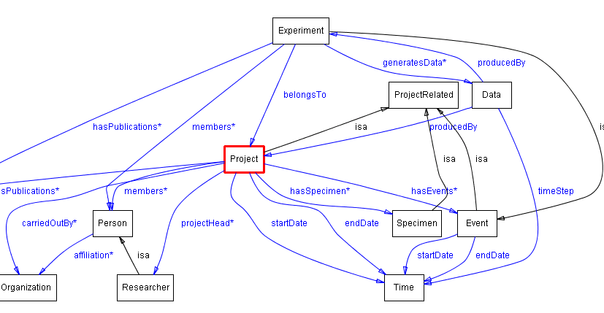
Project Model (generated by Ontoviz)

Slide 18
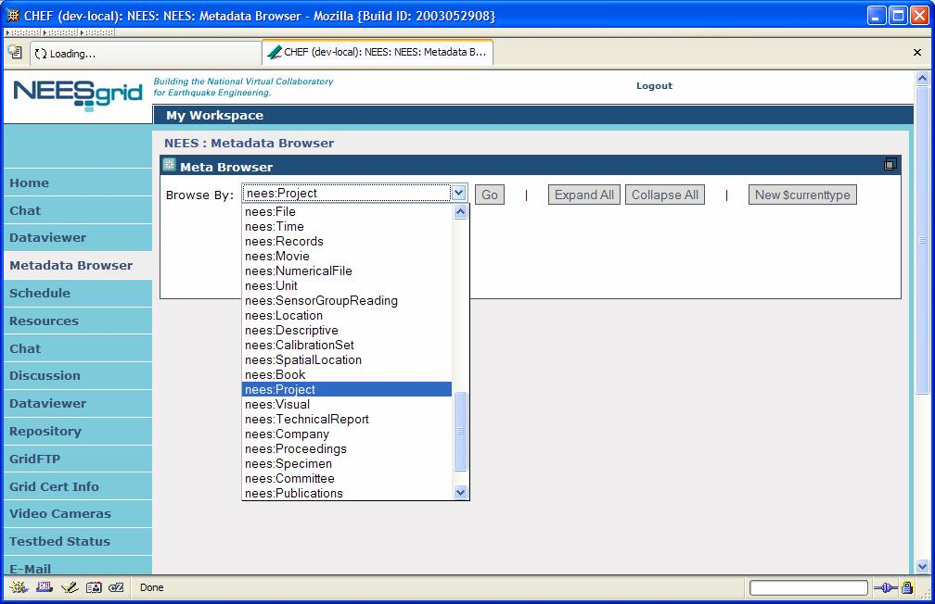
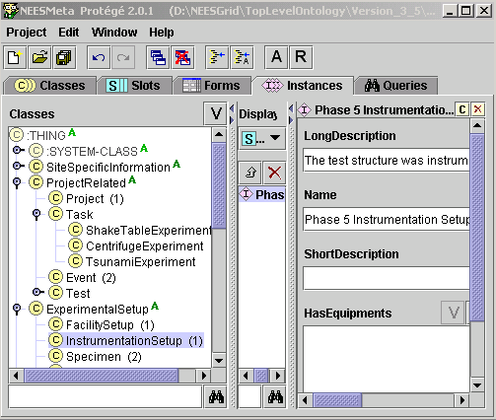
Models + Data Model
Repo
Data
RDF
Load
<owl:ObjectProperty rdf:ID="hasPublications">
<rdfs:domain>
<owl:Class>
<owl:unionOf rdf:parseType="Collection">
<owl:Class rdf:about="#Project"/>
<owl:Class rdf:about="#Task"/>
</owl:unionOf>
</owl:Class>
</rdfs:domain>
<rdfs:range rdf:resource="#Publications"/>
</owl:ObjectProperty>
Configure
Models
RDF/
OWL
Configure

Slide 19
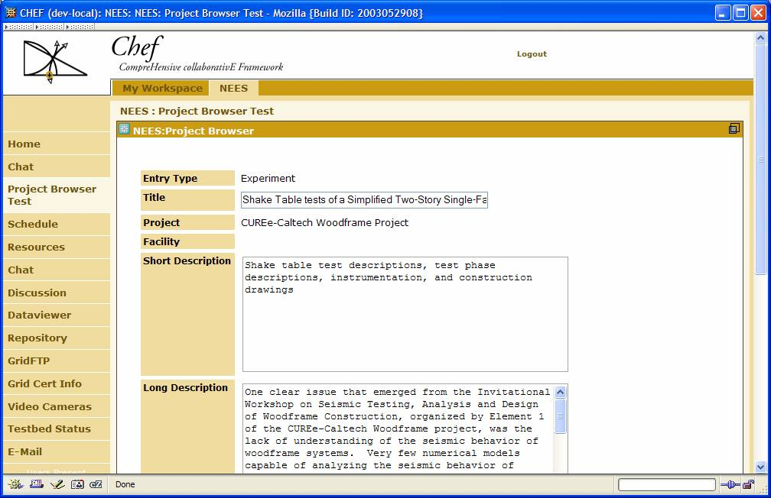
Models + Data Model
Repo
Data
RDF
Load
Configure
Models
Protégé - 2K
RDF/
OWL
Configure

Slide 20
Research Oriented Tools

Slide 21
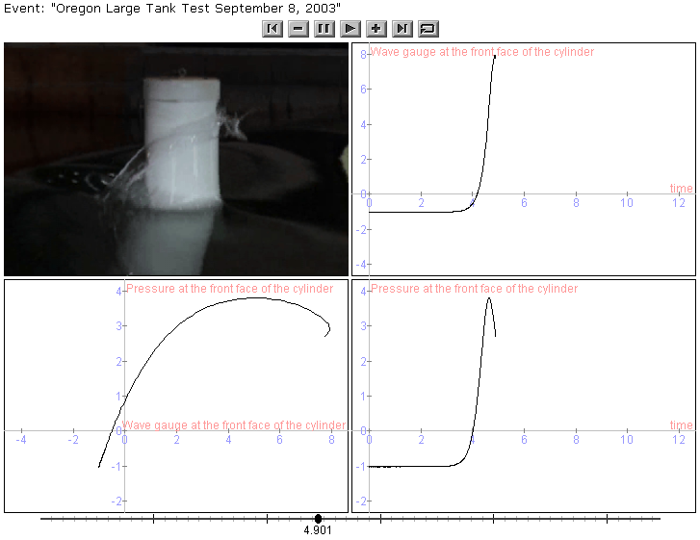
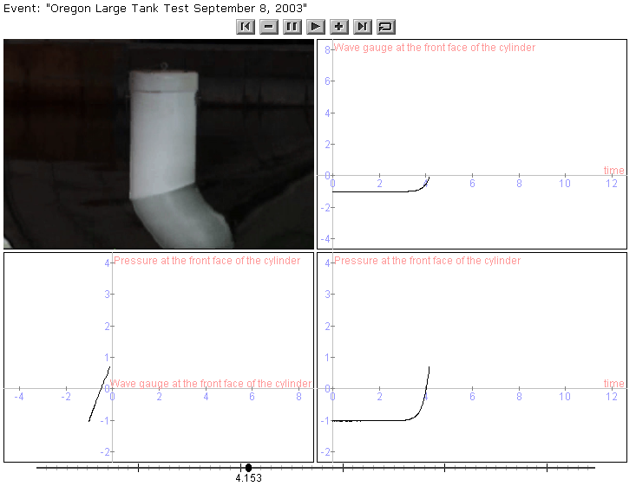

Slide 22

Capturing Video and Data
PTZ/
USB
Still
Capture
Camera Control
Gateway
DT Client
BT848
Video
Frames
DT Main System
DT Client
DAQ
Data
Capture
DT Client
Simulation
Coordinator
Site B
Site A

Slide 23
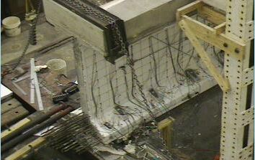
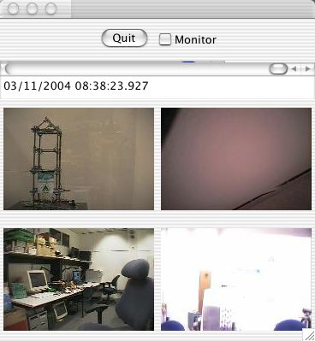
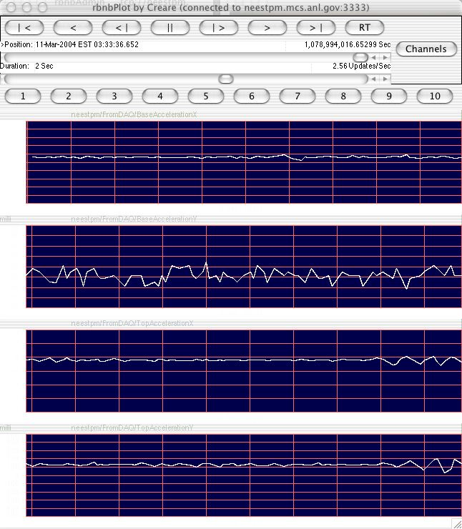
Data Monitoring Tools
Camera Control
Gateway
Still Image / Camera Control
Still image
camera
control
<
^
>
^
DT Main System
~
<
>
Thumb-
nail
Creare
viewers

Slide 24
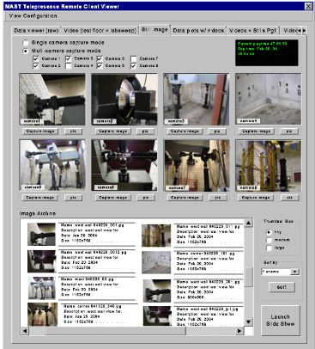
Video and
Data Tivo
Thumbnail + Audio + Data
<
>
+

Slide 25
Thanks…

