Slide 1
Using the Sakai Collaborative Toolkit in e-Research Applications
Charles Severance, Joseph Hardin, Glenn Golden
University of Michigan - Sakai Project, Ann Arbor, MI US
csev@umich.edu, hardin@umich.edu, ggolden@umich.edu
Robert Crouchley, Adrian Fish
Centre for E-science at Lancaster University, Lancaster, UK
r.crouchley@lancaster.ac.uk, a.fish@lancaster.ac.uk
Tom Finholt, Beth Kirschner, Jim Eng
University of Michigan - MGrid Center, Ann Arbor, MI, US
finholt@umich.edu, bkirschn@umich.edu, jimeng@umich.edu
Rob Allan
CCLRC e-Science Centre, Daresbury Laboratory, Warrington, UK
r.j.allan@dl.ac.uk

Slide 2
Sakai Overview in Four Slides…
www.sakaiproject.org

Slide 3






Placing the Sakai Product
Teaching
and
Learning
Collaboration and eResearch
Notes:
Sakai is a Collaborative Learning Environment. Sakai can be applied in both a teaching and learning environment as well as research collaboration.

Slide 4
Requirements Overlap
Quizzes
Grading Tools
Syllabus
SCORM
Grid Computing
Visualization
Physics
Research
Collaboration
Teaching
and
Learning
Data Repository
Chat
Discussion
Resources
Earthquake
Research
Collaboration
Large Data
Libraries
Notes:
Sakai

Slide 5
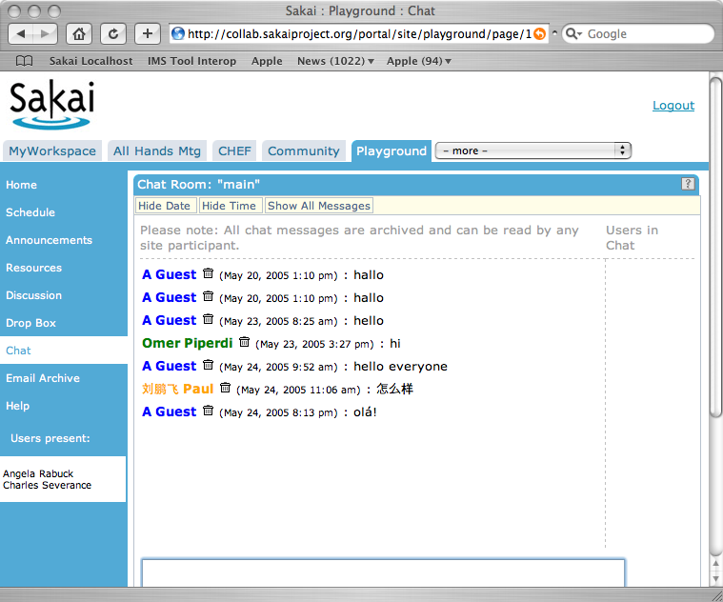
Sakai General Collaborative Tools
Announcements
Assignments
Chat Room
Threaded Discussion
Drop Box
Email Archive
Message Of The Day
News/RSS
Preferences
Resources
Schedule
Web Content
Worksite Setup
WebDAV
Notes:
Very much influenced by CHEF. Note that UMICH thinking of teaching and learning as collaboration. No real learning focused tools - all generic collaboration tools.

Slide 6
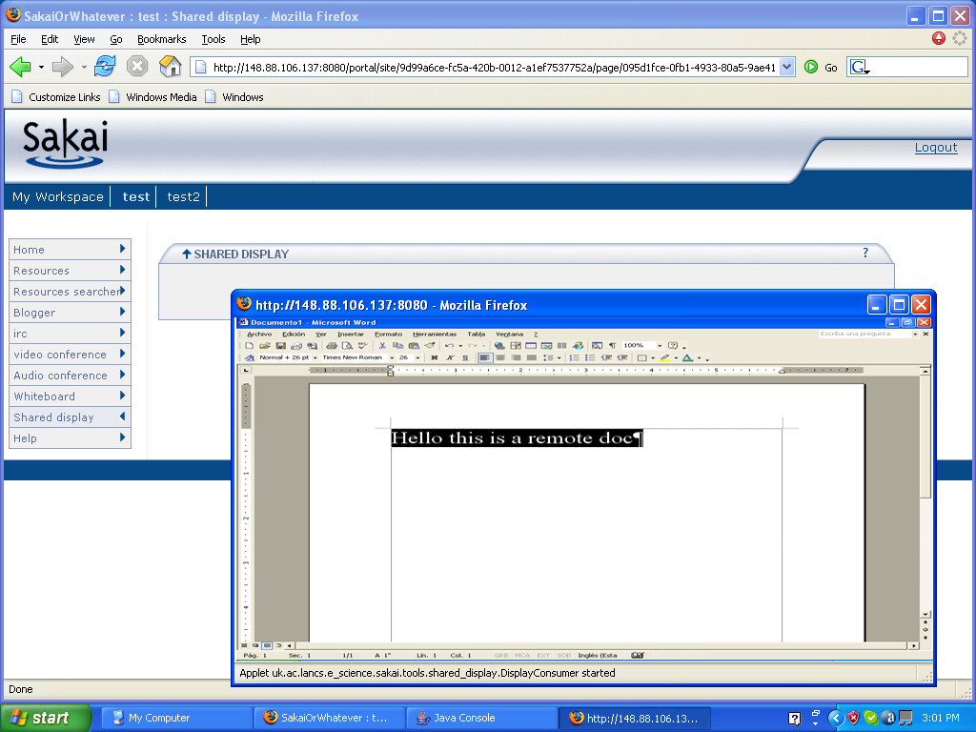
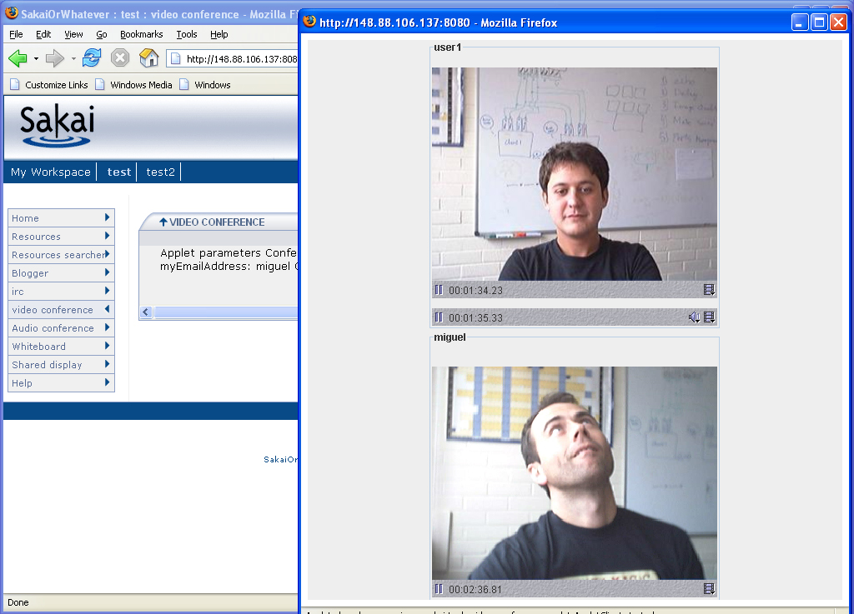
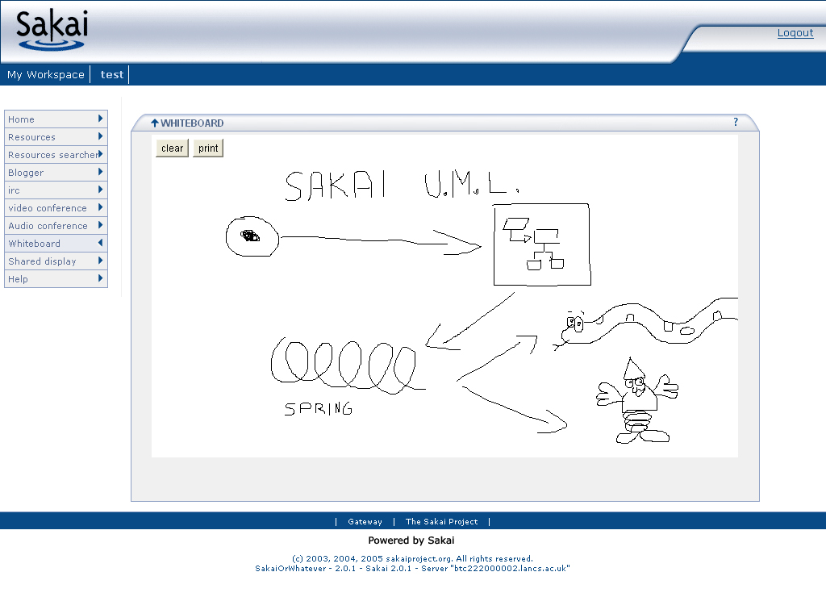
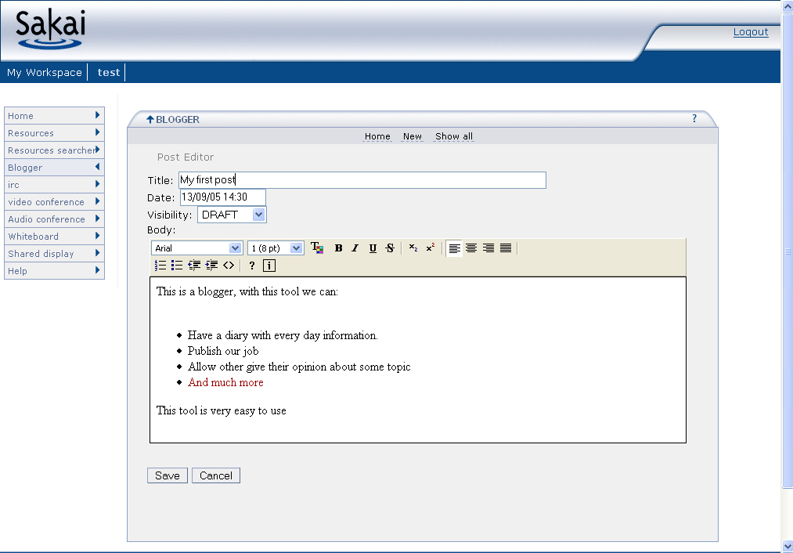
Additional General Collaboration
Tools Under Development
Wiki based on Radeox
Blog
Shared Display
Shared Whiteboard
Multicast Audio
Multicast Video
These are works-in-progress by members of the Sakai eResearch community. There are no dates for release.

Slide 7
Sakai Technology in a Collaborative eScience Context

Slide 8








Scope of Collaborative E-Science
“..composing and orchestrating many technologies…”
Portal
Technology
“..interoperability is key…”
Data
Sources
Collaborative
Tools
Identity
ACL
Shared
Compute
Data
Repository
Knowledge
Tools
Notes:
Cross cutting issues include identity, authorization, and access to resources.
Desktop.

Slide 9
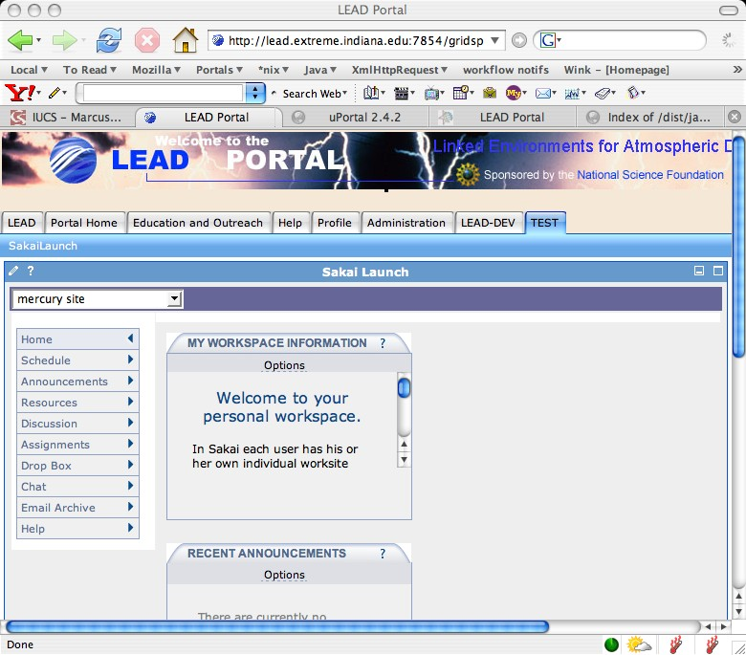
User Interface for
Collaborative E-Science
Portals are an excellent technology for building a federated user interface across these disparate components.
Portal
Technology
Data
Sources
Collaborative
Tools
Identity
ACL
Shared
Compute
Data
Repository
Knowledge
Tools
Notes:
OGCE architecture and approach is to invest in building reusable components which allow collaborative eScience technologies to be placed in a portal to provide a uniform user interface. Standards such as JSR-168 and WSRP insure that elements can be reused across projects.
Over time, the web/portal paradigm will likely be replaced by a desktop paradigm - but the portal provides a least common denominator and allows us to deploy solutions for collaborative eScience in the short term.

Slide 10
Focus of Sakai Activity in eScience
Sakai is focused primarily on integration with portals and working closely with data repositories.
Portal
Technology
Discuss First
Data
Sources
Collaborative
Tools
Identity
ACL
Shared
Compute
Data
Repository
Knowledge
Tools
Notes:
Sakai provides the Grid-aware collaboration tools which allow people to work together collaboratively. Sakai can be used standalone, but when Sakai is used in conjunction with a JSR-168 portal it allows eScience providers an easy platform to integrate across the whole scope of their eScience application.
The Sakai focus on data repository integration is intended to allow the “capture” of the human collaborative activities for permanent storage in the data repository along with all of the other science data to be stored in the repository.
Sakai also participated in the cross-cutting issues of federated identity and access control.

Slide 11
Collaboration .vs. Portal
Basic organization is about the shape of the people and groups
Customization based on the “group leaders”
New groups form quickly and organically
Doing one thing at a time - chat, upload - perhaps multiple active windows on a desktop
Very interactive
Think of navigation as picking a tool or switching from one class to another
Think “Application”
Basic organization is about the thing it represents - Teragrid, NVO
Site customization is based on the resource owners
Sometimes there is an individual customization aspect
Many small rectangles to provide a great deal of information on a single screen
Portals think of rectangles operating independently - like windows
Think “Dashboard”

Slide 12
Common Portlet Patterns
Portal with JSR-168 and WSRP Support
JSR-168
Portlet
JSR-168
Portlet
JSR-168
WSRP
Consumer
Web Svcs
Backend
Code
WSRP
Producer
Web Svcs
Remote
Facility
Remote
Portlet
Database

Slide 13
Sakai Portal Integration Steps
Use iFrames and Charon
  Highly Portable - manual configuration - separate rendering
Sakai JSR-168 Web Service Portlet
  Highly portable - automatic configuration - separate rendering
Web Services for Remote Portlets (WSRP)
  Highly portable - manual configuration - coordinated rendering
Sakai integrated into uPortal 3.0
  Not portable - automatic configuration - coordinated rendering

Slide 14
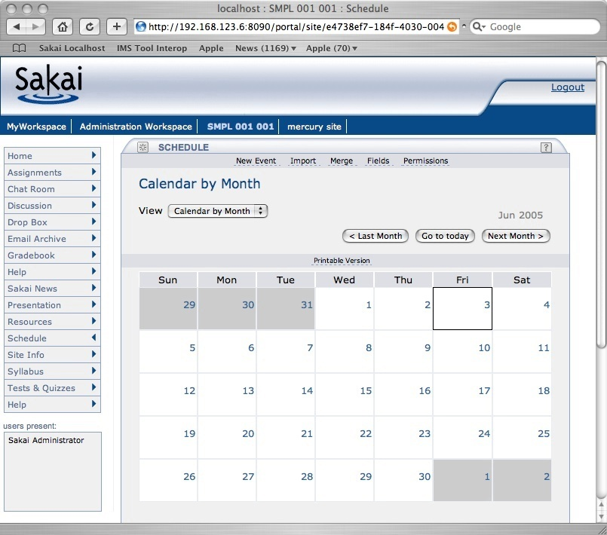
Sakai’s Rectangles
Login
Branding
Site
Selection
Tool
Selection
Tool Area
Presence

Slide 15
Sakai HTML Portal URLs
http://sakai.edu/portal/gallery
http://sakai.edu/portal/page/<id>
http://sakai.edu/portal/tool/<id>
http://sakai.edu/portal/wqrksite/<id>
Notes:
We can feed these rectangles out via iFrame and coming up via WSRP in a portable manner and JSR-168 with some effort within each portal.

Slide 16
Sakai JSR-168 Portlet
Web Services are used to login to Sakai establish a session and retrieve a list of Sakai Sites and IDs.
These are presented in the Portlet and as the user navigates between sites, an embedded iframe is used to show the site.
The portlet is 100% stock JSR-168
  Works in Pluto, uPortal, and GridSphere

Slide 17
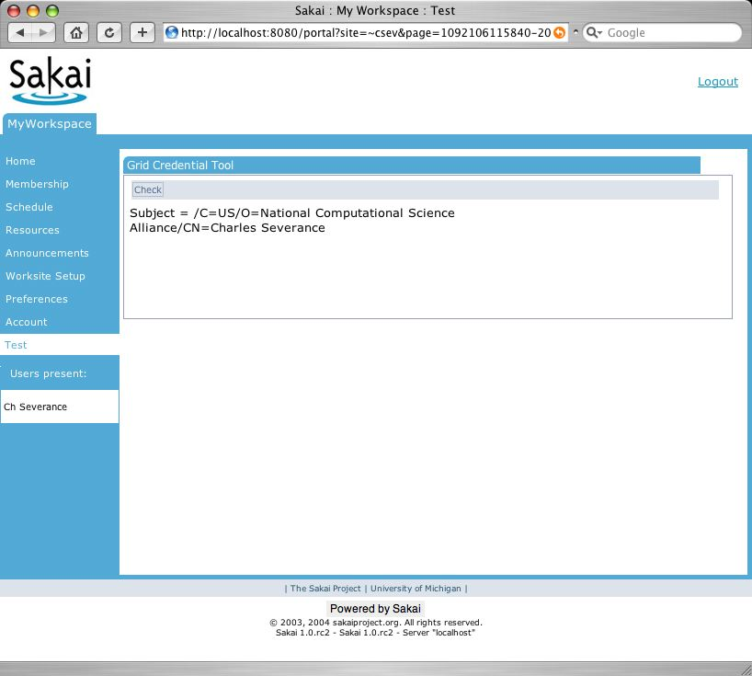
Sakai JSR-168 Use Case
JSR-168 Portal
JSR-168 Tool
JSR-168 Tool
JSR-168 Tool
HTTP
Sakai
tool
tool
Includes a complete Sakai site in any JSR-168 portal container.

Slide 18
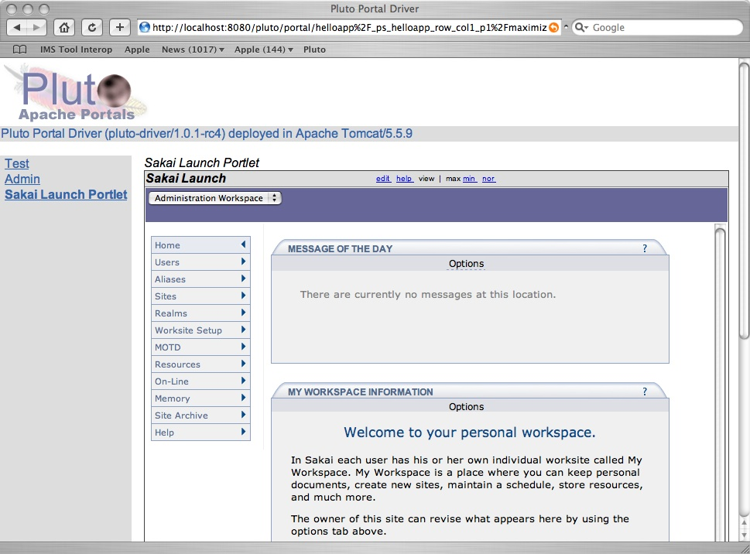
Sakai Portlet
JSR-168 Portlet
iFrame
Notes:
Two Clicks For animation. (1) Portlet Boundary (2) iFrame Boundary

Slide 19
Features
Preferences
  Sakai host, account, iframe height
Automatic login
  The portlet can be configured system-wide to have a designated Sakai host that people are to be automatically logged in.
  A shared secret between the portlet and the Sakai system allows bypass of any Sakai log in.
  There must be a Sakai account for each portal account. But if the account exists and the shared secrets match, integration is seamless

Slide 20
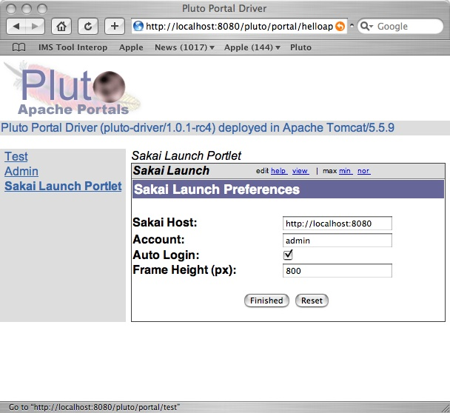
Preferences

Slide 21
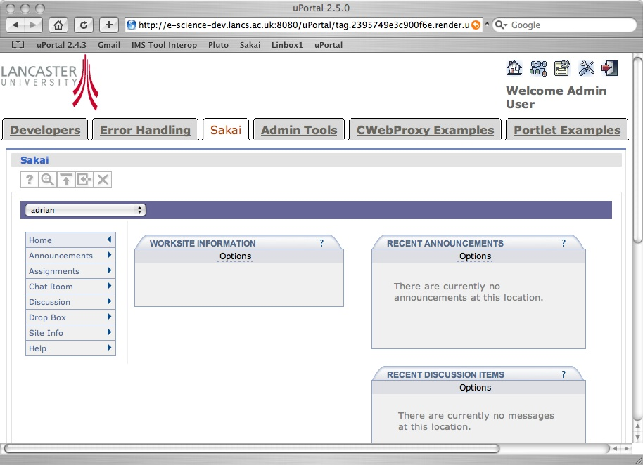
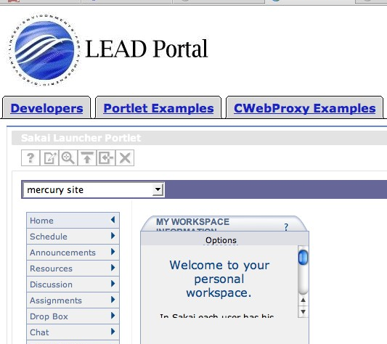
Sakai
JSR-168 Portlet
3
JSR-168 Portal
4
Sakai
Portlet
Portlet
Consumer
1
2
SiteList
Login
Sakai HTML
Portal
Web Svcs
Sakai
Notes:
When the Portlet Starts, it puts up a login screen or auto-logs in depending on configuration. The login is done with a web service. Once the session is established, the site list is retrieved and the portlet is displayed. As a site is selected, the portlet generates an appropriate iFrame with the Charon URL to the site. This uses session based launch to bypass Sakai’s login process.

Slide 22
uPortal
Thanks to Adrian Fish, Lancaster University for the uPortal screen shot

Slide 23
GridSphere
Thanks to Marcus Christie, Indiana University for the GridSphere screen shot

Slide 24

WSRP Activities
SunGard-led and funded: Vishal Goenka
Working with uPortal in their WSRP 3.0 effort
As we really try to use WSRP, we identify issues in the standard and WSRP4J implementation
Sakai and uPortal are becoming involved in WSRP standards activities and WSRP4J

Slide 25
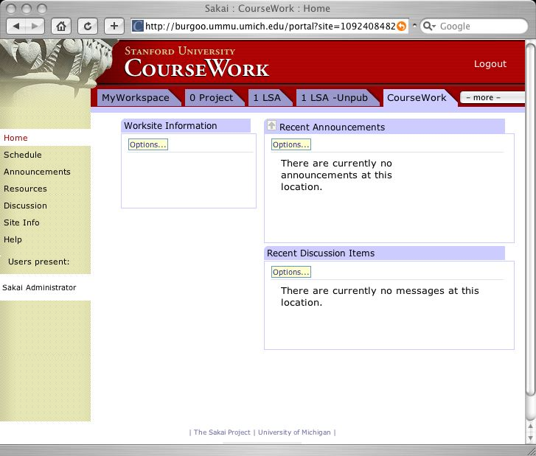
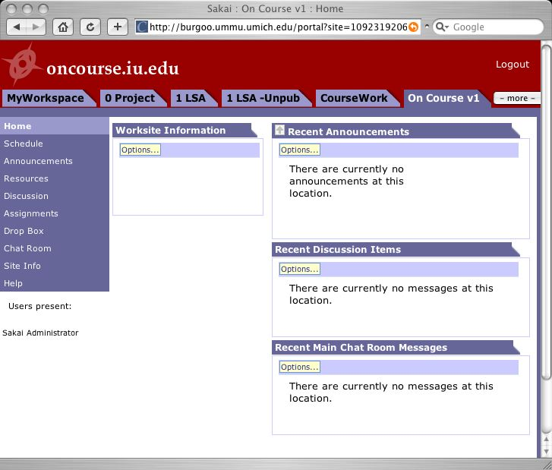
WSRP Use Case
Portal
Non-Sakai
Tool
Non-Sakai
Non-Java Tools
tool
tool
WSRP
WSRP
WSRP
WSRP
HTTP
HTTP
HTTP
Sakai
Sakai
Sakai
tool
tool
tool
tool
tool
tool

Slide 26
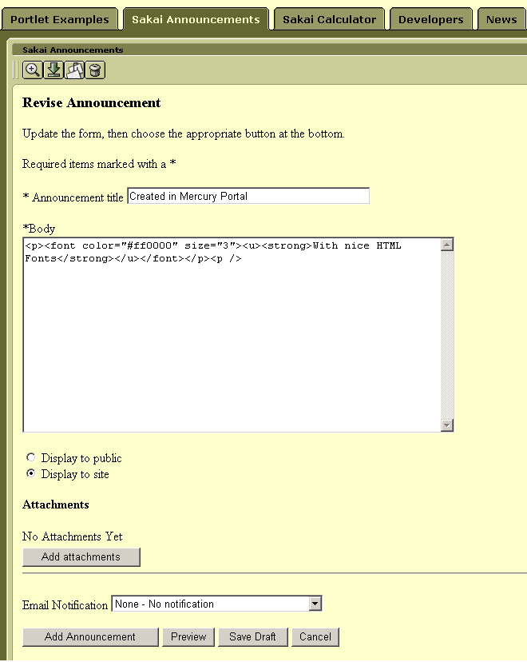
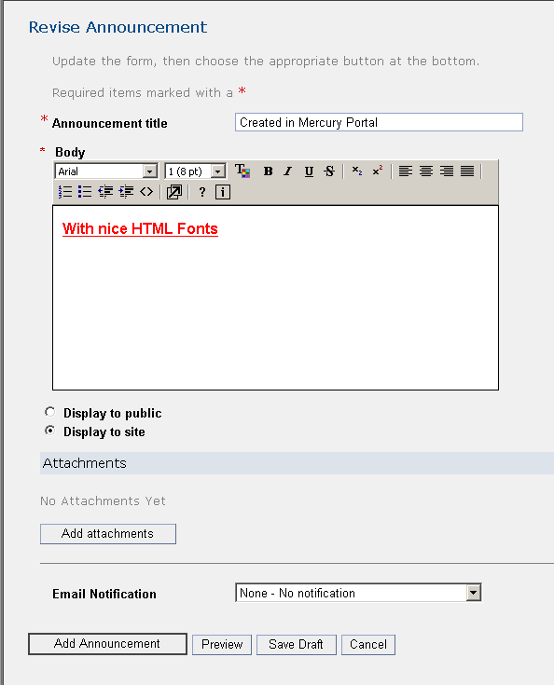
WSRP
Side-by-Side

Slide 27
WSRP
Architecture
WSRP Consumer
(uPortal)
Web Services
Apache WSRP4J
Portlet = Placement
Sakai WSRP
Provider
List Portlets
Tool ID
Mercury
Placements
Placement ID
Kernel Tool
Registry
Site
Placements
Get Markup
Request Filter
Tool A
Tool B
Tool C
URL Rewriting

Slide 28
Sakai / uPortal Integration
Sakai and uPortal in same Tomcat
Sakai becomes “pushed fragment” by adding component to uP3 render pipeline
  Sakai iFrame portlet
  Sakai JSR-168 portlet for tools capable of producing “fragment” responses
Sakai placements can be subscribed as channels/fragments
Sakai tools appear as place able channels
This is a lot of work and all we have are initial designs
Notes:
Initial design meeting September 5-6, 2005.
This is very close integration and will *only* work in uPortal.
Work is being done by community resources with no anticipated delivery date but the hope Is to deliver some elements of the design in the uP 3.0 release time frame.

Slide 29
uPortal/Sakai
uPortal’s Tomcat
uPortal
uPortal 3.0
iFrame
JSR-168
uPortal
GAPS
Groups
Placements
GAPs
Plug-ins
uPortal Render
Pipeline
Sites and
Placements
User
Plug-in
Users
uPortal
Sakai

Slide 30
Connecting Portal Instances with WSRP
Project Portal
Portlet
Consumer
Consumer
Producer
Producer
uPortal 3.0 (Repository)
uPortal 3.0 (Compute Farm)
Portlet
Portlet
Portlet
Portlet
Portlet
Portlet

Slide 31
Sakai Presentation Flexibility

Slide 32
uPortal via
WSRP
An Example
The Sakai Framework
HTML Based
Aggregator
This is a tool written using the Sakai JSF widget set
The tool builds its own API (Schedule)
The tool makes use of framework APIs.
The tool is rendered in HTML and displayed within uPortal via the Web Services for Remote Portlets (WSRP) protocol
Outside the tool, there is great flexibility which is hidden to the tool
Sakai JSF
Widget Set
The Sakai Tool Environment
GUI layout
(JSF/JSP)
Schedule
Tool (Java)
Schedule
API (Java)
OSID Id
API
System

Slide 33
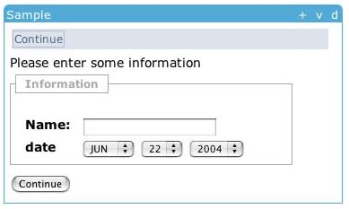
Tool Display in JSF
<sakai:view_container title="#{msgs.sample_title}">
<sakai:tool_bar> <sakai:tool_bar_item/> </sakai:tool_bar>
<sakai:instruction_message
value="#{msgs.sample_one_instructions}" />
<sakai:group_box
title="#{msgs.sample_one_groupbox}">
<h:inputText
value="#{MyTool.userName}" />
<sakai:date_input
value="#{MyTool.date}" />
<sakai:button_bar> <sakai:button_bar_item action="#{MyTool.processActionDoIt} value="#{msgs.sample_one_cmd_go}" />
</sakai:button_bar>
Notes:
Showing the separation between the “within tool” presentation and “within framework” presentation details. The tools use Sakai Widgets to express their layout needs and the framework renders the tags as appropriate for the different presentation approaches.
The variable values are populated from Java bean getter methods provided by the Java tool code in the display backing bean.

Slide 34
Describing Actions in JSF
<h:inputText
value="#{MyTool.userName}" />
MyTool.userName() {
}
<sakai:date_input
value="#{MyTool.date}" />
MyTool.date() {
}
<sakai:button_bar> <sakai:button_bar_item action="#{MyTool.processActionDoIt} value="#{msgs.sample_one_cmd_go}" />
</sakai:button_bar>
MyTool.processActionDoIt() {
}
Notes:
Similarly, the presentation in JSF links actions in the presentation to methods in the Java code which is the backing bean..

Slide 35
Rendering Flexibility
Sakai
iframe
Portals via
iframe
Sakai
Non iframe
Portals via
WSRP
uPortal via
JSR-168
The Sakai Framework
Servlet/HTML
Renderer
WSRP
Renderer
JSR-168
Renderer
Sakai JSF
Widget Set
The Sakai Tool Environment
Java Server
Faces in JSP
Java Tool Logic
Java Beans
Sakai Application
Services
Sakai and/or OKI
APIs
Notes:
There are many rendering options within Sakai, but the tool code does not have to change. Because presentation is delegated to the JSF widget set, all of this flexibility is hidden from the application.

Slide 36
Sakai Repository Integration Approach

Slide 37
Focus of Sakai Activity in eScience
Sakai is focused primarily on integration with portals and working closely with data repositories.
Portal
Technology
Data
Sources
Collaborative
Tools
Discuss Now
Identity
ACL
Shared
Compute
Data
Repository
Knowledge
Tools
Notes:
Sakai provides the Grid-aware collaboration tools which allow people to work together collaboratively. Sakai can be used standalone, but when Sakai is used in conjunction with a JSR-168 portal it allows eScience providers an easy platform to integrate across the whole scope of their eScience application.
The Sakai focus on data repository integration is intended to allow the “capture” of the human collaborative activities for permanent storage in the data repository along with all of the other science data to be stored in the repository.
Sakai also participated in the cross-cutting issues of federated identity and access control.

Slide 38
Collaboration .vs. Repository
Many different systems may be active at the same time
Systems evolve, improve, and are often replaced every few years
Systems focused on the dynamic needs of users and applications
Thousands of simultaneous online users
Performance tuning
Must be very easy to use; almost unnoticeable
Used informally hundreds of times per day per user
Think “E-Mail”
Generally one system for the area
Long term strategic choice for institution
System focused on accessing, indexing, curation, and storage
Millions of high quality objects properly indexed
Data and metadata quality
Must enforce standards and workflow to insure data quality
Most use is very purposeful: search, publish, add value
Think “Library”
Notes:
Collaborative systems often allow materials to be sloppy (copyright for example). IR’s must be very clear on copyright as there are likely to be different rules w.r.t. materials in IR’s. This may require some cleanup on materials from collab systems when moving to an IR.

Slide 39
Inbound Object Flow
Search
View
The lens or disseminator understands the data model and is capable of rendering the objects. The lens is part of the DR.
Reuse
Sakai
DR
Index
Lens
Store
Create and use in native form
Prepare for
storage
Data
Model
Curate, convert, update and maintain over time
Ingest
The DR establishes a data model for “site” objects. The CLE hands sites to the DR. The DR may have to do “model” or content cleanup before completing the ingest process.
Preparation for storage may include cleanup, conversion, copyright clearance, and other workflow steps.
Notes:
One of the goals here is data portability - making data relevant *beyond* the initial application that created it.
At some level, IMS Common Cartridge will move us along this path somewhat. A cartridge format could be usable as an export format as well as an import format.

Slide 40
Outbound Object Flow
Sakai can find and re-use objects in the repository.
Search
View
View
Sakai
Search
Index
Lens
Lens
Reuse
Reuse
Data
Model
Data
Model
DR
Notes:
Remember that this is only how Sakai will interoperate with the repository. Other applications will use the repo as well.
TwinPeaks is a start in the direction of reuse of content from a repository.

Slide 41
Going Forward
Instead of solving the problem by creating a single DR technology that is a superset - which might take years
Focus on data portability between systems - reduce the impedance mismatch (or needed conversion between systems)
RDF enables object portability across systems, languages, and technologies

Slide 42
Tangible Steps for Sakai
Move Sakai and other Collaboration systems toward RDF
  Experiment with using RDF as native storage format
  Investigate high-performance RDF
Move data repositories toward RDF
  Move from schema-based stovepipe objects to OWL/RDF based objects with referential integrity
  Explore dimensions of portability of disseminator / lenses - this is an important research area
Notes:
At some level RDF is a low-level enabler which is a pre-requisite. In a way RDF is like “Ethernet” is for the Internet. Additional aspects beyond RDF include OWL (Web Ontology Language) defines the models of data represented in RDF. And beyond RDF and OWL, there is the development of software that understands different onltolgies at increasing levels of semantic understanding.

Slide 43
Thank you for your time…
www.sakaiproject.org
collab.sakaiproject.org
csev@umich.edu

