Slide 1
Sakai Technical Update
Charles Severance
June 1, 2006
Download: www.dr-chuck.com/talks.php

Slide 2
State of Sakai in one Slide....
Sakai is used for Collaboration, Teaching, and Learning
Sakai Project started January 2004 (2.5 years old)
Non-profit Sakai Foundation October 2005
Open Source - 100% free - Apache License
Voluntary financial support from 90+ Higher Education, 15 companies, each paying $10,000 / year = $ 1M revenue
Six Sakai Foundation paid staff members
Over 200 installations of Sakai
Three full-scale installations > 50,000 users
Twenty+ installations with > 500 users (often pilot uses)
100+ people active in developing and testing Sakai releases

Slide 3
Sakai Foundation Legal Structure
Non-Profit Corporation - Apache Licensing
Companies
rSmart
Unicon
IBM
Apple
SUN
... (15 total)
Non-Profits
University
US (55)
World(18)
Colleges (7)
Non Profit (1)
Sakai Foundation
Board of Directors
Executive Director
Sakai Staff
We have made great progress in the past six months moving from project-oriented approaches to foundation-oriented leadership approaches.
Notes:
Sakai’s Organizational Structure is modeled after LinuX and Apache. Sakai tries to keep three things somewhat separate: (1) Governance, (2) Development, and (3) Commercial Application of Sakai.
Development is done by volunteers who work for organizations with an interest in Sakai.
The Foundation is supported by voluntary contributions of members

Slide 4
Important Processes
Sakai Requirements
Sakai Project Coordination
Provisional tools
Sakai Community Practice
Distributed Community based QA
Distributed Development - Increasingly diverse committer lists
Notes:
Up next - talk about the development patterns in the community.

Slide 5
A recent Sunday...
On May 21, 2006, at 6:27 AM, David Horwitz wrote:
For those of you not following SAK-4669 we think we have found the problem is somehow related to specific Linux kernels. Namely 2.6 kernels between 2.6.8 and a least 2.6.13. Using the same Sakai build (Columbia's qa build), with the same JAVA_OPTS and Sakai.properties We were able to reliably reproduce the problem on:
Suse Pro 9.3 (2.6.8-24.20-default)
Suse Pro 10 (2.6.13-15.8-smp)
SLES 9 (2.6.5-7.244-bigsmp)
While it ran fine on
WinXP
Ubuntu 6.0 (Dapper) - 2.6.15-23-386
Now we just have to track down what in the OSP is causing it :-)
Notes:
Look at how much testing went into this message. Probably 20+ hours..

Slide 6
Six hours later..
On May 21, 2006, at 12:32 PM, Charles Severance wrote:
Not to distract from your investigation, but most times, the reason for the non-startup is usually some combination of /etc/my.cnf settings and sakai.properties settings.
You might be mis-led because certain mistakes in sakai.properties *work* fine when not using innodb (i.e. depending on the /etc/my.cnf) - this misled me for a long time because my properties were *wrong* and I was working fine using MyIsam tables. Thankfully people smarter than me dug deeper :)
I could see a situation where each of these distributions choose a different default mysql configuration (/etc/my.sql) and as such - when you think you are moving across Linux distributions - you may just be changing your MySql configuation.
…..
Notes:
Notice that this is a response that indicates that the writer did not fully parse and understand the previous message.

Slide 7
23 minutes later....
On May 21, 2006, at 12:56 PM, Stephen Marquard wrote:
We've spent over a week tracking this problem down, and the details are in the JIRA issue:
http://bugs.sakaiproject.org/jira/browse/SAK-4669
Please read it for the history. We are not new to Sakai, we have listened to everything people have said on this list and in email and IM with developers, we have isolated the problem through extensive testing, and at this point it doesn't help to assume that we have made an obvious mistake.
Test it on your own Linux server with a pre-2.6.14 kernel and prove us wrong. We would be very happy, because it as this stage it looks as if we will be required to upgrade our production SuSe Linux app servers.
....
Notes:
Too bad PowerPoint does not have the blink tags. Should we suggest anger management for Stephen?

Slide 8
11 Minutes later...
On May 21, 2006, at 1:07 PM, Charles Severance wrote:
Sorry - no offense intended - I *know* that you and your team know more than me about this.
I will be quiet and let others help you figure this out because it is clearly past my level of skill.

Slide 9
Back to Stephen’s message…
On May 21, 2006, at 12:56 PM, Stephen Marquard wrote:
We've spent over a week tracking this problem down, and the details are in the JIRA issue:
http://bugs.sakaiproject.org/jira/browse/SAK-4669
Please read it for the history. We are not new to Sakai, we have listened to everything people have said on this list and in email and IM with developers, we have isolated the problem through extensive testing, and at this point it doesn't help to assume that we have made an obvious mistake.
Test it on your own Linux server with a pre-2.6.14 kernel and prove us wrong. We would be very happy, because it as this stage it looks as if we will be required to upgrade our production SuSe Linux app servers.
....
Notes:
This message is neither passive nor aggressive. This an assertive message that is making a very strong point using strong language because there is a great deal at stake. This type of assertive/firm message shows how far this organization has come in a few years. This whole incident also points out how we have come in terms of release and QA in two years.

Slide 10
Four days later...
On May 25, 2996, at 3:32 AM, Stephen Marquard wrote:
This is for completeness, for anyone who was interested in the cause of the OSP-related startup problem that we had.
This is now happily resolved, and the complete detail is in http://bugs.sakaiproject.org/jira/browse/SAK-4669
The problem was triggered by platform-specific differences in the load order of components, related to how different systems return a directory listing to the java JVM. The different component load order created problems with dependencies in OSP beans.
It was unrelated to mysql, and unrelated to Linux kernel versions (though possibly related to some other OS/distribution-specific issues).
The problem has been resolved by (a) resolving the dependency issues in the OSP code, and (b) changing the Sakai component manager to load components in a predictable order.
Our thanks to everyone who helped troubleshoot and resolve the problem including Josh, Seth, Clay, Antranig, Glenn, Chris M, and John E.

Slide 11
Sakai’s Developer Community
K, Inc
Sakai Foundation
Sakai staff
Sakai Paid Staff
U of Z
Sakai Volunteers
U of X
U of Y
U of B
J, Inc
U of C
Members of the Sakai Developer Community operate in two contexts.
Notes:
Our goal was to produce an IT organization the federated developers around the world together into one IT organization, cooperatively working on one product.
The Foundation is supported by voluntary contributions of members

Slide 12
Sakai’s Virtual IT Organization
Sakai Foundation
Sakai staff
Sakai Paid Staff
Sakai Volunteers
Many developers really are quite heavily integrated into the Sakai context.
Notes:
Kind of Looks like “War of the Worlds” !
But it is not that “simple” - This figure might be mis-interpreted to mean that the volunteers “report” to the foundation.

Slide 13
Apache Foundation = Independent Projects
Tomcat
Release
Pluto
Release
Httpd
Release
WSRP4J
Axis
Release
Committer
Project
Incubator
Notes:
Why does Sakai need so much money? How is Sakai different from Apache?
Sakai is very similar to Apache in terms of the rule of “Meritocracy” and how projects are formed, and how projects work internally.
Sakai adds value “above and beyond” the apache model.

Slide 14
Sakai Foundation = Projects + Coordination + Release
Sakai Release
Framework
Gradebook
Web Services
Release
Schedule
O.S.P.
Committer
Foundation Staff
Blog
Release
Melete
Release
Project
Provisional Project
Contributed Project
Notes:
This is why Apache needs only 100K and Sakai needs $2 Million per year. In Sakai we must have coordination across 50+ developers for 15+ projects. The number of developers and size of the Sakai code base has doubled each year of the effort. This coordination is not something to be left to chance - so we pay for staff to do the coordination on many levels from technical, to look and feel, to project management.
A contributed project works with Sakai and is independently released.
A provisional project is included in a Sakai release but turned off by default.
To move from contributed to provisional, a project must be working in production at a number of sites and meet a set of technical criteria. To move from provisional to fully part of the Sakai release, the tool must meet additional criteria and be seen as useful by the community.

Slide 15
Sakai Foundation Staff
Paid
  Mary Miles - Administration
  Anthony Whyte - Technical Support
  Megan May - Quality Assurance
  Peter Knoop - Project Coordinator
  Wende Morgaine - Conference Coordinator
  Susan Hardin - Webmaster
Unpaid
  Glenn Golden - Framework Architect
  Lance Speelmon - Release Manager
  Margaret Wagner - Newsletter
  Lon Raley - Business Manager

Slide 16
Sakai Distributed Development
Sakai is an international iniative by an expanding community
Development, QA and Release of Sakai
  Developers + QA = 105
  Institutions of higher-ed represented = 32
  Commercial affiliates represented = 2
  Continents represented = 4
    (North America, Europe, Asia, Africa)
  The Sakai team continues to
  diversify beyond the “original six”

Slide 17
Sakai Fellows - 2006
Ian Boston - Cambridge
Johan van der Berg - UNISA
John Ellis - rSmart
Clay Fenlason - Boston University
Steven Githens - Northwestern University
Seth Theriault - Columbia University
Zach Thomas - Texas State
Aaron Zeckowski - VA Tech

Slide 18
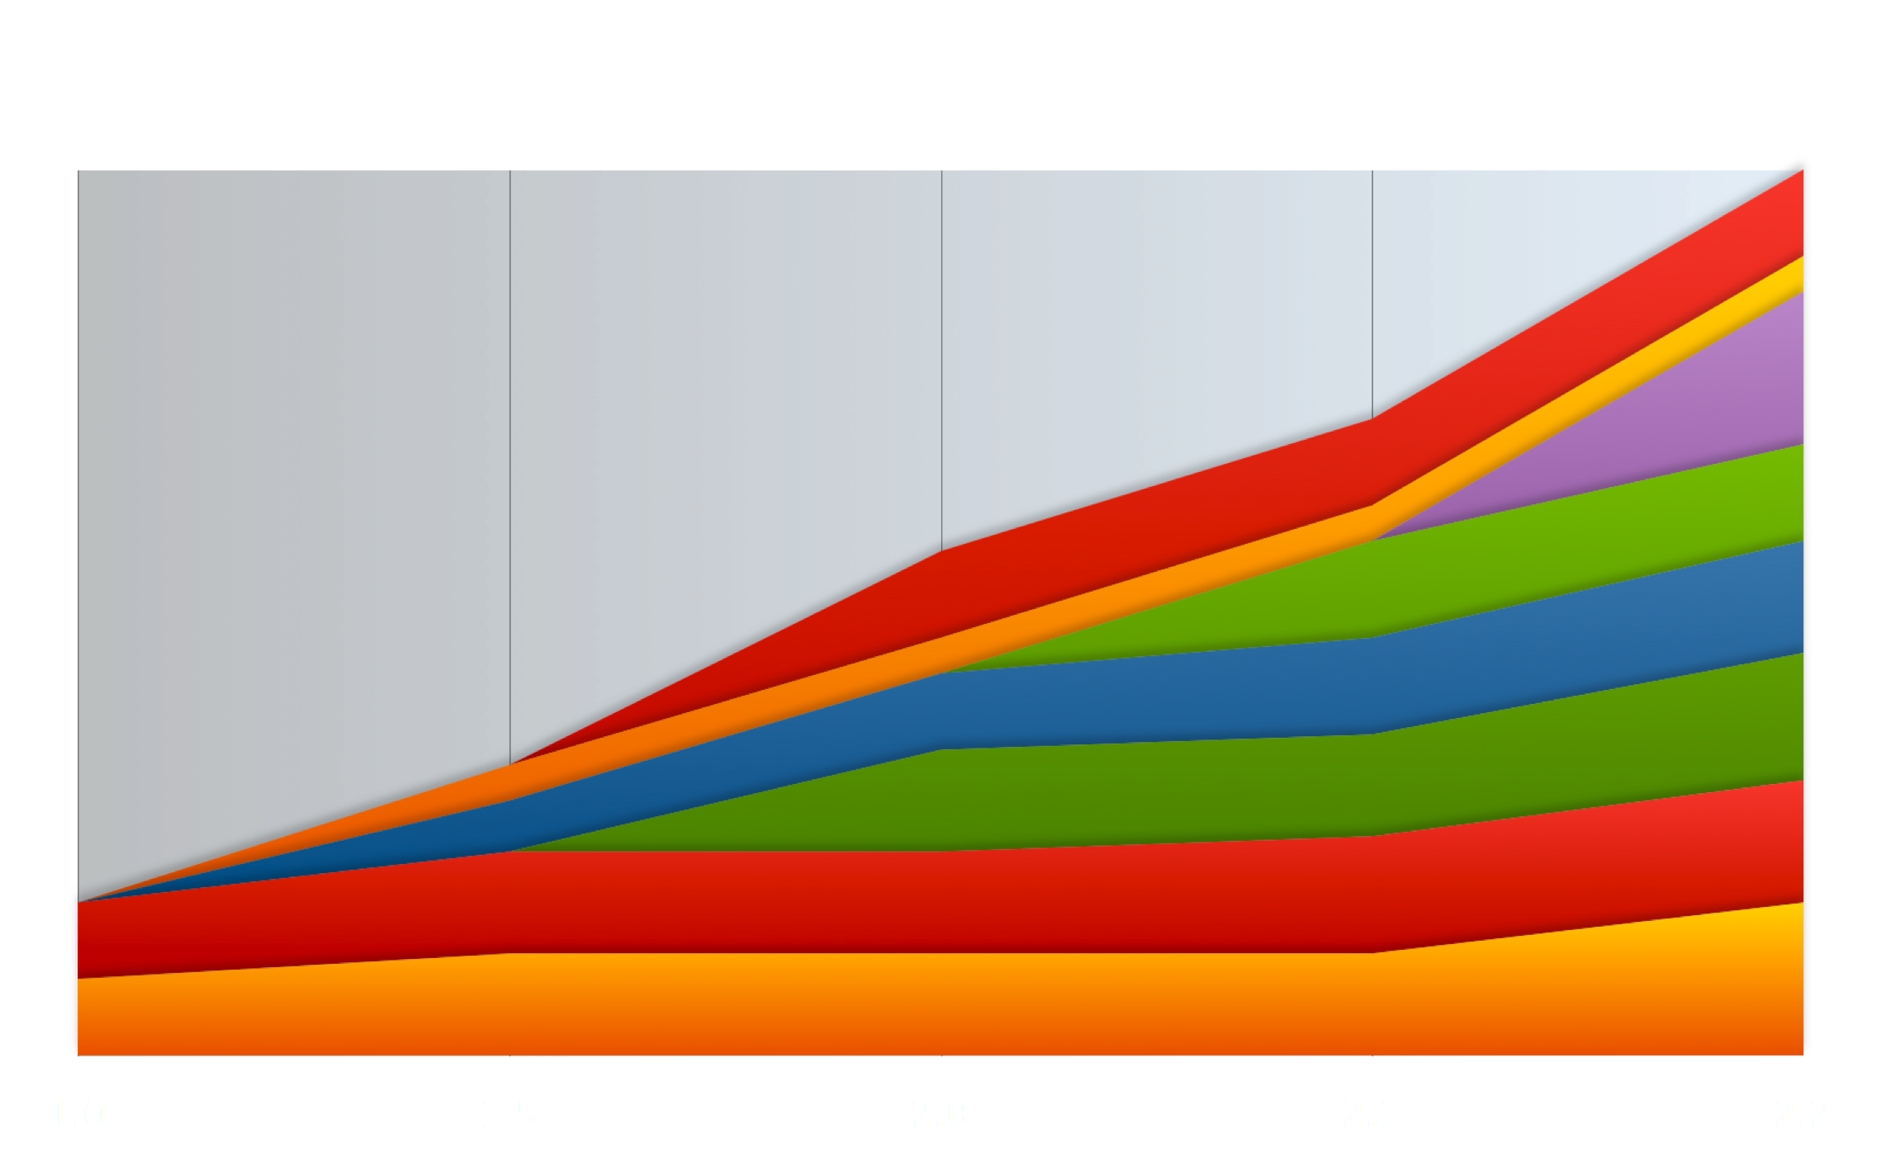
Sakai 2.2 - 880K lines of code
Framework | 234K
Michigan | 154K
Stanford | 152K
Indiana / OSP | 145K
Cambridge | 80K
Foothill | 80K
Berkeley | 35K
Portfolio
JForum
Wiki
Message
Modules
Syllabus
Roster
Test and Quizzes
Collaboration Suite
Framework
6/2006

Slide 19
Sakai 2.2 - Dates
2.2 Integration Week - 5/1/06
  Next integration week will be a “working meeting for Sakai senior developers”
2.2 is currently in QA on tag 2.2.0_003
  Impressive QA performance
2.2 Release - 06/15/06
  Might be a week or two late (sorry)
Notes:
Integration week is where we bring the key folks together for the release so we can work on the release with 100% focus and make and execute decisions quickly. Going forward we want this to be more inclusive - a “Sakai senior developers meeting” - architectural sticky bits often get worked through. Sometimes we work through things that need to be handled between now and the next release. Thinking about expanding what it is and how it works.

Slide 20
Source / Package Refactor
Package Renaming - End of “legacy”
Source refactor - more modular
Sakai Mini - minimalist distribution
Intended to enable “parallelism” within “framework” code

Slide 21
Provisional in 2.2
OSP - Indiana / rSmart
  Forms, Evaluations, Glossary, Matrices, Layout, Templates, Reports, Wizards
Search/Lucene - Cambridge
Samigo - Stanford
MessageCenter - Indiana
Postem - Indiana
Calendar - Penosa

Slide 22
Samigo - Provisional in 2.2
This was a community decision
Many fixes from 2.0 to 2.1.2
Increasing production use at IU, Rutgers, Foothill, and others - exposed deeper issues that may not be so quick to fix
Decided to stop thinking that the “ultimate fix” was a “week away”
Production stress was making things worse not better

Slide 23
Quiz and Test - Fall 2006
Rutgers, IU, and Foothill
  Evaluation almost complete - looking at PHP based testing system
  Rutgers has built a reusable proxy tool to ease the integration of external applications into Sakai
Samigo will continue to evolve and improve under Stanford’s leadership
  Need to increase the developer community - Contact Lydia Li
  Suggest that those sites that can, use Samigo with “friendly” users
  Avoid - “high stakes” testing situations

Slide 24
Samigo - Fall 2007
Hope to have a Samigo review late summer, early fall
  Bring Sakai senior tech leadership together
  Review Samigo
  Explore ways to get Samigo solid for Fall 2007
In the meantime…
  We need some performance testing done on Samigo
  If you can, begin looking at Samigo and developing an understanding of the code base so you can help

Slide 25
Important Contrib Work
Programmer’s Café - VA, UC Davis, Texas State
iTunesU - UM
IMS Tool Interoperability - Sakai
IMS Common Cartridge - Texas State
Proxy Tool - Rutgers

Slide 26
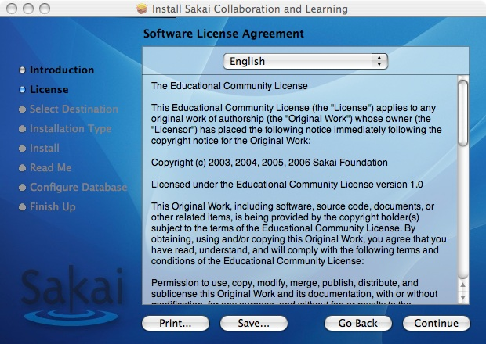
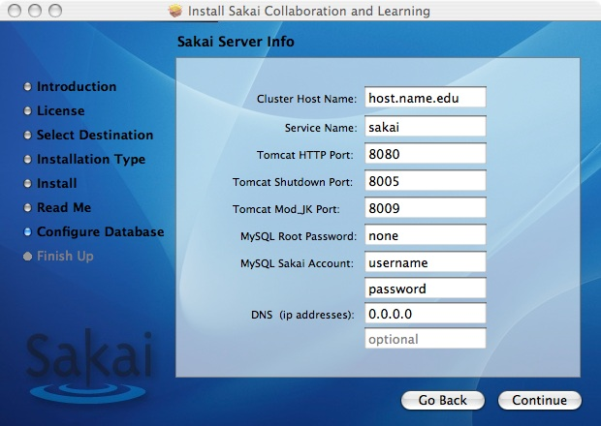
Simpler Installation

Slide 27
Maintenance Branches
Goals
  Want to be more conservative in maintenance branches - no DB changes
  Want to work on “next release” work earlier
Naming convention
  2-3-x (non-upwards/risky stuff for next release)
  trunk (low risk stuff - bug fixes, etc)
  2-2-x (production ready taken from trunk)
In 2.2 we can branch modules separately

Slide 28
Quick Questions
When do we allow the use of Java 1.5 -only constructs in code?
Should we change the next release schedule?
  Sakai 2.3 - November 1
  Sakai 2.4 - May 15

Slide 29
Production Approaches
Hang back a release unless you are really ready - not odd even - just n-1 or n-2
If you are conservative and yet want every new feature - create two production environments and let users choose - reduces internal risk (bugs and performance problems are isolated)
Require tech support involvement for use of provisional tools
Upgrade once per year

Slide 30
Wanted:Branch Managers
We need to find branch managers for 2.0, and 2.1
Branch managers should be from a site running the branch in production - so they eat their own dog food.
We should move toward a pattern where we support releases for at least 18 months after release.
We need to form sub-communities around each of these versions so they can help each other.

Slide 31
Going Forward

Slide 32
Short Term Radar (Summer)
Import/Export
Resource release dates
Jforum for Oracle
RSS
Course Management

Slide 33
Mid Term Radar (2.3)
OCW - EduCommons
SakaiBrary
More Search
OSP Portal
LON/CAPA
Hierarchy
SCORM
Melete 3.0
Students as a programming resource - VA Tech
Sakai RPM Install

Slide 34
On The Horizon
Null Portal
Lancaster tools - Whiteboard, Audio, Video, Screen share
LAMS
RDF / Data Modeling / Data Interoperability

Slide 35
Crazy Projects
Build a set of HTTPUnitTests for Sakai Functionality
Integrate JackRabbit's WebDav in Sakai
Add Pluto to Sakai (JSR-168 Support)
Extend the Sakai JSR-168 portlets to implement delegated security
Add Charon-like functionality to Sakai's WSRP Producer
Set of Joomla Utilities to gateway between Joomla and Sakai
Set of Plone Utilities to gateway between Plone and Sakai
Build a Working with Sakai in PHP kit
Build a Working with Sakai in Python Kit
Build a Working with Sakai in Ruby kit
A Sakai Portal that does HTTP Proxy (i.e. eliminates iFrames)
Build support for IMS Tool Interoperability Producer into Sakai
Build support for IMS Tool Interoperability Producer into Moodle
Build support for IMS Tool Interoperability Producer into ATutor
Build support for IMS Tool Interoperability Producer into Boddington
Work on the Sakai Apple Desktop
P.S. I need to make these Requirements and describe them better

Slide 36
Data Interoperability Needs
Going forward, Sakai needs to increasingly function as a component of a larger enterprise architecture along with many other applications. Each enterprise will evolve their mix of applications independently over time.
Notes:
In addition, there are some elements which still need to be completed.

Slide 37
Sakai Requirements Process
Gathers and prioritize use cases and refine design documents to set long-term strategy for the Sakai Product.
  Anyone can submit a requirement (using JIRA).
  Two phases of prioritization
    Community - wide (anyone)
    Sakai Member Representatives
  Sakai Staff (Project Coordinator) attempt to “match make” between high priority requirements and community developers
  Iterative Process - Once for each major Sakai release
    First round produced 385 requirements.

Slide 38
Sakai Requirements (Sample)
REQ-282 Users should have more information and control over site import
REQ-26 Emails Should Contain Site URL and Item URL
REQ-173 Chat should allow users to search for messages from a particular user
REQ-159 Graphical content in rich text editor
REQ-65 Email Archive should be deep-linkable/bookmarkable
REQ-375 Timed Release of documents/files in Resources tool
REQ-109 Search across site and sites
REQ-124 Add SCORM Player to Sakai
REQ-129 Support for Learning Design and other Work Flow Engines

Slide 39
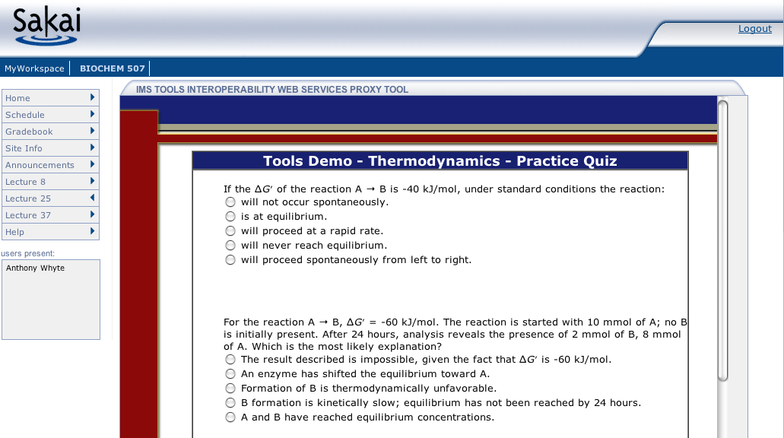
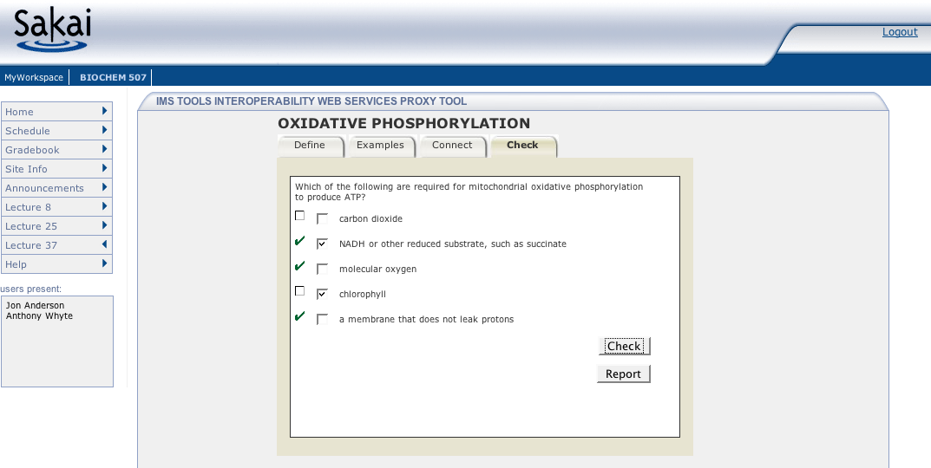
Sakai and Standards
Sakai needs to use its position and resources to influence ever richer standards so as to insure an ecology of many different collaboration and learning systems which are highly interoperable.
  JSR-168 Portlet / WSRP 1.0
  JSR-286 Portlet 2.0 / WSRP 2.0
  IMS Tool Interoperability
  IMS Common Cartridge

Slide 40
Sakai and Web 2.0
Web 2.0 is about making sure data is available in some form beyond just displayed in the Sakai Tool Set.
  Formats
    RSS
    Resource Description Framework (RDF)
    HTML
  Protocols
    RSS / getData / SOAP / REST
  Consuming Applications
    Portals
    Google
    delic.io.us

Slide 41

















Sakai Data Interoperability
Personal
Learning
Environment
Portal
Environment
LMS Systems
Authoring
Environment
Collaboaration
Environment
Content
Management
Enterprise
Directory
Data
Repository
... interoperability and data portability are key elements...
Student
Information
Notes:
One word people use for this is an “ecology”. An rich, nurturing supportive environment where stuff “grows”.
Mention SakaiBrary.

Slide 42

Sakai “Swiss Army Knife”
HTML
HTML
CalDav
RSS
Collaboration
and
Learning
Collaboration
and
Learning
SOAP
WebDav
SOAP
WebDav
iCal
SPARQL
Current Sakai
REST
Future Sakai

Slide 43
Sakai Integration Efforts
Repositories
  Read/Search - DR OSID / Sakaibrary
  Writable repositories / DR OSID / JSR 170
  Export / long-term archival - Fedora / DSpace
Learning Design - LAMS / CopperCore
Collaborative Learning Environments (IMS TI)
  Moodle / ATutor
  Blackboard / WebCT / Angel
Portals - JSR-168 portals / PHP based portals
Desktop - PLEX / VUE / Apple
RDF - Haystack / Piggybank / Welkin

Slide 44
Challenges
Continue to move quickly ahead while staying rock solid
Going Parallel - Scaling Development
Skilled people with free time
Documentation
Transformable, Accessible, and “Better looking”
Unit testing
Performance testing
Increase OSP community
Increase Samigo Community

Slide 45
End Part I

