Slide 1
Sakai / uPortal / JSR-286 BOF
Charles Severance

Slide 2
Questions
What do people want?
Who wants this so badly to work on it?

Slide 3
Easier Questions
How many would tolerate iFrames in the portal? Or would you just keep Sakai as a bookmark which pops up in a new window?
How many would use RSS do give a Dashboard view?
How many simply want “all of Sakai under a tab”?
How many want Sakai Tools as placeable channels?
How many want Tools contextualized in classes as placeable channels.

Slide 4
JSR-286
Events - also work across servers in WSRP - Best Effort
Bridges - Struts JSF, etc
Session Scoping
Better Portlet to servlet “connectivity”
Apache R.I. and Technology Kit will be provided
* Everything mentioned here is subject to change

Slide 5
Sakai - JSR-168
Beta Quality Portlets
  Web Services
  iFrames
  Delegated authentication

Slide 6
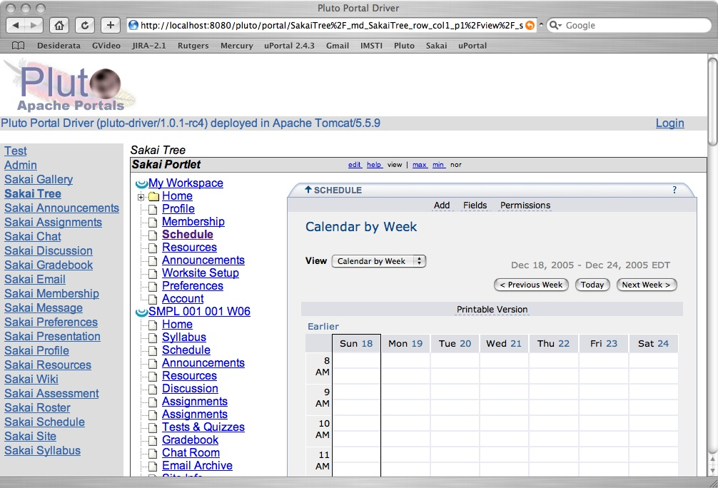
Sakai Tree View
Notes:
Note display is in Pluto - most portals display Portlet links across the top so in portals like uPortal and GridSphere, you won’t see two columns of buttons.

Slide 7
How Tree View Works
/portal/page/FF96
Charon
Portal
Sakai
uPortal, Pluto, or GridSphere
ToolList
Sakai
Portlet
Web Svcs
Login
Notes:
When the Portlet Starts, it puts up a login screen or auto-logs in depending on configuration. The login is done with a web service. Once the session is established, the site/tool list is retrieved and the portlet is displayed with the hierarchy displayed as a tree. As a page or tool are selected, the tree control places the iFrame with the Charon URL to the site into the iFrame. This iframe URL uses session based launch to bypass Sakai’s login process.

Slide 8
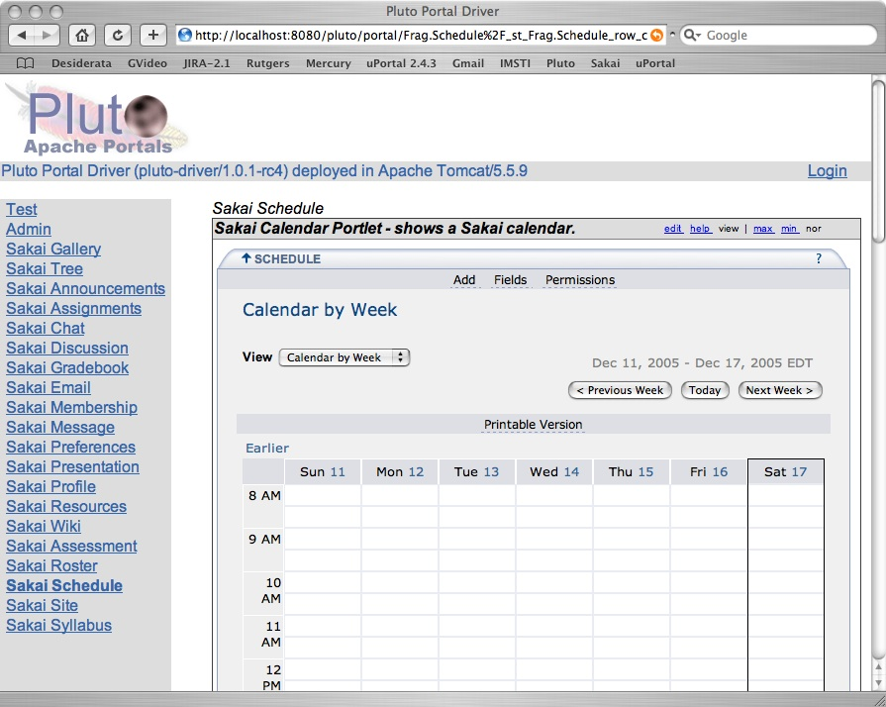
Sakai Proxy Tool

Slide 9
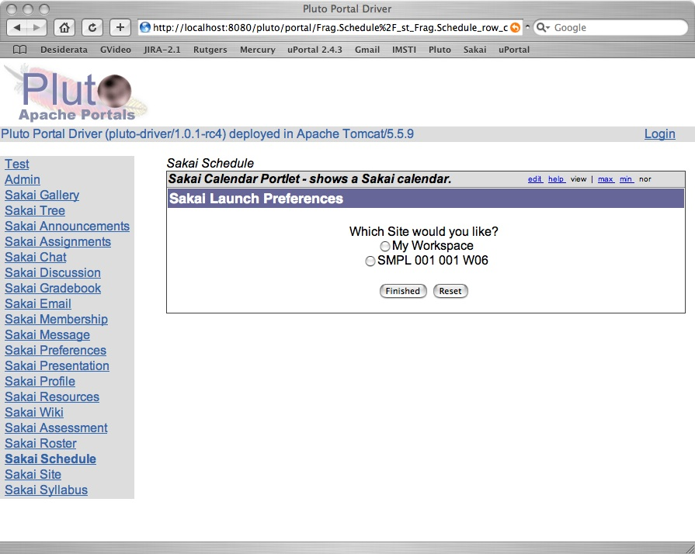
Proxy Tool Selection
Notes:
When there are more than one site with the calendar tool with in the Sakai server, the user is given the choice as to which Sakai calendar is to be displayed. This choice is saved in the user’s preferences. If there is only one calendar, this step is skipped and the user goes directly to the tool. This “only one placement scenario” happens for “My Workspace” tools like Preferences. So, the user never sees this step is skipped when placing the Preferences portlet.

Slide 10
Sakai WSRP
Alpha quality consumer from Daresbury
Alpha quality producer from SunGard
  Sakai has a “sakai.fragment” - indicates body only response, and delegated URLs
  Not all tools - velocity tools work best
  CSS is still Sakai’s CSS
  Provisioning is weak - must look at Sakai tool placement GUIDs and construct handles

Slide 11
High Level Architecture
WSRP Consumer
(uPortal)
Web Services
Apache WSRP4J
Portlet = Placement
Sakai WSRP
Provider
List Portlets
Tool ID
Mercury
Placements
Placement ID
Kernel Tool
Registry
Site
Placements
Get Markup
Request Filter
Tool A
Tool B
Tool C
URL Rewriting
Notes:
WSRP Portal was produced by Vishal Goenka of SunGard SCT over the past six months. It uses the kernel’s tool registry and tool dispatch just like every other portal. The Sakai WSRP portal satisfies the Apache WSRP4J producer API.

Slide 12
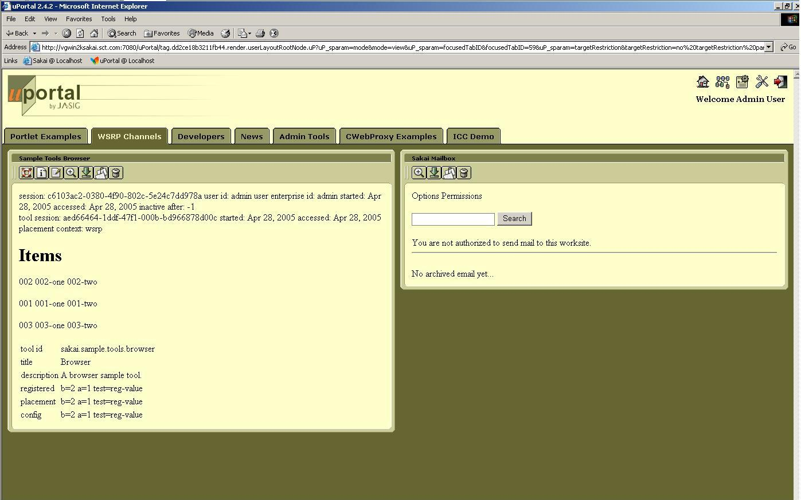
Sakai Tools in uPortal 2.4.2

Slide 13
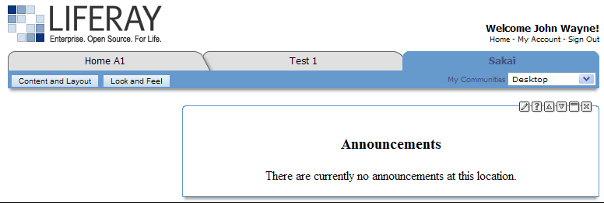
Announcement Tool (Mercury Context) in LIFERAY Portal
Thanks to Andrew Petro (Yale) for this Screen Shot

Slide 14
Sakai WSRP - Going Forward
Waited 1 year for community resource to step forward
UNISA will experiment with provisioning and productionizing WSRP with a simple scope.
Still want to do a replacement for Sakai’s internal Aggregator which is available at a well-known handle “/gallery”

Slide 15
WSRP Challenges
Getting CSS/Javascipt right - solve by putting Sakai CSS/Javascript into the portal HEAD
Eliminating iframes and working through issues when we do back/refresh differently
Performance re-tuning

Slide 16

















Sakai Data Interoperability
Personal
Learning
Environment
Portal
Environment
LMS Systems
Authoring
Environment
Collaboaration
Environment
Content
Management
Enterprise
Directory
Data
Repository
... interoperability and data portability are key elements...
Student
Information
Notes:
One word people use for this is an “ecology”. An rich, nurturing supportive environment where stuff “grows”.
Mention SakaiBrary.

Slide 17
Sakai and RSS
Sakai will likely add a number of RSS feeds for sites, tools, etc
User-contextualized
This can allow Sakai to be integrated into a wide range of applications including portals, browsers and desktop apps

Slide 18
Going Forward
We will use the Sakai Portal list for the UNISA development discussions
We will see where this goes - The community will lead here
UNISA will blaze a trail connecting uPortal and Sakai - but the work will not be done
  UNISA priority is to solve UNISA problems
Others will have to continue to evolve the work.
Lets keep an open mind to HiJacking the WSRP4J project in a branch

