Slide 1
Sakai and Portals
Charles Severance
Portals and Portlets Workshop
July 2006

Slide 2
State of Sakai in one Slide....
Sakai is used for Collaboration, Teaching, and Learning
Sakai Project started January 2004 (2.5 years old)
Non-profit Sakai Foundation October 2005
Open Source - 100% free - Apache License
Voluntary financial support from 90+ Higher Education, 15 companies, each paying $10,000 / year = $ 1M revenue
Six Sakai Foundation paid staff members
Over 200 installations of Sakai
Three full-scale installations > 50,000 users
Twenty+ installations with > 500 users (often pilot uses)
100+ people active in developing and testing Sakai releases

Slide 3
Outline
History
  Sakai and JSR-168
  Sakai and WSRP
  Sakai and JSR-168 (part 2)
Going Forward
  JSR-168 portlets
  WSRP / uPortal
  UNISA’s Work
  Sakai and RSS
  Sakai’s internal JSR-168
This is a moving target and it has been a challenge to find dedicated resources for this portal/portlet work
Notes:
This is three years of pain around the boundary between a large application (Sakai) and a portal. Lots of things did not work - some worked and we have learned a lot!
I am assuming two things - (a) you know something about portals and (b) you know something about Sakai. Aargh.

Slide 4
History - Sakai and JSR-168
What we hoped in 2003
  Sakai’s presentation layer *would* be JSR-168
  Using JSR-168 would make Sakai tools portable between JSR-168 compliant portal containers
  Sakai tools would just “be portlets” which would work in any portal
What happened
  As a standard, JSR-168 was just too small and basic to support Sakai’s requirements in critical areas
    Navigation
    Cross-portlet context
    Support for “services” that work across portlet
How we reacted
  Look into WSRP and see if we could solve the problems using two JVMs (one for the Portal and one for Sakai)
Notes:
Like many applications, navigation and layout is *part* of the application’s domain. In portlets, the purpose of the APIs is to separate container aspects from portlet aspects. SO it is impossible to use portlets as the natural unit of expansion.
We did not even “try” to rewrite Sakai using portlets as the primary component expansion.

Slide 5
History - Sakai and WSRP 1.0
What we hoped
  By separating the problem into two JVMs across WSRP Sakai could provide our tools all the support we needed and just move markup back and forth.
What happened
  We built a tightly integrated WSRP producer in Sakai 2.1
  WSRP provisioning is very poor - does not meet user requirements - perhaps this is just a limitation of how portal writers architect simple WSRP consumers - but it is reality
  WSRP interoperability is poor between containers
  Dual provisioning does not make administrators happy
How we reacted
  Wrote the JSR-168 Sakai proxy portlets

Slide 6
Sakai WSRP
Alpha quality consumer from Daresbury
Alpha quality producer from SunGard
  Sakai has a “sakai.fragment” - indicates body only response, and delegated URLs
  Not all tools - velocity tools work best
  CSS is still Sakai’s CSS
  Provisioning is weak - must look at Sakai tool placement GUIDs and construct handles

Slide 7
High Level Architecture
WSRP Consumer
(uPortal)
Web Services
Apache WSRP4J
Portlet = Placement
Sakai WSRP
Provider
List Portlets
Tool ID
Mercury
Placements
Placement ID
Kernel Tool
Registry
Site
Placements
Get Markup
Request Filter
Tool A
Tool B
Tool C
URL Rewriting
Notes:
WSRP Portal was produced by Vishal Goenka of SunGard SCT over the past six months. It uses the kernel’s tool registry and tool dispatch just like every other portal. The Sakai WSRP portal satisfies the Apache WSRP4J producer API.

Slide 8
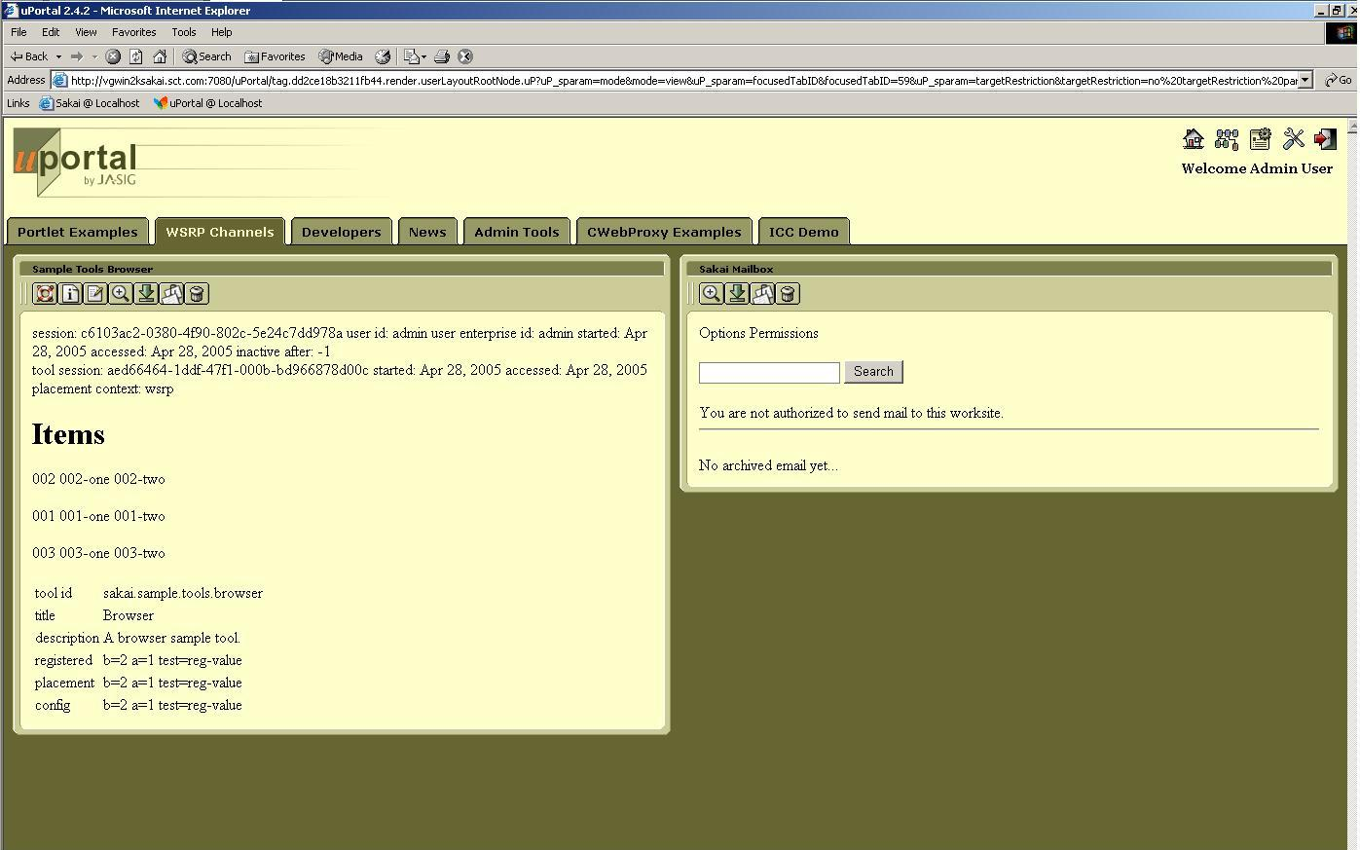
Sakai Tools in uPortal 2.4.2

Slide 9
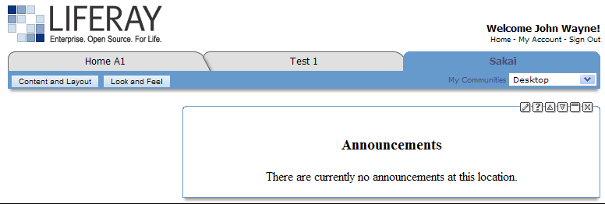
Announcement Tool (Mercury Context) in LIFERAY Portal
Thanks to Andrew Petro (Yale) for this Screen Shot

Slide 10
History - Sakai and 168 (v2)
What we hoped
  Provide a simple, basic capability that was totally portable for people to use as long as they accepted the shortcomings (iframes)
What happened
  Using web services and iframes these portlets worked very simply and pretty well and were pretty portable
  Some uptake - but iframes still limited user satisfaction
  Used in OGCE
Where we are at
  Reasonable portlets - need to be improved

Slide 11
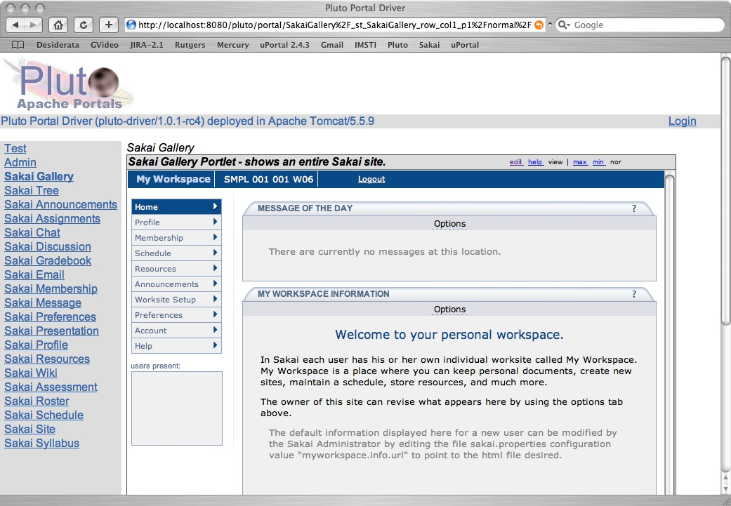
Sakai Gallery View
Notes:
Note display is in Pluto - most portals display Portlet links across the top so in portals like uPortal and GridSphere, you won’t see two columns of buttons.

Slide 12
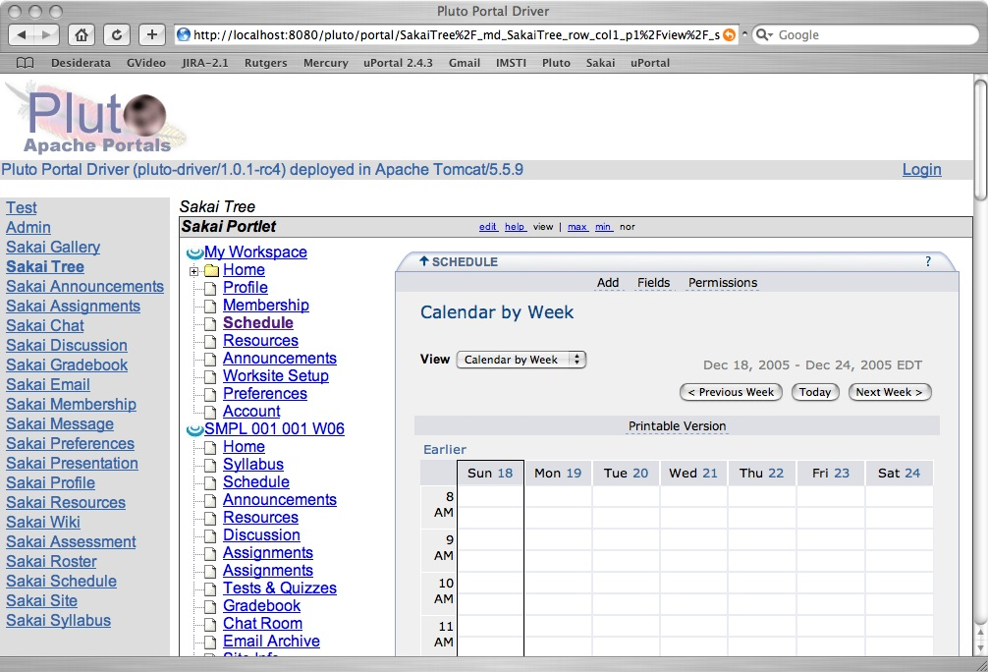
Sakai Tree View
Notes:
Note display is in Pluto - most portals display Portlet links across the top so in portals like uPortal and GridSphere, you won’t see two columns of buttons.

Slide 13
How Tree View Works
/portal/page/FF96
Charon
Portal
Sakai
uPortal, Pluto, or GridSphere
ToolList
Sakai
Portlet
Web Svcs
Login
Notes:
When the Portlet Starts, it puts up a login screen or auto-logs in depending on configuration. The login is done with a web service. Once the session is established, the site/tool list is retrieved and the portlet is displayed with the hierarchy displayed as a tree. As a page or tool are selected, the tree control places the iFrame with the Charon URL to the site into the iFrame. This iframe URL uses session based launch to bypass Sakai’s login process.

Slide 14
SakaiSite.getToolsDom
<sites>
<portal>http://localhost:8080/portal</portal>
<server>http://localhost:8080</server>
<gallery>http://localhost:8080/gallery</gallery>
<site>
<title>My Workspace</title>
<id>~csev</id>
<url>http://localhost:8080/portal/worksite/~csev</url>
<pages>
<page>
<id>af54f077-42d8-4922-80e3-59c158af2a9a</id>
<title>Home</title>
<url>http://localhost:8080/portal/page/af54f077-42d8-4922-80e3-59c158af2a9a</url>
<tools>
<tool>
<id>b7b19ad1-9053-4826-00f0-3a964cd20f77</id>
<title>Message of the Day</title>
<toolid>sakai.motd</toolid>
<url>http://localhost:8080/portal/tool/b7b19ad1-9053-4826-00f0-3a964cd20f77</url>
</tool>
<tool>
<id>85971b6b-e74e-40eb-80cb-93058368813c</id>
<title>My Workspace Information</title>
<toolid>sakai.iframe.myworkspace</toolid>
<url>http://localhost:8080/portal/tool/85971b6b-e74e-40eb-80cb-93058368813c</url>
</tool>
</tools>
</page>
</pages>
</site>
</sites>
New WS method is upwards compatible with getSitesDom

Slide 15
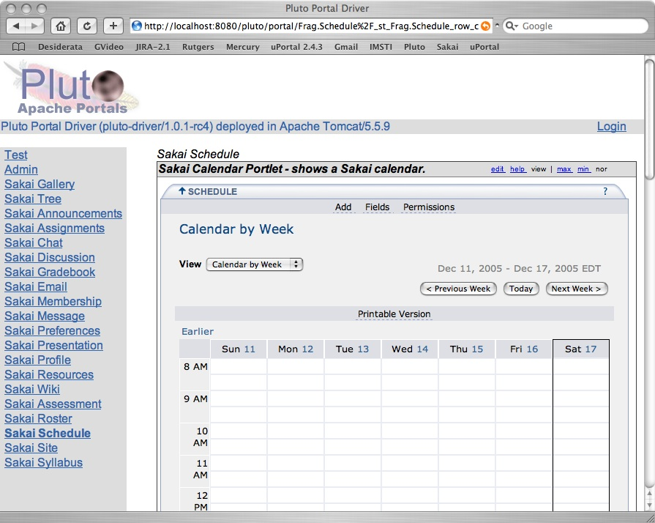
Sakai Proxy Tool

Slide 16
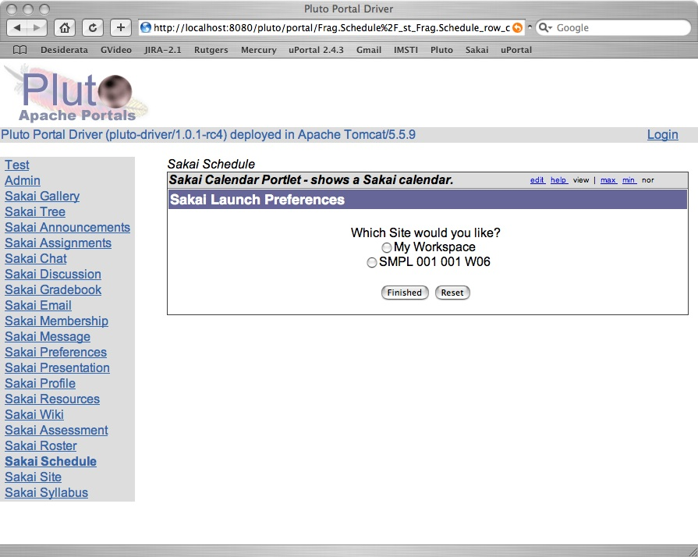
Proxy Tool Selection
Notes:
When there are more than one site with the calendar tool with in the Sakai server, the user is given the choice as to which Sakai calendar is to be displayed. This choice is saved in the user’s preferences. If there is only one calendar, this step is skipped and the user goes directly to the tool. This “only one placement scenario” happens for “My Workspace” tools like Preferences. So, the user never sees this step is skipped when placing the Preferences portlet.

Slide 17
How Proxy Portlet Works
/portal/page/FF96
Charon
Portal
2
Sakai
uPortal, Pluto, or GridSphere
SiteList
Sakai
Portlet
Web Svcs
1
Login
Notes:
This portlet logs in like any other version of the Sakai portlet. It knows that it is a “sakai.calendar”. It retrieves the entire list of sites, pages, and tools, and searches for sakai.calendar placements. If it finds 2 or more placements, it puts up a selection dialog (1) - the user chooses which placement they are interested in, and then that tool placement is displayed (2). The placement is also put in the user’s preferences so the next time the tool comes right up, bypassing the selection.

Slide 18
Future Plans
Explore Sakai and RSS
Improve JSR-168 Portlets
Improve WSRP / uPortal
Review UNISA Portal Integration Plans
Support JSR-168 within Sakai
All of this depends on volunteer resources

Slide 19

















Sakai Data Interoperability
Personal
Learning
Environment
Portal
Environment
LMS Systems
Authoring
Environment
Collaboaration
Environment
Content
Management
Enterprise
Directory
Data
Repository
... interoperability and data portability are key elements...
Student
Information
Notes:
One word people use for this is an “ecology”. An rich, nurturing supportive environment where stuff “grows”.
Mention SakaiBrary.

Slide 20
Sakai and RSS
Sakai will likely add a number of RSS feeds for sites, tools, etc
User-contextualized
This can allow Sakai to be integrated into a wide range of applications including portals, browsers and desktop apps

Slide 21
Future - Sakai 168 Portlets
Improve use of iFrames so tools look as good when shown as Portlets look as good as good as when they are shown in Sakai - need auto frame resize
Add coordinated AuthZ for proxy portlets so that Sakai “trusts” the AUTHZ in the portal - no standard for isUserInRole :(
Allow direct placement of Sakai portlets in new contexts with AuthZ controlled by the Portal (again non-standard)
(really tough) get rid of iFrames through a proxy layer to rewrite URLs

Slide 22
Future - Sakai WSRP Producer
Build WSRP handle “/portal” that produces the Sakai portal view in WSRP markup
  Initially use iframes for the tool area
  Later eliminate iFrames
Improve tool placement support - allow the separate placement and provisioning of new tools via WSRP.

Slide 23
Sakai WSRP - Going Forward
Waited 1 year for community resource to step forward
UNISA will experiment with provisioning and productionizing WSRP with a simple scope.
Still want to do a replacement for Sakai’s internal Aggregator which is available at a well-known handle “/gallery”

Slide 24
WSRP Challenges
Getting CSS/Javascipt right - solve by putting Sakai CSS/Javascript into the portal HEAD
Eliminating iframes and working through issues when we do back/refresh differently
Performance re-tuning

Slide 25
WSRP - UNISA Version
UNISA will be replacing Sakai’s portal with uPortal by January
Will try to use WSRP - if this is too hard they will fall back to a web proxy mechanism.
The basic idea
  Provision from the SIS system into GAPs in uPortal
  Build providers in Sakai that pull from GAPs
  Build a WSRP handle convention that encodes the “placement” in the handle
  Augment Sakai’s WSRP producer to auto-provision sites and tools transparently when a new handle is encountered
UNISA can constrain scope to insure on-time delivery

Slide 26
uPortal Sakai at UNISA
uPortal
WSRP Consumer
?site=COS101-06-Y1&page=Mesage+of+the+Day&tool=sakai.motd
GAPS
Authentication
& Group Access Control
WSRP
User, Site, Page, Tool
as parameters
Web Services
Sakai
Tool
Produces a Fragment
WSRP Producer
Creates sites, pages, tools on the fly if they don't exist
Dispatch
Respond
API's
Providers
Written specifically
for uPortal
Notes:
This will produce a point solution that we can generalize. This will put WSRP into production - which will strengthen both Sakai and uPortal’s WS WSRP code.

Slide 27
UNISA Effect
Upsides
  If all goes well - WSRP will be deployed in large-scale production with a lot of developer eyes on both the uPortal 2.5 WSRP Consumer and Sakai 2.x WSRP producer
Weaknesses
  UNISA’s limited scope will not produce a universal solution - but it will move us to the point where iterative improvement will be possible
Risks
  UNISA decides WSRP is too hard so just writes their own proxy tool which uses web services and ends up with a purely point solution that is unreusable.

Slide 28
JSR-168 Support in Sakai
Since Sakai’s API and tool environment are a superset of JSR-168, it *should* be simple
Pluto 1.1 was written to be “embedded” - instead of building “one portal”, make it so that many applications can support portlets

Slide 29
Use Cases for Sakai-168
Prepare a Pluto-style portlet war file and drop it into Sakai as a webapp
Sakai finds the portlets in the web app and auto-registers them as tools
Users simply use Sakai’s Site Info tool to place portlets like any other Sakai tool
Portlets can be stealthable just like Sakai tools
It will be possible to use any Sakai API within a JSR-168 Portlet
Sakai will provide a JSR-168 complaint CSS so that portlets have the same look and feel as Sakai tools
Will work with all Sakai aggregators (Charon, OSP, Mercury …)

Slide 30
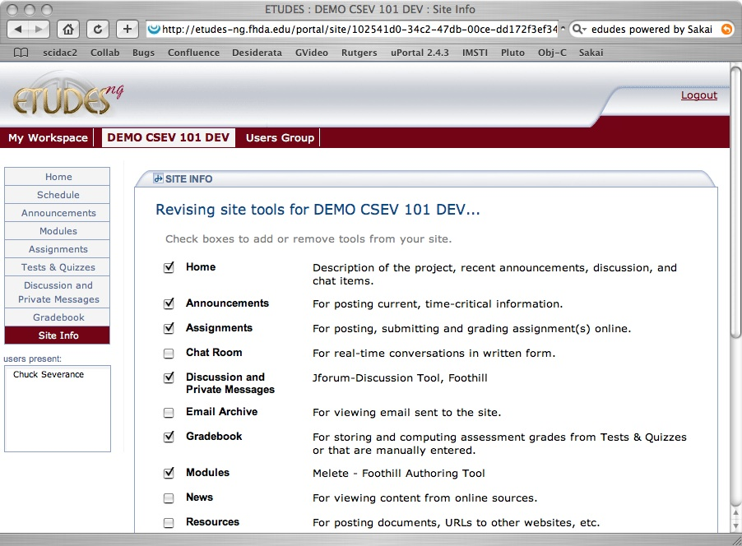
Number Guess
A sample JSR-168 portlet which is a game to guess numbers
TestSuite1
JSR-168 Conformance Test Portlets

Slide 31
Major Components of Sakai-168
Implementing the PortletServlet to map between the needs of the Sakai Aggregator and Portlet
Implementing the interfaces for persistence and portlet data structures

Slide 32
Sakai-168 Initialization
War preparation
  Using Sakai specific implementation for PortletServlet in shared/lib, we plan to transparently support Pluto’s war conventions.
  Developers can use Pluto’s ant target or other Pluto-provided mechanisms to prepare their war files.
Portlet registration
  Prefer a completely automatic auto-registration mechanism - perhaps PortletServlet can do this or perhaps some system-wide startup process
  PortletID (test.TestSuite2) is fine as ToolID (equivalent to sakai.chat)
Notes:
Note - there is no need to notify a portlet when it is placed. It just sees the first request when it sees it.

Slide 33
Initialization
webapps/testsuite
<servlet>
<servlet-name>TestPortlet1</servlet-name>
<display-name>TestPortlet1Wrapper (Pluto Invoker)</display-name>
<description>Auto Generated Portlet Invoker Servlet</description>
<servlet-class>org.apache.pluto.core.PortletServlet</servlet-class>
<init-param>
<param-name>portlet-class</param-name>
<param-value>
org.apache.pluto.portalImpl.portlet.TestPortlet
</param-value>
</init-param>
<init-param>
<param-name>portlet-guid</param-name>
<param-value>testsuite.TestPortlet1</param-value>
</init-param>
</servlet>
<servlet-mapping>
<servlet-name>TestPortlet1</servlet-name>
<url-pattern>/TestPortlet1/*</url-pattern>
</servlet-mapping>
<portlet>
<description>TestSuiteDescription</description>
<portlet-name>TestPortlet1</portlet-name>
<display-name>Test Portlet #1</display-name>
<portlet-class>
org.apache.pluto.portalImpl.portlet.TestPortlet
</portlet-class>
<supports>
<mime-type>text/html</mime-type>
<portlet-mode>VIEW</portlet-mode>
<portlet-mode>EDIT</portlet-mode>
<portlet-mode>HELP</portlet-mode>
</supports>
<portlet-info>
<title>Test Portlet #1</title>
<short-title>Test #1</short-title>
<keywords>Testing</keywords>
</portlet-info>
</portlet>
The implementation for PortletServlet is a Sakai-specific implementation and is placed in shared/lib for all portlets to use. As each servlet instance starts up, it registers the portlet as a Sakai Tool using the portlet-guid as the Sakai Tool id.
This servlet will combine the registration functionality of org.sakaiproject.util.ToolListener and the request processing functionality of org.sakaiproject.util.RequestFilter and the portlet lifecycle support functionality of the original PortletServlet.
Notes:
How does auto registration happen? How does it *know* when WAR expansion is complete for a particular war? Will this be a listener in the portal?
Note - a listener would be simpler but would require changing the war file - which we want to avoid - of course since we “own” the PortalServlet implementation it makes it easier, I think. Just do it as part of the servlet startup. Glenn - will this work?
Just as a note, we cannot have the pluto *portal* in the same JVM as it will want its own PortletServet implementation in shared.

Slide 34
Sakai-168 Run-Time Issues
Portlet Instance ID
  Instance ID will be same as Sakai Tool placement ID
Portlet Preferences
  Scoped to Sakai Tool Placement and stored as namespaced properties as part of the Sakai tool placement
Portlet Session
  Must be shared with Servlets which run after portlet
Remote User
  Sakai Enterprise ID is already in remote user
isUserInRole
  Initially backed directly as a Sakai AuthZ call
  May need some “special” ones or perhaps even add permissions
PortletRequest.USER_INFO
  user.name, user.name.given, user.namefamily, user.home-info.online.email, user.name.full
EncodeUrl
  Already used across Sakai - both for fragment style requests and foll page requests
Notes:
May need as plan B to scope portlet properties per placement - per user - will require a new store. Note to self - check with Jetspeed as to how prefs are scoped - may need to follow Jetspeed.
IsUserInRole will be a long running fun set of questions. This will depend on the portlets we encounter.

Slide 35
Sakai-168 Markup Cycle
Sakai PortletServlet dispatcher
  Will perform the request filter functions
  Will do redirect between action and render to support book marking
  Will handle the request parameter values placed by Charon properly
  Supports both fragment approaches
    Normal markup with servlet will generating the head material
    Fragment request to support the Sakai WSRP producer
Notes:
Question - Does the portal do the redirect?

Slide 36
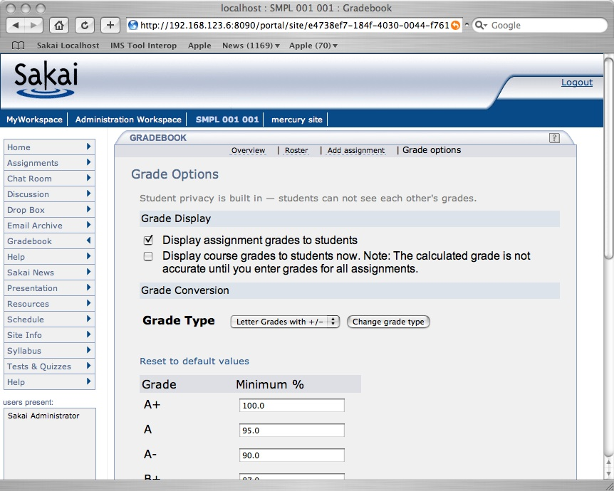
Full
Page Markup Cycle
Browser
Sakai Aggregator (Charon)
In the normal Sakai markup case, the PortletServlet will generate a full page with head, etc as directed by the Sakai Aggregator.
In this variant, PortletServlet will be a little “mini portal”.
webapp
org.apache.pluto.core.PortletServlet
Portlet
Code
Helper
Servlet
Notes:
Who insures that the portlet can forward to servlets with context intact? Tomcat? Or PortletServlet? DO we have to make that work in some particular way so that session is properly passed between Portlet and Servlet?

Slide 37
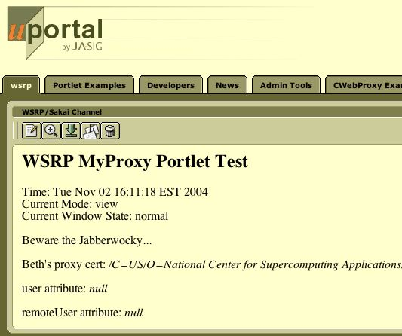
Fragment Markup Cycle
WSRP Consumer
Sakai WSRP Producer
When Sakai’s WSRP Producer is making the request (indicated by sakai.fragment), the PortletServlet is operating more naturally, returning a fragment, with URLs encoded using WSRP Producer’s wrapped request object’s EncodeURL() method.
webapp
org.apache.pluto.core.PortletServlet
Portlet
Code
Helper
Servlet
Notes:
Who insures that the portlet can forward to servlets with context intact? Tomcat? Or PortletServlet?
WSRP producer sends in a wrapped request - this is how WSRP gets a chance to touch EncodeURL - see tool/tool-util/servlet/src/java/org/sakaiproject/util/RequestFilter.java line 390

Slide 38
Sakai-168 Plans
Working with David DeWolf who is the designer of the embedded version of Pluto 1.1 to have him do the Sakai integration
Have had initial scoping meetings - things are moving forward

Slide 39
Summary
There is no magic bullet here - Standards focus on the simplest use cases
Sakai has moved from trying to use standards to do *everything* to finding the right uses for standards within the Sakai context
Lets keep an open mind to HiJacking the WSRP4J project in an Apache branch - Sakai would be happy to incubate this
JSR 286/WSRP 2.0 will not change where these standards “fit” in our architectures - they will just do a better job than JSR168/WSRP1.0
Notes:
Instead of feeling “constrained/bound” by the standards in Sakai - we are taking a very vendor like approach (like Liferay, Oracle, BEA, etc) - we need to support and use standards as integration points but not use the standards *as* our internal architecture.
The key is that for these standards to truly evolve the right way - we must first find real use of them in their current form and put that in production and in front of end users to evolve the real use cases.

