Slide 1
"Campus IT Solutions: Commercial Applications or Open Source?"
Dr. Charles Severance
Executive Director
Sakai Foundation

Slide 2
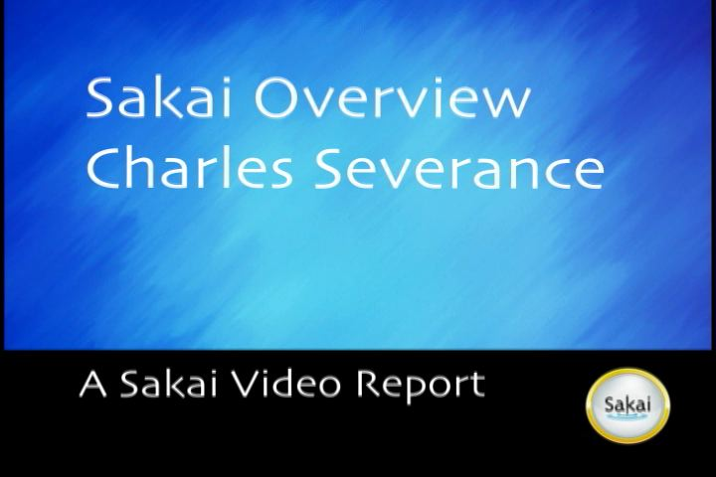
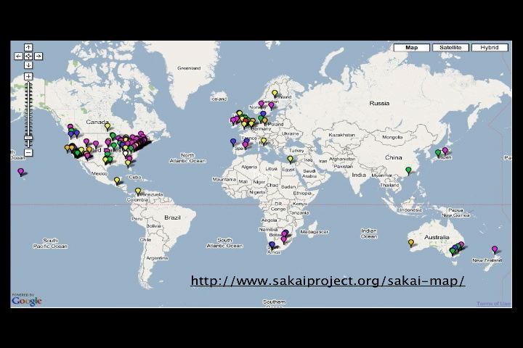
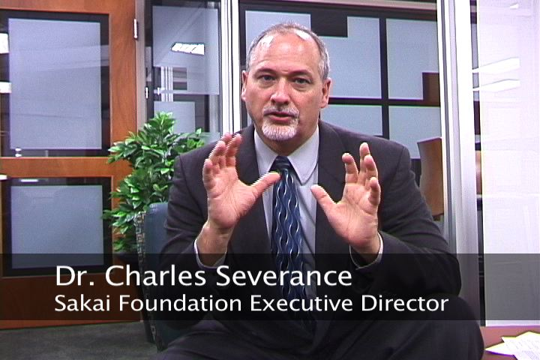
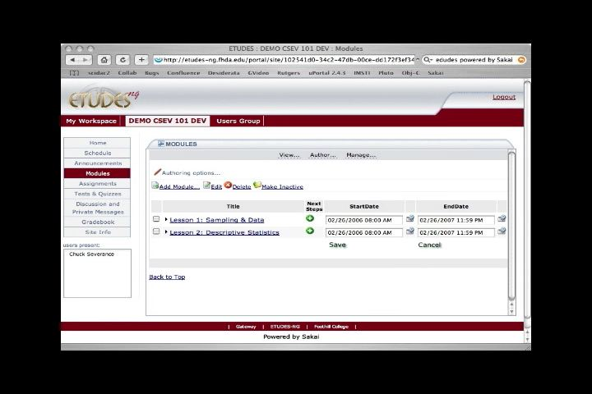
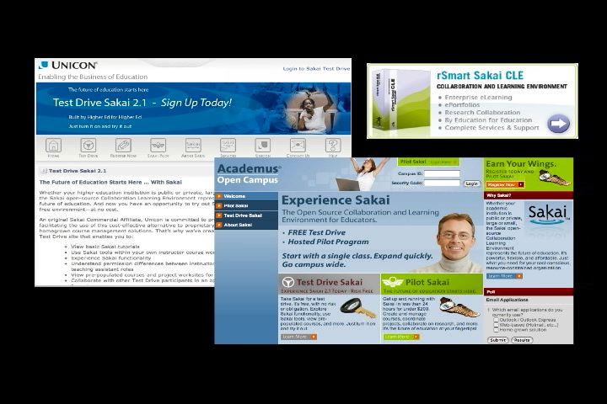
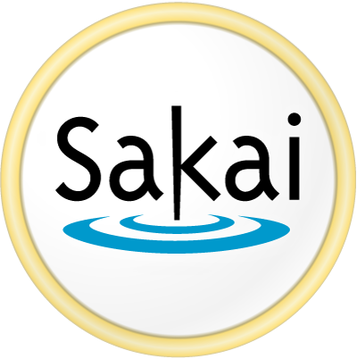
Sakai Overview
Sakai is used for Collaboration, Teaching, and Learning
Sakai Project started January 2004 (2.5 years old)
Non-profit Sakai Foundation January 2006
Open Source - 100% free - Apache License
Voluntary financial support from 100+ Higher Education, 15 companies, each paying $10,000 / year = $ 1M revenue
Executive Director for the Foundation and six paid staff members
100+ people active in developing and testing Sakai releases
Nifty Web site www.sakaiproject.org
Sakai Community Google Map Mashup
Very cool “Sakai Overview” (10 minutes)

Slide 3
It is not as simple as “Commercial versus Open Source”
Really three independent questions:
Who is developing the software?
Can *you* join the group? Can you monitor the group?
Is the “group” simply “employees of company X”?
Is there a management team that assigns you tasks?
Can you have the source code, retain, and modify it?
Yes (Guaranteed by license) / No / Maybe (Vendor Choice)
Did you have to pay for the product?
Yes / No / Either (User Choice) / Maybe (Vendor Choice)

Slide 4
Product | Community | Source | Cost
Linux | Open | Yes (GPL) | Free
Moodle | Open | Yes (GPL) | Free
Apache | Open | Yes (Apache) | Free
Sakai | Open | Yes (BSD-Like) | Free
MySql | Managed | Yes (GPL) | User Choice
Moodle Partners | Managed | Yes (GPL) | Vendor Choice
Sakai Partners | Managed | Vendor Choice | Vendor Choice
Apache Adopter | Managed | Vendor Choice | Vendor Choice
Red Hat (Linux) | Managed | Yes (GPL) | Pay
WebSphere | Managed | No (Prop) | User Choice
Blackboard | Managed | No (Prop) | Pay
Free Open Source Software

Slide 5











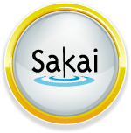

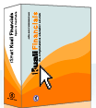
There are many different business models at work here.
Managed Community Open
Free Cost Pay
Yes Source Code No
No Source Code Yes
Free Cost Pay
Free Open
Source Software
Managed Community Open
Notes:
Think of this as “Who does the work”, “Can you get, modify, and retain the source code”, “how much does it cost”

Slide 6



Open Commercial is cooperation between FOSS and commercial in a myriad of models.
Note: The IBM and Oracle placements on this figure do not represent plans or products. They are just shown as possibilities.
o Agree to License
o Disagree
[Submit] [Cancel]
No Source Code Yes
Managed
Community
Open
Free Cost Pay
Free Open Source Software
Notes:
Sakai’s business plan is kind of “all of the above”/ It is pretty complex. We emulate Apache which supports any and all business models with the reuse of their software.

Slide 7
Open Commercial is cooperation between FOSS and commercial in a myriad of models.
Note: The IBM and Oracle placements on this figure do not represent plans or products. They are just shown as possibilities allowed by software license
Note: Sakai, Moodle and Kuali Partners have a choice as to whether their value-added software is Pay or Free.
No Source Code Yes
Managed
Community
Open
Free Cost Pay
Free Open Source Software
Notes:
Sakai’s business plan is kind of “all of the above”/ It is pretty complex. We emulate Apache which supports any and all business models with the reuse of their software.

Slide 8
Moving Up the stack
Brian Behlendorf of the Apache Foundation on the evolution of the OS Model…
Skeptics of the OS model would say…
… sure it works for simple utilities … but it’ll never work for a compiler…
… ok, it works for compilers… but it’ll never work for a web server…
… ok, it works for a web server… but it’ll never work for an operating system…
… ok, it works for operating systems… but it’ll never work for an end user application…
The fact is the OS model has been applied to software of steadily increasing complexity…
  … there’s no reason to believe this trend will stop…
  Linux is #2 to MS Windows… growing at a rate of 3x Windows in the enterprise server mkt.
  Apache web server dominates with 2/3 mkt share.
  MySQL claims 1/3 of the database mkt—just below Oracle and Microsoft
  Mozilla Firefox browser is #2 to Microsoft with a steadily growing share. (currently 10%)

Slide 9
Why do organizations pay for Proprietary?
Not because they are forced…
Proprietary software has better “fit and polish”.
Mac OS/X versus Linux
Microsoft Office versus Open Office
Proprietary software has good documentation and training.
Because there is “Value for Money”
Sometimes it is inertia or lack of suitable alternatives :(
Notes:
Two kinds of lock in. (1) Satisfied and very happy. (2)Some other reason.

Slide 10
Why do organizations want free software that comes with source code?
Agility - Ability to react to new user requirements
Flexibility - The option to never upgrade their software
Reliability - Ability to diagnose and solve problems locally on their own timescale
Cost Management - Ability to make the decision when to invest more or less in their software
Cost Management - Especially for large organizations - per seat licensing can be very expensive.

Slide 11
Why are *some* organizations eager to join Community Source and Open Source efforts?
Because they are *tired* of reapplying their customizations for each successive release - especially when lots of their customizations are just good ideas or features that are not in the product.
When they want to be able to materially participate in the direction of the software.
Because they want to break the upgrade cycle where the vendor can “schedule” when the whole market is forced to upgrade.
When they want (and can afford) to spend their money developing their *own* staff’s talent rather than out sourcing it all.
Because they realize just how much of their IT infrastructure is based on openly developed technology and they want to “give something back”
Community Source - Much of the interest, investment and resources are from institutions running the software in production

Slide 12
What are the claimed risks of non-Proprietary software?
The sense of “local responsibility” with “no one to call”
No one to “blame” or hide behind or “sue”
Uncertain Quality Assurance
Uncertain Release Cycles
How will my feature get into a release?
Is this a toy or real Enterprise Application - Will it scale?
How will this be sustained for the long-term?
Weak fit and polish
Weak documentation
Notes:
How often do universities sue their vendors?

Slide 13
Sakai - Addressing the risks - up front
Sakai Partners - Commercial organizations who stand behind the Sakai product and provide “someone to call”
Sakai Foundation - Supported by Voluntary contributions ($1M / year) - provides coordination role across the volunteer developer team. Provides single point of contact for release and QA schedule and long term direction and sustainability for the project. Since all bugs, testing, and QA are 100% transparent - you can form your *own* opinion about the product’s quality.
Community Development Approach - Many developers support large-scale production systems and included performance and scaling in the development / deployment cycle for every release. Community QA volunteers - 2050 hours for the last release.
Fit and Polish and Documentation - These are still a challenge - we hope to address these when we can “catch up” on essential development tasks.

Slide 14
Sakai Governance - Checks and Balances
Often the developers, partners, and adopters are the same organization. This shortens communication path
for new requirements
and needs.
Sakai
Foundation
Money
Product
Coordination
Sakai
Partners
Volunteer
Developers
Requirements
Releases
Adopters
Users
Notes:
Open source when there is a complex user interface is more complex than building basic infrastructure. Sakai has governance in place to insure that *all* of the important stakeholders are represented including the developers, system administrators, end users, academic partners, and commercial partners. Setting priorities across the needs of these stakeholders is very complex. Checks and balances insure that all stakeholders have a voice and that no single stakeholder (including the Foundation) has excessive influence. All of the stakeholders are interdependent - in community source, everyone is at risk to one degree or another and has to respect the needs of the other stakeholders and understand the “needs of the many”.

Slide 15
The most important issue of all - choice
With investment in interoperability and standards and a diversity in the market place, we can mix and match without vendor lock in.
Microsoft Office or Open Office
Windows or Mac OS/X or Linux
When there is interoperability and choice - proprietary products must compete on delivered value rather than lock in. When proprietary vendors allow their users a choice - it drives the vendor’s internal focus towards delivering value in a competitive environment rather than trying to eliminate competition.
When there is interoperability and standards across proprietary and openly developed software, users quite often strongly prefer proprietary solutions because of the resulting delivered value from the proprietary vendors.
Notes:
Having competition is *motivating* for an organization.

Slide 16
Summary
There are three dimensions of the market - community structure, source code license,and cost
To be successful - especially in user-facing applications increasing governance is required as well as hybrid models blending open source and commercial approaches.
Even within “Open Commercial” there are a number of business models being explored.
Ultimately the choice of open or proprietary depends on a careful analysis of an organization’s needs - one size does not fit all. For some applications you simply want a “product” and other times you want a “path”

