Slide 1
Sakai JSR-168 Approach
Charles Severance
JA-Sig Meeting
Atlanta, GA - Dec 4, 2006

Slide 2
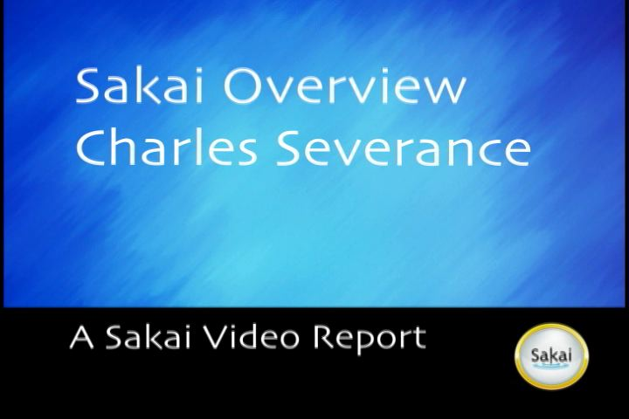
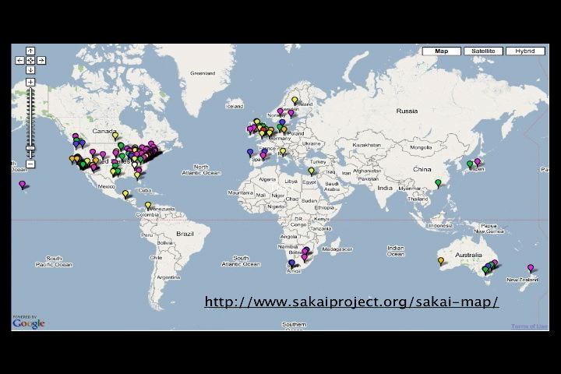

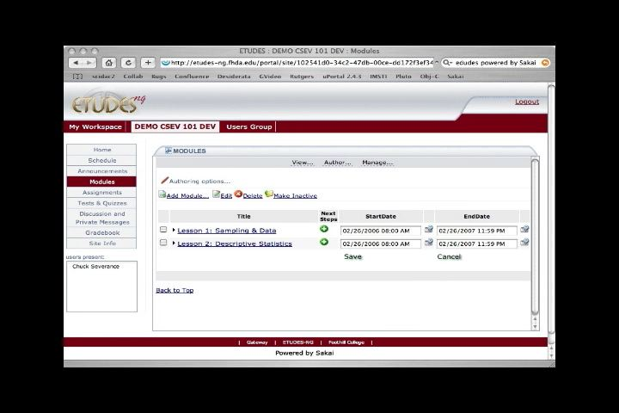
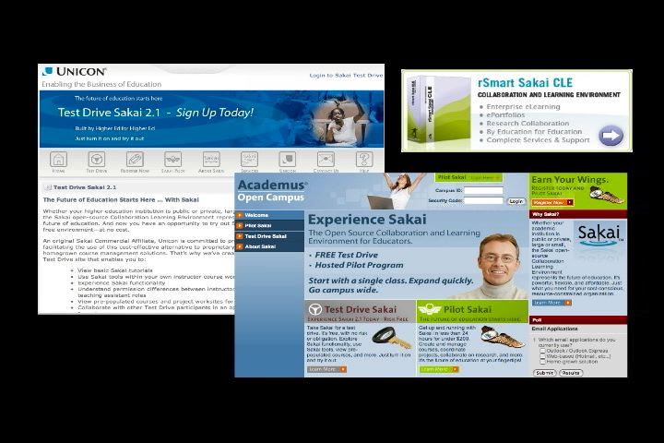
Overview Slide
Sakai is used for Collaboration, Teaching, and Learning
Sakai Project started January 2004 (2.5 years old)
Non-profit Sakai Foundation January 2006
Open Source - 100% free - Apache License
Voluntary financial support from 100+ Higher Education, 15 companies, each paying $10,000 / year = $ 1M revenue
Executive Director for the Foundation and six paid staff members
Worldwide community with 100+ people active in developing and testing Sakai releases
Nifty Web site www.sakaiproject.org
  Sakai Community Google Map Mashup
  Very cool “Sakai Overview” Video (10 minutes)

Slide 3
Outline
Requirements Gathering
History and Current Status
My JSR-286 Epiphany
Sakai and JSR-168
Sakai WorkGroup Portal
Looking forward

Slide 4
Portal Integration Requirements Initiative

Slide 5
Requirements Gathering
Involves Sakai and JA-Sig Board
Led by Ian Dolphin as he is on both boards

Slide 6
Methodology
Circulate a brief description of potential integration patterns or scenarios to the Sakai and uPortal communities. Request feedback as to which are the highest priority, and gather information about any work to date.
Gather, brainstorm and elaborate use cases within these integration patterns.
Illustrate a representative selection of use cases with visual designs/mockups.
Take indicative polls throughout to ensure community priorities are recognised.
Notes:
Led by Ian Dolphin - will involve Sakai and JA Sig Board.

Slide 7
Potential Use Cases
Single/Simplified Sign-On (SSO) - Sakai appears in a portal as a single rectangle
“Dashboard” - Sakai produces a rich set of alerts enabling the construction of “dashboard-like" summary portlets of varying granularity
Sakai Tool Portlet - Sakai tools surfaced individually via a portlet
  With or without the context of a Sakai worksite
  With or without Sakai running in a different JVM
Notes:
There is a converse to the second point – the ability of Sakai to accept alerts from other enterprise systems or an enterprise ESB. This more properly lies outside the specific interest of Sakai-uPortal integration, but feel free to respond expressing interest around this if you wish).

Slide 8
History and Current Status

Slide 9
History - Sakai and JSR-168
Switching to JSR-168 was part of Sakai’s Grant (2003)
  Sakai’s presentation layer *would* be JSR-168
  Using JSR-168 would make Sakai tools portable between JSR-168 compliant portal containers
  Sakai tools would just “be portlets” which would work in any portal
What happened
  As a standard, JSR-168 was just too small and basic to support Sakai’s requirements in critical areas
    Navigation
    Cross-portlet context
    Support for “services” that work across portlet
How we reacted
  Look into WSRP and see if we could solve the problems using two JVMs (one for the Portal and one for Sakai)
Notes:
Like many applications, navigation and layout is *part* of the application’s domain. In portlets, the purpose of the APIs is to separate container aspects from portlet aspects. SO it is impossible to use portlets as the natural unit of expansion.
We did not even “try” to rewrite Sakai using portlets as the primary component expansion.

Slide 10
History - Sakai and WSRP 1.0
What we hoped
  By separating the problem into two JVMs across WSRP Sakai could provide our tools all the support we needed and just move markup back and forth.
What happened
  We built a tightly integrated WSRP producer in Sakai 2.1
  WSRP provisioning is very poor - does not meet user requirements - perhaps this is just a limitation of how portal writers architect simple WSRP consumers - but it is reality
  WSRP interoperability is poor between containers
  Dual provisioning does not make administrators happy
How we reacted
  Wrote the JSR-168 Sakai proxy portlets

Slide 11
Sakai WSRP
Alpha quality consumer from Daresbury
Alpha quality producer from SunGard
  Sakai has a “sakai.fragment” - indicates body only response, and delegated URLs
  Not all tools - velocity tools work best
  CSS is still Sakai’s CSS
  Provisioning is weak - must look at Sakai tool placement GUIDs and construct handles

Slide 12
High Level Architecture
WSRP Consumer
(uPortal)
Web Services
Apache WSRP4J
Portlet = Placement
Sakai WSRP
Provider
List Portlets
Tool ID
Mercury
Placements
Placement ID
Kernel Tool
Registry
Site
Placements
Get Markup
Request Filter
Tool A
Tool B
Tool C
URL Rewriting
Notes:
WSRP Portal was produced by Vishal Goenka of SunGard SCT over the past six months. It uses the kernel’s tool registry and tool dispatch just like every other portal. The Sakai WSRP portal satisfies the Apache WSRP4J producer API.

Slide 13
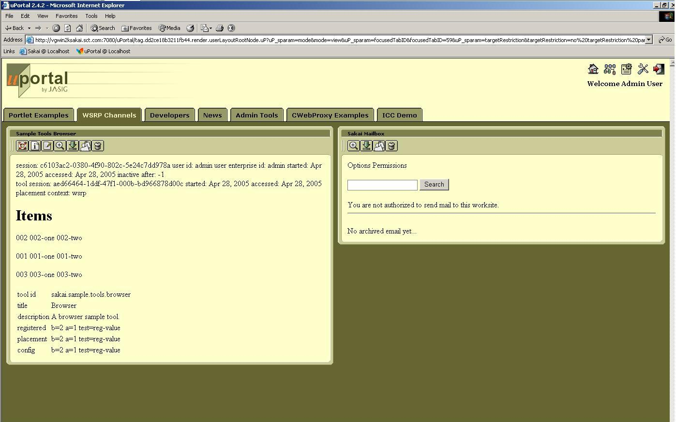
Sakai Tools in uPortal 2.4.2

Slide 14
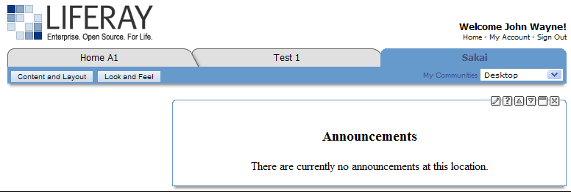
Announcement Tool (Mercury Context) in LIFERAY Portal
Thanks to Andrew Petro (Yale) for this Screen Shot

Slide 15
History - Sakai and 168 (v2)
What we hoped (early 2005)
  Provide a simple, basic capability that was totally portable for people to use as long as they accepted the shortcomings (iframes)
What happened
  Using web services and iframes these portlets worked very simply and pretty well and were pretty portable
  Some uptake - but iframes still limited user satisfaction
  Used in OGCE
Where we are at
  Reasonable portlets - need to be improved
Notes:
When WSRP was finishing up…

Slide 16
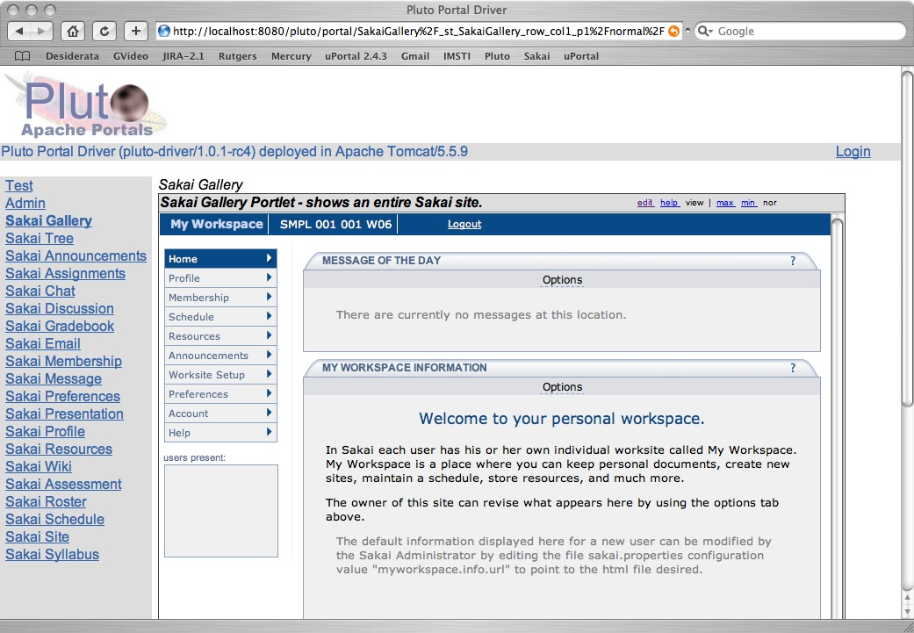
Sakai Gallery View
Notes:
Note display is in Pluto - most portals display Portlet links across the top so in portals like uPortal and GridSphere, you won’t see two columns of buttons.

Slide 17
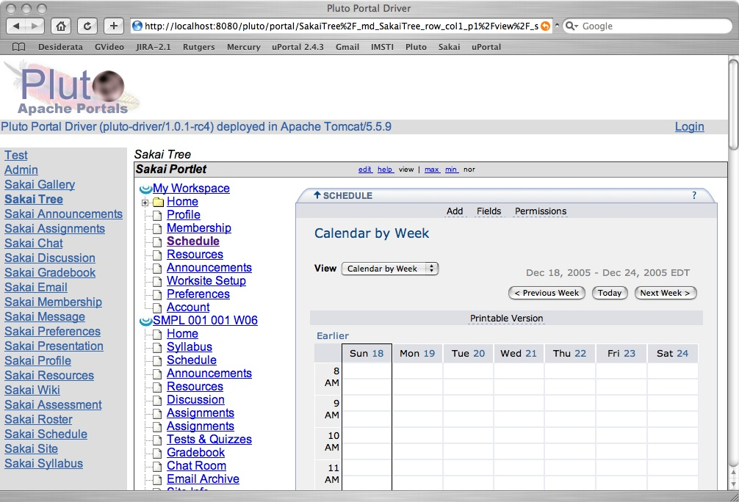
Sakai Tree View
Notes:
Note display is in Pluto - most portals display Portlet links across the top so in portals like uPortal and GridSphere, you won’t see two columns of buttons.

Slide 18
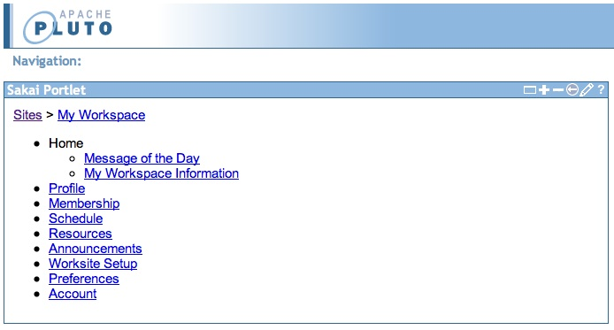
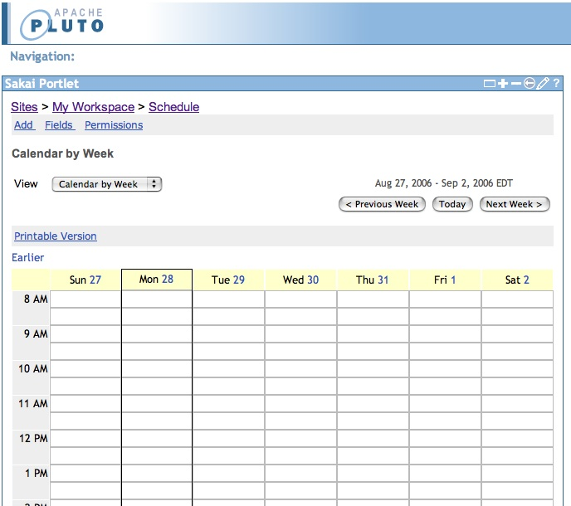
Sakai Launcher
Sakai Launch View

Slide 19
How Tree/Gallery/Launch View Works
/portal/page/FF96
Charon
Portal
Sakai
uPortal, Pluto, or GridSphere
ToolList
Sakai
Portlet
Web Svcs
Login
Notes:
When the Portlet Starts, it puts up a login screen or auto-logs in depending on configuration. The login is done with a web service. Once the session is established, the site/tool list is retrieved and the portlet is displayed with the hierarchy displayed as a tree. As a page or tool are selected, the tree control places the iFrame with the Charon URL to the site into the iFrame. This iframe URL uses session based launch to bypass Sakai’s login process.

Slide 20
SakaiSite.getToolsDom
<sites>
<portal>http://localhost:8080/portal</portal>
<server>http://localhost:8080</server>
<gallery>http://localhost:8080/gallery</gallery>
<site>
<title>My Workspace</title>
<id>~csev</id>
<url>http://localhost:8080/portal/worksite/~csev</url>
<pages>
<page>
<id>af54f077-42d8-4922-80e3-59c158af2a9a</id>
<title>Home</title>
<url>http://localhost:8080/portal/page/af54f077-42d8-4922-80e3-59c158af2a9a</url>
<tools>
<tool>
<id>b7b19ad1-9053-4826-00f0-3a964cd20f77</id>
<title>Message of the Day</title>
<toolid>sakai.motd</toolid>
<url>http://localhost:8080/portal/tool/b7b19ad1-9053-4826-00f0-3a964cd20f77</url>
</tool>
<tool>
<id>85971b6b-e74e-40eb-80cb-93058368813c</id>
<title>My Workspace Information</title>
<toolid>sakai.iframe.myworkspace</toolid>
<url>http://localhost:8080/portal/tool/85971b6b-e74e-40eb-80cb-93058368813c</url>
</tool>
</tools>
</page>
</pages>
</site>
</sites>

Slide 21
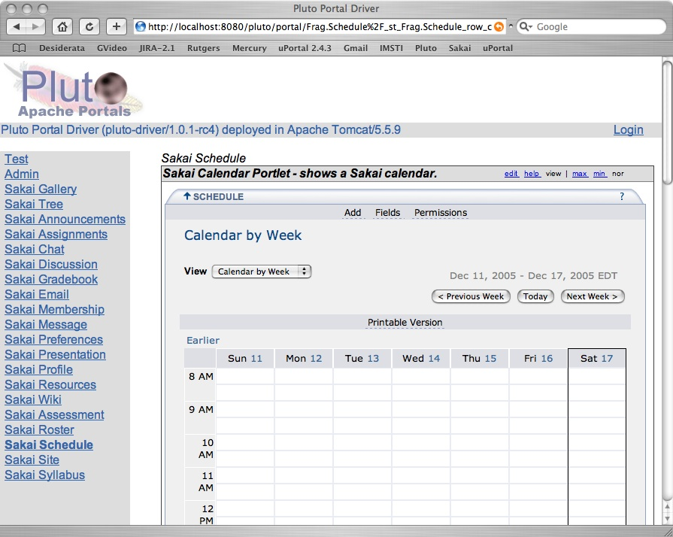
Sakai Proxy Tool

Slide 22
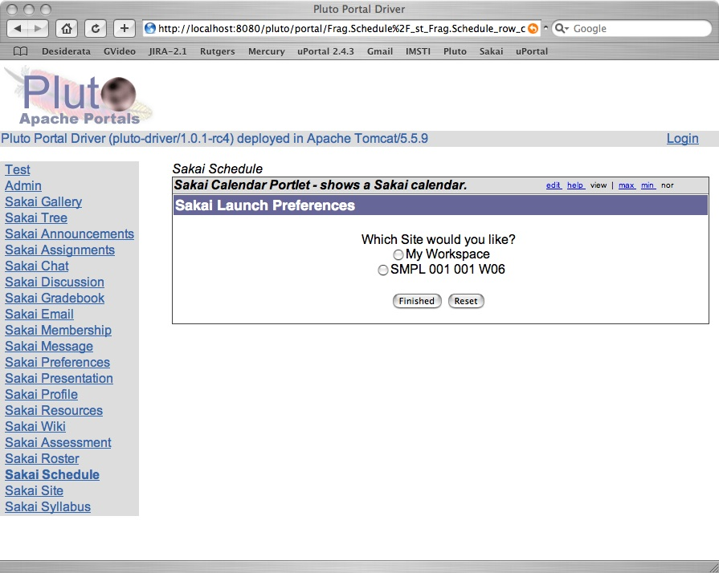
Proxy Tool Selection
Notes:
When there are more than one site with the calendar tool with in the Sakai server, the user is given the choice as to which Sakai calendar is to be displayed. This choice is saved in the user’s preferences. If there is only one calendar, this step is skipped and the user goes directly to the tool. This “only one placement scenario” happens for “My Workspace” tools like Preferences. So, the user never sees this step is skipped when placing the Preferences portlet.

Slide 23
How Proxy Portlet Works
/portal/page/FF96
Charon
Portal
2
Sakai
uPortal, Pluto, or GridSphere
SiteList
Sakai
Portlet
Web Svcs
1
Login
Notes:
This portlet logs in like any other version of the Sakai portlet. It knows that it is a “sakai.calendar”. It retrieves the entire list of sites, pages, and tools, and searches for sakai.calendar placements. If it finds 2 or more placements, it puts up a selection dialog (1) - the user chooses which placement they are interested in, and then that tool placement is displayed (2). The placement is also put in the user’s preferences so the next time the tool comes right up, bypassing the selection.

Slide 24
Summary Current Status
iFrames+ SSO seeing some use
Sakai’s JSR-168 Portlets seeing some use
Others have JSR-168 portlets (Unicon)
Sakai’s WSRP producer is unused - no good way to provision
There is a WSRP Consumer Sakai tool from Daresbury Labs

Slide 25
Epiphany from 286 EG…
History v3 (??)

Slide 26
Understanding JSR-168
JSR-168 is an API defining a reusable “portlet” that can be used across many different portals
JSR-168 is *not* an architecture for a portal
We mistakenly thought that JSR-168 was the way to merge all component-based applications into a single system image.
JSR-168 is about what is *inside* the rectangles - not about navigation, layout, administration, provisioning, etc etc.
There will be many different applications that *look somewhat like* a portal
Notes:
Netvibes google yahoo

Slide 27
Enterprise
Portal
WSRP Producer
Container
Portlet
Portlet
Desktop
Application
Collaborative
System
Content
Management
Portlet
Portlet
Portlet
The Portlet is unaware of its surroundings - each of the applications use the JSR-168 API to “fit” the portlet into the appropriate context. The beauty of the JSR-168 API is that the container is in complete control of the portlet and deploys the portlet’s functionality as appropriate in each environment.
Notes:
The portlet is not and never will be allowed to interact with or suggest things to the portal at all - it is a violation. Being in a portlet is like being imprisoned in a rectangle.

Slide 28
Evolving Pluto
Pluto 1.0 was a reference implementation of a “portal” which supported JSR-168
Pluto 1.1 is a set of utilities which make it easy for *any* application to have portlet support.
JSR-286 will be supported by Pluto 2.0 in an upwards compatible way.
WSRP 2.0 is still a bit vague as to where the O/S implementation will come from - IBM??
Pluto 1.0
Collaborative
System
Enterprise Portal
Pluto 1.1
Pluto 1.1
Portlet
Portlet
Portlet

Slide 29
Circa 2004 - Merge applications
Collaborative
System
Enterprise
Portal
Portlet
Portlet
Content
Management
It is important to realize that merging is far more than just merging the “portlets”. The applications themselves have significant requirements (administration, configuration, navigation, etc) that need to “extend” the enterprise portal.
Portlet
Notes:
Sakai got stuck trying to bring in all the baggage (admin, config setup, etc) of a collaborative system into an enterprise portal and finding it a bad match.

Slide 30
Circa 2004 - Merge applications
Enterprise Portal Based on Pluto 1.0
Collaborative
System
Content
Management
Payroll
System
Portlet
Portlet
Portlet
Portlet
Portlet
The problem with this approach is that these “applications” have a lot baggage and requirements that are *outside* the portlets. It is difficult to expand an Enterprise Portal’s infrastructure to support the superset of requirements for all applications. Also this extended infrastructure is *not* part of the JSR-168 standard so each portal becomes a mess.
Notes:
Sakai got stuck trying to bring in all the baggage (admin, config setup, etc) of a collaborative system into an enterprise portal and finding it a bad match.

Slide 31
Circa 2008 - Reuse Portlets
If all these systems support JSR-168, now the *portlets* can be reused. Previously we were trying to reuse the enterprise portal code for a different purpose than it was originally intended.
Life is much simpler if we just reuse the *portlets* - they way it was intended in the beginning.
Enterprise
Portal
Pluto 1.1
Mail
Mail
Chat
Chat
Collaborative
System
Quiz
Pluto 1.1
Chat
Quiz

Slide 32
JSR-168 in Sakai

Slide 33
Sakai JSR-168 Roadmap
Build support in Sakai for JSR-168 using Pluto 1.1 - expected in Sakai 2.4 2Q07
Enable the use of existing *truly portable* JSR-168 portlets within Sakai
Enable new Sakai tools to be written as JSR-168 portlets
  This will only be suitable for the class of tools that simply need a unique placement.
  Will lead to a set of simple and very reusable collaborative tools

Slide 34
JSR-168 In Sakai
Took some NSF and JISC funding and retained David DeWolf - lead committer for Pluto and JSR-26 EG member to put Pluto 1.1 into Sakai
Coordination / Sakai Architecture work is being handled by Ian Boston of Cambridge
Expect initial version for Daresbury, UK to test early December 2006
Have discussed using our funds to support David to help with uP to move to Pluto 1.1 when the time comes - if this is desired by uP community.

Slide 35
Use Cases for Sakai-168
Prepare a Pluto-style portlet war file and drop it into Sakai as a webapp - autoregister
Users simply use Sakai’s Site Info tool to place portlets like any other Sakai tool
It will be possible to use any Sakai API within a JSR-168 Portlet
Sakai will provide a JSR-168 complaint classes so that portlets have the same look and feel as Sakai tools

Slide 36
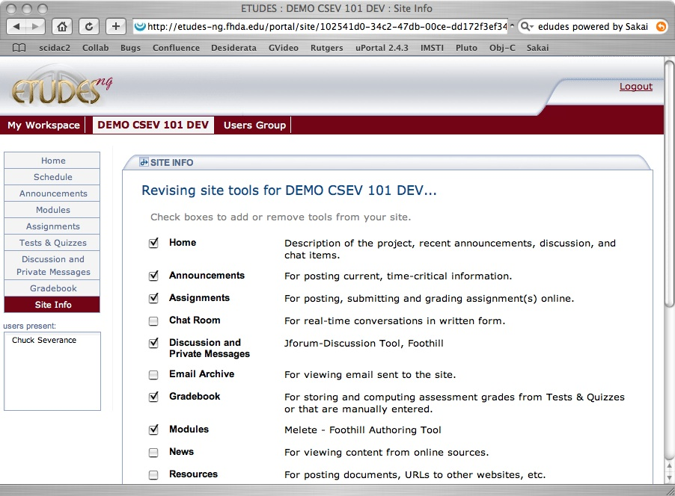
Number Guess
A sample JSR-168 portlet which is a game to guess numbers
TestSuite1
JSR-168 Conformance Test Portlets

Slide 37
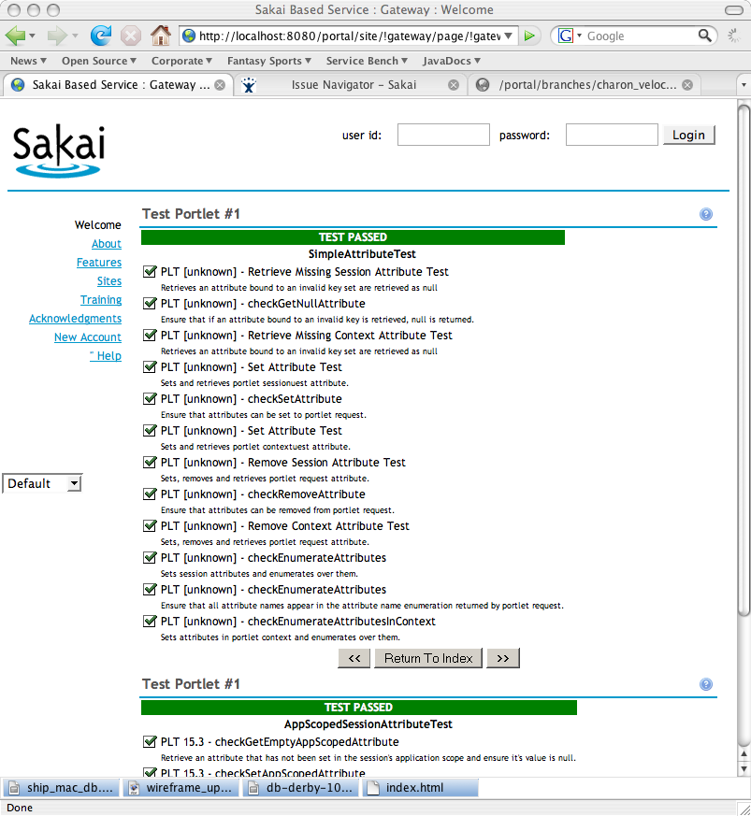
JSR168 in Sakai

Slide 38
Circa 2008 - Reuse Portlets
Collaborative
System
Enterprise
Portal
Pluto 1.1
Pluto 1.1
Course
Mail
Chat
Chat
Quiz
Project
Chat
Quiz
If all these systems support JSR-168, now the *portlets* can be reused. Previously we were trying to reuse the enterprise portal code for a different purpose than it was originally intended. Different applications will place the portlets in different “contexts”.

Slide 39
Sakai WorkGroup Portal

Slide 40
Sakai WorkGroup Portal
Extend the Sakai “gateway” site which is displayed prior to log in to display more than one “site”
Display any site which grants the anonymous user “site.visit” permission
Site buttons are controlled by which permissions are granted to the anonymous user.
Allows Sakai to be used as a simple Content Management System like Mambo or Plone
Sakai Workgroup portal is expected in Sakai 2.4

Slide 41
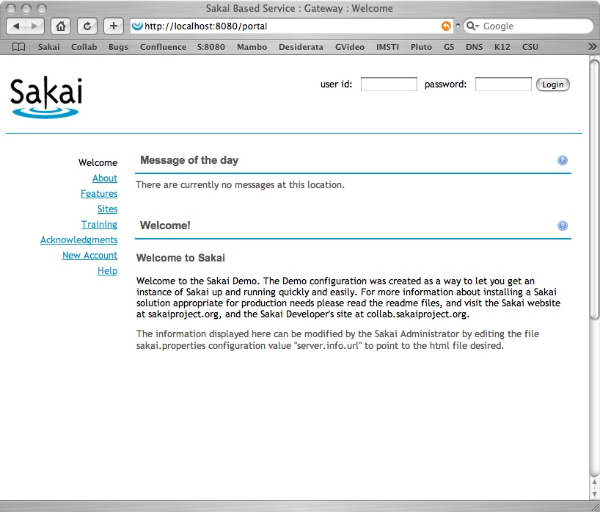
Sakai Gateway Site

Slide 42
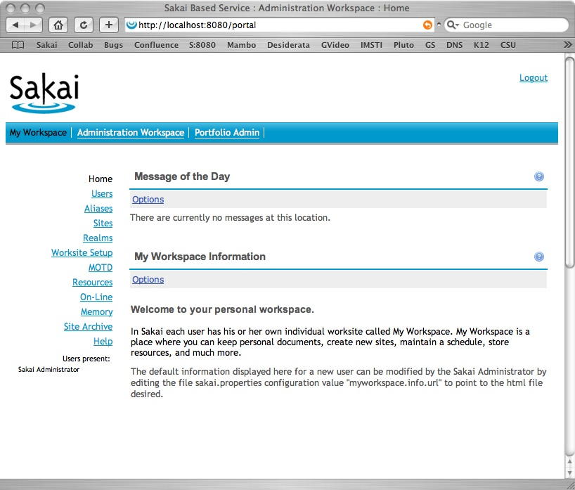
Logged In
Sites
Tools

Slide 43
WorkGroup Portal Mockup
Sites
Home | Community | Download | Developers | Roadmap | Requirements
Latest Release | Quick Start | Installation Instructions | Previous Versions
Tools
Show only the tools for which the .anon role has permission

Slide 44
Going Forward…

Slide 45
Future Plans
Support JSR-168 within Sakai 2.4
  Experiment with portlets in Sakai
Explore Sakai and RSS
Improve JSR-168 Portlets
Improve WSRP producer
All of this depends on volunteer resources

Slide 46

















Sakai Data Interoperability
Personal
Learning
Environment
Portal
Environment
LMS Systems
Authoring
Environment
Collaboaration
Environment
Content
Management
Enterprise
Directory
Data
Repository
... interoperability and data portability are key elements...
Student
Information
Notes:
One word people use for this is an “ecology”. An rich, nurturing supportive environment where stuff “grows”.
Mention SakaiBrary.

Slide 47
Sakai and RSS
Sakai will likely add a number of RSS feeds for sites, tools, etc
  Some exist - Wiki for example
  Varying granularity
  Need cross-site synoptic RSS feed - what is new?
User-contextualized
This can allow Sakai to be integrated into a wide range of applications including portals, browsers and desktop apps
Nice to have something more in 2.4

Slide 48
Sakai and iCal
This has been started many times - some code in hand
Always looking for volunteers
I have a person who has picked up the task
Nice to have something by 2.4

Slide 49
Future - Sakai 168 Portlets
Add coordinated AuthZ for proxy portlets so that Sakai “trusts” the AUTHZ in the portal - no standard for isUserInRole :(
Allow direct placement of Sakai portlets in new contexts with AuthZ controlled by the Portal (again non-standard)
(really tough) get rid of iFrames through a proxy layer to rewrite URLs - perhaps this would be easier through the use of a proxy portlet

Slide 50
WSRP In Sakai
Sakai has a somewhat re-factored and bug fixed WSRP producer
uP3 also has a somewhat re-factored and bug fixed WSRP producer
Both - do not work with Pluto 1.1
WSRP 1.0 really needs a Pluto 1.1-like refactor and then needs to be connected to Pluto 1.1
Who will do this?
What will happen when WSRP 2.0 comes out?

Slide 51
Sakai / uP3
Research and understand the requirements
  Identify community resources to address requirements
Exchange JSR-168 portlets
  Sakai tool writers will be encouraged to do portlets when they can
  Understand portability of portlets and what it means to write a portable portlet

Slide 52
Summary
There is no magic bullet here - Standards focus on the simplest use cases
Sakai has moved from trying to use standards to do *everything* to finding the right uses for standards within the Sakai context
Lets keep an open mind to HiJacking the WSRP4J project in an Apache branch - Sakai would be happy to incubate this
JSR 286/WSRP 2.0 will not change where these standards “fit” in our architectures - they will just do a better job than JSR168/WSRP1.0
Notes:
Instead of feeling “constrained/bound” by the standards in Sakai - we are taking a very vendor like approach (like Liferay, Oracle, BEA, etc) - we need to support and use standards as integration points but not use the standards *as* our internal architecture.
The key is that for these standards to truly evolve the right way - we must first find real use of them in their current form and put that in production and in front of end users to evolve the real use cases.

Slide 53
Conclusion
This has been a long path with many twists and turns
Each step forward informs the following steps
As things become solid on either side of the uP3/Sakai border - it is easier to design and build bridges
Please participate in the requirements process - don’t just say “yes”

