Slide 1
Ruby on Rails
Charles Severance
Textbook: Build Your own Ruby on Rails Application by Patrick Lenz (ISBN:978-0-975-8419-5-2)

Slide 2
What is Ruby?
Ruby is a programming language
  At one level any programming language can be used to solve any problem - everything is *possible* in any language
  Languages differentiate them selves based of ease of use, elegance, power, simplicity, efficiency, and many other subtle but very important factors

Slide 3
Ruby’s Advantages
Truly Object Oriented from the ground up - very consistent patterns to the language
User-friendly language syntax - easy to read and easy to learn
Help the user develop nice, clean, powerful programs
Very powerful run time class extensions - make applications like Rails not only possible but very natural

Slide 4

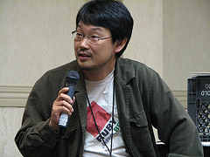
Ruby History
Originally developed in Japan by Yukihiro Matsumoto (aka “Matz”)
  “I wanted a scripting language that was more powerful than Perl, and more object-oriented than Python. That's why I decided to design my own language.”
Work started in 1993, and released it to the public in 1995.
"Ruby" was named as a gemstone alluding to name of Perl
Also pearl is the birthstone for June, and ruby is the birthstone for July.
English version in 1998

Slide 5
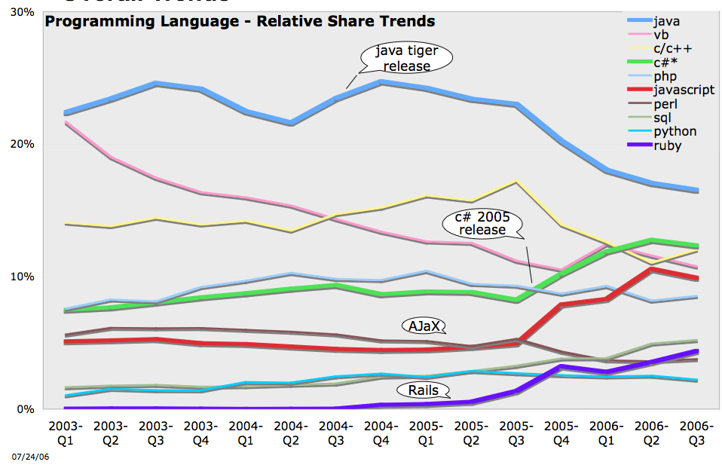
http://radar.oreilly.com/archives/2006/08/programming_language_trends_1.html

Slide 6
What is Rails?
Rails is a full-stack web application framework
  The Rails framework includes common functionality that is useful across a wide range of web applications
  By starting with Rails - you get a lot for “free” - you can focus on your application and its data rather than writing lots of plumbing
Rails is written in Ruby

Slide 7
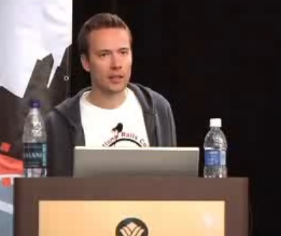
Rails History
David Heinemeir Hansson from Denmark developed a web application called Basecamp
Rails was created by taking the general purpose bits of the Basecamp application out so they could stand on their own
Rails 1.0 was released in December of 2005.
http://www.youtube.com/watch?v=mp4z2eK1Avw

Slide 8
Rails Development Principles
Convention over Configuration
Don’t Repeat Yourself
Agile Development
Scaffolding
Model - View - Controller Architecture

Slide 9
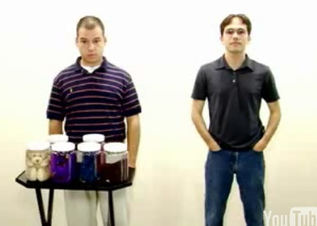
Convention Over Configuration
Add a column to a database table and in-memory objects immediately have new methods supporting the column - no need to change configuration many places throughout the application
A reaction to Java + Spring + Hibernate which has lots of flexibility and choice and lots of configuration files all over the place.
http://www.youtube.com/watch?v=PQbuyKUaKFo

Slide 10
Don’t Repeat Yourself
This is a basic tenet of the Object Oriented approach
You should not have to cut and paste the same code over and over in many places - this leads to future bugs where code is changed one place and not the other.
Powerful libraries such as Ajax support, and Object Relational Modeling are built in and easy to use with a minimum number of lines of code

Slide 11
Agile Development
Build quickly, test, evaluate, and refine - iterate from a prototype to production
You can work independently on application look and feel, storage patterns, and program logic
Quick development - edit a file - press refresh on a browser
Includes convenient testing framework

Slide 12
Scaffolding
Rails provides the framework and will write skeleton applications to use the framework at your direction
Saves a lot of typing and reading
  ruby script/generate controller Music index details edit
Code produced is functional - and has hints about what to do next
A leg up for beginning programmers - not just a blank slate

Slide 13
Model - View - Controller
Model - Persistent Storage - Database - stores across all sessions and across time
View - Look and Feel of the application - usability, accessibility, design, appeal, functionality, drag and drop, ....
Controller - Program logic, business rules, flow form screen to screen controls each session independently.

Slide 14
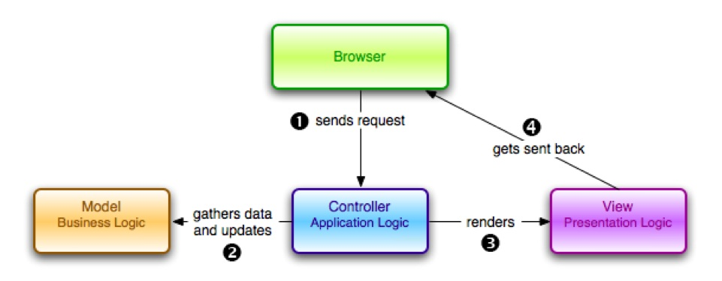
MVC - Request - Response Cycle

Slide 15
MVC Sequence
User presses button, browser sends data to application
Controller receives the data, and makes updates to and/or retrieves from the model as necessary
User output data is passed to the View - view applies final look and feel and the response goes back to the Brower.

Slide 16
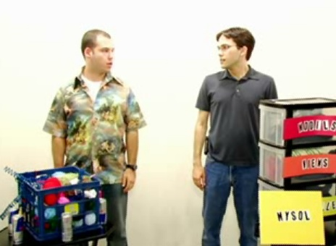
Rails and MVC
Rails is a MVC application framework - you should just accept the MVC pattern and work with it
This is OK because MVC is a very popular approach to developing web applications
Rails effectively pre-chooses 90% of the architecture choices of a web application.
http://www.youtube.com/watch?v=Ld919lziKgE

Slide 17
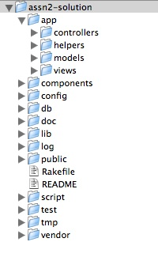
A Rails Application
Rails even dictates the layout of an application directory - one less decision for a developer to make
The directory structure precisely reflects the MVC architecture
This helps Rails developers know where to look for things when faced with a new Rails application
Removing choice improves clarity

Slide 18
Potential Rails Gotcha’s
There is no such thing as a perfect framework that does it all for you magically.
Sometimes you must step around or outside the framework to get things done that the framework is simply not ready to handle
As we gain experience with Rails we will find areas that need improvement
The hope if that Rails will need fewer of these “bypass” operations and when it must be done - it can be done elegantly.

Slide 19
Ruby’s Future
Most see Python and Ruby as the likely “what’s next?”
Interesting question - Will Ruby replace perl as the data-grocking language?
Ruby has been adopted by Sun and Java - Java version 6 will have support for a Ruby in the Java Run Time environment - this will make it much easier for Ruby to become an enterprise language - Ruby will be easy - Java.
Apple in the 10.5 release makes Ruby as one of the languages which can be used to develop desktop applications in Cocoa - up to now Desktop applications on Macintosh were generally written in a very OO language called Objective C

Slide 20
Rails Future
Rails is the most innovative full-stack web development framework ever.
  It is far easier than Java / Spring / Hibernate
  It is much cleaner than PHP
For small to medium sized applications starting now with 2-5 year life spans - Ruby is the current smart answer
For the largest applications with 10+ year life spans, the jury will be out for many years

Slide 21
Conclusion
Ruby is a very strong contender along with Python as the ideal Object Oriented Language in the market today
Ruby and Rails are experiencing strong growth at this point in time
Ruby on Rails is already demonstrated to be well suited for small and medium sized web applications
More time and experience is needed for Ruby to begin to take Enterprise market share from Java and C# (.Net)

