Slide 1
IMS Developer Network
Dr. Charles Severance
IMS GLC Developer Network Coordinator

Slide 2
Goals of the Developer Network
Increase adoption of IMS Standards in real, shipping products
Increase developer involvement in standards development – use implementation experiences
Improve interoperability between different implementations of IMS Standards on “day 1”
Notes:
This is a little different from Microsoft and Apple’s developer networks.

Slide 3
Adding Value to Member Efforts
IMS does not have developers, nor do we build products
Coordination and communication amongst member developers – increase efficiency
Build structures for exchanging information between member developers- like open source
Notes:
Intellectual property is very important to track – standards are under development outside public view – implementations are IP that one or another member

Slide 4

Communication
IMS Developer Network (members only)
  Work in development – working with draft specs
Webinars – To the membership and public
Speaking outreach at developer-oriented meeting
Developer tutorials – at meetings or on site
Software artifacts
Notes:
Google Summer of Code

Slide 5
Open Source IMS Artifacts
Apache 2 contribution agreements and license
  Reusable code – think jar file
  Sample code – multiple languages
  Test code to help exercise implementations
Clean Intellectual Property is very important so these artifacts can be used in shipping products
Notes:
Not going to build an LMS. That is what the members do.

Slide 6

Resources
Some of this will be an exercise in “herding cats” – motivating “volunteers” to help each other
Increasing IMS Developer Network Membership will increase resources
Will engage in some fund raising to retain resources to do bits and pieces here and there

Slide 7
Value Proposition of DevNet
Once a member’s developers “are hooked in” information will come to them
I will actively work to “pull information” out of one member to be shared with all members
Members can adopt/implement more specs with less time and less travel.
Notes:
This is about pulling and pushing like a pump.

Slide 8
Next Steps
Work with IMS to develop legal structure for developer network
Continue work with LTI 2.0 to help define the mission and approach – investigate LTI Alliance
Broaden involvement to other efforts as opportunities present themselves

Slide 10


IMS Learning Tools Interoperability 2.0
Building the Standards for Learning Functionality Mashup

Slide 11
IMS Tool Interoperability
A standard which is currently under development by IMS (www.imsglobal.org) for functionality mash up
Effectively provides Facebook-like capabilities for learning management systems
Read-write access from a tool to the LMS

Slide 12

IMSTools Interoperability 1.0
Demonstrated at IMS Alt-I-Lab 2005 in Sheffield England
Balckboard, Sakai, WebCT, Moodle, Samigo, ConceptTutor

Slide 13
Caveat: This section discusses a specification still under development – anything can change as the specification progresses.

Slide 14
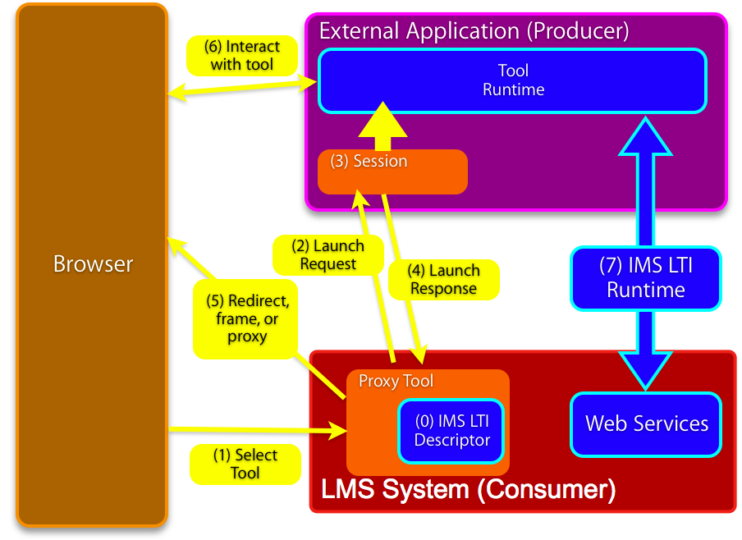

Slide 15
IMS Learning Tool Interoperability 2.0
Currently in Development
Specification Leads
Bruno van Haetsdaele -Wimba
Chris Moffatt - Microsoft
Learning Functionality Mash Up
Integrated into “Add Resource” in learning
systems

Slide 16
Scenarios
IMS LTI 2.0 tool installed by the administrator – end-users don’t even realize the tool is hosted externally
IMS LTI 2.0 generic tool available to instructors – to be placed and configured Mash-Up style (like a general-purpose RSS reader or web-content tool)
An IMS LTI 2.0 tool is placed when a publisher cartridge is loaded – often these are partially provisioned

Slide 17
Virtual Tool - Admin Install
Administrator installs a proxy tool and makes it available as a regular tool
Administrator configures services “sandbox” for the remote tool – exchange of key material
  Tool may have permission to connect asynchronously
  Tool may have permission to places “resources” – instances of itself in a course shell

Slide 18
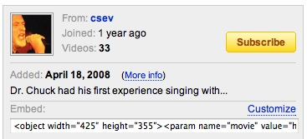
Instructor MashUp – YouTube
Instructor creates some learning object in an external service (freelearningsoftware.com)
The service presents a URL + password
The instructor pastes
this information into
an LTI Consumer Tool
in the LMS

Slide 19
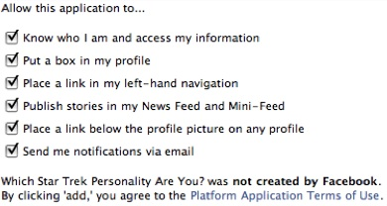
Instructor MashUp – SandBox
For instructor mash up – the Instructor configures the ”sandbox” at the time of mash up
The admin can set an
inherited “sandbox”
for all instructor-
placed tools.

Slide 20
Common Cartridge
Scenario 1: Content points to a pre-trusted host such as content.pearson.com – administrator has a sandbox pre-configured for tools that point to the pre-trusted host
Scenario 2: When there is no pre-arranged trust/sandbox – a placement from a cartridge behaves as an instructor-placed IMS LTI proxy tool.

Slide 21

Case Study: UM.SiteMaker www.gvcsitemaker.com
SiteMaker is a simple, end-user tool to build web sites
Database capability called “data tables”
Combination of power and simplicity
Written in Apple’s Web Objects by Michgan
Now has its own open source community and commercial vendor
Should we rewrite SiteMaker in Sakai? No.
www.gvcsitemaker.com

Slide 22
Sakai / Sitemaker Integration
Launching via IMS LTI 2.0 (an early draft)
Experiment in the ease of workflow of mashing a tool up
Model: YouTube - “paste this HTML”
Production: Fall 2008
www.gvcsitemaker.com

Slide 23
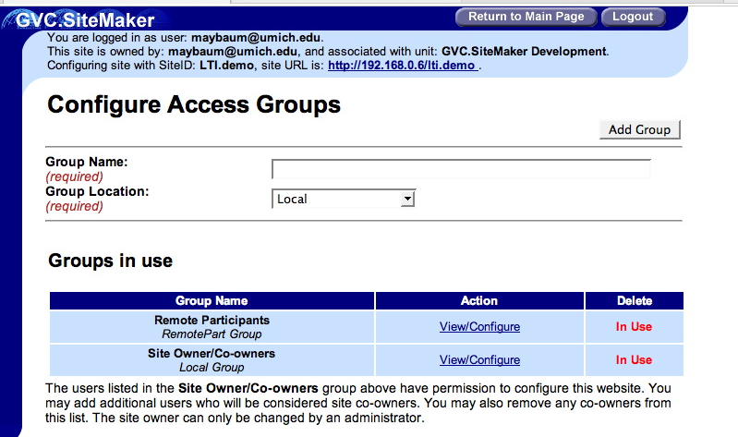

Slide 24
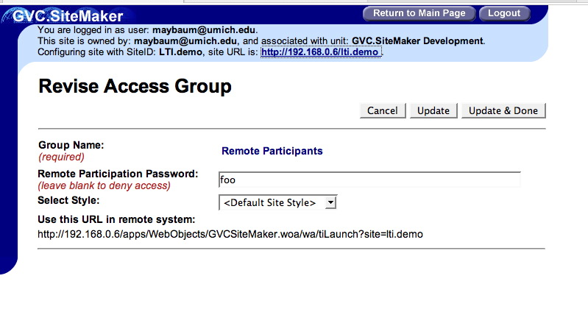

Slide 25
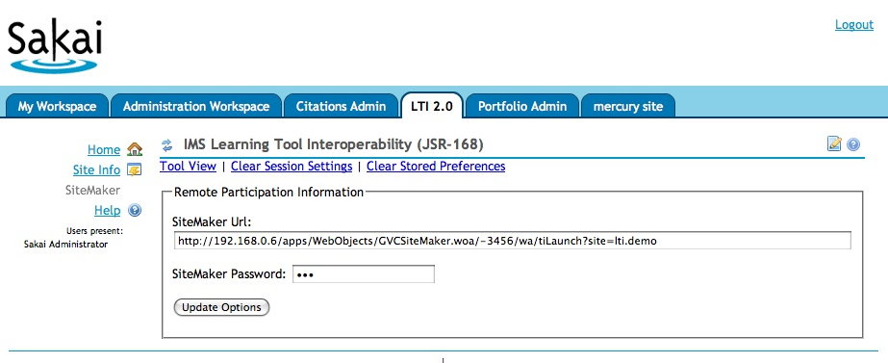

Slide 26
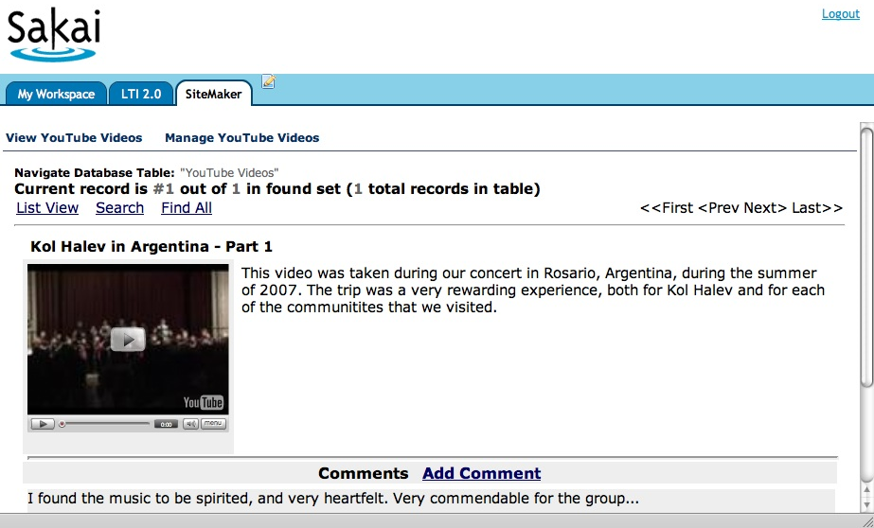

Slide 27
IMS Learning Tools Interoperability Demonstration
IMS Learning Impact
May 12-16, 2008, Austin, TX, USA
http://www.imsglobal.org/

Slide 28
Thanks
Wimba
Microsoft
Blackboard
Icodeon
Ucompass
Pearson
University of Michigan

Slide 29
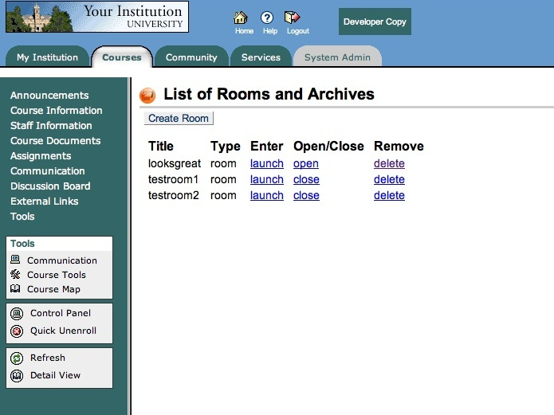

Slide 30
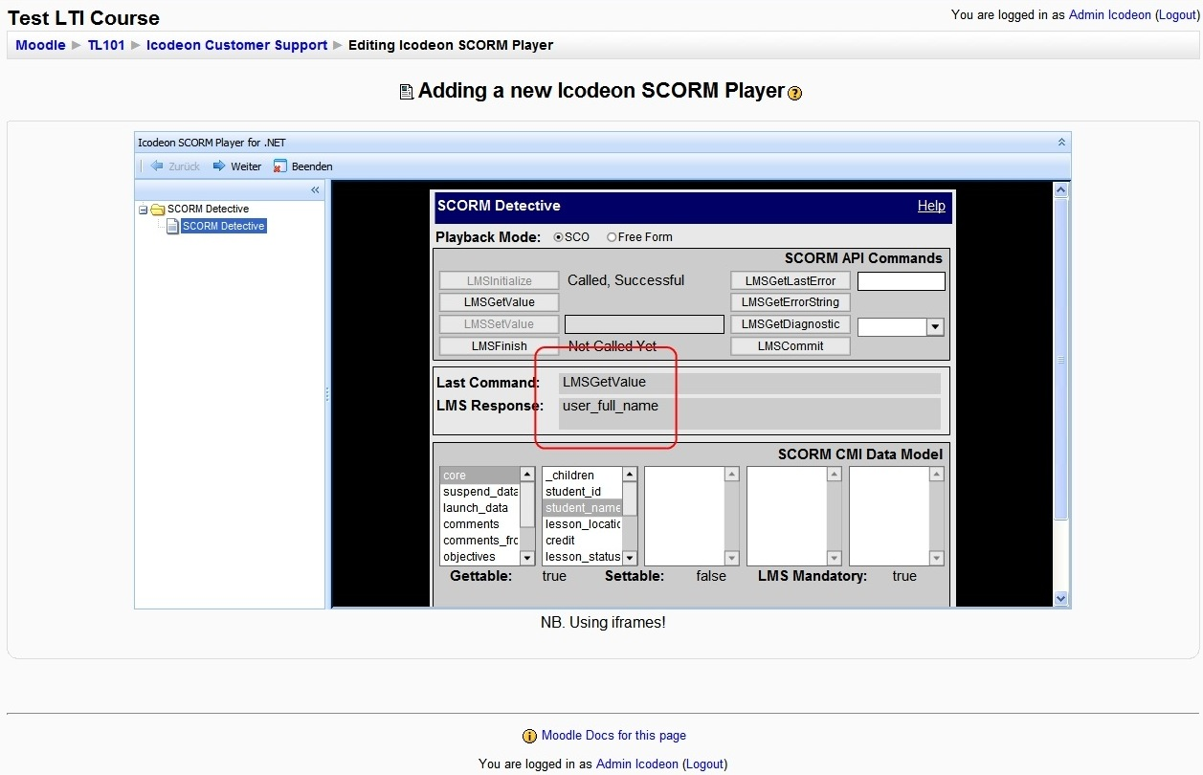

Slide 31
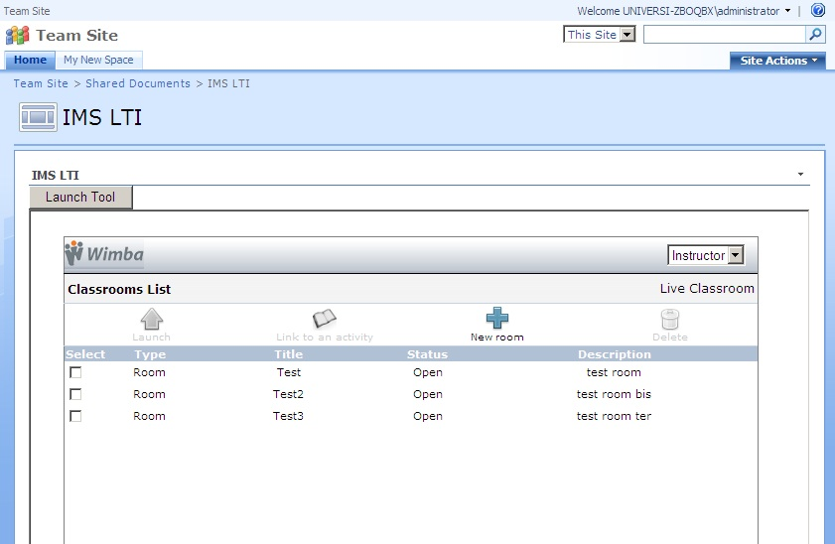

Slide 32
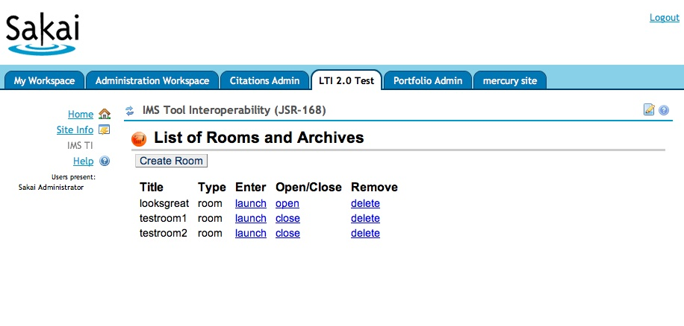

Slide 33
IMS Developer Network
My task is to develop the IMS Developer Network
Improve “in-the-field” availability of standards-compliant implementations
Develop reusable bits / sample code / test code
Work with and go-between developers implementing IMS Specs in their products

Slide 34


IMS / Sakai
Google Summer of Code

Slide 35
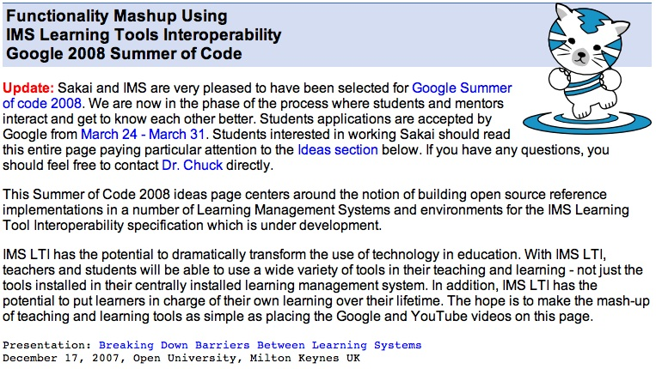

Slide 36
General Idea
Build many different implementations of IMS Tool Interoperability
Variations on a theme - think beyond just learning management systems
Try to create an initial body of work to make it worth while to build tools using IMS Tool Interoperability

Slide 37
Proposed Project Ideas
Sakai
Consumer
Producer
Moodle
Consumer
Producer
Atutor
Elgg
Chisimba
Drupal
Google Android
Rails IMS TI Test Kit
Consumer
Producer
Proxied access
Consumer = LMS Producer = Tool

Slide 38


IMS / Sakai
Google Summer of Code
An IMS LTI Producer for Sakai – Katherine Edwards, McGill University
An IMS LTI Producer for Moodle – Jordi Piguillem Poch - Universitat Politècnica de Catalunya
Improving Sakai’s Presense Capability – Eli Foley – Georgia Tech

Slide 39
Next Steps
Work with IMS to develop legal structure for developer network
Continue work with LTI 2.0 to help define the mission and approach – investigate LTI Alliance
Broaden involvement to other efforts as opportunities present themselves

