Slide 1
Creating New Architectures for Functionality Mashup
Dr. Charles Severance
University of Michigan
IMS Global Learning

Slide 2
Defininitions
Content Mashup – Reusing data in new places / ways
Functionality Mashup – Reusing interactive software in new places / ways
Learning Tools Interoperability – using learning tools in new places / ways

Slide 3
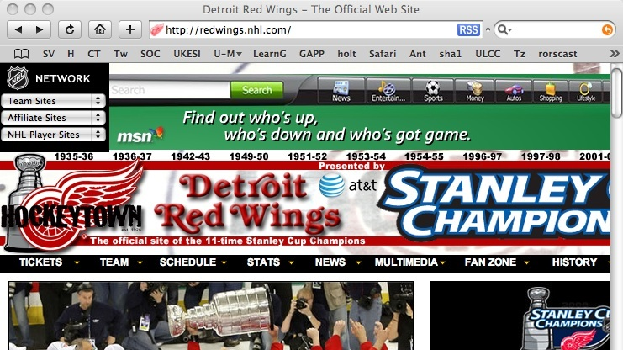
Content Mashup - RSS Feeds

Slide 4
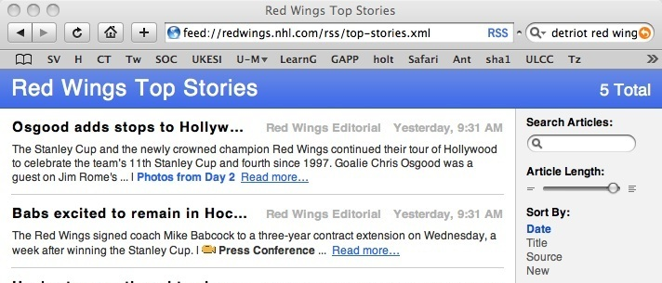
Content Mashup
Using data in a new context

Slide 5
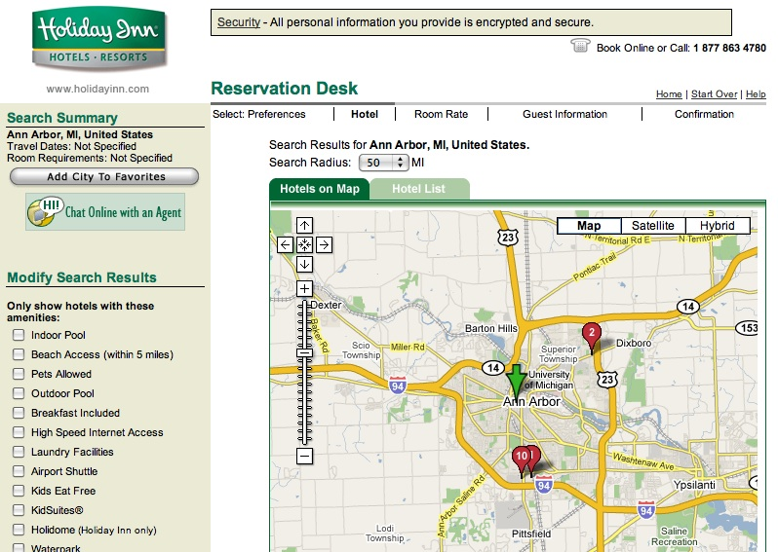
Functionality Mashup
Using Google Maps software in a Hotel web site context

Slide 6
Functionality Mashup
Using Google Maps software in a Hotel web site context

Slide 7

Functionality Mashup

Slide 8
Functionality Mashup

Slide 9
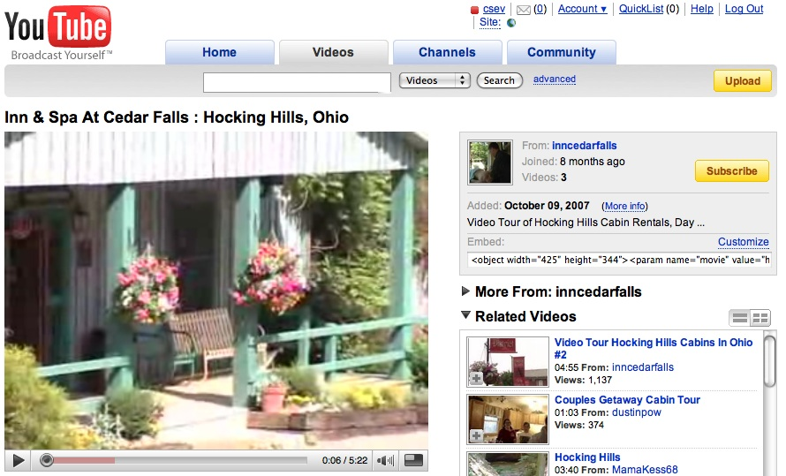
Functionality Mashup

Slide 10
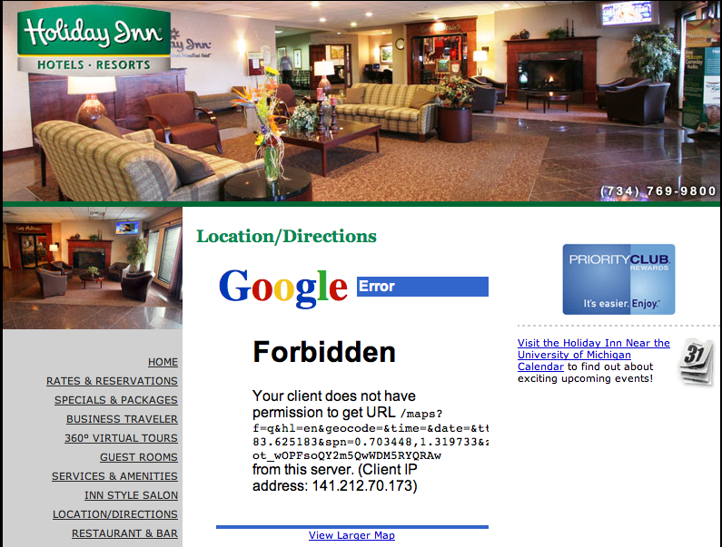
Exchange of Identity

Slide 11
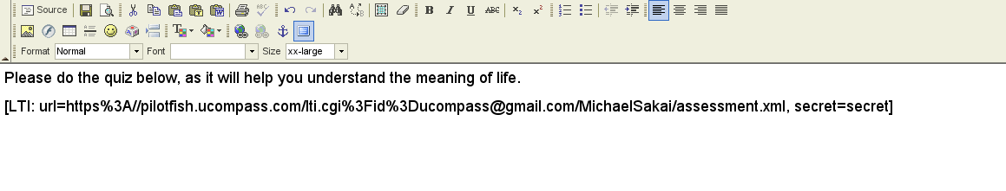
Learning Tools Interoperability
Learning System: Kewl3 – Authoring a Blog Entry
Assessment Player - uCompass

Slide 12
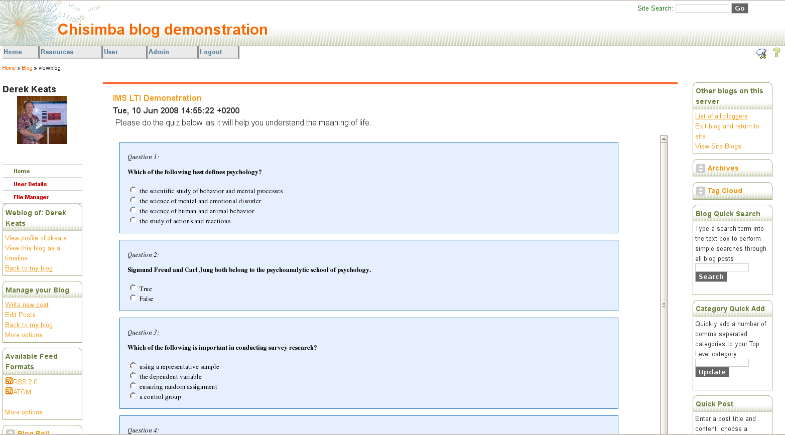
Learning Tools Interoperability

Slide 13
Functionality Mashup Utopia
It should not matter what learning (or other) system you use as your primary tool for teaching and learning – all tools should be available in all systems
The capability of your learning system needs to be expanded thousands of times per data under the control of teachers and learners

Slide 14
Panel Participants
Bruno van Haetsdaele, co-Founder and CTO, Wimba
Bob Alcorn, Senior Architect, BlackBoard, Inc., Architect, BlackBoard Building Blocks
Derek Keats, Executive Director, Information and Communication Services, The University of the Western Cape, Cape Town SA

