Slide 1


IMS Learning Tool Interoperability 2.0
Building the Standards for Learning Functionality Mashup

Slide 2
Learning Tool Interoperability
A standard which is currently under development by IMS (www.imsglobal.org) for functionality mash up
Effectively provides Facebook-like capabilities for learning management systems
Read-write access from a tool to the LMS

Slide 3
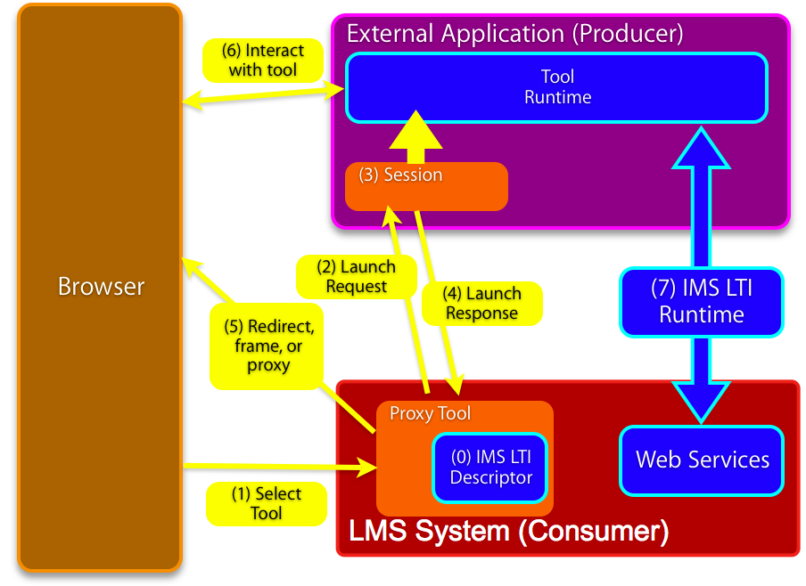

Slide 4
IMS Learning Tool Interoperability 2.0
Currently in Development
Specification Leads
Bruno van Haetsdaele -Wimba
Lance Neumann - Blackboard
Learning Functionality Mash Up
Integrated into “Add Resource” in learning
systems

Slide 5
Scenarios
IMS LTI 2.0 tool installed by the administrator – end-users don’t even realize the tool is hosted externally
IMS LTI 2.0 generic tool available to instructors – to be placed and configured Mash-Up style (like a general-purpose RSS reader or web-content tool)
An IMS LTI 2.0 tool is placed when a publisher cartridge is loaded – often these are partially provisioned

Slide 6
Virtual Tool - Admin Install
Administrator installs a proxy tool and makes it available as a regular tool
Administrator configures services “sandbox” for the remote tool – exchange of key material
  Tool may have permission to connect asynchronously
  Tool may have permission to places “resources” – instances of itself in a course shell

Slide 7
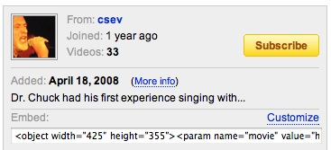
Instructor MashUp – YouTube
Instructor creates some learning object in an external service (freelearningsoftware.com)
The service presents a URL + password
The instructor pastes
this information into
an LTI Consumer Tool
in the LMS

Slide 8
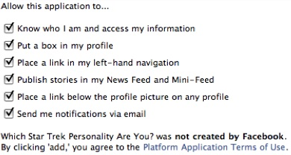
Instructor MashUp – SandBox
For instructor mash up – the Instructor configures the ”sandbox” at the time of mash up
The admin can set an
inherited “sandbox”
for all instructor-
placed tools.

Slide 9
Common Cartridge
Scenario 1: Content points to a pre-trusted host such as content.pearson.com – administrator has a sandbox pre-configured for tools that point to the pre-trusted host
Scenario 2: When there is no pre-arranged trust/sandbox – a placement from a cartridge behaves as an instructor-placed IMS LTI proxy tool.

Slide 10
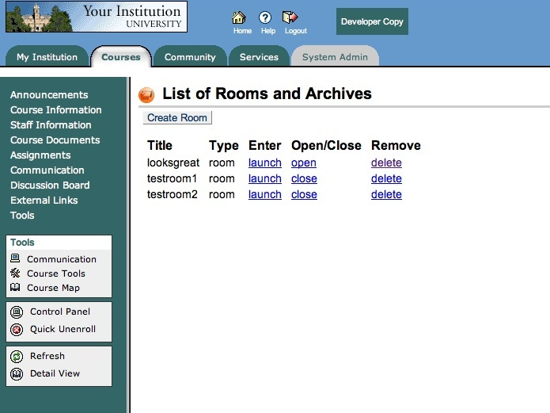

Slide 11
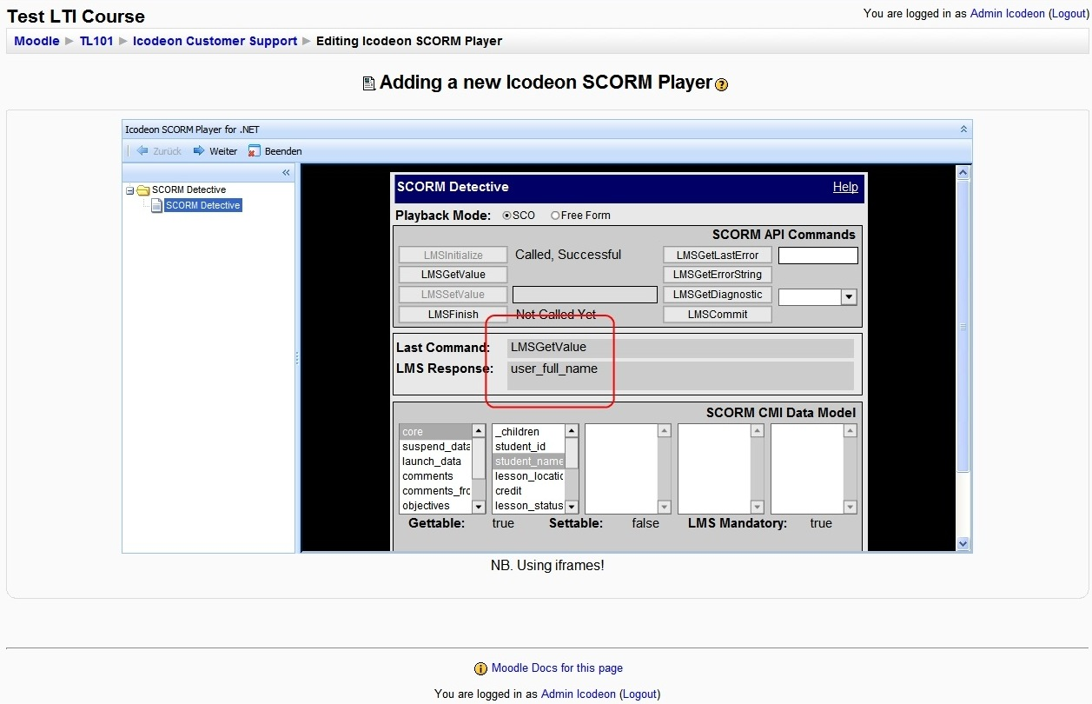

Slide 12
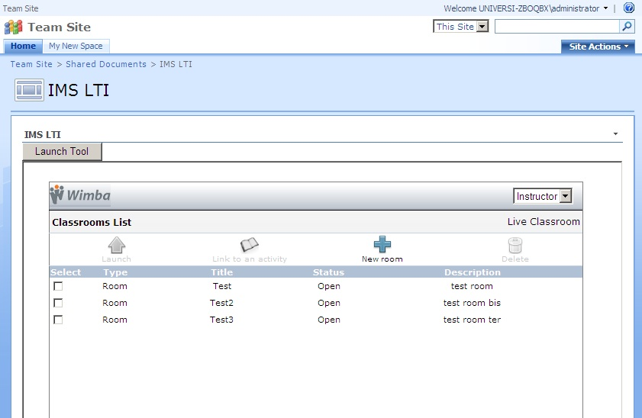

Slide 13
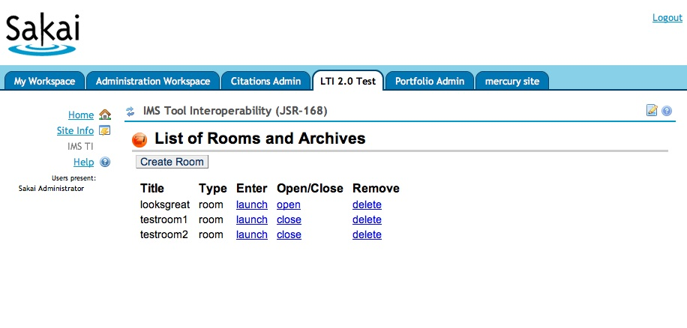

Slide 14
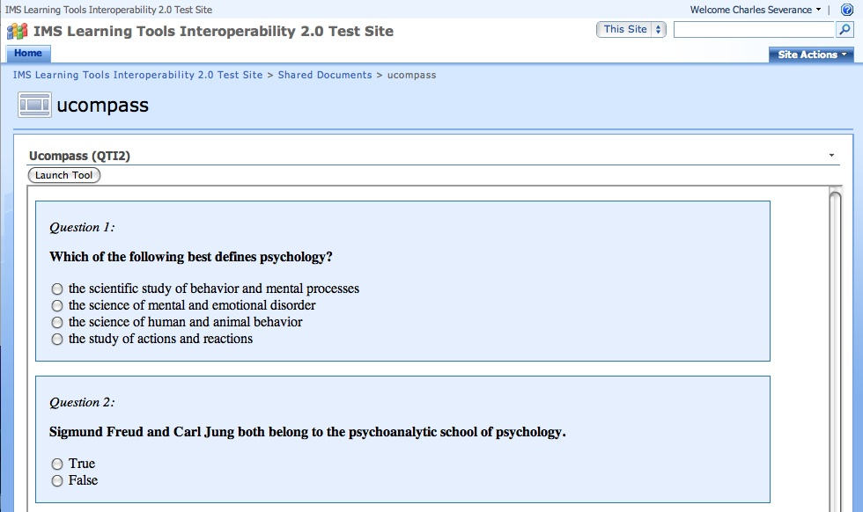

Slide 15
Current Status
We have permission to use elements of Blackboard’ proxy tool approach
Working to align the spec with Blackboard 9.0
As part of the IMS Developer’s network I have several Google Summer of Code students working on LTI implementations (simplelti.appspot.com)

Slide 16
Thanks
Wimba
Microsoft
Blackboard
Icodeon
Ucompass
Pearson
University of Michigan

