Slide 1


IMS Learning Tool Interoperability 2.0
Building the Standards for Learning Functionality Mashup

Slide 2
Defininitions
Content Mashup – Reusing data in new places / ways
Functionality Mashup – Reusing interactive software in new places / ways
Learning Tools Interoperability – using learning tools in new places / ways

Slide 3
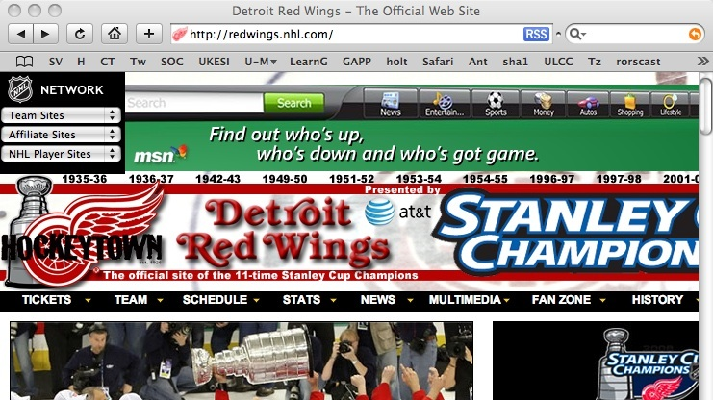
Content Mashup - RSS Feeds

Slide 4
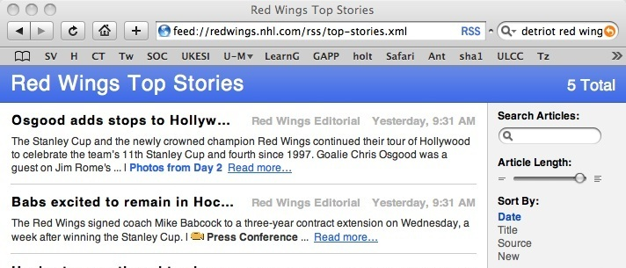
Content Mashup
Using data in a new context

Slide 5
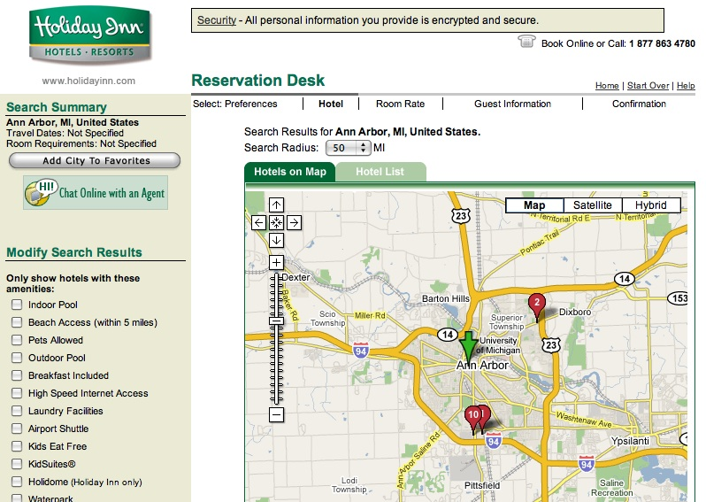
Functionality Mashup
Using Google Maps software in a Hotel web site context

Slide 6
Functionality Mashup
Using Google Maps software in a Hotel web site context

Slide 7

Functionality Mashup

Slide 8
Functionality Mashup

Slide 9
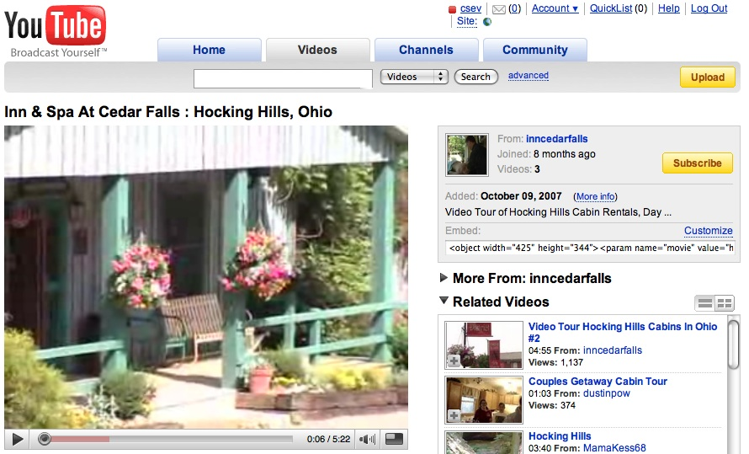
Functionality Mashup

Slide 10
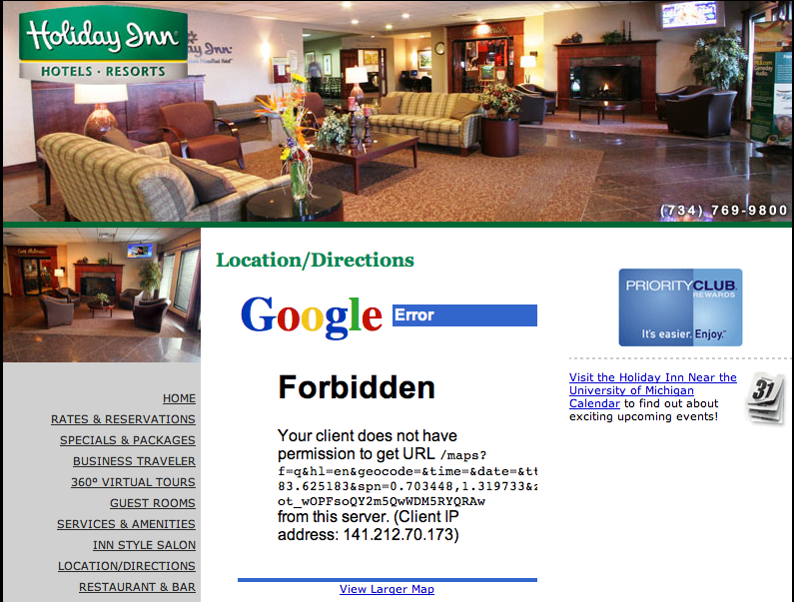
Exchange of Identity

Slide 11
Learning Tool Interoperability
A standard which is currently under development by IMS (www.imsglobal.org) for functionality mash up
Effectively provides Facebook-like capabilities for learning management systems
Read-write access from a tool to the LMS

Slide 12
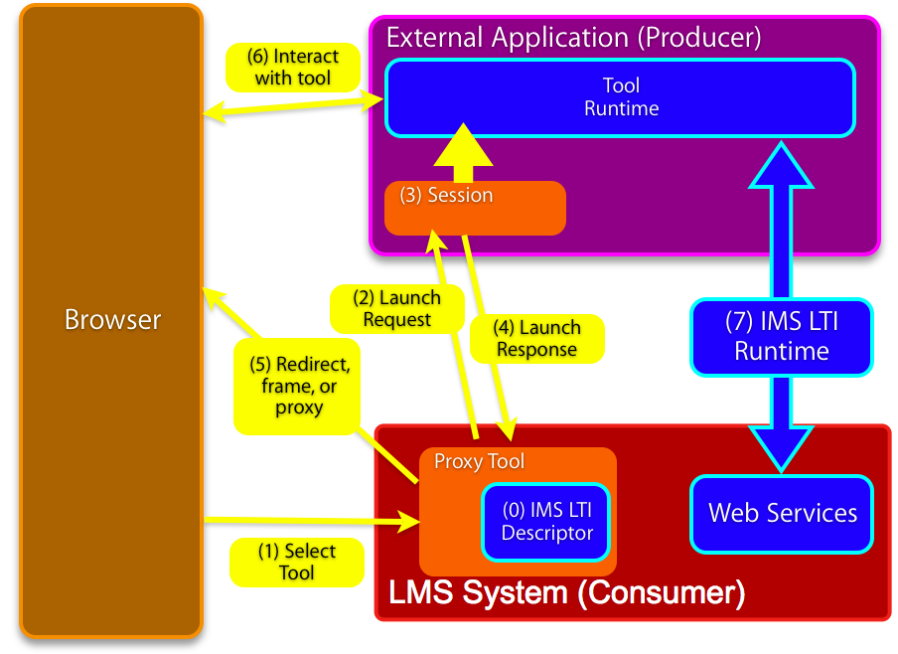

Slide 13
IMS Learning Tool Interoperability 2.0
Currently in Development
Specification Leads
Bruno van Haetsdaele -Wimba
Lance Neumann - Blackboard
Learning Functionality Mash Up
Integrated into “Add Resource” in learning
systems

Slide 14
Scenarios
IMS LTI 2.0 tool installed by the administrator – end-users don’t even realize the tool is hosted externally
IMS LTI 2.0 generic tool available to instructors – to be placed and configured Mash-Up style (like a general-purpose RSS reader or web-content tool)
An IMS LTI 2.0 tool is placed when a publisher cartridge is loaded – often these are partially provisioned

Slide 15
Virtual Tool - Admin Install
Administrator installs a proxy tool and makes it available as a regular tool
Administrator configures services “sandbox” for the remote tool – exchange of key material
  Tool may have permission to connect asynchronously
  Tool may have permission to places “resources” – instances of itself in a course shell

Slide 16
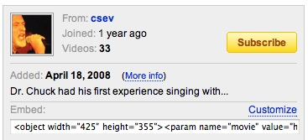
Instructor MashUp – YouTube
Instructor creates some learning object in an external service (freelearningsoftware.com)
The service presents a URL + password
The instructor pastes
this information into
an LTI Consumer Tool
in the LMS

Slide 17
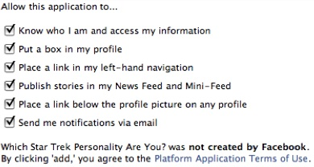
Instructor MashUp – SandBox
For instructor mash up – the Instructor configures the ”sandbox” at the time of mash up
The admin can set an
inherited “sandbox”
for all instructor-
placed tools.

Slide 18
Common Cartridge
Scenario 1: Content points to a pre-trusted host such as content.pearson.com – administrator has a sandbox pre-configured for tools that point to the pre-trusted host
Scenario 2: When there is no pre-arranged trust/sandbox – a placement from a cartridge behaves as an instructor-placed IMS LTI proxy tool.

Slide 19
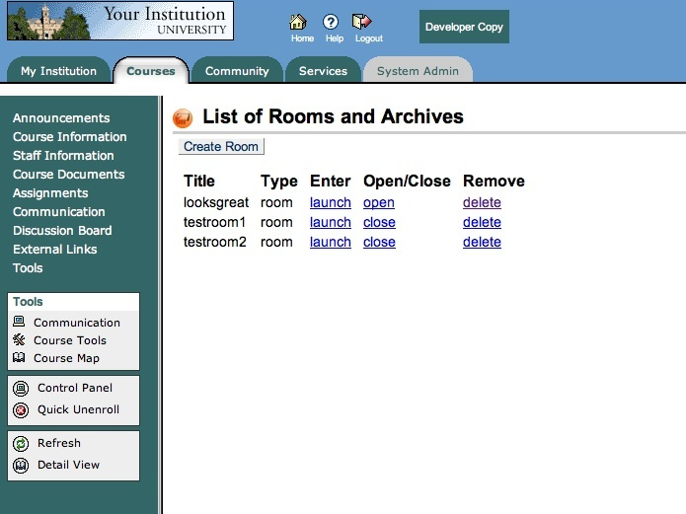

Slide 20
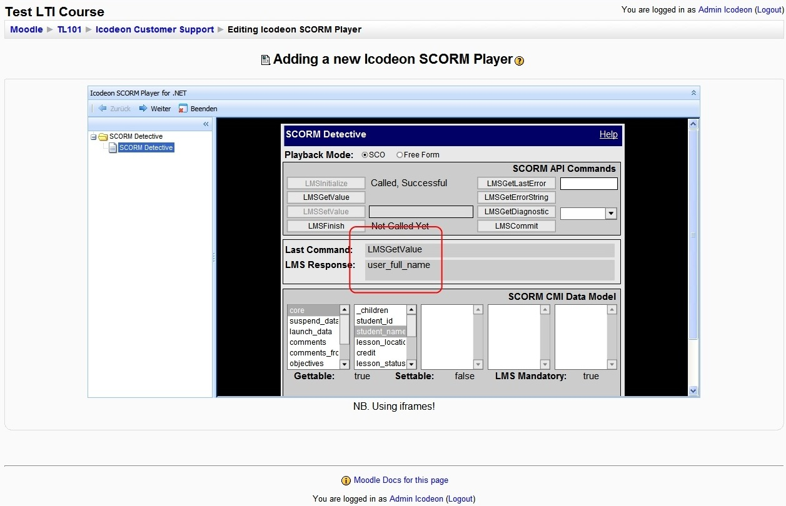

Slide 21
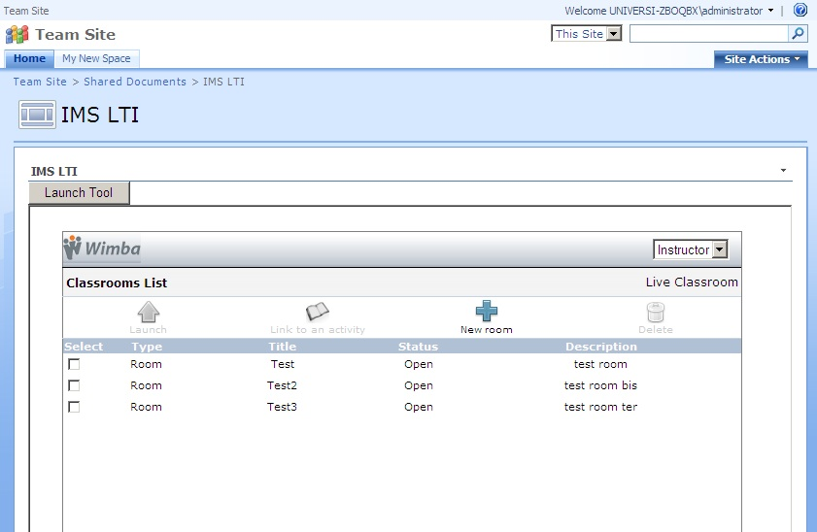

Slide 22
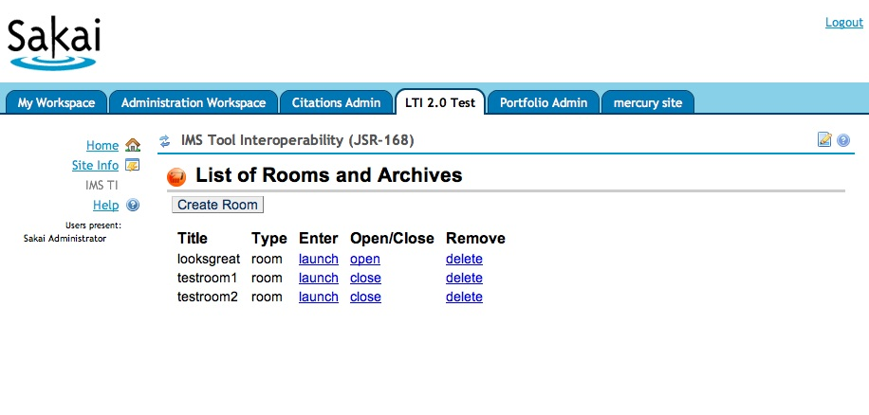

Slide 23
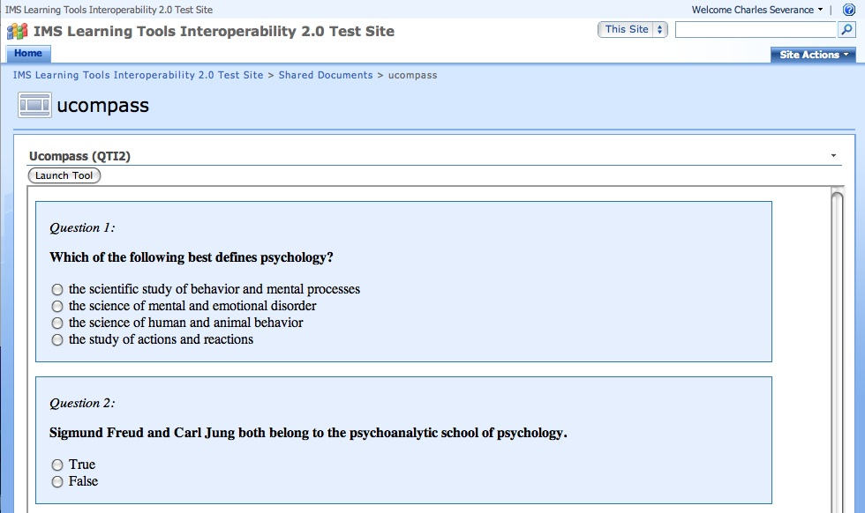

Slide 24
Sample K12 Scenario
Publisher content integrated into a variety of LMS systems
  Single key per school or single key per course
Single sign on via web services
Provisioning (lazy) of rosters as students launch
Future: Reverse flow for grades or tracking

Slide 25
Current Status
We have permission to use elements of Blackboard Version 9 “Proxy Tool” approach
Working to align the spec with Proxy Tool
As part of the IMS Developer’s network I have several Google Summer of Code students working on LTI implementations (simplelti.appspot.com)

