Slide 1


Functionality Mashup – Building the Next Generation of LMS
Dr. Charles Severance
University of Michigan
IMS Global Learning

Slide 2
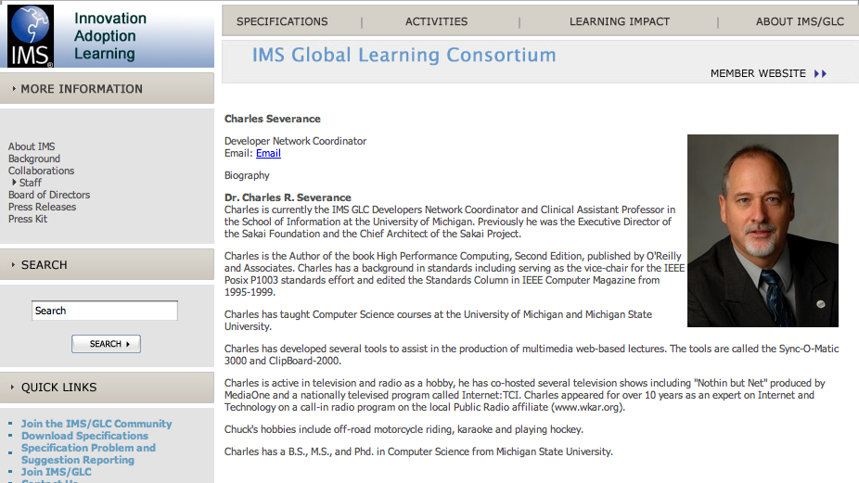

Slide 3
Defininitions
Content Mashup – Reusing data in new places / ways
Functionality Mashup – Reusing interactive software in new places / ways
Learning Tools Interoperability – using learning tools in new places / ways

Slide 4
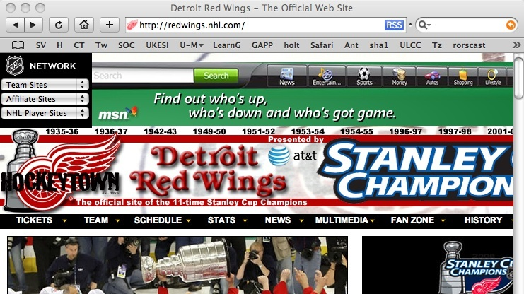
Content Mashup - RSS Feeds

Slide 5
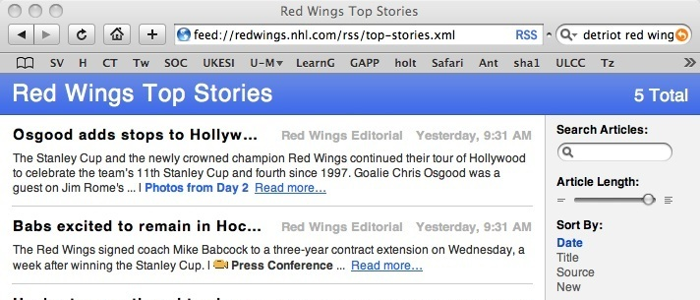
Content Mashup
Using data in a new context

Slide 6
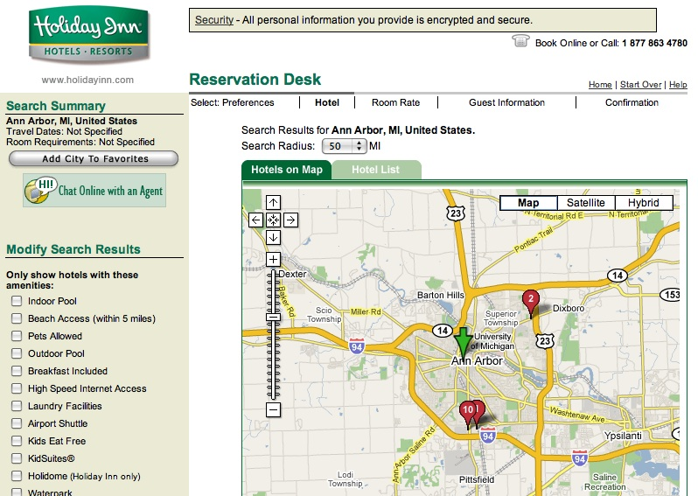
Functionality Mashup
Using Google Maps software in a Hotel web site context

Slide 7
Functionality Mashup
Using Google Maps software in a Hotel web site context

Slide 8

Functionality Mashup

Slide 9
Functionality Mashup

Slide 10

Functionality Mashup

Slide 11
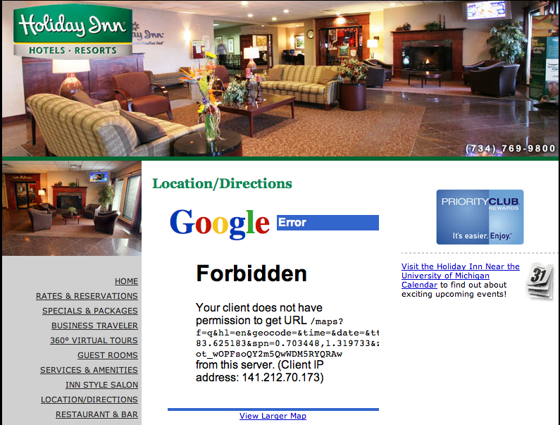
Exchange of Identity

Slide 12
Learning Tool Interoperability
A standard which is currently under development by IMS (www.imsglobal.org) for functionality mash up
Effectively provides Facebook-like capabilities for learning management systems
Read-write access from a tool to the LMS

Slide 13
IMS Learning Tool Interoperability 2.0
Currently in Development
Specification Leads
Bruno van Haetsdaele -Wimba
Lance Neumann - Blackboard
Learning Functionality Mash Up
Integrated into “Add Resource” in learning
systems

Slide 14
Scenarios
IMS LTI 2.0 tool installed by the administrator – end-users don’t even realize the tool is hosted externally
IMS LTI 2.0 generic tool available to instructors – to be placed and configured Mash-Up style (like a general-purpose RSS reader or web-content tool)
An IMS LTI 2.0 tool is placed when a publisher cartridge is loaded – often these are partially provisioned

Slide 15
Virtual Tool - Admin Install
Administrator installs a proxy tool and makes it available as a regular tool
Administrator configures services “sandbox” for the remote tool – exchange of key material
  Tool may have permission to connect asynchronously
  Tool may have permission to places “resources” – instances of itself in a course shell

Slide 16
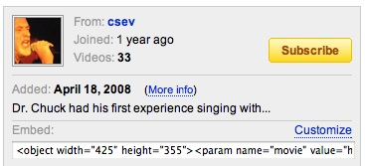
Instructor MashUp – YouTube
Instructor creates some learning object in an external service (freelearningsoftware.com)
The service presents a URL + password
The instructor pastes
this information into
an LTI Consumer Tool
in the LMS

Slide 17
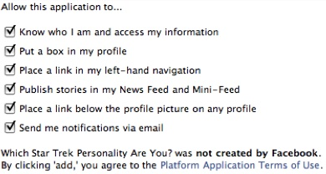
Instructor MashUp – SandBox
For instructor mash up – the Instructor configures the ”sandbox” at the time of mash up
The admin can set an
inherited “sandbox”
for all instructor-
placed tools.

Slide 18
Common Cartridge
Scenario 1: Content points to a pre-trusted host such as content.pearson.com – administrator has a sandbox pre-configured for tools that point to the pre-trusted host
Scenario 2: When there is no pre-arranged trust/sandbox – a placement from a cartridge behaves as an instructor-placed IMS LTI proxy tool.

Slide 19
Specification Prototypes
Evolve the spec and write prototypes all along the way
First phase – led by Wimba – Moodle, BlackBoard, Sakai, Sharepoint, Icodeon (SCORM), Wimba, uCompass

Slide 20
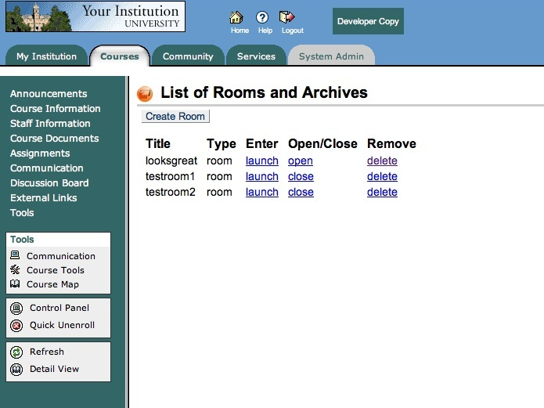

Slide 21
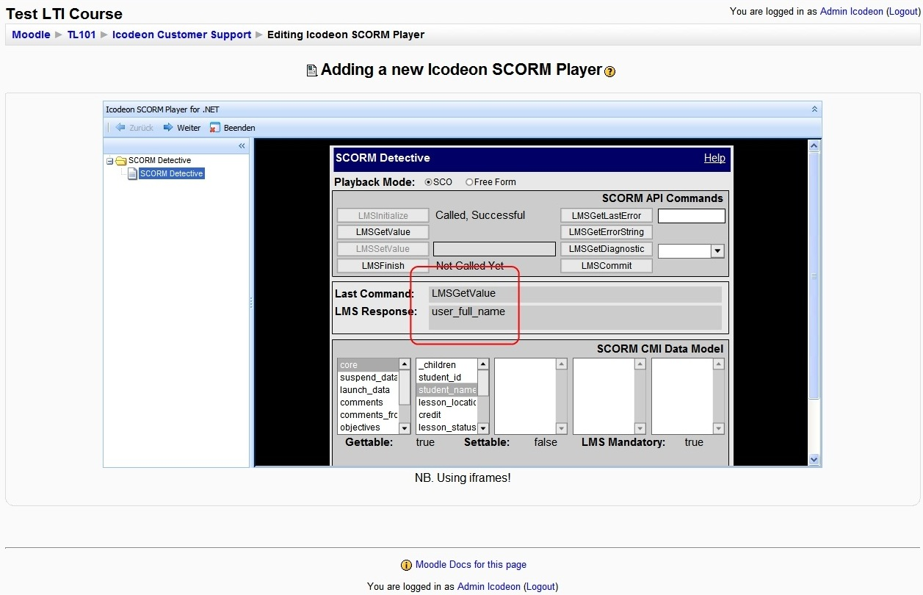

Slide 22
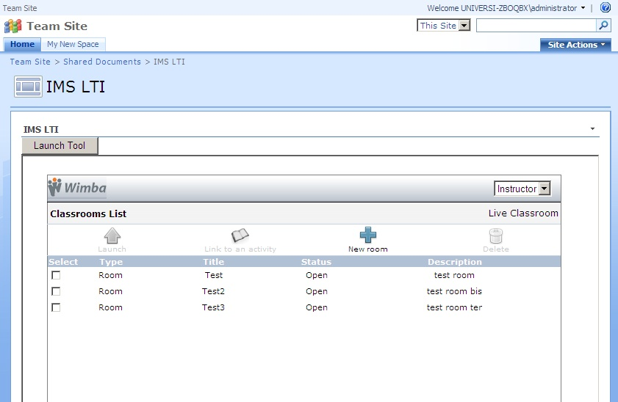

Slide 23
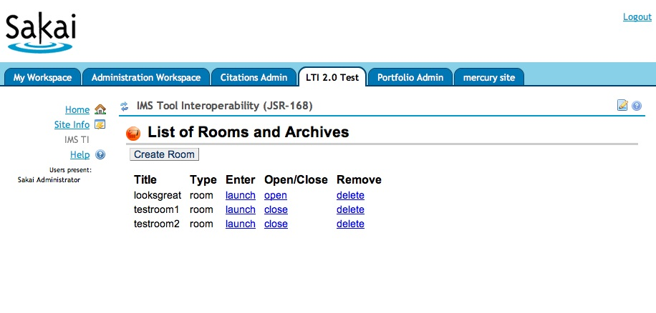

Slide 24
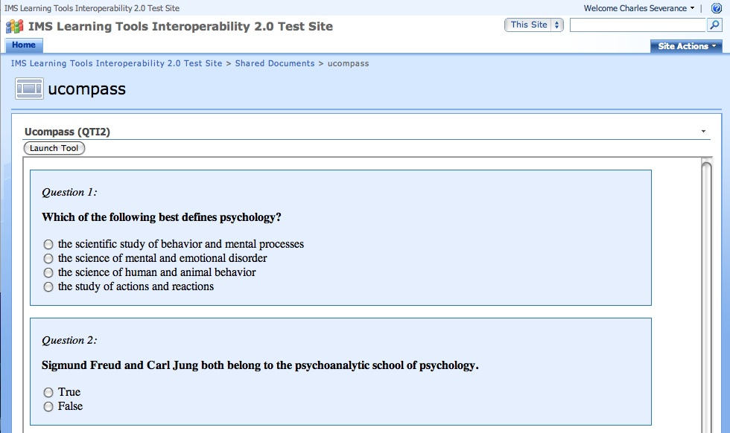

Slide 25
Working Group Status
Blackboard brought their Proxy tool pattern to the working group
Pearson brought their Integration approach to the working group
We liked the new approaches so decided to re-align the standard with these efforts

Slide 26
Technical Overview of IMS Learning Tools Interoperability

Slide 27
IMS Learning Tool Interoperability
A protocol between a “Proxy Tool” in an LMS and an “External tool” written in any languages
  Provisioning and configuration
  Tool launch
  Run-time web services such as files, grades, or rosters

Slide 28




Browser
External Tool
Interact
Provision
And
Launch
Run-time
Web
Services
LMS
Select
LMS Proxy Tool

Slide 29
Simple LTI
In order to jump-start some interactions outside the working group, I created an IMS LTI very-Lite specification
Focuses on the provisioning and launch phase
It is a subset of IMS LTI and is similar to but not identical to portions of the current IMS LTI draft

Slide 30
simplelti.appspot.com
Emulators for the Proxy Tool and External Tool
Developer specification (30 pages)
Sample source code for php, perl, python, java, and .Net
Launch types: Form POST, iFrame/GET, Widget

Slide 31
Form POST Launch
<form action="http://simplelti.appspot.com/launch" name="ltiLaunchForm"
method="post">
<input type="hidden" size="40" name="action" value="direct"/>
<input type="hidden" size="40" name="sec_nonce" value="b4b2be6-c7a391a"/>
<input type="hidden" size="40" name="sec_created"
value="2008-06-20T14:26:03Z"/>
<input type="hidden" size="40" name="sec_digest"
value="5uUP9Ai5HJiXgY/ocg06ECRYiUI="/>
<input type="hidden" size="40" name="user_id" value=”o299839849438"/>
<input type="hidden" size="40" name="user_role" value="Administrator"/>
<input type="hidden" size="40" name="course_id" value="2081-362952"/>
<input type="submit" value="Continue">
If you are not redirected in 15 seconds press Continue.
</form>
http://docs.oasis-open.org/wss/2004/01/oasis-200401-wss-username-token-profile-1.0.pdf

Slide 32
Demo

Slide 33


IMS / Sakai
Google Summer of Code

Slide 34
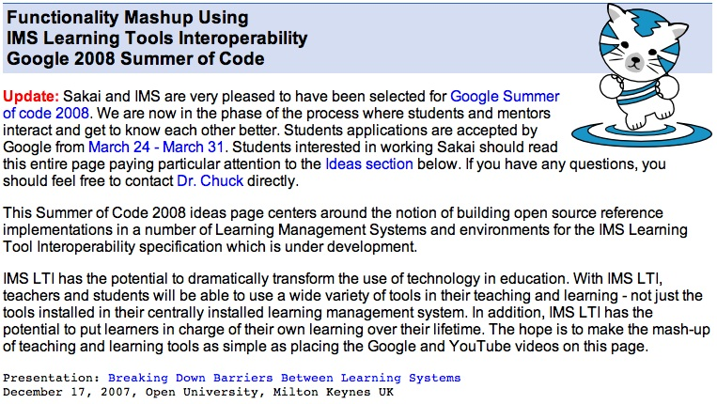

Slide 35
General Idea
Build many different implementations of IMS Tool Interoperability
Variations on a theme - think beyond just learning management systems
Try to create an initial body of work to make it worth while to build tools using IMS Tool Interoperability

Slide 36


IMS / Sakai
Google Summer of Code
An IMS LTI Producer for Sakai – Katherine Edwards, McGill University
An IMS LTI Producer for Moodle – Jordi Piguillem Poch - Universitat Politècnica de Catalunya
Improving Sakai’s Presence Capability – Eli Foley – Georgia Tech

Slide 37

Moodle Plans – Summer of Code
Moodle acts as a Simple LTI External Tool Provider
A Simple LTI tool available in “Add Resource”
A Moodle Filter for SimpleLTI
[LTI: http://imsti.wimba.com/launch, secret]

Slide 38
Progress to Date - SOC
Axis2 has been added to Sakai
Sakai acts as a Simple LTI External Tool Provider
Building plug-in for site info so instructors can enable LTI on a tool by tool basis
Complete Simple LTI Proxy Tool in Contrib – has upwards compatibility features for linktool

Slide 39
Demo of Sakai

Slide 40
Crazy Plans / Ideas
Working with two publishers to add support for Simple LTI External Tool
Write a BlackBoard Building Block
Write Wiki Macro for LTI in Sakai {LTI url|secret}
Add a ResourceHandler for LTI
Build an LTI widget for CamTools
Add an IMS LTI Resource Type to Melete

Slide 41
Summary
The IMS LTI Group is going strong with deep involvement of BlackBoard, Pearson, Wimba, and others.
The current spec is very nice to work with
Learning Functionality Mash-up is going to happen with standards and multiple implementations in the marketplace

Slide 42

What is IMS?

Slide 43
IMS Membership

Slide 44
Goals of the Developer Network
Increase adoption of IMS Standards in real, shipping products
Increase developer involvement in standards development – use implementation experiences
Improve interoperability between different implementations of IMS Standards on “day 1”
Notes:
This is a little different from Microsoft and Apple’s developer networks.

Slide 45
Adding Value to Member Efforts
IMS does not have developers, nor do we build products
Coordination and communication amongst member developers – increase efficiency
Build structures for exchanging information between member developers- like open source
Notes:
Intellectual property is very important to track – standards are under development outside public view – implementations are IP that one or another member

Slide 46

Communication
IMS Developer Network (members only)
  Work in development – working with draft specs
Webinars – To the membership and public
Speaking outreach at developer-oriented meeting
Developer tutorials – at meetings or on site
Software artifacts
Notes:
Google Summer of Code

Slide 47
Open Source IMS Artifacts
Apache 2 contribution agreements and license
  Reusable code – think jar file
  Sample code – multiple languages
  Test code to help exercise implementations
Clean Intellectual Property is very important so these artifacts can be used in shipping products
Notes:
Not going to build an LMS. That is what the members do.

Slide 48

Resources
Some of this will be an exercise in “herding cats” – motivating “volunteers” to help each other
Increasing IMS Developer Network Membership will increase resources
Will engage in some fund raising to retain resources to do bits and pieces here and there

Slide 49
Value Proposition of DevNet
Once a member’s developers connected information will come to them
I will actively work to “pull information” out of one member to be shared with all members
Members can adopt/implement more specs with less time and less travel.
Notes:
This is about pulling and pushing like a pump.

